Slide 1
Stand Against Racism
2016 Orientation Webinar

Slide 2

Stand Against Racism Webinar Agenda
Introduction
History/Purpose/Goals
New Website
Important Dates
Registration
Toolkit Items
Highlights & Ideas
Questions and Comments

Slide 3
Introduction
Donte Hilliard, Director of Mission Impact; dhilliard@ywca.org
StandAgainstRacism@ywca.org
StandAgainstRacism.org
YWCA USA on Facebook
@YWCAUSA on Twitter
#StandAgainstRacism
#OnAMission

Slide 4
History, Purpose and Goals
Founded in 2007 by YWCA Trenton and YWCA Princeton, in 2015 Stand Against Racism was adopted as a signature campaign by YWCA USA.
Stand Against Racism is one part of YWCA USA’s national strategy to fulfill our mission of eliminating racism and empowering women.

Slide 5
History, Purpose and Goals
To build community among those who work for racial justice and to raise awareness about the negative impact of institutional and structural racism in our communities.

Slide 6
History, Purpose and Goals
This year, our theme is On A Mission for Girls of Color! We will amplify the national discussion about the impacts of institutional and structural racism on the lives of girls of color.

Slide 7
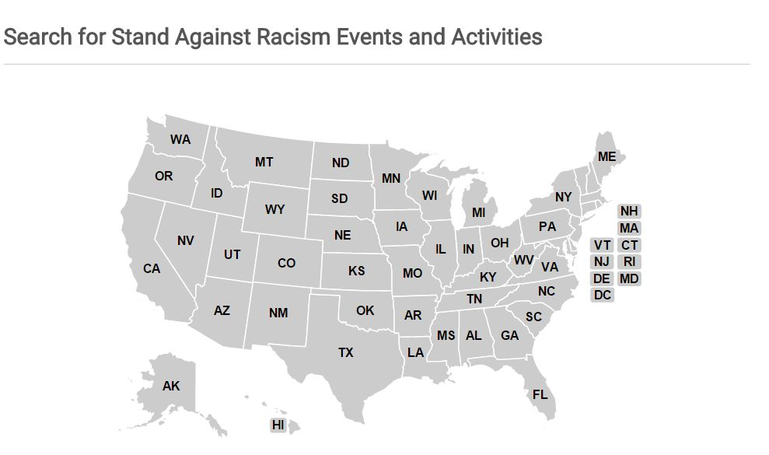
History, Purpose and Goals
In 2015, over 750 locations hosted Stand Against Racism events across 44 states!
In 2016 our goal is to have more than 1000 registered sites and at least one Stand in each of the 47 states where there is a YWCA association.

Slide 8
New Website
StandAgainstRacism.org
Mobile Optimized
New Logo
Updated Branding
Enhanced Functionality

Slide 9


New Website
Notes:
Home: Main Page
About: Ready to Stand; Get Connected; Take the Pledge

Slide 10
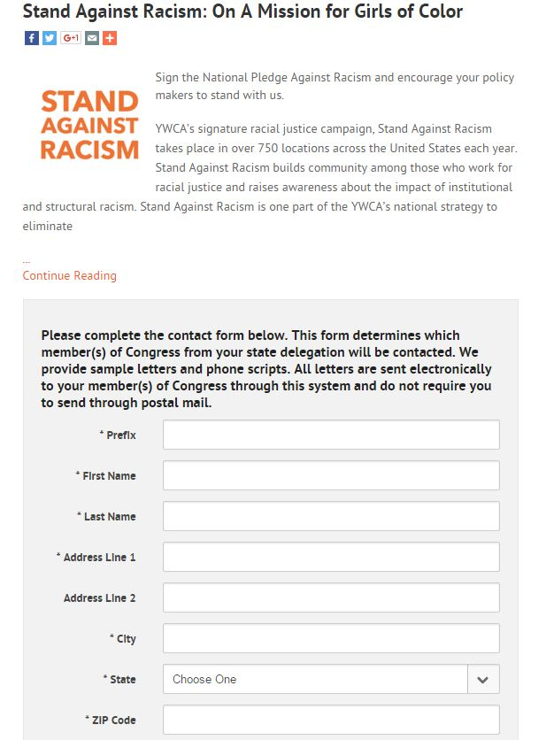
New Website: New Function

Slide 11
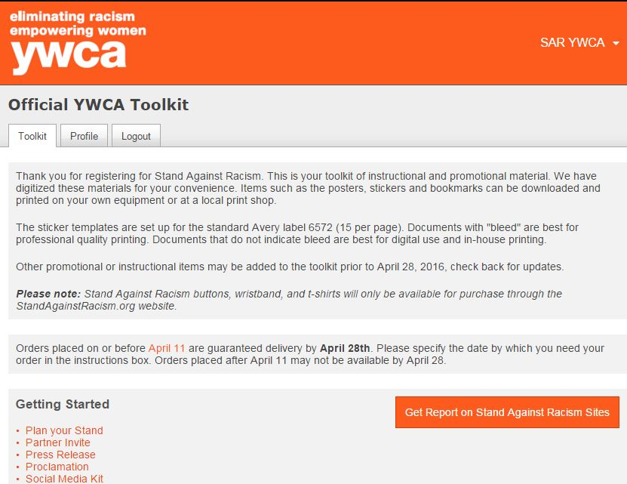
New Website: New Function

Slide 12
Questions & Comments

Slide 13
Important Dates
Campaign
April 28 – May 1, 2016
YWCA Day of Commitment to Eliminate Racism
Thursday, April 28, 2016
National Day of Action
YWCA USA Issue Briefing
Merchandise Orders
April 11, 2016
Guaranteed Delivery by April 28th

Slide 14
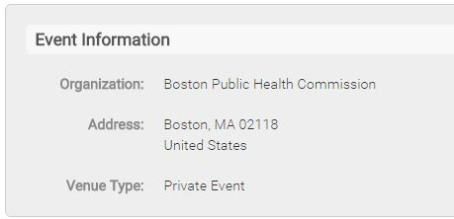
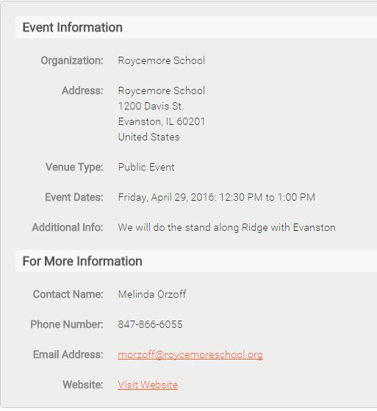
Registration
Types
Public vs. Private
YWCA Sites & Community Sites

Slide 15
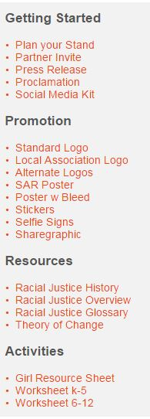
Toolkit
New Items
Categories
Youth Resources & Worksheets
Suite of Logos
Forthcoming
GOC Resource Sheet
Bookmark w/ Short Pledge
Revised, Long Pledge
Notes:
Please Read the instruction on the top of the toolkit
Bleed vs Non Bleed files
Stickers Avery label 6572 (15 per page)
Community Site TK does not include: Logo Suite,

Slide 16
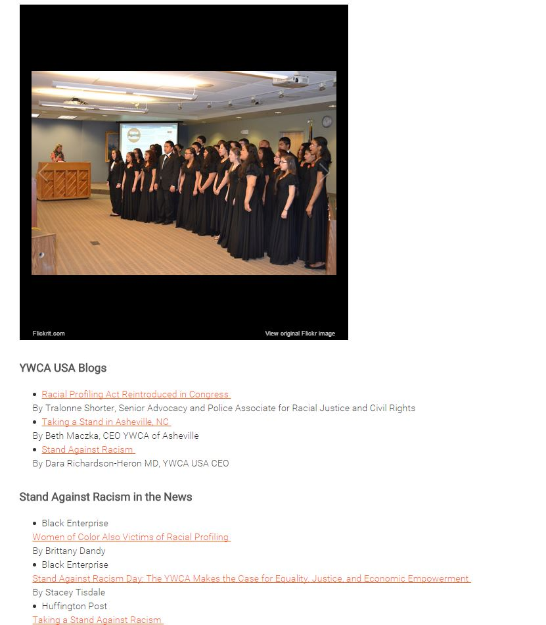
Highlights & Ideas
Engage Public Policy
Makers (April 28th)
Governors, Mayors,
City Council, etc.
Visits to Statehouse
Visit City Hall
Public Forums
Proclamations
National Pledge
Notes:
Plan Your Stand Doc –Toolkit

Slide 17
Questions & Comments

Slide 18
Thank You!
Questions? standagainstracism@ywca.org

