Slide 1
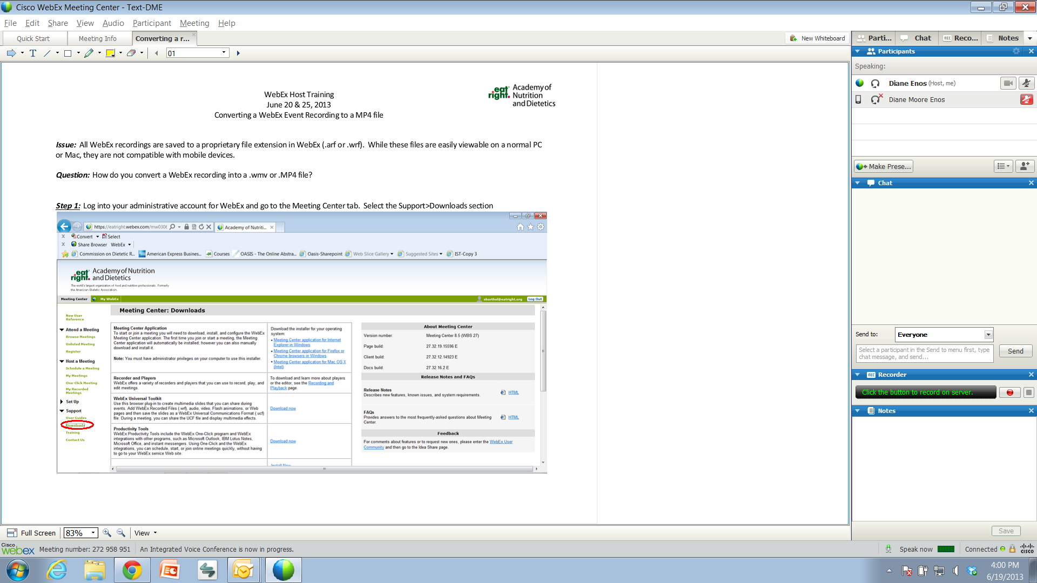
Welcome to the XX Webinar!
Thank you for joining us. Our program will begin shortly.
**Please test your audio speakers to make sure WebEx recognizes your computer **
Go to Audio in the upper left of your WebEx screen and select Speaker/Microphone Audio Test
Select the speakers you wish to use to hear the presentation and click OK when you hear sound.
You do not need an active microphone as all lines are muted. Questions should be submitted via the Chat Box for this live event.
All attendees are muted upon entry.
Please leave yourself muted.
Submit questions via the chat feature.

Slide 2
Speaker(s)
Date and Time
Title

Slide 3
Speaker Disclosure
[Speakers - REQUIRED - Insert Name of Presenter on this line]
[Type of Support – Categories and example shown below; please modify accordingly]
{If nothing to disclose, please state that below in place of options provided}
Example: Dietary Guidelines Advisory Committee | Board Member/Advisory Panel
Example: USA Wheat Federation | Consultant
Example: ARAMARK Corporation | Employee
Example: Academy Foundation | Research Support
Example: Washington Speakers Bureau | Speaker’s Bureau
Example: Pfizer, Inc. | Stock/Shareholder

Slide 4
Learning Objectives
Measurable and action oriented
Measurable and action oriented
Measurable and action oriented

Slide 5
Content Slides

Slide 6
Practice Applications & Conclusions
How can participant apply/advance practice?
Any final conclusions?

Slide 7
Questions?

