Slide 1

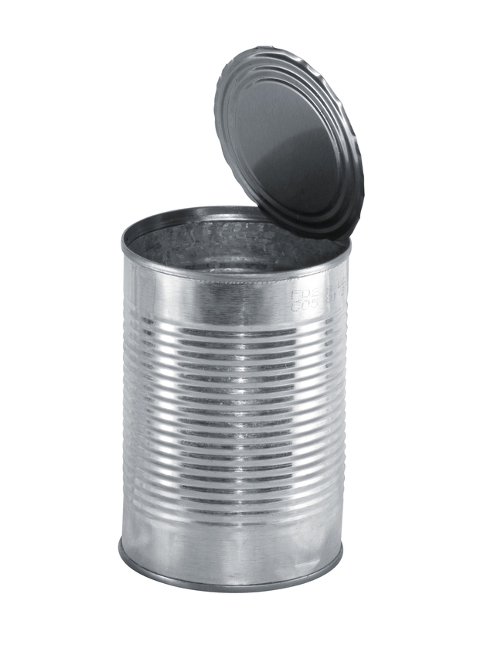
What’s in Our Food?
The Science and Safety
of Food Additives
Amy Myrdal Miller, MS, RDN, FAND
Founder and President
Farmer’s Daughter Consulting, Inc.
Roger Clemens, DrPH, CFS, CNS, FACN, FIFT, FIAFST
Adjunct Professor
USC School of Pharmacy, International Center for Regulatory Science
Photo credit: www.freeimages.com/ovetopfer
Notes:
(Lisa)
Welcome to the Academy of Nutrition and Dietetics Foundation Future of Food webinar titled, “What’s in Our Food? The Science and Safety of Food Additives.”
Today’s webinar is approved for 1.0 CPEU for live webinar attendees. A CPEU certificate and pdf of the slides will be sent to all registered live webinar attendees by late tomorrow. Please be sure to print a copy for your files.
All participant lines have been muted, but please make sure your line remains muted throughout the presentation. The microphone icon at the bottom of the screen should have a red slash through it. With xxx registered participants today, this will ensure you have a clear listening line for the presentation. Please type in your questions at any time via the “chat” box and we will hold a formal Q & A following the presentation.
Today’s webinar is part of the Academy of Nutrition and Dietetics Foundation Future of Food Initiative and is supported through an educational grant from National Dairy Council. This webinar was developed in collaboration with the Institute of Food Technologists. Much of the content of this webinar was shared via live presentations at 3 annual affiliate meetings in 2016 and we are pleased to now bring it to all Academy members through this webinar.

Slide 2

Session Objectives
1. Describe the history of food additives and their specific function in food systems.
2. Describe major contributions of food additives as well as their risks and benefits.
3. Identify sources of credible, science-based information for the public about food additives.
Notes:
(Lisa)
By the end of today’s webinar, you will be able to (Review slide)

Slide 3



Speakers
Roger Clemens, DrPH, CFS, CNS, FACN, FIFT, FIAFST
Adjunct Professor
USC School of Pharmacy, International Center for Regulatory Science
Amy Myrdal Miller, MS, RDN, FAND
Founder and President
Farmer's Daughter Consulting, LLC
Lisa Medrow, RDN, LD
Foundation Project Specialist
Academy of Nutrition and Dietetics Foundation
Notes:
I am pleased to introduce today’s speakers.
Dr. Roger A. Clemens is co-founder and executive vice president of PolyScience Consulting. He is part-time faculty within the USC International Center for Regulatory Science program where he enjoys an adjunct appointment as Professor of Pharmacology and Pharmaceutical Sciences within the USC School of Pharmacy. He also developed and facilitates graduate courses in the Global Medicine program within the USC School of Medicine. He served as Scientific Advisor for Nestlé USA for more than 21 years and then consultant to and Chief Scientific Officer for Horn for about a decade.
Dr. Clemens is a past president of the Institute of Food Technologists (IFT) and former member of the IFT Board of Directors. He co-founded, established and contributes to a Food, Medicine and Health column published monthly in Food Technology since 2004. In 2017, Dr. Clemens will launch a new column in Nutrition Today that addresses the regulatory status, safety, and functional properties of food ingredients. Dr. Clemens was a member of the USDA 2010 Dietary Guidelines Advisory Committee, and is a third-term member of the US Pharmacopeia Food Ingredient Expert Committee.
Dr. Clemens received an AB in Bacteriology, a MPH in Nutrition, and a DrPH in Public Health Nutrition and Biological Chemistry from the University of California, Los Angeles.
Amy Myrdal Miller is an award-winning dietitian, farmer’s daughter, public speaker, author, and president of Farmer’s Daughter® Consulting, LLC, an agriculture, food, and culinary communications firm. During her 20-year career, Amy has worked for a global public relations firm, a small clinical research firm, a California-based commodity board, and a world-renowned culinary college. A farmer’s daughter from North Dakota, today Amy and her husband Scott Miller live in Carmichael, California.
My name is Lisa Medrow and I serve as a contractor with the Academy Foundation as a Project Specialist. I help to manage Kids Eat Right and Future of Food projects, including the development of webinars like this one. I will serve as the moderator for today’s webinar.
I will start by sharing about the Future of Food Initiative, then Roger will provide an overview of food additives and regulations, Amy will share where consumers are on this issue and how you can communicate accurate messages. And lastly, we will wrap up the webinar with a 15- minute Q & A session. Please send your questions via the chat function throughout the webinar and we will address as many of them as we can at the end of the webinar.

Slide 4

Tweeting Today?
@eatrightPRO
@AmyMyrdalMiller
@FoodGeekRoger
Notes:
If you are engaging in social media during the webinar, we welcome you to use these handles and hashtags.

Slide 5
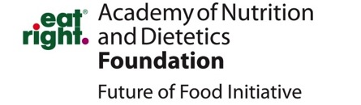
Future of Food Initiative
Academy of Nutrition and Dietetics Foundation
Notes:
I would like to tell you a little bit more about the Academy Foundation’s Future of Food initiative, which began in 2012 and is the first Foundation initiative which really started increasing member awareness about the intersection of nutrition, health, and agriculture.

Slide 6
Future of Food Resources for Members
Toolkits www.eatrightfoundation.org/toolkits-webinars
  Hunger in Our Community. What We Can Do.
  Smart Choices. For a Healthy Planet. (English/Spanish!)
  Tossed Treasures. How We All Can Waste Less Food. (English/Spanish!)
Supervised Practice Concentrations:
  Food Insecurity and Food Banking—available now! www.healthyfoodbankhub.org
  Food Systems—under development!
Webinars and Infographics www.eatrightfoundation.org
Affiliate Presentations:
  “Changing the Way We Look at Agriculture” 32 affiliates/DPGs (2015)
  Food waste, food additives, and GMO presentations 10 affiliates (2016)
  Foods of future, farming tools, and food preservation presentations 10 affiliates (2017)
Notes:
The Future of Food initiative has made available several new resources for Academy members.
Three ready-made toolkits are available on the Academy Foundation website (review). Toolkits come complete with PPT slides, notes pages, suggested activities, and downloadable handouts. And, over $50,000 in mini-grants have been awarded to Academy members to lead presentations from these toolkits in their communities!
A Food Insecurity and Food Banking Supervised Practice Concentration has been developed, and is now available on the NDEP portal and also publicly available on the Healthy Food Bank Hub. Currently a healthy food systems concentration is under development (expected to be released summer of 2018).
A total of 15, free, live CPEU Future of Food webinars were offered to Academy members focusing on food insecurity and agriculture. They are all now available for public viewing on the Foundation website. And, several infographics are available on the Foundation website.
(review affiliate presentations)

Slide 7
Last year our donors’ generosity
helped us award:
$446,900 in student scholarships to 194 students
$14,000 in student stipends to help 140 students attend FNCE.
$40,000 through Home Food Safety Challenge grants to dietetics students.
www.eatrightfoundation.org
Notes:
The Academy Foundation depends on donations from Academy members and not membership dues to strengthen programs like the Future of Food. Visit our website today to learn more about us and to make a donation today.
Last year, donors’ generosity helped us award…
At this time I will pass it over to Dr. Clemens.

Slide 8
Adjunct Professor, Pharmacology & Pharmaceutical Sciences
USC School of Pharmacy, International Center for Regulatory Science, Los Angeles, CA clemens@usc.edu
Roger Clemens, DrPH, CFS, CNS, FACN, FIFT, FIAFST
@FoodGeekRoger

Slide 9
Disclosures (2010-2016)
Abbott Nutrition
Almond Board of California
American Society for Quality
Aspire Food Group
Assure Water
Authen Technologies
Barilla
Bayer
Biothera
California Walnut Commission
Coca-Cola (honorarium directly given to charity)
Corn Refiners Association
Danish Agriculture and Food Council
Dairy Council of California
Dentons LLP; E.T. Horn
FMC (honorarium directly given to charity)
Food Minds
HyCite
Jenner & Block LLP
Karma Agency (honorarium directly given to charity)
Kellogg
Kerry
Malaysian Palm Oil Council
McDonalds
Mead Johnson
Mushroom Council
National Aeronautical Space Agency
National Fisheries Institute
National Restaurant Association
Nestlé SA
Petcurean
Pfizer
Quaker Oats
Schwann Foods
Senomyx (honorarium directly given to charity)
Spherix Consulting
U.S. Dept. of Agriculture
Whitewave
Yakult
Notes:
(review slide)

Slide 10
What is a Food?¹
Food
  Defined as “articles or components of articles used for food or drink for humans or animals”
  Safety standard:
    Presumption of safety (unless it contains a poisonous or deleterious substance in an amount which is shown to make it ordinarily injurious to health)
(FD&C Act §201(f))
Notes:
Before we begin the discussion on food additives, here are some basic food-related definitions that well assist us.
This slide provides a statutory definition of food. This definition includes chewing gum and components in foods that are consumed orally. Food, within this definition, refers to items that are taken orally. Items that are inhaled, applied transdermally, provided through suppositories or any other non-oral means are not foods. These items are drugs under US regulations.
Food has a stringent safety standard. That safety standard is embedded in several statutes, including the Food Additives Amendment of 1958, which will be introduced later.
Reference:
Food and Drug Administration Web site. http://www.fda.gov/regulatoryinformation/legislation/federalfooddrugandcosmeticactfdcact/. Accessed February 3, 2016.

Slide 11
What is a Food Additive?²
Food Additive (See Food Additive Amendment, 1958)
Any substance, the intended use of which may reasonably be expected to, directly or indirectly, becoming a component or otherwise affecting the characteristics of any food
Exclusions:
  Pesticides in or on raw agricultural commodities
  Color additives
  Prior sanctioned substances
  Substances that are generally recognized as safe (GRAS)
Safety burden on the manufacturer
(U.S. Public Law 85-929, 1958)
Notes:
Food additives are clearly defined in the food regulations. There are direct and indirect food additives, which will be discussed later. It is noteworthy that these additives may be GRAS US regulations prior to 1958. Since that time, food ingredients must undergo extensive safety evaluation either through a food additive petition or GRAS process (self-affirmation or notification). The safety of these substances requires, in part, an assessment of exposure to establish acceptable daily intake (ADI) without harm. This will be noted later.
Reference:
U.S. Public Law 85-929. September 6, 1958. http://uscode.house.gov/statutes/pl/85/929.pdf. Accessed February 3, 2016.

Slide 12
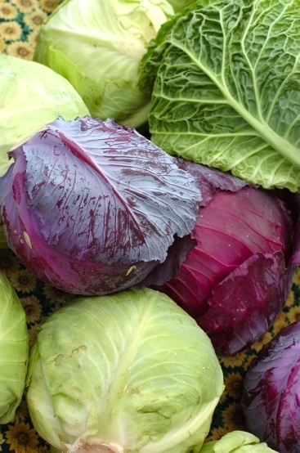
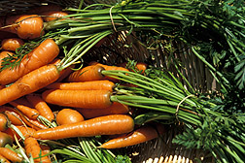
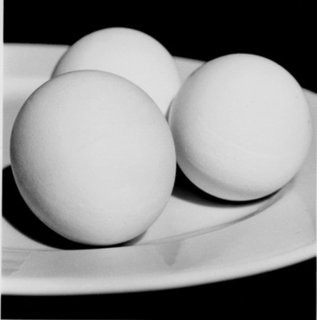
Added Substances to Foods³
In cases where the substance is not naturally present in food but is a contaminant or added ingredient, the safety standard is quite different
A food is adulterated if it contains any poisonous or deleterious substance that may render it injurious
http://www.ars.usda.gov/is/graphics/photos/k7191-4.htm
www.freeimages.com/helenbjork
www.freeimages.com/williamstadler
(FD&C Act, Section 402)
Notes:
The bottom line here is that substances introduced into the food supply must not be detrimental to health.
Interestingly, “natural” components in foods may, in fact, be toxic. These substances are naturally occurring. For example, carototoxin, which is innate to carrots, does not pose a health risk. Yet, it is a well-established toxin. Similarly, avidin which is innate to raw eggs, is a biotin antagonist. Yet, upon cooking, this anti-nutrient is denatured and subsequently does not affect the biotin in the egg or other biotin-containing components in the diet. Cabbage is another example. This popular plant-based food has nearly 50 mutagens and carcinogens. Importantly, the majority of these natural toxicants at the doses typically consumed are not detrimental to health. If the substances, when consumed at typical doses pose health risks, then they are considered adulterants…regardless of their source…nature or man.
Reference:
U.S. Food and Drug Administration Web site. FD&C Act, Section 402.
http://www.fda.gov/RegulatoryInformation/Legislation/FederalFoodDrugandCosmeticActFDCAct/FDCActChapterIVFood/. Accessed February 4, 2016.

Slide 13
Additive Safety &
Delaney Clause^{4,5,6}
Part of the 1958 Food Additives Amendment; invoked in 1959
Governs regulation of pesticide residues in processed foods (zero-tolerance)
Pesticide Residue Amendment (focus on raw commodities) of 1954
  EPA must conduct risk/benefit analysis
Many subsequent conflicting laws
  Regulation of new / old pesticides in raw and processed foods
  “Negligible risk” (1/1,000,000)
  Pesticide registration
“De minimis” risk policy in 1988; over turned 1992
Notes:
(animated slide—one section appears at a time—advance slide to view next section)
Cranberry Scare at Thanksgiving: Traces of aminotriazole, a weed killer, which had been shown to cause thyroid cancer in rats found in cranberries.
De minimis : adj. (dee-minnie-miss) Latin for "of minimum importance" or "trifling." Essentially it refers to something or a difference that is so little, small, minuscule, or tiny that the law does not refer to it and will not consider it.
The Delaney Clause in the Food Additives Amendment remains an integral component of food regulations in the US. While there was a motion to strike this provision, this de minimus policy was reinstated in 1992. 9th Circuit Court of Appeals over turned “de minimis” in 1992.
Thus, all food additives and food ingredients (even GRAS ingredients) are subject to this statute.
The Delaney Clause focuses on food additives and potential or known carcinogens in the food supply. With respect to a slide on laws and policies affecting food additives, that “slide” would be quite extensive. The RDN needs to be aware of the regulatory complexities, all of which are intended to assure a safe and nutritious food supply.
Reference:
The Free Dictionary Web site. http://legal-dictionary.thefreedictionary.com/De+Minimis. Accessed February 4, 2016.
Merrill, RA. Food Safety Regulation: Reforming the Delaney Clause. Annual Review of Public Health. 1997;18:313-40.
Fortin ND. Food Regulation – Law, Science, Policy and Practice. John Wiley & Sons, Inc.; 2009.

Slide 14
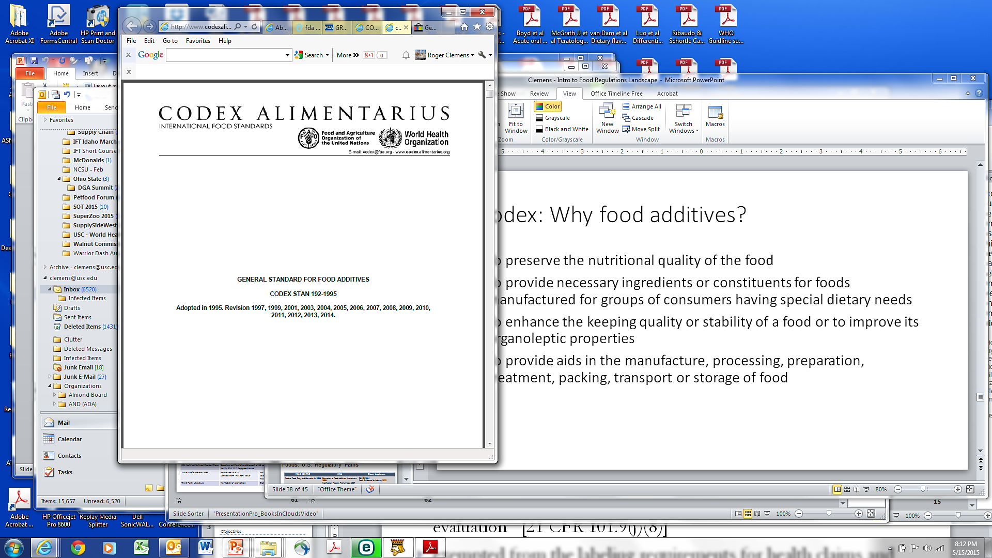
Codex: Why Food Additives?⁷
To preserve the nutritional quality of the food
To provide necessary ingredients or constituents for foods manufactured for groups of consumers having special dietary needs
To enhance the keeping quality or stability of a food or to improve its organoleptic properties
To provide aids in the manufacture, processing, preparation, treatment, packing, transport or storage of food
Notes:
(animated slide—one section appears at a time—advance slide to view next section)
Codex, with its multiple reassessments, defines the use and safety of food additives. These provisions, applicable in mostly European countries, outlines the general applications of food additives.
Codex is the European Union standard for food safety. Food in global. One challenge is that the safety standards in Europe and the USA (as well as Canada) affect the production and distribution (including agricultural practices) of food. Unfortunately, there is a lack of harmony or continuity of food safety assessments in the international community.
Reference:
Codex Alimentarius Web site. Codex General Standard for Food Additives (GSFA) Online Database.
http://www.fao.org/fao-who-codexalimentarius/standards/gsfa/en/. Accessed February 4, 2016.

Slide 15
Food without Food Additives
Consider bread, e.g., baking soda, folic acid, B vitamins
Consider ice cream, e.g., colors, flavors and consistency
Consider medical foods, e.g., vitamins and mineral
Consider foods with standards of identity, e.g., vitamin A and vitamin D in milk and other dairy products
Consider product stability, e.g., preservatives
Consider food sustainability, e.g., re-worked foods and ingredients → reduce waste

Slide 16
Why Food Preservatives?⁸
Fundamental functions
Promote food safety
Provide greater food choices
Promote food conveniences
Example:
Sulfites reduce lipid oxidation (rancidity; <10 ppm-1000 ppm)
Nitrate/nitrite to inhibit C. botulinum (natural in some vegetables, such as beets)
Benzoic acid (salts) inhibits bacteria and molds (natural in some vegetables, such as strawberries and tomatoes)
Sorbic acid (K, Na, Ca) antimicrobial originally isolated from berries (often used in wine < 300 ppm)
Notes:
The FDA provides a nice summary on the “purpose” of food additives as well. This slide provides several functions of food preservatives as identified by the FDA.
Reference:
Food and Drug Administration Web site. 21CFR101.22
http://www.fda.gov/Food/IngredientsPackagingLabeling/FoodAdditivesIngredients/ucm094211.htm.
Accessed February 3, 2016.

Slide 17
Types of Food Additives^{9,10}
Direct
Added during processing
Functions
  Provide nutrients
  Help process or prepare the food
  Keep the product fresh
  Make the food more appealing
Indirect
May be found in food during or after it is processed
Substances found in trace amounts due to
  Packaging migration
  Storage environment
  Handling procedures
Notes:
(animated slide—”direct” section appears first—advance slide to view “indirect” section)
As noted below, food additives may be direct and indirect. Regardless of their introduction to the food supply, ingredient safety is paramount. In this case, it’s important to remember that most food additives have upper limits of usage and exposure (discussed later). It remains critical that the exposure, typically via the oral route, demonstrates safety across population groups.
References:
U.S. Food and Drug Administration Web site. Loss of Indirect Additives Used in Food Contact Substances. http://www.fda.gov/Food/IngredientsPackagingLabeling/PackagingFCS/IndirectAdditives/default.htm. Accessed February 4, 2016.
U.S. Food and Drug Administration Web site. Food Additive Status List. http://www.fda.gov/Food/IngredientsPackagingLabeling/FoodAdditivesIngredients/ucm091048.htm. Accessed February 4, 2016.

Slide 18
Food Additives Amendment^{11,12,13}
Food Additives Amendment of 1958
Substances subject to prior sanction
GRAS substances are exempt from food additive requirements
  If a substance did not have a common use prior to 1958, the substance is subject to scientific review procedures (same criteria for food additive)
  Exemptions to GRAS → commodities; separate regulations primarily under FDA and USDA jurisdiction
  (21CFR181; 21CFR170.30(b); 21CFR170.35(c)(1))
Notes:
The Food Additives Amendment of 1958 was a line of demarcation. Substances in the food supply that were commonly used prior to this date and did not present any untoward effects (at that time), were accepted as safe. Ingredients subsequently introduced to the food supply needed to undergo extensive safety review.
21CFR181 identifies food additives that were declared safe in 1958 (prior to the food additives amendment). Their safety was reviewed during the Nixon administration. Prior-sanctioned substances include antioxidants (e.g., BHA, BHT), driers (e.g, several iron, cobalt and manganese salts that absorb moisture) that can be added to packaging materials, plasticizers that may be added to packaging materials, and an array of food stabilizers that are typically added to packaging materials (e.g., calcium, magnesium, potassium, and sodium salts). The safety focuses on the possible migration of these substances into packaged foods.
Importantly, ingredients that were considered GRAS were not subject to the Food Additives Amendment. Importantly, these ingredients were and are required to meet the same safety assessment…regardless of food additive petition or GRAS notification (self-affirmation, which was enacted in 1997)
References:
U.S. Government Publishing Office Web site. Electronic Code of Federal Regulations. (21CFR181). http://www.ecfr.gov/cgi-bin/text-idx?rgn=div5&node=21:3.0.1.1.12. Accessed February 4, 2016.
U.S. Food and Drug Administration Web site. 21CFR170.30(b). http://www.accessdata.fda.gov/scripts/cdrh/cfdocs/cfcfr/CFRSearch.cfm?fr=170.30. Accessed February 4, 2016.
U.S. Food and Drug Administration Web site. 21CFR170.35(c)(1). http://www.accessdata.fda.gov/scripts/cdrh/cfdocs/cfcfr/cfrsearch.cfm?fr=170.35. Accessed February 4, 2016.

Slide 19
Defining Safety¹⁴
Hazard
  Types of toxic effects caused by the chemical
  Manifestation depends on route, amount, duration and frequency of exposure
Risk
  Likelihood that the toxic properties of a chemical will be produced in populations of individuals under their actual conditions of exposure; exposure must precede adverse event
Safety
  Little or no harm will result from chemical under given set of exposure circumstances
  It is not the absolute absence of risk; it is the inverse of risk
Notes:
19
This slide carefully outlines the differences and continuum associated with ingredient safety. The important message here is for the audience to understand and apply the concept of “risk” and “hazard” to food ingredients, regardless of source.
Reference:
U.S. Food and Drug Administration. FDA Food Code 2009. http://www.fda.gov/Food/GuidanceRegulation/RetailFoodProtection/FoodCode/ucm186464.htm. Accessed February 4, 2016.

Slide 20
Safety Analysis¹⁵
Chemical
Characterization
Raw Materials
Processing
Product Specifications
Bridging to Existing Data
Safe Level (ADI)
Animal Toxicology
Metabolic Fate
Human Trials
Historical Exposure
Estimate of Intake (EDI)
Intended
Use
Target Population
Intake
Safety Determination
Courtesy of C. Kruger, PhD
Notes:
20
This flow diagram provides a scheme of safety assessment applied under current food additives petition and GRAS notification (and self-affirmation). The safety criteria are the same. The only difference is a) the time from review to market, and b) who conducts the review.
This graphic is the flow diagram for safety assessment under current FDA statutes, including GRAS notifications and Food Additive petitions.
Reference:
U.S. Food and Drug Administration Web site. Generally Recognized as Safe (GRAS). http://www.fda.gov/Food/IngredientsPackagingLabeling/GRAS/. Accessed February 4, 2016.

Slide 21
Regulatory Defaults for Safety^{16,17}
Human trumps animal data
In the absence of human data, animal data are used
In the absence of information to demonstrate that the selection is incorrect, data from the animal species showing the greatest sensitivity are selected for the risk assessment
Animal data using the same route of exposure as relevant to human exposure are preferred
For all toxic effects other than carcinogenicity, a threshold is assumed
Thresholds in humans are established by application of safety factors to data
For carcinogens, a linear, no threshold dose-response model is assumed to apply
Notes:
(animated slide—one bullet appears at a time—advance slide to view next bullet)
This slide provides critical points for safety assessments and ultimate conclusions. There should be few variations from these regulatory defaults. Those variations require extensive justification through high-quality scientific research.
Regarding carcinogens…This statement is based on the fundamentals of toxicology. These fundamentals applied to potential carcinogenicity are presented in Hayes’ Principles and Methods of Toxicology (Chapter 25 by Williams, Iatropoulos, Enzmann and Deschl) and the classic Casarett & Doull’s Essentials of Toxicology (Chapter 8 by Pitot and Dragan).
Reference:
Williams, Iatropoulos, Enzmann, et al. Hayes’ Principles and Methods of Toxicology . 6th ed. CRC Press; 2014:25.
Klaassen C, Watkins JB. Casarett & Doull’s Essentials of Toxicology. 7th ed. McGraw-Hill; 2010:8.

Slide 22
Direct Food Additives¹⁸
Anticaking agents and free-flow agents
Antimicrobial agents
Antioxidants
Colors and color adjuncts
Curing and pickling agents
Dough strengtheners
Drying agents
Emulsifiers and emulsifier salts
Enzymes
Firming agents
Flavor enhancers
Flavor agents and adjuvants
Flour-treating agents
Food preservatives
Formulation aids
Fumigants
Humectants
Leavening agents
Lubricants and release agents
Nonnutritive sweeteners
Nutrient supplements
Nutritive sweeteners
Oxidizing and reducing agents
pH control agents
Processing aids
Propellants, aerating agents, and gases
Sequestrants
Solvents and vehicles
Stabilizers and thickeners
Surface-active agents
Surface-finishing agents
Synergists
Texturizers
(21CFR184)
Notes:
22
This slide summarizes 33 categories of direct food additives as stated in the U.S. regulations.
Section 184 refers to direct food additives identified as GRAS following the Nixon administration review mandates. Section 172 identifies various functional categories of direct food additives. In this case, some of the food additives appear in both sections.
Reference:
U.S. Food and Drug Administration Web site. (21CFR184). https://www.accessdata.fda.gov/scripts/cdrh/cfdocs/cfcfr/CFRSearch.cfm?CFRPart=184. Accessed February 5, 2016.

Slide 23
Food Preservatives^{8,19,20}
Substances added to foods to inhibit microbial growth or retard product deterioration
Prior sanctioned GRAS
Ascorbic acid
Erythorbic acid
Sorbic acid
Thiodipropionic acid
Ascorbyl palmitate
Butylated hydroxyanisole (BHA)
Butylated hydroxytoluene (BHT)
Calcium ascorbate
Calcium sorbate
Dilauryl thiodipropionate
Potassium bisulfite
Potassium metabisulfite
Potassium sorbate
Sodium ascrobate
Sodium bisulfite
Sodium metabisulfite
Sodium sorbate
Sodium sulfite
Sulfur dioxide
Tocopherols
(21CFR101.22; 21CFR182; 21CFR172)
Notes:
This graphic summarizes the types of permitted food preservatives under U.S. regulations. Note, some of these substances have multiple functions in a food matrix. For example, ascorbic acid and tocopherols are also nutrients, vitamin C and vitamin E derivatives, respectively.
References:
U.S. Food and Drug Administration Web site. 21CFR101.22. Accessed February 5, 2016.
U.S. Food and Drug Administration Web site. 21CFR182. Accessed February 5, 2016.
U.S. Food and Drug Administration Web site. 21CFR172. Accessed February 5, 2016.

Slide 24
Food Preservatives Usage Levels²¹
Applications
Depend on regulatory statutes and ingredient (often establish upper limits, e.g., < 0.1% [1000 ppm])
  Most regulations only stipulate usage levels within Good Manufacturing Practice
Depend on food matrix (e.g., liquid, dry, pH)
Depend on processing conditions (e.g., temperature), storage environment, transportation demands
Notes:
This slide provides limitations of food additive applications based on current regulatory statutes, good manufacturing practice and food matrices.
The usage level of food additives, other than statutes, is affected by light, pH and temperature. Other factors that influence usage level include manufacturing process and sensory characteristics. In this case, the pH of a food matrix may influence the functional properties and stability of a food additive.
Reference:
U.S. Food and Drug Administration Web site.
Code of Federal Regulations Title 21. http://www.accessdata.fda.gov/scripts/cdrh/cfdocs/cfcfr/cfrsearch.cfm. Accessed February 5, 2016.

Slide 25
Food Additives Risk Assessment²²
JECFA (Joint FAO/WHO Expert Committee on Food Additives) has evaluated more than 2,500 food additives
Risk assessment/safety evaluation of:
  Food additives (intentionally added)
  Processing aids (considered as food additives)
  Flavoring agents (by functional groups)
  Contaminants
  Natural toxins
  Exposure assessment
Notes:
25
JECFA, an internationally recognized organization, summarizes six categories of food additives. These categories will be discussed briefly.
For example, in 2015 JECFA considered the tox and spec for advantame, annatto extracts, silicon dioxide and sodium aluminum silicate.
Benzoates usage levels (83-209 ppm) and exposures are less than national limits (400-600 ppm), depending on the food category.
Current exposures across age groups indicate were below ADI (acceptable daily intake). ADI for toddlers (0.3-4.1 mg/kg bw), adolescents (0.2-2.7 mg/kg bw) and adults (0.1-1.7 mg/kg bw).
Aquatic biotoxins naturally produced by about 2% of marine algae (less than 80 species out of >4,000 difference species).
This “red tides”. Toxics produced by phytoplankton bloom bioaccumulate in shellfish. Biotoxins include compounds such as saxitoxin, brevetoxin, ciguatoxin, and tetrodotoxin. These are found in several types of shellfish globally, as wll as in North America and the South Pacific.
Reference:
Food and Agriculture Organization of the United Nations Web site. Chemical risks and JECFA. http://www.fao.org/food/food-safety-quality/scientific-advice/jecfa/en/. Accessed January 12, 2016.

Slide 26
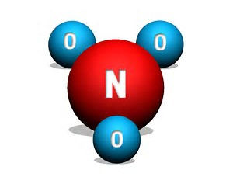
Food Additives Risk Assessment²²
Naturally generated by plants during nitrogen fixation process, and produced in humans
Naturally occur in soils (part of organic matter)
Naturally found in vegetables (e.g., celery, lettuce, spinach [500-1900 ppm]), fruits, meats, fish, dairy products, fermented beverages (e.g., beers), and cereals
Typical usage level < 500 ppm (food matrix dependent)
IARC (2010) classified these substances as probable carcinogens (Group 2A) to humans → ingested nitrate or nitrite under conditions that result in endogenous nitrosation → N-nitroso compounds
Reported toxicity by association; limited direct evidence except through nitrosation
Potential adverse effects → methemoglobinemia
Precursor to nitric oxide → limits gastric pathogens (antimicrobial effects, reduces pulmonary hypertension, promotes tissue perfusion
Nitrate
Nitrite=NO₂⁻
Image Credit: uswatersystems.com
Notes:
26
Nitrates and nitrites are naturally occurring food additives used primarily as meat curing agents. According to the FDA, these substances are used to cure ham, viz, to reduce the risk of Listeria monocytogenes and enhance color appeal.
Reference:
Food and Agriculture Organization of the United Nations Web site. Chemical risks and JECFA. http://www.fao.org/food/food-safety-quality/scientific-advice/jecfa/en/. Accessed January 12, 2016.

Slide 27
Processing Aids²³
Definition:
  Codex: Substances that fulfil a certain technological purpose during treatment or processing and which may result in the non-intentional but unavoidable presence of residues or derivatives in the final product
  FDA: Substances that are added to a food during the processing of such food but are removed in some manner from the food before it is packaged in its finished form
    Exempt from food labeling requirements in USA
    Under CVM, required labeling for pet food/livestock feed in USA
(21 CFR 101.100 (a) (3) (ii))
Notes:
Reference:
U.S. Food and Drug Administration Web site. 21 CFR 101.100 (a) (3) (ii) http://www.accessdata.fda.gov/scripts/cdrh/cfdocs/cfcfr/cfrsearch.cfm?fr=101.100. Accessed February 5, 2016.

Slide 28
Food (inorganic) Phosphates²⁴
Classification: monovalent salts, divalent salts, ammonium salts and aluminum salts
Regulatory: GRAS
Examples (usage levels)
  Mono, di and trisodium phosphate (< 0.5%)
  Mono, di and tripotassium phosphate (< 0.5%)
  Sodium hexametaphosphate (GMP)
  Ammonium polyphosphate (GMP)
  Sodium aluminum phosphate (GMP)
Notes:
(animated slide—one section appears at a time—advance slide to view next section)
Reference:
Weiner ML, Salminen WF, Larson PR, et al. Toxicological Review of Inorganic Phosphates. Food and Chemical Toxicology. 2001;39(8):759-86.

Slide 29
Food (inorganic) Phosphates²¹
Functional Properties (examples)
  TSP, 19.5% phosphorus,– sanitizer (cleaning reagents); emulsifier (pasteurized cheese)
  Sodium aluminum phosphate, 31% phosphorus– chemical leavening (baking powder)
Labeling
  Ingredient declared in descending order of prevalence
  Specific phosphorus contributions in Nutrition Facts Panel not quantified or required
(21CFR178.1010; 21CFR133.179; 21CFR182.1781)
Notes:
(animated slide—one section appears at a time—advance slide to view next section)
Reference:
U.S. Food and Drug Administration Web site. Code of Federal Regulations Title 21. http://www.accessdata.fda.gov/scripts/cdrh/cfdocs/cfcfr/cfrsearch.cfm. Accessed February 5, 2016.

Slide 30
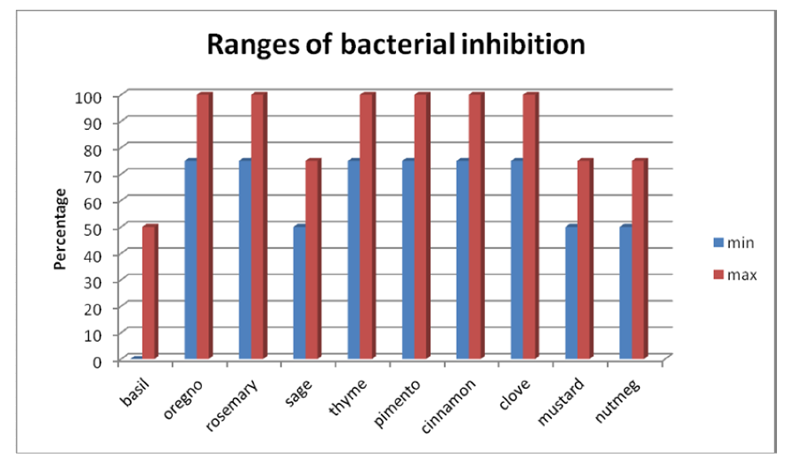
Future Role of Spices²⁵
Typical tested extract doses: 500-1000 ppm (0.05-0.1%); effectiveness depends on cultivar, extract, organism and food matrix.
(Crit Rev Food Sci Nutr 2013)
Notes:
30
This graphics depicts potential future applications of spices as possible bactericidal agents. Critical to this application is the complete characterization and dose of the spice. It will require special amendments to the existing “spice” regulations. Additional GRAS assessments for these doses will be necessary for US applications.
Reference:
De La Torre Torres, JE, Gassara F, Kouassi AP, et al. Critical Reviews in Food Science and Nutrition. 2013; DOI:10.1080/10408398.2013.858235.

Slide 31
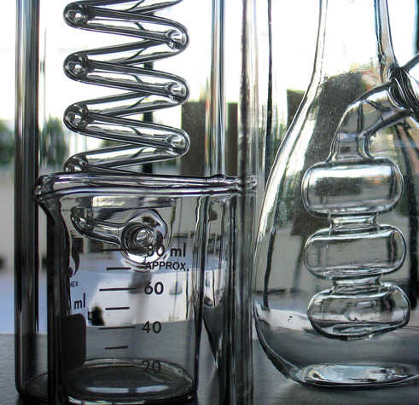
Conclusion
Public Health and Safety is the over-arching priority
Vigilance and good data on safety trump every other factor
Regulatory future
Photo credit: www.freeimages.com/zernliew
Notes:
This slide provides 3 conclusions relative to current and future food additives.

Slide 32

Key Messages
US has one of the safest and most abundant food supplies in the world.
Food safety is everyone’s responsibility.
Challenge to assure safe global food supply.
Challenge to harmonize safety assessment of food additives.
Photo credit: www.freeimages.com/jessetherrien
Notes:
This slide summarizes the current status of food additives in the US, while challenging the global regulatory community to harmonize safety assessments and usage applications.

Slide 33

Thank you!
Roger Clemens, DrPH, CFS, CNS, FACN, FIFT, FIAFST
Adjunct Professor, Pharmacology & Pharmaceutical Sciences
USC School of Pharmacy, International Center for Regulatory Science, Los Angeles, CA
clemens@usc.edu
Roger Clemens, DrPH
Quito, Ecuador
Notes:
Graphic presents Dr. Clemens being interviewed on RTS television in Quito, Ecuador, during a future food in South America conference (March 2015)

Slide 34
Founder and President
Farmer’s Daughter Consulting, Inc.
Carmichael, CA
Amy Myrdal Miller, MS, RDN, FAND
@AmyMyrdalMiller
Notes:
(RDN Farmer)

Slide 35
Disclosures
Academy of Nutrition and Dietetics Foundation – honoraria for speaking
American Beverage Association – consultant
California Leafy Greens Marketing Agreement – consultant
The Culinary Institute of America – consultant
Dairy Management, Inc. – honoraria for speaking
Dairy MAX – consultant
Florida Department of Citrus - consultant
Great Valley Publishing Company – blogger, honoraria for speaking
Monsanto Company – consultant
Monsanto Company – L.E.A.D. Network Member
Mushroom Council – consultant/research funding
National Dairy Council – Ambassador
Naturipe® Farms – consultant
Northarvest Bean Growers Association – consultant
Northern California Golden Arches Association – consultant
Produce Business / Phoenix Media Network – consultant/columnist
Produce Marketing Association – honoraria for speaking
University of California, Davis Honey and Pollination Center – honoraria for speaking
Notes:
(review slide)

Slide 36
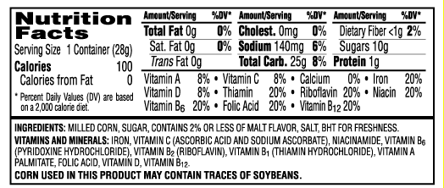
Where are Consumers?^{26,27,28}
51% report that additives have a strong influence on purchase
Over 30% “cautious about serving foods with preservatives” compared to 24% 10 years ago; trend for additives follows same progression
Shoppers sought products made without
  Preservatives – 33%
  Chemical additives - 32%
  High fructose corn syrup - 28%
25% sought products only with recognizable ingredients or shortest ingredient list
Image source: Kellogg’s
Notes:
Knowing how consumers currently perceive additive ingredients in food products is helpful. These are from various marketing research sources that track and report on consumer shopping behavior intent and purchasing practices. Here we see just over half are influenced by additives in general and that preservatives in particular are noted. Short ingredient lists with familiar names are another preference.
References:
Petrun L, Flood A, Sellnow T, . et al. Shaping health perceptions: Communicating effectively about chemicals in food. Food Protection Trends. 2014:35(1):24–35.
The NPD Group Web site. www.npd.com/wps/portal/npd/us/news/press-releases/2015/consumer-concern-about-food-ingredients-changes-their-view-on-how-natural-should-be-defined-on-food-labels-reports-npd-group/. Accessed January 22, 2016.
Sloan AE. The Top Ten Food Trends. Food Technology . 2015:69(4).

Slide 37

Where are Consumers?²⁹
59% believe fewer ingredients means a healthier product
Top claims among “free-from” claim product seekers:
Trans-fat-free 78%
Preservative-free 71%
Photo Credit: USDA ARS Image Number D1830-30. http://www.ars.usda.gov/is/graphics/photos/mar12/d1830-30.htm?pf=1
Notes:
Fewer ingredients emerged with notable meaning from this report which focused on consumers who seek “free from” claims on products. Although “trans fat” is not an additive it is likely indicative of those who make effort to avoid artificial partially-hydrogenated oils.
Reference:
Mintel Web site. www.mintel.com/press-centre/food-and-drink/84-of-americans-buy-free-from-foods-because-they-believe-them-to-be-more-natural-or-less-processed. Accessed January 22, 2016.

Slide 38
Where are Consumers?^{30,31}
“Very important” - absence of:
High fructose corn syrup 32% of respondents
No artificial colors 29%
No artificial flavors 30%
More than 60% of Americans say that the absence of artificial colors or flavors is important in their food-buying decisions.
Artificially sweetened “diet/light” products
12%
Notes:
Getting into more specific additives, high-fructose corn syrup, artificial colors and artificial flavors are cited by consumers as very important to avoid. And the Wall Street Journal has reported that over 60% of Americans say the absence of artificial colors or flavors is important in their food-buying decisions.
References:
Nielsen Web site. www.nielsen.com/us/en/insights/reports/2015/we-are-what-we-eat.html. Accessed January 22, 2016.
Gasparro A. Nestlé USA to Remove Artificial Ingredients From Candy. Wall Street Journal. Feb. 17, 2015.

Slide 39

Where are Consumers?³²
According to research from The Hartman Group, consumers deliberately avoid the following ingredients:
High fructose corn syrup 56%
Saccharin 52%
Growth hormones 52%
MSG 51%
Aspartame 49%
Artificial flavors 49%
Artificial colors or dyes 49%
Artificial preservatives 45%
Sucralose 42%
Partially hydrogenated vegetable oils 37%
Notes:
This report identifies even more specific additive ingredients consumers say they are avoiding.
References:
The Hartman Group Web site. www.hartman-group.com/acumenPdfs/ingredients-avoid-v-seek-infographic-2015-05-14.pdf. Accessed January 22, 2016.

Slide 40

Why?^{33,34,35,36}
Confusion and fear of the unknown continue to drive interest in simplified labels and more natural ingredients
“Clean” “Simple” “Real” used on labels to introduce natural, no additives or preservatives
Looking for removal of ‘artificial’ ingredients
Looking to avoid ingredients they know are additives, preservatives, or words they don’t know
Notes:
So, what’s driving consumer perception and intent? Confusion and fear of the unknown. Lots of fearmongering makes the rounds today via online sites, particularly social media. Simplistic terms like “clean”, “simple”, “real” and “pure” are describing product lines. Clean eaters tend to look for the absence of certain ingredients.
References:
Mintel Web site. www.mintel.com/blog/food-market-news/like-oil-and-water-brominated-vegetable-oil-being-phased-out-in-the-us. Accessed January 22, 2016.
Mintel Web site. www.mintel.com/press-centre/food-and-drink/mintel-serves-up-5-key-food-and-drink-trends-for-2015. Accessed January 22, 2016.
Food Business News Web site. www.foodbusinessnews.net/articles/news_home/Consumer_Trends/2015/09/How_consumers_define_clean_eat.aspx?ID=%7BA2B69947-B22D-48E1-AC70-C32011064786%7D. Accessed January 22, 2016.
NPD Web site. www.npd.com/wps/portal/npd/us/news/press-releases/2015/real-clean-and-fresh-are-the-attributes-consumers-will-look-for-in-the-foods-they-eat-in-2016/. Accessed January 22, 2016.

Slide 41
Additives and Labeling^{37,38}
Current Food Labeling Ingredient List Regulation Requirements:
Flavors – have definitions for compositional criteria and must be labeled “Artificial” unless Natural
Chemical Preservatives – identity must include function
Colors – identity must include function, even if of natural origin, when added solely to color
Functional labeling (ingredient purpose) - is permitted but not required for other additives
Incidental additives - insignificant levels, no technical/functional effect, introduced by another ingredient - processing aids, equipment or packaging substances are not required to be labeled
Notes:
(advance slide to view each section)
These are the basic FDA labeling requirements for additives noted by consumers. Flavors must be identified as such - “artificial” is required but natural flavors can just be called “flavor” or “flavoring” or optionally also include “natural”. Preservatives and colors must be identified with their function. Functional labeling – including the purpose – for any other additive is permitted but not required. Incidental additives need not be declared if non-functional in the end-product, contribute no nutritional significance, are not added directly but introduced by way of another ingredient or process, and are not one of the Big-8 allergens.
References:
U.S. Food and Drug Administration Web site. 21CFR101.22. www.gpo.gov/fdsys/pkg/CFR-2015-title21-vol2/xml/CFR-2015-title21-vol2-sec101-22.xml. Accessed January 22, 2016.
U.S. Food and Drug Administration Web site. 21CFR101.22. www.gpo.gov/fdsys/pkg/CFR-2015-title21-vol2/xml/CFR-2015-title21-vol2-sec101-100.xml. Accessed January 22, 2016.

Slide 42

Additive Labeling Implications^{39,40}
Consumers are willing to pay a premium when a product label says “free of” something
  But only if the package includes “negative” information on whatever the product is “free of”
When provided more information about ingredients, consumers are more confident about their decisions and value the product more.
Photo credit: ww.freeimages.com/billyalexander
Notes:
Claims about ingredient content – “absence-of” claims – appear to be more meaningful to consumers with some explanation behind them.
e.g. a food labeled “free” of a food dye will compel some consumers to buy that product. But even more people will buy that product if that same label also includes information about the risks of ingesting such dyes.
“ … information can also be important when labeling that a product is “free of” an ingredient or production practice. The implication of this research is that if mandatory labeling becomes law, food retailers should be able to mitigate some of the negative impacts of labels by promoting positive information about the ingredient or production process that is being labeled.”
References:
Liaukonyte J, Streletskaya NA, Kaiser HM, et al. Consumer Response to “Contains” and “Free of” Labeling: Evidence from Lab Experiments. Applied Economic Perspectives and Policy. 2013 doi: 10.1093/aepp/ppt015.
Council For Agricultural Science And Technology. Process Labeling of Food: Consumer Behavior, the Agricultural Sector, and Policy Recommendations. October 2015. www.cast-science.org/download.cfm?PublicationID=283819&File=1030ac46417e576660c87b6b2553352b6624TR. Accessed January 22, 2016.

Slide 43
What’s Influencing Consumers^{41,42}
Commonly listed additives at top ranked consumer-advocacy styled sites:
MSG
Nitrates
Potassium Bromate
Sulfites
BHA/BHT
Trans Fat
Color Additives
Artificial Sweeteners
Notes:
These are examples of specific additive names found at sites that ranking high when searching for information about ingredients and additives.
References:
Delish Web site. www.delish.com/cooking/g1586/food-additives/. Accessed January 22, 2016.
The Richest Web site. www.therichest.com/rich-list/the-biggest/unnatural-10-most-common-artificial-additives-to-avoid. Accessed January 22, 2016.

Slide 44
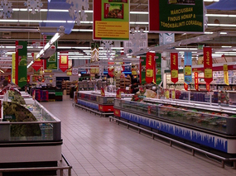
Facts About Function
To improve safety, freshness and keep quality (preservatives)
Nitrates/Nitrites
Sulfites
BHA/BHT
Photo credit: www.freeimages.com/tes
To enhance consumer acceptability including flavor and color
MSG (flavor enhancer)
To improve texture and flavor stability
Trans fat from partially hydrogenated oils
To maintain product consistency:
Potassium bromate (dough conditioner)
Notes:
and these are the functional purposes of those additives.

Slide 45
Additives in Perspective
For Food Preservation
Prevented spoilage – foodborne illness was once the #1 cause of death
Enabled geographic distribution – greater variety of food for more people in areas with less diverse agriculture
For Sensory Characteristics
Consumer appeal and acceptability to increase sales – some “conditioning” has resulted in establishing consumer expectations – e.g. “red” beverages like “fruit punch”; pink hot-dogs (might naturally be gray)
For Industry (internal) Cost-Savings
Some additives reduce labor costs, replace or minimize more expensive ingredients
Notes:
(advance slide to view each section)
Additives have played a vital and significant role in our food supply. Historically they were intended to improve the food supply. There was a time when foodborne illness was the #1 cause of death and preservatives were seen as a benefit or advantage.
Food additives have enabled food shelf life, storage and transportation for farther reaching distribution. This can be seen as a huge benefit to some, as not all geographic areas can grow all kinds of foods. With food additives, certain foods can now reach populations who are not near where that food naturally grows and would otherwise be unable to enjoy it.
The ability to modify the food supply initially for safety, storage and shelf-life also led to visual and other sensory improvements, and certain attributes in food products – such as color or appearance -- have since become expectations or common marketplace practices.
Additives can also assist with managing internal production costs. Big increase during the 1980s (not passed on to consumer in retail pricing) profit margin model “challenging” to “undo” as some additives reduce labor costs, replace or minimize more expensive ingredients.

Slide 46
Understanding Consumer Attitudes⁴³
Consumers tend to:
  amplify the risk when a food or a technology is unknown
OR
  minimize the risk in familiar foods or home preparation
Difficult-to-pronounce additive names lead to the impression of unfamiliarity, perceptions of higher health risk
Consumer perceptions and resulting actions determine the commercial future of any food ingredient
The goal of risk communication should be to consolidate these views and enable consumers to make informed decisions about food additives.
Notes:
(advance slide to view each bullet)
These are the challenges RDNs face working with consumers in the public-at-large to foster a better understanding of all the complex multifactorial and dynamic roles ingredient additives play in the contemporary food supply.
(Review slide)
It’s interesting to note that people with lower levels of education were more likely to purchase food with additives that follows government standards than those with higher levels of education. This suggests that consumers with lower levels of education are more likely to trust government institutions to regulate food additives.
Reference:
Kaptan B, Kayisoglu S. Consumers' Attitude towards Food Additives. American Journal of Food Science and Nutrition Research. 2015;2(2):21-25.

Slide 47
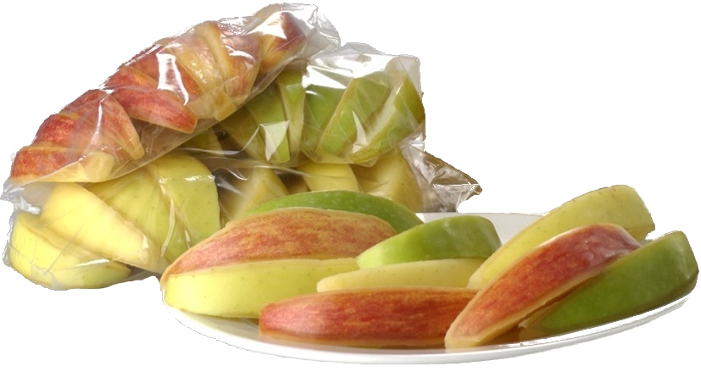
Photo credit: http://www.usappleblog.org/app/uploads/2012/03/fresh-slices3.jpg

Slide 48

How Industry is Responding
Several restaurant chains are eliminating additives such as artificial ingredients
Food manufacturers and grocers are replacing artificial colors and flavors with natural ingredients; working with suppliers and producers that avoid antibiotics
Photo credit: www.freeimages.com/simonstratford
Notes:
Industry is responding by working to remove many of the additives consumers report trying to avoid.

Slide 49
How Industry is Responding
↓ artificial colors & flavors
↓ preservatives/artificial preservatives
↓ artificial additives
↓ artificial sweeteners
↓ corn syrup/high fructose corn syrup
↓ MSG
↓ trans fat
↓ antibiotic use in production
Notes:
(Review slide)

Slide 50
Consumer’s “Right to Know”²⁶
What can Academy members do?
Provide more information on the benefits (functions) of certain additives
Refute misinformation
Understand consumer’s perception of risks
Consumers should be able to share concerns and Academy members should be able to provide accessible and accurate information.
Notes:
What can RDNs do about these challenges? (review slide)
Some research and study findings offer guidance for approaches leading to effective outcomes. Functional labeling of additive ingredients appears implicated as playing a role.
Consumers evaluate risk through different lenses
Health educators - adjust current communication strategies to reflect how consumers evaluate risk; develop materials for the needs of the target audience:
The food industry may benefit from explaining the purpose and benefit of components added to their products. In addition, information on both detrimental and beneficial chemicals may ease consumer uncertainty and worry, which could improve decision making.
Reference:
Petrun L, Flood A, Sellnow T, et al. Shaping health perceptions: Communicating effectively about chemicals in food. Food Protection Trends. 2014:35(1):24–35.

Slide 51
Consumer’s Right to Choose
Role of RD/RDN = science-based facts to enable informed decisions
Each consumer has the individual right to decide what they put in their body and choose foods based on their preferences.
Notes:
The RDN plays an important role translating sound science-based info for consumers to enable informed decision-making.

Slide 52
Consumer-Friendly Resources
FDA - Food Additives & Ingredients www.fda.gov/Food/IngredientsPackagingLabeling/FoodAdditivesIngredients/default.htm
FDA - Consumer Info About Additives & Ingredients www.fda.gov/Food/IngredientsPackagingLabeling/FoodAdditivesIngredients/ucm094210.htm
U.S. Dept. of Agriculture (USDA) Food Safety & Inspection Service (USDA-FSIS regulates meat and poultry products) - Additives in Meat and Poultry Products www.fsis.usda.gov/wps/portal/fsis/topics/food-safety-education/get-answers/food-safety-fact-sheets/food-labeling/additives-in-meat-and-poultry-products/additives-in-meat-and-poultry-products
Medline Plus - Food Additives www.nlm.nih.gov/medlineplus/ency/article/002435.htm
International Food Information Council www.foodinsight.org/Food_Ingredients_Colors

Slide 53
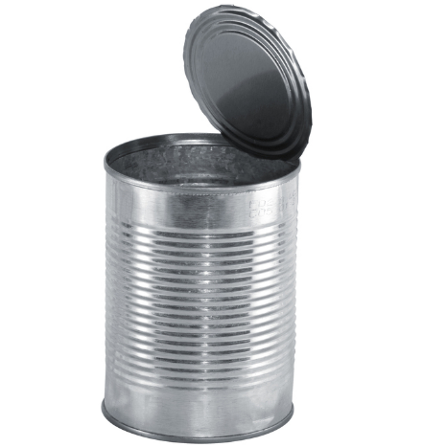
Thank you!
QUESTIONS?
Amy Myrdal Miller, MS, RDN, FAND
Roger Clemens, DrPH, CFS, CNS, FACN, FIFT, FIAFST
Please complete this short online feedback survey:
www.surveymonkey.com/r/fdaddweb
Photo credit: www.freeimages.com/ovetopfer
Notes:
Thank you!
At this time we will take questions.
Please provide your feedback by completing a short online survey through the website listed on the screen. Once again, you will receive the CPEU certificate by late tomorrow via email.
Thank you!

Slide 54
References
Food and Drug Administration Web site. http://www.fda.gov/regulatoryinformation/legislation/federalfooddrugandcosmeticactfdcact/. Accessed February 3, 2016.
U.S. Public Law 85-929. September 6, 1958. http://uscode.house.gov/statutes/pl/85/929.pdf. Accessed February 3, 2016.
U.S. Food and Drug Administration Web site. FD&C Act, Section 402. http://www.fda.gov/RegulatoryInformation/Legislation/FederalFoodDrugandCosmeticActFDCAct/FDCActChapterIVFood/. Accessed February 4, 2016.
The Free Dictionary Web site. http://legal-dictionary.thefreedictionary.com/De+Minimis. Accessed February 4, 2016.
Merrill, RA. Food Safety Regulation: Reforming the Delaney Clause. Annual Review of Public Health. 1997;18:313-40.
Fortin ND. Food Regulation – Law, Science, Policy and Practice. John Wiley & Sons, Inc.; 2009.
Codex Alimentarius Web site. Codex General Standard for Food Additives (GSFA) Online Database. http://www.fao.org/fao-who-codexalimentarius/standards/gsfa/en/. Accessed February 4, 2016.
Food and Drug Administration Web site. 21CFR101.22 http://www.fda.gov/Food/IngredientsPackagingLabeling/FoodAdditivesIngredients/ucm094211.htm. Accessed February 3, 2016.

Slide 55
References
U.S. Food and Drug Administration Web site. Loss of Indirect Additives Used in Food Contact Substances. http://www.fda.gov/Food/IngredientsPackagingLabeling/PackagingFCS/IndirectAdditives/default.htm. Accessed February 4, 2016.
U.S. Food and Drug Administration Web site. Food Additive Status List. http://www.fda.gov/Food/IngredientsPackagingLabeling/FoodAdditivesIngredients/ucm091048.htm. Accessed February 4, 2016.
U.S. Government Publishing Office Web site. Electronic Code of Federal Regulations. (21CFR181) http://www.ecfr.gov/cgi-bin/text-idx?rgn=div5&node=21:3.0.1.1.12. Accessed February 4, 2016.
U.S. Food and Drug Administration Web site. 21CFR170.30(b). http://www.accessdata.fda.gov/scripts/cdrh/cfdocs/cfcfr/CFRSearch.cfm?fr=170.30. Accessed February 4, 2016.
U.S. Food and Drug Administration Web site. 21CFR170.35(c)(1). http://www.accessdata.fda.gov/scripts/cdrh/cfdocs/cfcfr/cfrsearch.cfm?fr=170.35. Accessed February 4, 2016.
U.S. Food and Drug Administration. FDA Food Code 2009. http://www.fda.gov/Food/GuidanceRegulation/RetailFoodProtection/FoodCode/ucm186464.htm. Accessed February 4, 2016.

Slide 56
References
U.S. Food and Drug Administration Web site. Generally Recognized as Safe (GRAS). http://www.fda.gov/Food/IngredientsPackagingLabeling/GRAS/. Accessed February 4, 2016.
Williams, Iatropoulos, Enzmann, et al. Hayes’ Principles and Methods of Toxicology . 6th ed. CRC Press; 2014:25.
Klaassen C, Watkins JB. Casarett & Doull’s Essentials of Toxicology. 7th ed. McGraw-Hill; 2010:8.
U.S. Food and Drug Administration Web site. 21CFR184. https://www.accessdata.fda.gov/scripts/cdrh/cfdocs/cfcfr/CFRSearch.cfm?CFRPart=184. Accessed February 5, 2016.
U.S. Food and Drug Administration Web site. 21CFR182. Accessed February 5, 2016.
U.S. Food and Drug Administration Web site. 21CFR172. Accessed February 5, 2016.
U.S. Food and Drug Administration Web site. Code of Federal Regulations Title 21. http://www.accessdata.fda.gov/scripts/cdrh/cfdocs/cfcfr/cfrsearch.cfm. Accessed February 5, 2016.
Food and Agriculture Organization of the United Nations Web site. Chemical risks and JECFA. http://www.fao.org/food/food-safety-quality/scientific-advice/jecfa/en/. Accessed January 12, 2016.

Slide 57
References
U.S. Food and Drug Administration Web site. 21 CFR 101.100 (a) (3) (ii) http://www.accessdata.fda.gov/scripts/cdrh/cfdocs/cfcfr/cfrsearch.cfm?fr=101.100. Accessed February 5, 2016.
Weiner ML, Salminen WF, Larson PR, et al. Toxicological Review of Inorganic Phosphates. Food and Chemical Toxicology. 2001;39(8):759-86.
De La Torre Torres, JE, Gassara F, Kouassi AP, et al. Critical Reviews in Food Science and Nutrition. 2013; DOI:10.1080/10408398.2013.858235.
Petrun L, Flood A, Sellnow T, . et al. Shaping health perceptions: Communicating effectively about chemicals in food. Food Protection Trends. 2014:35(1):24–35
The NPD Group Web site. www.npd.com/wps/portal/npd/us/news/press-releases/2015/consumer-concern-about-food-ingredients-changes-their-view-on-how-natural-should-be-defined-on-food-labels-reports-npd-group/. Accessed January 22, 2016.
Sloan AE. The Top Ten Food Trends. Food Technology . 2015:69(4).
Mintel Web site. www.mintel.com/press-centre/food-and-drink/84-of-americans-buy-free-from-foods-because-they-believe-them-to-be-more-natural-or-less-processed. Accessed January 22, 2016.
Nielsen Web site. www.nielsen.com/us/en/insights/reports/2015/we-are-what-we-eat.html. Accessed January 22, 2016.

Slide 58
References
Gasparro A. Nestlé USA to Remove Artificial Ingredients From Candy. Wall Street Journal. Feb. 17, 2015.
The Hartman Group Web site. www.hartman-group.com/acumenPdfs/ingredients-avoid-v-seek-infographic-2015-05-14.pdf. Accessed January 22, 2016.
Mintel Web site. www.mintel.com/blog/food-market-news/like-oil-and-water-brominated-vegetable-oil-being-phased-out-in-the-us. Accessed January 22, 2016.
Mintel Web site. www.mintel.com/press-centre/food-and-drink/mintel-serves-up-5-key-food-and-drink-trends-for-2015. Accessed January 22, 2016.
Food Business News Web site. www.foodbusinessnews.net/articles/news_home/Consumer_Trends/2015/09/How_consumers_define_clean_eat.aspx?ID=%7BA2B69947-B22D-48E1-AC70-C32011064786%7D. Accessed January 22, 2016.
NPD Web site. www.npd.com/wps/portal/npd/us/news/press-releases/2015/real-clean-and-fresh-are-the-attributes-consumers-will-look-for-in-the-foods-they-eat-in-2016/. Accessed January 22, 2016.
U.S. Food and Drug Administration Web site. 21CFR101.22. www.gpo.gov/fdsys/pkg/CFR-2015-title21-vol2/xml/CFR-2015-title21-vol2-sec101-22.xml. Accessed January 22, 2016.

Slide 59
References
U.S. Food and Drug Administration Web site. 21CFR101.22. www.gpo.gov/fdsys/pkg/CFR-2015-title21-vol2/xml/CFR-2015-title21-vol2-sec101-100.xml. Accessed January 22, 2016.
Liaukonyte J, Streletskaya NA, Kaiser HM, et al. Consumer Response to “Contains” and “Free of” Labeling: Evidence from Lab Experiments. Applied Economic Perspectives and Policy. 2013 doi: 10.1093/aepp/ppt015.
Council For Agricultural Science And Technology. Process Labeling of Food: Consumer Behavior, the Agricultural Sector, and Policy Recommendations. October 2015. www.cast-science.org/download.cfm?PublicationID=283819&File=1030ac46417e576660c87b6b2553352b6624TR. Accessed January 22, 2016.
Delish Web site. www.delish.com/cooking/g1586/food-additives/. Accessed January 22, 2016.
The Richest Web site. www.therichest.com/rich-list/the-biggest/unnatural-10-most-common-artificial-additives-to-avoid. Accessed January 22, 2016.
Kaptan B, Kayisoglu S. Consumers' Attitude towards Food Additives. American Journal of Food Science and Nutrition Research. 2015;2(2):21-25.

