Slide 1

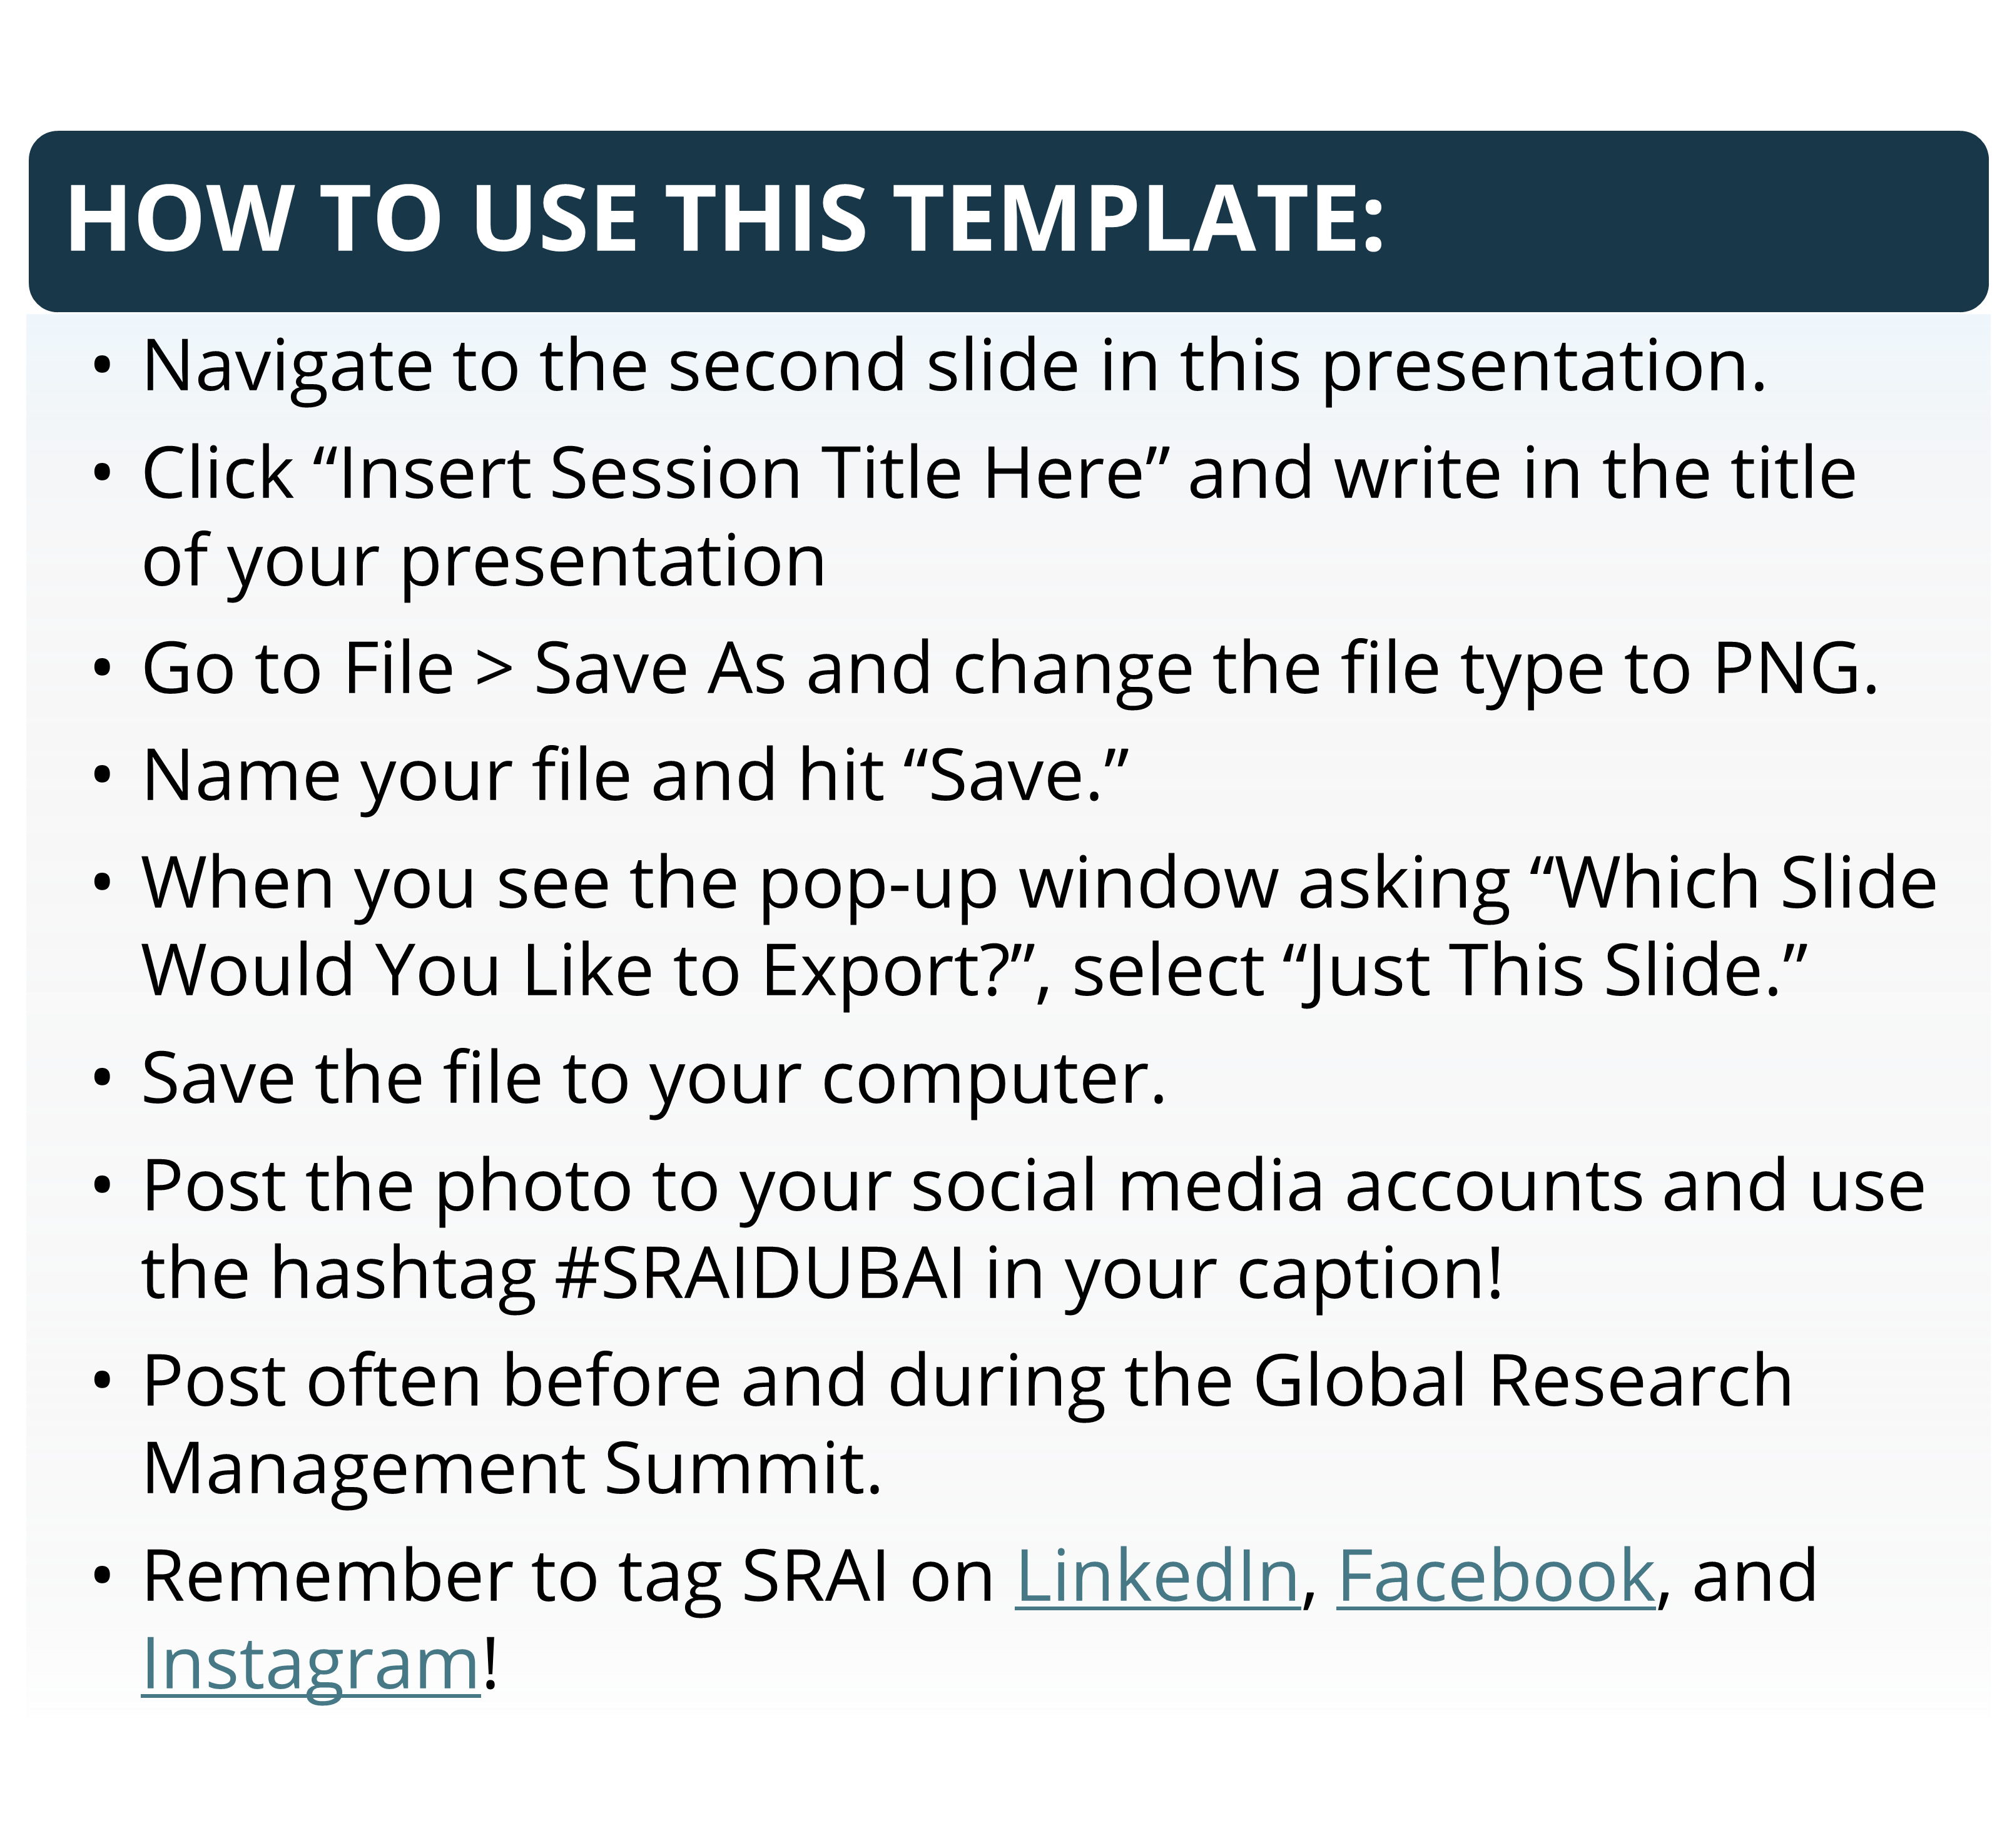


Slide 2

JOIN MY PRESENTATION
Insert Session Title Here

