Slide 1
Upstream A&D Today: The current market – James C. Row, CFA
11/15/2016

Slide 2


What Is The Clearinghouse Group?
The Clearinghouse – A&D
US oil & gas assets, small- and mid-market
Auctions
Negotiated transactions
Full service – marketing and closing/technical support
OFSCap - Investment Banking
OFSCap, LLC acquired The Oil & Gas Asset Clearinghouse II, LLC in March 2016
US and international transactions – global reach mid-market
Highly experienced team in deal-making and business development
Access to a wider range of strategic buyers and private equity
A group of companies that offer comprehensive services in oil & gas asset sales and investment banking across the energy sector to assist in the efficient execution of their divestment programs.

Slide 3
Transactions Speak Louder Than Words
Sales Transactions
Sales Volume
Over 32,000 transactions
Average auction lot size $160,000
Average negotiated deal size $33 Million
$13.2 billion in total volume
Auction lots from $100 - $22 million
Negotiated transaction from $1 million - $1 billion
The Oil & Gas Asset Clearinghouse II, LLC (“The Clearinghouse”) leverages over 20 years of experience, trust and relationships in the oil & gas industry to realize maximum value for our clients.
The Clearinghouse senior executives and business development personnel have extensive strategic contacts throughout the oil and gas industry.
The Clearinghouse has a proven track record of successfully managing the divestment of upstream assets.

Slide 4

Marketing & Closing Services
Transactions speak louder than words
Market Exposure
Data Room Support
Closing Assistance
Physical and online brochures
Digital marketing campaigns
Presentations by staff and executive teams
Information memorandum and flyer creation
Website
Physical and data rooms
Digital data rooms
Technical presentations
Receive bids
Analysis of offers
Bid negotiations
PSA facilitation
Escrow and settlement

Slide 5
Asset Variables
Producing (PDPs, %)
Oil vs. gas
Geographic location (basin, county, etc.)
Size (acreage)
Current or expected operator
Geologic attributes
Vertical or horizontal, age and duration
Production method
Operating costs
Financing costs, cash flow, pressures and corporate issues
Commodity pricing
Political events
Checkboard, position, strategy or story

Slide 6
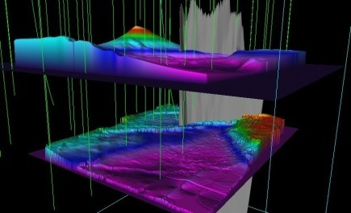
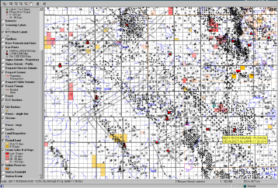
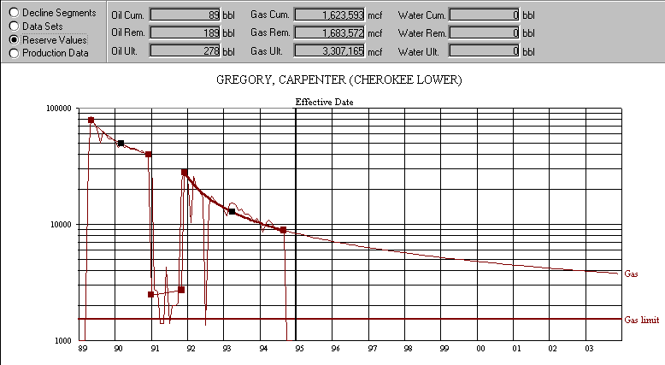
Technical Evaluation Services
Property Evaluation
Commercial analysis
Reserve report
Land summary
Project management
Coordination and closing
Business development
Contract and marketing
Technical resources
Engineering and geoscience support
Land
CA and PSA review
Organizational Support
The Clearinghouse applies knowledge, skills, tools and techniques to achieve one goal – maximum value for its clients.

Slide 7
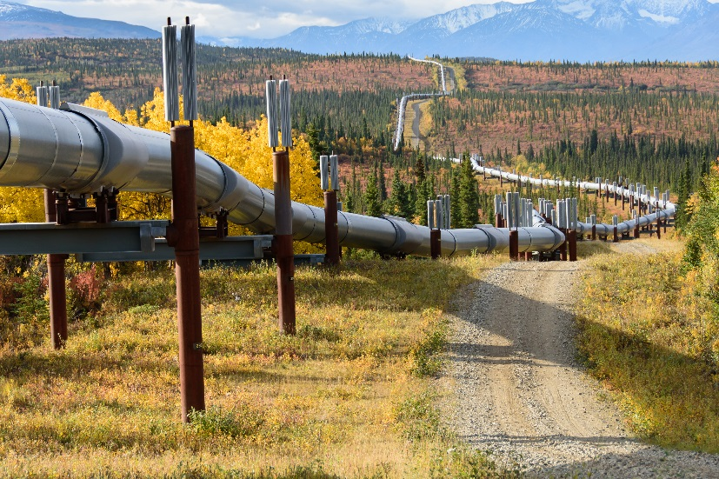
Overview – Market Metrics
Market metrics
Rig counts
Pricing overview
DUCs
Impacts on valuations
Final remarks
US oil & gas monthly M&A tear sheet – October 2016
YTD: 496 deals for $49.79bn
Monthly: 44 deals for $11.02bn
Market Snapshot To Date

Slide 8
OFSCap Services
OFSCap has a unique position being able to bridge multiple countries in multiple energy disciplines. Our specialties are (1) Raising capital and placement, (2) arranging joint venture partnerships, and (3) assisting with project developments.
OFSCap can manage and assist either private or public companies regarding capital raises or M&A activities and provides both buy-side and sell-side advisory. Our relationships, country and market knowledge with target entities have expedited strategic acquisitions and transactions. In addition, our contacts and expertise in arranging JV partnerships have accelerated project developments and qualified development projects for global project financing.
Whether raising capital, advising on M&A or finding the right joint venture partner, we work directly with senior management to develop a strong strategic plan based on their objectives and goals. OFSCap areas of expertise include:
Debt financing
Buy side
Oil & gas
Equity raise
Sell side
Oilfield services
Private placements
Public
Clean energy and power
Advisory
Private
Natural gas
Development
Government
Commodity contracts

Slide 9
OFSCap Overview
OFSCap, LLC (“OFSCap”) is a boutique investment banking and project development firm exclusively servicing the energy sector worldwide.
Team: 40+/- multilingual experienced energy investment banking professionals
Experience: All team members have senior operational, financial or managerial experience directly in the sector.
Global network: A team located in the major finance and industry capitals
Energy: Dedicated exclusively to the energy sector, OFSCap provides highly focused advisory and financing expertise to its clients.
Clients: Our team members have collectively over 300+ engagements with energy companies
Closings: Our team has closed over $50 billion of energy sector engagement
Research: Coverage and insight on energy sector trends in a number of sectors and countries
Development: For strategic projects, OFSCap can act as advisor or lead developer on infrastructure development projects with a high interest in clean energy projects such as solar PV, wind and water.
OFSCap prides itself on combining investment banking skills together with corporate finance and operational knowledge to provide both a financial and strategic solution.

Slide 10
OFSCap Global Reach & Partners
Oslo
Strategy Partners Moscow
FairCourt Capital London
Calgary
New York
OFSCap Houston
Washington DC
Tokyo
Hong Kong/Shenzhen
Mexico City
Protiviti Abu Dhabi
Bogota
Singapore
Luanda
OFSCap
Rio de Janeiro
Perth
OFSCap Offices
Buenos Aires
OFSCap Alliances
Team Locations
OFSCap’s network is global. Our team maintains contact with a wide range of senior stakeholders, board of directors, and investment committees throughout the global investment community.

Slide 11
Basin-By-Basin Deal Metrics
Basin | Buyers | Sellers | Value | Asset | Metrics
Permian | RSP Permian | Silver Hill | $2.4B | Winkler, Loving Co TX | $34,575/Daily BOE-$45,634/Acre
 | OXY | J Cleo Thompson | $1.765B | Reeves, Pecos Co TX | $35,000/Daily BOE-$40,500/Acre
 | SM Energy | Qstar LLC | $1.6B | Howard, Martin Co TX | $33,000/Daily BOE-$42,500/Acre
 | OXY | Marathon | $235MM | Yoakam, Hockley Co TX | $58,750/ Daily BOE
 | Resolute | Firewheel Energy LLC | $35MM | Reeves Co TX | $38,167/Daily BOE-$24,233/Acre
Mid-Con | Red Bluff | Gastar Exp | $61MM | (Stack) Canadian, Kingfisher OK | $28,122/Daily BOE-$2,927/Acre
Gulf Coast | Undisclosed | Clayton Williams | $400MM | Burleson, Robertson, Lee, Bastrop | $36,500/Daily BOE-$4,601/Acre
 | Carrizo | Sanchez | $181MM | Eagle ford acreage in Cotulla | $33,174/Daily BOE-$6,929/Acre
Rockies | Oasis | SM Energy | $785MM | McKenzie, Williams CO ND | $40,000/Daily BOE- $5,255/Acre
Source: 1Derrick Global M&A Database

Slide 12
North America Rigs Vs. US Production
Today ~8.5MM
Today 497
Source: Baker Hughes, EIA

Slide 13
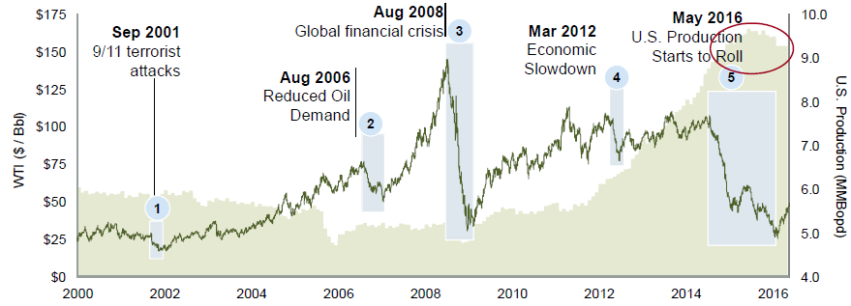
Key WTI Events – Oil Price
Longer recovery than historical, and expected to remain challenging
WTI Oil Price (2000 to Present)
Event | 9/11 Attacks | Reduced Demand | Global Financial Crisis | Economic Slowdown | Oversupply
Oil price decline | 38% | 32% | 69% | 29% | 75%
Decline period | ~2 months | 5-6 months | 5-6 months | 2-4 months | 22 months
Recovery | ~1 year | ~6 months | ~1-2 years | ~2 months | ?
Source: Bloomberg

Slide 14
Where Are We Headed?
Annual US E&P Onshore A&D Activity ($B)¹
Failed Deals
Estimate
$15
¹ Includes onshore US asset transactions greater than $20 million.
Source: RBC Richardson Barr internal database, public filings, company press releases

Slide 15
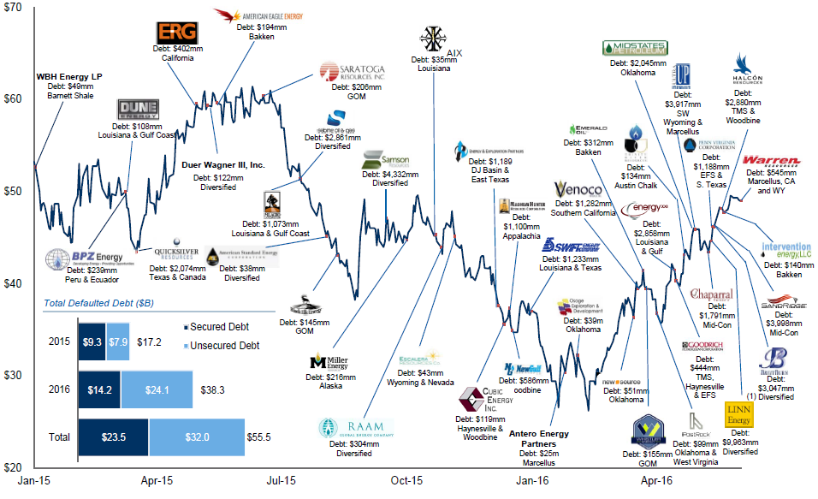
Key Bankruptcy Events
WTI Crude 2015 – 2016 performance vs. bankruptcies ($/Bbl)
Total Defaulted Debt ($B)
$17.2
$38.3
$55.5
¹ Debt as of 3/31/2016, adjusted for pro-forma events
Source: Public disclosure, Hanyes Boone LLC, FactSet as of June 2, 2016

Slide 16
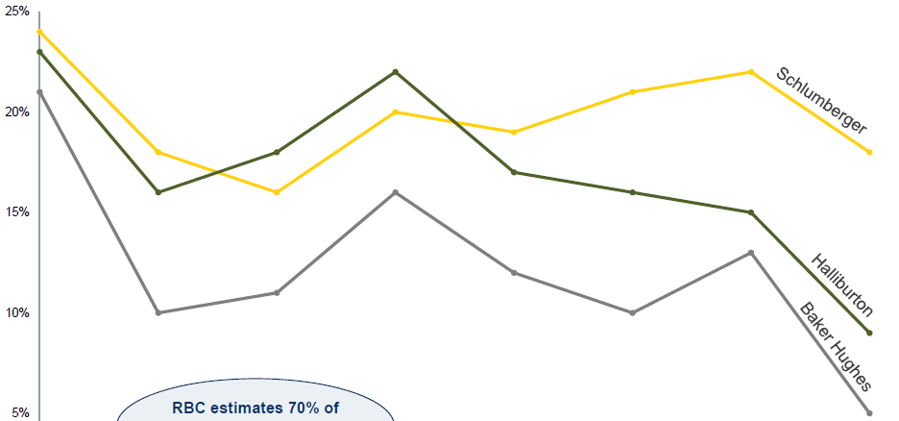
Service Costs Decreased Dramatically
RBC estimates 70% of current D&C cost savings are cyclical
Service Costs Have Come Down – OFS Global Margins (%)
Source: Schlumberger February 2016 Investor Presentation

Slide 17
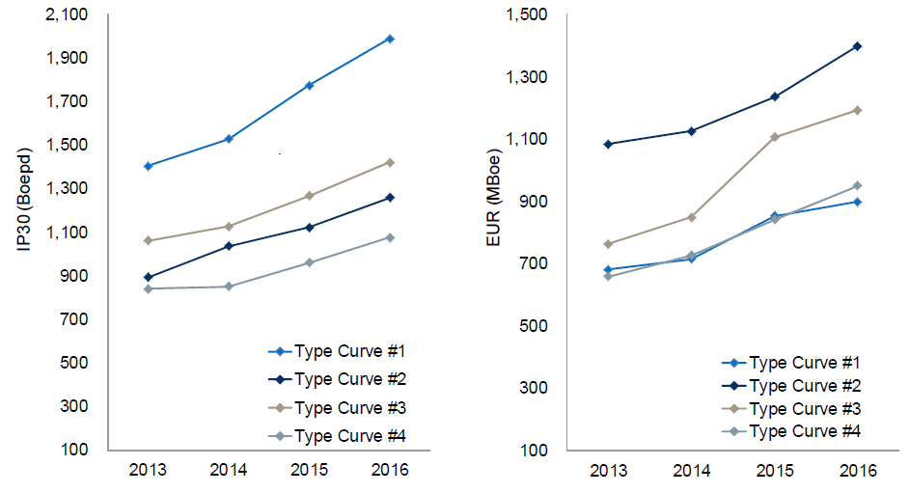
Companies Are More Efficient
Production Rates Increasing Over Time
EURs Increasing Over Time
Source: RBC Richardson Barr

Slide 18
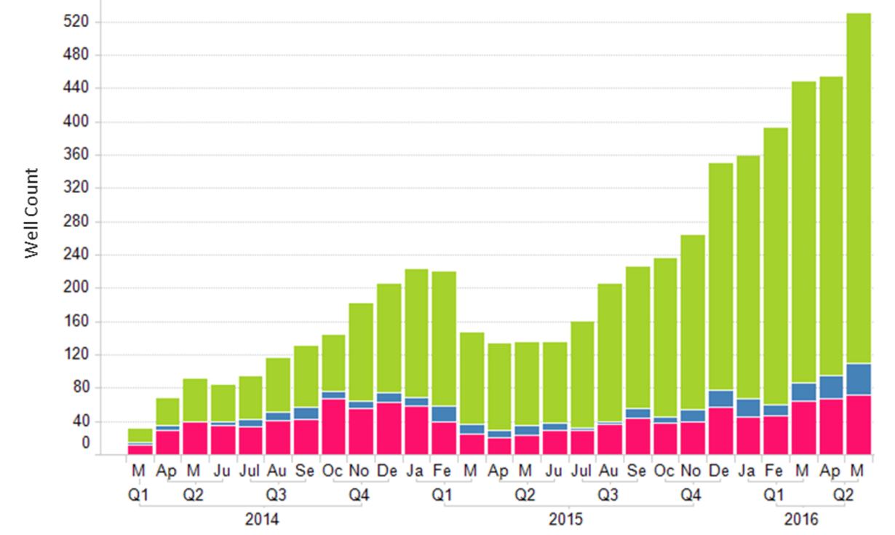

DUCs – Drilled Uncompleted
US DUC Wells by Vintage – 3/2014-5/2016 (Data As Of June 23, 2016)
Source: drillinginfo

Slide 19
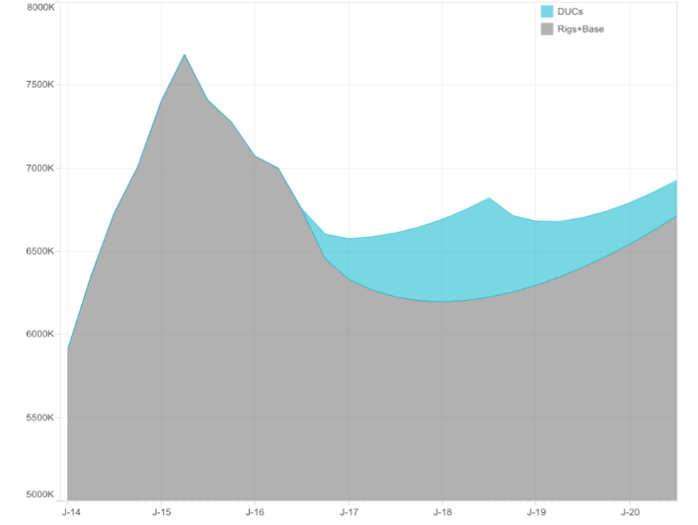

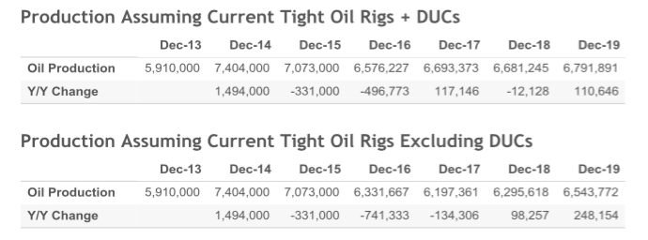
DUCs
Production assuming current tight oil rigs + DUCs
DUCs – drilled uncompleted
5000 – 7000 total wells, best guess is around 6000
Pricing effect
Tracked mostly by the Analyst Community
Source: Macquarie

Slide 20
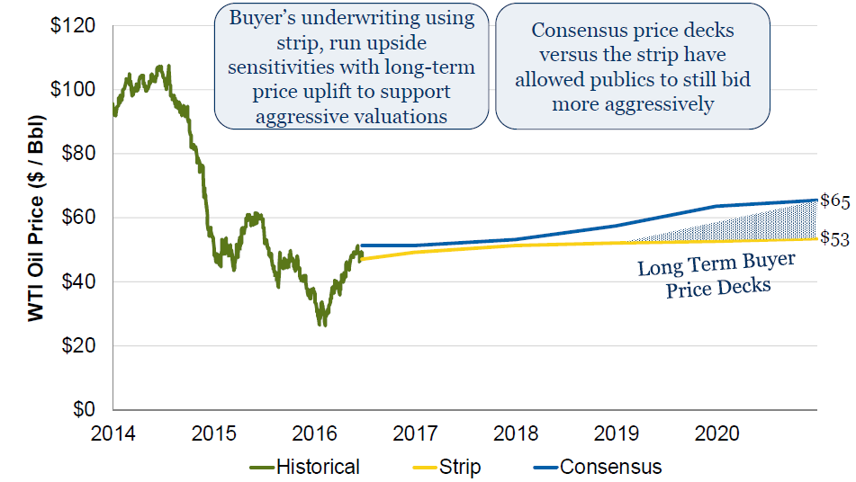
Oil Price Effect On Deal Making
WTI Oil Price
Buyer’s underwriting using strip, run upside sensitivities with long-term price uplift to support aggressive valuations
Consensus price decks versus the strip have allowed publics to still bid more aggressively
Source: RBC Research, Bloomberg and FactSet as of June 24, 2016

Slide 21
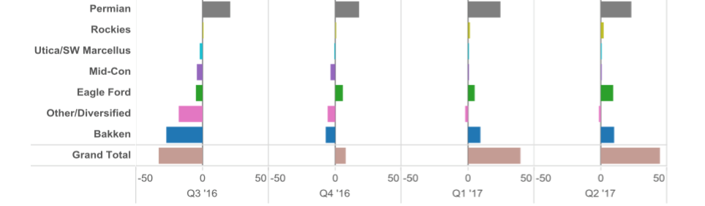
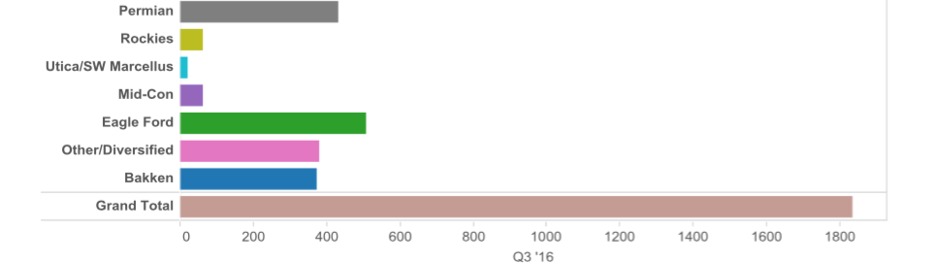
Consensus Growth Analysis
Sequential Growth By Region (KBD)
Total Sample Production Q3 2016 (KBD)

Slide 22
Consensus Growth Analysis
Flight to quality – Basin specific
Busy 2nd quarter ($16.7B vs. $5.3 Q1 - 117 vs. 71)
Improving 3rd quarter
Rule of thumb:
Flowing barrel
Most used:
PV
Cash flow
Permian (Delaware/Midland) – everything else
Acreage
Publics vs. private tilt
Reduction of RBL lending

Slide 23
Consensus Growth Analysis
Lots of money in the market
Bankruptcy transactions (distressed)
A&D market picking up (bid/ask spread)
Position consolidation vs. non-core
Public companies vs. PE-backed vs. small operators
International buyers and funding groups
Cash vs. costs
A&D is only part of the story
Saudis picked the wrong fight

Slide 24



































Distinguished Repeat Clientele

Slide 25

Choose The Clearinghouse
The premium choice for oil & gas A&D
Our technical team leverages over 300 years of combined oil and gas, land and transactional expertise, access to physical and virtual data rooms and our database of over 20,000* registered and approved buyers. Through auctions and negotiated sales, we have the credibility and stability you need.
The Clearinghouse has built the right mix of technical know-how with key relationships to create proven, streamlined processes that ensure a smooth, hassle-free experience for our clients.
*Number includes buyers and sellers.

Slide 26
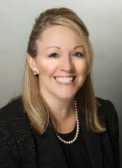
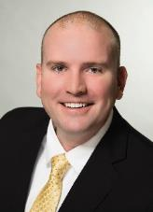
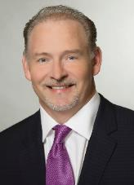
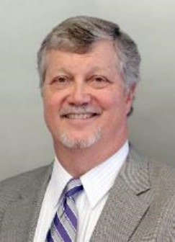
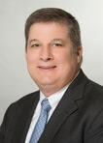
The Clearinghouse Management Team
For additional questions about the The Clearinghouse or to obtain information regarding the sale or acquisition of properties with us, please contact our management team:
Denna Arias
Vice President Houston, TX
832-601-7605
darias@ogclearinghouse.com
Thomas Medlin
Vice President Oklahoma City, OK
405-445-1305
tmedlin@ogclearinghouse.com
Chase Morris
Vice President Dallas, TX
214-500-0582
cmorris@ogclearinghouse.com
Ron Barnes
President Houston, TX
832-601-7611
rbarnes@ogclearinghouse.com
Pat DaPra
Vice President Houston, TX
832-601-7655
pdapra@ogclearinghouse.com
The Clearinghouse
1235 North Loop West Ste 500
Houston, Texas 77008
Phone: 281-873-4600
Email: sales@ogclearinghouse.com
All securities transactions executed by The Oil & Gas Asset Clearinghouse II, LLC (“The Clearinghouse”) are performed by The Clearinghouse personnel who are FINRA registered representatives of The Clearinghouse (member, FINRA/SIPC),

