Slide 1
Your Name goes here
„Title of your presentation
goes here“
State your University
State your Discipline
State your Semester
State your Degree Aspiration
State when you will finish school
Don‘t forget to add a portrait of yourself
Your quality
Portrait Picture

Slide 2
Title of your presentation
Your Name
Your University

Slide 3
Outline
As always,
No more
Than
6
Bullets
For your outline
Your Name

Slide 4
Regular Slide
This presentation shall last
20 minutes + 10 minutes Q&A
→ Please stick to those times, otherwise we will cut you off
10-15 slides may be advisable
And don‘t overload the slides!
No more than 5 bullets per slide (except outline)

Slide 5
Commercialism
Take out commercial character!
Only mention company and product names on first and last slide (=following SPE guidelines!)
More info can be found in this SPE video: http://youtu.be/_SMLMWx6JGA

Slide 6
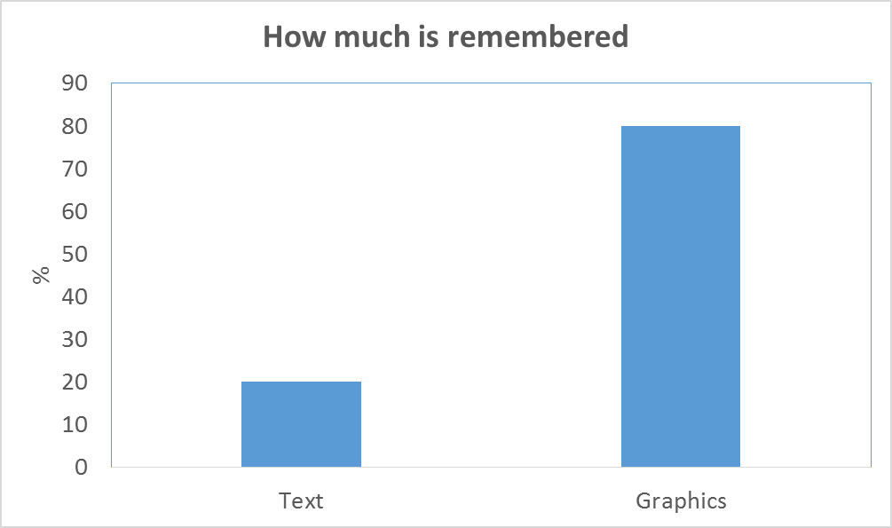
Make slides graphical

Slide 7
Animations
Don‘t just dazzle!
Audience should focus on content, not animation
Instead, make it easy to follow
Some animation can help there
But not too much...

Slide 8
Some advice
TLA‘s –
spell out the three-letter-acronyms
Have the slides support you –
don‘t just support the slides
Practice –
have a friend give you feedback
Time yourself when practicing

Slide 9
More advice
Speak towards the audience
Look at laptop (if needed), not the big screen
Speak slowly and with appropriate intonation
Pause where an important point is made
Don‘t just read off the slides!
Use body language when appropiate, e.g. to emphasize certain points

Slide 10
Even more advice
Consider: How knowledgeable is your audience? People will have diverse backgrounds
  take the audience with you. That may imply that you have to start explaining at a more basic level rather than at a very high level
  It may also mean that not everyone understands your (scientific) language. Keep it simple!
Use pointer sparely

Slide 11
Legibility
Contrast needs to be good
Can the guys in the back read it?
…and certainly not aggressive!!!
Don‘t fully phrase out sentences rather than just simple bullets which would be a lot shorter, easier to grasp, better to remember, To read, etc etc. Instead, please be concise!
Don‘t make it look childish
Don‘t distract!

Slide 12
Summary
Have a summary slide
Just main points
Remember – make it easy to follow!

Slide 13
Thank you!
Questions?
Get in contact with us!

