Slide 1




Unlocking your
potential!
Leveraging LinkedIn

Slide 2

Best Practices
LinkedIn
Engagement
Job Search
Profile photo
Banner
Headline
About
Experience
Education
Skills
Recommendations
Accomplishments
New connections
Follow company’s page
Skills endorsement
LinkedIn Groups
Like, comment, share relevant posts
LinkedIn Learning
#OpenToWork feature
Jobs search
Review requirements
Connect/contact job poster
Engage with company’s content

Slide 3

Platform
Resume
How does LinkedIn help with job search?
Professional networking platform designed to connect individuals with potential employers, colleagues, and business partners
It serves as an online resume where users can showcase their education, work experience, skills, and achievement
Opportunities
Engagement
Offers opportunities for networking, job searching, and professional development. #1 tool for jobseekers and recruiters
Follow companies, groups and engage with content relevant to your career and personal interests.

Slide 4


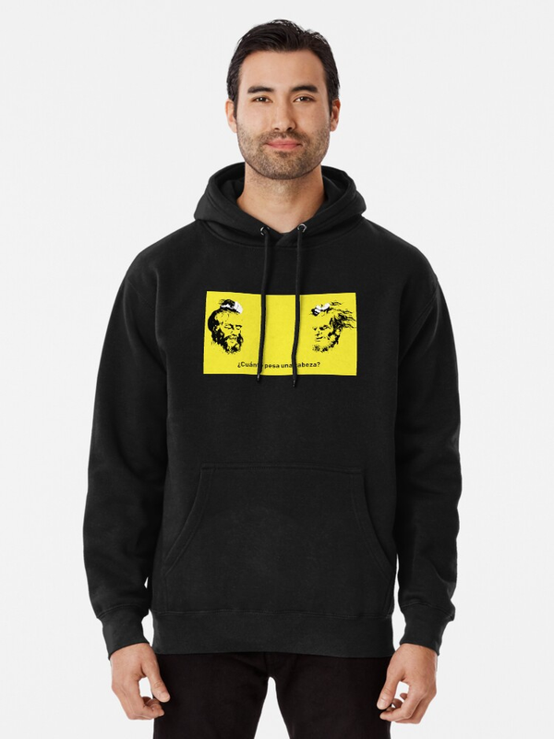

Professional Photo
First impression of how potential employers will perceive you
High quality increases profile’s visibility & engagement
Set a positive tone for your professional identity
Your personal image and brand
What are your first impressions of these profile photos?

Slide 5




Take a Great Photo
Dress for the job you want
Smile and have a friendly expression
Use a background that isn’t distracting
Make sure your face takes up a majority of the frame
Take a high qaulity picture that is not fuzzy
Members with profiles photos receive up to 21x more views and 9x more connection requests!

Slide 6






LinkedIn Banner
Another way to express yourself or brand

Slide 7
Tagline / Headline
Opportunity to make a strong impression, it’s like a “handshake” when you meet someone!
Up to 220 characters but keep is short and simple
Used by LinkedIn and other search engines (e.g. Google) for searches. Optimize your headline for top search engine rankings.
Also useful to catch the attention of hiring managers and recruiters
Jane Doe
Detail-Oriented Cybersecurity Specialist with CCNA | Harnessing Unique Insights to Fortify Digital Security | Seeking Oppotunities in Detroit
John Doe
Autism-Enhanced Analytical Expertise in Cybersecurity | CCNA Certified | Open to cybersecurity positions in Detroit
Write your own
unique “Tag Line”
Use ChatGPT to help you.

Slide 8
About
Your elevator speech, communicate your role, career aspirations, etc.
As a dedicated and detail-oriented cybersecurity professional, my journey into the world of digital protection has been both unique and rewarding. With a CCNA certification in hand, I bring a meticulous approach to analyzing and strengthening network security, a skill set sharpened by my focused and analytical perspective—traits that my autism enhances.
I am now looking to join an organization that values innovation, integrity, and inclusiveness, where I can apply my cybersecurity knowledge, contribute to safeguarding digital assets, and continue to evolve as a resilient and insightful cybersecurity professional.
Embarking on a path where technology meets security, I have carved a niche for myself in the cybersecurity domain, fueled by my passion for safeguarding digital environments. Holding a CCNA certification, I possess a keen eye for detail and a systematic approach to problem-solving, attributes enhanced by the unique perspectives I gain from my experience with autism.
My autism grants me the ability to focus intensely on complex tasks and approach problems with a distinctive analytical lens, qualities that I believe are assets in the dynamic field of cybersecurity. I am enthusiastic about joining a forward-thinking team in Detroit, where I can contribute to robust cybersecurity defenses and continue my trajectory of professional and personal growth.
Write your own
unique “About” section.
Use ChatGPT to help you.

Slide 9


Experience
List current roles, previous positions, responsibilities, etc. Let is read like a resume.
Education
Experience
Summer Intern
Complete your education information, including relevant certifications and licenses.
Detroit Cyber Consultants - Intern
June 2023 - August 2023
Detroit, Michigan
During my cybersecurity internship, I gained hands-on experience in identifying and mitigating network vulnerabilities, enhancing my understanding of threat landscapes and security protocols. Chis experience not only deepened my technical expertise but also honed my problem-solving skills, preparing me for a proactive role in protecting digital environments.
Update your Experience & Education section so it provides a good overview of what you did, learned, etc.
Book Reader
Early Childhood Development Center - Volunteer
Jan 2022 - June 2023
Dearborn, Michigan
As a volunteer book reader at an early childhood development center, I played an integral role in stimulating young minds through engaging storytelling, fostering a love for reading and learning among children. This experience allowed me to contribute positively to the early literacy development and enhancing their cognitive skills and imagination in a nurturing environment.

Slide 10
Other important sections
Skills
LinkedIn gives you 50 skill slots and take full advantage of filling out your profiles.
Skills keywords will help your profile ranking in recruiter searches
Include both hard and soft skills.
Recommendations
A strong way to show employers your work ethics, skills, etc.
Get recommendations from Living & Learning leaders, your mentors and prior supervisors
Accomplishments
Brag about your accomplishments (e.g. Employee of the month, honor student, etc.)
Mention and projects, hobbies, etc. that will complement your professional career.
Add training programs that you have attended.
You can also add languages in this section.
Update these sections and keep them current with new information.

Slide 11
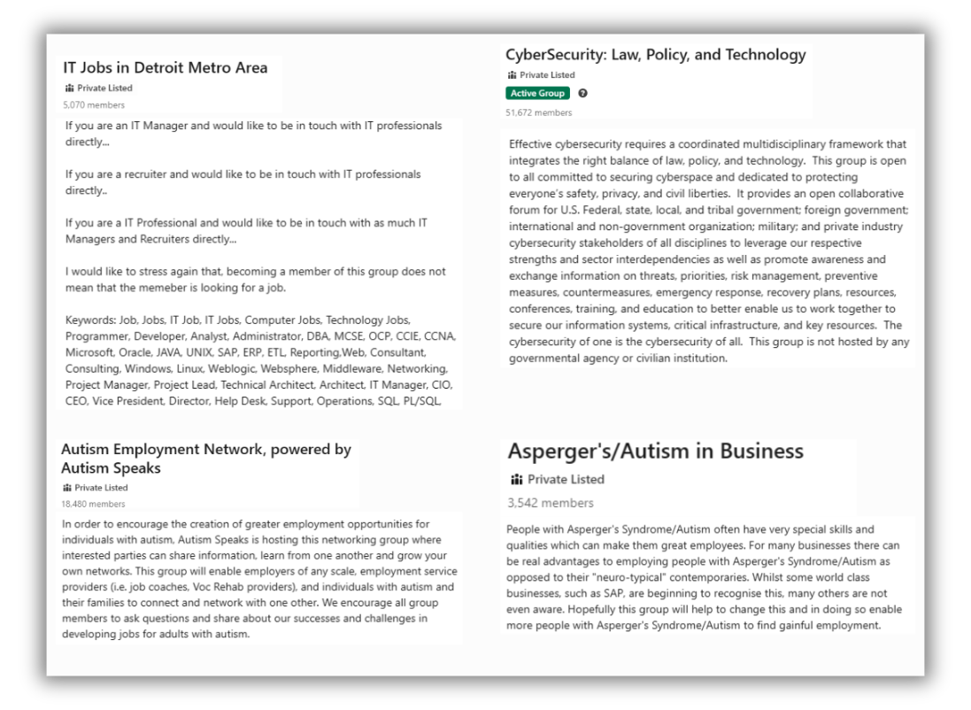
LinkedIn Groups
A dedicated space for like-minded professionals.
Targeted opportunity to learn, read about topics of common interests.
You can seek advice from other professionals.
Network with your peers.
Research groups that interest you and join them

Slide 12

LinkedIn
Jobs

Slide 13
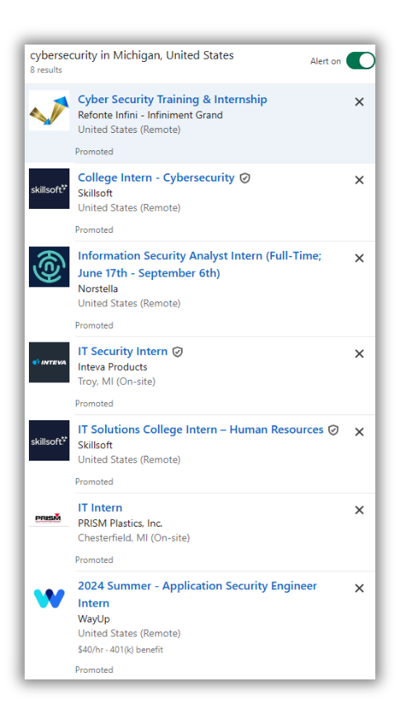

1.
2.
3.
4.
Click on Job’s icon
Click search Bar
Edit the filters
Set Alerts

Slide 14
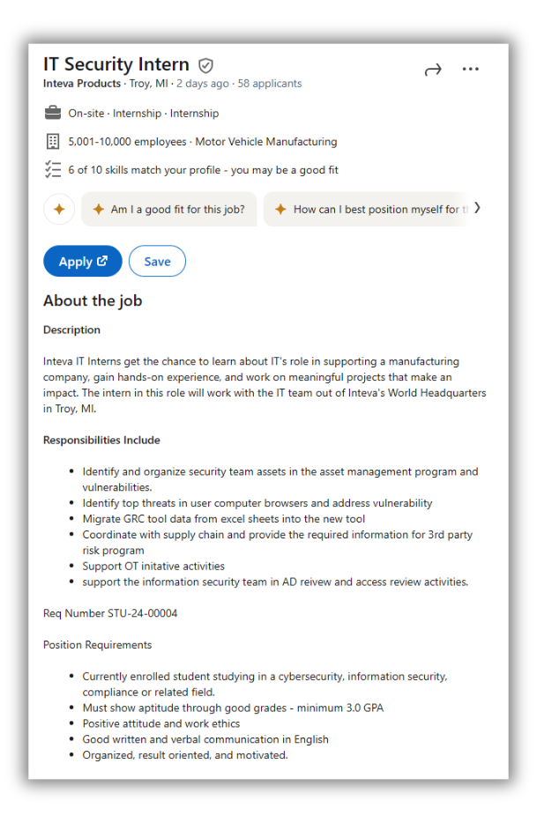
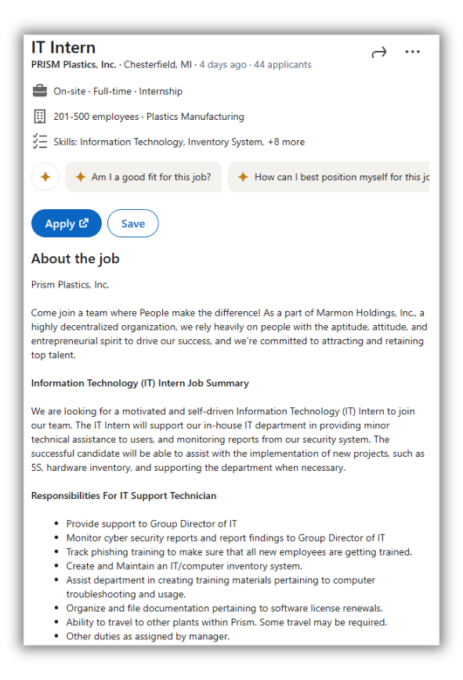

Review the job requirements
Research the organization
Research hiring managers and/or contacts at the organization
Apply

Slide 15
Thank You
LinkedIn
Engagement
Job Search
Profile photo
Banner
Headline
About
Experience
Education
Skills
Recommendations
Accomplishments
New connections
Follow company’s page
Skills endorsement
LinkedIn Groups
Like, comment, share relevant posts
LinkedIn Learning
#OpenToWork feature
Jobs search
Review requirements
Connect/contact job poster
Engage with company’s content

