Slide 2
What is Fire Protection engineering for those in middle school?
Name of Presenter
Title
Organization
Date

Slide 3
My background
Education
Employer
Job function
Interesting professional experiences
Insert Speaker’s SFPE information here
  Membership level & length of membership
  Local Chapter
  Committees, volunteerism

Slide 4
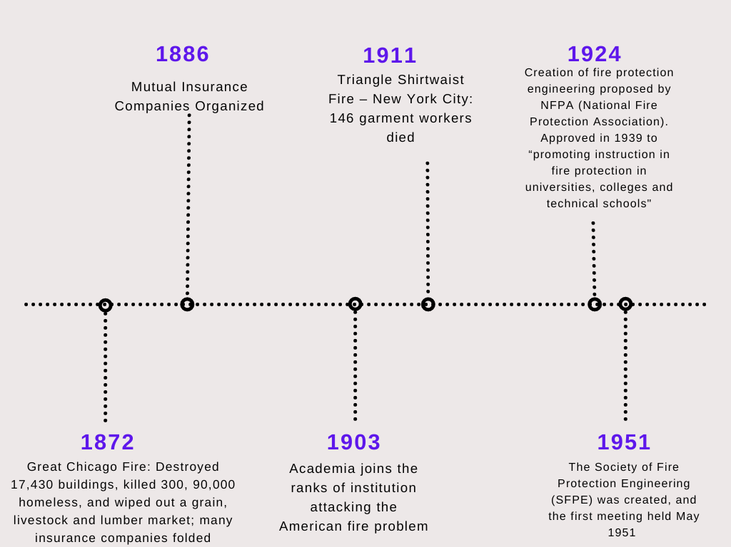
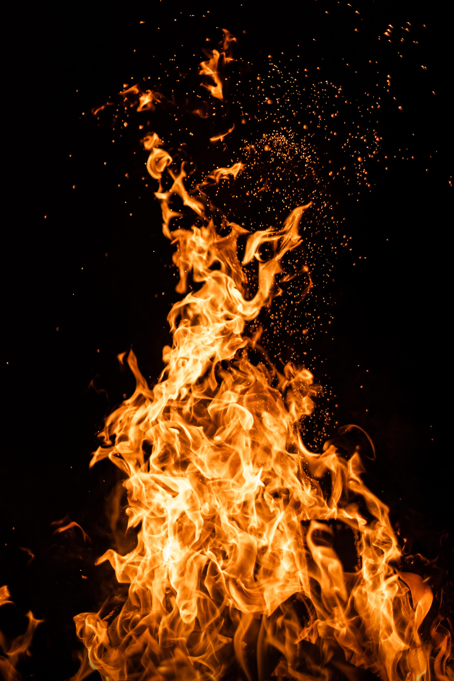
EARLY HISTORY: Catastrophes were common – Something needed to be done. Engineers of the day rose to the challenge and institutions of fire protection were established
Notes:
Fire protection engineering grew out of the Industrial Revolution, in response to the need of the day. Since that time, the profession has grown in structure as well as size. The field has made credible progress in important areas that typically serve to define a profession including its body of knowledge, professional registration and education even while it is still behind other disciplines. The development of academic programs has experienced the most difficulty.

Slide 5
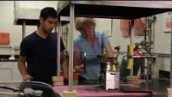
What is Fire Protection Engineering (FPE)?
Making people and places safe from fire

Slide 6
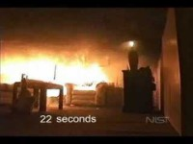
How does a fire start and grow?

Slide 7
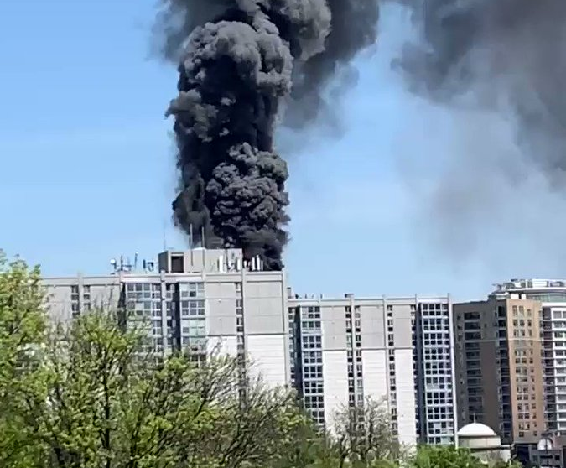

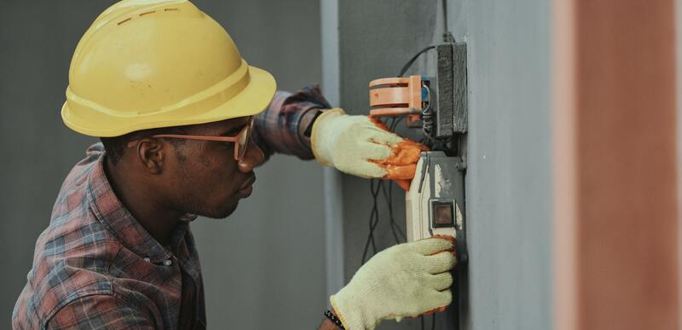
What is a fire protection engineer?
Fire protection engineering is the application of science, engineering principles and experience to protect people and their environments from the destructive effects of fire.
Or more briefly: Fire Protection Engineers use science and technology to make our world safe from fire
Works to improve public health, safety and welfare related to fire events.
Notes:
By strict definition, we use the skills, knowledge and experiences we gain to engineer safer buildings, products and more. We learn from prior experiences; research and testing; and from the investigation of tragic events to help eliminate loss of life and property.
Research - there is still much to be learned about fire growth, fire severity and the damaging affects of fire on materials and to humans;
Organizations - like the Society of Fire Protection Engineers are dedicated to reducing the loss of life and property from the effects of fire;
Design - individuals and companies are constantly looking for new materials that slow or eliminate fire growth; provide new ways to extinguish fire; and make occupiable facilities safer;
Construction - engineers then provide the link to transfer these technologies into the built environment.

Slide 8
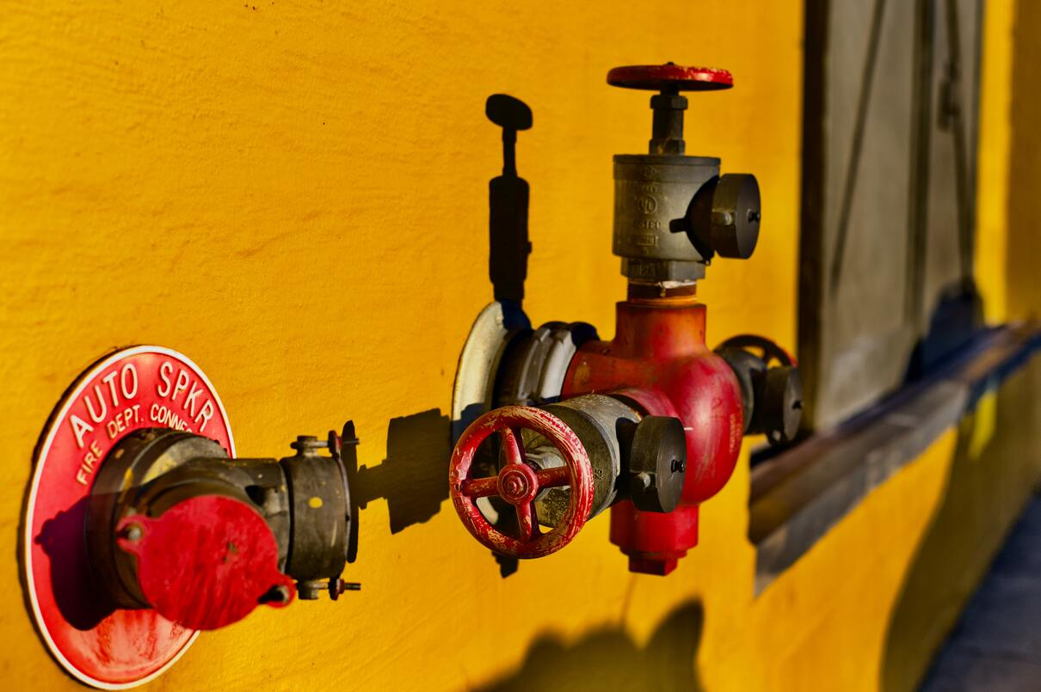
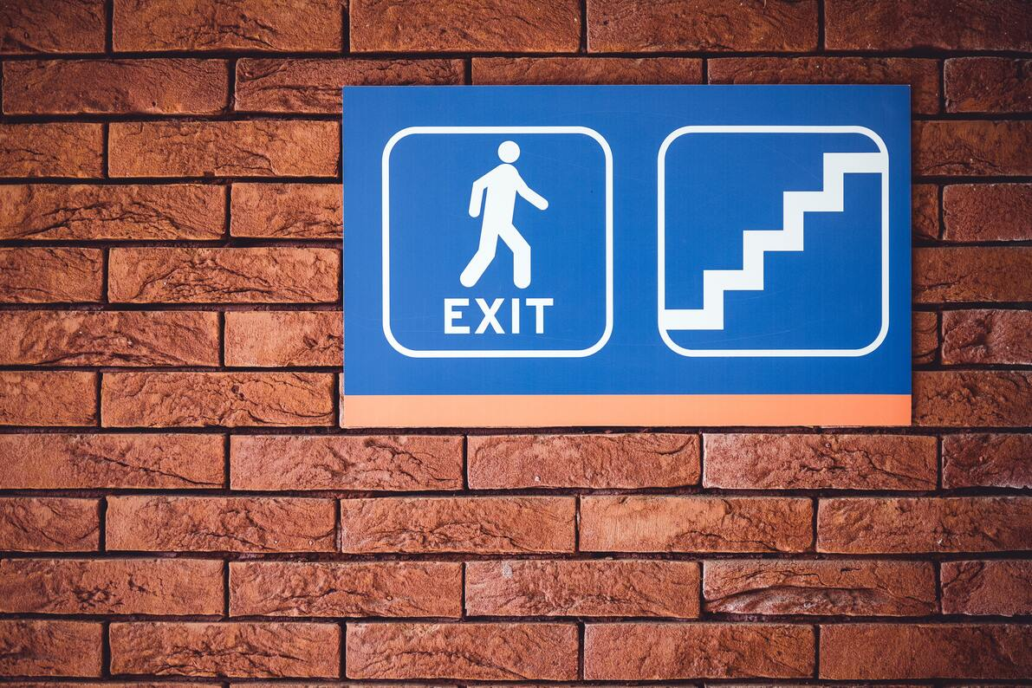
How fpes make us safe from fire
Design safer buildings
Evaluate buildings to pinpoint risks
Conduct fire safety research
Evaluation industrial processes and their associated hazards
Evaluate new approaches for buildings and operations
Performance-Based Design
Investigate fires
Lessons Learned
Notes:
(Hidden as info is repeated on slide 11)

Slide 9
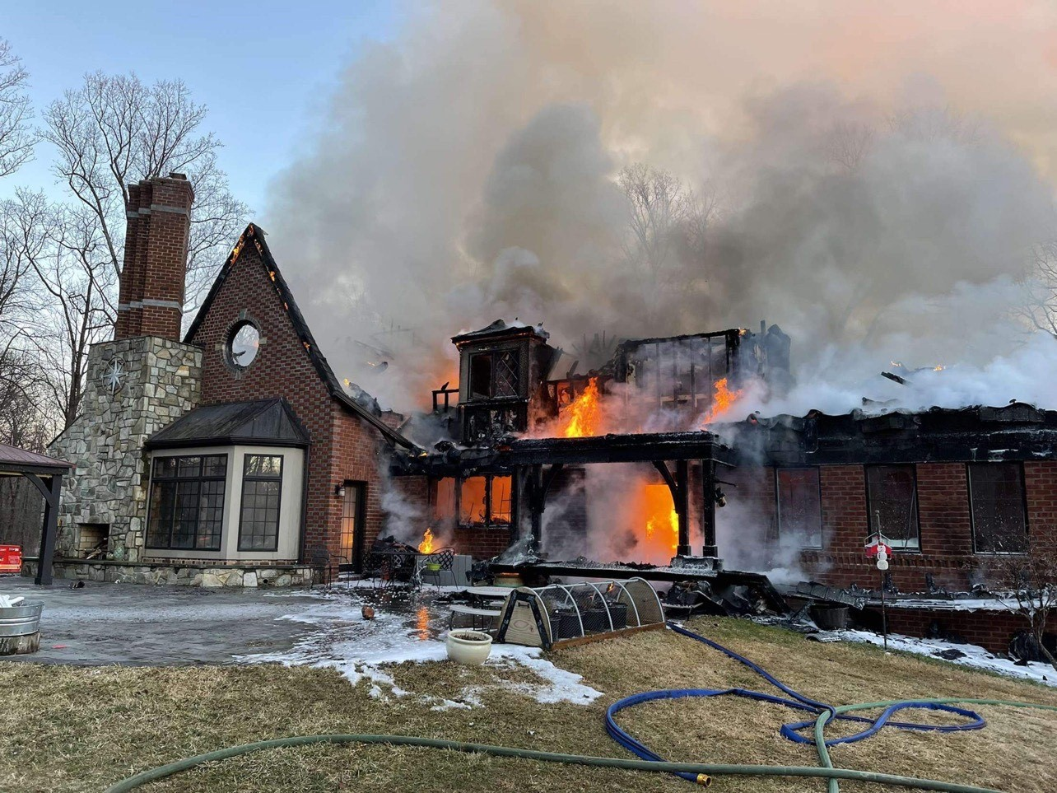
Why are FIRE PROTECTION ENGINEERS important?
Last Year in the United States:*
1.35 million fire responses
3,800 civilian deaths
14,700 civilian injuries
70 firefighter deaths (non-COVID)
$15.9 billion property damage
*NFPA, 2021
Notes:
Updated 2021 NFPA numbers added
https://www.nfpa.org/News-and-Research/Data-research-and-tools/US-Fire-Problem/Fire-loss-in-the-United-States
https://www.nfpa.org/News-and-Research/Data-research-and-tools/Emergency-Responders/Firefighter-fatalities-in-the-United-States

Slide 10
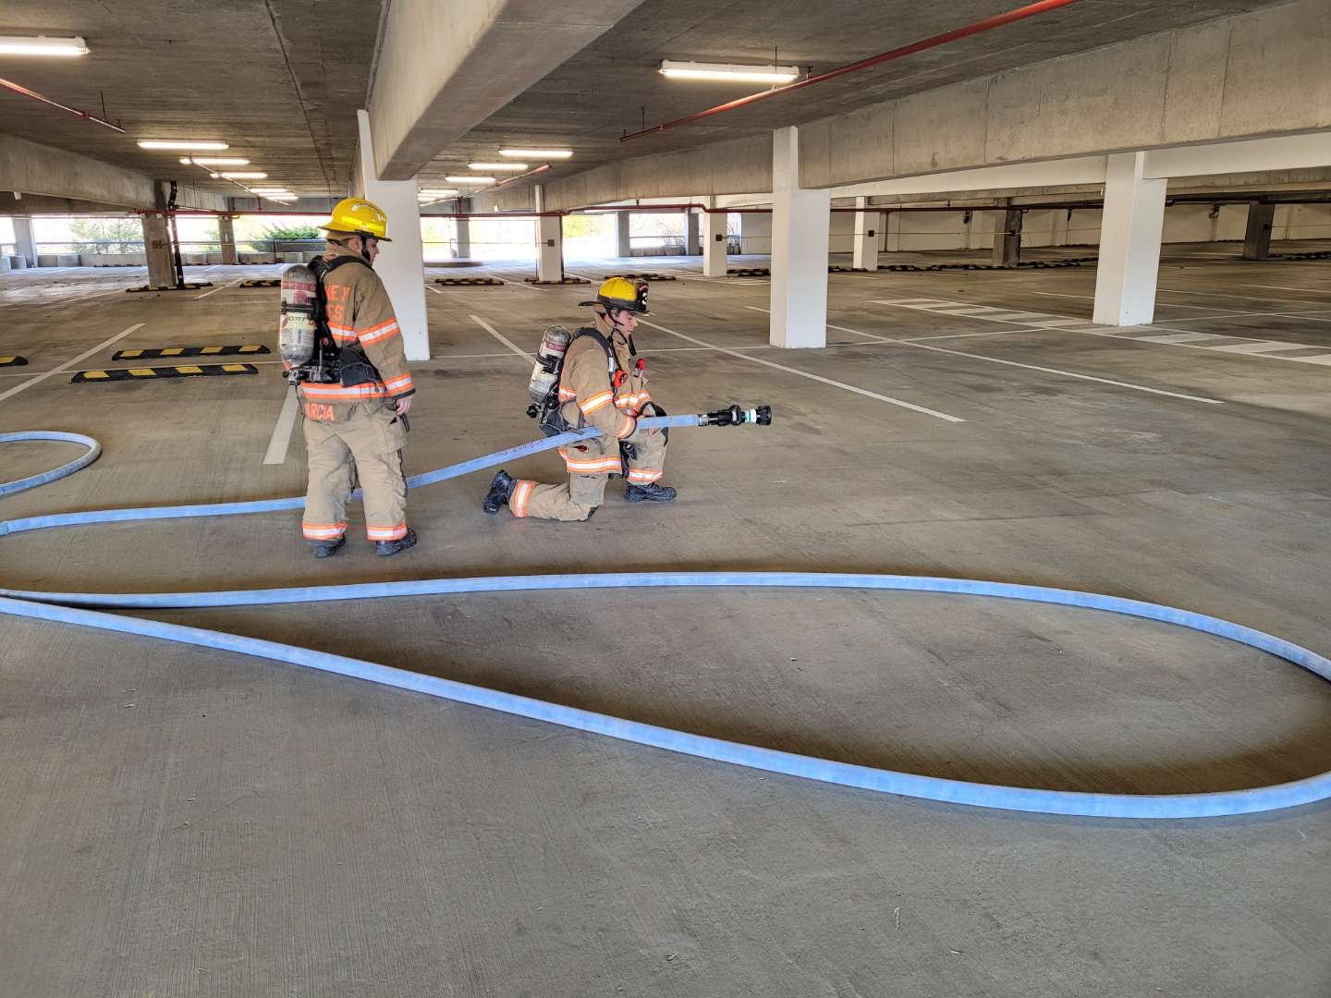
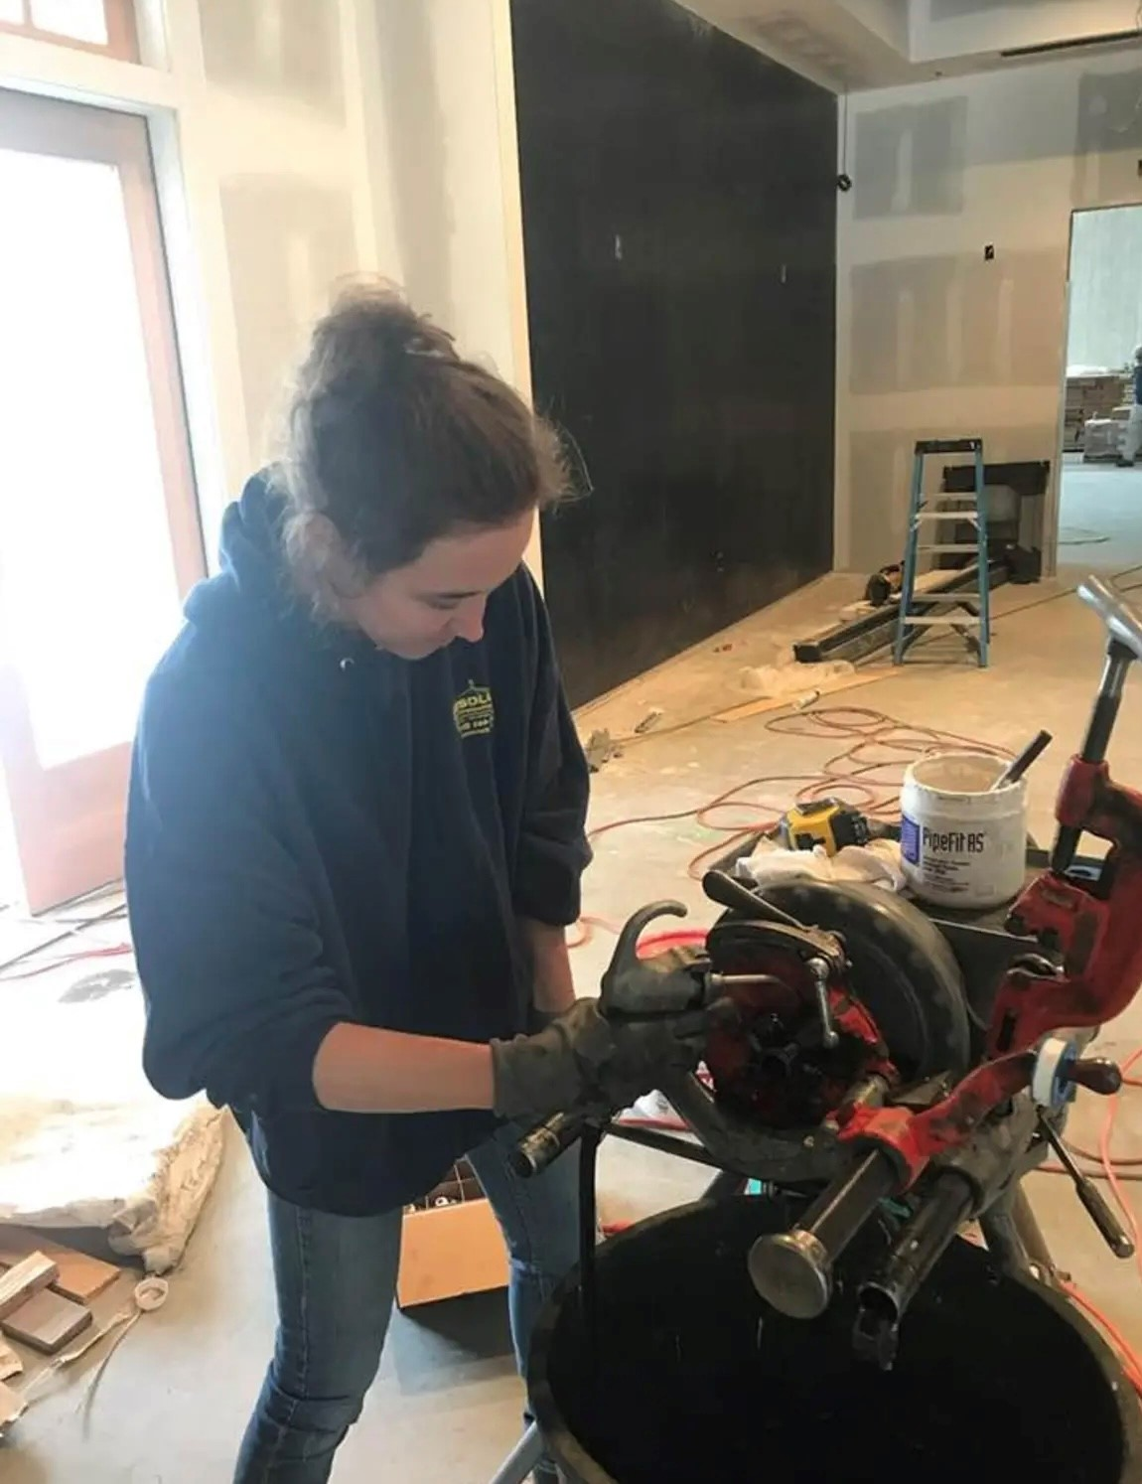
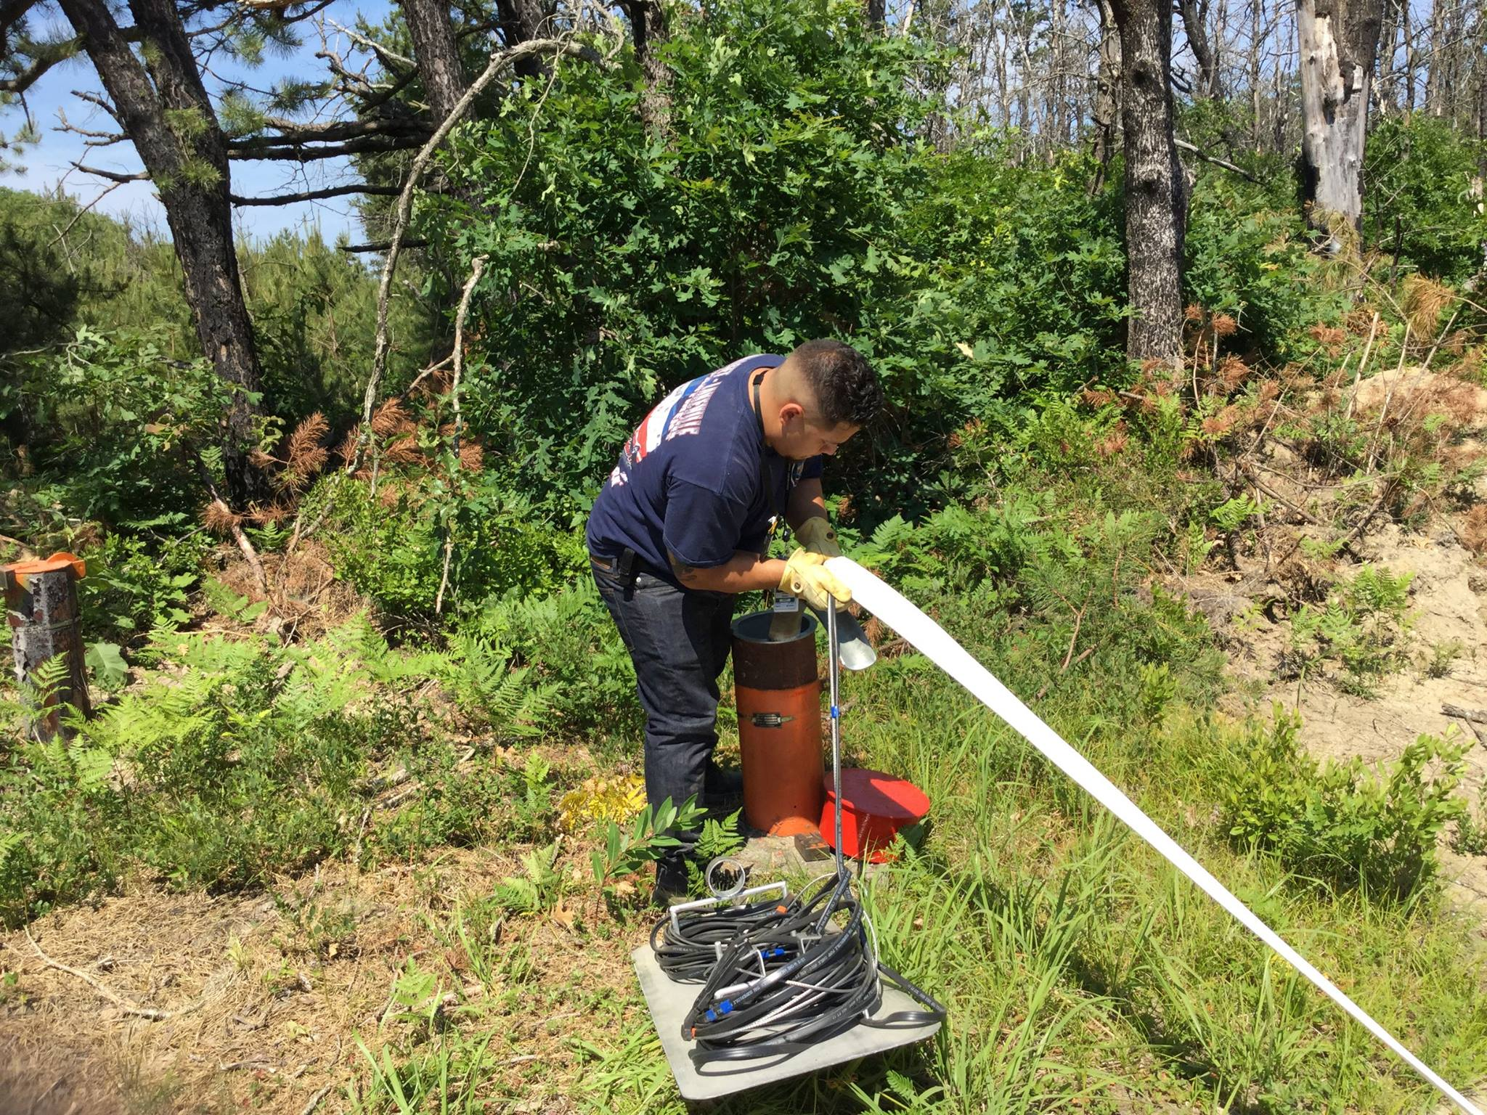
Designing safer buildings
Design Systems that:
Control Fires
Alert People to Danger
Means for Escape
Protect Structure and Contents

Slide 11
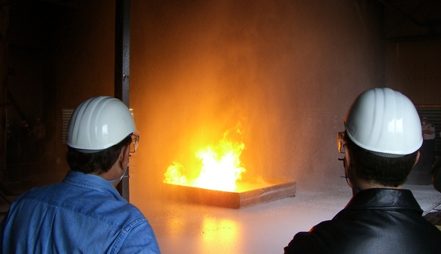
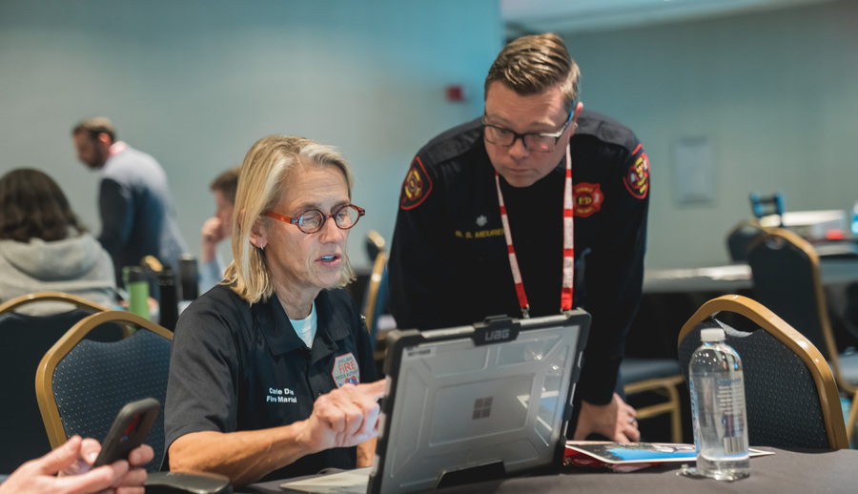
How do FPEs Make Us Safe From Fire?
Design safer buildings
Review design documents
Evaluate buildings to identify risks
Conduct fire safety research
Investigate fires

Slide 12
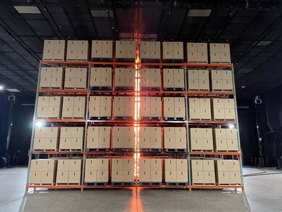
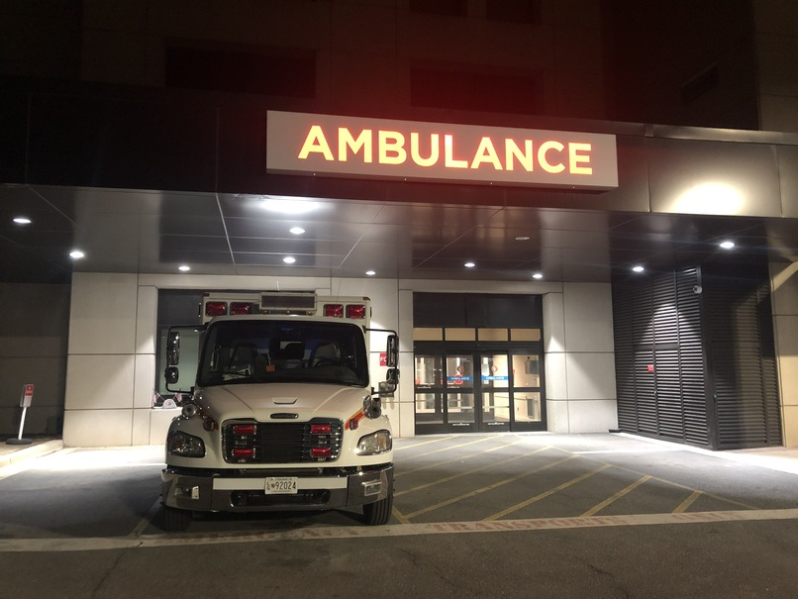
Where do we work?
Consulting engineering firms
Fire departments (public & private)
Fire equipment and system design / sales
Government
Hospitals and healthcare facilities
Notes:
The 2003 Profile of the Fire Protection Engineer shows that more than 40 percent of our engineers work in the consulting field. But you can find FPE’s at The Boeing Company making airlines travel safer as well as supporting the development of fire protection programs for military aircraft and space craft. The fire service employs FPE’s for plan review as well as product testing for fire fighter safety, fire department program development and more. Sprinkler and fire alarm designers have traditionally been mechanical and electrical engineers cross trained in fire protection. Today, the specialized knowledge of the FPE is expanding the capabilities of these systems. NASA, the CIA, the Navy, the Smithsonian Institute, the National Institute of Standards and Technology are only a few of the government agencies using the services of an FPE. Fire protection in healthcare facilities is critical for those people incapable of protecting themselves.
Historically, the insurance industry was the largest employer of FPE’s. Today fewer engineers are involved in loss control and prevention as an insurance demand because the emphasis has moved to incorporating fire protection and life safety as a mainstay of society. Many of the oil companies, pharmaceutical companies and chemical companies employ FPE’s for the protection of their facilities as well as research into safer methods of handling hazardous materials. The Walt Disney World Entertainment Company employs FPE’s to handle the concerns of their theme parks and to help the to push the concepts of design of buildings and materials. Fire protection engineers perform reviews of fire and explosion scenes in the movies to ensure the safety of the cast members as well as the public long before a scene is filmed. Forensic scientists and lawyers count on the technical know how of FPE’s for accident reconstruction and the development of guidelines to prevent reoccurrence of accidents.

Slide 13
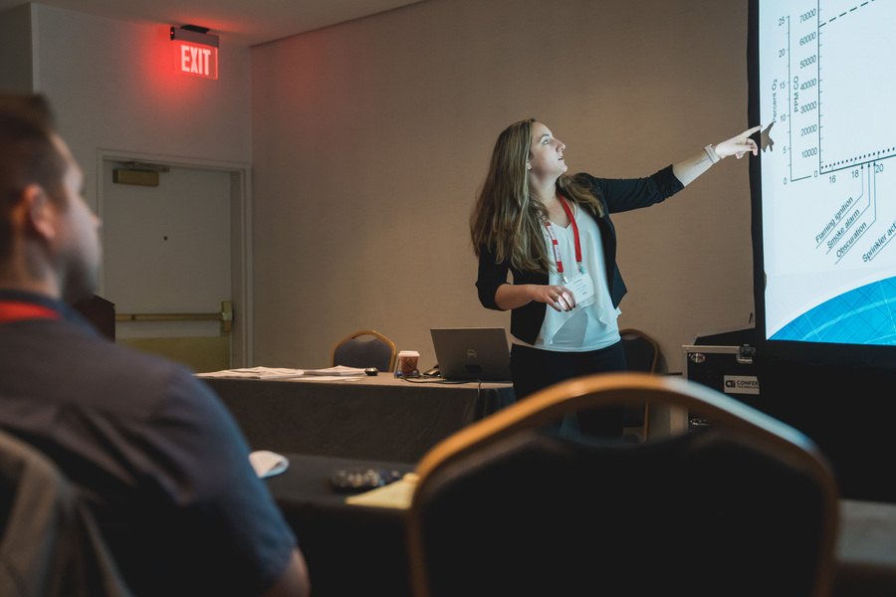
Where do we work? (continued)
In test labs to develop fire performance data such as fire size, heat release and severity
Insurance industry
Testing and certification labs
Universities and colleges
Entertainment industry, including movies and theme parks
Notes:
Historically, the insurance industry was the largest employer of FPE’s. Today fewer engineers are involved in loss control and prevention as an insurance demand because the emphasis has moved to incorporating fire protection and life safety as a mainstay of society. Many of the oil companies, pharmaceutical companies and chemical companies employ FPE’s for the protection of their facilities as well as research into safer methods of handling hazardous materials. The Walt Disney World Entertainment Company employs FPE’s to handle the concerns of their theme parks and to help the to push the concepts of design of buildings and materials. Fire protection engineers perform reviews of fire and explosion scenes in the movies to ensure the safety of the cast members as well as the public long before a scene is filmed. Forensic scientists and lawyers count on the technical know how of FPE’s for accident reconstruction and the development of guidelines to prevent reoccurrence of accidents.

Slide 14
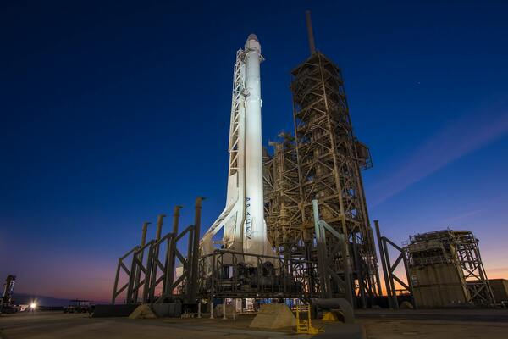

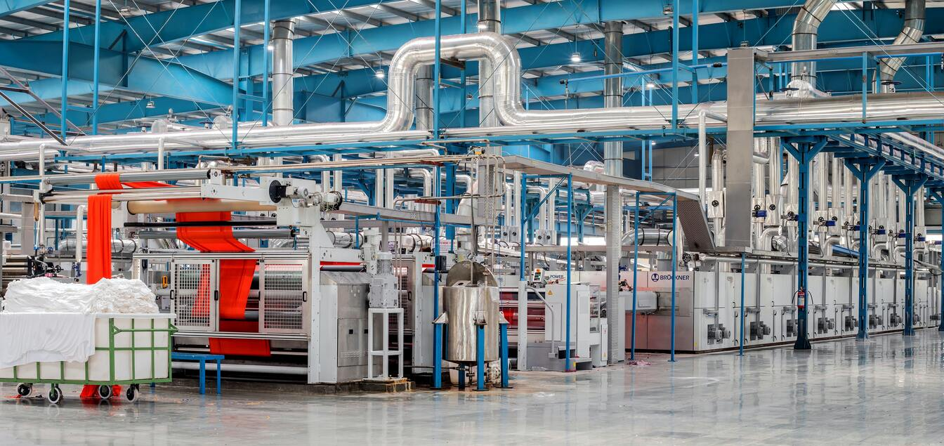

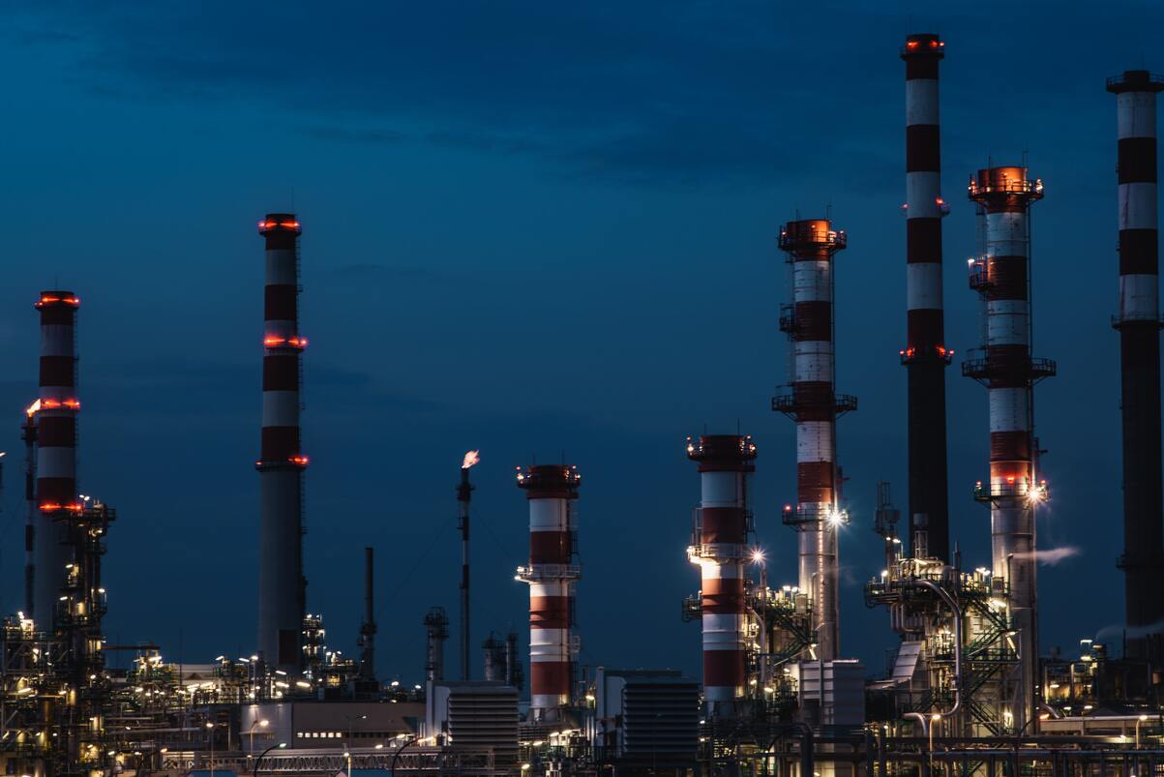
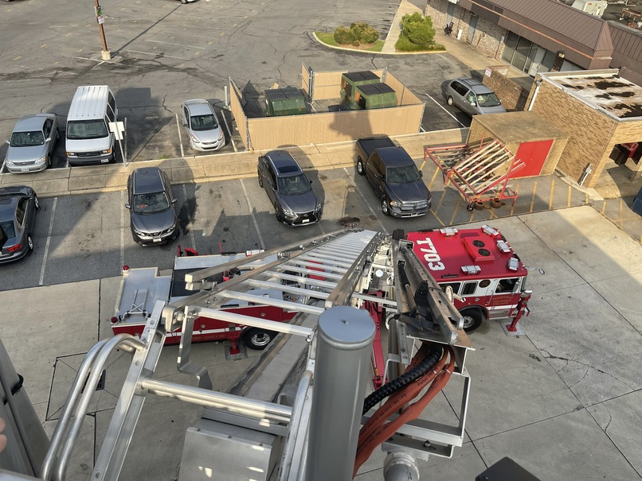
What kind of projects? Almost all of them!

Slide 15
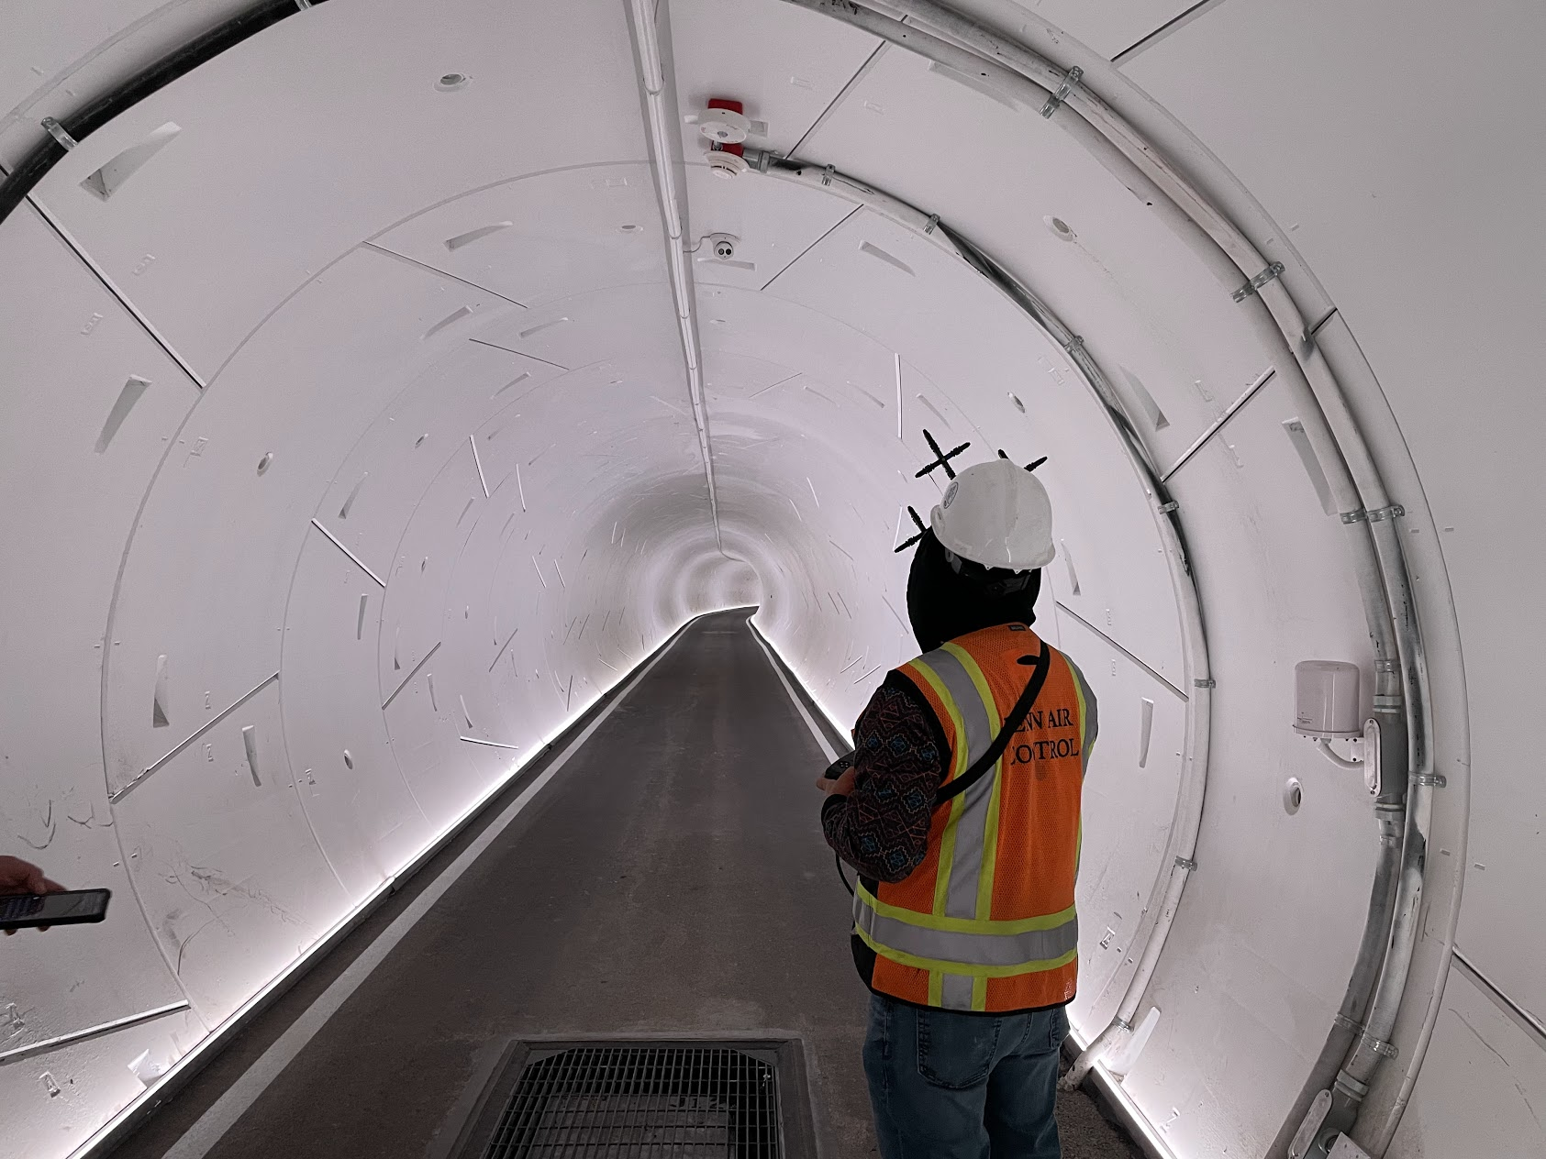
Why did we pick fpe as a profession?
Job satisfaction
Huge variety of career opportunities
Challenging work
Intellectual development
Potential to benefit society
Financial security
Technological and scientific discovery
Creative thinking
Never boring!
Notes:
Fire protection engineers pick this career field for many of the same reasons that anyone elects to go into engineering. The Dean of Engineering for UCLA offers the following as the top 10 rewards and opportunities for a career in engineering. There are no exceptions to these for fire protection engineering. Using our college preparation, we have the opportunity to recognize problems before they manifest and to create unique solutions and innovations.

Slide 16
A day in the life of a fire protection engineer
Meet with an Architect to determine a novel way to ensure life safety in a mega high-rise
Perform egress fire modeling of historic structure to ensure occupants can exit safely
Design a fire alarm and fire sprinkler system
Evaluate a new additive manufacturing process for turbine jet engines
Witness a full-scale fire test of building components
Evaluate the origin and cause of a large fire
Write new requirements for the fire and building codes
Work within the 3D model of a new chemical plant or LNG facility to determine the best location for fire detection/protection equipment

Slide 17

Variety of work
“There are so many different things to do. I’m involved with everything – a huge variety of tasks. I’m never stuck behind a desk.”
- Vidar Landa, Fire Protection Engineer, Jensen Hughes

Slide 18
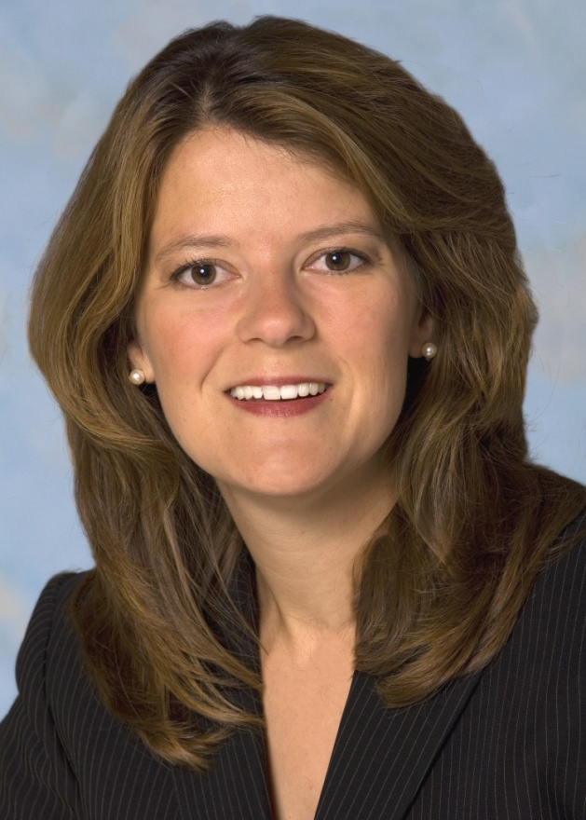
FPEs make the world a better place!
“I feel there’s a big reason why I go to work each morning. It gives me an incredible sense of purpose.”
- Stacey Welch, Fire Protection Engineer, Marriott International

Slide 19
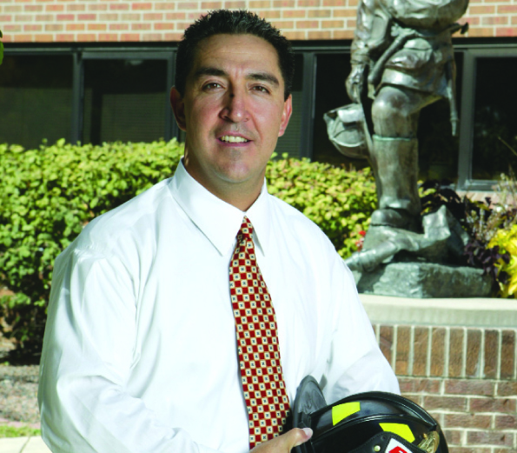
Opportunities for world travel
“In my first job, I spent my first five years traveling internationally, so I got to see a lot of cool places.”
- Tony Caro, Fire Prevention Bureau & Investigation Division, City of Denver

Slide 20
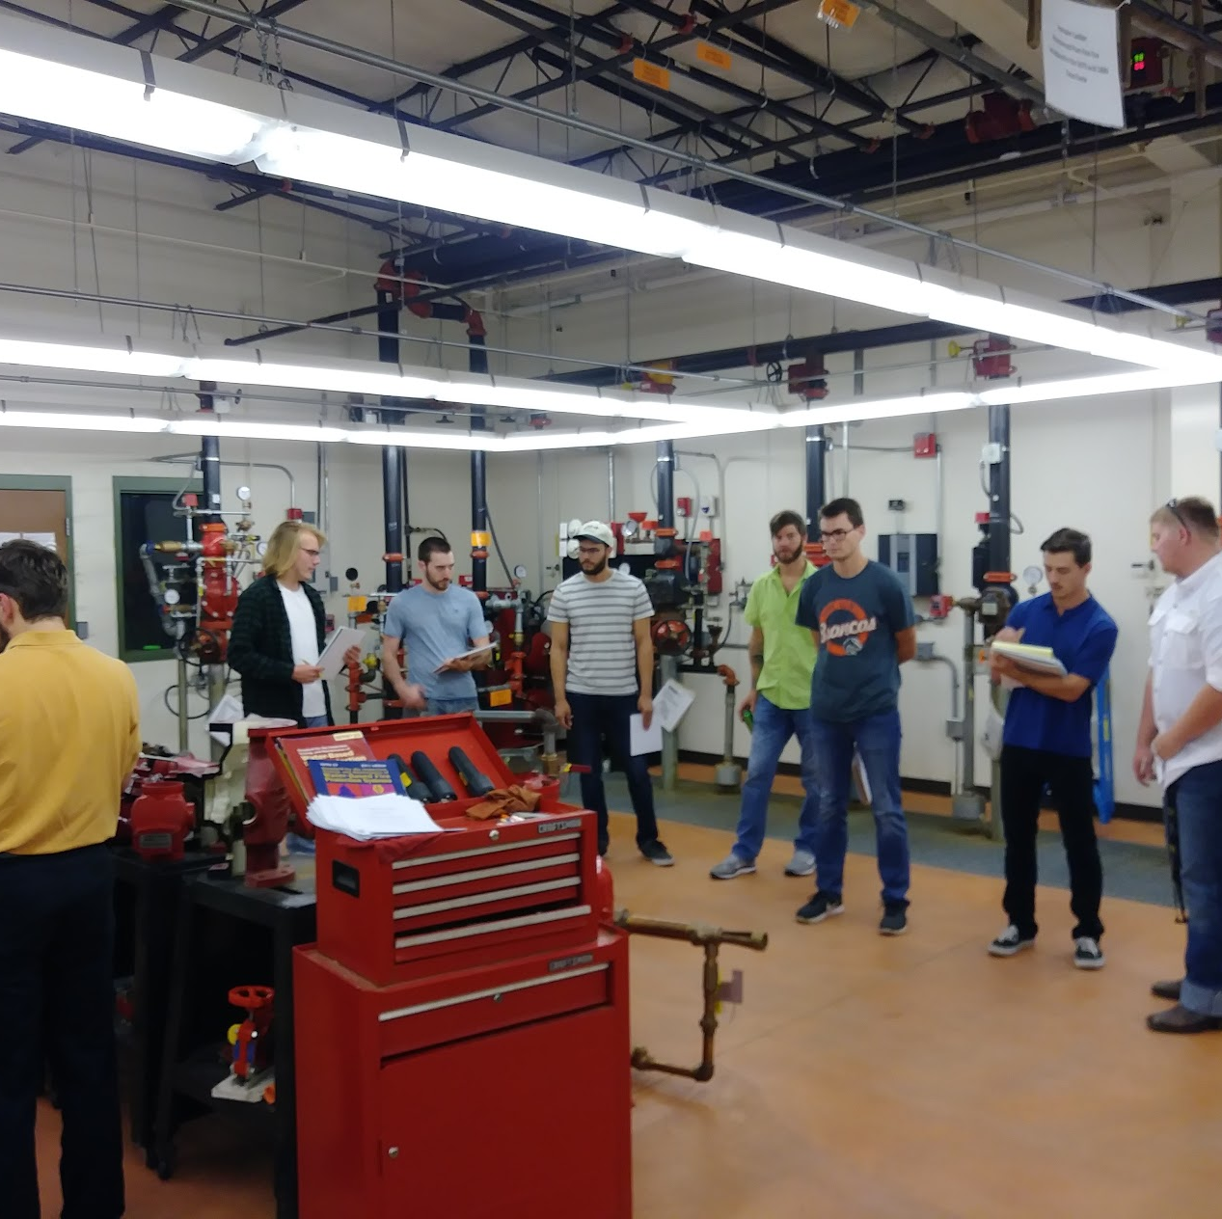
What are the prerequisites for an education in fire protection engineering?
College preparatory high school curriculum
A demonstrated proficiency in math and science
Strong academic record
Participation in extracurricular activities can assist in acceptance
Acquisition of a specialized talent or skill
Notes:
These criteria while they may seem to be scary to us as engineers did not seem to bother potential engineering students. My son, a freshman in engineering saw that as a goal to assure that he could get into the field.

Slide 21
Recommended high school classes
Engineering applicants are strongly advised to include the following in their high school program:
Mathematics – Four units including geometry, trigonometry and introductory calculus
Laboratory science – At least three units, including both chemistry and physics
Computing – At least one unit, including introduction to a programming language
Notes:
Engineers apply the theories and principles of science and mathematics to research and develop economical solutions to technical problems. Therefore, a solid foundation is these areas is critical to success in the undergraduate program. No matter what engineering discipline one chooses, these same requirements prevail.

Slide 22



Undergraduate and graduate programs in fire protection engineering and Fire and safety engineering technology
University of Maryland
(www.fpe.umd.edu)
Worcester Polytechnic Institute
(www.wpi.edu/+FPE)
Oklahoma State University
(fpst.okstate.edu)
Notes:
So, where do I go to get the much-needed degrees? Here are a few sources. Additional schools and programs can be found at the SFPE web site. Each of the schools listed herein offer different types of degrees that are found among the 5000 members of the Society of Fire Protection Engineering. There are other degree programs leading to non-engineering certificates.
For a full listing with contact information:
https://www.sfpe.org/career/students/universityprograms

Slide 23
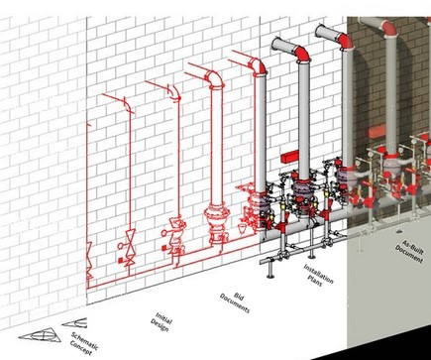
Common engineering classes
Physics
Chemistry
Calculus
Statics
Dynamics
Mechanics of Materials
Thermodynamics
Heat Transfer
Fluid Mechanics
Notes:
Part of any undergraduate engineering degree involves these courses. They are the building blocks on which the selected discipline can be built. Many students choose to study these subjects closer to home in smaller classroom settings before transferring to a major university with fire protection engineering. Others elect to get a degree in another engineering discipline before choosing to enter a Masters Degree program for fire protection engineering. Yet others elect to avoid the intense science and math requirements and pursue a technology degree.

Slide 24
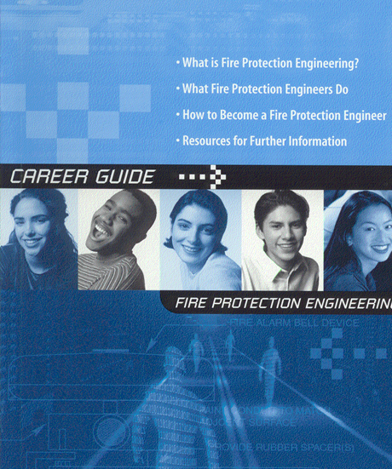
How do I find out more?
Meet with your Guidance Counselor
Request Information from Engineering Colleges
Visit Colleges
Speak with experienced engineers
Find an engineering mentor
Contact your local chapter of the Society of Fire Protection Engineers
Search the Internet
(ex. -www.sfpe.org & www.nspe.org)
Notes:
How do you find out more? These steps offer a beginning. You may want to spend a day with a fire protection engineer to see for yourself what they do.

Slide 25
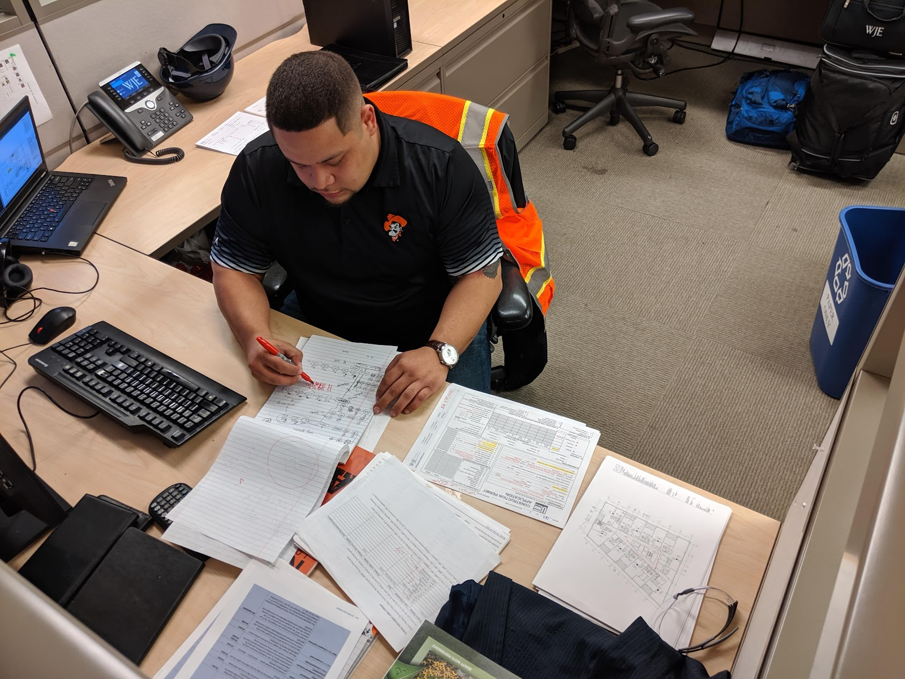
Current job opportunity examples
SFPE (free): https://jobs.sfpe.org/
Examples include
  Exp Federal
  MycoWorks
  PDI
  SeeScan
  Oak Ridge National Laboratory
  Walgreens
  General Services Administration
  AMA Group
  Jensen Hughes

Slide 26
Questions?
For More Information, visit
  http://www.sfpe.org
  https://www.sfpe.org/career/careers
  https://www.sfpe.org/career/fpe
  https://www.sfpe.org/career/students/universityprograms/scholarships

Slide 27
References
Coming of Age, David A. Lucht, https://journals.sagepub.com/doi/abs/10.1177/104239158900100201 Last accessed 02/03/22.
How to Become a Fire Protection Engineer, Fire Science, https://www.firescience.org/how-to-become-a-fire-protection-engineer/ Last accessed 02/03/22.
Research Roadmap: Identifying Research Needs for the Fire Safety Engineering Profession, SFPE, https://www.sfpe.org/research/research-roadmap Last accessed 02/03/22.
SFPE Standards, SFPE, https://www.sfpe.org/standards-guides/standards , Last accessed 02/03/22
25 Percent of Profession’s Workforce to Retire in Next 10 Years, SFPE, https://www.sfpe.org/publications/magazine/fpearchives/2015q4/fpe2015q45b Last accessed 02/03/22.
Firefighter Fatalities in the United States in 2021, NFPA, https://www.nfpa.org/News-and-Research/Data-research-and-tools/Emergency-Responders/Firefighter-fatalities-in-the-United-States last accessed 11/9/2022
Fire Loss in the United States in 2021, NFPA, https://www.nfpa.org/News-and-Research/Data-research-and-tools/US-Fire-Problem/Fire-loss-in-the-United-States Last accessed 11/9/2022

Slide 28
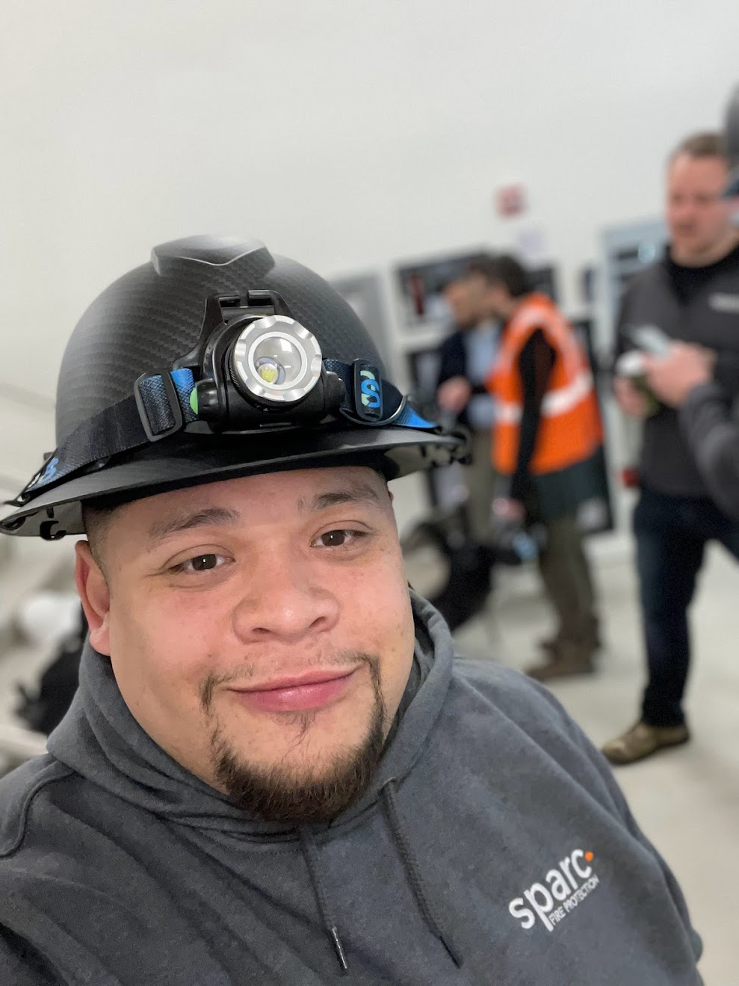
Photos courtesy of:
Jonathan Bernal
Benjamin Chen, Rockville Volunteer Fire Department
Emily Thomas, Jensen Hughes
Thomas Good, University of Maryland, Baltimore
Benjamin Fogel, SFPE
Christopher Hallock, Jensen Hughes
Pete Piringer, MCFRS PIO
Derek Cookson
Emmanuel Ikwu
Bernard Hermant
Kevin Butz
Lalit Kumar
Sean Pollock
Thomas Serer
Tobias Rademach
This Is Engineering
UL Research
Thank you!

Slide 29

SFPE EDUCATION
Dozens of upcoming live virtual, live in-person, and on-demand virtual education opportunities
Notes:
SFPE’s live education connects fire protection and fire safety engineering professionals with the best and brightest experts in the industry. These live, interactive programs provide best-in-class learning with the opportunity to ask questions and/or chat with instructors. Conveniently available via webinars, multi-part online seminars, and in-person seminars.
Plus, SFPE’s on-demand education provides industry-leading technical knowledge on diverse topics specifically tailored to the needs of fire protection and fire safety engineering professionals. Developed from recordings of past presentations by expert speakers, these webinars and seminars provide convenient access to SFPE information on a schedule and timeframe that is convenient for you.

Slide 30
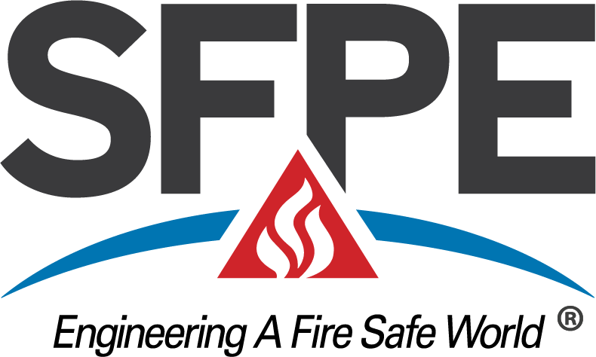
A final thought
“Today is your opportunity to build the tomorrow you want”
- Ken Poirot
Notes:
Ken Poirot is an accomplished author, entrepreneur and public speaker Published several books that include Mentor Me and Your Greatest Achievement

