Slide 2
What is Fire Protection engineering for those in elementary school?
Name of Presenter
Title
Organization
Date

Slide 3
My background
Name
Current job
What do I like about this job?

Slide 4
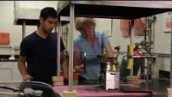
What is Fire Protection Engineering (FPE)?
Making people and places safe from fire

Slide 5
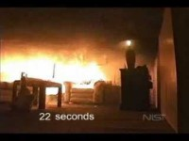
How does a fire start and grow?

Slide 6
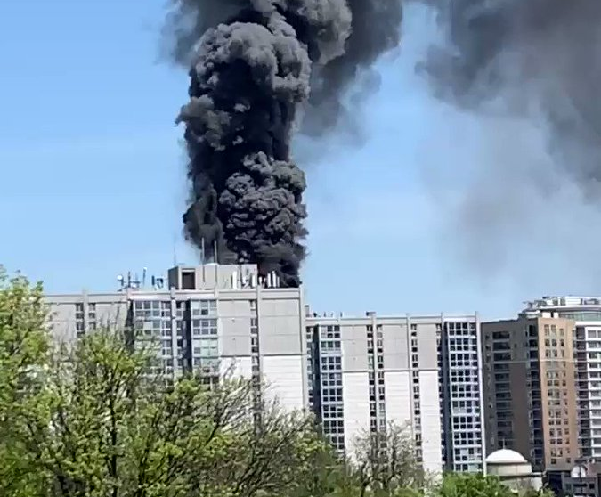

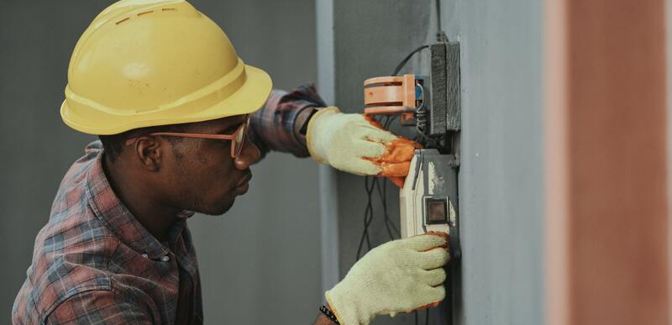
What is a fire protection engineer?
A person who’s job it is to keep us safe from emergencies
A person who helps protect people from fires
A person who makes rules to follow during a fire drills
A person who helps build fire alarms
Notes:
By strict definition, we use the skills, knowledge and experiences we gain to engineer safer buildings, products and more. We learn from prior experiences; research and testing; and from the investigation of tragic events to help eliminate loss of life and property.
Research - there is still much to be learned about fire growth, fire severity and the damaging affects of fire on materials and to humans;
Organizations - like the Society of Fire Protection Engineers are dedicated to reducing the loss of life and property from the effects of fire;
Design - individuals and companies are constantly looking for new materials that slow or eliminate fire growth; provide new ways to extinguish fire; and make occupiable facilities safer;
Construction - engineers then provide the link to transfer these technologies into the built environment.

Slide 7
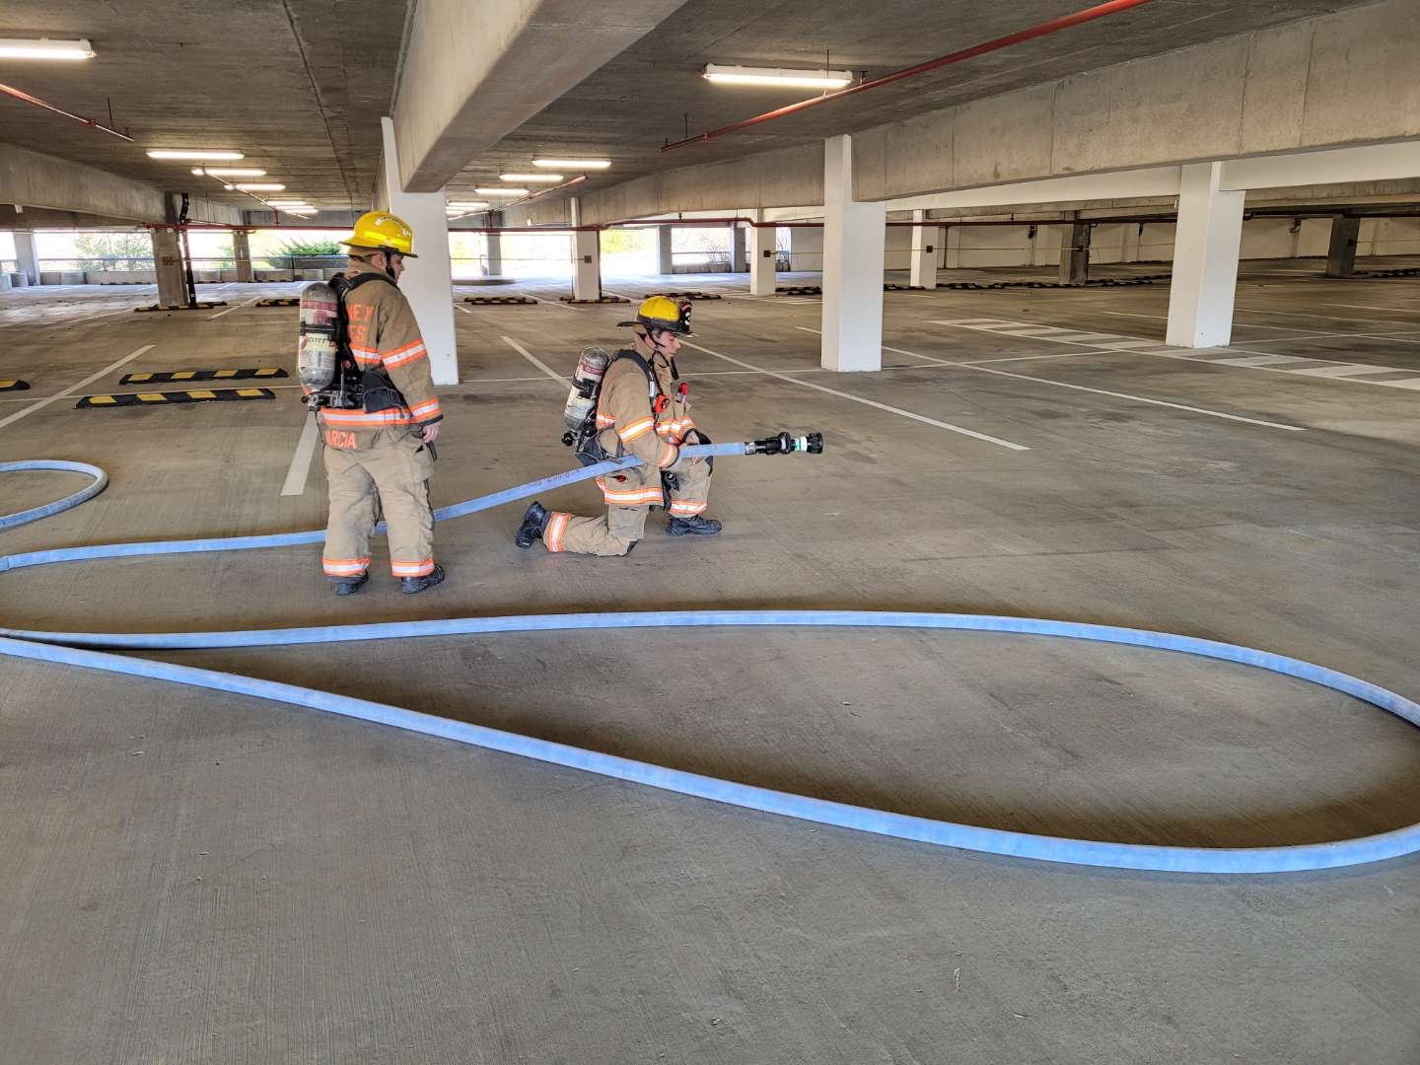
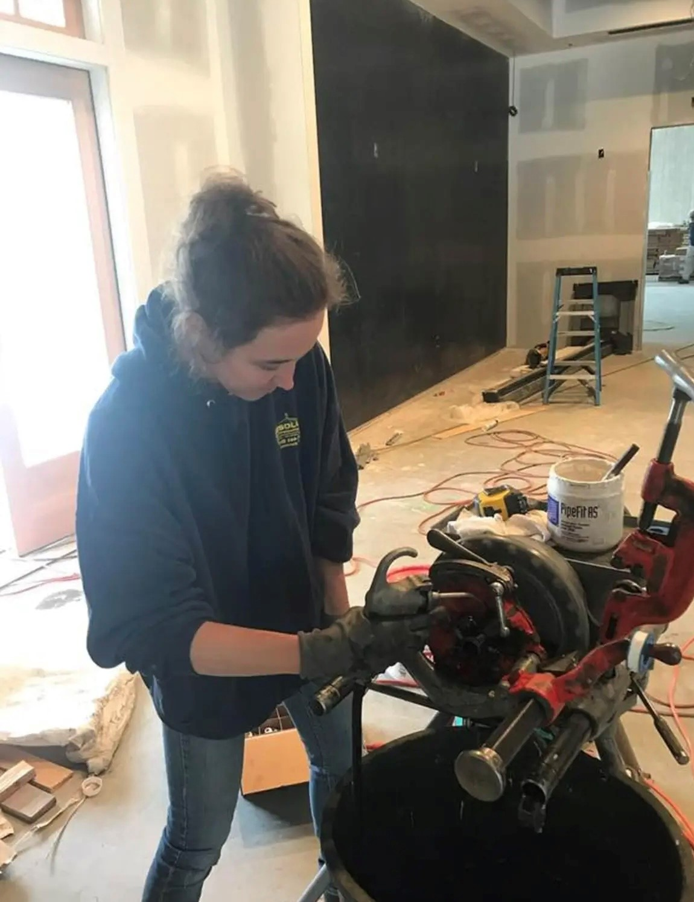
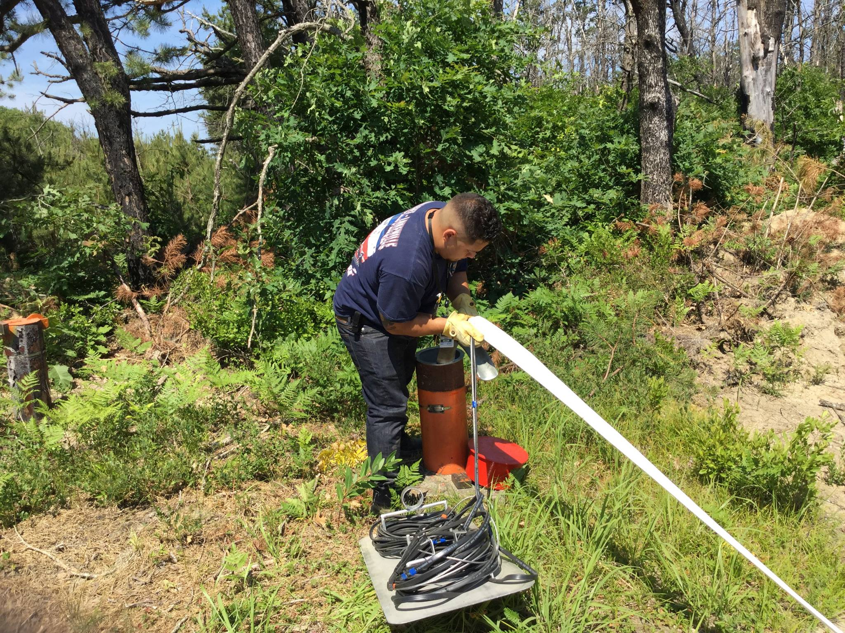
Designing safer buildings
Design Systems that:
Control Fires
Alert People to Danger
Help us Escape
Protect Buildings

Slide 8
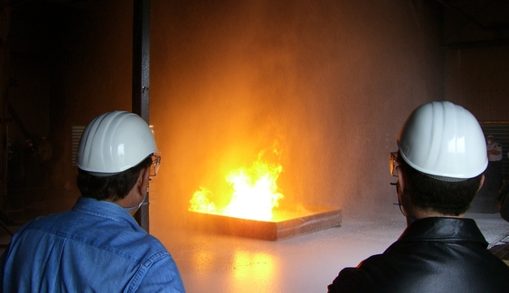
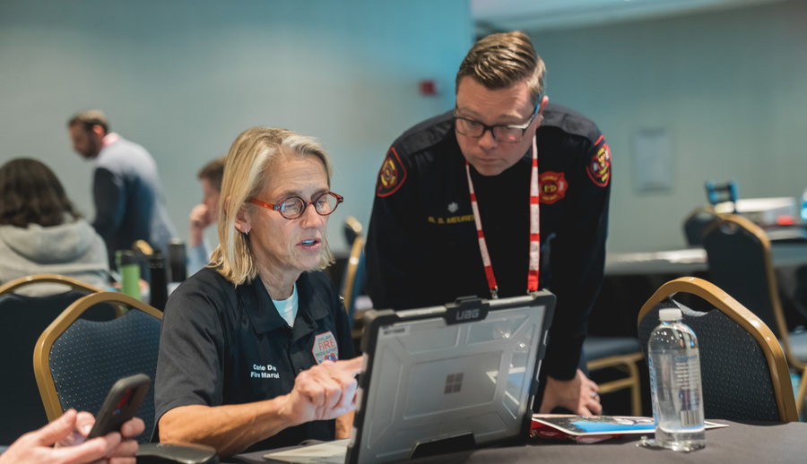
How do FPEs Make Us Safe From Fire?
Design safer buildings
Help protect people during a fire
Investigate fires

Slide 9


What are some things in your school to prevent fires, and help you escape in an emergency?

Slide 10
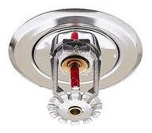
Automatic sprinkler

Slide 11
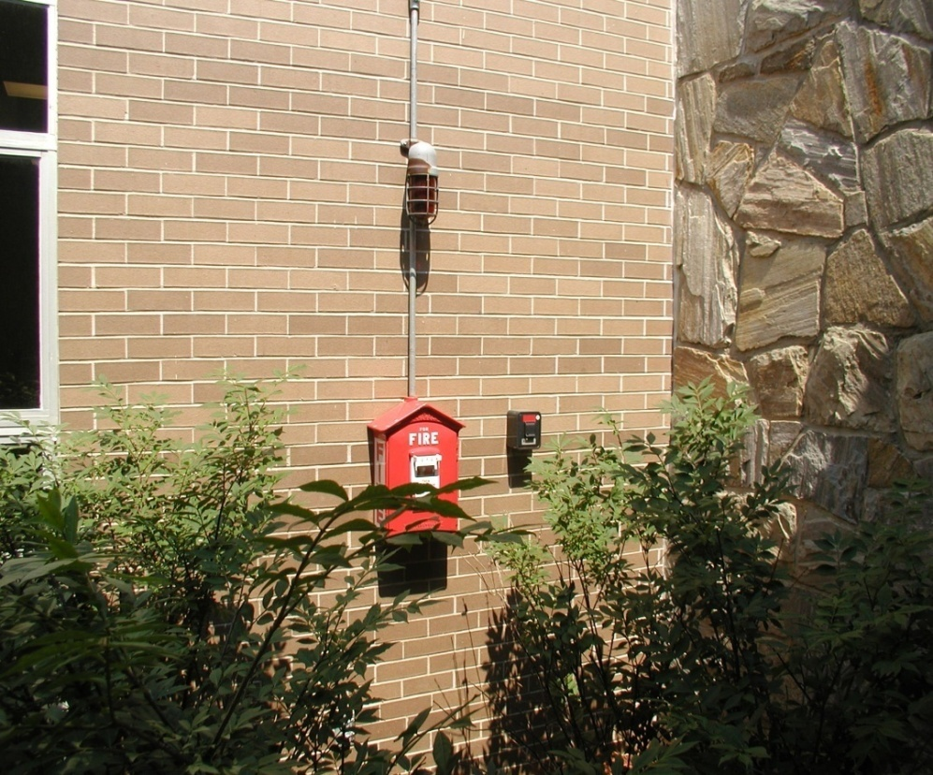
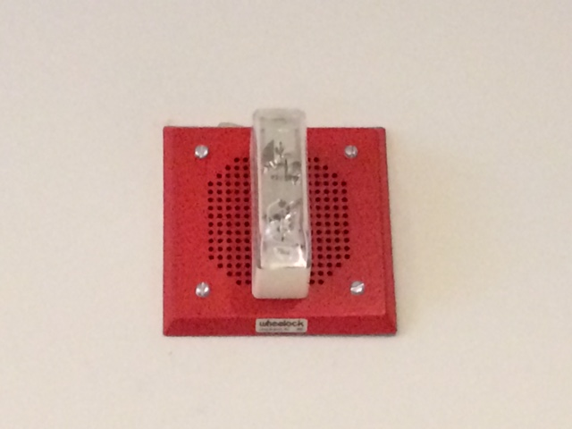
Fire alarm

Slide 12
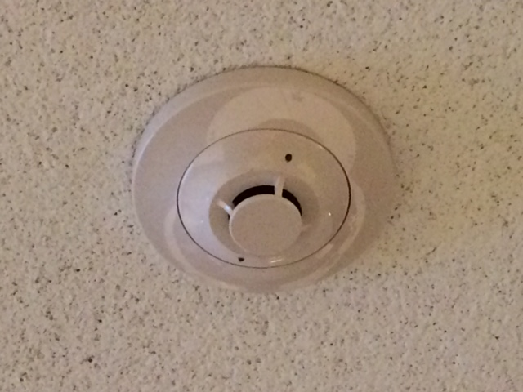
Smoke detector

Slide 13
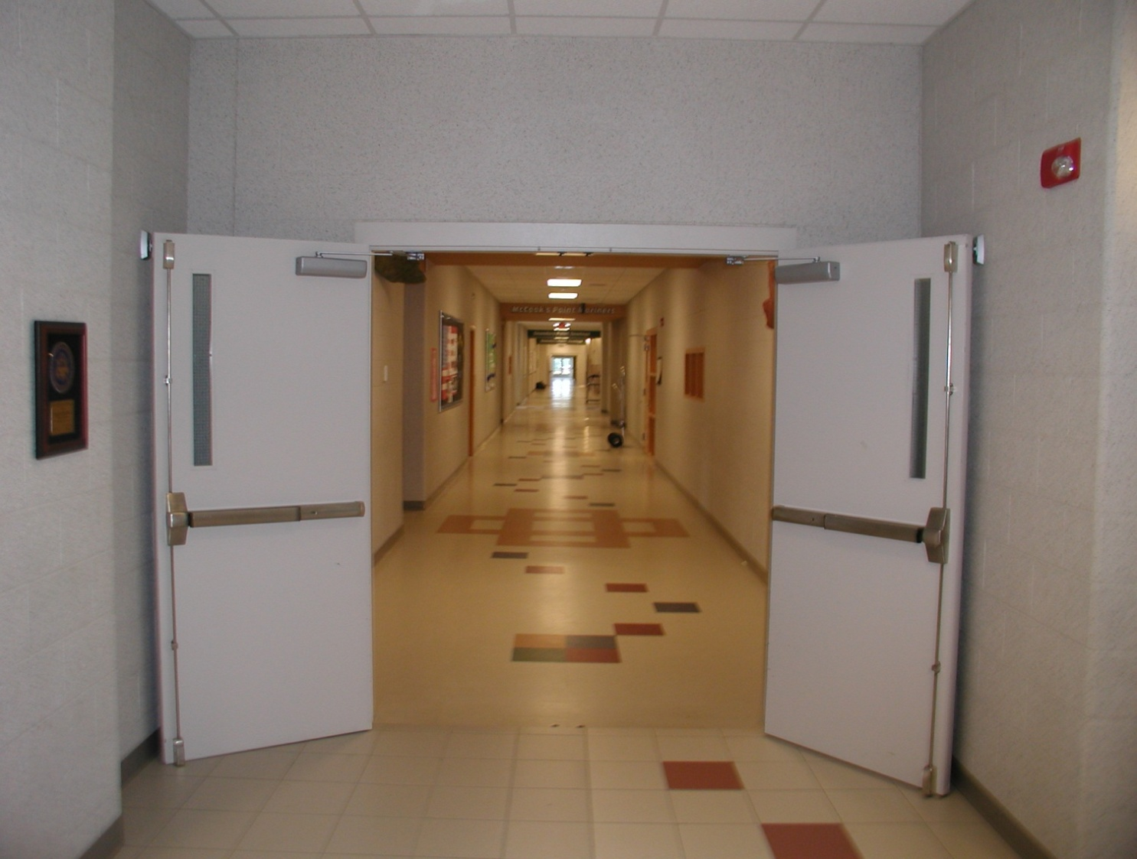
Door / door hardware

Slide 14
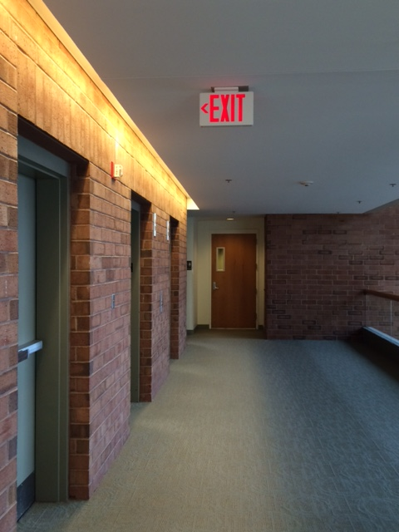
Exit sign

Slide 15
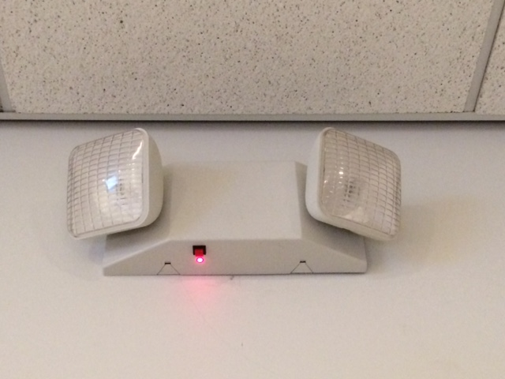
Emergency lighting

Slide 16
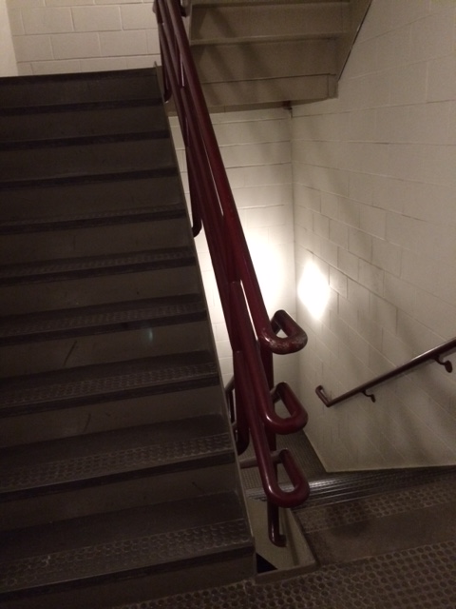
Egress stairs

Slide 17
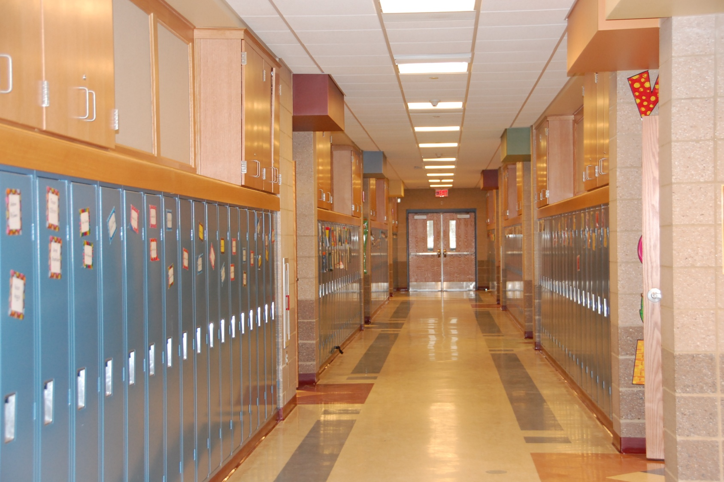
corridors

Slide 18
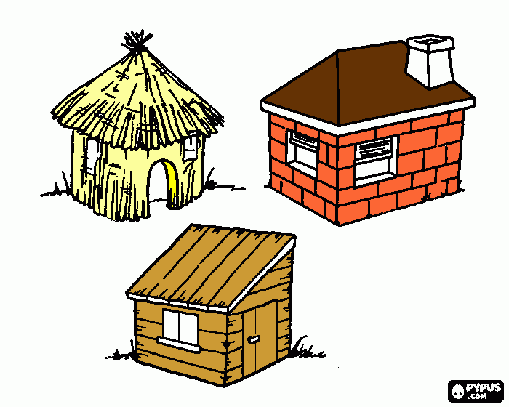
Building construction materials
Notes:
Remember the three little pigs houses? Any guesses which house would burn the fastest based on construction? Which would burn the least? Building materials are often rated to minimize how quickly they will burn-to prevent the spread of fire and give people time to get out of a building safely in the event of a fire. Even fabrics such as curtains can be treated to be fire resistant.

Slide 19
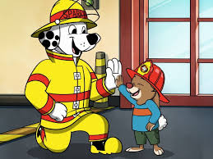
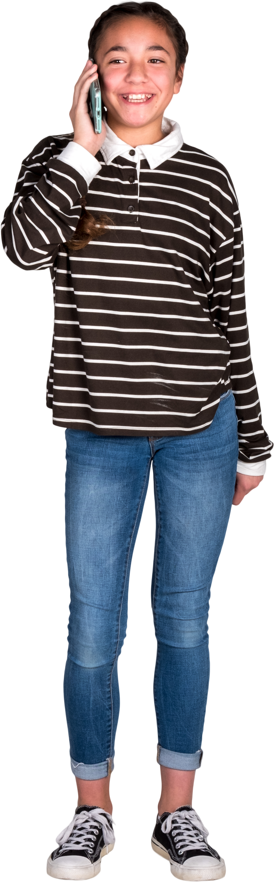
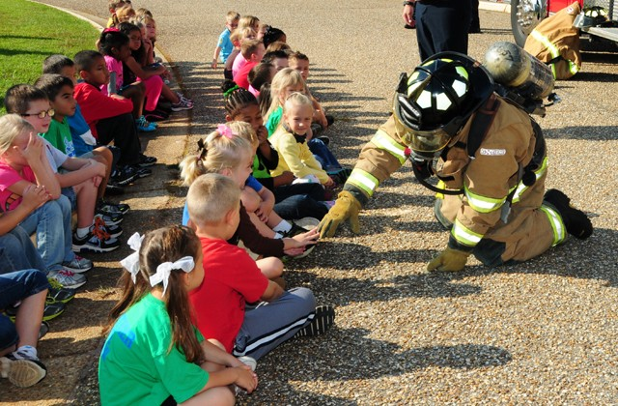
Remember fire safety!
  During a fire alarm: stay calm, walk, and listen to instructions from your teacher
  If you smell smoke or see fire, tell an adult or call 9-1-1 for help!
  Stop, drop and roll!
  Rember that firefighters are here to help, even if they have masks on!

Slide 20
Questions?
For More Information, visit
  http://www.sfpe.org
  https://www.sfpe.org/career/careers
  https://www.sfpe.org/career/fpe
  https://www.sfpe.org/career/students/universityprograms/scholarships

Slide 21
References
Coming of Age, David A. Lucht, https://journals.sagepub.com/doi/abs/10.1177/104239158900100201 Last accessed 02/03/22.
How to Become a Fire Protection Engineer, Fire Science, https://www.firescience.org/how-to-become-a-fire-protection-engineer/ Last accessed 02/03/22.
Research Roadmap: Identifying Research Needs for the Fire Safety Engineering Profession, SFPE, https://www.sfpe.org/research/research-roadmap Last accessed 02/03/22.
SFPE Standards, SFPE, https://www.sfpe.org/standards-guides/standards , Last accessed 02/03/22
25 Percent of Profession’s Workforce to Retire in Next 10 Years, SFPE, https://www.sfpe.org/publications/magazine/fpearchives/2015q4/fpe2015q45b Last accessed 02/03/22.
Firefighter Fatalities in the United States in 2021, NFPA, https://www.nfpa.org/News-and-Research/Data-research-and-tools/Emergency-Responders/Firefighter-fatalities-in-the-United-States last accessed 11/9/2022
Fire Loss in the United States in 2021, NFPA, https://www.nfpa.org/News-and-Research/Data-research-and-tools/US-Fire-Problem/Fire-loss-in-the-United-States Last accessed 11/9/2022

Slide 22
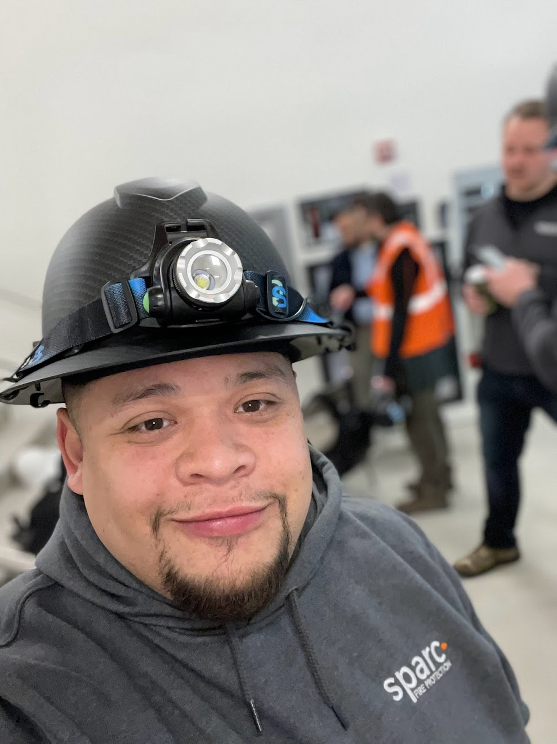
Photos courtesy of:
Jonathan Bernal
Benjamin Chen, Rockville Volunteer Fire Department
Emily Thomas, Jensen Hughes
Thomas Good, University of Maryland, Baltimore
Benjamin Fogel, SFPE
Christopher Hallock, Jensen Hughes
Pete Piringer, MCFRS PIO
Derek Cookson
Emmanuel Ikwu
Bernard Hermant
Kevin Butz
Lalit Kumar
Sean Pollock
Thomas Serer
Tobias Rademach
This Is Engineering
UL Research
Thank you!

Slide 23

SFPE EDUCATION
Dozens of upcoming live virtual, live in-person, and on-demand virtual education opportunities
Notes:
SFPE’s live education connects fire protection and fire safety engineering professionals with the best and brightest experts in the industry. These live, interactive programs provide best-in-class learning with the opportunity to ask questions and/or chat with instructors. Conveniently available via webinars, multi-part online seminars, and in-person seminars.
Plus, SFPE’s on-demand education provides industry-leading technical knowledge on diverse topics specifically tailored to the needs of fire protection and fire safety engineering professionals. Developed from recordings of past presentations by expert speakers, these webinars and seminars provide convenient access to SFPE information on a schedule and timeframe that is convenient for you.

