Slide 2
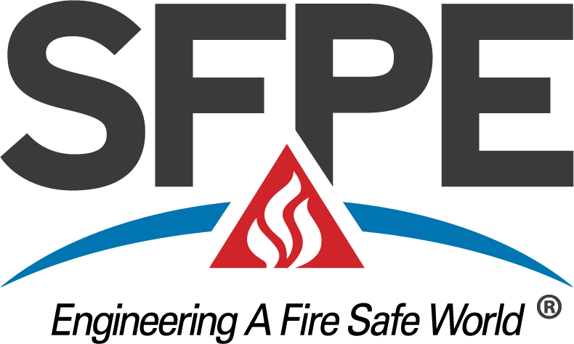
What is Fire Protection engineering for those considering higher education
Name of Presenter
Title
Organization
Date

Slide 3
My background
Education
Employer
Job function
Interesting professional experiences
Insert Speaker’s SFPE information here
  Membership level & length of membership
  Local Chapter
  Committees, volunteerism

Slide 4
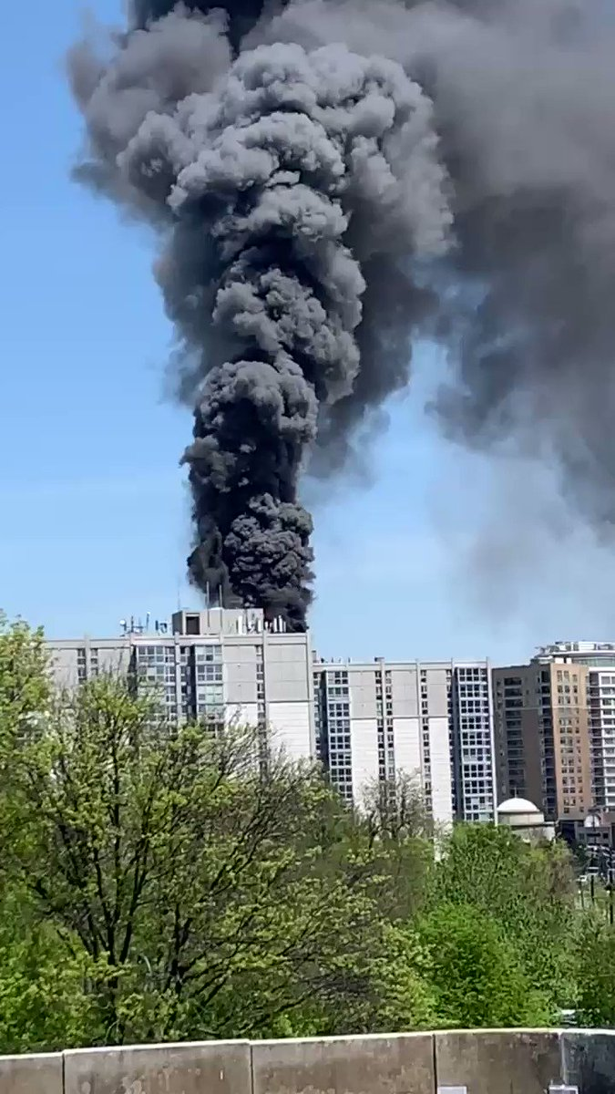

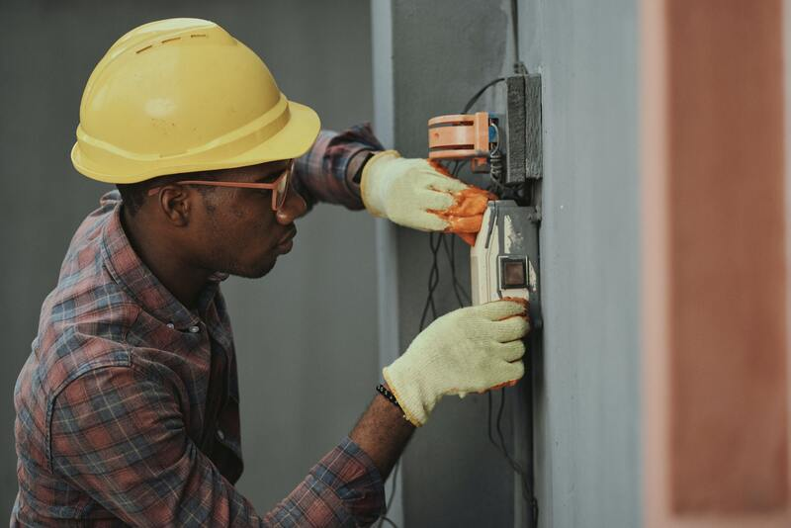
What is a fire protection engineer (FPE)?
Fire protection engineering is the application of science, engineering principles and experience to protect people and their environments from the destructive effects of fire.
Or more briefly: Fire Protection Engineers use science and technology to make our world safe from fire
Works to improve public health, safety and welfare related to fire events.
Notes:
By strict definition, we use the skills, knowledge and experiences we gain to engineer safer buildings, products and more. We learn from prior experiences; research and testing; and from the investigation of tragic events to help eliminate loss of life and property.
Research - there is still much to be learned about fire growth, fire severity and the damaging affects of fire on materials and to humans;
Organizations - like the Society of Fire Protection Engineers are dedicated to reducing the loss of life and property from the effects of fire;
Design - individuals and companies are constantly looking for new materials that slow or eliminate fire growth; provide new ways to extinguish fire; and make occupiable facilities safer;
Construction - engineers then provide the link to transfer these technologies into the built environment.

Slide 5
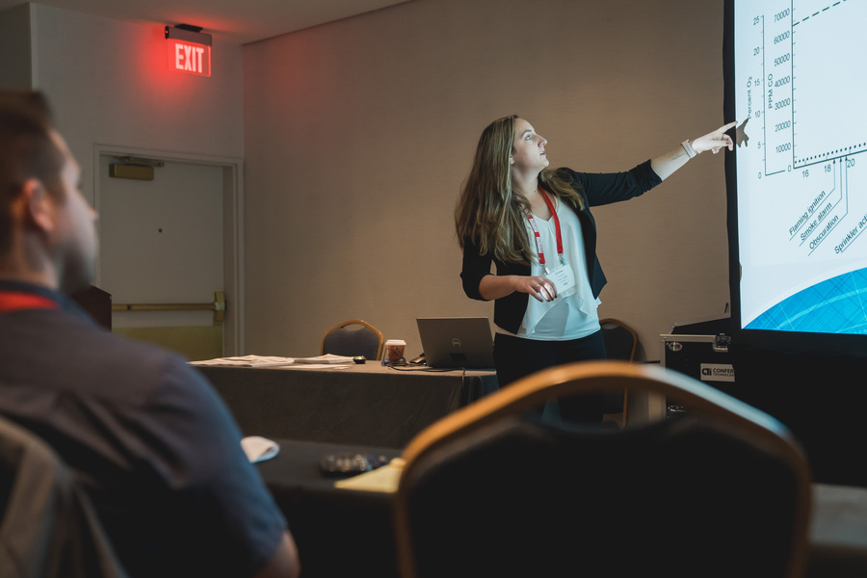
How fpes make us safe from fire
Design safer buildings
Evaluate buildings to pinpoint risks
Conduct fire safety research
Evaluation of industrial processes and their associated hazards
Evaluate new approaches for buildings and operations
Performance-Based Design
Investigate fires
Lessons Learned

Slide 6
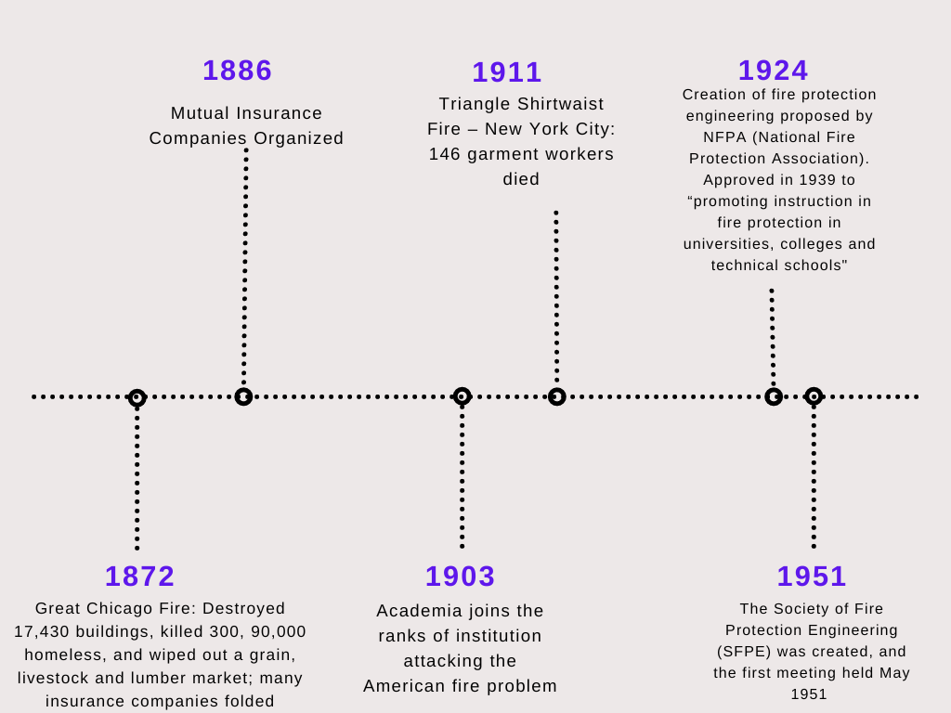
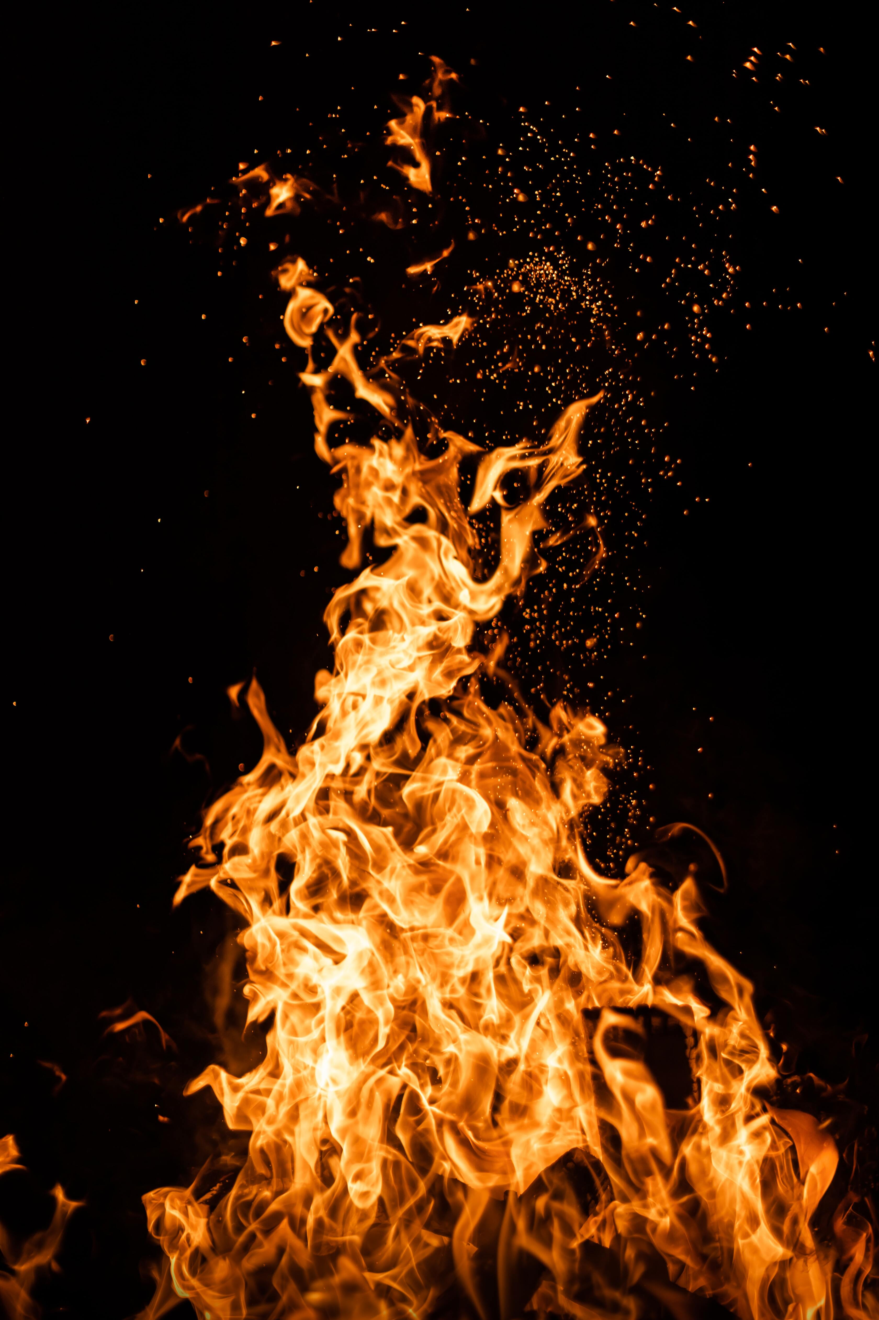
EARLY HISTORY: Catastrophes were common – Something needed to be done. Engineers of the day rose to the challenge and institutions of fire protection were established
Notes:
Fire protection engineering grew out of the Industrial Revolution, in response to the need of the day. Since that time, the profession has grown in structure as well as size. The field has made credible progress in important areas that typically serve to define a profession including its body of knowledge, professional registration and education even while it is still behind other disciplines. The development of academic programs has experienced the most difficulty.

Slide 7
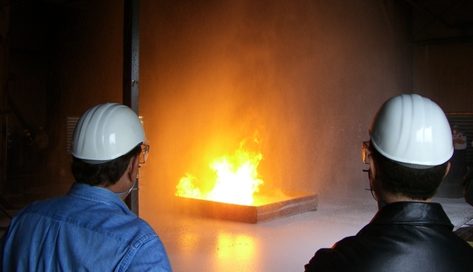
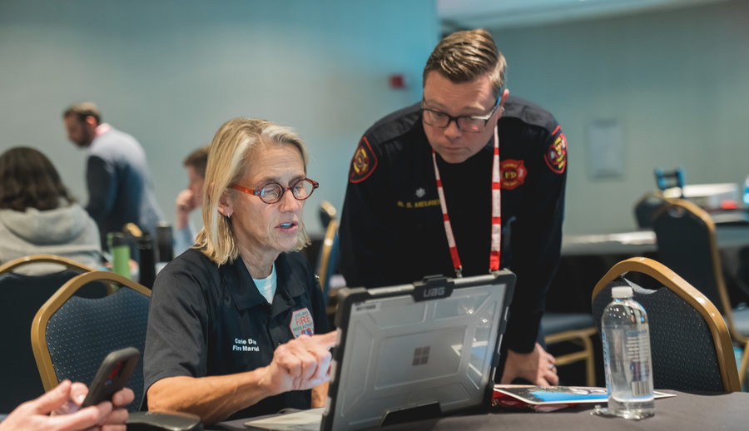
Where do fpes work?
Consulting firms
Architectural/engineering Firms
Fire protection system manufacturers
Fire Marshal offices
Building code officials
Fire departments
Insurance industry
Notes:
The 2003 Profile of the Fire Protection Engineer shows that more than 40 percent of our engineers work in the consulting field. But you can find FPE’s at The Boeing Company making airlines travel safer as well as supporting the development of fire protection programs for military aircraft and space craft. The fire service employs FPE’s for plan review as well as product testing for fire fighter safety, fire department program development and more. Sprinkler and fire alarm designers have traditionally been mechanical and electrical engineers cross trained in fire protection. Today, the specialized knowledge of the FPE is expanding the capabilities of these systems. NASA, the CIA, the Navy, the Smithsonian Institute, the National Institute of Standards and Technology are only a few of the government agencies using the services of an FPE. Fire protection in healthcare facilities is critical for those people incapable of protecting themselves.
Historically, the insurance industry was the largest employer of FPE’s. Today fewer engineers are involved in loss control and prevention as an insurance demand because the emphasis has moved to incorporating fire protection and life safety as a mainstay of society. Many of the oil companies, pharmaceutical companies and chemical companies employ FPE’s for the protection of their facilities as well as research into safer methods of handling hazardous materials. The Walt Disney World Entertainment Company employs FPE’s to handle the concerns of their theme parks and to help the to push the concepts of design of buildings and materials. Fire protection engineers perform reviews of fire and explosion scenes in the movies to ensure the safety of the cast members as well as the public long before a scene is filmed. Forensic scientists and lawyers count on the technical know how of FPE’s for accident reconstruction and the development of guidelines to prevent reoccurrence of accidents.

Slide 8
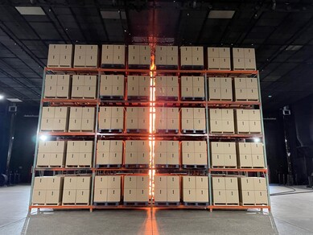
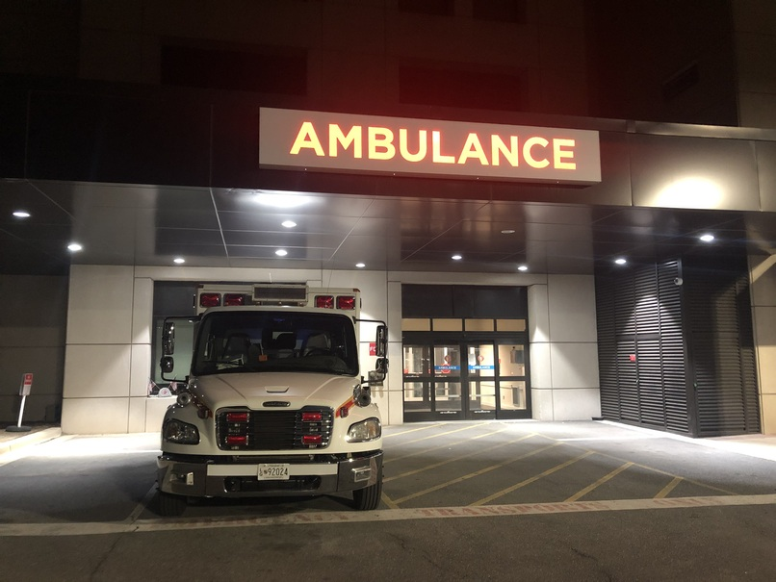
Where do fpes work? continued
Federal, state and local governments
Forensic Science - Investigations
Hospitals and Healthcare Facilities
Petrochemical instantly
Testing and certification laboratories
Entertainment industry

Slide 9
What high school education is needed?
College preparatory high school curriculum
Strong academic record, especially in math and science
Participation in extracurricular activities
Mathematics – Geometry, trigonometry, and introductory calculus
Laboratory Science – Chemistry, biology, physics
Computing – Introduction to a programming language
Technical writing, if offered
Learn what you enjoy the most and develop those skills
Notes:
These criteria while they may seem to be scary to us as engineers did not seem to bother potential engineering students. My son, a freshman in engineering saw that as a goal to assure that he could get into the field.
Engineers apply the theories and principles of science and mathematics to research and develop economical solutions to technical problems. Therefore, a solid foundation is these areas is critical to success in the undergraduate program. No matter what engineering discipline one chooses, these same requirements prevail.
Scholarship opportunities are available, especially to successful students

Slide 10
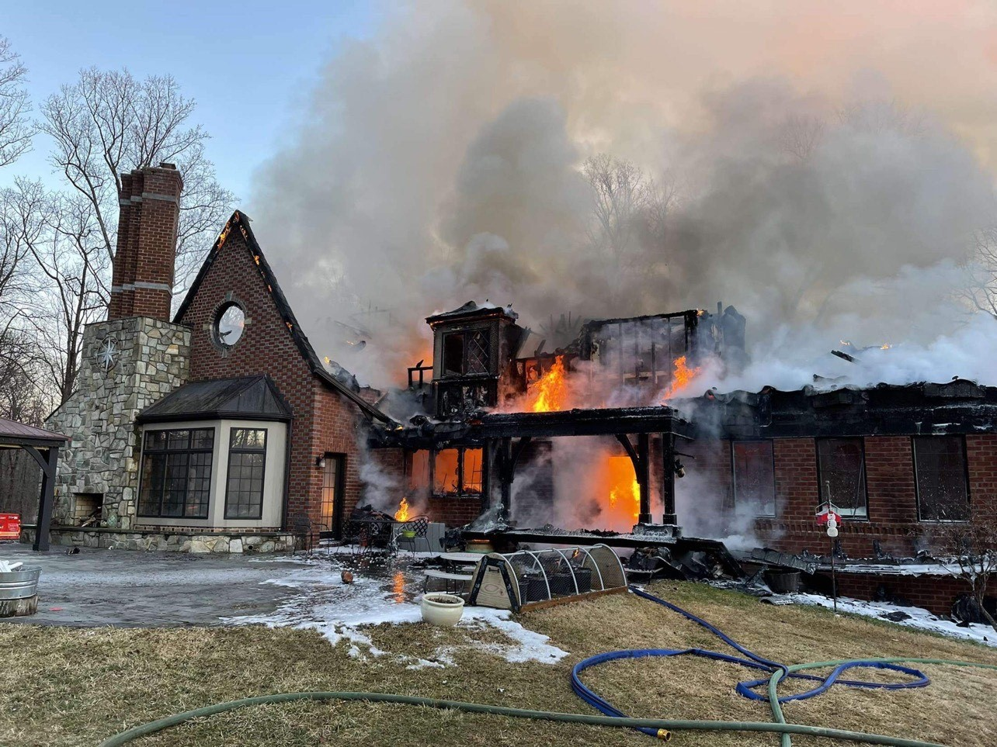
Why are fpes important?
Last Year in the United States:*
1.35 million fire responses
3,800 civilian deaths
14,700 civilian injuries
70 firefighter deaths (non-COVID)
$15.9 billion property damage
*NFPA, 2021
Notes:
Updated 2021 NFPA numbers added
https://www.nfpa.org/News-and-Research/Data-research-and-tools/US-Fire-Problem/Fire-loss-in-the-United-States
https://www.nfpa.org/News-and-Research/Data-research-and-tools/Emergency-Responders/Firefighter-fatalities-in-the-United-States

Slide 11
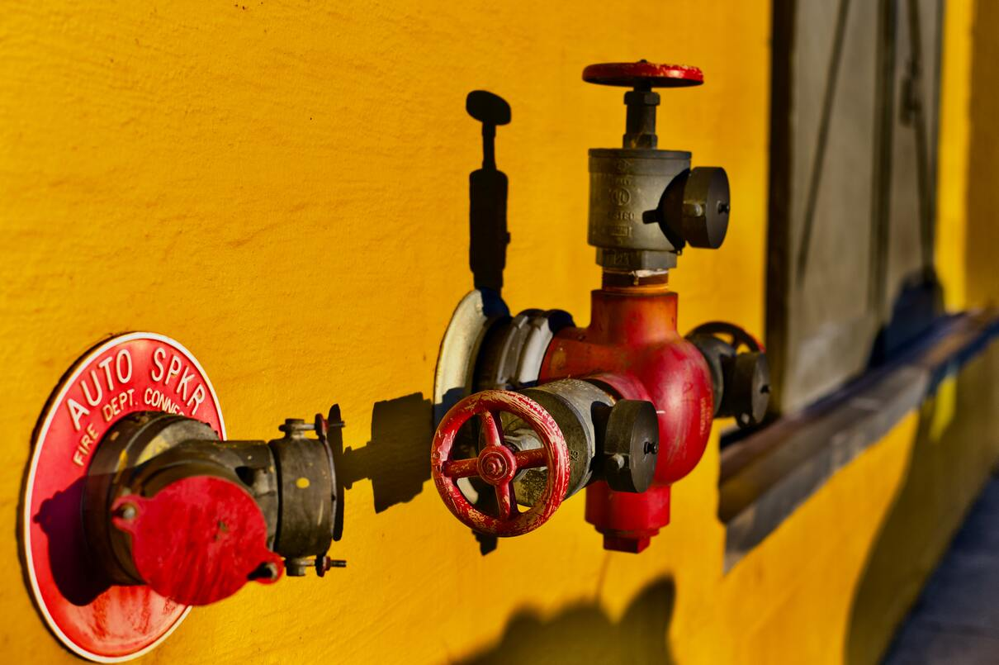
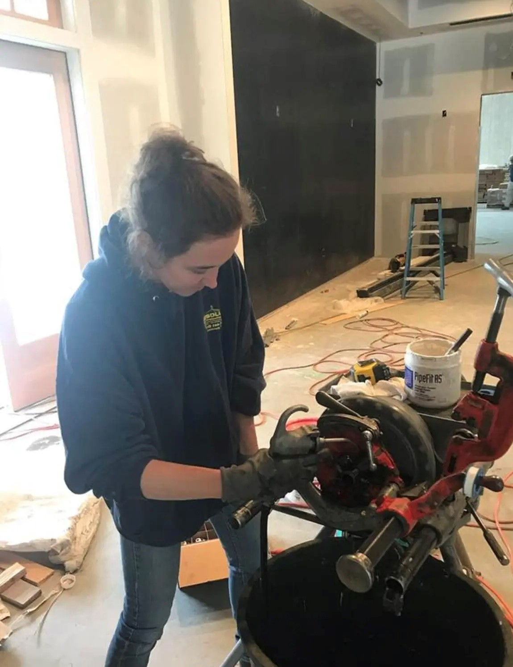
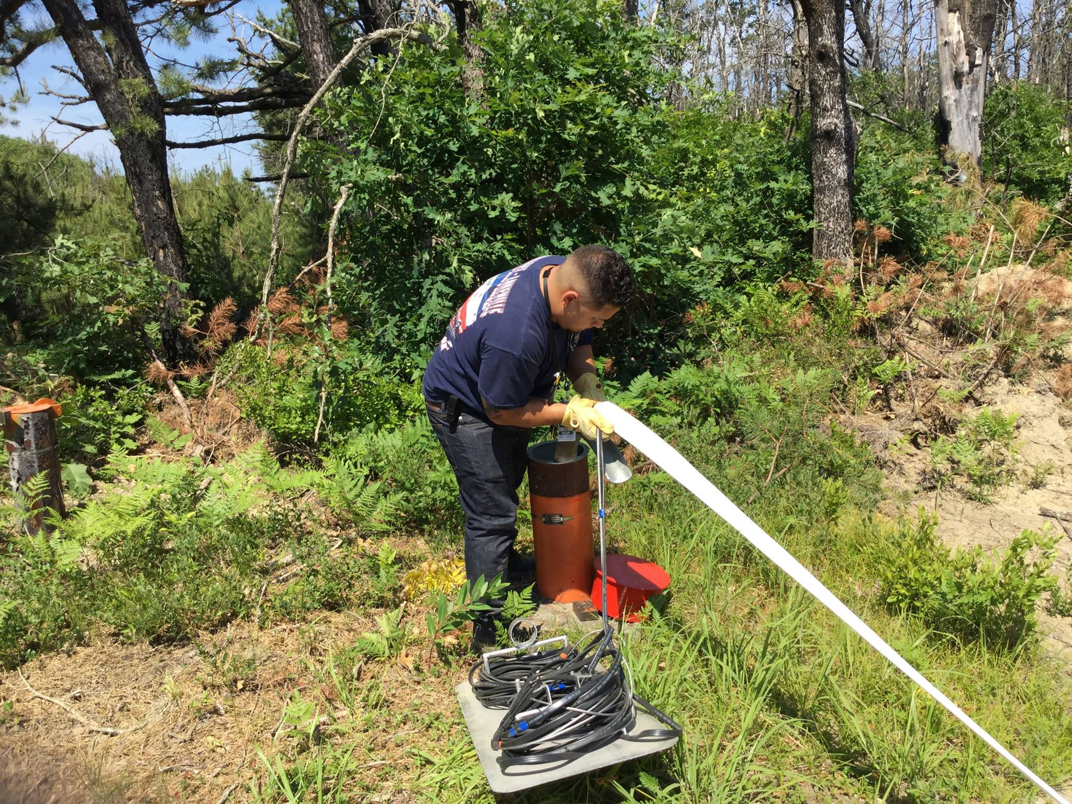
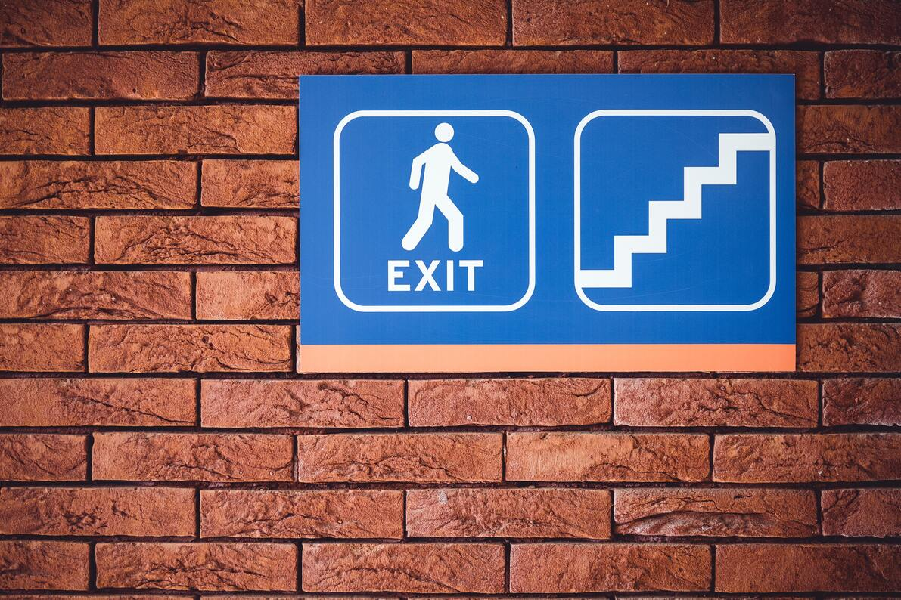
Making safer buildings
Design Systems that:
Control Fires
Alert People to Danger
Means for Escape
Protect Structure and Contents

Slide 12
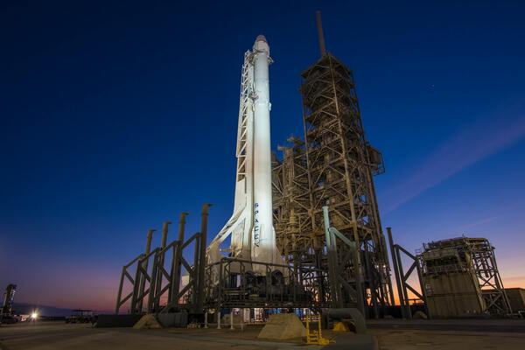

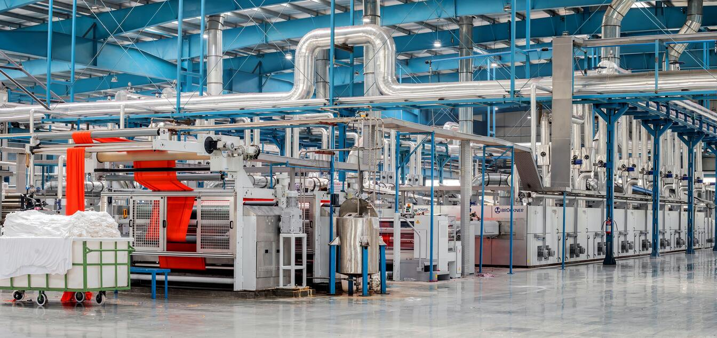

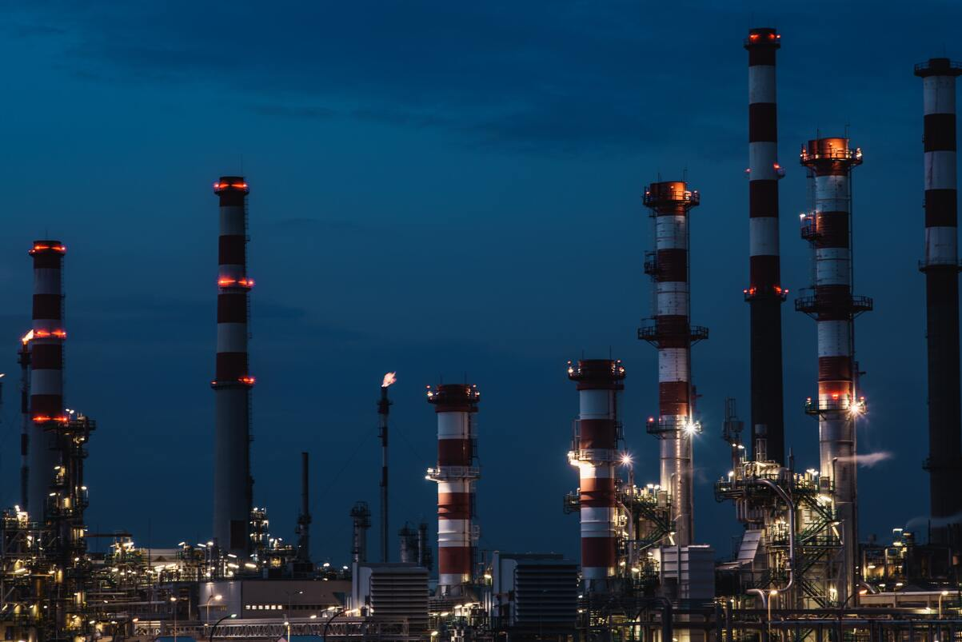
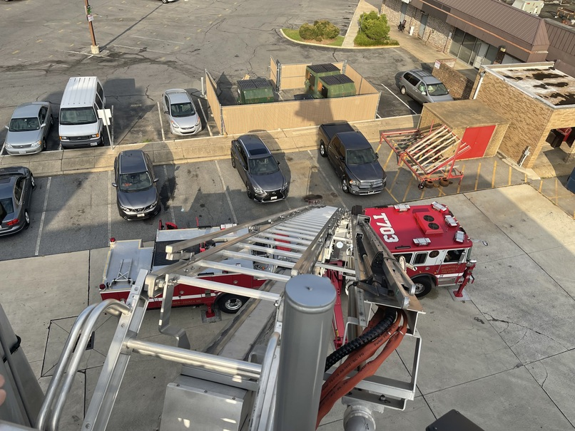
What kind of projects? Almost all of them!

Slide 13
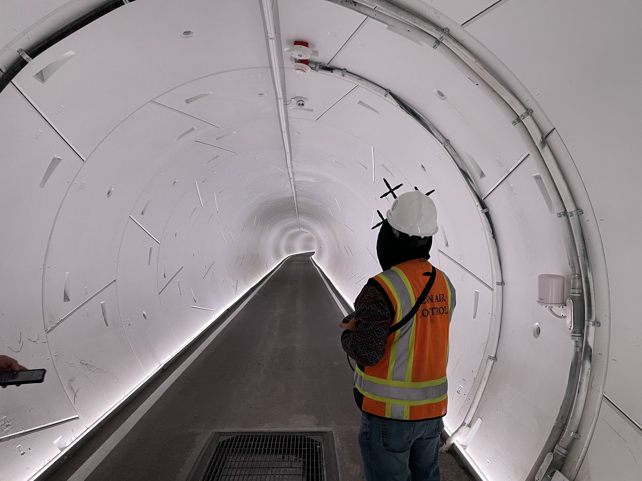
Why did we pick fpe as a profession?
Job satisfaction
Huge variety of career opportunities
Challenging work
Intellectual development
Potential to benefit society
Financial security
A specialized field with multiple options
Technological and scientific discovery
Creative thinking
Never boring!

Slide 14
A day in the life of a fire protection engineer
Meet with an Architect to determine a novel way to ensure life safety in a mega high rise
Perform egress fire modeling of historic structure to ensure occupants can exit safely
Design a fire alarm and fire sprinkler system
Evaluate a new additive manufacturing process for turbine jet engines
Witness a full-scale fire test of building components
Evaluate the origin and cause of a large fire
Write new requirements for the fire and building codes
Work within the 3D model of a new chemical plant or LNG facility to determine the best location for fire detection/protection equipment

Slide 15
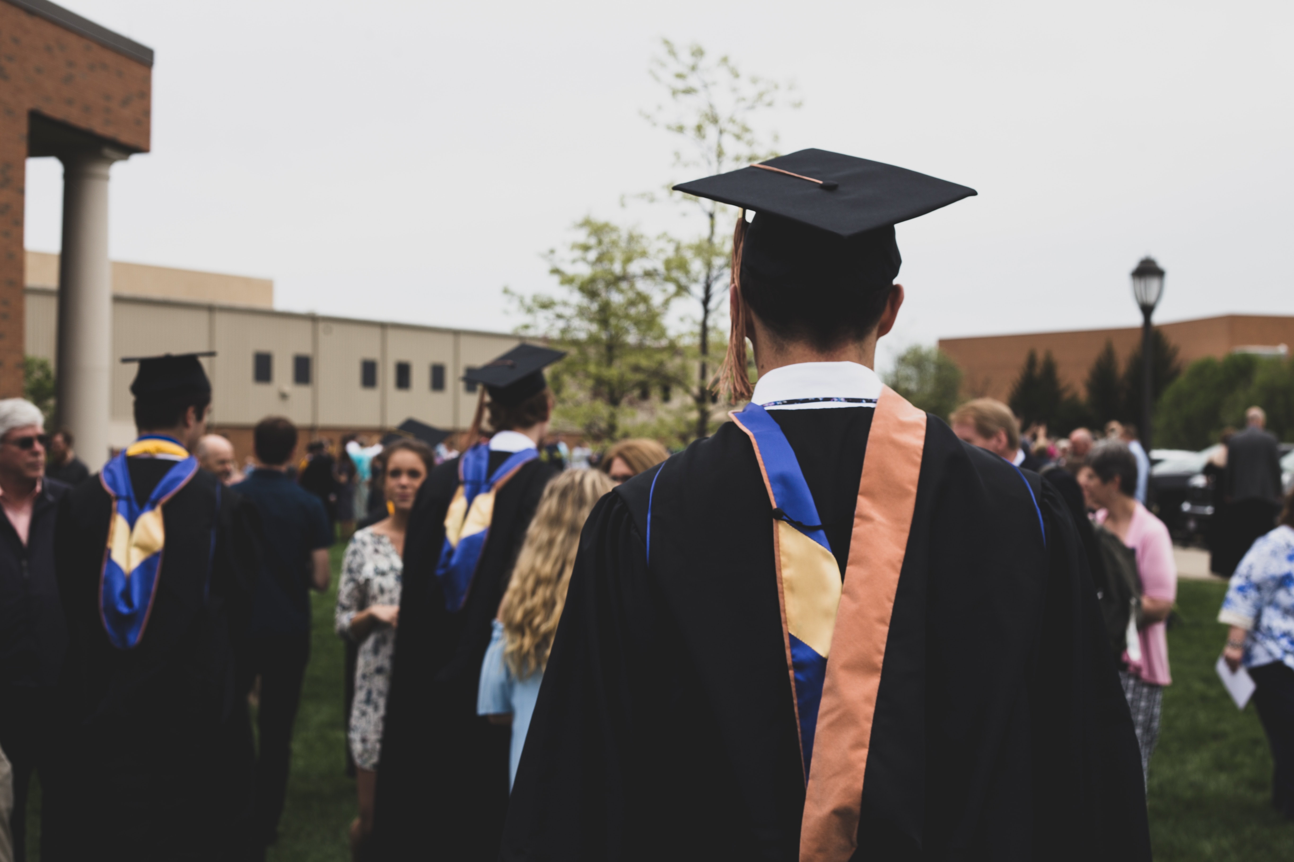
Paths for fire protection higher education
Certificate Programs
Associates Degree – Fire Protection Engineering Technology
Bachelors Degree – Fire Protection Engineering, Fire Protection Technology, or similar
Masters Degree – Fire Protection Engineering, Fire Protection Technology, or similar
Combined 5-year programs
  Typically, another degree and Fire Protection Engineering, Fire Protection Technology, or similar as a Masters Degree

Slide 16
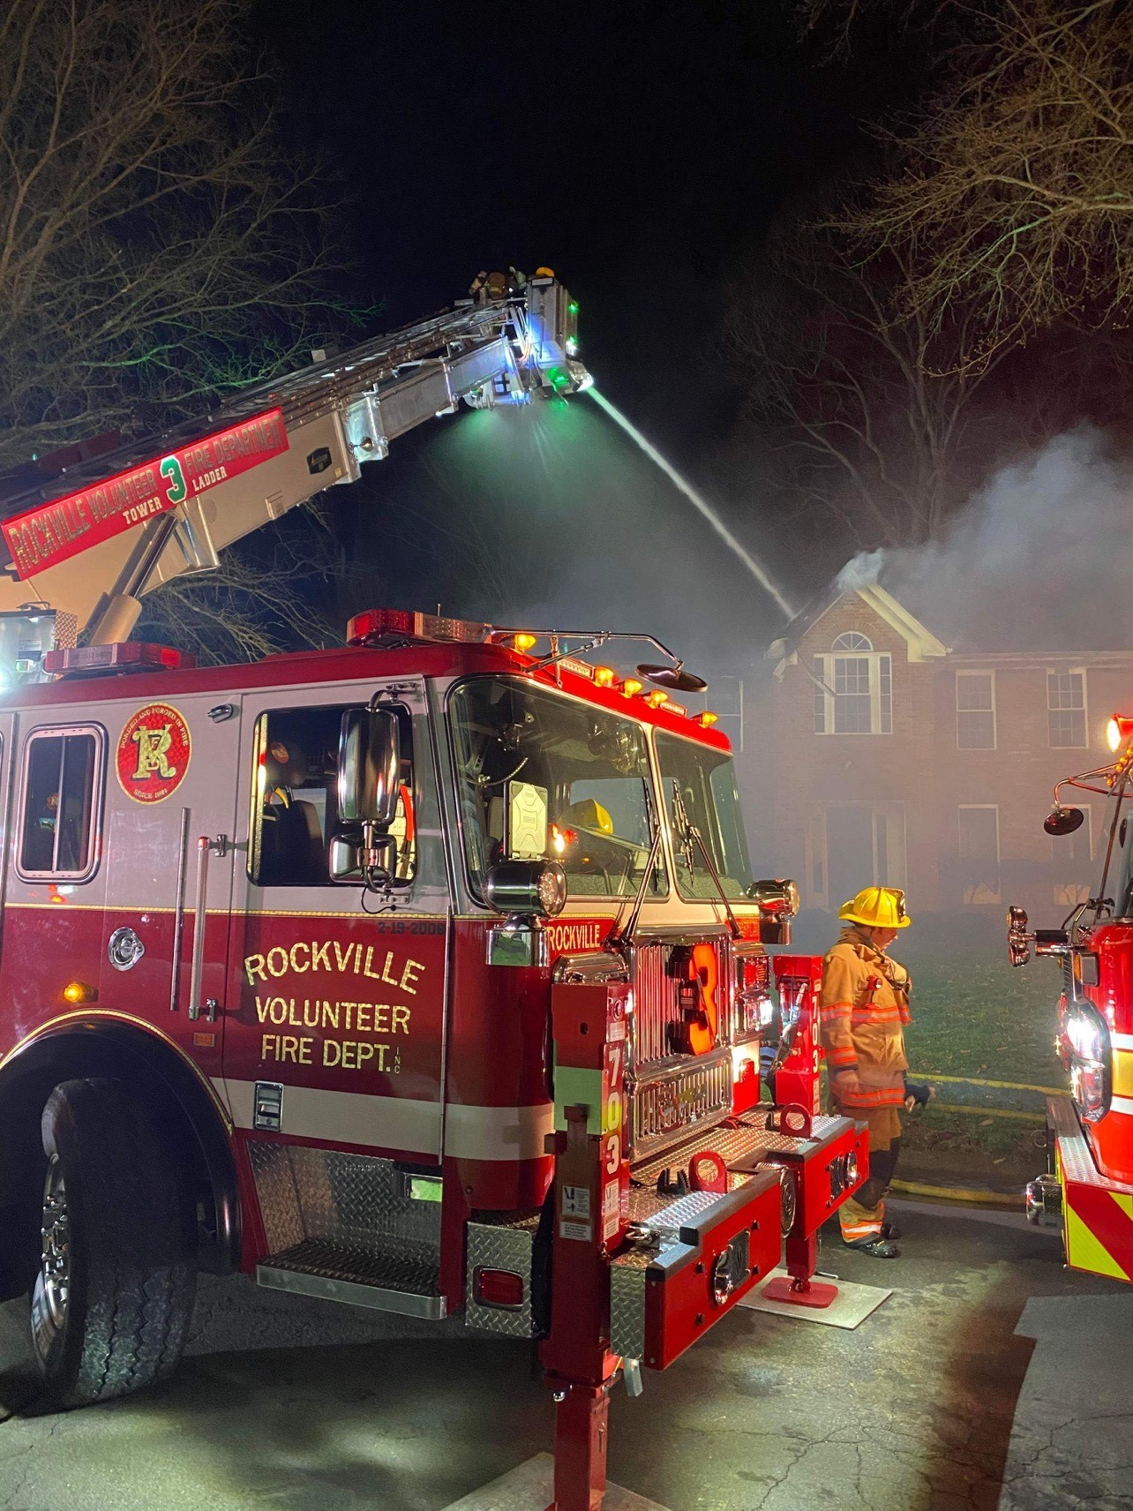
Higher education considerations –
Before you start (Experience)
Traditional College Experience
  Full time classes
    More traditional schedule of classes
Currently Working and College Experience
  Part time classes
    Night classes
    Online classes
Some schools offer a mix of online and in person and with various class times
Some Universities have agreements with the local fire departments for students to live in the fire station at no cost (assuming they’re a member of the department)

Slide 17

Higher education considerations –
Before you start (paying for it)
Funding your education
  Traditional avenues
    Parents, family, yourself, etc.
  Scholarships
    Scholarships are available (next slide)
  Employer Funded Opportunities
    Many companies will pay for classes that will benefit the company
      Check your employer
A new trend is to start your adventure at a local community or Junior college and then transfer to a University offering fire protection engineering
  Think ahead to make sure your credits can be easily transferred

Slide 18
There are numerous scholarships available!
Local SFPE Chapters
  Over 16 chapters offer scholarships
  https://www.sfpe.org/career/students/universityprograms/scholarships
Most Universities that offer Fire Protection Engineering have scholarships
  For example, University of Maryland has over 19 individual scholarships internal to the FPE department, and a number offered by outside entities

Slide 19

Post - Higher education considerations
Looking to the Future - Not all Universities that offer Fire Protection Engineering are ABET (https://www.abet.org/) accredited
  Graduating from an ABET accredited program helps when obtaining your Professional Engineer License
  University Programs offer various career paths
    Hands on work:
      Inspection, testing and maintenance of fire protection systems.
    Design work:
      Design of fire protection systems, building life safety systems and smoke control systems
    Consulting work:
      Reviewing designs, risk assessments and construction administration

Slide 20



Undergrad and graduate programs in fire protection engineering and fire and safety engineering technology
For a full listing with contact information:
  https://www.sfpe.org/career/students/universityprograms
Partial Listing (BS/MS/Ph.D.)
  California Polytechnic State University
  Carleton University
  Case Western University
  Eastern Kentucky University
  ETH Zurich
  Ghent University
  Lund University
  Oklahoma State University
  University of Canterbury
  University of Edinburgh
  University of Leeds
  University of Maryland
  Worcester Polytechnic Institute
Notes:
So, where do I go to get the much-needed degrees? Here are a few sources within the USA and Internationally. Additional schools and programs can be found at the SFPE web site. Each of the schools listed herein offer different types of degrees that are found among the 4000 members of the Society of Fire Protection Engineering. There are other degree programs leading to non-engineering certificates.

Slide 21
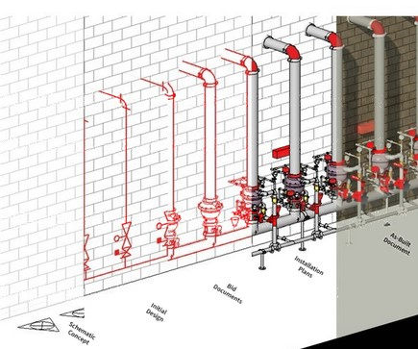
Common engineering classes
Physics
Chemistry
Calculus
Statics
Dynamics
Mechanics of Materials
Thermodynamics
Heat Transfer
Fluid Mechanics
Notes:
Part of any undergraduate engineering degree involves these courses. They are the building blocks on which the selected discipline can be built. Many students choose to study these subjects closer to home in smaller classroom settings before transferring to a major university with fire protection engineering. Others elect to get a degree in another engineering discipline before choosing to enter a Masters Degree program for fire protection engineering. Yet others elect to avoid the intense science and math requirements and pursue a technology degree.

Slide 22
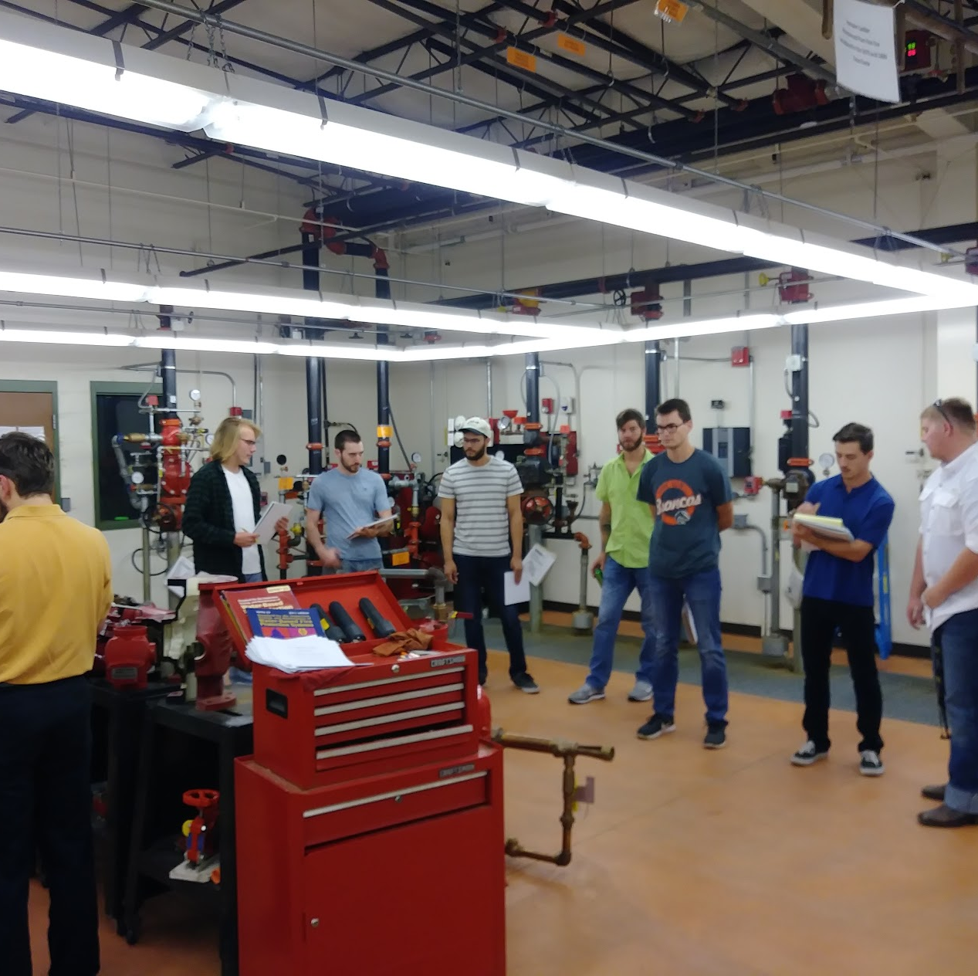
Example Fire Protection Engineering Classes
Structural Fire Protection
Fire Protection Hazard Analysis
Life Safety and Risk Analysis
Fire Modeling
Fire Dynamics
Fire Assessment
Fire Detection and Suppression Systems

Slide 23

Variety of work
“There are so many different things to do. I’m involved with everything – a huge variety of tasks. I’m never stuck behind a desk.”
- Vidar Landa, Fire Protection Engineer, Jensen Hughes

Slide 24
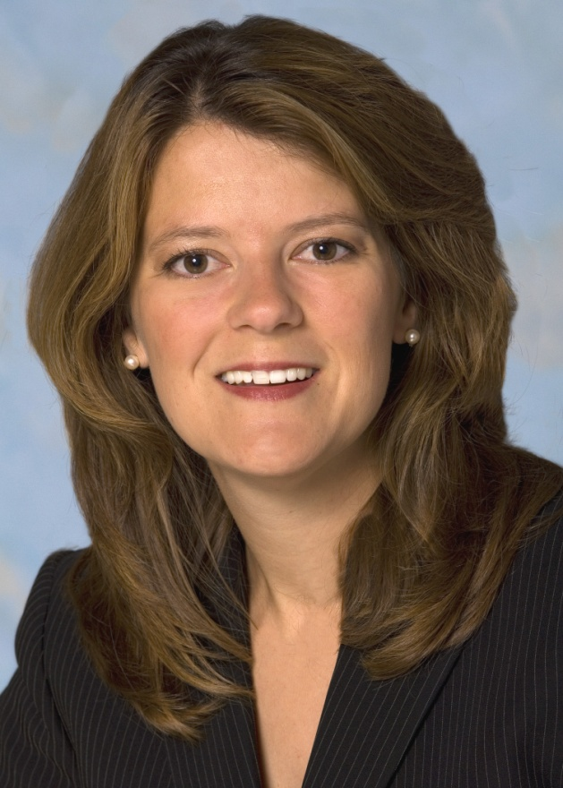
FPEs make the world a better place!
“I feel there’s a big reason why I go to work each morning. It gives me an incredible sense of purpose.”
- Stacey Welch, Fire Protection Engineer, Marriott International

Slide 25
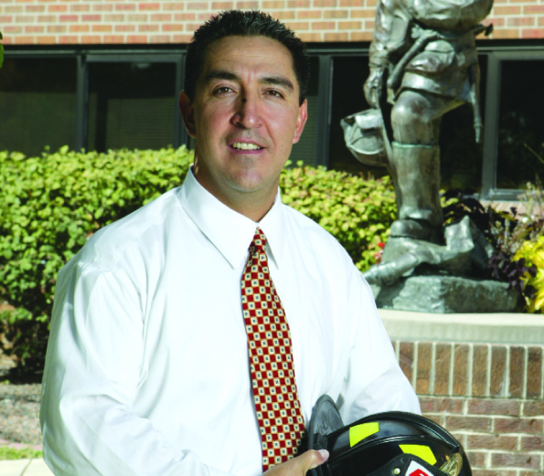
Opportunities for world travel
“In my first job, I spent my first five years traveling internationally, so I got to see a lot of cool places.”
- Tony Caro, Fire Prevention Bureau & Investigation Division, City of Denver

Slide 26
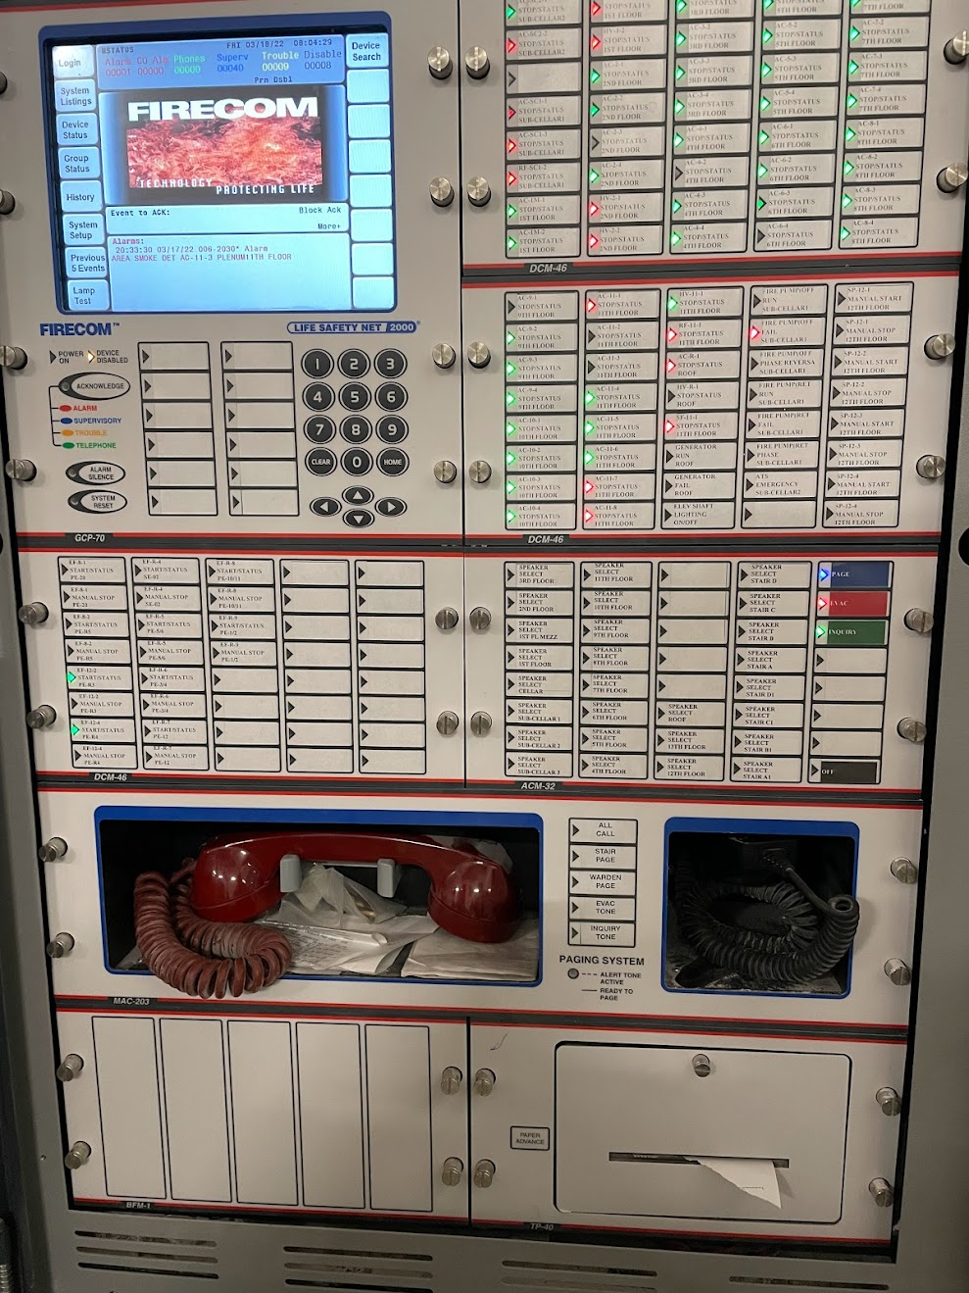
Beneficial life skills for engineers
Good communication
Written
Oral
An inquiring nature
Mathematical ability
Judgement
Common Sense
Creativeness
Ingenuity
Questioning Attitude
Integrity

Slide 27
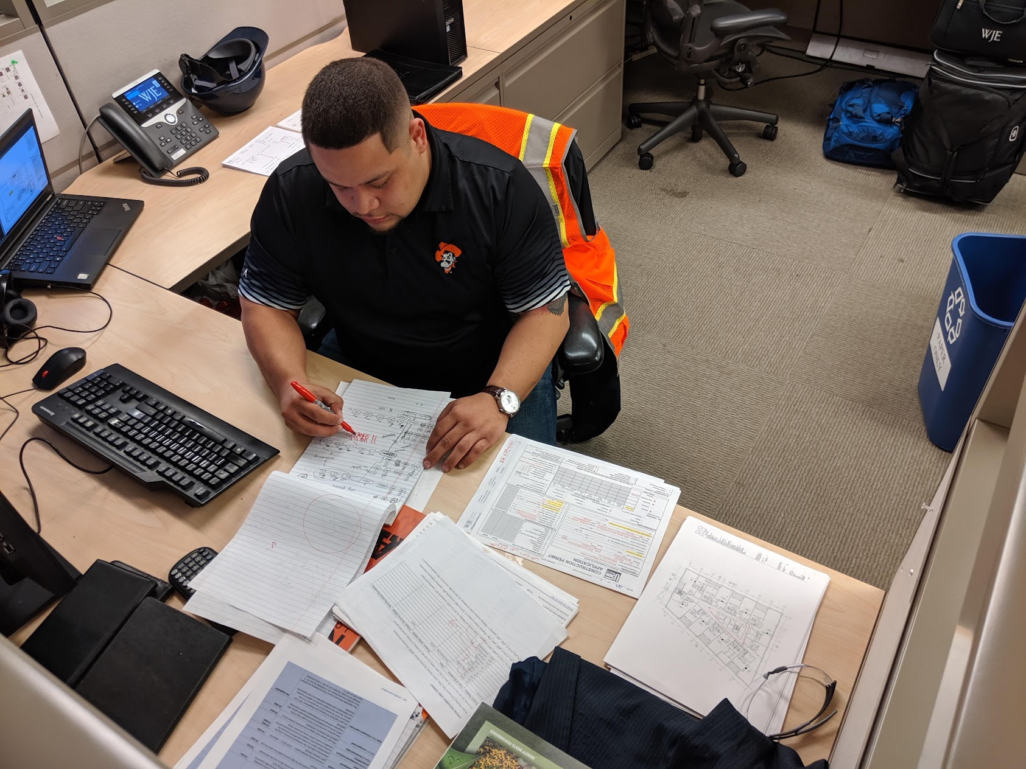
Current job opportunity examples
SFPE (free): https://jobs.sfpe.org/
Examples include
  Exp Federal
  MycoWorks
  PDI
  SeeScan
  Oak Ridge National Laboratory
  Walgreens
  General Services Administration
  AMA Group
  Jensen Hughes

Slide 28
Why become an fpe?
Enjoy solid wages, strong benefits and pension options with public agencies
Gain personal and professional satisfaction from knowing you play a part in saving lives and taking a bite out of millions of dollars in property damages lost to fires each year
25 percent of the profession's workforce will retire in the next 10 years
The demand for FPE profession for engineers has exceeded the supply for decades

Slide 29
Salary profile for fpes*
The latest SFPE report reports that the median salary for a FPE is $118,800 in base salary and $127,200 in total compensation.
SFPE claims FPE’s with a four-year college degree draw higher starting salaries when compared to other engineering fields
* https://www.sfpe.org/career/fpe-career-salary-facts

Slide 30
Questions?
For More Information, Visit
  http://www.sfpe.org
  https://www.sfpe.org/career/careers
  https://www.sfpe.org/career/fpe
  https://www.sfpe.org/career/students/universityprograms/scholarships

Slide 31
references
Coming of Age, David A. Lucht, https://journals.sagepub.com/doi/abs/10.1177/104239158900100201 Last accessed 02/03/22.
How to Become a Fire Protection Engineer, Fire Science, https://www.firescience.org/how-to-become-a-fire-protection-engineer/ Last accessed 02/03/22.
Research Roadmap: Identifying Research Needs for the Fire Safety Engineering Profession, SFPE, https://www.sfpe.org/research/research-roadmap Last accessed 02/03/22.
SFPE Standards, SFPE, https://www.sfpe.org/standards-guides/standards , Last accessed 02/03/22
25 Percent of Profession’s Workforce to Retire in Next 10 Years, SFPE, https://www.sfpe.org/publications/magazine/fpearchives/2015q4/fpe2015q45b Last accessed 02/03/22.
Firefighter Fatalities in the United States in 2021, NFPA, https://www.nfpa.org/News-and-Research/Data-research-and-tools/Emergency-Responders/Firefighter-fatalities-in-the-United-States last accessed 11/9/2022
Fire Loss in the United States in 2021, NFPA, https://www.nfpa.org/News-and-Research/Data-research-and-tools/US-Fire-Problem/Fire-loss-in-the-United-States Last accessed 11/9/2022

Slide 32
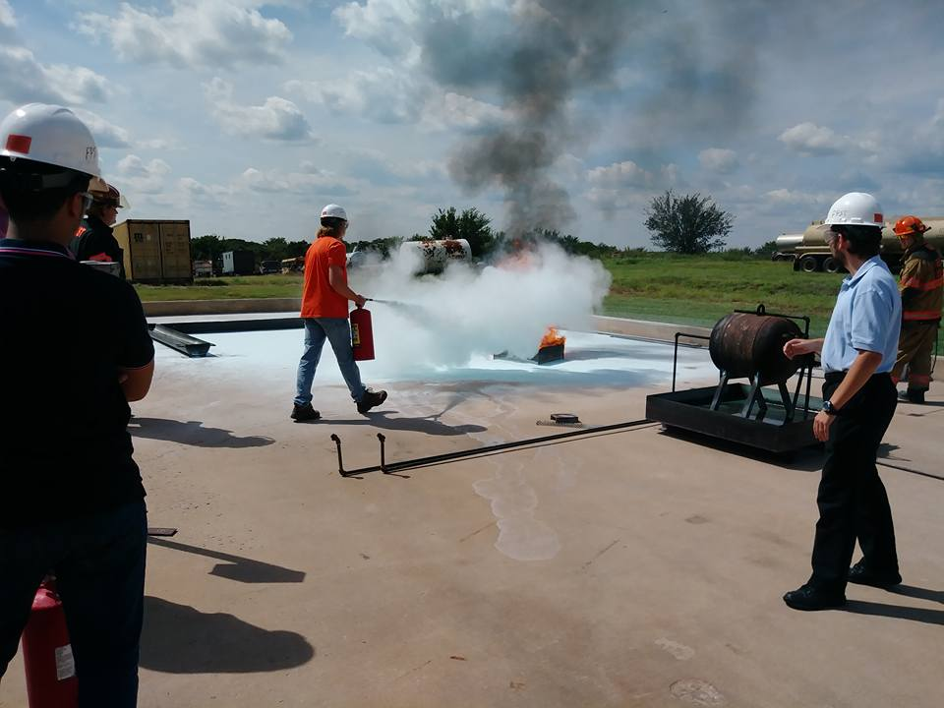
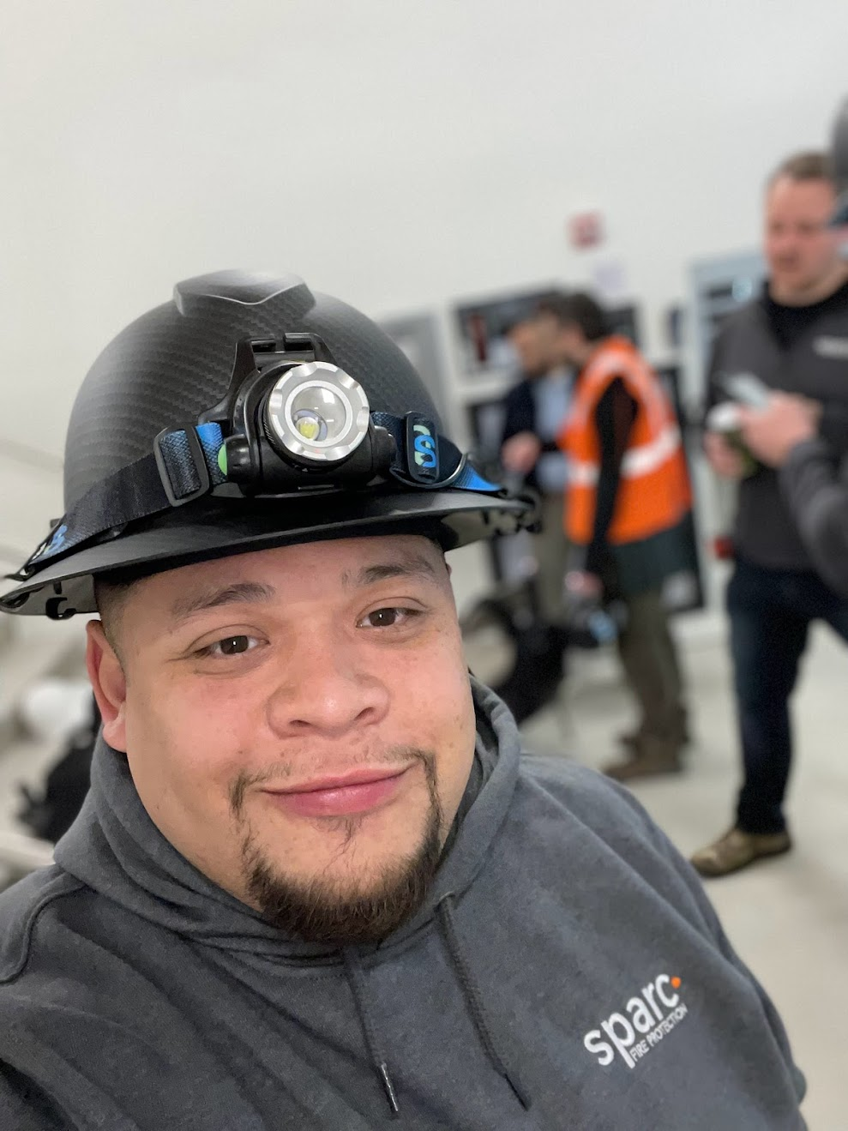
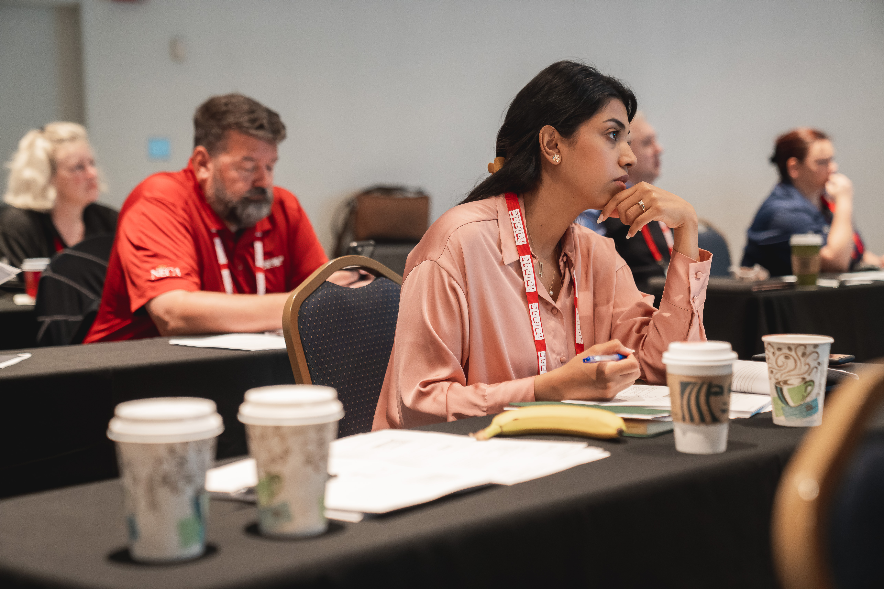
Photos courtesy of:
Jonathan Bernal
Benjamin Chen, Rockville Volunteer Fire Department
Emily Thomas, Jensen Hughes
Thomas Good, University of Maryland, Baltimore
Benjamin Fogel, SFPE
Charles Deloye
Christopher Hallock, Jensen Hughes
Pete Piringer, MCFRS Public Information Officer
Derek Cookson
Emmanuel Ikwu
Bernard Hermant
Kevin Butz
Lalit Kumar
Clay Banks
Sean Pollock
Thomas Serer
Tobias Rademach
This Is Engineering
UL Research
Thank you!

Slide 33

SFPE EDUCATION
Dozens of upcoming live virtual, live in-person, and on-demand virtual education opportunities
Notes:
SFPE’s live education connects fire protection and fire safety engineering professionals with the best and brightest experts in the industry. These live, interactive programs provide best-in-class learning with the opportunity to ask questions and/or chat with instructors. Conveniently available via webinars, multi-part online seminars and in-person seminars.
Plus, SFPE’s on-demand education provides industry-leading technical knowledge on diverse topics specifically tailored to the needs of fire protection and fire safety engineering professionals. Developed from recordings of past presentations by expert speakers, these webinars and seminars provide convenient access to SFPE information on a schedule and timeframe that is convenient for you.

Slide 34
A final thought
“Today is your opportunity to build the tomorrow you want”
- Ken Poirot
Notes:
Ken Poirot is an accomplished author, entrepreneur and public speaker Published several books that include Mentor Me and Your Greatest Achievement

