Slide 1
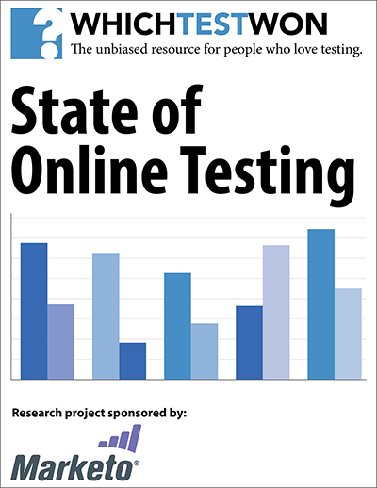
How to Use These Charts:
This research is copyright protected. Our goal is to encourage the global growth of testing. Therefore, you may use the individual charts included in this zip file to:
Create presentations for public or internal viewing
Post online via blogs, social media or on your site
Distribute the charts via email, print-outs, or other media to your contacts and colleagues.
You may not:
Excerpt or alter the charts in any manner (aside from overall size) including but not limited to removing logos and copyright information.
Sell the data contained herein – or derivative works based in part or whole on it.
For further permission and copyright information, contact
CustomerService@WhichTestWon.com
For a free copy of our 20-page analysis report on this data, go to: StateofOnlineTesting.com
Background:
State of Online Testing research conducted August 28-September 5, 2014.
841 total respondents.
Published by WhichTestWon, the unbiased resource for people who love testing. http://WhichTestWon.com
Sponsored by Marketo, a leader in online testing. http://Marketo.com

Slide 6
Which Department Is In Charge of Managing Testing?

Slide 8
Source: State of Online Testing Survey 2014, WhichTestWon & Marketo.
© 2014, WhichTestWon, a division of Anne Holland Ventures Inc. All rights reserved.

Slide 10
Which Basic Online Sales Tests Have The Highest Impact?
Source: State of Online Testing Survey 2014, WhichTestWon & Marketo. N=255
© 2014, WhichTestWon, a division of Anne Holland Ventures Inc. All rights reserved.

Slide 11
Which Basic Lead Generation Tests Have The Highest Impact?
Source: State of Online Testing Survey 2014, WhichTestWon & Marketo. N=166
© 2014, WhichTestWon, a division of Anne Holland Ventures Inc. All rights reserved.

Slide 12
Source: State of Online Testing Survey 2014, WhichTestWon & Marketo. N=166
© 2014, WhichTestWon, a division of Anne Holland Ventures Inc. All rights reserved.

Slide 14
Which Are the Most-Used Research Tools to
Construct Hypotheses?
Source: State of Online Testing Survey 2014, WhichTestWon & Marketo N=545
© 2014, WhichTestWon, a division of Anne Holland Ventures Inc. All rights reserved.

Slide 15
Which Sophisticated Testing Practices Are Most Used?

Slide 16
Source: State of Online Testing Survey 2014, WhichTestWon & Marketo. N=540
© 2014, WhichTestWon, a division of Anne Holland Ventures Inc. All rights reserved.

Slide 17
For How Many Weeks Do Marketers Run
Tests to Very Low-Traffic Pages
 | 2013 | 2014
Average | 5.4 weeks | 4.8 weeks
Source: State of Online Testing Survey 2014, WhichTestWon & Marketo.
© 2014, WhichTestWon, a division of Anne Holland Ventures Inc. All rights reserved.

Slide 18
How Long Do Marketers Run Tests to Very High Traffic Pages?

Slide 19
Source: State of Online Testing Survey 2014, WhichTestWon & Marketo. N=537
© 2014, WhichTestWon, a division of Anne Holland Ventures Inc. All rights reserved.

Slide 20
Source: State of Online Testing Survey 2014, WhichTestWon & Marketo. N=264
© 2014, WhichTestWon, a division of Anne Holland Ventures Inc. All rights reserved.

Slide 21
Source: State of Online Testing Survey 2014, WhichTestWon & Marketo. N=519
© 2014, WhichTestWon, a division of Anne Holland Ventures Inc. All rights reserved.

