Slide 1
RIMS CHICAGO CHAPTER
Harry Caray’s (MVP room) 33 Kinzie Street
Chicago, IL 60654
What Every Risk Manager Needs to Know about D&O Liability & Insurance
Presenter:
William G. Passannante, Esq.
(212) 278-1328
wpassannante@andersonkill.com

Slide 2
Disclaimer
The views expressed by the participants in this program are not those of the participants’ employers, their clients, or any other organization. The opinions expressed do not constitute legal advice, or risk management advice. The views discussed are for educational purposes only, and provided only for use during this session.

Slide 3

Your Speaker
William G. Passannante, Esq.
wpassannante@andersonkill.com
(212) 278-1328

Slide 4
OVERVIEW
How Do D&O Liability and Insurance Meet?
D&O Liability Insurance Top 10 Major Issues
What to Do Next?

Slide 5
Claim Against Directors and Officers
Entity Claim?
Corporate Indemnification?
Side “C”
No
Side A
Yes
Side B
Insured -
Corporate Entity in SEC Claims, other claims?
Individual
Directors and Officers
Corporate Balance Sheet
Personal Assets
Corporate Protection
Corporate Protection
“Side A”:
Individual D&Os
“Side B”:
Corporate Reimbursement
“Side C”:
Corporate Entity Coverage?
“Personal Assets Protection”
“Corporate Risk Transfer”

Slide 6
D&O Insurance is the Last Line of Defense
First line of defense
Last line of defense
State Statutory Protection
Corporate By-laws
Corporate Indemnification Agreements
D&O Insurance

Slide 7
II. Nature of the D&O Liability Exposure
“Wrongful Act”
  Typical Types of Wrongful Acts
  High Dollar Amount Claims
  Other Claims
Insurance Claims
  Pro-active steps
  “cooperation clause”
  “consent to settle”

Slide 8
Business Judgment Rule
A business decision – inaction must be conscious
Disinterested – not self-dealing (contrast with benefit to corporations as whole).
Reasonable Due Care to inform themselves
No abuse of discretion – no national basis, not protected.
Lack of Good Faith eliminates protection

Slide 9
Avoid D&O Claims
  Respect Duties
    Duty of Obedience
    Duty of Loyalty
    Duty of Diligence
    Duty of Candor
  Select Outside Directors with Independence
  Regular Board Meetings & Preparation
    Minutes of Deliberations
  Avoid Conflicts in Decisions

Slide 10
By-Laws and Indemnification Agreements
Most companies want to provide the broadest protection possible to their directors and officers.
Many by-laws, however, have not been reviewed or updated in a long time and do not provide the most protection possible.
Directors and officers should insist on the following:
  Mandatory indemnification and advancement of defense costs.
  A contractual right to indemnification that cannot be amended.
  Strong disincentives for the board to vote against indemnification when it is not mandated by statute.
But indemnification provisions won’t help if the company goes bankrupt or prohibited by law.

Slide 11

2014-15 ⎯ D&O Liability Insurance
Developments
A Review and Look Ahead
Notes:
Welcome
Significant Problems
Economist- not a lot to learn; a lot to say.

Slide 12
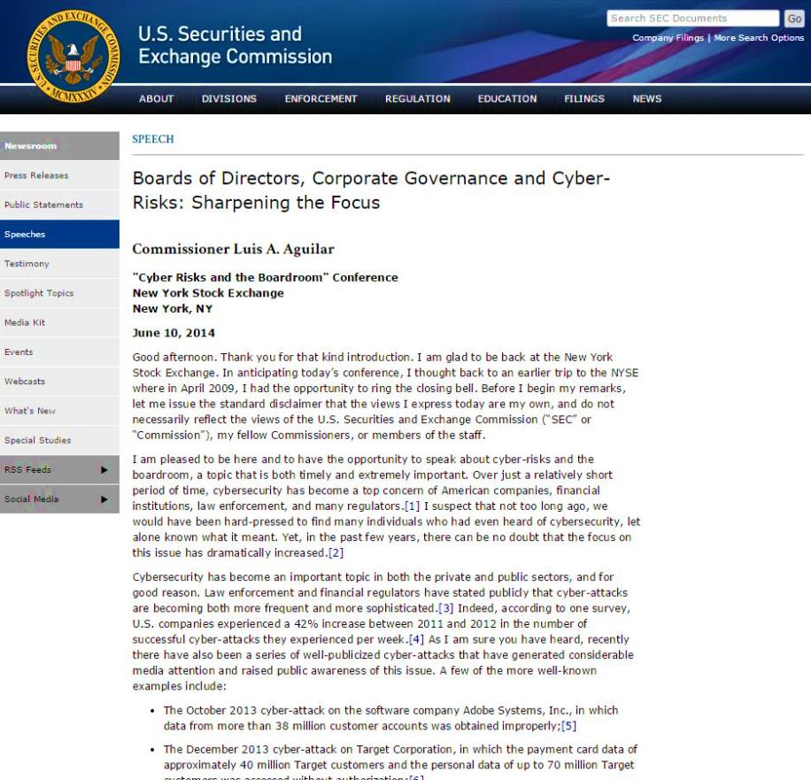
10. SEC Statement on Cyber Risks
“[T]he increased pervasiveness and seriousness of the cybersecurity threat raises questions about whether more should be done to ensure the proper functioning of the capital markets and the protection of investors. "
Commissioner Luis A. Aguilar, "The Commission’s Role in Addressing the Growing Cyber-Threat," March 26, 2014.

Slide 13
10. SEC Statement on Cyber Risks
For example, on February 26, 2014, the U.S. Commodity Futures Trading Commission (“CFTC”) published guidance outlining the data security practices it expects from firms it oversees and the third parties they contract with.
CFTC Staff Advisory No. 14-21, Gramm-Leach-Bliley Act Security Safeguards (Feb. 26, 2014), available at http://www.cftc.gov/ucm/groups/public/@lrlettergeneral/documents/letter/14-21.pdf.
SEC examiners will review whether asset managers have policies to prevent and detect cyber-attacks and are properly safeguarding against security risks that could arise from vendors having access to their systems.
Sarah N. Lynch, “SEC examiners to review how asset managers fend off cyber attacks,” Reuters (Jan. 30, 2014), available at
http://www.reuters.com/article/2014/01/30/us-sec-cyber-assetmanagers-idUSBREA0T1PJ20140130.

Slide 14

10. SEC Statement on Cyber Risks Cyber Liability – Current Forms
Current Cyber forms not comprehensive
Cloud Computing, Social Media, BYOD, Sophisticated Hacking Incidents.
Coverage under Fidelity, Fiduciary, D&O, E&O and GL? Amendments?
Enterprise Risk Management
Target
Notes:
Banks- Session Hijacking
Pos Retail- Eastern Europe Card Swipe
Nature of Claim

Slide 15
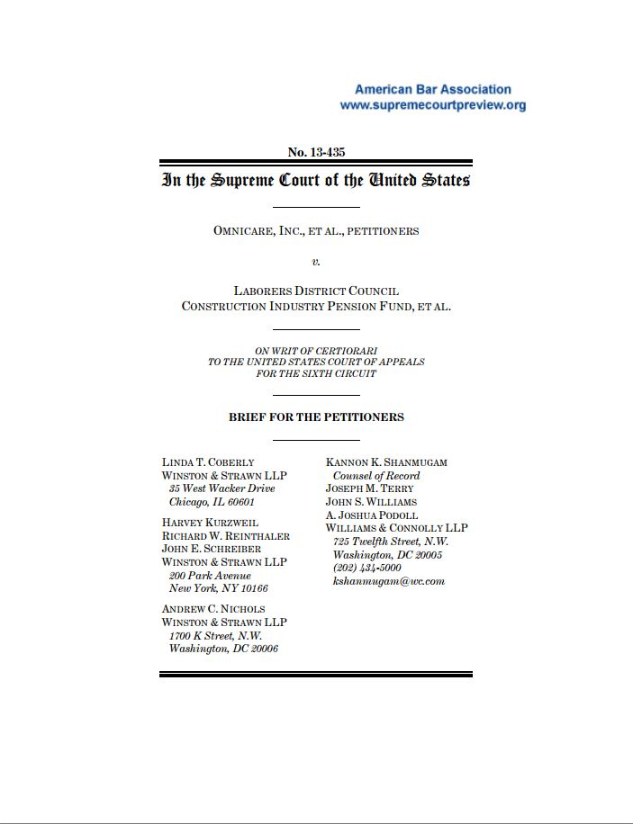
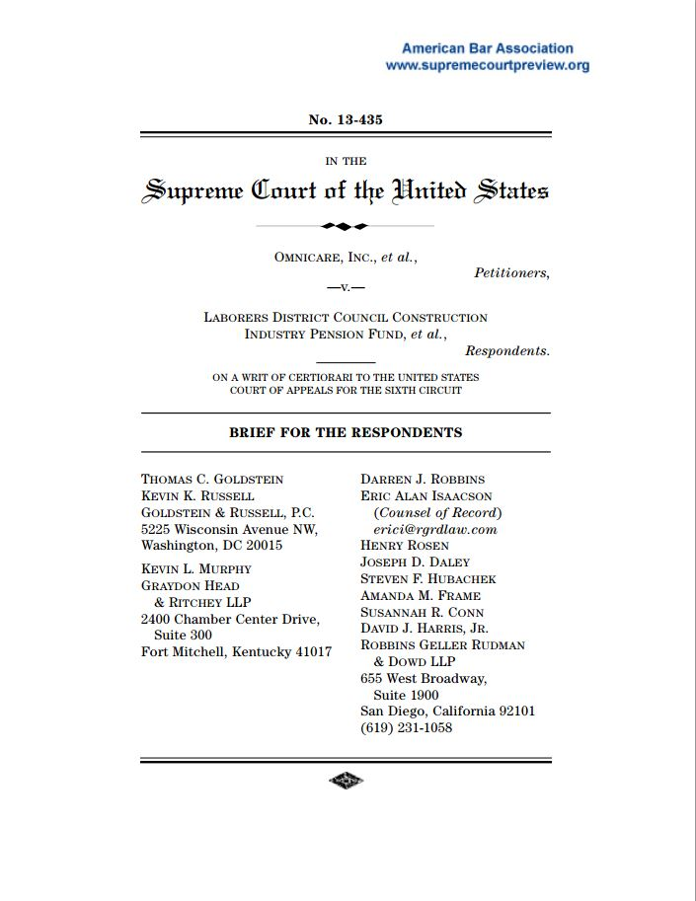
9. Omnicare – Is Objectively Determined Belief Actionable?
Does a claim under Section 11 of the Securities Act of ‘33, permit a plaintiff to plead that a statement of opinion was “untrue” merely by alleging that the opinion itself was objectively wrong (as the 6th Circuit has held in Omnicare) or must the plaintiff allege that the statement was subjectively false. In other words, the speaker’s actual opinion was different from the one expressed, which is the holding in the 2d, 3rd, and 9thCircuits.
U.S. Supreme Court Argument took place on November 3, 2014.
Is subjective falsity needed to make a statement of opinion actionable.
Implications given split in jurisdictions.
Decision expected possibly by June 2015.
Omnicare, Inc. v. Laborers District Council Construction Industry Pension Fund, Case No.12-5287 (U.S. Supreme Court).

Slide 16
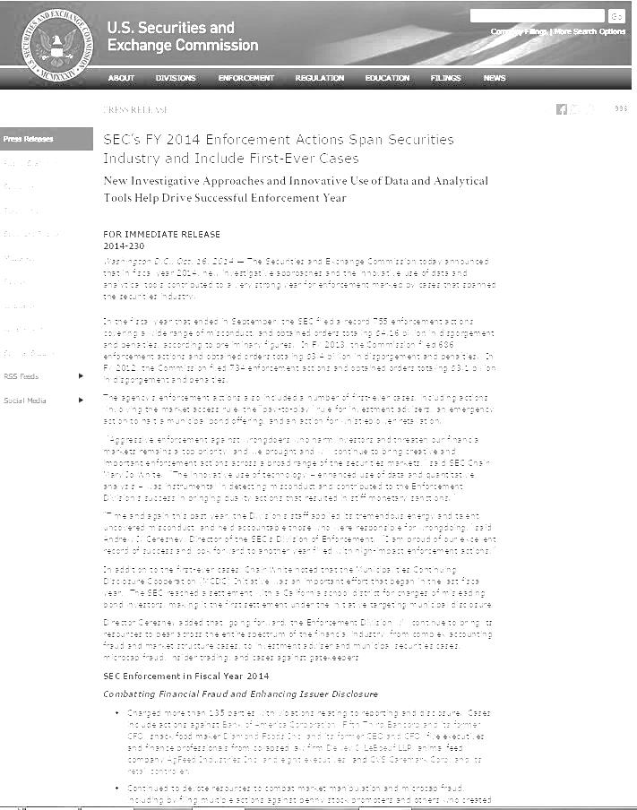
8. Record Number of SEC Enforcement Actions
FY 2014 - SEC filed a record 755 enforcement actions obtained orders totaling $4.16B in disgorgement and penalties.
FY 2013 - 686 enforcement actions and $3.4B in disgorgement and penalties.
FY 2012 - 734 enforcement actions and obtained orders totaling $3.1 billion in disgorgement and penalties.
The agency’s enforcement actions also included a number of first-ever cases, including actions involving the market access rule, the “pay-to-play” rule for investment advisers, an emergency action to halt a municipal bond offering, and an whistleblower retaliation.
“SEC’s FY 2014 Enforcement Actions Span Securities Industry and Include First-Ever Cases -- New Investigative Approaches and Innovative Use of Data and Analytical Tools Help Drive Successful Enforcement Year” Release 2014-230 (Oct. 16, 2014) available at http://www.sec.gov/News/PressRelease/Detail/PressRelease/1370543184660#.VPtyAHzF_To

Slide 17
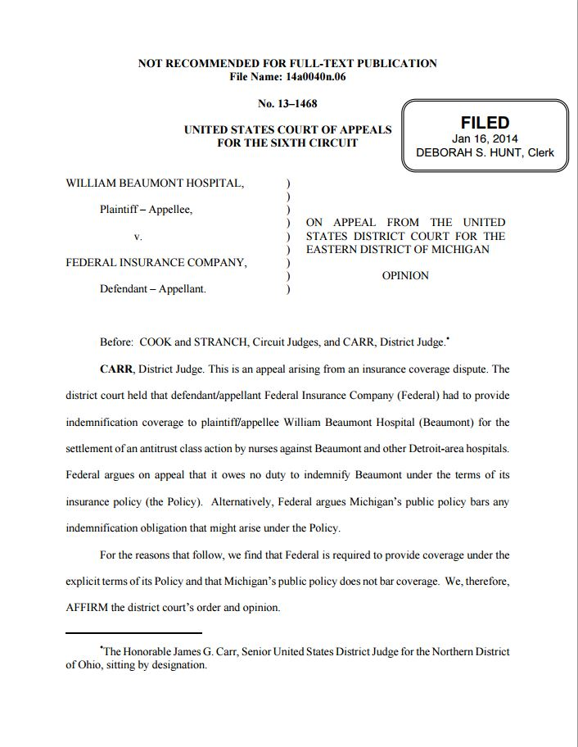
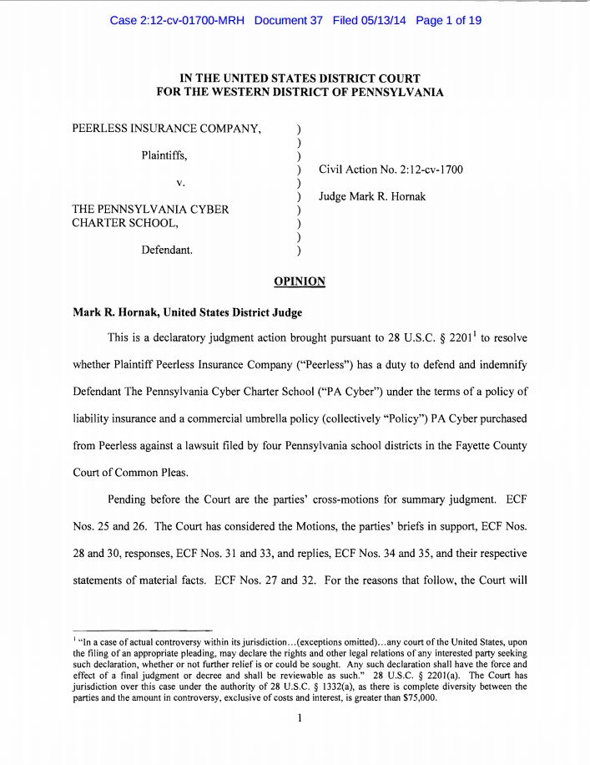
7. “Loss”, Disgorgement and Public Policy
William Beaumont Hosp. v. Federal Ins. Co., 2014 WL 185388, at *5-7 (6th Cir. Jan. 16, 2014) (No. 13-1468).
Michigan public policy and an D&O policy’s definition of “Loss” do not preclude insurance for class action settlement consisting of wages allegedly were wrongfully retained in violation of the Sherman Act.
Court noted “retained” is not “taken.”

Slide 18
7. “Loss”, Disgorgement and Public Policy
The Sixth Circuit joins a number of other jurisdictions that have distinguished Level 3 Communications, Inc. v. Federal Insurance Co., 272 F.3d 908 (7th Cir. 2001).
J.P. Morgan Securities v. Vigilant Insurance, No. 113, slip op. (N.Y. June 11, 2013).
Court agreed that had not “decisively repudiate Bear Stearns’ allegation that the SEC disgorgement payment was calculated in large measure on the profits of others.”
No case in which coverage was nullified where the disgorgement payment at issue went to third parties, the court concluded that it could not dismiss Bear Stearns’ insurance claims.

Slide 19
7. “Loss”, Disgorgement and Public Policy
Peerless Insurance Co. v. Pennsylvania Cyber Charter School, Civ. Action No. 2:12–cv–1700 (W.D. Pa. May 13, 2014), reconsideration denied (W.D. Pa. Aug. 29, 2014).
lawsuit by county school districts alleging that they were entitled to the return of certain funds
Court noted not uniformly excluded claims from “loss” where the restitutionary funds are offset by a benefit provided by the policyholder.
held that PA Cyber did not receive a profit or advantage to which it was not entitled.
Others.

Slide 20
Possible Gradient in Fraud Exclusion
7. “Loss”, Disgorgement and Public Policy
Final adjudication of fraud in the underlying proceeding
Final,
non-appealable adjudication in the underlying proceeding
Final,
non-appealable adjudication in the underlying proceeding, applicable only to officers
Final adjudication of fraud
“In fact” or worse wording
Admission of guilt
No exclusion
Worst
Best

Slide 21
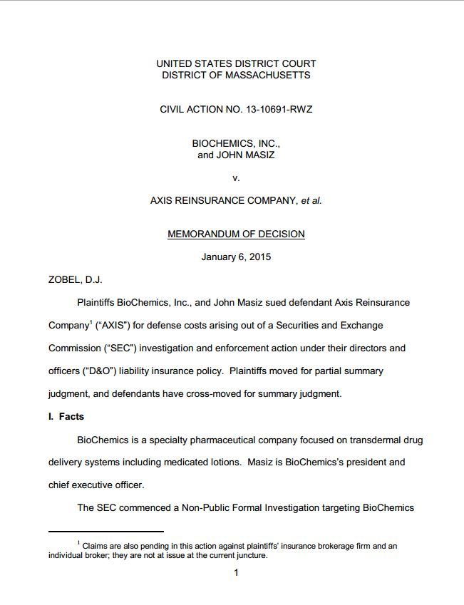
6. D&O Coverage for Investigations - Is governmental subpoena “written demand for non-monetary relief.”
Court found no coverage under D&O policy for SEC investigation and enforcement action against the company and CEO where company had been served with investigative subpoena prior to policy period. Court held claim made when subpoena served and therefore was not in policy period.
“Claim” defined including “civil, arbitration, administrative or regulatory proceeding against any Insured commenced by … the filing of a notice of charge, investigative order or like document.”
Other issues, claims.
Biochemics, Inc., and John Masiz v. Axis Reinsurance Co., et al., CIV. NO. 13-10691-RWZ U.S.D.C., D. Mass. (January 6, 2015).

Slide 22
5.“Entire Fairness” – Independent Directors in Buyouts
Last year: Kahn v. M&F Worldwide, C.A. No, 65661 *(Del. Sup. Ct. March 14, 2014)
unanimously affirmed Chancery’s decision that more deferential “business judgment rule”, rather than “entire fairness” standard of review.
applies to controlling stockholder buyouts if merger discussions and negotiation and approval of independent committee and an un-coerced, fully informed, majority-of-the-minority stockholder vote.)

Slide 23
5.“Entire Fairness” – Independent Directors in Buyouts
Pleading standard for independent director has breached fiduciary duties in connection with controlling shareholder buyout.
Certified for interlocutory appeal to Delaware Supreme Court in a pair of recent Chancery cases.
In re Cornerstone Therapeutics Stockholder Litigation, No. CIV.A. 8922-VCG (Del. Ch. Sept. 10, 2014) (Glasscock, V.C.);
In re Zhongpin Stockholders Litigation, No. CV 7393-VCN (Del. Ch. Nov. 26, 2014) (Noble, V.C.).

Slide 24
4. UK Corporate Veil Piercing -
Prest v Petrodel Resources Ltd [2013] UKSC 34, the UK Supreme Court has recently reviewed the English law
limited power to ignore separate corporate personality.
identify a fraudster with a company they control to compensate victims of fraud.
Called "piercing the corporate veil“
UK High Court permitted “veil piecing” in this matrimonial case where individual had total control over network of offshore companies. Company found to hold assets on behalf of individual and subject to remedy against individual.

Slide 25
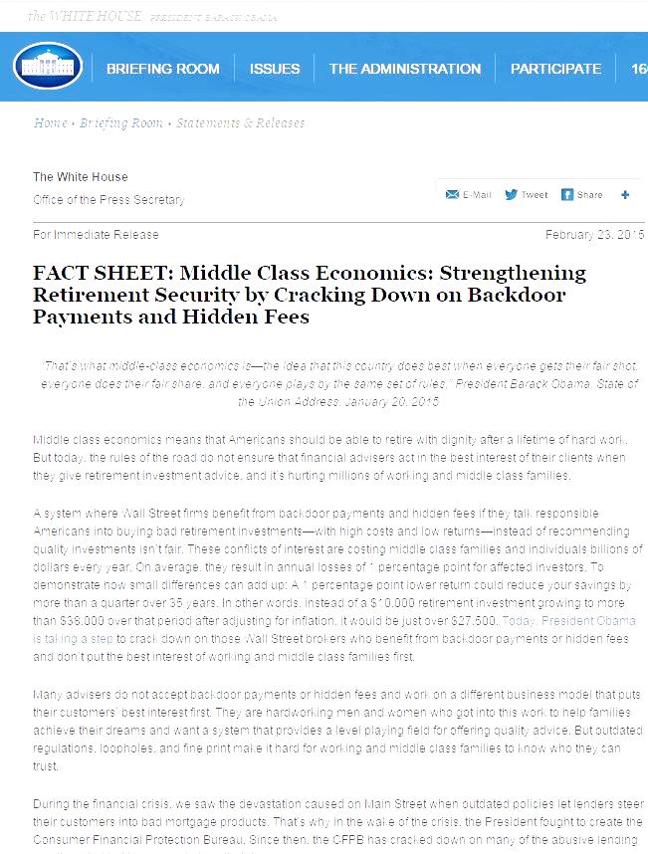
3. Increase Fiduciary Liability?
February 23, 2105 - President directed Dept of Labor to move forward with proposed rulemaking requiring retirement advisers to abide by a “fiduciary” standard.
Previous statute did not get through House.
Implications for Fiduciary liability insurance.
Non-ERISA liability?
Over $7 trillion in individual retirement accounts alone.

Slide 26
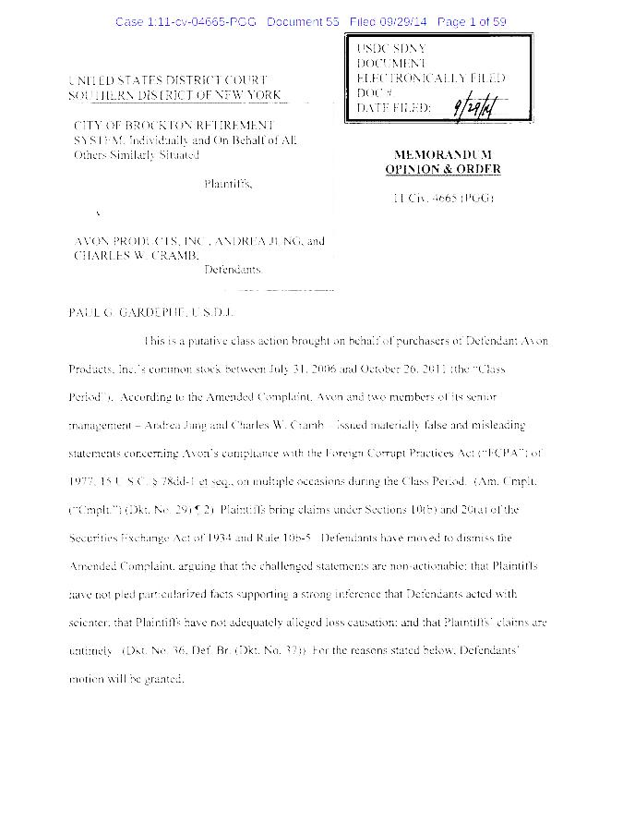
2. FCPA Enforcement Fines and Follow On Securities cases
The Foreign Corrupt Practices Act (FCPA) 1977
In response to revelations of widespread bribery of foreign officials by U.S. companies in order to win business.
Enforcement actions by SEC and DOJ have increased in recent years.
FCPA follow-on securities class action lawsuits increase.
One involving Avon Products illustrates

Slide 27
2. FCPA Enforcement Fines and Follow On Securities cases - Avon
September 29, 2014 SDNY granted motion to dismiss the plaintiffs’ complaint.
Avon’s disclosures prior to the October 2008 8-K filing, Court found failed to show that misleading statements had been made with knowledge of existence of the allegedly improper payments.
Court found allegations that executives “must have known” about the improper payments because of their positions and direct involvement in the negotiation of the Chinese licenses did not satisfy state-of-mind pleading requirements.

Slide 28

And the
Number 1 D&O Liability Insurance Development
in 2014-15…

Slide 29
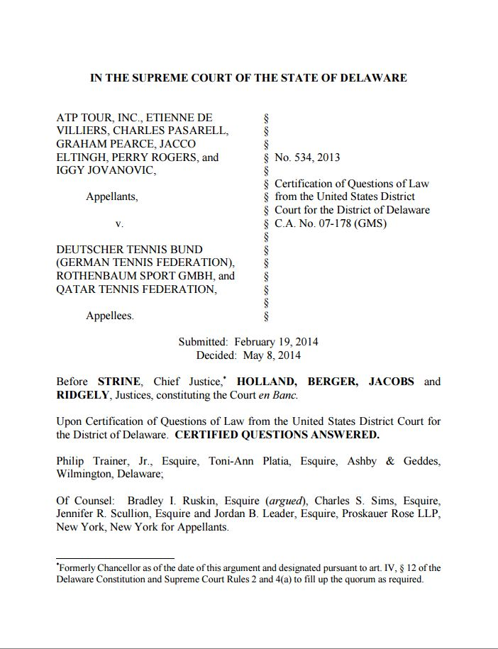
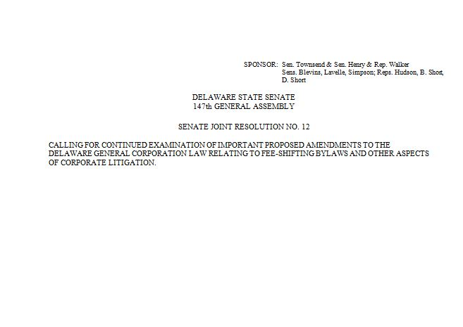
1. Delaware-Fee Shifting Bylaws – ATP Tours
Board of Delaware non-stock corporation may adopt a fee-shifting by-law that requires a plaintiff-stockholder to pay the corporation's legal expenses if the plaintiff loses a claim against the corporation. ATP Tour, Inc., et al. v. Deutscher Tennis Bund, et al., No. 534, 2013, 2014 WL 1847446 (Del. May 8, 2014).
Section 114 Delaware General Corporation Law (DGCL) applies statute to non-stock corporations. The ruling can be presumed to apply to ordinary, stock-issuing Delaware corporations. The Supreme Court added that a fee-shifting by-law would apply equally to all members of the non-stock corporation, including those who were members before the by-law was adopted.
A provision for fee-shifting is not required to be included in the charter and can therefore be adopted in the by-laws (DGCL § 102(a)).

Slide 30
1. Delaware-Fee Shifting Bylaws - Legislation
May 2014, Delaware State Bar Association will considered proposed amendment to the DGCL that would limit ATP Tour to non-stock corporations. The proposed amendment to the DGCL would amend Section 102(b)(6) and add a new Section 331 to clarify that these costs cannot be borne by stockholders of stock corporations.
June 18, 2014, Delaware Legislature passed, with the approval of the Governor, a Resolution directing Delaware State Bar Association to continue examining the proposed amendments to the Delaware General Corporation Law regarding fee-shifting by-laws and other aspects of corporate litigation.

Slide 31

Things to Do:
Understand the exposure.
Review indemnity rights, corporate bylaws, indemnity agreements and D&O liability insurance policies.
Avoid new exclusions.
Avoid gaps.
Enlist an expert consultant or broker.
DO NOT TAKE “NO” FOR AN ANSWER!

Slide 32

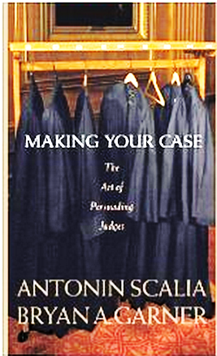
Brokers and Consultants - Fix These Continuing Problems - Originalism
Arbitration
Continuity at Renewal
Exhaustion
Fraud Exclusion
Notes:
Scalia- Making Your Case
Language of Constitution/Contracts/Insurance Policies
Intent . What it means not what it says.
Fix a u/w time.

Slide 33
RIMS CHICAGO CHAPTER
Harry Caray’s (MVP room) 33 Kinzie Street
Chicago, IL 60654
What Every Risk Manager Needs to Know about D&O Liability & Insurance
Presenter:
William G. Passannante, Esq.
(212) 278-1328
wpassannante@andersonkill.com

