Slide 1


Cyber Security Coverage: the What, the Why, and the How Come
Tim Lessman
Partner
312.894.3359
tlessman@salawus.com
Colin Gainer
Partner
312.894.3331
cgainer@salawus.com

Slide 2
The Intent of Cyber Policies
Offer both First and Third Party Coverages
Non-Standardized (coverage is typically negotiable)
Fills in gaps for cyber risks created in other lines of coverage
Safeguards limits of other types of policies that arguably could respond

Slide 3

Types of Coverages Offered

Slide 4
Types of Coverages Offered
First Party (Country)
Hiring Independent Security/Forensics Firm
Public Relations
Data Recovery & Damage to network and systems
Notification Costs
Credit Monitoring/Identity Theft Solutions
Legal Services and advice
Claims Management Services
E-Extortion costs
Business Interruption expenses
Denial of service costs
Intellectual property losses

Slide 5
Types of Coverages Offered
Third Party (and Western)
Third party claims (consumers, other companies and clients from loss of PII/PHI and/or other damages)
Related defense costs
Media liability (libel, slander, defamation)
Regulatory fines and penalties (PCI?)

Slide 6
Underwriting Issues
Generally speaking….

Slide 7

Know Your Risk: Ascertain How the Potential Insured Addresses the Following?
Does it know the parameters of what needs to be protected from cyber threats?
Does it know how to protect it?
Does it have a plan to address cyber threats?

Slide 8

Privacy by Design
7 Foundational Principles
  Proactive not Reactive
  Default Privacy Setting
  Privacy Embedded into Design
  Full Functionality
  End-to-End Security
  Visibility and Transparency
  Respect for User Privacy

Slide 9

The “Roadmap” for a Comprehensive Privacy Program
Designate personnel responsible for privacy within an organization
Conduct oversight of service providers
Conduct risk assessments that address training, management, product development, etc.
  Identify how you will implement controls to address risks identified
  Evaluate and adjust privacy program as necessary giving testing and monitoring

Slide 10
Privacy cont.
Keep any privacy promises made to consumers
Privacy notices: keep it simple!
Advise consumers of policy changes
Audit existing privacy policies (utilize third-party vendor for less routine audits)

Slide 11
Security by Design
Conduct risk assessments
Minimize data collected
Test security measures
Train employees on security measures
Address security issues at proper management level
Consider vendor and service providers abilities
Reasonable access control measures

Slide 12
Risk Assessment Includes:
Inventory of computer hardware and software that make up the information system
The categories and qualifications of staff members who use the system
The functions and activities that are supported by the information system
The data and information that are collected, processed, and stored by the information system
The physical environment that houses information system components
On-site and off-site storage of information
The organizations to which information is transmitted
The data and information that are transmitted to other organizations
The internal and external connections between the information system and the information systems of other organizations

Slide 13

Data Minimization
The more data, the more risk
Increased data more likely to exceed client’s reasonable expectations of how their data will be used
Examine business needs and limit data collection to purpose needed to collect
De-identity if collecting a lot of data
Limit collection of sensitive data
Dispose of data when no longer need it

Slide 14
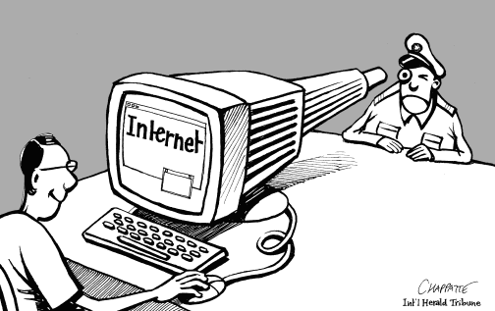
Security Tips...
Monitor and patch known vulnerabilities
Notify customers about security risks and updates
Make sure third party vendors implement reasonable security measures as well …incorporate into contract negotiations

Slide 15
Security Tips…
Encrypt, encrypt, encrypt (on network, work station hard drives, laptops, mobile devices, external storage media, and emailed data)
Strong company password requirements
Detection intrusion methods
Adequate training of employees…onboard training won’t cut it
Multi-factor authentication for remote access
If allowed to access network from home, make sure virtual desktop
Operating system patches

Slide 16
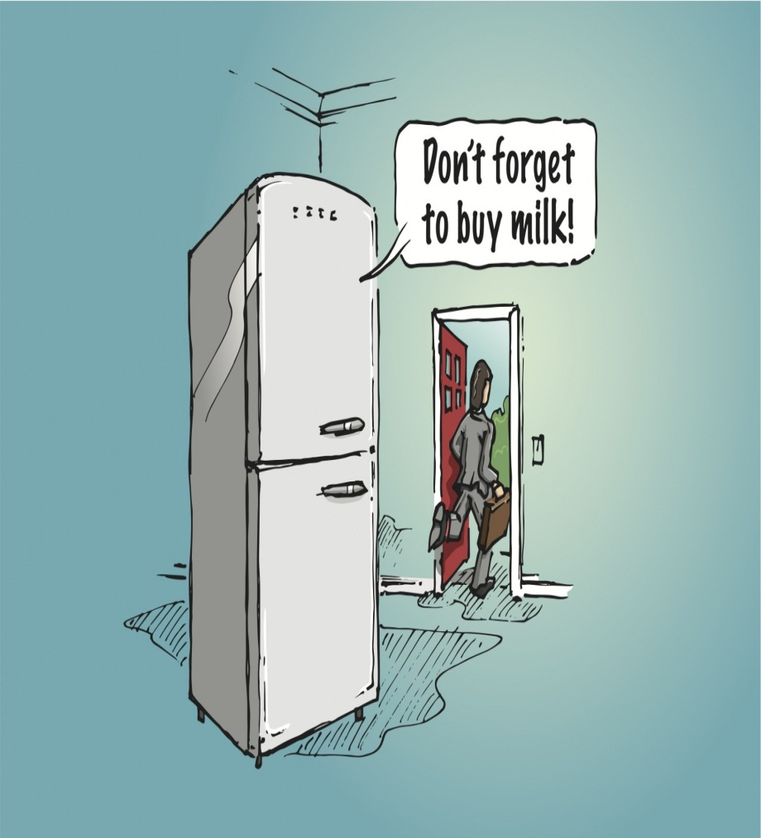
“Internet of Things”

Slide 17
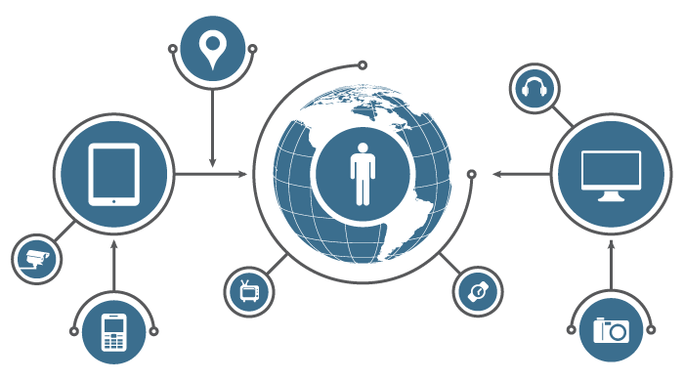
IOT
What constitutes “reasonable security” for a given device will depend on amount and sensitivity of data collected and costs of remedying the security vulnerabilities

Slide 18
Mobile Device Management
  Have a mobile device management policy
  Authentication to unlock devices
  Locking out device after failed attempts
  Encrypt data
  Remote wiping on lost or stolen data
  Try to prevent public Wi-Fi access to mobile system with sensitive/confidential data
  Limit (where you can) sensitive information on mobile device
  Train your employees on mobile device management

Slide 19
Vendor Concerns
Do they comply with HIPAA?
Do they contract to outside vendors?
Who is responsible for storing the data?
  Cloud storage? (co-location facility or other facility?)
How is data backed up?
How can you get access if security measures hacked?
  Do they have access?
Incorporate your security standards into vendor agreement
Involve your IT staff with process
Mandate that they contact you with security incidents involving our stored data and absolutely necessary that they contact you if a breach within set time frame
Have they had security incidents?
Are they insurable?

Slide 20
Final Guidelines Pre-Breach
Even with “reasonable security,” an incident or breach will occur
Have a breach response plan
  Test it—at least quarterly
  Make sure everyone knows their roles/responsibilities
  Train all employees as necessary on breach response tactics—who they can contact and what to do if they have a security incident

Slide 21
Underwriting Issues
These general guidelines help
Also important for underwriting to identify the Insured’s Business – Different Industries Involve Different Risks
  Retail
  Professional Services
  Healthcare
  Non-traditional Cyber Exposures

Slide 22

Underwriting Issues
Retail Industry:
  As security increases, claim frequency can rise (more able to identify intrusions)
  Credit Card Transaction volume typically directly proportional to expected loss (large retailers offer higher exposure)
  POS Controls – identify encryption; if not encrypted at any point during transaction, poses higher risk.
  What software do they use? Windows XP unsupported.

Slide 23
Underwriting Issues
Trends in Retail:
  Larger Limit Towers for large retailers (Target breach illustrated limits offered may not be enough)
  Lost revenue as a result of damaged reputation (Target experienced dip in transaction volume)
  Neiman Marcus decision: rise of class actions?
  Chip & pin in Credit Cards – largely only applicable to in-person transactions.

Slide 24
Underwriting Issues
Retail: Common Insured Objections
  “We don’t store credit card info”
* but can be on device itself (POS)
  “We don’t outsource payments to POS vendors”
* but data still stored on devices
  Need to know how/where data is stored!

Slide 25
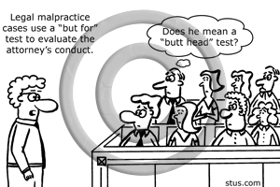
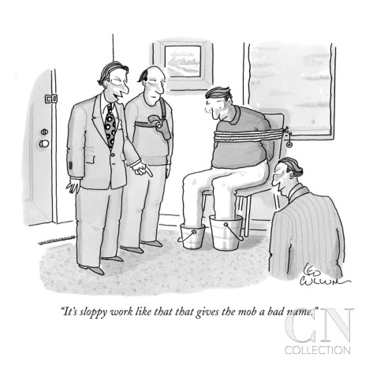
Underwriting Issues
Professional Services Industry

Slide 26
Underwriting Issues
Professional Services Industry
Identify industry and typical types of exposure (first party vs. third party)
Business does not face risk of loss of client/customer data, first party may be more important (business interruption type issues predominate)
Business does store consumer data – risk of lawsuits is evident, third party may be important consideration.
Match markets with products
  * e.g. – will an endorsement suffice, or is a stand-alone policy needed?
  stand alone policy: higher limits, more coverages
  endorsement: lower limits, no second set of policy terms, but may erode limits of another type of coverage (e.g., E & O)

Slide 27
Underwriting Issues
Professional Services Industry: What Insureds Will Look For
  Industry-specific breach response package
  Definition of “insured” (corporation, partnership, LLC, etc.)
  Other Insurance issues/coverage overlaps
  Specific types of exclusions and relevance on type of company
  Encryption warranties in application

Slide 28
Underwriting Issues
Selling Cyber Coverage to Professional Service Insureds
  Simplify the process as much as possible
  Focus on incident responses
  Industry examples of exposures and responses

Slide 29

Underwriting Issues
Healthcare Industry
  HIPAA and HITECH – a floor or a ceiling?

Slide 30
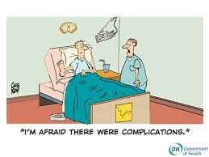
Underwriting Issues
Healthcare Exposures
  Largest Exposure: Human Error
  Encryption:
    “The 4 Ps”
      PII, PHI, PCI, Paper
      where is your data, how is it protected? PHI much more valuable than simple credit card numbers
  EHR/EMR
  Business Associates

Slide 31
Underwriting Issues
Healthcare: Evaluating Risks
  HIPAA Compliance is a baseline
  Quantifying Risks: Data Access
    How much data?
    Who has access?
    What type of protection?
    How is it managed?
  Business Associates: Can your process identify anomalous behavior?
  Incident Response plan: holistic involvement of the entire organization
  PCI Compliance? Is it an issue?

Slide 32
Underwriting Issues
Non-Traditional Industries Face Risks
  Utilities: Coordinated Attacks can threaten infrastructure
  Manufacturing: German steel mill example
  Business Interruption Risks due to unavailability of communications/website disruption
* Selling to these insureds may require tailoring of coverage to address industry-specific needs

Slide 33
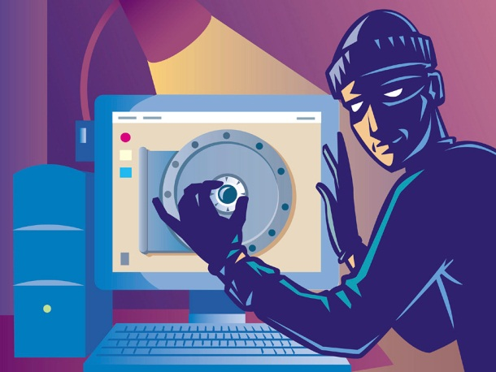
Underwriting Issues – General Summary
Must Understand Data Collection Habits of the Insured
  how may records are maintained?
  who has access?
  what type of security is in place?
  is there a Breach Response Plan?
  employee training protocol
  use of third party vendors and their access

Slide 34
Underwriting Issues – Other Considerations
Retroactive Date: Cyber attacks can have long latency periods (average of 243 days before detection); short retro dates minimizes risk.
Sublimits: No precise formula for how to set limits, but proper first party handling may help mitigate third party exposures.
More tailor made for larger clients? (overlap issues)

Slide 35
Cyber Claims: Recent Statistics
Headline data breaches (Sony Pictures, Target, Anthem) are not the typical claims, though they present large loss potential
Lost laptops, misdirected e-mails and malicious insiders are the more typical claims.
Most costly data breaches caused by malicious and criminal attacks

Slide 36
Cost of a Data Breach
Approximately $200 per record estimate?
  Better estimate is a range between roughly $50,000 and $90,000 for a breach of 1,000 records. Larger breaches involve wider ranges
  Smaller breaches may still be costly:
    forensic investigation, notification laws implicated
A strong security posture decreased cost of breach
Appointment of Chief Information Security Officer decreased breach cost by more than $6.00/record
70% of claims have payouts less than $1 million

Slide 37
Breakdown of Costs Per Claim
Data from Net Diligence Cyber Claims Study

Slide 38
Claims Concerns
Preparation for a Claim:
  Agreements with Forensic Experts and Law Firms
  Can the insured use their own? Comfort levels with such arrangements – best to address in advance of a claim
Specialized claims handlers provide great marketing potential
Cyber coverage serves to minimize potential exposure as best as possible
Most insureds only apply after experiencing a breach
Saturation in small and middle market is not very high

Slide 39
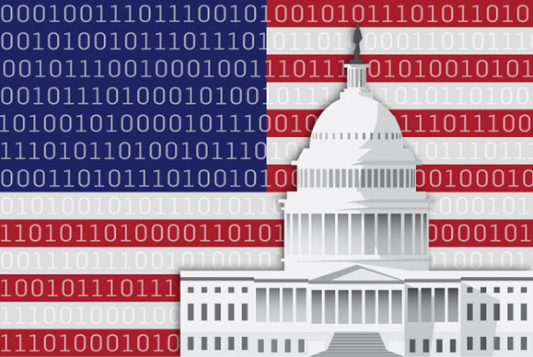
Enforcement
Sizable Fines
  FTC
  HHS/OCR
  FCC
    “proportional to harm”
Oversight
  Ordered to implement comprehensive privacy programs
Auditing

Slide 40
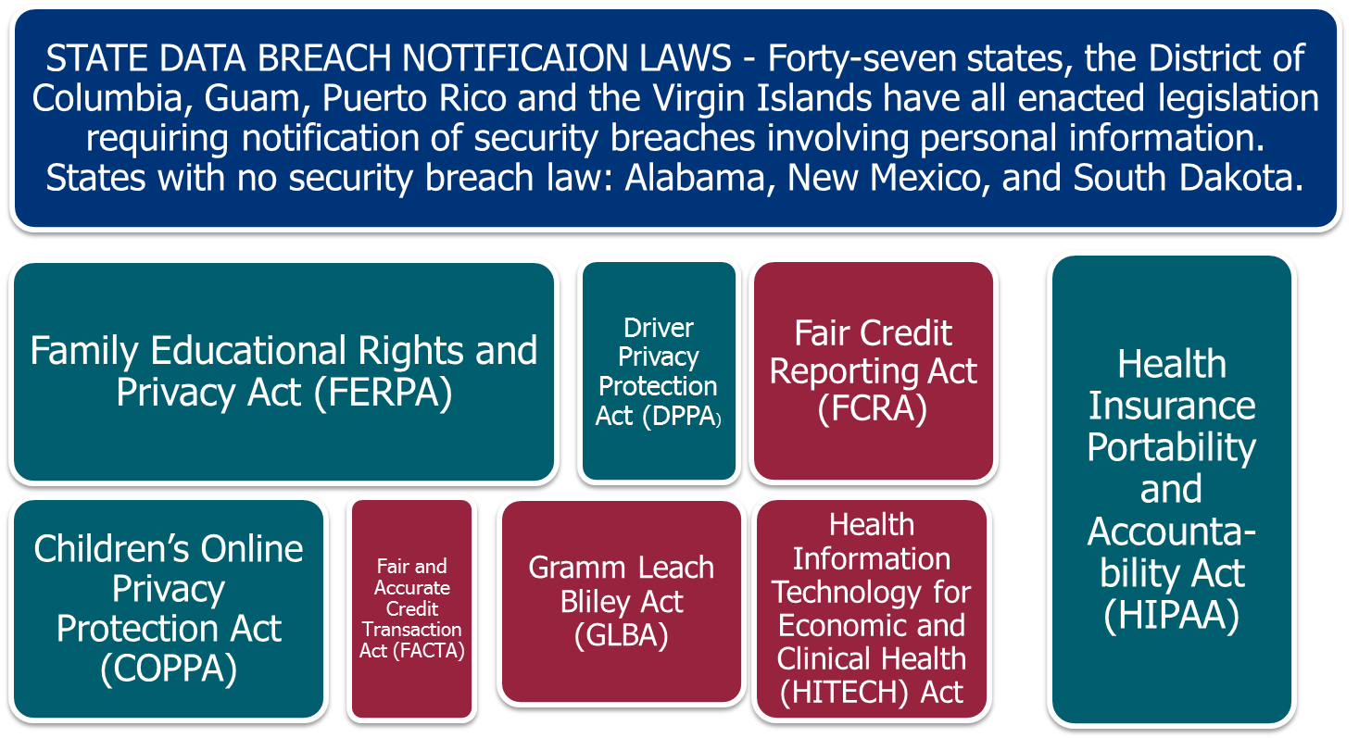

Slide 41
What are the Agencies saying….
  Privacy by Design
  Easy to Use Choice
  Transparency
  Training
  Documenting
  Risk Assessment
  Self-Auditing

Slide 42

Incident and Breach Response

Slide 43
Breach Response Plans
What to include?
  Contact information for your response team (HR, IT, C-suite, PR, legal counsel, Chief Privacy Officer)
  Define roles and responsibilities of each member of the response team
  Include insurance information and contact information
  “go to” forensics investigator that you have properly vetted
  Distinguish in plan between security events, incidents, and breaches….will everyone be contacted for each occurrence?
  Contact information for law enforcement
  How the investigation will be documented and who will be documenting it
  Any business partners to notify?
  Your state’s notification requirements (but note, if consumers residents of numerous states, those states’ notification laws will be applicable)

Slide 44
A Breach Occurred…Now What?
Look to the plan! Start the contact process
Get legal counsel involved asap
Record date/time of breach...record date/time of when response efforts initiated
Stop the bleeding—contain the breach
Secure premises where breach occurred to preserve evidence
Determine extent of information breached and those involved (where do they live?)
Insurance?, contact and put on notice
Contact law enforcement if necessary
Consider remediation tactics….credit monitoring services?
PR response?
Alert Data Breach Resolution Vendor?…can offer assistance with handling calls from those affected, issuing notification, and providing protection products for those involved

Slide 45
Notification
Involve legal counsel to ensure compliance
Multiple state laws may apply to one data breach due to where consumers reside
Strict timeline for reporting—no time to waste!
State specific content to include in notification letter
Notification usually may be delayed if law enforcement believes it would interfere with an ongoing investigation
Improper notification can lead to serious legal issues
Determine how you will handle notification before the breach to handle more efficiently if a breach occurs

Slide 46
Auditing Your Plan
Have you identified all of your breach response vendors?
    forensics, outside counsel, etc.
Does everyone know their roles?
Meet with IT security to analyze risks
    any recent security events, etc.
Review legal compliance requirements
    notification of consumers, law enforcement, AGs, etc.)
Does your plan need updates?
    Certain employees no longer with you that were part of breach response team?
Audit at least yearly (recommended to do more often)

Slide 47


Slide 48


Thank You!
Tim Lessman
Partner
312.894.3359
tlessman@salawus.com
Colin Gainer
Partner
312.894.3331
cgainer@salawus.com

