Slide 1
Employment Practices Liability, FCRA & Background Checks
RIMS – St. Louis, November 13th, 2013
Missouri Athletic Club

Slide 2
Table of Contents/Agenda
FCRA
  What is it and why is it important?
Background Checks
  Statistics
  EEOC focus
FCRA
  Background search requirements
Claims and Litigation
  FCRA Class Action Statistics
  Claim Example
Preventative Measures
Conclusion

Slide 3
FCRA
What Is It and Why Is It Important?
Fair Credit Reporting Act - United States Federal Law (15 USC § 1681) - along with the Fair Debt Collection Practices Act, regulate the aggregation, collection, and distribution of consumer credit data.

Slide 4
Background Checks
How many of you use criminal background checks as part of your hiring process?
  69% of employers conduct criminal background checks
  Internet searches
  Reference checking
  More in-depth use of Consumer Reporting Agencies (CRA)
    Equifax, Experian, etc.
    Creditworthiness
    Criminal records

Slide 5
FCRA Statistics
Tens of millions of criminal record checks annually
12 million ex-felons in the U.S.
700,000 individuals released from prison every year
Intensely scrutinizing criminal screening practices of employers

Slide 6
The “Green Factors”
Green v. Missouri Pacific Railroad, 523 F.2d 1290 (8th Cir. 1975)
  Plaintiff Green, a black man who had served a prison term for refusing military induction,1 was denied a job as a clerk with defendant, Missouri Pacific Railroad (Mo-Pac) because of Mo-Pac's policy of refusing employment to persons convicted of crimes other than traffic violations.
  The nature and gravity of the offense or conduct.
  The time that has passed since the offense, conduct, and/or completion of the sentence.
  The nature of the job held or sought.

Slide 7
Background Checks
Overarching Issue:
  The employer must prove that any criminal background is relevant to the position in question;
  Poses credible risk (day care, for example); and
  The risk posed is great enough to hire someone without such a criminal record.

Slide 8
FCRA and EEOC
Hot button issue for EEOC
EEOC’s Systemic Discrimination Program
EEOC’s Interest in pursuing class actions
  New Trend
  Claims of improperly conducted applicant/employee background checks that lead to disparate impact
April 25, 2012 – EEOC issued its Enforcement Guidance on the Consideration of Arrest and Conviction Records in Employment Decisions Under Title VII
  Issued on heels of $3.1M settlement of case involving 300 job applicants screened out due to criminal records
EEOC wants employers to consider:
  Nature and gravity of the offense
  The time that has passed since the offense
  Job-relatedness

Slide 9
Claims and Litigation
  If Employer Negligently Violates FCRA
  Actual Damages
  Attorneys Fees and Costs
If Employer Willfully Violates FCRA
  Actual Damages OR $100 to $1000 (no actual damages need be shown)
  Attorneys Fees and Costs
  Punitive Damages

Slide 10
Claims Scenarios
Employer screens 4,500 applicants per year
Two year Statute of Limitations = 9,000 class members
Minimum damages: $100 X 9,000 = $900,000
Maximum damages: $1,000 x. 9,000 = $9M
  Plus all attorneys’ fees and costs
  Possible punitive damages

Slide 11
Claims and Litigation
Multi-million dollar settlements ($5.9M and $2.6M)
Very expensive to defend
On the plaintiffs’ attorneys radar
Tailor-made for class actions
  Large class members
  2 year statute of limitations
  Employer likely uses the same procedure
  No cap on total liability

Slide 12
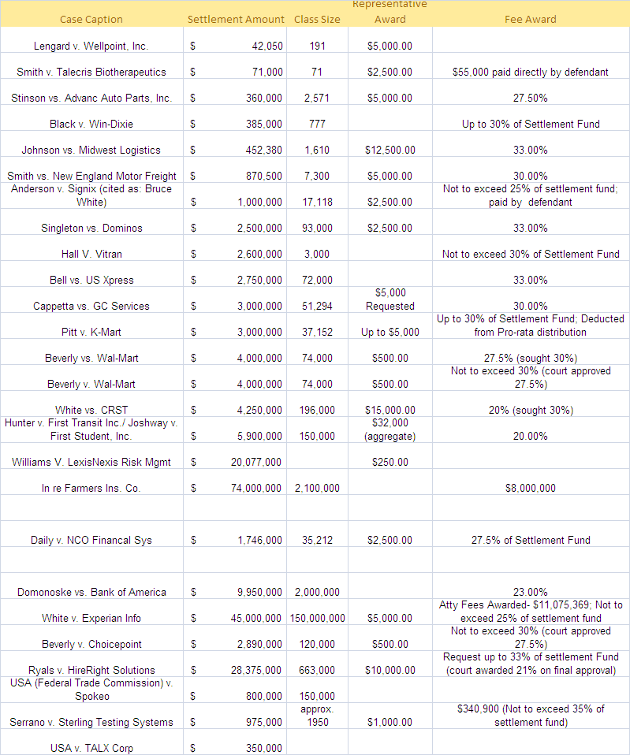
Claims and Litigation

Slide 13
Preventative Measures
Using Consumer Reporting Agency
  Must Comply with the FCRA
    Properly disclose intent to procure the consumer report
    Obtain express authorization
    Provide applicant/employee with pre-adverse action notice if employer plans to take an adverse action based on the report
    Must give a “reasonable” amount of time for applicant to respond
    Provide adverse action notice
  Requirements are very precise and detailed

Slide 14
Preventative Measures
Policy
  Company does not exclude people merely because of a conviction record.
  The employer will consider the facts and circumstances of the conviction and the relation to the particular job at issue.
  Advise applicants to fully disclose the information requested and provide sufficient detail for the employer to make a meaningful analysis. Failure to fully disclose or providing false information is grounds for disqualification or termination if disclosed after hire.
  Arrest records will not be considered, but that where the Company learns of misconduct leading to an arrest, the facts and circumstances of the arrest will be considered.

Slide 15
Preventative Measures
Communication and Certification
  You must have the applicants permission and signature authorizing the background check.
  The authorization that is signed must clearly spell out what the nature of the check may be
  A conviction is not an automatic bar to employment/advancement.
  Train all managers/supervisors on the relevant state, local and federal laws and the Company policy.
  If the Company believes that certain crimes warrant exclusion from employment, it should lawfully detail how such crimes are job-related and the business necessity for the exclusion.
    Each candidate must be assessed individually to determine if they have overcome the presumed exclusion from employment.
  If the employer excludes any candidate from employment based on a conviction record, the employer should maintain its notes and other evidence proving that it made an individual assessment.
  When screening candidates, it should limit inquiries about criminal records to only those crimes that are related to the job. Such limited inquiries reinforce the concept that other convictions are truly irrelevant.
  As with EPLI handbooks, regular certification should be required and documented.

Slide 16
Preventative Measures - PII
If you find out something that makes you decide to not hire the individual that is called an adverse action and you must inform the person of the adverse action by letter, supply them with a copy of the report and allow them to respond to the report.
Control of Data – PII, Background, or Other Sensitive Items
Control hardware and electronic media through the entire lifecycle, from initial receipt to final removal
  Disposal
  Re-use
  Accountability
  Data Backup and storage
Use technical safeguards to control and restrict access to EPHI to persons and software programs that are authorized to have such access
  Unique user IDs
  Password management
  Automatic log-off
  Log-in monitoring
  Encryption/Decryption
  Protection from malicious software

Slide 17
Preventative Measures - PII
What to do before a breach occurs:
  Establish a Breach Notification Policy
  Review and amend plan documents
  Review Business Associate Agreements
What to do after a breach occurs:
  Perform the “Harm Test”: financial, reputation, or other harm?
  Provide notice if necessary
  Document the steps taken to mitigate the harm
http://www.hhs.gov/ocr/privacy/hipaa/administrative/breachnotificationrule/postedbreaches.html

Slide 18
Conclusion
Liability
Face facts – truth or dare…
Cost of defense and settlement
  E-Discovery
  Economy is still sluggish; High unemployment
  More layoffs, furloughs, terminations
  Out of work longer = more damages
  Well seasoned plaintiff’s attorneys
  Reputational risk
Increase in multi-party claims and class actions
More aggressive and coordinated Plaintiffs’ counsel
More aggressive and greater funded enforcement agencies
Risk Transfer

Slide 19
Conclusion – The Key Points
Prior written authorization
Pre-adverse action notice
Adverse action notice
The employer must prove that any criminal background is relevant to the position in question;
Poses credible risk (day care, for example); and
The risk posed is great enough to hire someone without such a criminal record.

Slide 20

The data contained in this presentation is for general informational purposes only. The analysis of the data by the presenter is his own and does not necessarily represent the views of American International Group, Inc. or any other third party.
American International Group, Inc. (AIG) is a leading international insurance organization serving customers in more than 130 countries.. AIG companies serve commercial, institutional, and individual customers through one of the most extensive worldwide property-casualty networks of any insurer. In addition, AIG companies are leading providers of life insurance and retirement services in the
United States. AIG common stock is listed on the New York Stock Exchange and the Tokyo Stock Exchange.
Additional information about AIG can be found at www.aig.com | YouTube: www.youtube.com/aig | Twitter: @AIG_LatestNews | LinkedIn: http://www.linkedin.com/company/aig
AIG is the marketing name for the worldwide property-casualty, life and retirement, and general insurance operations of American International Group, Inc. For additional information, please visit our website at www.aig.com. All products and services are written or provided by subsidiaries or affiliates of American International Group, Inc. Products or services may not be available in all countries, and coverage is subject to actual policy language. Non-insurance products and services may be provided by independent third parties. Certain property-casualty coverages may be provided by a surplus lines insurer. Surplus lines insurers do not generally participate in state guaranty funds, and insureds are therefore not protected by such funds.

