Slide 1
EVOLUTION OF ADDITIONAL INSURED COVERAGE
NEW ISO CHANGES, COURT CASES, AND PRACTICAL IMPLICATIONS
October 27, 2014
Presented by:
Karen A. Reutter, CPCU, ARM
Marsh USA, Inc.
Patrick J. Wielinski
Cokinos Bosien & Young

Slide 2
Agenda
Contractual risk transfer (CRT)
Evolution of ISO additional insured endorsements
2013 ISO changes
Review national case law changes affecting AI coverage
Implications for CRT
Notes:
1

Slide 3
Contractual Risk Transfer (CRT)
Cornerstone of managing risk
Upstream and downstream risk sharing
Keys to transferring risk
  Should be in the hands of the party most able to manage the risk
  Should be identifiable
  Should be equitable
Indemnification and hold harmless agreements
Separate from insurance requirements

Slide 4
Contractual Risk Transfer (CRT)
Indemnification language
  Broad
  Intermediate
  Limited
Indemnification language is supported by the ISO general liability form for claims arising out of negligence, within the contractual liability coverage grant
  However, the coverage (dollars) are limited to damages that include defense within limit
    Give back in the contractual liability exclusion; there is coverage for “insured contracts”
    Legal/defense expenses incurred for a party other than the insured are deemed to be damages
    “Damages” are limited to limits of insurance on the declarations page

Slide 5
Contractual Risk Transfer (CRT)
Belt and suspenders approach to transferring risk
Most contracts require contractual indemnification and insurance for liabilities assumed in a contract: belt
Most contracts require that the indemnitor also provide the indemnitee with additional insured status on the indemnitor’s insurance policies: suspenders
  For our purposes, we are focusing on the general liability policy
Keep in mind that indemnification language and additional status/insurance requirements are usually and should be kept separate in the contract

Slide 6
Additional Insured Status
Additional insured status provides financial backing to defense and indemnity obligations, also provides independent rights for the indemnitee to the indemnitor’s insurance coverage
As additional insured, the indemnitee …
  Can make a claim directly against the insurance policy
  Usually has the same coverage afforded to him/her as the policy holder
  Does not incur a deductible, if one exists; the first named insured is responsible for the deductible
  Has coverage for defense and indemnity payments
Two other concepts to address before we go further …

Slide 7
Additional Insured Status
Additional named insured (versus additional insured)
  Gets confused with additional insured
  Problem with this is that the additional named insured on a policy becomes a “you” under the policy definitions (“your” employees, etc., may also be covered)
    BUT
      “You” now have duties to the insurer, and
      “Your” work/product exclusions could become applicable
Owners and contractors protective (OCP) policy
  Separate policy
  Indemnitee has its own policy with its own limits
  Liability arising out of the “general supervision” of the indemnitor
  No completed operations

Slide 8
Additional Insured Status
Evolution of ISO Additional Insured forms
Construction focused forms
  CG 2010 (11 85 ed.)
  CG 2010 (10 01 ed.) PLUS CG 2037 (10 01 ed.)
  CG 2010 (07 04 ed.) PLUS CG 2037 (07 04 ed.)
  CG 2010 (04 13 ed.) PLUS CG 2037 (04 13 ed.)
Why changes?
  Legal trends
  Social trends
  Commercial trends

Slide 9
Additional Insured Status
Changes over time
  Ongoing operations versus completed operations
  Sole negligence
  Tied to contract
    Dollar amount
    Coverage
  Legality in state
  Manuscripted endorsements

Slide 10
2013 ISO Changes
Broad Coverage Endorsements
Form # | Form Name | Includes Completed Operations | Includes Sole Negligence | Written, Oral Contracts | Primary & Non-contributory Coverage
CG 2010 (11-85) | Additional Insured: Owners, Lessees, or Contractors | Yes, by using words “your work” | Yes, by court interpretation of the use of “arising out of “ | Silent | Coverage is not specifically stated on the endorsement. It will have to be requested.
CG 2026 | Additional Insured: Designated Person or Organization | Yes | Yes, by court interpretation of the use of “arising out of” | Silent | Coverage is not specifically stated on the endorsement. It will have to be requested.

Slide 11
2013 ISO Changes
Intermediate Coverage Endorsements
Form # | Form Name | Includes Completed Operations | Includes Sole Negligence | Written, Oral Contracts | Primary and Noncontributory Coverage
CG 2010 (10 93) | Additional Insured: Owners, Lessees, or Contractors | No, by using words “ongoing operations” | Yes, by court interpretation of the use of “arising out of“ | Silent | Coverage is not specifically stated on the endorsement. It will have to be requested.
CG 2010 (03 97) CG 2010 (10 01) | Additional Insured: Owners, Lessees or Contractors — Scheduled Person or Organization | No, by using words “ongoing operations” | Yes, by court interpretation of the use of “arising out of” | Silent | Coverage is not specifically stated on the endorsement. It will have to be requested.
CG 2033 (03 97) CG 2033 (07 98) CG 2033 (10 01) | Additional Insured: Owners, Lessees or Contractors — Automatic Status When Required in a Construction Contract | No, by using words “ongoing operations” | Yes, by court interpretation of the use of “arising out of” | Silent | Coverage is not specifically stated on the endorsement. It will have to be requested.
CG 2037 (10 01) | Additional Insured: Owners, Lessees or Contractors — Completed Operations | Yes | Yes | Silent | Coverage is not specifically stated on the endorsement. It will have to be requested.

Slide 12
2013 ISO Changes
Limited Coverage Endorsements
Form # | Form Name | Includes Completed Operations | Includes Sole Negligence | Written, Oral Contracts | Primary and Noncontributory Coverage
CG 2010 (07 04) | Additional Insured: Owners, Lessees or Contractors — Scheduled Person or Organization | No, by using words, “ongoing operations” | No, coverage amended to exclude sole negligence of additional insured by using “caused, in whole or in part, by” | Silent | Coverage is not specifically stated on the endorsement. It will have to be requested.
CG 2033 (07 04) | Additional Insured: Owners, Lessees or Contractors — Automatic Status When Required in a Construction Contract | No, by using words, “ongoing operations” | No, coverage amended to exclude sole negligence of additional insured by using “caused in whole or in part, by” | Silent | Coverage is not specifically stated on the endorsement. It will have to be requested.
CG 2026 (07 04) | Additional Insured — Designated Person or Organization | No, by using words, “ongoing operations” | No, coverage amended to exclude sole negligence of additional insured by using “caused, in whole or in part, by” | Silent Silent | Coverage is not specifically stated on the endorsement. It will have to be requested.
CG 2037 (07 04) | Additional Insured: Owners, Lessees or Contractors — Completed Operations | Yes | No, coverage amended to exclude sole negligence of additional insured by using “caused, in whole or in part, by." It does include coverage for shared responsibility. | Silent | Coverage is not specifically stated on the endorsement. It will have to be requested.
CG 2010 (04 13) | Additional Insured: Owners, Lessees or Contractors — Scheduled Person or Organization | No, by using words, “ongoing operations” | No, coverage amended to exclude sole negligence of additional insured by using “caused, in whole or in part, by” | States that the insurance afforded to such additional insured only applies to the extent permitted by law. If coverage provided to the additional insured is required by a contract or agreement, the insurance afforded to such additional insured will not be broader than that which you are required by the contract or agreement to provide for such additional insured. | Coverage is not specifically stated on the endorsement. It will have to be requested.

Slide 13
2013 ISO Changes
Limited Coverage Endorsements (continued)
Form # | Form Name | Includes Completed Operations | Includes Sole Negligence | Written, Oral Contracts | Primary and Noncontributory Coverage
CG 2033 (04 13) | Additional Insured — Owners, Lessees or Contractors — Automatic Status When Required in Construction Agreement with You | No, by using words, “ongoing operations” | No, coverage amended to exclude sole negligence of additional insured by using “caused in whole or in part, by” | Silent | Coverage is not specifically stated on the endorsement. It will have to be requested.
CG 2026 (04 13) | Additional Insured — Designated Person or Organization | No, by using words, “ongoing operations” | No, coverage amended to exclude sole negligence of additional insured by using “caused, in whole or in part, by” | Silent | Coverage is not specifically stated on the endorsement. It will have to be requested.
CG 2037 (04 13) | Additional Insured — Owners, Lessees or Contractors — Completed Operations | Yes | No, coverage amended to exclude sole negligence of additional insured by using “caused, in whole or in part, by." It does include coverage for shared responsibility. | States that the insurance afforded to such additional insured only applies to the extent permitted by law. If coverage provided to the additional insured is required by a contract or agreement, the insurance afforded to such additional insured will not be broader than that which you are required by the contract or agreement to provide for such additional insured. | Coverage is not specifically stated on the endorsement. It will have to be requested.

Slide 14
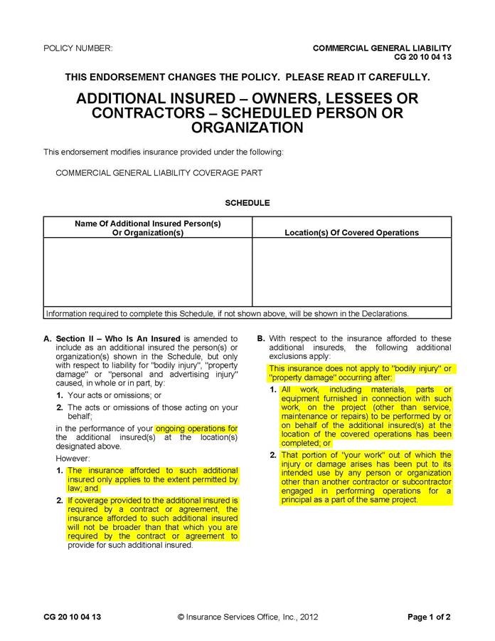
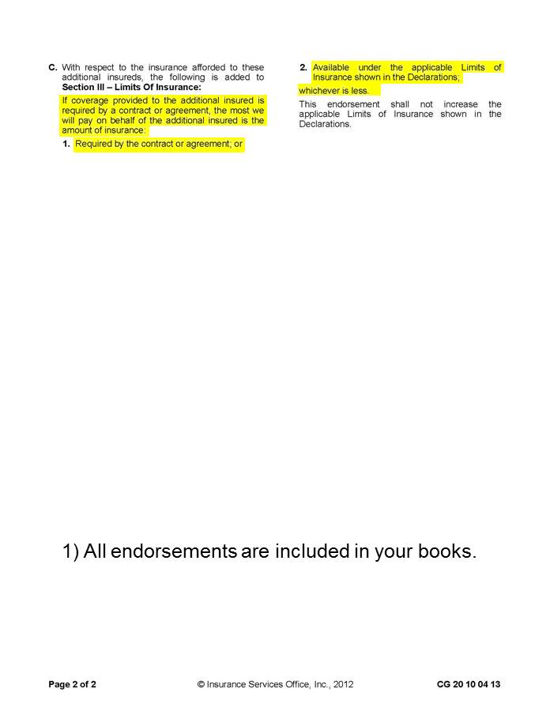

Slide 15
2013 ISO Changes
Key changes in 2013
  AI endorsement is tied to contract
    Legality in state
    Amount available to indemnitee
    Insurance coverage
  Other changes

Slide 16
Implications for CRT
Understand the state/legal environment you’re working in.
Develop philosophy regarding CRT; risk management philosophies change over time.
Ensure your subcontractors have appropriate limits; push back will be that they can’t buy additional limit, cost prohibitive, etc.
Develop contract language to address the “coverage” issue:
  Example: “Insurance required by this contract and supported by the additional insured endorsement shall be as broad as necessary to support the indemnification requirement in said contract or as broad as the subcontractor’s insurance coverage, whichever is broader.”
  Not recommended: Outlining in the contract specific coverage. The contract should not become a surrogate for the actual insurance policy.

Slide 17
Contract Language
Contract reviews
  Old language — red flags
  ISO changes
  Unsophisticated lenders, unusual lenders
  Don’t assume just because you are reviewing a contract developed by a lawyer that the insurance requirements are appropriate
    Lawyers understand law, not necessarily insurance
    Insurance policies and endorsements change frequently
Red flags (e.g., BFPD, “Comprehensive GL”)

Slide 18
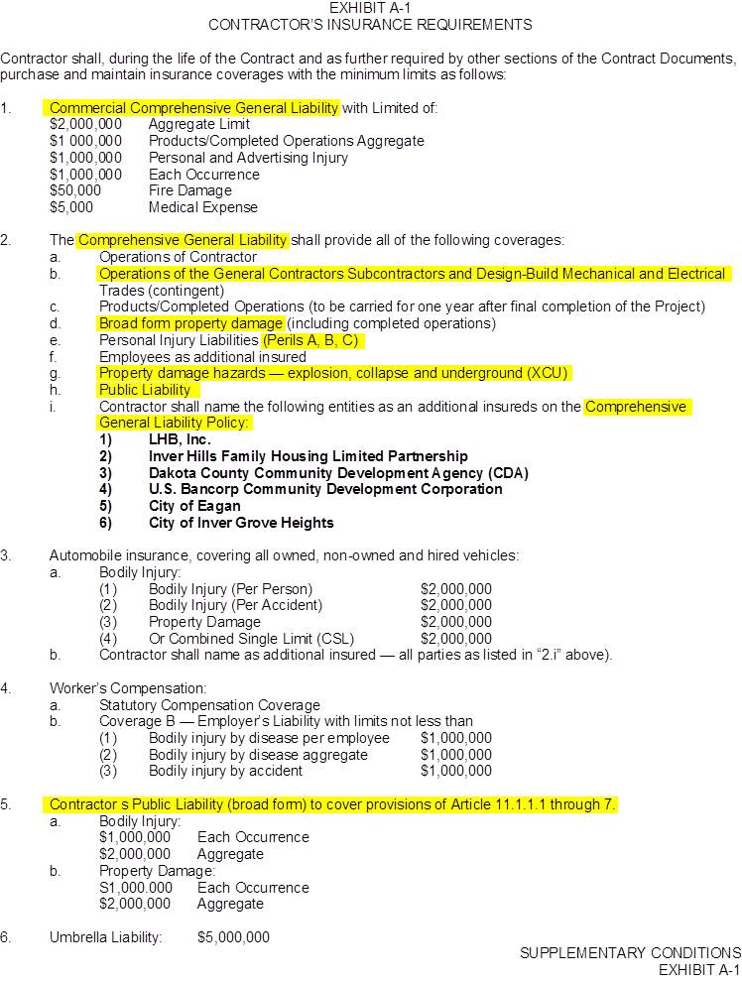

Slide 19
The Evolution of Additional Insured Coverage
Theory and Practice
Belt (Contractual Liability) should be considered in context with suspenders (AI)
  Don’t forget the key: defense
Practical realities that influence how these endorsements and policies work
  Case law
  Statutes
  “Patchwork of Coverage”
    Swiss cheese

Slide 20
Theory Review
Both 2004 ISO and 2013 ISO AI endorsements extend coverage for AI’s partial (but not sole) negligence.
  But the 2013 endorsement adds two conditions:
    Insurance afforded only applies to the extent permitted by law.
    If AI coverage required by agreement, coverage will not be broader than that required by contract.

Slide 21
Theory Review
Recognition of changing state laws affecting indemnity and insurance agreements.
  A. ISO thinks those changing laws should affect AI coverage — but how?
  Figure out interplay between endorsement, 50 state laws, and unique contract requirements.
.

Slide 22
What Do These 2013 Conditions Mean?
What does it mean to determine scope of coverage by existing law?
  There are certain statutes that restrict what type of insurance contracts or coverage that can be provided.
  But some argue the grant of insurance coverage is the functional equivalent of indemnity.
    Do the anti-indemnity statutes prohibit AI coverage covering the fault of the additional insured?
    Some anti-indemnity statutes prohibit not just indemnity but also defense if caused by promisee’s negligence.
      Does that prohibition now apply to AI coverage?
    The extent, if any, that anti-indemnity laws are intended to influence AI coverage is not clear.

Slide 23
Belt and Suspenders
To Understand How the 2013 ISO Endorsement Might Work, We Should …
  Understand how it will interplay with contractual liability coverage, and
  How it may affect duty to defend
Will Need a 50-State Knowledge of …
  State common law
  Anti-indemnity statutes
  Specific statutes limiting or allowing insurance contracts
  Statutes affecting the duty to defend
  See handout - 50-state

Slide 24
Analytical Framework
AI
2013 Additional Insured Endorsement
Does State Allow
Coverage of AI’s Negligence
or Only Insured’s?
If Allowed,
Look to Other Contractual
Conditions
CL
Contractual Liability Coverage
Scope of
Insured Contract of Indemnity
Is Indemnification of
Promisee’s Negligence Allowed?
If Not, Is Illegal Indemnity “Saved” by an Allowable Promise To Procure Insurance?
Split in Jurisdictions

Slide 25
States with No Statutes
8 States with No Statutory Restriction on AI or Construction Indemnities
  Alabama, Maine, Nevada, North Dakota, Pennsylvania, Vermont, Wisconsin, Wyoming
  Often Strict Construction (e.g., Nevada)
    1. Intent must be “expressed in clear and unequivocal terms”
Laws Do Not Effect AI Coverage
  Scope of Coverage under 2013 Endorsement Should be Comparable to 2004
Contractual Liability Coverage: Broad Form Indemnity for Promisee’s Sole and Partial Negligence Allowed
  A. Should Be Covered under Contractual Liability Coverage

Slide 26
Sole Negligence Prohibitions
15 States Prohibit Indemnity for Indemnitee’s Sole Negligence
  Alaska, Arizona (priv. projects), Arkansas, Georgia, Hawaii, Idaho, Indiana, Maryland, Michigan, New Jersey, South Carolina, South Dakota, Tennessee, Virginia, West Virginia
Of Those 15 States
  One expressly allows AI without reference to indemnity: Arkansas
  One prohibits insurance covering sole negligence of another: Georgia
  Of Those 15 States
    A. Six say indemnity law doesn’t affect validity of insurance contract, presumably CL and AI coverage: Alaska, Maryland, New Jersey, South Carolina, Virginia, West Virginia

Slide 27
Broad and Intermediate Prohibitions
I. 28 States Prohibit Indemnity for Sole or Partial Negligence of the Promisor
  Arizona (public), California, Colorado, Connecticut, Delaware, Florida, Illinois, Iowa, Kansas, Kentucky, Louisiana (prime on public projects), Massachusetts, Minnesota, Mississippi, Missouri, Montana, Nebraska, N. Hampshire, New Mexico, New York, N. Carolina, Ohio, Oklahoma, Oregon, Rhode Island, Texas, Utah, Washington
II. 18 Have Insurance “Savings” Legislation Allowing Certain Insurance Contracts Despite Finding Broad or Intermediate Indemnity Illegal
  A. Arizona, Arkansas, Connecticut, Delaware, Illinois, Kansas, Kentucky, Minnesota, Mississippi, Missouri, Montana, Nebraska, New Mexico, New York, N. Carolina, Oklahoma, Rhode Island, Texas

Slide 28
Broad and Intermediate Prohibitions
III. 9 Have Express Restrictions on Ability To Provide AI Coverage
  California, Colorado, Kansas, Michigan, Minnesota, New Mexico, Oklahoma, Oregon, Texas
IV. 2 Have Express Restrictions on CL Coverage:
  A. Mississippi, North Carolina

Slide 29
Texas Anti-Indemnity Statute: Texas Insurance Code Chapter 151
Unique Approach To Handle Recurring Litigation (eff. As to contracts entered into after January 1, 2012)
Tacked on to CCIP legislation
No history yet.

Slide 30
Texas Anti-Indemnity and AI Legislation – Chapter 151
A contract, subcontract, or agreement, or a performance bond assuring the performance of any of the foregoing, entered into or made by an owner, architect, engineer, contractor, construction manager, subcontractor, supplier, or material or equipment lessor for the design, construction, alteration, renovation, remodeling, repair, or maintenance of, or for the furnishing of material or equipment for, a building, structure, appurtenance, or other improvement to or on public or private real property, including moving, demolition, and excavation connected with the real property. The term includes an agreement to which an architect, engineer, or contractor and an owner's lender are parties regarding an assignment of the construction contract or other modifications thereto.

Slide 31
Types of contracts:
Contracts for public or private construction
Demolition and excavation contracts
Design contracts
Performance bonds
Assignment agreements with owner’s lender

Slide 32
Basic Prohibition: §151.102
A provision in a construction contract is void to the extent it requires the indemnitor to indemnify, hold harmless or defend the indemnitee against a claim caused by the negligence or fault, breach of statute, breach of contract, etc. of the indemnitee.

Slide 33
“To the Extent”
“To the extent” implies that the indemnity clause is void and unenforceable only to the extent of the indemnitee’s own negligence or fault.
May be possible to obtain indemnity at least to the extent of the indemnitor’s own negligence under that same clause.

Slide 34
Employee Exception §151.103
Section 151.102 does not apply to a provision in a construction contract that requires a person to indemnify, hold harmless, or defend another party to the construction contract or a third party against a claim for the bodily injury or death of an employee of the indemnitor, its agent, or its subcontractor of any tier.

Slide 35
Scope of Indemnity Permitted – Third Party Over Actions
An indemnitee can be indemnified for liability arising out of the bodily injury or death of an employee of the indemnitor or its subcontractor as alleged in a third party over action.
Broad form indemnity is allowed as to sole negligence or fault of the indemnitee in causing the injury.

Slide 36
Additional Insured Prohibition– §151.104
A provision in the construction contract that requires the purchase of additional insured coverage, or any coverage endorsement, or provision within an insurance policy providing additional insured coverage, is void and unenforceable to the extent that it requires or provides coverage the scope of which is prohibited under this Chapter 151 for an agreement to indemnify, hold harmless, or defend.

Slide 37
Additional Insured Coverage –General Prohibition
Additional insured coverage is allowed only to the extent of the named insured’s negligence or fault and corresponds to comparative or limited form indemnity.
More restrictive than current standard form additional insured endorsements.

Slide 38
Additional Insured Exception:
Employee Injuries
Incorporates the exception in 151.103 for injuries to named insured’s (indemnitor’s) employees or subcontractors
Additional insured coverage is permitted for the additional insured’s (indemnitee’s) own negligence or fault as to bodily injury alleged by the employees of the named insured or its subcontractors in a third party over action.

Slide 39
Exceptions
    A. Consolidated insurance programs (CIPs)
    B. Breach of warranty
    C. Loan agreement indemnities
    Single family homes and duplexes
    Surety general indemnity agreements
    Public works contracts with municipalities
    Joint defense agreements after claim is made

Slide 40
Other Notable Statutes Affecting AI (or CL) Coverage
I. Colorado: Agreements to indemnify, insure, or defend another for that other’s negligence are void.
  Doesn’t prohibit AI or CL for promisor’s negligence.
  Provisions requiring AI for fault of others beyond promisor’s are void.
II. Kansas: Broad and intermediate indemnity is void.
  Provision requiring AI coverage for AI’s negligence void.
  Exception: indemnity supported by insurance to the extent of coverage.
  III. Montana: Agreements to indemnify, insure, or defend the other party for that party’s negligence are void.
  Indemnity covering negligence of third party and indemnitor valid.
  Doesn’t affect insurer’s obligation to its insured!

Slide 41
Other Notable Statutes Affecting AI (or CL) Coverage
IV. New Mexico: Agreements to indemnify, insure, or defend the other party for that party’s negligence are void
  Can indemnify and insure indemnitee for indemnitor’s negligence.
  Allows CIPs and builders risk.
V. Oklahoma: Provisions requiring entity, its insurer, or surety to indemnify, insure, or defend another entity for the other entity’s negligence are void.
  Insurance or bond will not cover more than negligence of indemnitor.
  Allows CIPs, OCP, and builders risk.
VI. Oregon: Provision requiring a person or that person’s surety or insurer to indemnify another for indemnitee’s negligence is void.
  A. Surety or insurance covering negligence of indemnitor is valid.

Slide 42
Summary
Consider rolling liability CIP
  Project-specific AI coverage in certain states
  Clarify that defense and indemnity separate obligations
    States where defense not limited to extent of indemnitor’s fault
  III. Clarify in contract’s insurance specification that AI coverage is not an indemnity but a separate contract to provide insurance
  IV. Consider choice of law
    Obtain better policy interpretation
    Better indemnity and insurance for the indemnity
  V. Consider using a different AI endorsement

Slide 43
QUESTION AND ANSWER SESSION

Slide 44
Marsh is part of the family of Marsh & McLennan Companies, including Guy Carpenter, Mercer, and the Oliver Wyman Group (including Lippincott and NERA Economic Consulting)
This document and any recommendations, analysis, or advice provided by Marsh (collectively, the “Marsh Analysis”) are intended solely for the entity identified as the recipient herein (“you”). This document contains proprietary, confidential information of Marsh and may not be shared with any third party, including other insurance producers, without Marsh’s prior written consent. Any statements concerning actuarial, tax, accounting, or legal matters are based solely on our experience as insurance brokers and risk consultants and are not to be relied upon as actuarial, accounting, tax, or legal advice, for which you should consult your own professional advisors. Any modeling, analytics, or projections are subject to inherent uncertainty, and the Marsh Analysis could be materially affected if any underlying assumptions, conditions, information, or factors are inaccurate or incomplete or should change. The information contained herein is based on sources we believe reliable, but we make no representation or warranty as to its accuracy. Except as may be set forth in an agreement between you and Marsh, Marsh shall have no obligation to update the Marsh Analysis and shall have no liability to you or any other party with regard to the Marsh Analysis or to any services provided by a third party to you or Marsh. Marsh makes no representation or warranty concerning the application of policy wordings or the financial condition or solvency of insurers or reinsurers. Marsh makes no assurances regarding the availability, cost, or terms of insurance coverage.
Copyright ©2014 Marsh Inc. All rights reserved.

