Slide 1
RIMS DELAWARE VALLEY CHAPTER
Anderson Kill
December 9, 2014
8:30 am – 9:30 am
Everything a Risk Manager Needs to Know about D&O Liability Insurance

Slide 2
Disclaimer
The views expressed by the participants in this program are not those of the participants’ employers, their clients, or any other organization. The opinions expressed do not constitute legal advice, or risk management advice. The views discussed are for educational purposes only, and provided only for use during this session.

Slide 3
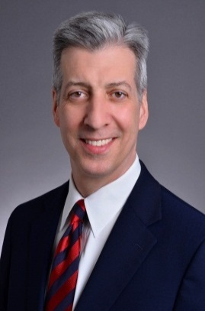
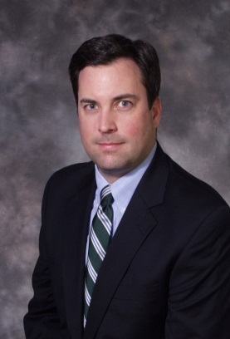
Your Speakers
William G. Passannante, Esq.
wpassannante@andersonkill.com
(212) 278-1328
Darin J. McMullen, Esq.
dmcmullen@andersonkill.com
(267) 216-2708

Slide 4
OVERVIEW
How Do D&O Liability and Insurance Meet?
D&O Liability Insurance Top 10 Major Issues

Slide 5
Claim Against Directors and Officers
Entity Claim?
Corporate Indemnification?
Side “C”
No
“Side A”
Yes
“Side B”
Insured -
Corporate Entity in SEC Claims, other claims?
Individual
D&O’s
Balance Sheet
Personal Assets
Corporate Protection
Corporate Protection
Individual D&Os
Corporate Reimbursement
“Side C”:
Corporate Entity Coverage?

Slide 6
D&O Insurance is the Last Line of Defense
State Statutory Protection
(e.g. Del. Code §145)
Corporate By-laws
Individual Indemnification Agreements
D&O Insurance
First line of defense
Last line of defense

Slide 7
II. Nature of the D&O Liability Exposure
“Wrongful Act”
  Typical Types of Wrongful Acts
  High Dollar Amount Claims
  Other Claims
Insurance Claims
  Pro-active steps
  “cooperation clause”
  “consent to settle”

Slide 8
Business Judgment Rule
A business decision – inaction must be conscious
Disinterested – not self-dealing (contrast with benefit to corporations as whole).
Reasonable Due Care to inform themselves
No abuse of discretion – no rational basis, not protected.
Lack of Good Faith eliminates BJR protection

Slide 9
Avoid D&O Claims
  Respect Duties
    Duty of Obedience
    Duty of Loyalty
    Duty of Diligence
    Duty of Candor
  Select Outside Directors with Independence
  Regular Board Meetings & Preparation
    Minutes of Deliberations
  Avoid Conflicts in Decision Making Process

Slide 10
By-Laws and Indemnification Agreements
Most companies want to provide the broadest protection possible to their directors and officers.
Many by-laws, however, have not been reviewed or updated and do not provide the most protection possible.
Directors and officers might request:
  Mandatory indemnification and advancement of defense costs.
  A contractual right to indemnification.
  Strong protection for indemnification when it is not mandated by statute.
Indemnification no help if company goes bankrupt or prohibited by law.

Slide 11

2013-14 ⎯ D&O Liability Insurance
Top 10 Major Issues
Notes:
Welcome
Significant Problems
Economist- not a lot to learn; a lot to say.

Slide 12

10. Cyber Liability
Current Cyber forms not comprehensive
Cloud Computing, Social Media, BYOD, Sophisticated Hacking Incidents.
Coverage under Fidelity, Fiduciary, D&O, E&O and GL? Amendments?
Enterprise Risk Management
Notes:
Banks- Session Hijacking
Pos Retail- Eastern Europe Card Swipe
Nature of Claim

Slide 13
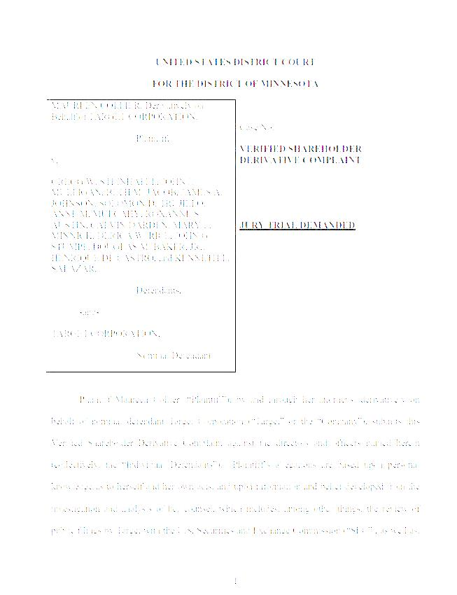
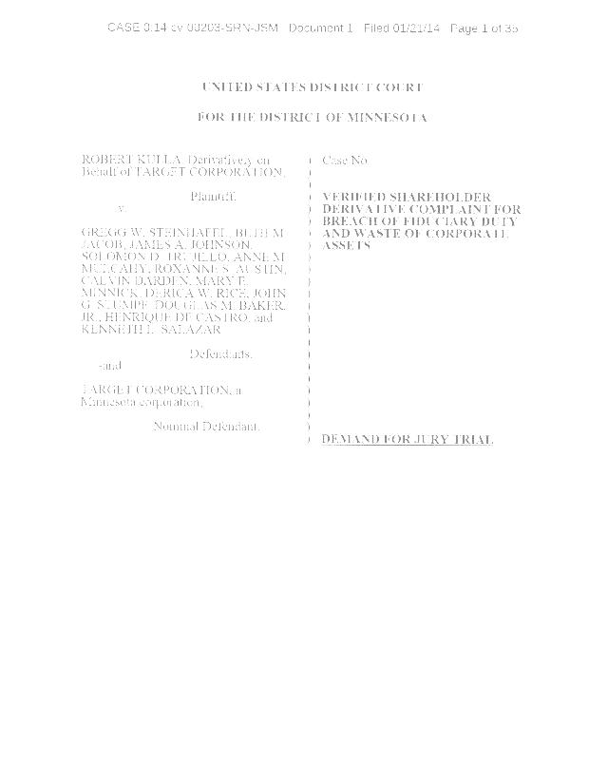

10. Cyber Liability - Target
Two derivative Complaints filed alleged importance of security of private customer information and the risks to the company of data breach.
Assert company failed to take reasonable steps to protect "customers’ personal and financial information” and failed to implement systems "to detect and prevent” a data breach.
Allege that damage was aggravated by "failing to provide prompt and adequate notice" and by "releasing numerous statements meant to create a false sense of security to affected customers.”
Investigation by the United States Secret Service and the Department of Justice, and class actions
Hundreds of millions of dollars of damages alleged.

Slide 14
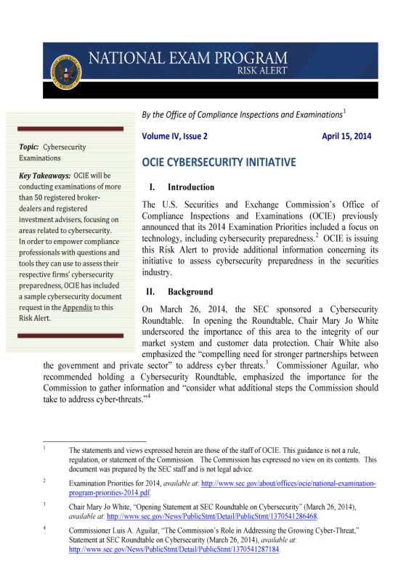
SEC- Office of Compliance Inspections and Examinations (OCIE)
Cybersecurity Initiative 2014
Examinations of more than 50 registered broker-dealers and investment advisors.
Focus on:
  cyber security risks and governance
  Protection of Networks and information
  Remote customers access and fund transfers
  Vendors and third parties
  Detection of unauthorized activity.
  Available at: http://www.sec.gov/ocie/announcement/Cybersecurity+Risk+Alert++%2526+Appendix+-+4.15.14.pdf
Notes:
More governmental regulation
Broker Dealers
SEC-OCIE one of many gov’t and
industry groups.

Slide 15

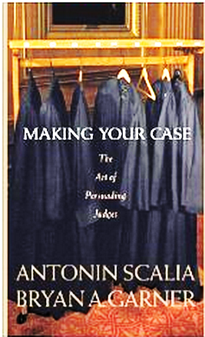
9. Brokers and Consultants - Fix These Continuing Problems - Originalism
Arbitration
Continuity at Renewal
Exhaustion
    “Bodily Injury” Exclusion
Fraud Exclusion
Notes:
Scalia- Making Your Case
Language of Constitution/Contracts/Insurance Policies
Intent . What it means not what it says.
Fix a u/w time.

Slide 16
Possible Gradient in Fraud Exclusion
9. Brokers and Consultants – Con’t.
Final adjudication of fraud in the underlying proceeding
Final,
non-appealable adjudication in the underlying proceeding
Final,
non-appealable adjudication in the underlying proceeding, applicable only to officers
Final adjudication of fraud
“In fact” or worse wording
Admission of guilt
No exclusion
Worst
Best

Slide 17
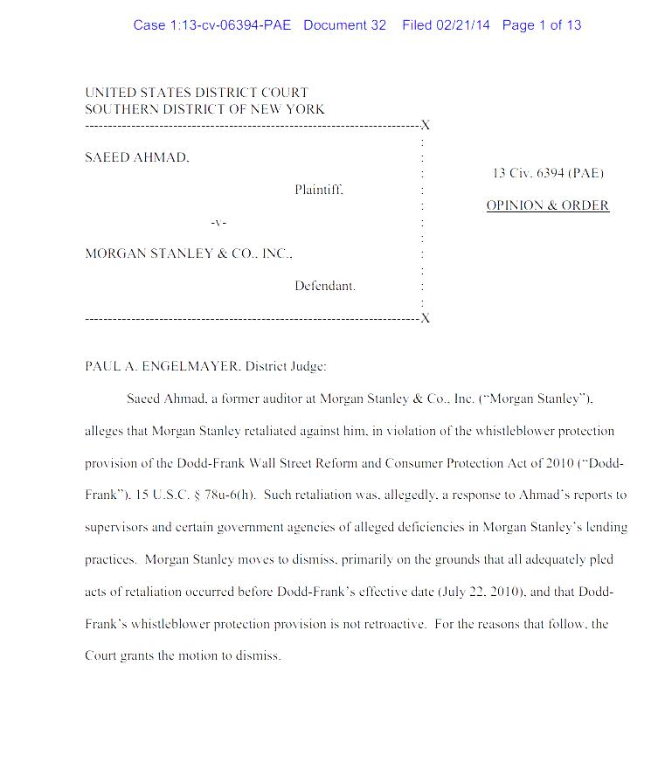
8. Dodd-Frank Whistleblower Protections Not Retroactive
  Alleged retaliation by employer
  Asserted deficiencies in lending practices
  Court found that insufficient allegation that retaliatory act took place after Dodd-Frank July 22, 2010 effective date.
  Case dismissed by United States District Judge Paul A. Engelmayer.
Saeed Ahmad v. Morgan Stanley & Co., Inc. No. 13 Civ. 6394 (PAE) (SDNY)(February 21, 2014).
Notes:
2010
Good news for defendant’s not unexpected.

Slide 18
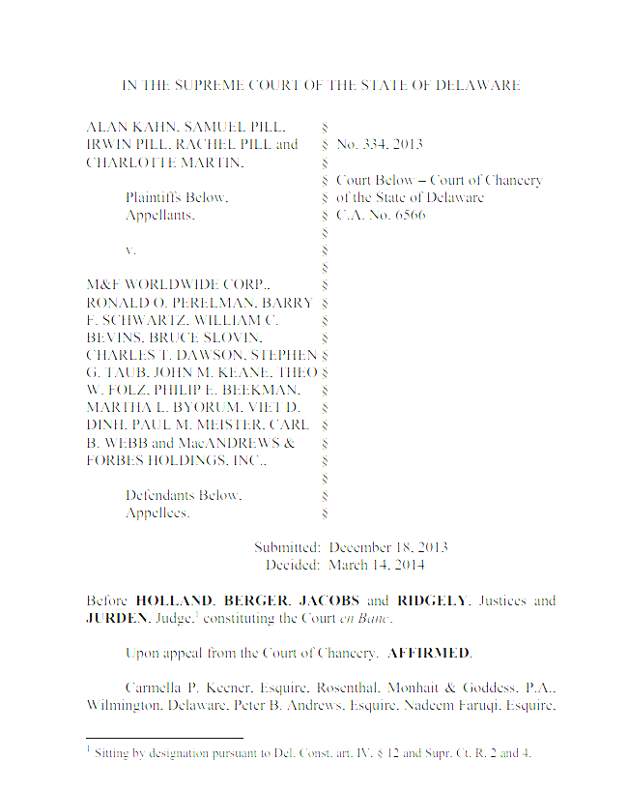
7. Business Judgment Rule – Not Entire Fairness – Going Private Transactions
The business judgment rule rather than the fact-intensive “entire fairness” standard applies to certain “going private” mergers involving controlling shareholders.
BJR applies if (1) an independent and well-functioning special committee, with its own advisors has the power to say “No” to the transaction; and (2) a majority of the minority stockholders; both approve the transaction.
Despite the work of the Special Committee and the approval of the minority shareholders, plaintiffs sued alleging the merger was unfair and that the MFW Board and the Special Committee members had breached their fiduciary duties.
Summary judgment granted; Affirmed by Delaware Supreme Court.
Kahn v. M&F Worldwide, C.A. No 65661 *(Del. Sup. Ct. March 14, 2014).
Notes:
“Business Judgment Rule” = dismissal possible
“Entire Fairness” = not dismissed; not SJ?
Standard is key
Enhanced protection for D&O’s

Slide 19
6. Change In SEC Settlement Policy
June 18, 2013, SEC Chair Mary Jo White announced that the agency would in certain cases require admissions as a condition of settlement.
(Eaglesham & Ackerman, SEC Seeks Admissions of Fault, Wall Street Journal (June 18, 2013)(online.wsj.com).
Neither-admit-nor-deny settlements would remain standard practice, but admissions would be required in “certain cases where heightened accountability or acceptance of responsibility through the defendant’s admission of misconduct may be appropriate, even if it does not allow us to achieve a prompt resolution.”
(Orzeck, SEC To Seek More Admissions Of Guilt In Settlements, Law 360 (June 18, 2013)(law360.com)
Admissions might be required in cases of “egregious intentional misconduct,” in which defendant obstructed the investigation, or where the conduct “harmed large numbers of investors.”
(ElBoghdady, SEC to Require Admissions of Guilt in Some Settlements, Washington Post (June 18, 2013)(washingtonpost.com).
Notes:
Admissions now may be required.
Egregious intentional misconduct.
Large number of investors harmed.

Slide 20

5. Recoupment – Permissive/Mandatory
Individual insureds D&O liability policy -- defense had been “successful on the merits or otherwise,” corporate indemnification was beyond being second-guessed by the D&O liability insurance company.
Order Affirming Commissioner’s Report and Recommendation, HLTH Corporation v. New Hampshire Ins. Co., C.A. No. 07C-09-102 RRC (July 23, 2013).
Inquiry determination of whether the advancement of defense costs would be “permissive indemnification” as opposed to “mandatory indemnification” under indemnification statutes.
Notes:
Ins. Co. argued that successful defense in criminal case was improperly “advanced” by corporation.
Court found that since D&O’s were “Successful on merits or otherwise” in their defense— mandatory indemnification.
Terminology.

Slide 21

5. Recoupment – Permissive/Mandatory
“Any result other than conviction must be considered success in a criminal action.” Merritt-Chapman & Scott Corp. v. Wolfson, 321 A.2d 138, 141 (Del. Super. 1974).
“successful on the merits or otherwise” permits indemnification if a defendant is successful on a “technical” defense even if that does not involve the defendant being adjudged “innocent.” See, e.g., Perconti v. Thornton Oil Corp., 2002 WL 982419, at *4 (Del. Ch. May 3, 2002).
If a D&O is “successful on the merits or otherwise” under section 145(c), the D&O is entitled to indemnification without the necessity of any analysis of the requirements of section 145(a).
Notes:
“Technical win”
SOL
Evidence

Slide 22
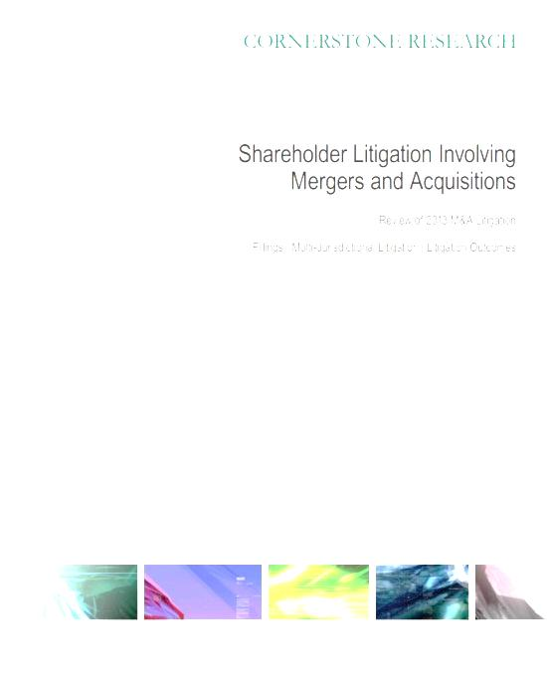
4. 94% M&A Deals Shareholder Suits
4th consecutive year, shareholders suits > 90% of M&A deals over $100 million.
In 2013, 94% of M&A deals were challenged by shareholders.
Average of more than five lawsuits.
62% of deal litigation was multi-jurisdictional.
Shareholder Litigation Involving Mergers and Acquisitions Review of 2013 M&A Litigation (CORNERSTONE RESEARCH March 13, 2014) available at www.cornerstone.com

Slide 23
4. 94% M&A Deals Shareholder Suits
Most Active Courts: Delaware Court of Chancery; New York County, NY; Santa Clara County, CA; and Harris County, TX.
Litigation resolved pre-closing 75% deals.
Vast majority lawsuits settled.
Shareholder Litigation Involving Mergers and Acquisitions Review of 2013 M&A Litigation (CORNERSTONE RESEARCH March 13, 2014) available at www.cornerstone.com.

Slide 24
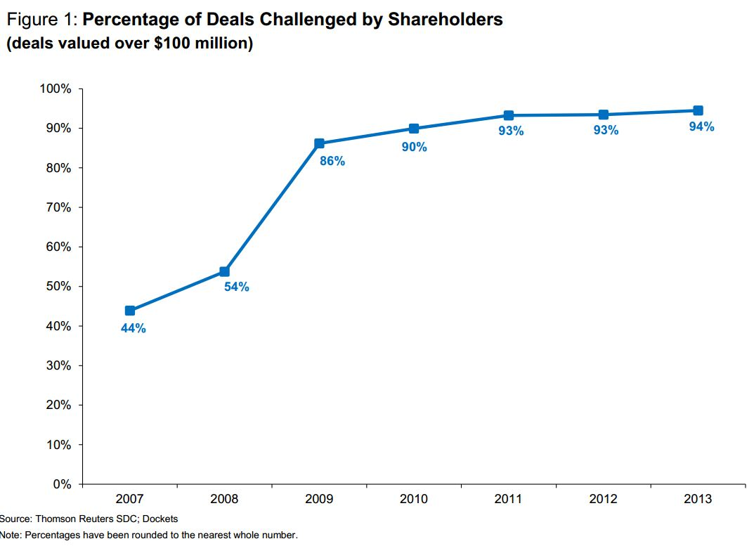
4. 94% M&A Deals Shareholder Suits
Shareholder Litigation Involving Mergers and Acquisitions Review of 2013 M&A Litigation (CORNERSTONE RESEARCH March 13, 2014) available at www.cornerstone.com.

Slide 25
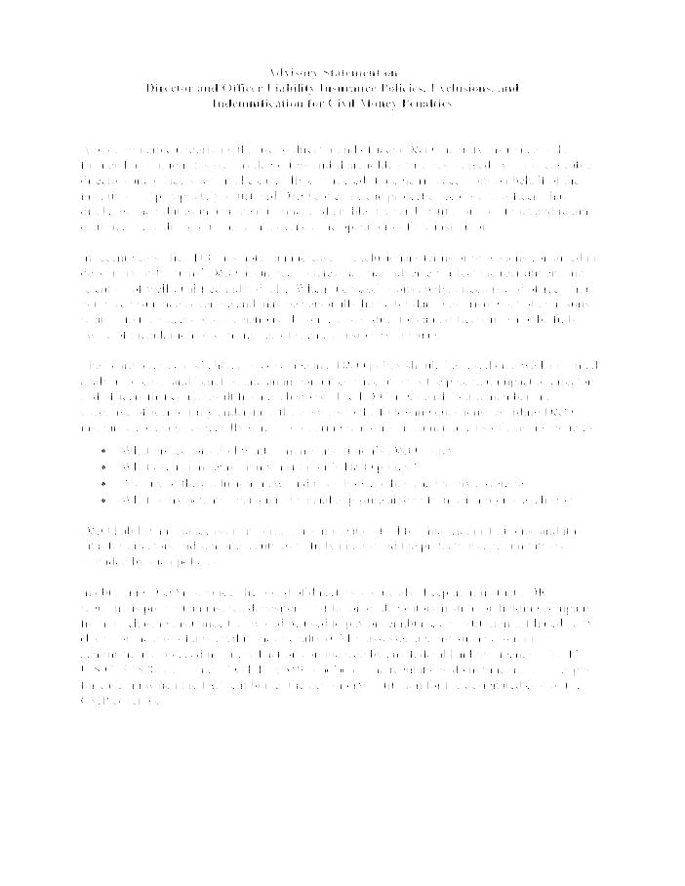
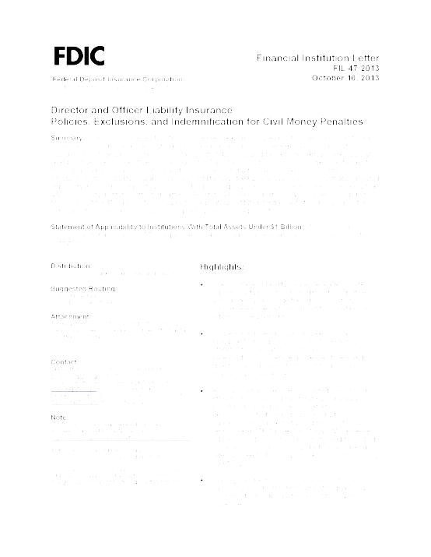
3. FDIC - FIL-47-2013
“The FDIC has recently noted an increase in exclusionary terms or provisions in director and officer liability insurance policies purchased by financial institutions. These exclusions may limit insurance coverage under certain circumstances, thereby increasing the potential personal exposure of board members and bank officers in civil lawsuits. ....”
Financial Institution Letters, FIL-47-2013 (October 10, 2013)
Notes:
FDIC – Financial Inst. Letter.
Noted increase in exclusions
If Fed Govt. noticed, you should
FDIC as receiver.

Slide 26
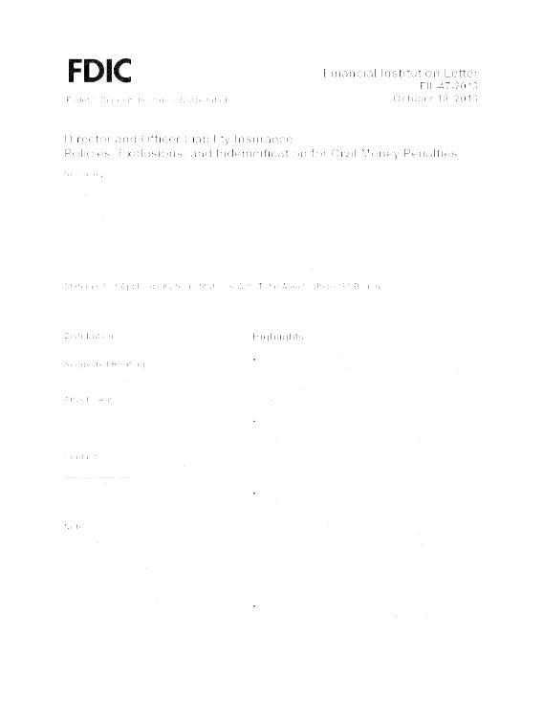
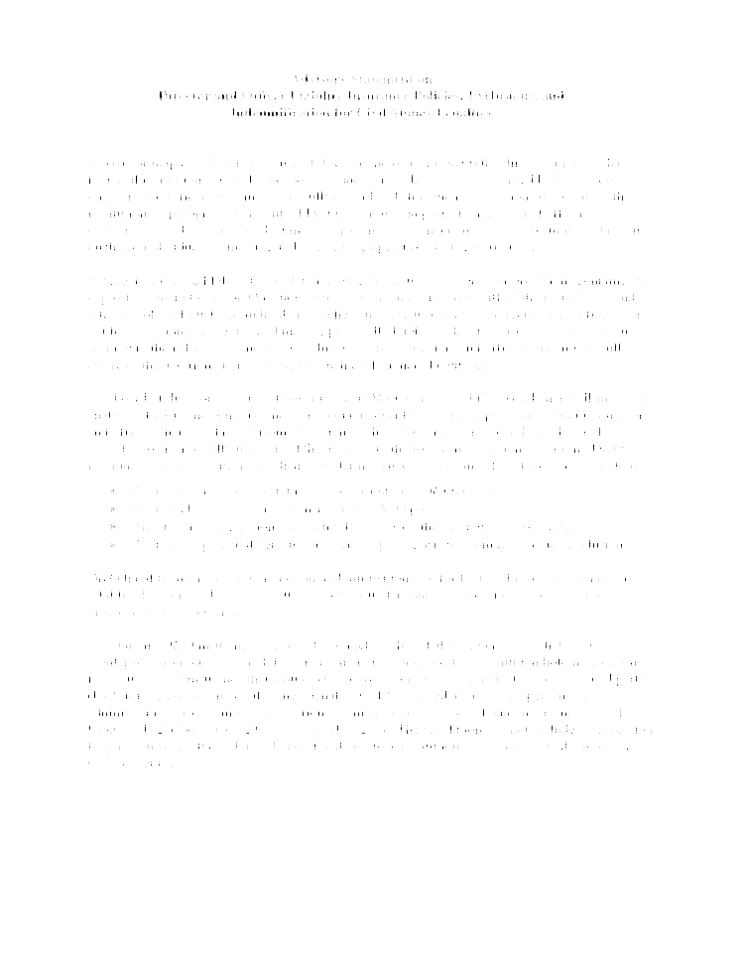
3. FDIC - FIL-47-2013
“The FDIC urges each board member and executive officer to fully understand the answers to the following questions regarding D&O insurance coverage, especially when considering renewals and amendments of existing policies:
What protections do I want from my institution’s D&O policy?
What exclusions exist in my institution’s D&O policy?
Are any of the exclusions new, and if so, how do they change my coverage?
What is my potential personal financial exposure arising from each policy exclusion?”
Financial Institution Letters, FIL-47-2013 (Oct. 10, 2013)
Notes:
Good Questions
Have you asked?

Slide 27
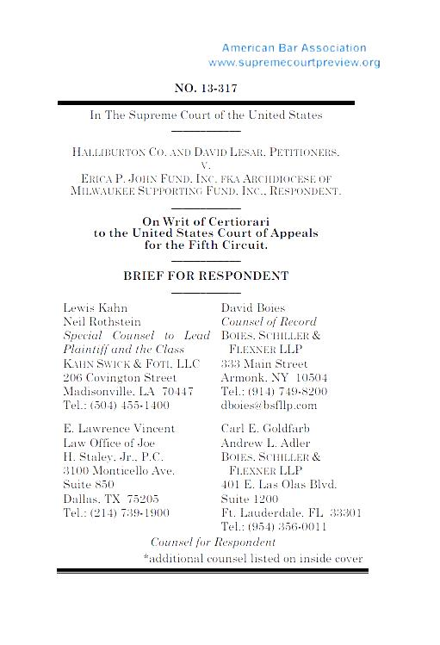
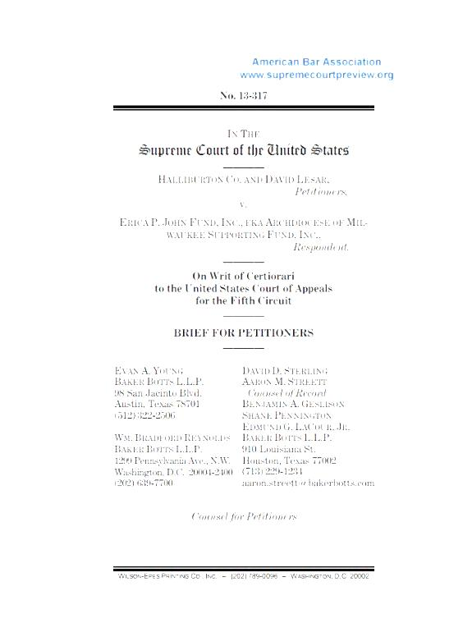
2. HALLIBURTON II – U.S. Supreme Court –
“Fraud On The Market”
The United States Supreme Court issued its ruling in Halliburton Co. v. Erica P. John Fund, Inc. No. 13-317 on June 23, 2014.
Court had agreed to revisit the “fraud on the market” presumption in securities class action lawsuits – can change how cases litigated
.
The Basic, Inc. v. Levinson presumption permits plaintiffs to pursue class certification without showing that each individual member of the class relied upon the alleged 10(b) misrepresentation. The presumption remains.
Supreme Court held that a defendant in a securities case at the class certification stage may “rebut the presumption of reliance with evidence of a lack of price impact.” Opinion at 16. In other words “through evidence that an alleged misrepresentation did not actually affect the stock’s market price . . .” Id. at 23.
Notes:
10(b)(5) Securities class actions
Argue last month in U.S. Supreme Court
The basic presumption of a “fraud on the market” permits plaintiffs to pursue certification without showing reliance of all class members.
Reliance can be difficult to show.

Slide 28

And the
Number 1 D&O
Liability Insurance Development . . .

Slide 29
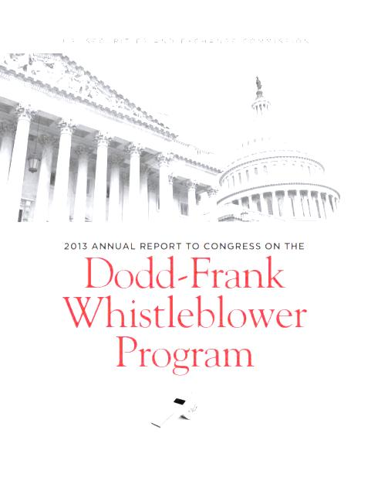
1. Dodd-Frank Act:
FY 2014 Whistleblower Report
First bounty awarded in 2012. (Over $1MM, 10-30%)
One “primary goal” of OWB is to “increase public awareness.”
Form TCR (Tip, Complaint Or Referral)
2011 (334); 2012(3,001); 2013(3,238); 2014 (3,620)
Tips from eighty-three (83) countries, sixty (60) of those countries in FY 2014.
On September 22, 2014 SEC authorized a $30 million award to a whistleblower in an enforcement action.
The Securities Exchange Commission’s Annual Reports on the Dodd-Frank Whistleblower Program for Fiscal Years 2013 (November 15, 2013) and 2014 (November 17, 2014) available at http://www.sec.gov.
Notes:
Office of Whistleblower — 2010 Dodd-Frank
Tips UP

Slide 30
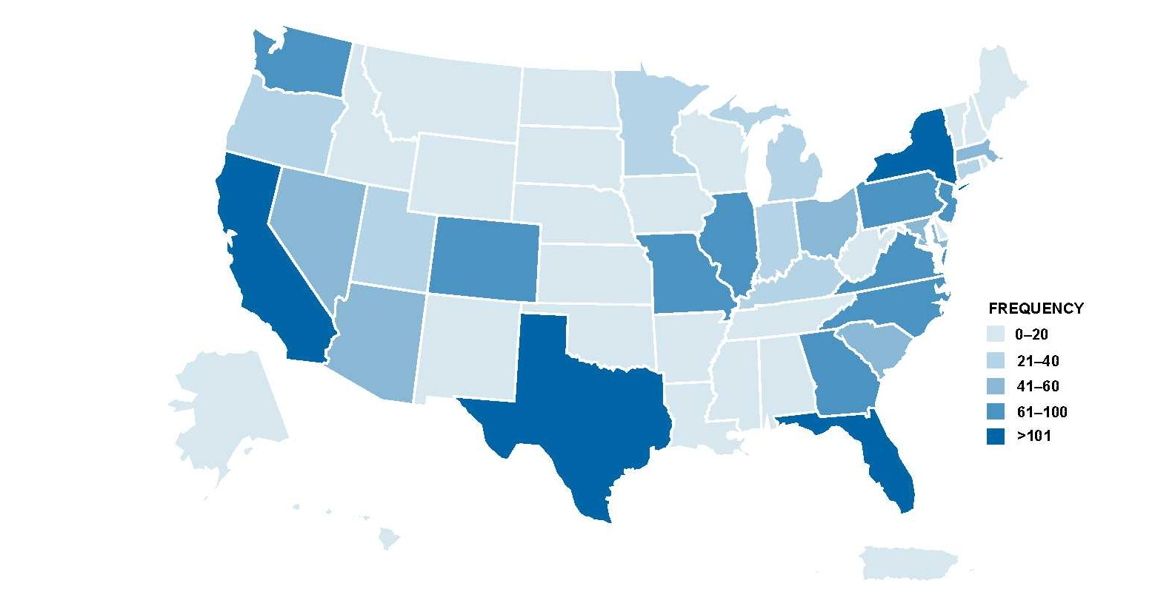
1. Dodd-Frank Act:
FY 2014 Whistleblower Report
The Securities Exchange Commission’s Annual Report on the Dodd-Frank Whistleblower Program for Fiscal Year 2014 (November 17, 2014) available at http://www.sec.gov.
Notes:
U.S. Distribution

Slide 31
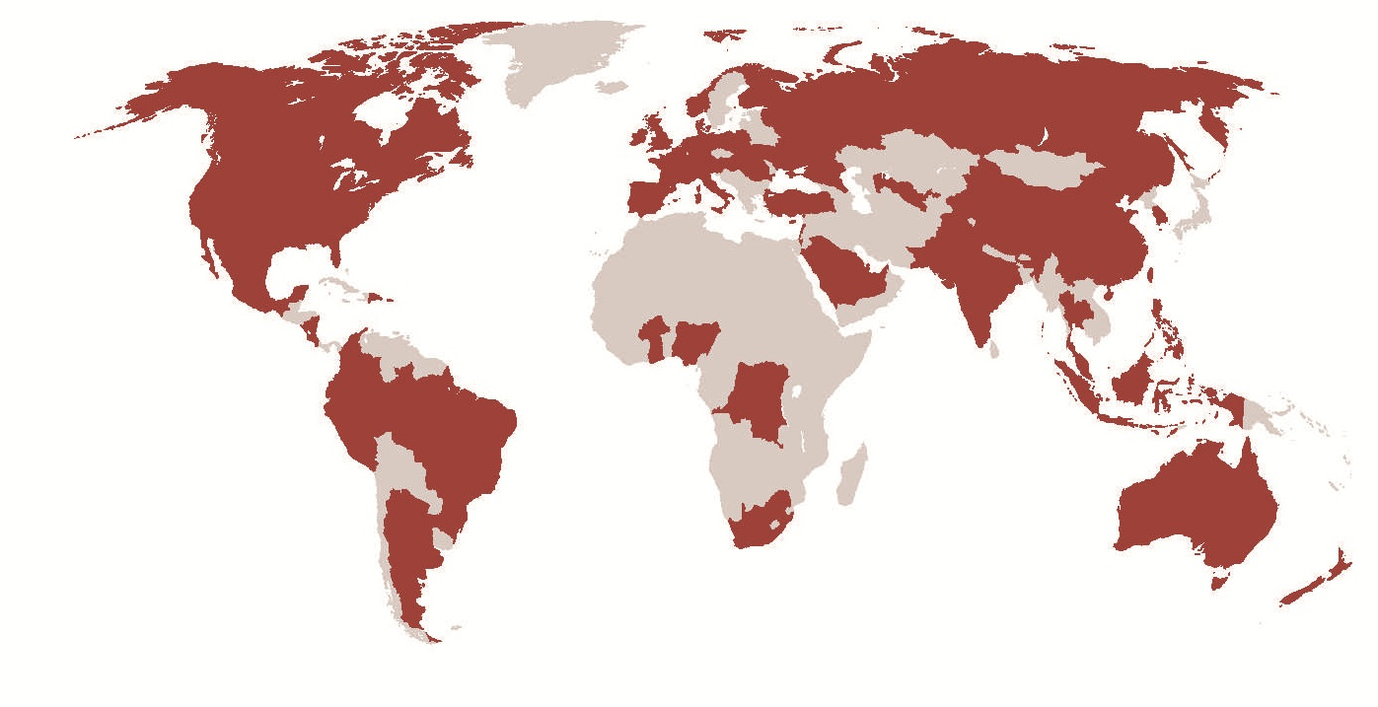
1. Dodd-Frank Act:
FY 2014 Whistleblower Report
All countries in which whistleblower tips originated during Fiscal Year
2014. The Securities Exchange Commission’s Annual Report on the Dodd-Frank Whistleblower Program for Fiscal Year 2014 (November 17, 2014) available at http://www.sec.gov.
Notes:
Worldwide Distributions
Multi-Nationals

Slide 32

Things to Do:
Understand the exposure.
Review indemnity rights, corporate bylaws, indemnity agreements and D&O liability insurance policies.
Avoid new exclusions.
Avoid gaps.
Enlist an expert consultant or broker.
DO NOT TAKE “NO” FOR AN ANSWER!

Slide 33
Thank You.
William G. Passannante, Esq.
wpassannante@andersonkill.com
(212) 278-1328
Darin J. McMullen, Esq.
dmcmullen@andersonkill.com
(267) 216-2708

