Slide 1

The Vow Factor:
Women’s health, marriage and social policy
Lisa F Berkman, Ph.D.
Professor and Director, Harvard Center for Population and Development Studies
THE PAA and APC Congressional Briefing
April 17,2015, US Capitol Visitor Center, Congressional Meeting Room North

Slide 2
Rationale
Life course trajectories are key to understanding wellbeing in old age: Single parenthood experienced during early/ middle adulthood is associated with long run poor health.
Demographic trends suggest trouble down the road: Single parenthood in the US is on the rise
Policies enacted for short term benefits turn out to have long term consequences- implying in this case- more unmeasured benefits compared to costs: the case of maternity leave

Slide 3
Life Expectancy at Birth in 22 OECD Countries; 1980 – 2008; Females
Notes:
Do we need/have a source for this?

Slide 4
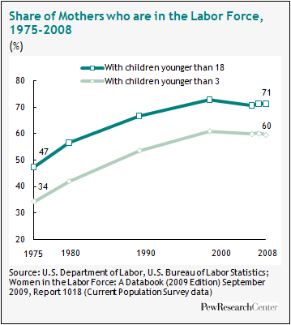
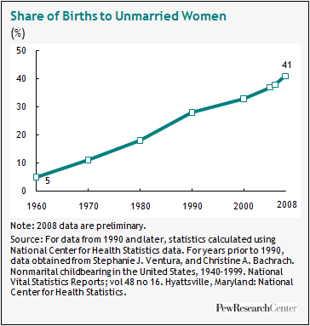
Changing work-family landscape in US

Slide 5
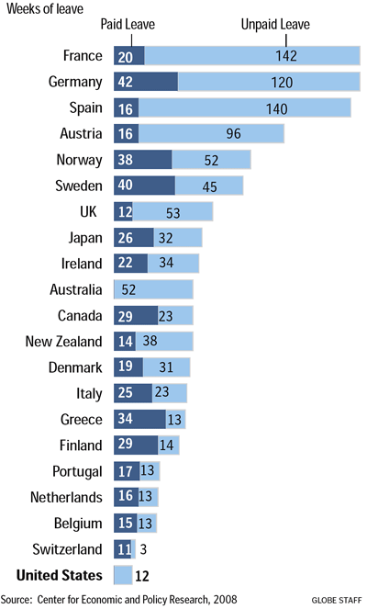
Formal Social Protection Policies Lacking
Weeks of paid & unpaid maternity leave, by country

Slide 6
Single Motherhood in Early-Middle Adulthood and Late Life Disability and Health
Comparative Population-Based Studies of Older Adults in the US and Europe
Berkman, LF, Zheng, Y, Avendano, Börsch-Supan, A, Glymour, MM, Sabbath, EL (in press). “Mothering alone: cross-national comparisons of later-life disability and health among women who were single mothers. Journal of Epidemiology and Community Health.
This study was supported by a grant from NIA
Notes:
Can you put in the whole reference here.. I think its coming out in April 21.. If you can find it in our correspondence.. If not, this is fine as ref

Slide 7
Sample
Women aged 50 and over in:
  Health and Retirement Study (HRS)
  English Longitudinal Study of Ageing (ELSA)
  Survey of Health, Ageing and Retirement in Europe (SHARE)
  2004 – 2009,
Women without any children before age 50 were excluded from the analysis
Notes:
For the study analysis, we pooled data from three surveys on health and ageing: HRS for the US, ELSA for the UK, and SHARE for thirteen countries in continental Europe. These surveys have been designed to be comparable to one another and individuals enrolled are representative of the community population aged 50 and over and their spouses. We used two waves of data from each survey, which were collected in 2004 and 2006. In HRS respondents were asked about information for up to four marriages, as well as children’s information, during the first interview. In ELSA a life history interview was conducted in wave 3 regarding retrospective information in cohabiting relationships , children, work history and so on. In SHARE a similar survey on lifetime events was conducted in year 2008 to 2009 on individuals interviewed in either wave 1 or wave 2 or both. For ELSA and SHARE only respondents with the life history interviews were included in the analysis.

Slide 8
% of Women Aged 50+ with Single Motherhood Experience
Region | % Single motherhood | % Single motherhood without partners
US | 32.8 | NA
England | 22.0 | 18.3
Scandinavia | 38.2 | 26.9
Western Europe | 22.8 | 19.3
Southern Europe | 10.2 | 8.8
Eastern Europe | 20.4 | 17.8
Data sources: SHARE wave 1 and 2 and SHARELIFE;
ELSA wave 2 and 3; HRS wave 7 and 8, weighted
Notes:
This table shows the fraction of single mothers by region, and sample size of all women in each region. Women in the US are most likely to have single motherhood experience, with the fraction of 0.28. Scandinavia and UK ranked second and third, with 0.26 and 0.19, respectively. In Central Europe and Eastern Europe the fractions are 0.18 and 0.17. Mediterranean countries have the lowest fraction: 0.08. Sample sizes also differ. The US data has the largest sample size: more than 18,000 observations. Next is Central Europe. Sample sizes and the fraction of single mothers both affect how precise our estimates would be.
SHARE data was weighted by cross-sectional weight in SHARE in wave 3, but not adjusted by non-response in SHARELIFE
ELSA data was weighted by the final weight for life history interview respondents in wave 3
HRS data was weighted by cross-sectional weight in wave 7

Slide 9
Outcomes
  Any activities of daily living (ADL) limitations
    bathing, dressing, eating, getting in and out of bed, walking across a room
  Any Instrumental ADL limitations
    making meals, shopping, making phone calls, taking medications and managing money
  Self-rated health (SRH) is fair/poor

Slide 10
Adjusted RRs of any single motherhood:
ADL
 | Model I | Model II
US | 1.27*** | 1.09
England | 1.51*** | 1.40***
Scandinavia | 1.50* | 1.40*
Western Europe | 1.09 | 0.99
Southern Europe | 1.13 | 0.97
Eastern Europe | 0.93 | 0.90
P-value for equivalence of RRs | 0.074 | 0.037
Control for current HH income and wealth | No | Yes
*P<0.05, **P<0.01, ***P<0.001
All models control for age, education, current marital status, number of children, country dummies, and interview year dummies
Notes:
Comparison group: Mothers without single motherhood experience before age 50.
Use Poisson regressions to estimate adjusted relative risks (RR) of single motherhood on health outcomes & examine how they differ by region:
Six regions: US, England, and four within SHARE:
Scandinavia (Sweden and Demark)
Western Europe (Austria, France, Germany, Switzerland, Belgium, Netherlands)
Southern Europe (Italy, Spain and Greece)
Eastern Europe (Poland and Czech Republic)
Control for age, education, current marital status, number of children, country dummies, and interview year dummies, allowing for coefficients to differ by region.

Slide 11
Adjusted RRs of single motherhood by duration, all regions pooled
Notes:
If you can make the colored boxes in the key LARGER that would be great. If not dong work

Slide 12
Adjusted RRs by causes of single motherhood, conditional on 8-13 yrs of duration
Notes:
Colors bigger

Slide 13
Conclusions
Single motherhood experience was most health damaging in England, next in the US, Scandinavia and Western Europe. No significant associations in Southern Europe and Eastern Europe
Longer duration of single motherhood was more harmful
Divorced single mothers and single mothers at younger ages were at higher risks

Slide 14
The Long-run Effect Of Maternity Leave Benefits On Women’s Mental Health
Avendano M, Berkman LF, Brugiavini A, Pasini G. Social Science & Medicine (2015) doi:10.1016/j.socscimed.2015.02.037
This work was supported by NIA.
Notes:
Cite the maternity leave paper that Avendano is first on.. Social science in Medicine– you have it

Slide 15
Maternity leave policies
Maternity leave policies affect labor market outcomes (Klerman & Leibowitz, 2000; Rossin et al, 2013):
  Wage level and growth
  career prospects
  labour market attachment
  Employability
Positive effects on the newborn’s health (Ruhm, 2000; Tanaka 2005; Rossin, 2011)
Positive effects on mothers health immediately after childbirth (Chatterji & Markowitz 2012; Staehelin et al., 2007)
“Scarring” effect of maternity: reduce stress at period of birth, maternal depression linked to long term offspring outcomes

Slide 16
Data: SHARE
Multidisciplinary, cross-country panel survey representative of 50+ population across Europe
30,000 men and women over 13 European countries
retrospective data on life histories:
  Complete working history
  Complete fertility history
Mental Health in 2004 and 2006: Euro-D Scale
We know exact year of maternity, country of residence, labour market status at childbirth, exact length of interruption
Extensive measures of physical health, demographics, labour market behaviour, pensions

Slide 17
Policy Data
Anne Gauthier (2011): “Family Policy Database" on:
  Maternity, parental, and childcare leave policies
  Cash benefits
The database covers the period 1960-2010 and all SHARE countries
Maternity leave: leave granted (only) to mothers in connection with childbirth, and which usually includes a period of leave prior and after childbirth. We use total number paid work weeks
Notes:
The distinction in the literature between maternity, parental, and childcare leave policies is often blurred and inconsistent

Slide 18
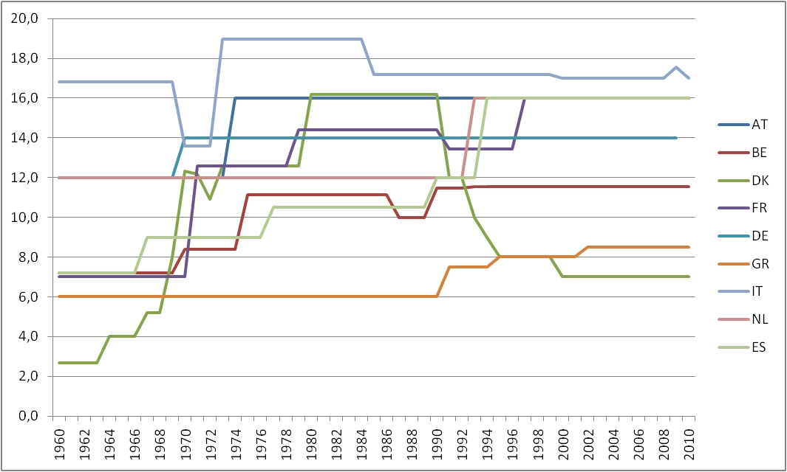
Paid maternity leave by country: Full wage weeks (excluding Sweden)
Weeks

Slide 19
Depression score by Full Wage Weeks of Maternity leave, treatment and controls
 | Full-wage week of maternity leave benefits |  | Difference high-low | % change
 | Low | High
working | 2,64 | 2,51 | -0,13
not working | 2,52 | 2,82 | 0,30
 |  | DiD | -0,43 | -16,17%
Interpretation: 16.2% difference in depression score between low vs. high country-specific cut-offs for full-wage weeks, with respect to mean value among European women working at childbirth
Notes:
The policy variable is country specific: it is a dummy which takes value 1 if FWW is larger than 12 weeks in Denmark, Germany, France, Austria and the Netherlands. It is 1 if FWW is larger than 18 in Sweden, larger than 16 in Italy, larger than 9 in Belgium and Spain First childbirths only
We focus on women having their first child between 16 and 25. Reduced possibilty to adjust labour market involvement as a response to match leave policy in such a short and early time period
Country and year of birth fixed effects
Control for quadratic in age, education, marital status, total fertility, physical health at old age, health behavior, birth control, country-specific year of birth trends
gen cnt12=(denmark==1 | germany==1 | france==1| austria==1| netherlands==1)
gen FWWhigh=(fwwround>12) if fwwround!=. & cnt12==1
replace FWWhigh=(fwwround>=9) if fwwround!=. & belgium==1
replace FWWhigh=(fwwround>=9) if fwwround!=. & spain==1
replace FWWhigh=(fwwround>16) if fwwround!=. & italy==1
replace FWWhigh=(fwwround>18) if fwwround!=. & sweden==1

Slide 20
Conclusions
Depression in old age is linked to maternity leave policies during the critical period of the birth of a first child:
  Moving from a maternity leave with limited coverage to one with comprehensive coverage at the birth of a first child reduces depression scores by 16% in older ages
Potential Mechanisms:
  postpartum stress and depression linked to recurrent depression
  Reduced stress over the life-cycle
Depression is costly:
  Older people with depression use more health services, homecare and assisted living than older people without depression
  Mean direct health care costs in old age per patient were €5241 per year for depressed individuals, as compared to €3648 per year for non-depressed individuals, corresponding to a 30% difference (Luppa et al., 2008). Cost-benefit analyses should take into account the potential loss in women’s welfare in old age resulting from diminishing the comprehensiveness of maternity leave benefits

