Slide 1

Tara Thomas, Senior Government Affairs Manager
September 9, 2025
Notes:
Bass

Slide 2
Federal Funding FY26
President’s Proposal
Cuts $12.4 billion from ED, about $6 billion from K12
Level funds Title I-A
Block grants (most of) IDEA
Block grants 18 other competitive and formula programs ($6.5 billion ≠ $2 billion)
Eliminates Title I-C, Title III, Full-service Community Schools, Teacher and School Leader Incentive Grants, GEAR UP, TRIO
House Proposal
Cuts ED funding by more than $12 billion​
Cuts Title I-A by $3.78 billion​
Eliminates 14 programs including Title I, Part C & D, Title II, and Title III​
Increases funding for REAP, Title IV, Part A and Impact Aid (+5 million each) ​
Rescinds $1.7 billion of Title II and $938 million of Title I funds that schools are planning to access Oct. 1)
Senate Bipartisan Proposal
Increases Title I-A (+50 million), IDEA (+50 million), Head Start (+85 million), and REAP (+5 million)
Level funds most other K12 programs
Reduced funding for school safety national activities, Full-service Community Schools, Arts in Education, TQP, and Education Innovation and Research, among others
Adds language to require funding goes out by July 1 and prevents transfer of programs to another Department

Slide 3
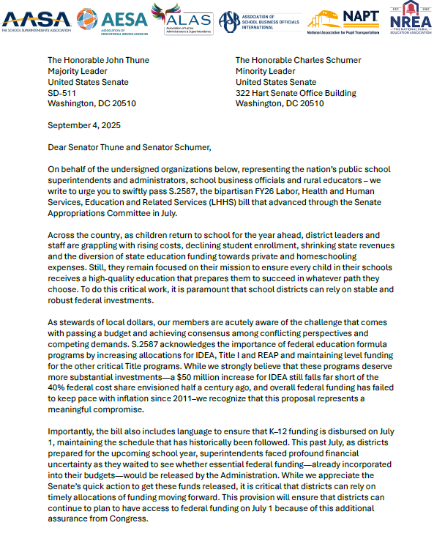
Appropriations – Next Steps
Will the Senate bill pass the full Senate?
Does the House proposal have a chance?
But the most important question: how long will the inevitable continuing resolution be for??
Looming large: rescissions (Pocket, “silent”, and official)

Slide 4
Reconciliation
Appropriations
VS.
Technical procedure that allows Senate procedure to bypass Senate filibuster.
Education funding that could be included/impacted:
New voucher program: Educational Choice for Children Act
School-based Medicaid program
The annual federal process for spending bills.
Determines levels of funding for education programs (AKA discretionary), including:
IDEA
Title I
Title II
Title III
Head Start
Competitive grant programs

Slide 5
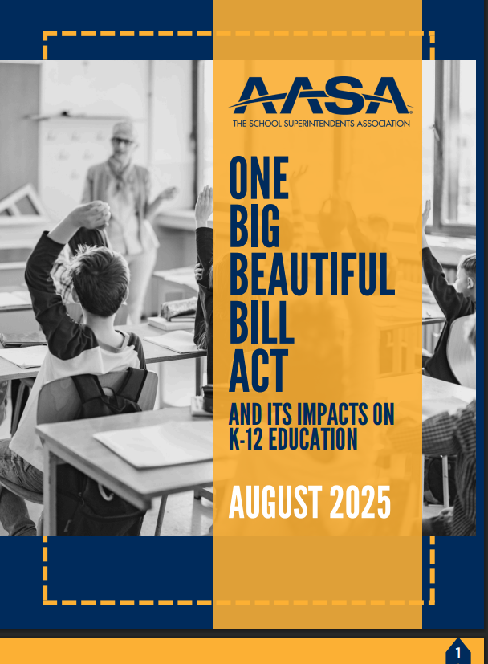
One Big, Beautiful Bill Act (AKA H.R. 1)
Access the report here

Slide 6
One Big, Beautiful Big Act
Jam-packed with policy and funding policy
SALT fix for high-tax states (yay for them!)
More hungry kids coming to school: 2- 3 million kids will lose SNAP benefits.
Nearly $1 trillion in cuts to Medicaid- the pressure on States to make up the difference (and find money by cutting education funding) will be enormous.
In total, district budgets may be hit hard. Direct certification numbers given Medicaid and SNAP denials will go down making it more costly for districts to keep feeding kids
What will States do? Raise taxes? Scale back investments in food and healthcare? Both? No one knows yet.

Slide 7
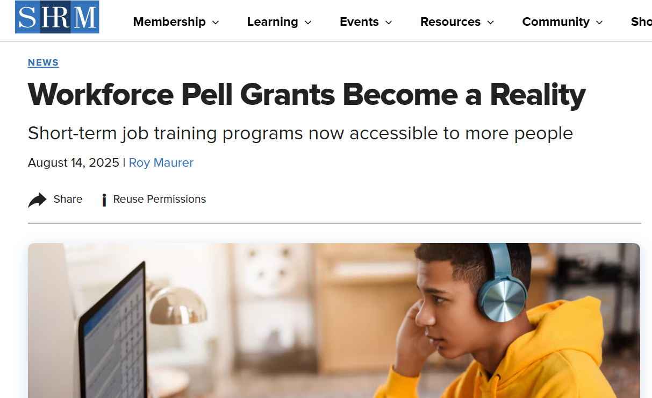
One Big, Beautiful Bill Act
Established “workforce” or “short-term” Pell Grants
Expand Pell Grant eligibility to learners and workers who want to pursue a short-term job training program (8 to 15 weeks)
States will have a significant role in the eligibility, creation, and maintenance of eligible programs

Slide 8
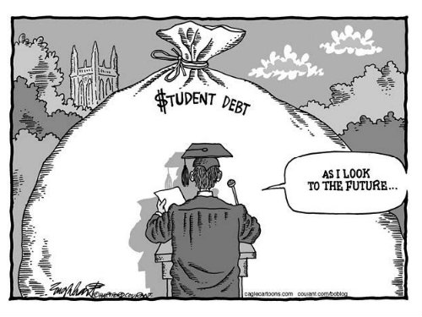
One Big, Beautiful Bill Act
Higher education changes:
Creates limits for borrowers
Eliminates Grad Plus loans
Changes repayment options
Program accountability

Slide 9
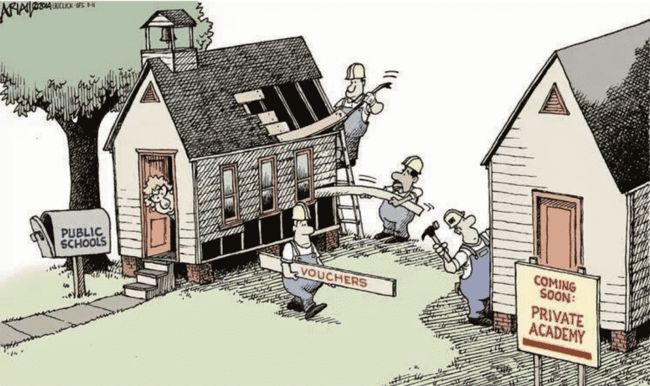
One Big, Beautiful Bill Act
ECCA vs OBBB:
The bad news: No aggregate cap on the tax credit– ECCA was capped at $4b, this is unlimited. One analysis estimates this could cost $51b a year
The better news:
Still a dollar-for-dollar tax credit, but limited to $1700 individual donation/$3400 married couples. No donation of stock. No tax shelter.
No homeschoolers allowed to benefit
Treasury can issue regulations as can States
Credit is available as of Jan 1, 2027- States have the next 18 months to determine how they want to run their programs.

Slide 10
Public School Vouchers? Possibly.
States can voluntarily opt-in. Taxpayers in every state can benefit, but they can do so by donating to private school entities in other states.
There is no cost for States to create these programs; this makes it very challenging to convince legislators to not create voucher programs
If a Governor or State agrees to create or expand their voucher program they could open this to public schools that would want to create a 501c3 that would pay for these items, services and activities for public school students:
Academic Tutoring
Books, supplies and equipment
Special education related services
Computer, software or internet access and related technology
Transportation
Supplemental educational services (afterschool programs)
Access memo from the National Coalition for Public Education here.

Slide 11
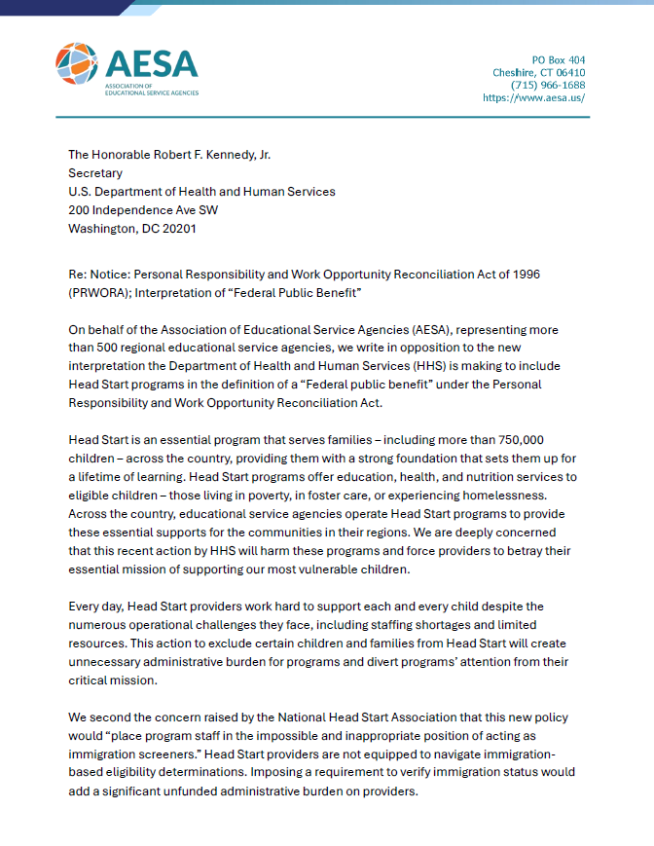
PRWORA
Personal Responsibility and Work Opportunity Reconciliation Act
ED, HHS and USDA issued notices redefining what constitutes as a “public benefit” – and therefore limiting who can participating in these programs
Most notably for K-12, Head Start and CTE/dual enrollment are included
Guidance from HHS expected soon

Slide 12
What else?
Secure Rural Schools must be reauthorized ASAP
Efforts to rollback E-Rate flexibilities
Student privacy has re-entered the chat
WIOA reauthorization?
OCTAE now at Dept. of Labor?

Slide 13






Contact Us
Joan Cell: 920-420-8822
Tara Cell: 703-303-2551
https://aesa.us
jwade@aesa.us
tthomas@aasa.org

Slide 14


Thank You!
Join the conversation!

