Slide 1
Work Smarter, Not Harder— Discover OLAC’s Game-Changing Resources
OESCA Fall Conference
September 8, 2025

Slide 2
Agenda
Provide an overview of the Ohio Leadership Advisory Council
Provide Shared/Collaborative Leadership Information
Answer Questions

Slide 3
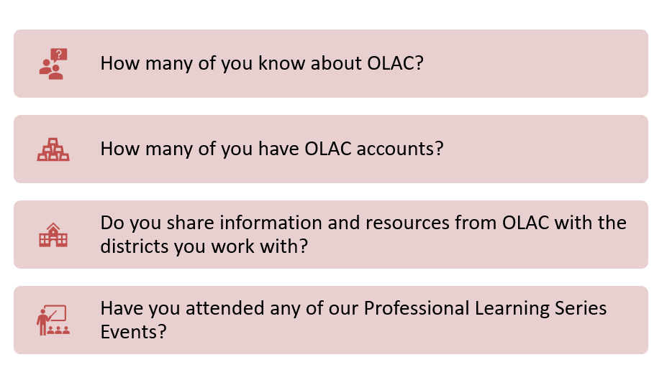
Questions for You

Slide 4
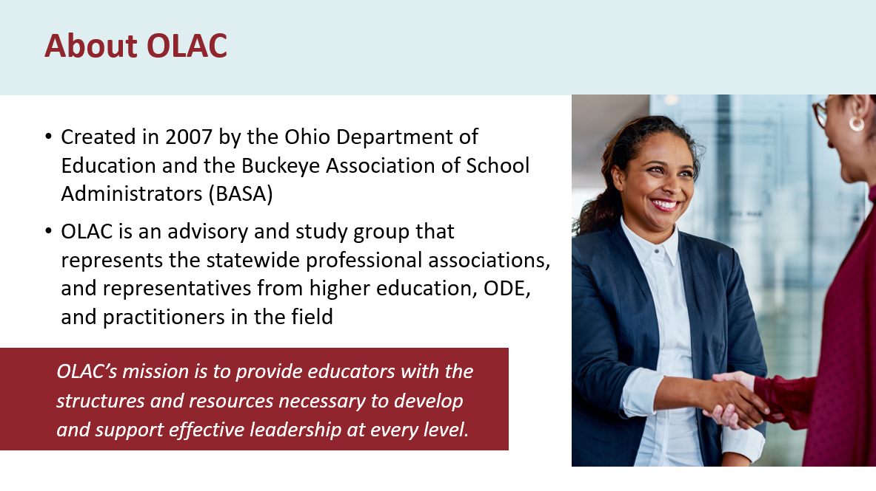
OLAC History

Slide 5
Why Leadership Matter
The purpose of leadership is the improvement of instructional practice and student performance, regardless of role;
Ohio’s leadership system must be anchored in teaching and learning, focused on building community, and directed to ensuring the success of all children; and
A common and collective understanding of essential practices or behaviors is needed to create a coherent leadership development system.

Slide 6

Ohio’s Leadership Development Framework

Slide 7
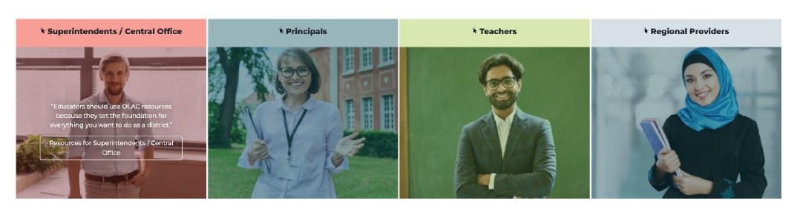
Resources by Role

Slide 8
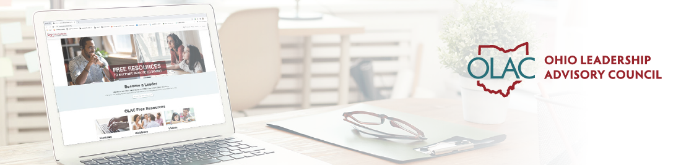


Free Resources

Slide 9
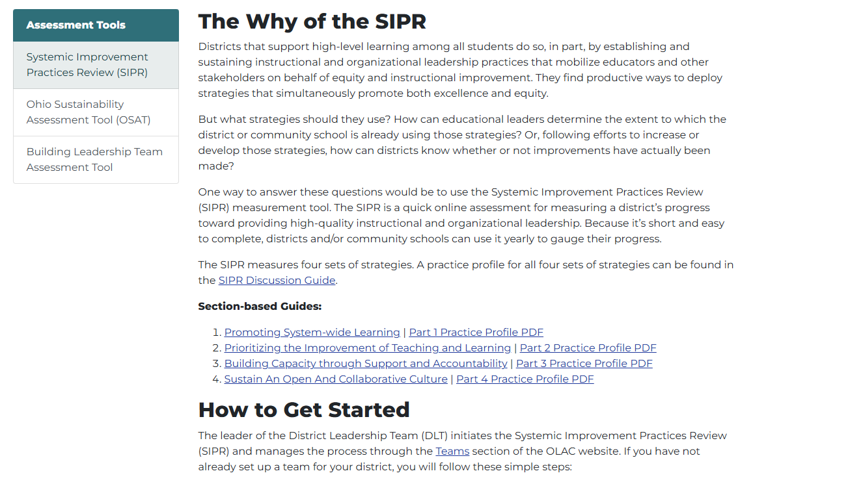
Systemic Improvement Practices Review (SIPR)

Slide 10
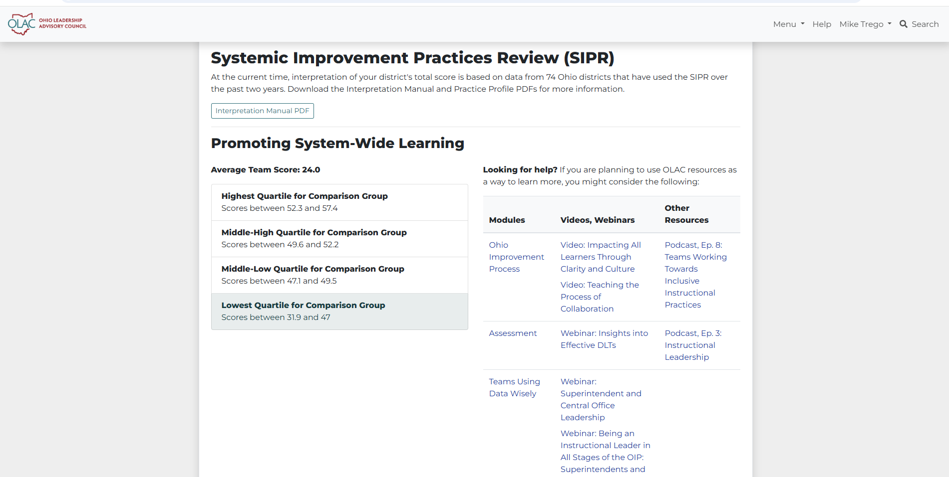
SIPR Report

Slide 11
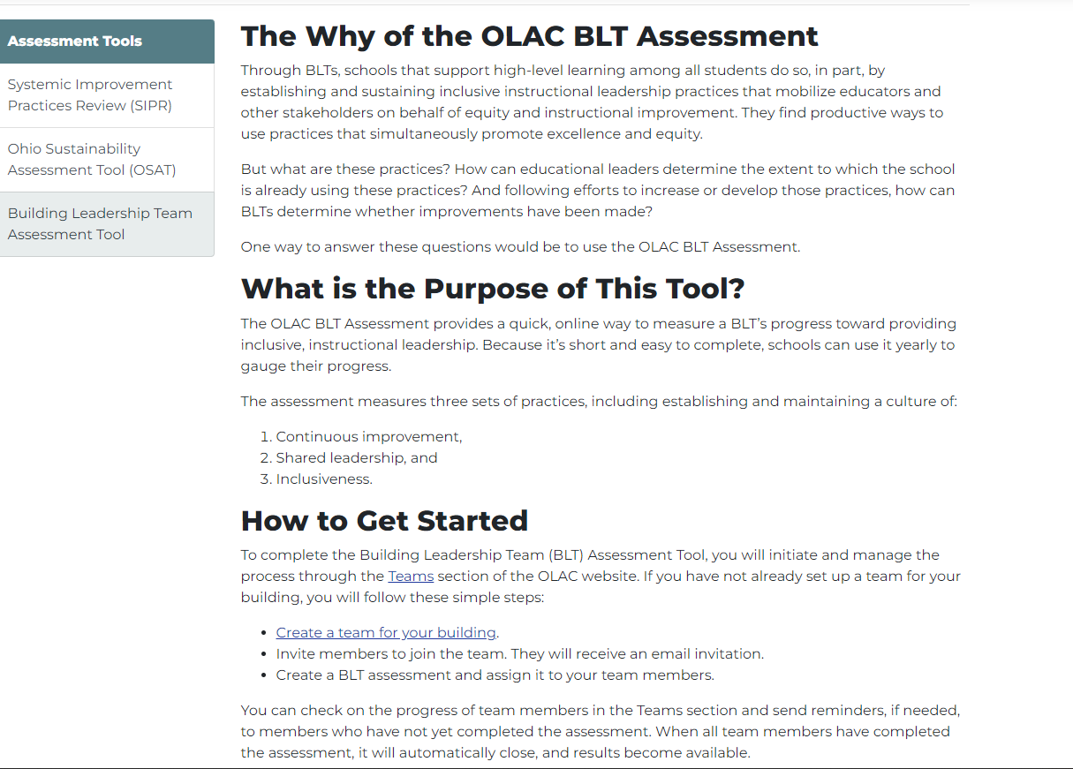
Building Leadership Team (BLT) Assessment

Slide 12
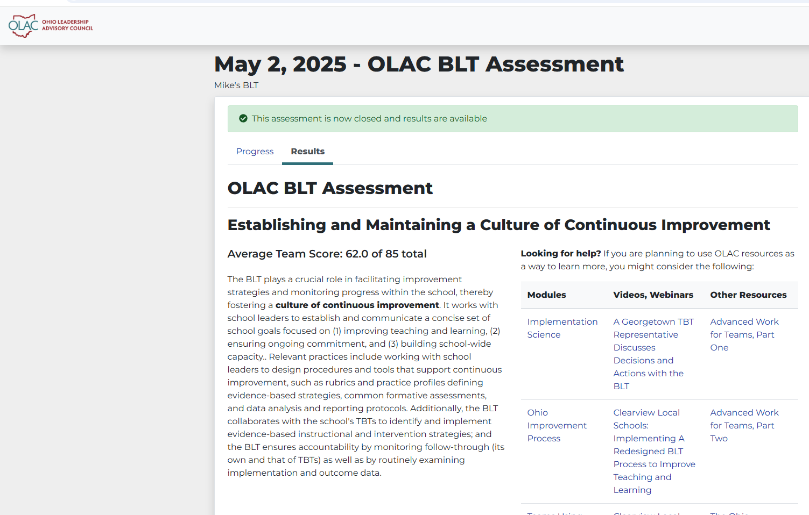
BLT Report

Slide 13
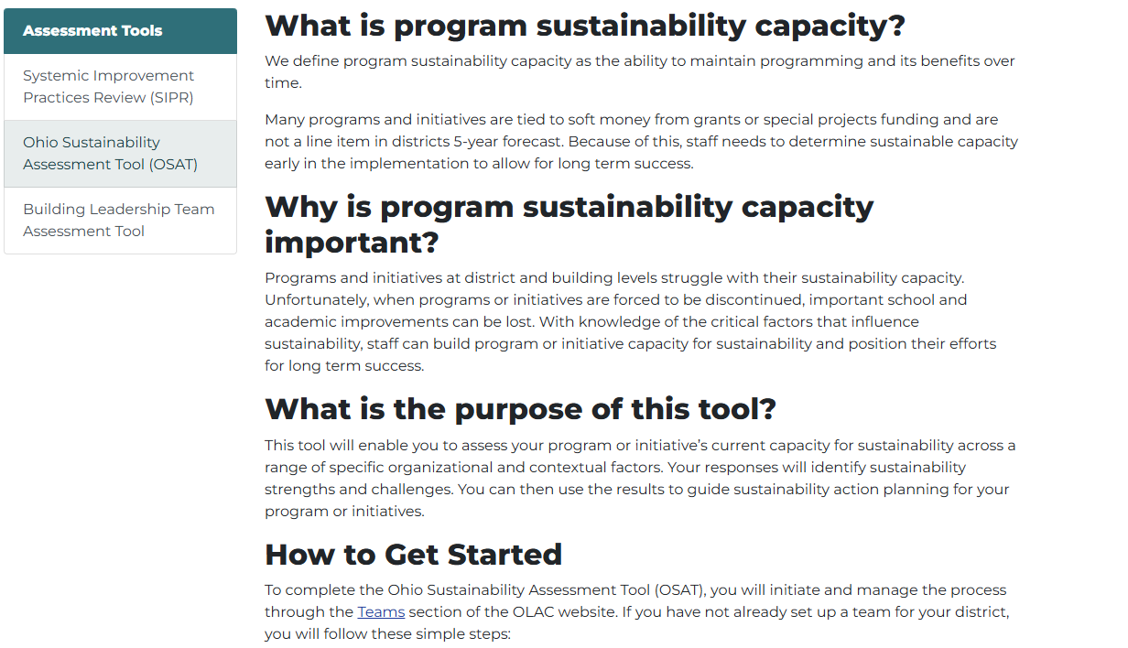
Ohio Sustainability Assessment Tool (OSAT)

Slide 14
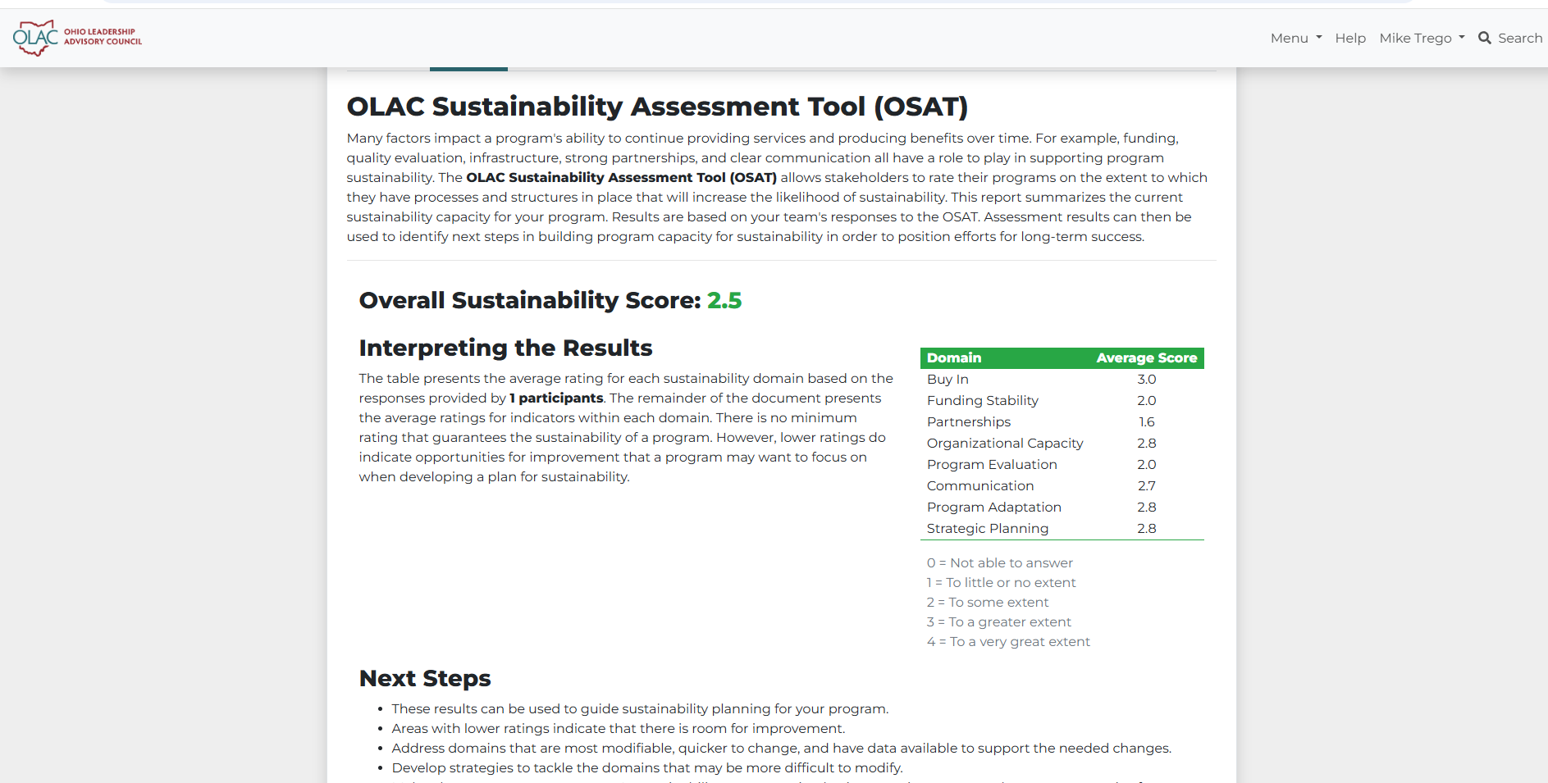
OSAT Report

Slide 15
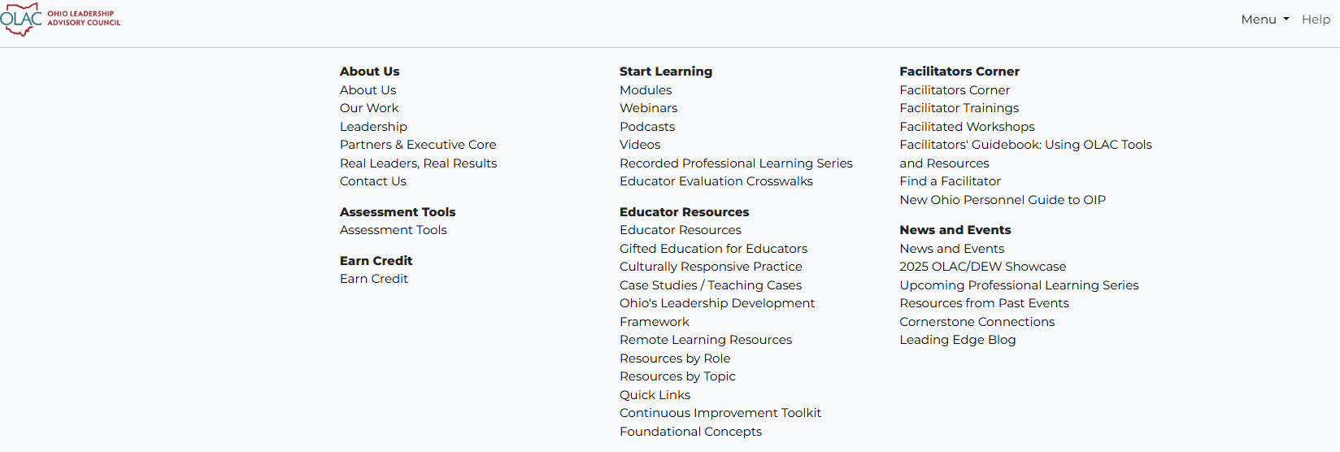
Quick Links Menu

Slide 16
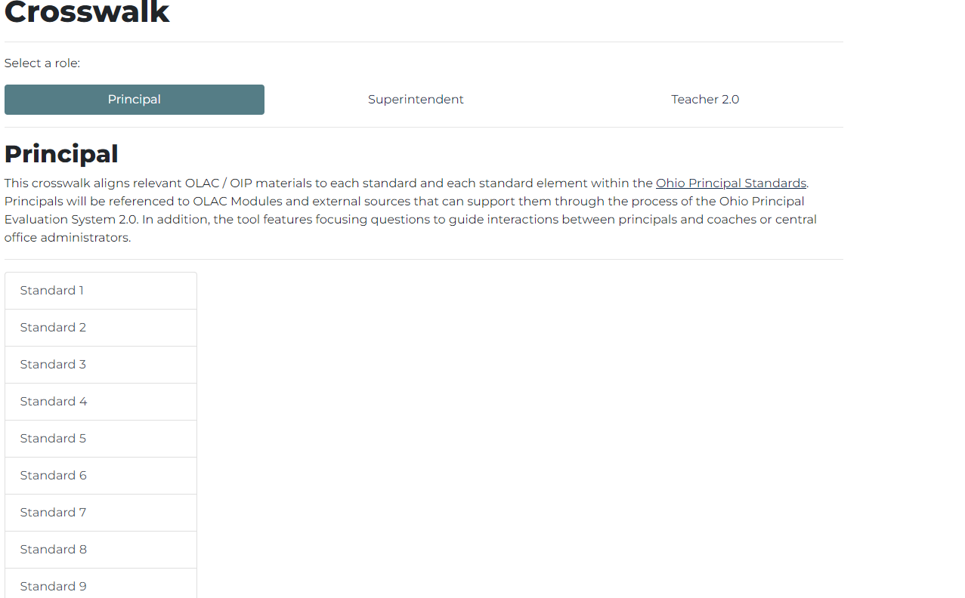
Evaluation Crosswalks

Slide 17





NEW: At the Table Podcast

Slide 18
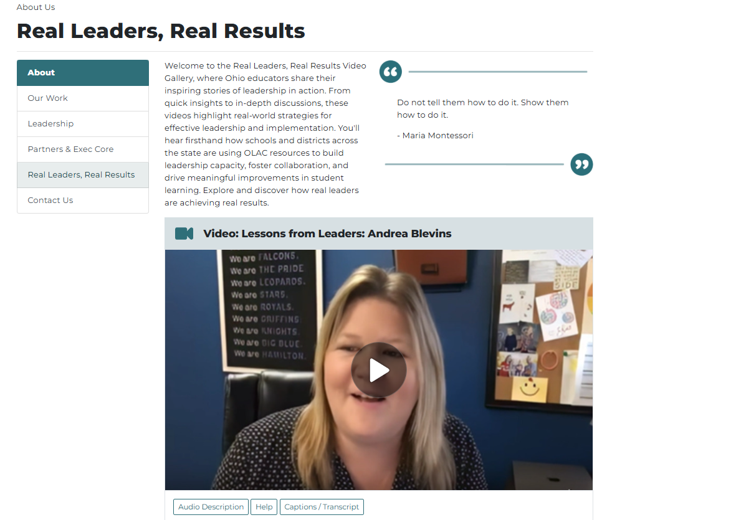
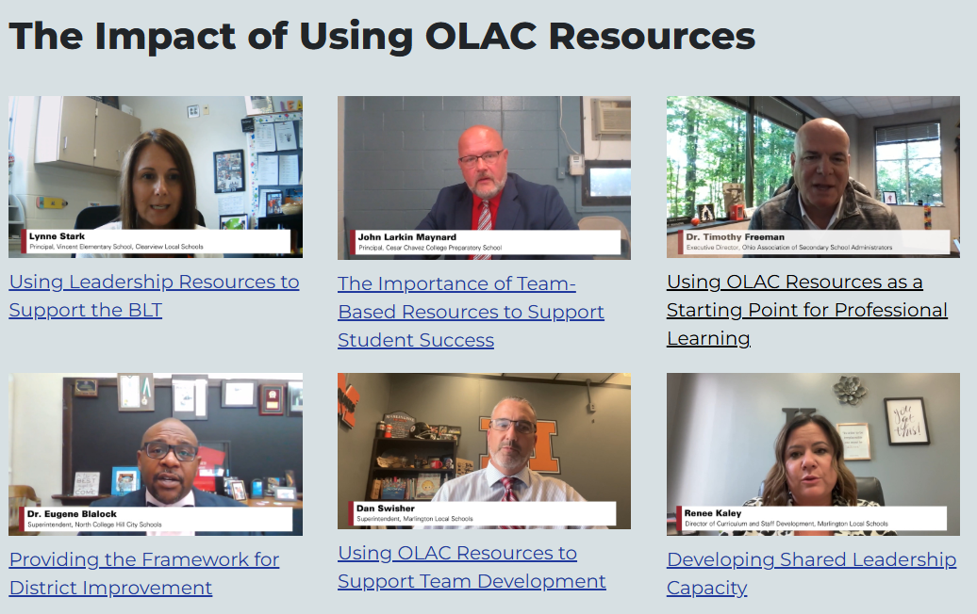
Real Leaders, Real Results

Slide 19
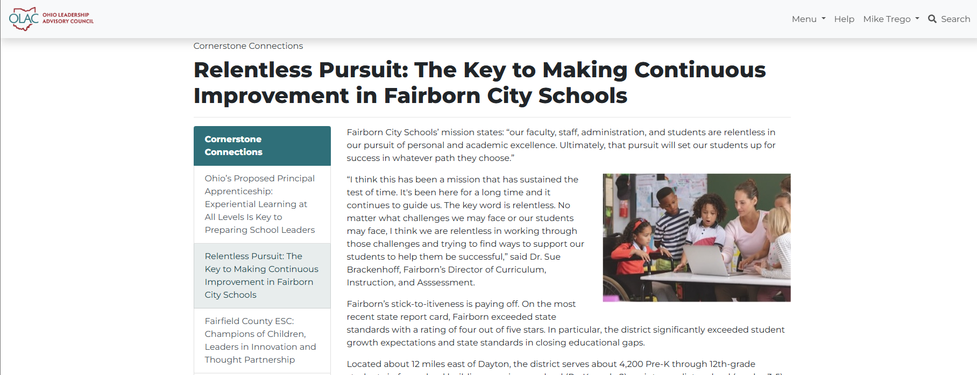
Cornerstone Connection

Slide 20

FREE Professional Learning Series

Slide 21
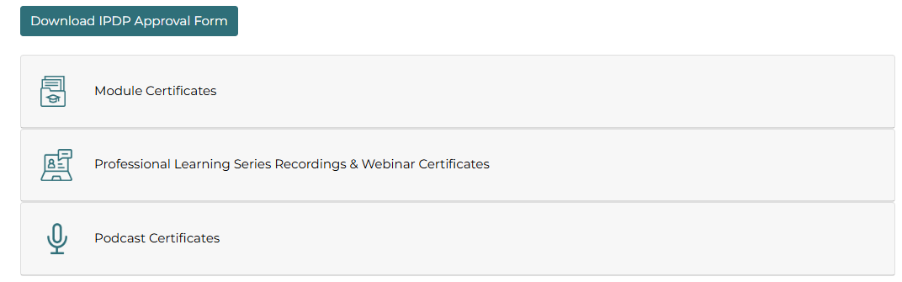


Credit Options

Slide 22


