Slide 1

Innovative Solutions Empowering Ohio’s Education Community

Slide 2

Who Am I?
Matt Calmes
Director of State Software
matt.calmes@mcoecn.org

Slide 3

Vision, Values & Mission
Vision: The Management Council will be the catalyst to optimize resources and collaboration across the Ohio Education Computer Network
Values:
Stakeholder-Aligned Solutions
Student-Focused Leadership
Innovate with Integrity
Collaborate Efficiently
Trusted Advocacy
Notes:
This slide is not required, but offered here should you need it.
When speaking about our mission, we describe it as: “To Make a Difference in the lives of Ohio’s Learners, Teachers, and Leaders as we Connect ITCs, Secure Data, Optimize Technologies, and Empower Education.”

Slide 4
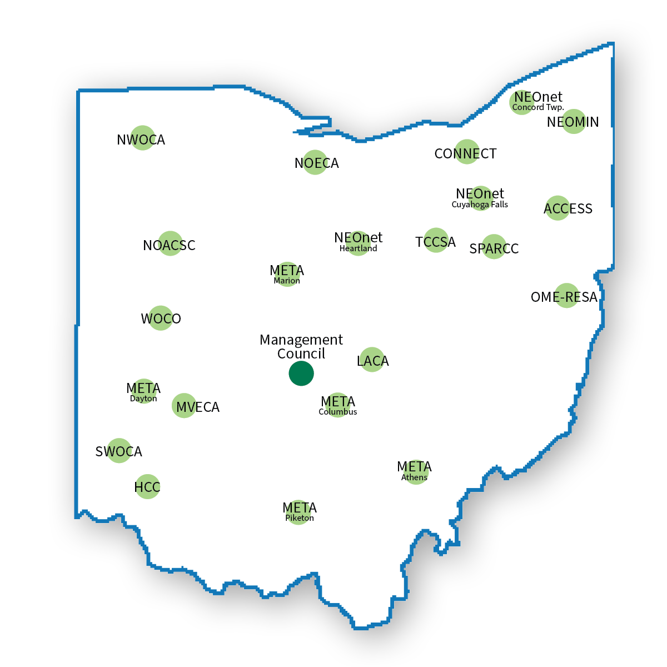
ACCESS
CONNECT
HCC
LACA
META
MVECA
NEOMIN
NEONET
NOACSC
NOECA
NWOCA
OME-RESA
SPARCC
SWOCA
TCCSA
WOCO
We Work With Your ITCs
Notes:
It’s your ITC!
Here’s a map of all the ITCs in Ohio. Some of these acronyms might be familiar to you. You may have heard them mentioned, but you weren’t sure what it meant. Now you know!
So, let me briefly tell you what your ITC does.

Slide 5





Five Core Services
Fiscal
Student Information
Information Technology Centers
EMIS
Internet Connectivity
Library Automation
Notes:
In Ohio Administrative Code, ITCs support five core services for school districts:
Fiscal (From our example earlier, ITCs help ensure folks get paid.)
Student Information (ITCs help ensure students can get scheduled accurately.)
EMIS (Data is accurately reported to ODE.)
Internet (Enough bandwidth for teaching and learning.)
Library Automation (Through INFOhio, which is provided to your districts through your ITC.)
In a nutshell, ITCs do the back-end IT work that is essential to the operation of every school district in Ohio.
But, wait! There’s more!

Slide 6
Additional Services
Additional Services (examples)
Tier 2 support
Specialized data analysis and reporting
Collective Purchasing
Cybersecurity
Application Hosting
Legislative Advocacy
All manner of custom reporting and tools
The Ohio Education Job Board

Slide 7
State Software Products
USAS – Uniform School Accounting System
USPS – Uniform School Payroll System
ODDEX – Ohio District Data Exchange
CNDC – Child Nutrition Direct Certification
EMSFFE – EMIS Flat File Editor
EMIS SIF Agents
Inventory – Inventory Management and Reporting
ESS – Employee Self Service Application
IPDP – Individual Professional Development Application
ITC-M – ITC Management Application
More to come….

Slide 8
IPDP – Individual Professional Development Plan
IPDP Provides the following functionality:
Allows employees to create both professional development plans and activities.
These can then be submitted to the LPDC for approval
Allows employees to view information about their licenses.
Allows LPDC committees to manage and report on employees’ professional development progress.
Currently requires USPS integration, but work is underway to allow this to run “standalone”

Slide 9
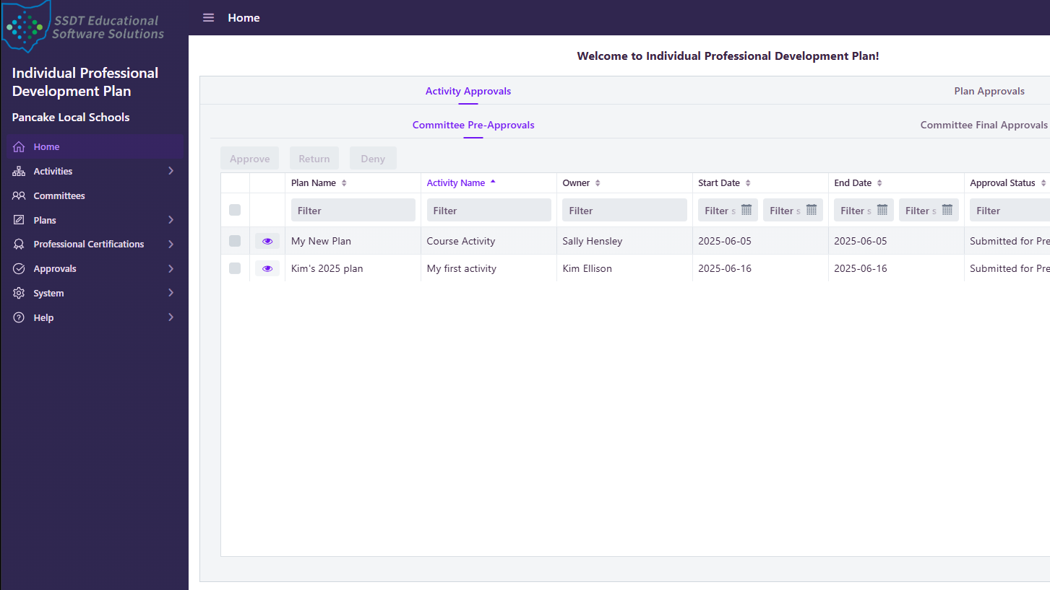

Slide 10
ESS – Employee Self Service
ESS provides the following functionality:
Integrated directly with USPS
Allows employees to view the following information: biographical details, position information, payslips, W2s, leave balances, job calendars
Allows employees to submit change requests if information is inaccurate.
Facilitates the submission and approval of leaves.
Includes functionality to allow sub-coordinators to view positions requiring a substitute and to assign a qualified substitute.
Allows announcements to be displayed to employees.
Allows supervisors and other admin personnel the ability to view, approve and report on leave requests
Incorporates timesheet functionality allowing employees to enter timesheets and admin staff to approve and import this data into USPS.
Notes:
See the MC Branding Guidelines at https://community.mcoecn.org/display/MCStaff/MC+Branding

Slide 11
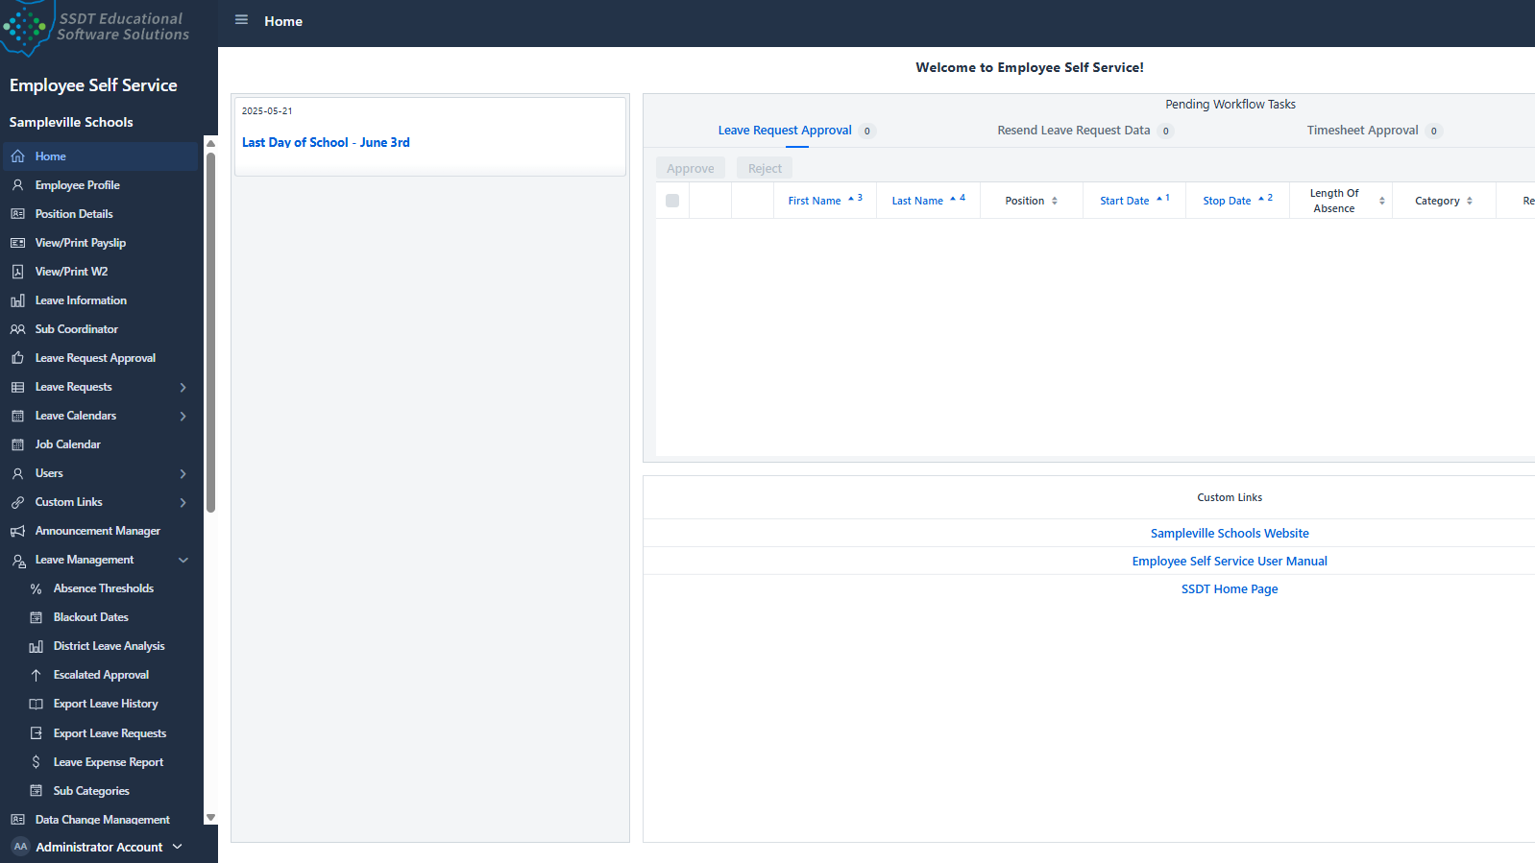

Slide 12
SubHub Ohio
This is a new product under development.
Development is scheduled for completion in July of 2026
This product will allow the maintenance of lists of authorized substitutes for positions in Ohio schools.
This will be integrated with our ESS application and allow substitutes to be contacted (via text messaging and email) and to accept open positions.
Third-party integration points will be created to allow potential integration with other products.
We are working closely with our User Focus Group to guide development.

Slide 13
H.B. 96 Key Mandates
Disclaimer
The following information is for informational purposes only and is not legal advice.
Local Governments should consult legal counsel and their technology vendors to ensure compliance.
Local Government Entities Must
Implement a cybersecurity program
Obtain approval from their legislative body for ransomware payments
Cyber incidents must be reported within specific timeframes to DPS and AOS.

Slide 14
H.B. 96 Compliance Timelines
Applies to all political subdivisions:
"Political subdivision" means a county, township, municipal corporation, or other body corporate and politic responsible for governmental activities in a geographic area smaller than that of the state.
Auditor of State Compliance Timeline for Cyber Program
Counties and Cities should have a program in place by January 1, 2026.
For all other entities, the deadline will be July 1, 2026.
Compliance Timeline for Reporting Incidents to DPS and AOS
September 30, 2025

Slide 15
H.B. 96 Cybersecurity Program Requirements
The legislative authority of a political subdivision shall adopt a cybersecurity program that safeguards the entity’s data, information technology, and information technology resources to ensure availability, confidentiality, and integrity.
The program shall be consistent with generally accepted best practices for cybersecurity, such as, National Institute of Standards and Technology (NIST) cybersecurity framework and Center for Internet Security (CIS) cybersecurity best practices.

Slide 16
H.B. 96 Cybersecurity Program Components
The program may include, but is not limited to the following:
Identify critical functions and risks
Assess the potential impact of breaches
Implement threat detection mechanisms
Establish incident response procedures
Plan for recovery and continuity
Define employee training requirements
Training from Ohio Persistent Cyber Initiation (O-PCI) could satisfy this requirement.
The O-PCI program delivered by the Ohio Cyber Range Institute (https://www.ohiocyberrangeinstitute.org/opci) and the Ohio Cyber Reserve (https://homelandsecurity.ohio.gov/ohio-cyber-integration-center/overview) includes online, hybrid and in person modules tailored to various types of organizations, from small to large, rural to urban and is funded by the State and Local Cybersecurity Grant Program.

Slide 17
H.B. 96 Ransomware Definition
(3) "Ransomware incident" means a malicious cybersecurity incident in which a person or entity introduces software that gains unauthorized access to or encrypts, modifies, or otherwise renders unavailable a political subdivision's information technology systems or data and thereafter the person or entity demands a ransom to prevent the publication of the data, restore access to the data, or otherwise remediate the impact of the software.

Slide 18
H.B. 96 Ransomware Payments
Local Governments may not pay or comply with ransomware demands unless a formal resolution or ordinance is passed.
The resolution must justify why payment is in the best interest of the organization.
(B) A political subdivision experiencing a ransomware incident shall not pay or otherwise comply with a ransom demand unless the political subdivision's legislative authority formally approves the payment or compliance with the ransom demand in a resolution or ordinance that specifically states why the payment or compliance with the ransom demand is in the best interest of the political subdivision

Slide 19
RC 9.64 (A)(1) Definition of a Reportable Incident
A substantial loss of confidentiality, integrity, or availability of a covered entity's information system or network;
A serious impact on the safety and resiliency of a covered entity's operational systems and processes;
A disruption of a covered entity's ability to engage in business or industrial operations, or deliver goods or services;
Unauthorized access to an entity's information system or network, or nonpublic information contained therein, that is facilitated through or is caused by:
A compromise of a cloud service provider, managed service provider, or other third-party data hosting provider; or
A supply chain compromise.
"Cybersecurity incident" does not include mere threats of disruption as extortion; events perpetrated in good faith in response to a request by the system owner or operator; or lawfully authorized activity of a United States, state, local, tribal, or territorial government entity.

Slide 20
Cybersecurity Incident Reporting Requirements
If a cybersecurity incident occurs local governments must notify:
Ohio Department of Public Safety (DHS/OHS)
Within 7 days
To be submitted to the Ohio Cyber Integration Center (OCIC)
Ohio Auditor of State (AOS)
Within 30 days

Slide 21
Cybersecurity Incident Reporting
Ohio Cyber Integration Center
Phone: 614-387-1089
Email: OCIC@dps.ohio.gov
Website: https://homelandsecurity.ohio.gov/ohio-cyber-integration-center
Ohio Auditor of State
Phone: 866-FRAUD-OH
Reporting Form: ohioauditor.gov/fraud/docs/CybersecurityReportingForm.pdf
Email: cyber@ohioauditor.gov
Website: www.ohioauditor.gov

Slide 22
Public Records Exemption
Records related to:
Cybersecurity programs
Incident reports and procurement documents are not public records under R.C. §149.43
This protects the confidentiality of sensitive systems and data.

Slide 23

Questions?

