Slide 1

Congratulations and welcome
Notes:
Hard work pays off, and you're proof of that. We applaud and honor each of you for the time and effort that you've put into making your dreams come true.
Congratulations and welcome to Sigma.

Slide 2

Notes:
Becoming a part of Sigma isn’t just about the honor. It’s also about the connections you make along the way. We’re a community united by a dedication to Global Nursing Excellence, and together, we have the power to make a difference.

Slide 3
Your chapter Leadership Team
Jada Craze
President, CDEL2
Jessica Parsons
President Elect
Krystal Nolan
Vice President
Karen Stranton
Treasure
Diane Nielsen
Secretary
Marje Silcox
Awards Chair
Lyndsi Engels-
Awards Member
Tina Myers
AU Counselor
Karla Adu
MVNU Counselor, Gov.
Comm. Chair , CDEL1
Sarah Marshall
Governance Committee
Debra Garee
Leadership Succession
Chair
Malinda Ashcraft
Leadership Succession
Notes:
So, let’s introduce you to your chapter leadership team.

Slide 4
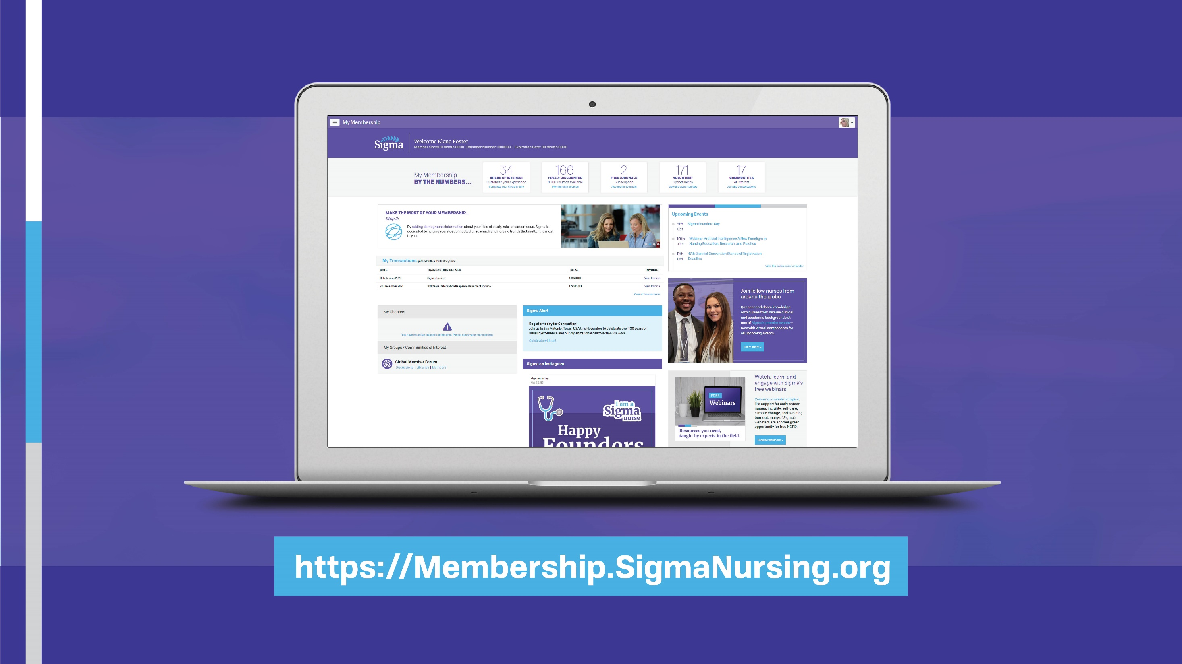
Notes:
Your achievements have opened up a lifelong opportunity and Sigma is dedicated to supporting you throughout your entire nursing career.
To get started, visit My Membership at Membership.SigmaNursing.org. Think of My Membership as your go-to spot to access all of your member benefits, update your contact information and demographics, and set your email preferences.

Slide 5

Notes:
We encourage you to update the email account tied to your Sigma membership if it currently has a .edu extension as email addresses ending in .edu may impact deliverability. Using a personal email is recommended to ensure that our emails are getting through to you!
Make sure you look for Sigma Update, our monthly all-member email that’s sent on the first day of every month. In Sigma Update, you will find Sigma news, including chapter news, event information, new nursing continuing professional development (NCPD) courses, upcoming webinars, and more!

Slide 6
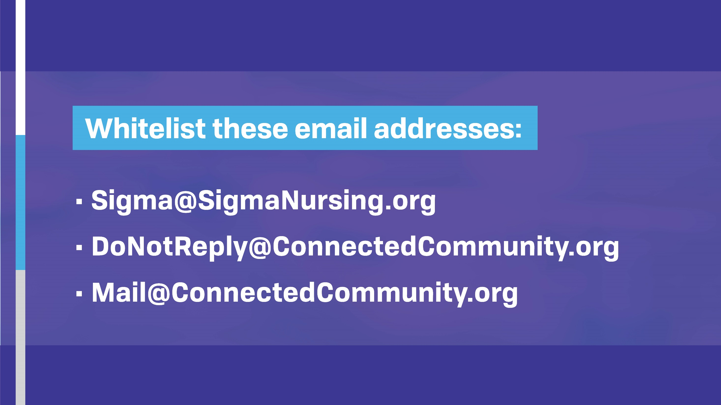
Notes:
It is also important to whitelist these email addresses so that they do not get caught in any spam blockers:
• Sigma@SigmaNursing.org
• DoNotReply@ConnectedCommunity.org
• Mail@ConnectedCommunity.org

Slide 7

#WeAreSigmaNurses
Notes:
We love seeing new Sigma faces and want to connect! Don’t forget to tag your posts with #WeAreSigmaNurses.

Slide 8

Your Sigma member benefits
Image of the guide and a QR code
Notes:
Now, let’s discuss your Sigma member benefits, designed to meet your needs at every stage of your career.
Start by scanning this QR code to view Sigma’s New Member Guide. In it, you will find an overview of all of the benefits to which you now have access. I highly recommend that you take some time to review it because wherever you are in your professional journey, Sigma has the resources and knowledge to help you grow and achieve your goals.

Slide 9
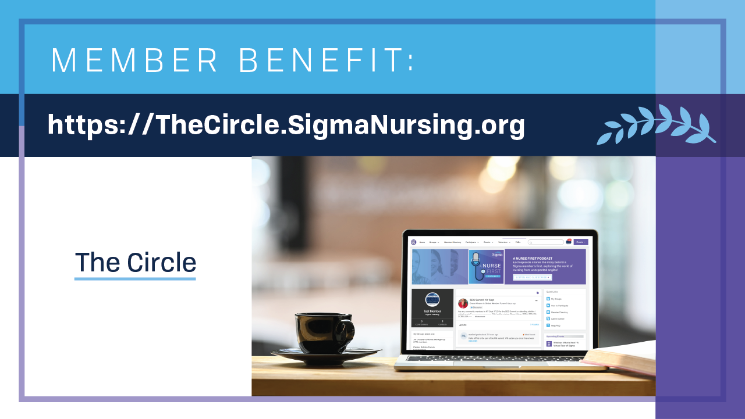
Notes:
Home - The Circle (sigmanursing.org)
As a Sigma nurse, you belong to a community of nurses who are dedicated and passionate like you. Interact virtually with members from around the world on The Circle, our online community.
On The Circle, you can:
Receive the support you need and share your voice.
Participate in more than 15 communities of interest.
Get career advice through the Career Advice Forum.
Collaborate with peers around the world through the Global Member Forum.
Maintain chapter connections.
And find volunteer opportunities on the local, regional, and international level.
You can also access our chapter website at Rho Nu at-Large.sigmanursing.org/home.

Slide 10
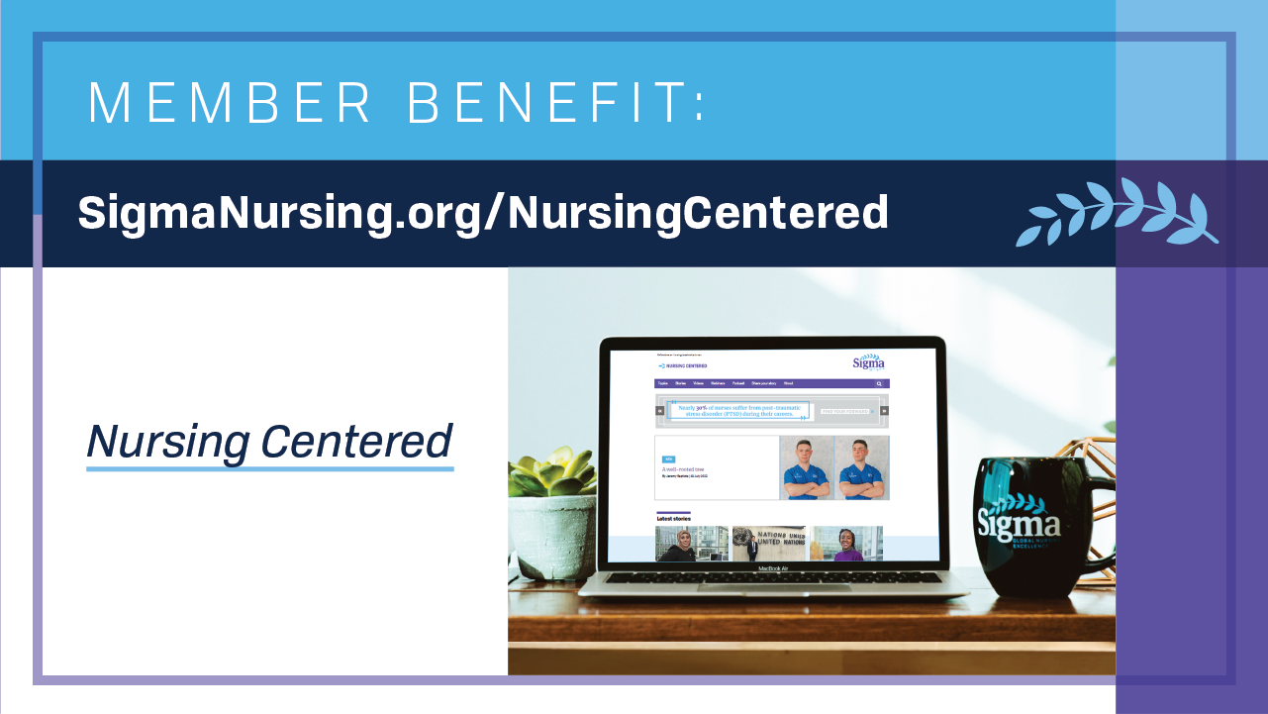
Notes:
Another valuable Sigma member benefit is Nursing Centered—Sigma’s online resource center.
On Nursing Centered, you can download a podcast episode, watch an expert-led webinar and collect NCPD contact hours, and hear from Sigma members about their latest research and experience.

Slide 11

Notes:
Sigma offers several free webinars each month, covering a variety of topics, like support for early career nurses, NCLEX test strategies, incivility, self-care, climate change, and avoiding burnout. But if you are unable to make a live webinar, recordings are available on Nursing Centered for you to watch on-demand.
Sigma also offers a What’s Next webinar that provides a tour of everything Sigma has to offer.

Slide 12

Notes:
Along with webinars, Sigma also develops online NCPD courses to help you thrive as a nurse. By nurses, for nurses, these courses cover topics like incivility and bullying, healthcare leadership, how to publish your work, human tracking, sexual assault, and more. Sigma’s peer-reviewed and evidence-based courses are some of the best offerings for nurses and I encourage you to access these valuable resources.

Slide 13
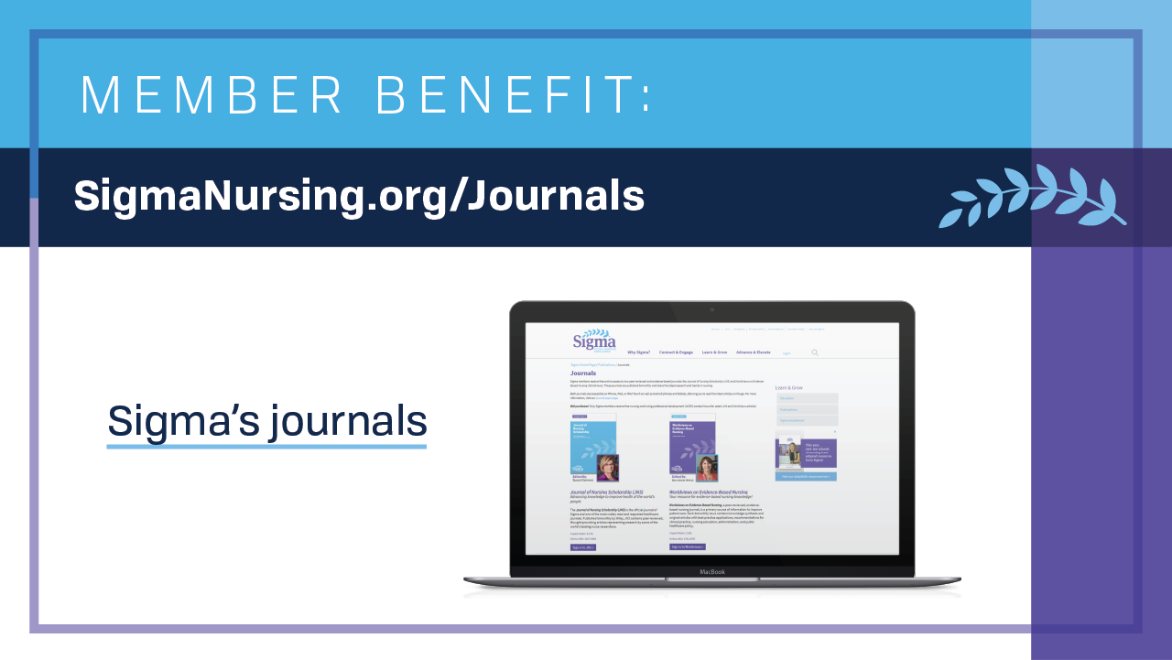
Notes:
Being a Sigma nurse also opens up opportunities to stay current on nursing trends with your free online subscriptions to Sigma’s two peer-reviewed and evidence-based journals, Journal of Nursing Scholarship (JNS) and Worldviews on Evidence-Based Nursing (Worldviews). You can also receive free NCPD contact hours for select articles.

Slide 14

Notes:
The Sigma Repository is another great resource that provides free, open access to the latest research. You can submit your own work to the Repository, too!

Slide 15
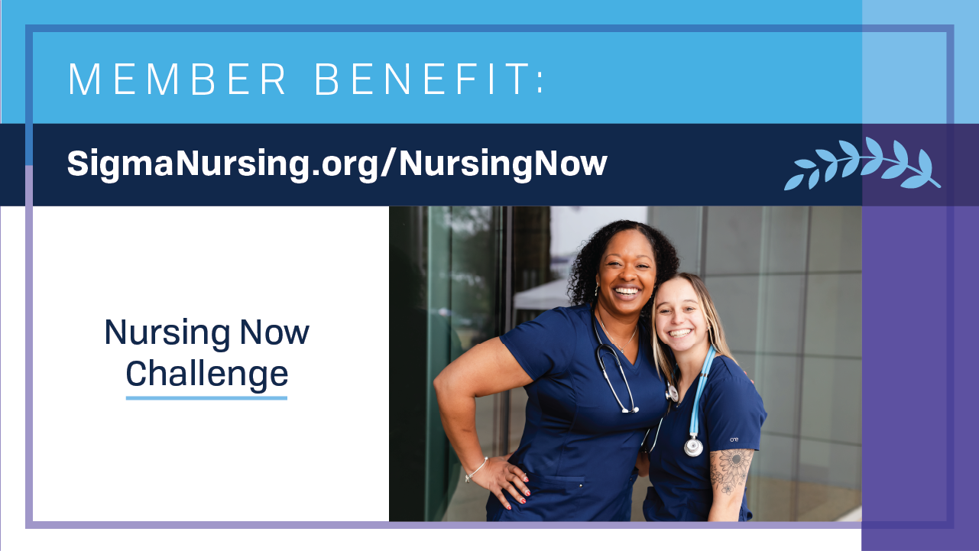
Notes:
Want to grow and develop leadership skills, connect with experienced nurse leader mentors, and network with other nurses globally? Join the Nursing Now Challenge!
This 12-month program is specifically designed for early-career nurses and will elevate your leadership skills and help you become the confident leader you aspire to be. Plus, it is free for Sigma members!

Slide 16

Notes:
As a Sigma member, you have so many opportunities to participate in the advancement of healthcare on a global scale. Sigma has a seat at the table when it comes to global health issues and concerns. We are actively involved in the United Nations (UN) and have special consultative status because of our expertise in the field of nursing and global health.
With our commitment to the UN, Sigma encourages you to better understand and help contribute to the Sustainable Development Goals (SDGs). The SDGs are the blueprint to achieve a better and more sustainable future for all by 2030.
As the next generation of Sigma leaders, we know the future is bright!

Slide 17

Notes:
You made it. You're a Sigma nurse.
Let's celebrate this achievement together and continue to strive for Global Nursing Excellence in all that we do.

