Slide 1

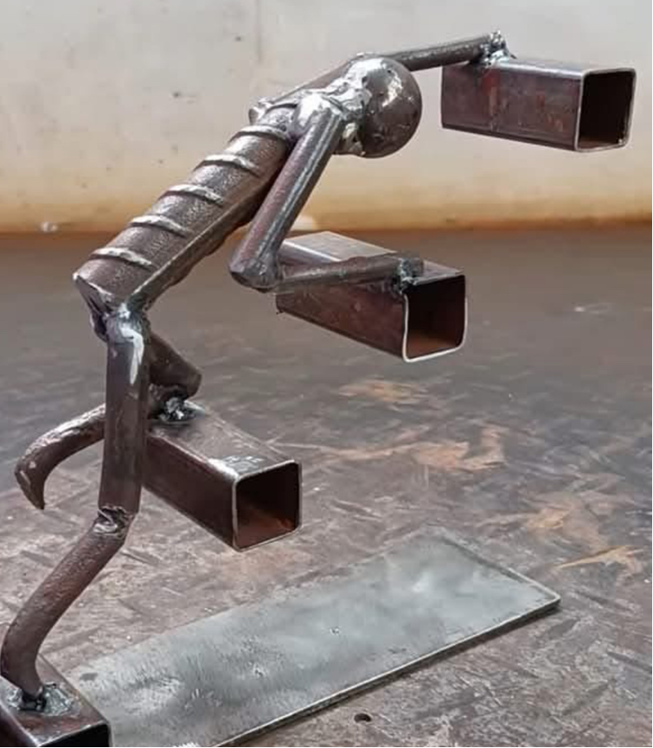

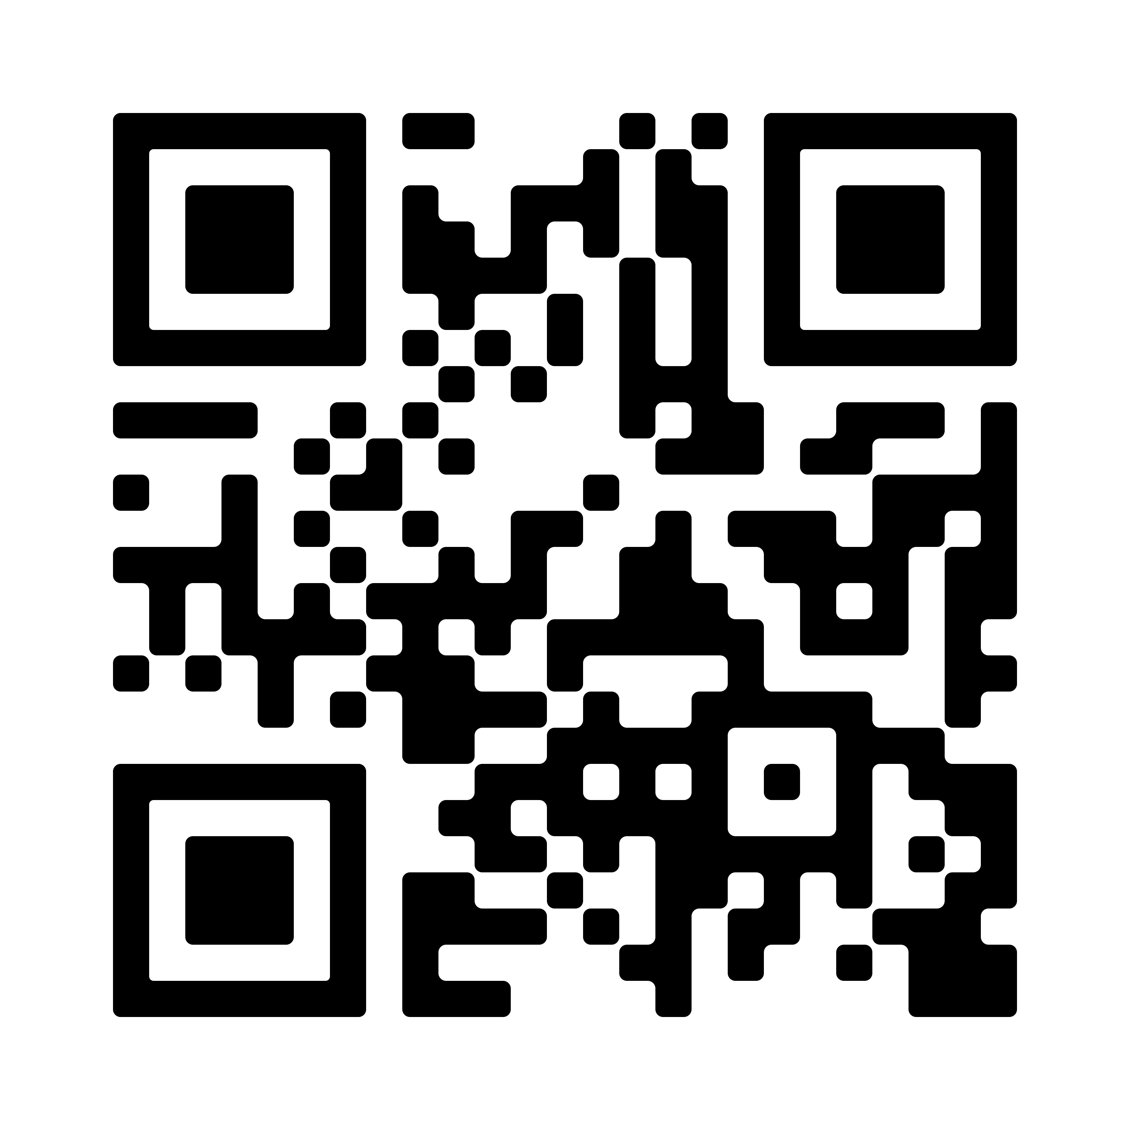
Elevating Your Practice: Soaring to New Heights
2025 Nursing Conference
April 26, 2025
7:30am – 4:00pm
Atlanta Administration and Conference Center,
Mercer University, Atlanta, GA
Join us for our inaugural conference sponsored by the Pi Gamma at-Large Chapter of Sigma Theta Tau and Georgia Baptist College of Nursing of Mercer University. We invite alumni, current graduate students, our clinical partners who serve in myriad nursing roles, and nurse leaders from across the country to engage in community and explore concrete ways to elevate our practice as nurses.
Accepting Poster Submissions NOW Through April 10, 2025 – Click HERE for Details or Scan QR Code:
Click here for Registration and Agenda: https://www.eventbrite.com/e/elevate-your-practice-soaring-to-new-heights-tickets-1279727873519?aff=oddtdtcreator

