Slide 1
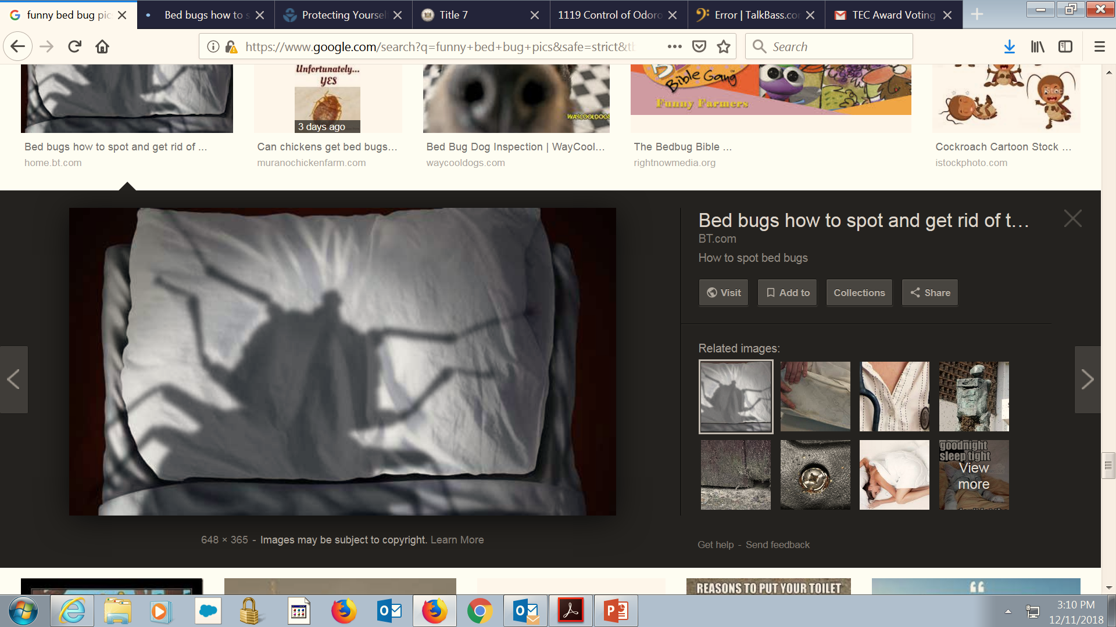

Bedbugs
Delaware Division of Public Health
Health Systems Protection
Ken Belmont
302-744-4721

Slide 2
What are bed bugs?
Bed bugs are small, flat, oval, wingless insects reddish-brown in color that feed on humans and other warm-blooded animals
These insects about one fourth (¼) of an inch in length.
Immature bed bugs (nymphs) are usually lighter in color but otherwise resemble adults.
The typical life span of a bed bug is about 10 months. They can survive for weeks to months without feeding.

Slide 3
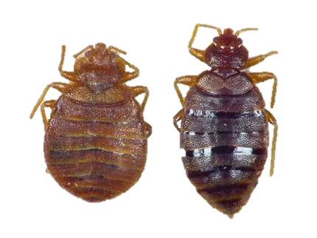

Slide 4
BED BUGS – QUICK FACTS:
Bed bugs were controlled, but never completely eradicated in the USA after WWII through the use of highly toxic pesticides like DDT. However, limited infestations occurred in certain areas of the country.
Many of the pesticides that were effective against bed bugs aren’t available now.
Bed bugs have developed resistance to many of the pesticides that have been used to kill them.
Increased foreign travel, immigration, and importation of goods has helped to spread bed bugs.

Slide 5
BED BUGS – QUICK FACTS:
Bed Bugs aren’t known to transmit disease.
Bed bugs are blood feeders.
Bed bug bites normally occur at night, and the bite is generally painless.
Bed bugs are not killed by cold. “Freezing them out” doesn’t work.

Slide 6
BED BUGS – MYTHS
A FEW BED BUG MYTHS
“Only dirty people get bed bugs.”
“Bed bugs are only found in places like military barracks where people are crowded together”
“Bed bugs are only a problem for low – income people.”

Slide 7
BED BUGS ARE EVERYWHERE!
Bed bugs have been found in:
Senior Housing.
Nursing homes.
Apartment buildings.
Hotels.
Schools.
Private Homes.
Churches.
Movie Theatres.
College Dorms.
Social Service Agency Offices.
Others.......

Slide 8
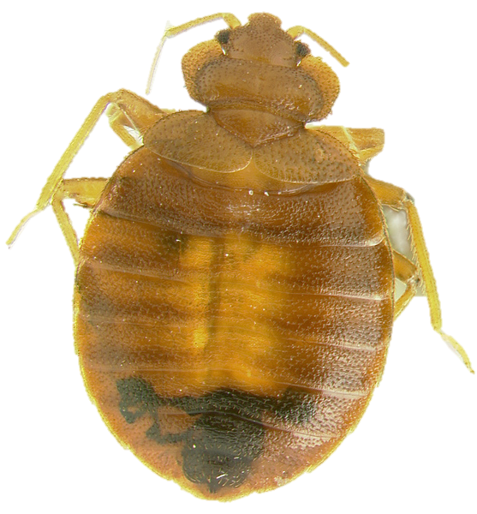
Bed Bugs : Life Cycle and Feeding Behavior

Slide 9
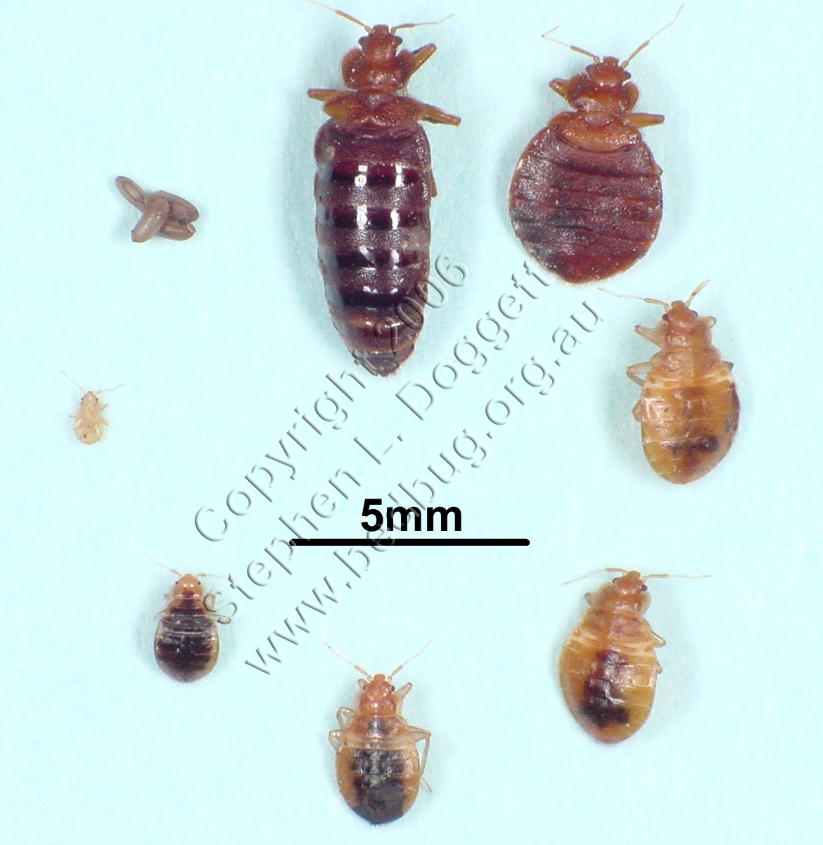

Slide 10
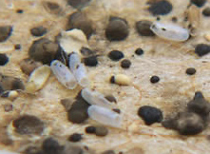
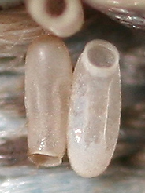
Life Cycle of a Bed Bug
A female may lay from 1 to 5 eggs per day and more than 200 eggs during her lifetime.
It takes from 7 to 17 days for the eggs to hatch, depending upon the temperature. As soon as the nymph exits the egg, it is ready for a blood meal.
EGGS

Slide 11
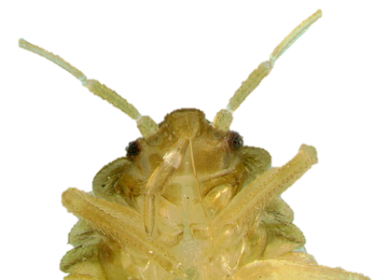
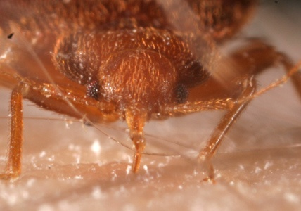
Bed bug bites
Mouth parts
Bed bugs do not transmit diseases in nature. They penetrate the skin with sharp beak-like mouth parts that are bundled as two ventral tubes. First they inject saliva down one tube to thin the blood. Intense itching results from an individual response to the injection of saliva.
Feeding lasts several minutes and bed bugs may bite again a few inches away from the first bite location. All stages of nymphs and both males and females take blood.

Slide 12
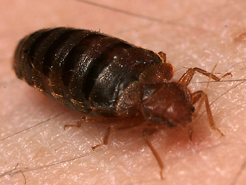
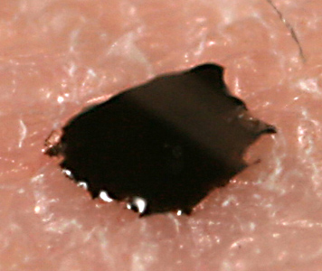
Reactions to bed bug bites
Location of bites are on exposed parts of the body while the host is sleeping. Welts are often a more severe reaction that develops over time to frequent bites. Some individuals show almost no response to the bites of bed bugs while others have a severe reaction of itching and welts. It is difficult to be sure that bites are from bed bugs without collecting a sample of a bed bug specimen.
During feeding, the adult expands with engorged blood and leaves behind a small fecal droplet.

Slide 13
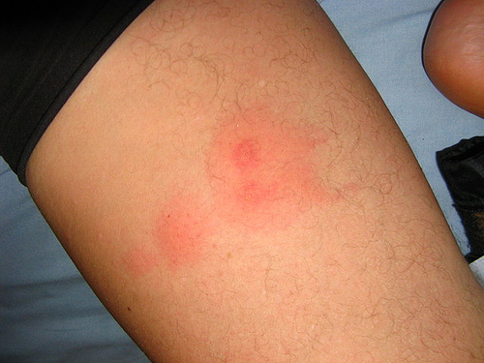
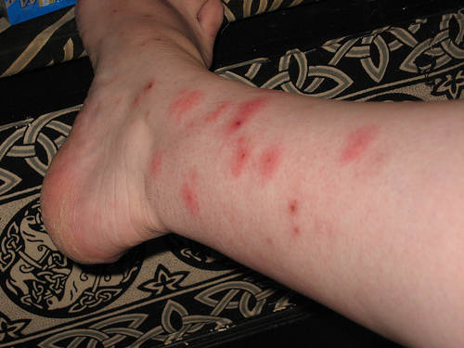
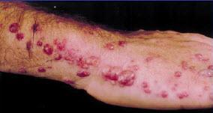
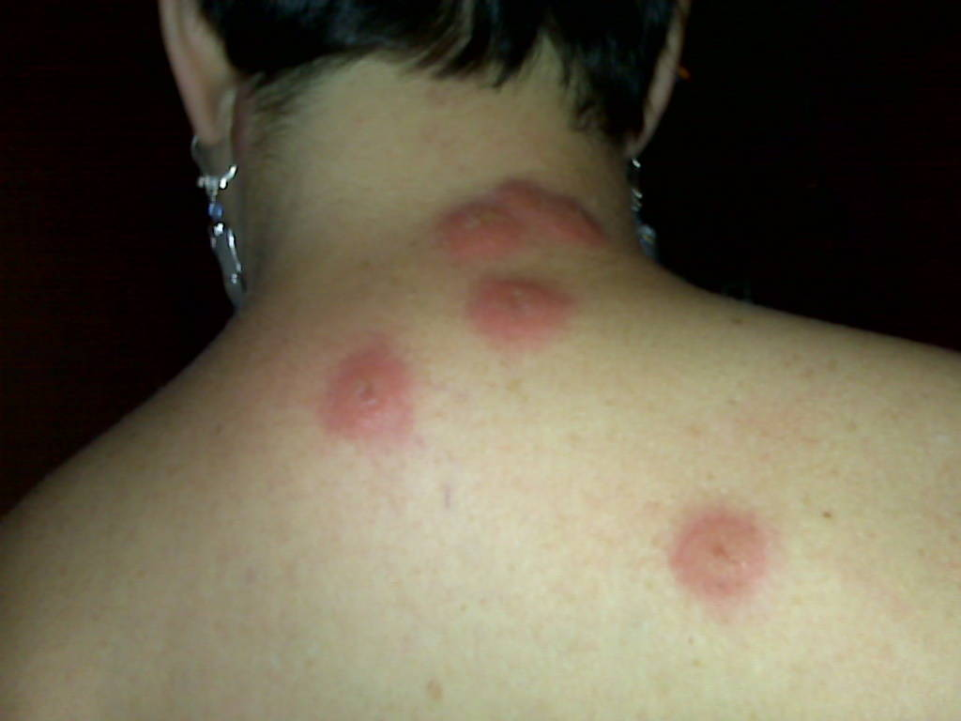
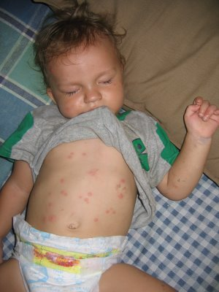
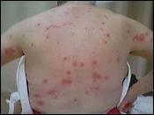

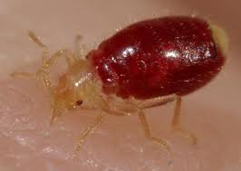

Slide 14
Options for Treatment
Self Treatment – typically ineffective but frequently what many people can afford (Can Be Done However)
Chemical Application – Requires intense preparation and repeated treatment(s)
Heat treatment – requires professional application/preparation and can be a one-time effort

Slide 15
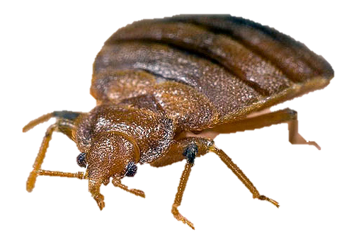

Slide 16
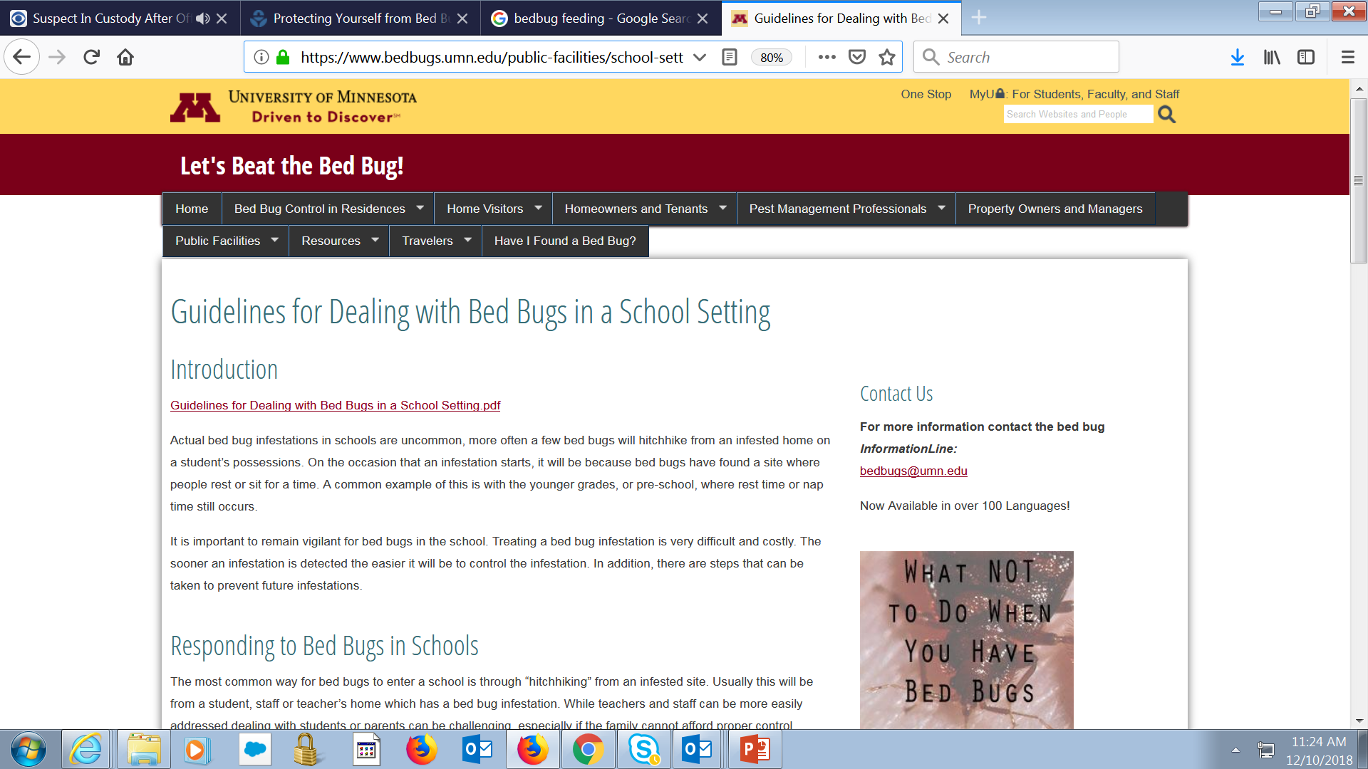
Bedbug SOPS – Examples
https://www.bedbugs.umn.edu/public-facilities/school-setting

Slide 17
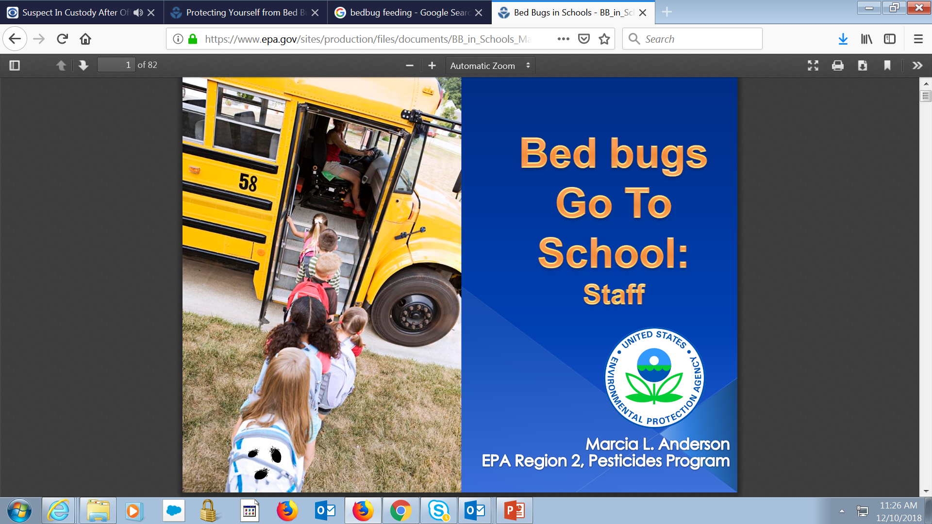
Bedbug SOPS – Examples
https://www.epa.gov/sites/production/files/documents/BB_in_Schools_May_2012.pdf

Slide 18
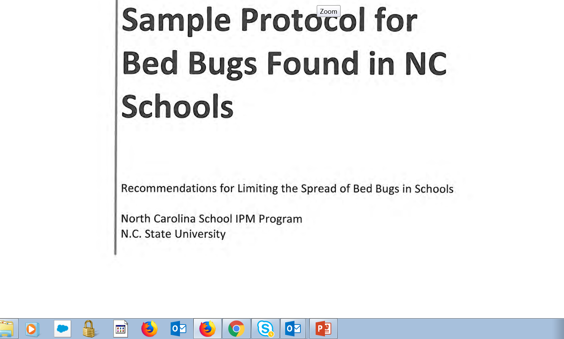
Bedbug SOPS – Examples
https://cchealth.org/bedbugs/pdf/2016-Sample-Protocol-BB-Schools.pdf

Slide 19
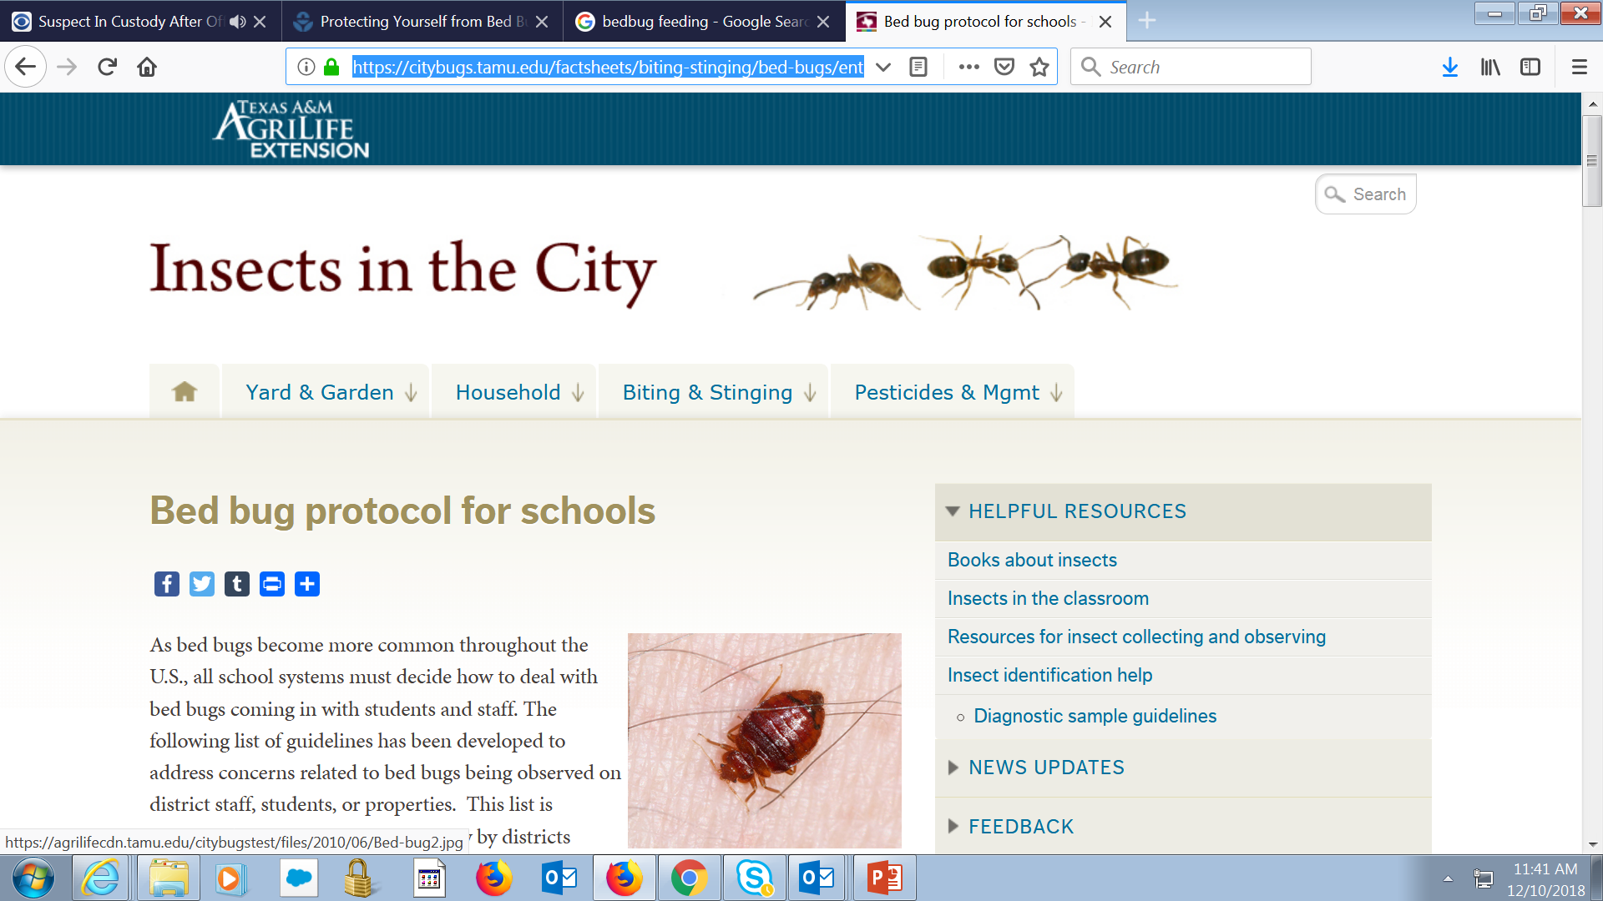
Bedbug SOPS – Examples
https://citybugs.tamu.edu/factsheets/biting-stinging/bed-bugs/ent-3014/

Slide 20
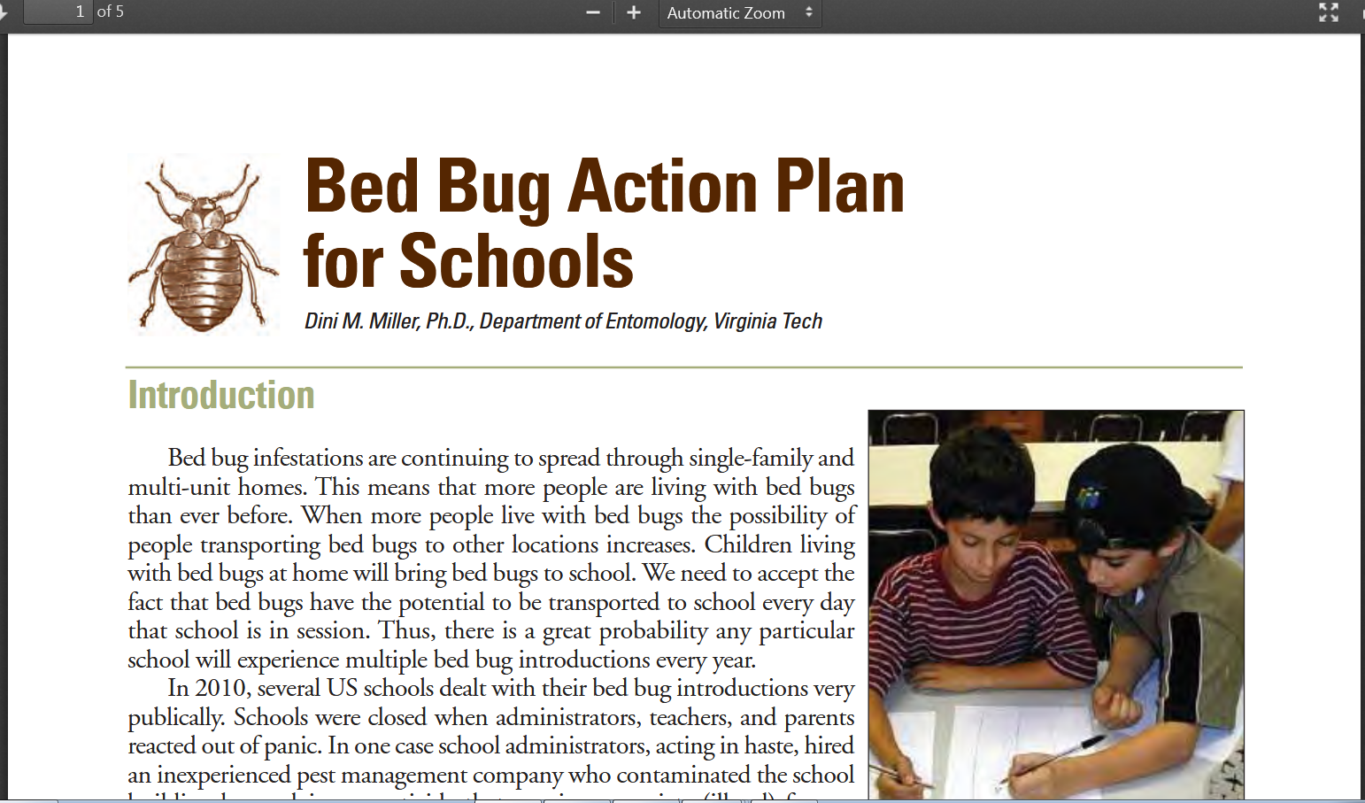
Bedbug SOPS – Examples
http://www.vdacs.virginia.gov/pdf/bb-schools1.pdf

Slide 21
Thank you
Any Questions ?
Ken Belmont 302-744-4721

Slide 22

Stomach bugs
Delaware Division of Public Health
Health Systems Protection
SandI SpIEGEL
302-744-4546

Slide 23
What are stomach bugs?
Gastrointestinal pathogens
    Bacteria
    Viruses
    Parasites
    Toxins

Slide 24
What are the most prevalent stomach bugs that can be transmitted through food?
Norovirus
Shiga Toxin producing E.Coli (STEC)
Hepatitis A
Typhoid Fever
Shigellosis
Nontyphoidal Salmonella (NTS)
We call these the BIG 6!

Slide 25
What are the symptoms of foodborne illness?
Vomiting
Diarrhea
Fever
Chills
Sweats
Cramps
Jaundice

Slide 26
Other viruses mimic foodborne illness but are either not reportable or are transmitted in another means besides through food.
Examples: Sapovirus and Astrovirus

Slide 27
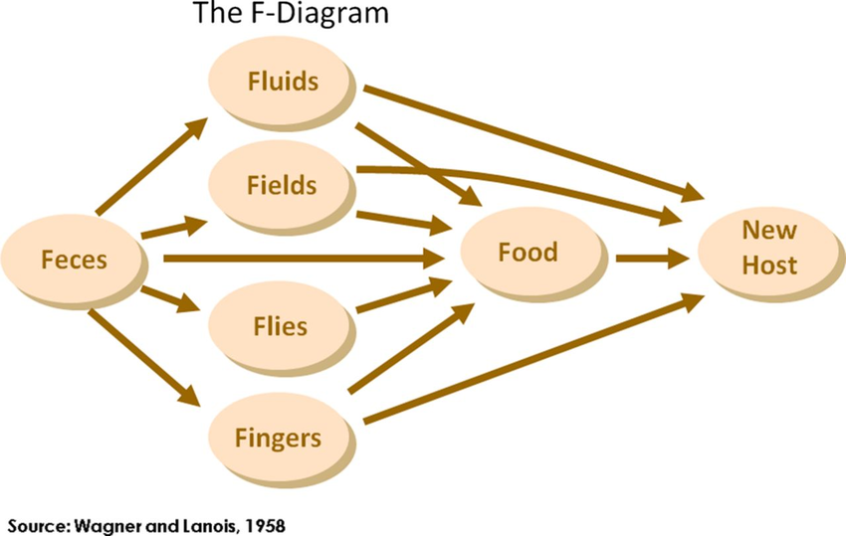
How does foodborne illness spread?
Oral-Fecal Route

Slide 28
What are some indicators that a stomach bug is viral in nature and how do you mitigate?
A parent becomes sick 24-48 hours after the kid is sick. Secondary transmission from a student to a parent is evident. Advise parents to clean the flat surfaces, bathrooms, and high touch surfaces using CDC norovirus clean up procedures. Tell them not to prepare food for their family for 48 hours after symptoms subside.
A second/additional student becomes sick 24-48 hours after the first kid is sick. Secondary transmission from a student to a student is evident. Ensure the environmental/custodial services have proper personal protective equipment (PPE) to clean, have the same surfaces cleaned using CDC procedures.

Slide 29
How do you minimize transmission of stomach bugs?
Use PPE and CDC clean up procedures
Proper handwashing
Encouraging parents/kids to stay away from work/school for at least 24 hours after symptoms have subsided.
Encouraging food workers and food handlers not to prepare food for at least 48 hours after symptoms subside.

Slide 30
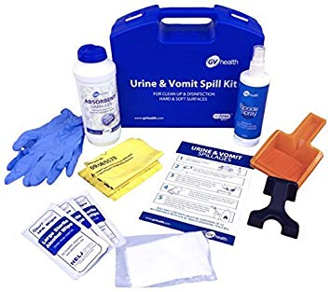
Do you have a vomit and diarrhea clean up plan?
Do you have the PPE to accompany it?
Do you have the desiccant and bags?

Slide 31
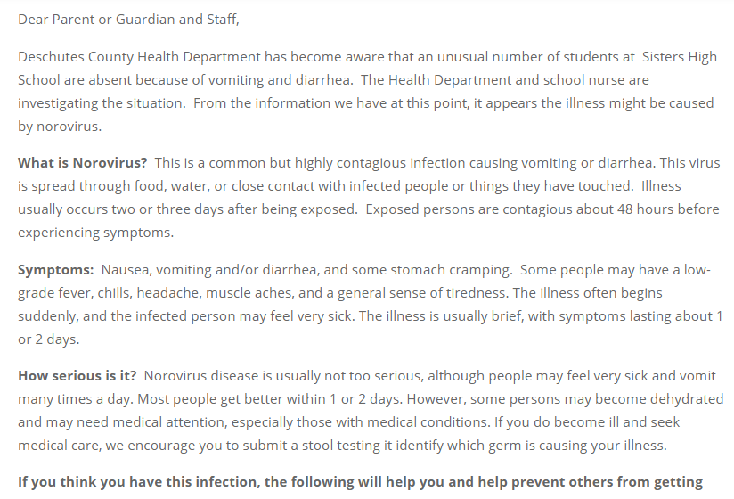
Do you have a letter ready to share with teachers and parents if an outbreak of stomach illness occurs?
Example
Found here: http://ssd6.org/noronov14/

Slide 32

Proper Handwashing is the Number 1 way to minimize foodborne illness transmission.

Slide 33
Resources:
CDC Bad Bug Book:
  https://www.fda.gov/downloads/Food/FoodborneIllnessContaminants/UCM297627.pdf
CDC Norovirus Key Facts:
  https://www.cdc.gov/norovirus/downloads/keyfacts.pdf
National Association of School Nurses:
  https://schoolnursenet.nasn.org/blogs/nasn-profile/2018/05/06/learn-how-to-prevent-spreading-norovirus-in-your-s
Cleaning Up Vomit and Diarrhea
  https://www.dhss.delaware.gov/dhss/dph/hsp/files/ofpvanddinfo.pdf
Focus on Food Safety in the First State
  https://www.dhss.delaware.gov/dhss/dph/hsp/files/focusonfoodsafety.pdf

Slide 34
Thank you
Any Questions ?
Sandi Spiegel 302-744-4546

