Slide 1
2019 NASBLA Enforcement and Training Committee

Slide 2
Survey Participation and Evaluation
2019 National Training Survey received 32 respondents.
Traditional courses remain in highest demand.
How do we better meet your training needs ?
Is NASBLA doing enough to market training options ?

Slide 3
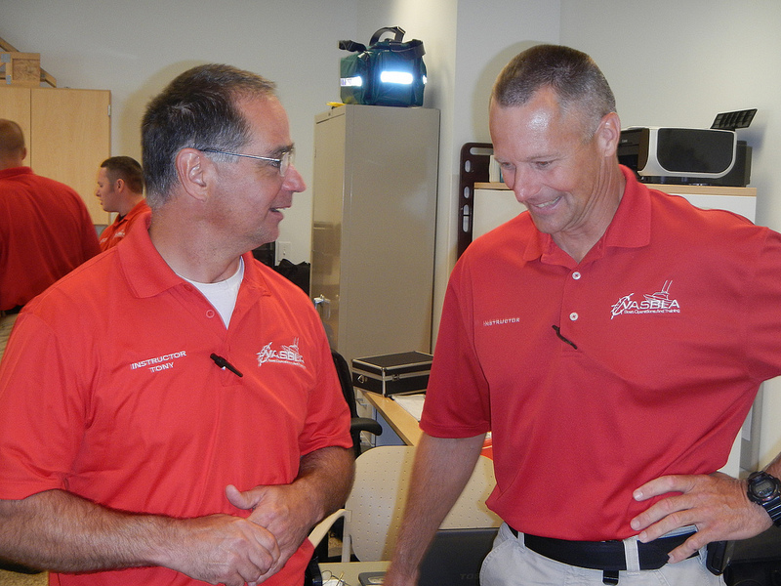
Survey Analysis and possible solutions
Review 2019 National Training Survey
Review existing delivery models
Prioritize the future development

Slide 4
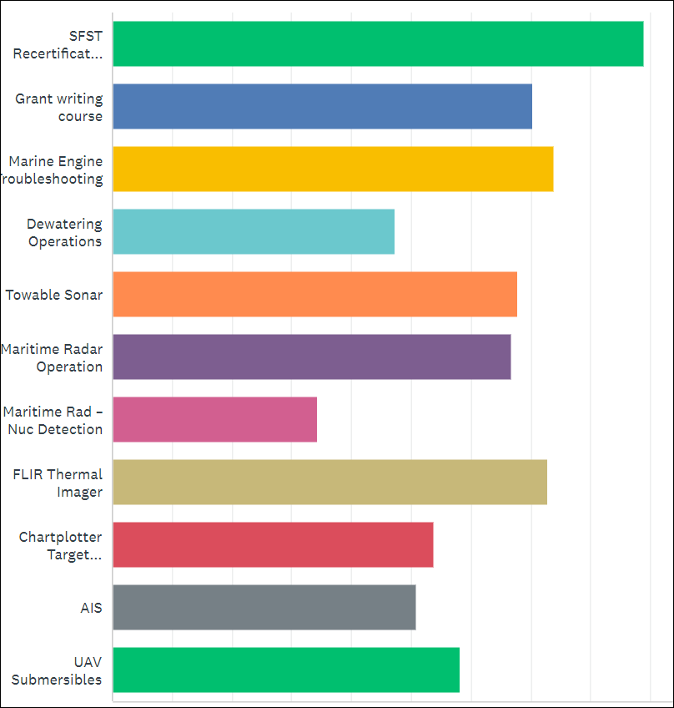
BUI and the SFST stay at the top of the list w/ 42 % of respondents selected as their number 1 request.
At 17 % - Grant writing was the second highest requested course
Followed by marine engine troubleshooting at 14 %
Notes:
What eLearning courses would you like to see created?

Slide 5
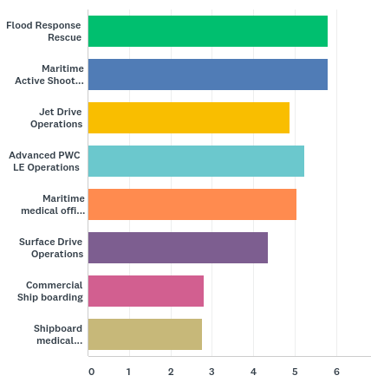
Top requests for training not currently available
Flood Response
34 % selected as their first priority
Notes:
Flood Response Rescue
Maritime Active Shooter
Jet Drive Operations
Advanced PWC LE Operations

Slide 6
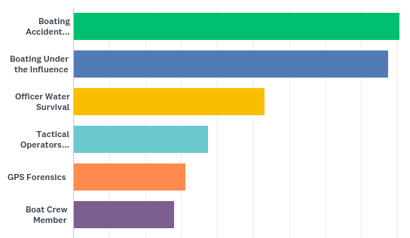
What courses do you currently offer within your agency
About 90 % are offering BAI & BUI

Slide 7

Training opportunities available through:
USCG Grant Funded
Tuition Based
Accreditation
Group A
Group B
Group C

Slide 8
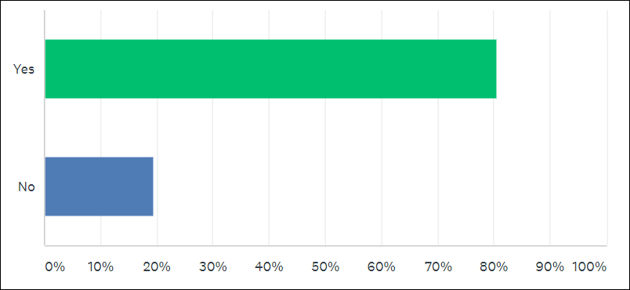
Webinars and eLearning Opportunities
More than 80% said they wanted more webinars and eLearning

Slide 9
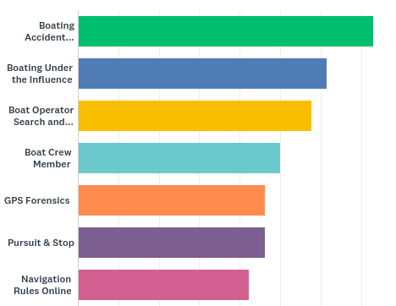
Courses that members identified for eLearning components for wider delivery

Slide 10
What training would you like developed into a BOAT course?
Notes:
Open-ended question

Slide 11
Vessel Firearms Usage
Basic Boat Maintenance and Troubleshooting
Cold Water Survival
Motorboat Noise Enforcement
Solo Officer Patrol
Operation courses for inland states with smaller water bodies
Alcohol Physiology & Drug Recognition

Slide 12
Recreational Vessel Safety Inspection Process
Lifejacket labeling, stowage and usage requirements
Sound signals and devices
Lighting requirements
Ventilation purpose and requirements
Flame arrestor purpose and requirements
Visual distress signal carriage and usage
Vessel registration and numbering requirements
Documented vessel requirements

Slide 13
Next Steps
We need to dig a little deeper
What are your challenges
BOAT Advisory Board – April 30 – May 1

Slide 14
And now a couple of questions…

