Slide 1
User Guide for Completing an Application for
Certificate of Number
per 33 CFR Part 174
33 CFR Part 174 - State Numbering & Casualty Reporting Systems
Last Updated 7/31/2026

Slide 2
Table of Contents
Slide 3: Training Purpose
Slide 4: Training Importance
Slide 5: Training Objectives
Slides 6-7: Vessel Owner Information
Slide 8: State of Principal Operation
Slide 9: Vessel Specifications
Slide 10: Primary Operation
Slide 11: Vessel Make/Model
Slide 12: Model Year & Vessel Length
Slide 13-14: Hull Identification Numbers
Slides 15-19: Vessel Type, Hull Material, Propulsion, Engine Drive & Fuel
Slide 21: Temporary Certificate
Slide 22: Certificate Formats & Duration
Slide 23: State Numbering Format
Slides 24-25: Number & Sticker Information
Slide 26: Common Data Inaccuracies
Slide 27: Key Takeaways
Slide 28: Contact info for Questions
Slides 29-51: Appendices

Slide 3
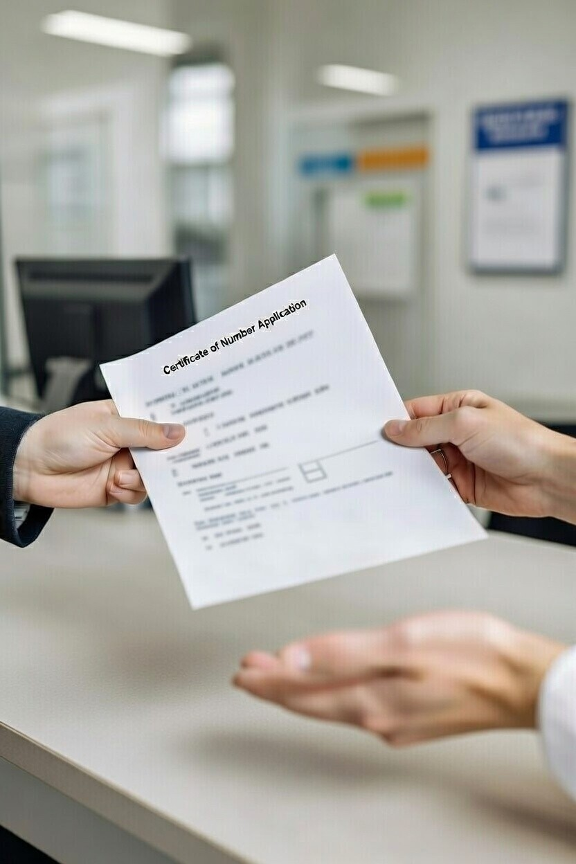
Training Purpose
This training aid will assist you with correctly completing or reviewing an Application for Certificate of Number (aCON) as outlined in 33 CFR Part 174 and to provide accurate registration and title ownership to the customer.
Having an accurate CON (registration) and title information is critical because it assists new buyers with a smooth transfer, facilitates loan processes, streamlines the filing of insurance claims, and assists law enforcement fraud and theft investigations.
Each state aCON may have a slightly different format, but the information captured is required to be consistent.
This training aid is a “step-by-step” approach to ensure consistency within each section of the aCON.

Slide 4
Training Importance
Regardless of your personal boating experience, as an agency representative, providing knowledge and guidance to customers is essential.
This training aid will guide you in reviewing vessel aCON and identifying common data inaccuracies, including incorrect state of principal operation, hull identification numbers (HIN), vessel type, and user information.
Errors on the aCON jeopardize accurate watercraft identification, create significant issues for sales and transfers to other states and law enforcement investigations.
By thoroughly reviewing applications for completeness, customer service representatives ensure accurate information entry from the very first step.

Slide 5
Training Objectives
By the end of this guide, you will be able to:
Review an aCON for completeness and accuracy.
Verify all 10 required vessel specifications, including the 12-character HIN.
Correctly identify vessel type, hull material, propulsion type, and engine drive type.
Distinguish State of Principal Operation from Primary Operation.
Recognize common data errors and know the steps to correct them.
Explain the CON certificate formats, validity periods, and state numbering and sticker rules to customers.

Slide 6
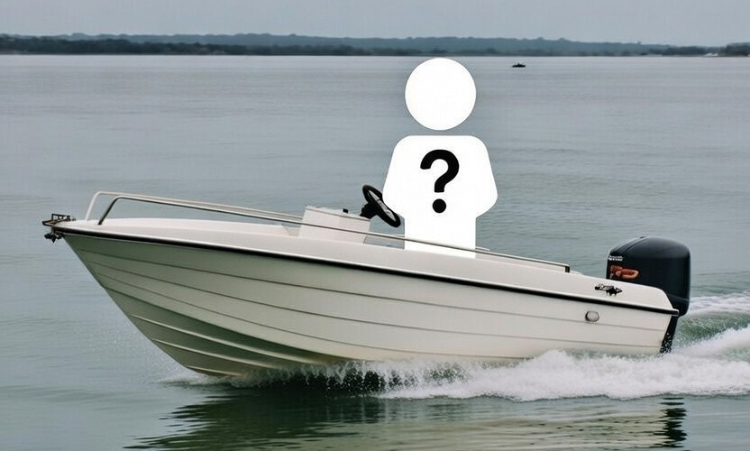
Application for CON
Vessel Owner Information
The vessel owner must be identified and shall include:
Legal name of owner
Mailing address of owner, including ZIP Code
Unique owner identifiers:
  Tax identification number, OR
  Date of birth together with driver's license number, OR
  Date of birth together with other unique number (system generated, passport, etc.)

Slide 7
Owner Information: Special Cases
Multiple or non-individual owners
Co-owners: record the full name and unique identifiers for each owner listed on the application.
Businesses, trusts, or estates: capture the entity’s legal name and tax identification number, plus the name of an authorized representative.
Supporting documents to confirm
Proof of ownership - bill of sale, manufacturer’s certificate of origin, or prior title/registration.
Government-issued photo ID for each owner.
Names and identifiers on the documents must match the application exactly.
Follow your agency’s procedures for the specific documents required in your state.

Slide 8
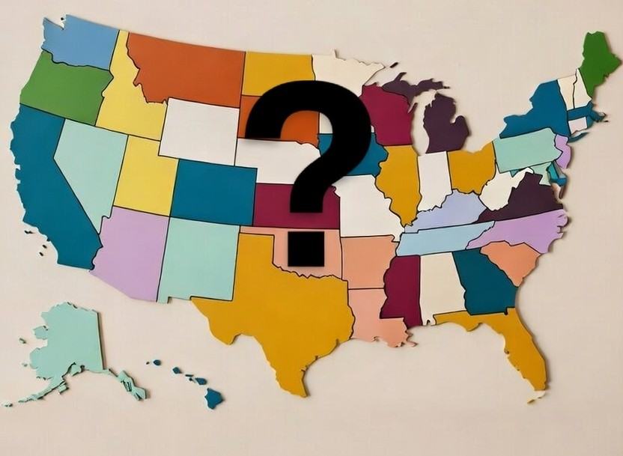
Application for CON:
State of Principal Operation
  State of principal operation means the state in whose waters a vessel is or will be operated most during a calendar year. (This identifies the state - not to be confused with “Primary Operation,” which describes how the vessel is used (recreational or commercial).)
  This is critical information to determine if the vessel should be registered in your state.
  If the state of principal operation is not your state, DO NOT register this vessel or issue a CON.
  Note: Any vessel registered in the US must physically be in the US for a minimum of 1 day. This prevents the US from being used as a “Flag of Convenience.”

Slide 9
Application for CON:
Vessel Specifications
There are ten (10) vessel specifications that must be recorded on every aCON.
Primary Operation (type of use)
Make and Model
Model Year
Hull identification number
Overall Length
Vessel Type
Hull Material
Propulsion Type
Engine Drive Type
Fuel

Slide 10
Primary Operation
The vessel’s primary use (recreational or commercial) – not the state the vessel will be operated in.
Primary Operation refers to the most common reason the owner is operating the vessel. Most vessels will be for “pleasure” recreational use such as a weekend fishing or skiing.
The commercial operation options should be used if the Primary Operation of the vessel is “for hire” occurring when any form of compensation is given to a vessel owner for use of the vessel.
Primary Operation options allowed on the aCON:
Pleasure
Commercial Passenger Carrying
Rent or Lease
Dealer or Manufacturer Demonstration
Charter Fishing
Other Commercial Operation
Commercial Fishing
Charter Fishing: means a vessel carrying a passenger(s) for hire who is (are) engaged in recreational fishing.
Commercial Fishing: means a vessel that commercially engages in the catching, taking, or harvesting of fish which, either in whole or in part, is intended to enter commerce through sale, barter, or trade.

Slide 11
Vessel Make and Model
The vessel’s make (the company that manufactured the vessel) must correspond to the US Coast Guard-assigned Manufacturer Identification Code (MIC).
It is important to verify that the MIC (the first 3 characters of the vessels HIN) is both:
VALID, and
MATCHES the manufacturer listed on the USCG MIC website: Manufacturer Identification Code (MIC)
With the exception of Canada, foreign countries do not use the same MIC database at the US – therefore, it’s imperative to ensure the vessel was properly imported and assigned a US HIN.
If the MIC is incorrect/invalid or the listed manufacturer on the USCG MIC database does not match the manufacturer listed on the aCON, contact your supervisor for assistance.
The vessel’s model ensures accuracy in identifying the watercraft, documents its specifications, and assists law enforcement in recovering stolen vessels.

Slide 12
Vessel Model Year
Indicates the model year or year it was offered for sale by the manufacturer. Determined by the HIN
Vessel Length
The U.S. Coast Guard requires accurate vessel length - specifically Length Overall (LOA) - because it directly dictates federal safety equipment carriage requirements (life jackets, fire extinguishers, and visual distress signals), and establishes eligibility for vessel documentation and formal tonnage measurement.
For a simplified definition and example of length, see appendix

Slide 13
Hull Identification Number (HIN)
Accurately recording the HIN is critical. It is the unique identifier that tracks a vessel throughout its lifetime. Because it is easy to mistype,
please double-check it for accuracy.
Since November 1, 1972, three HIN formats have been used:
                Straight Year Format - Used November 1, 1972 – July 31, 1984
Model Year Format - Used November 1, 1972 – July 31, 1984
Current Format - Used August 1, 1984 – to present – This is the only valid format for boats built August 1, 1984 and newer.
For detailed information about HIN requirements,
see the NASBLA HIN PowerPoint
https://community.nasbla.org/viewdocument/hin-validation-verification-guide

Slide 14
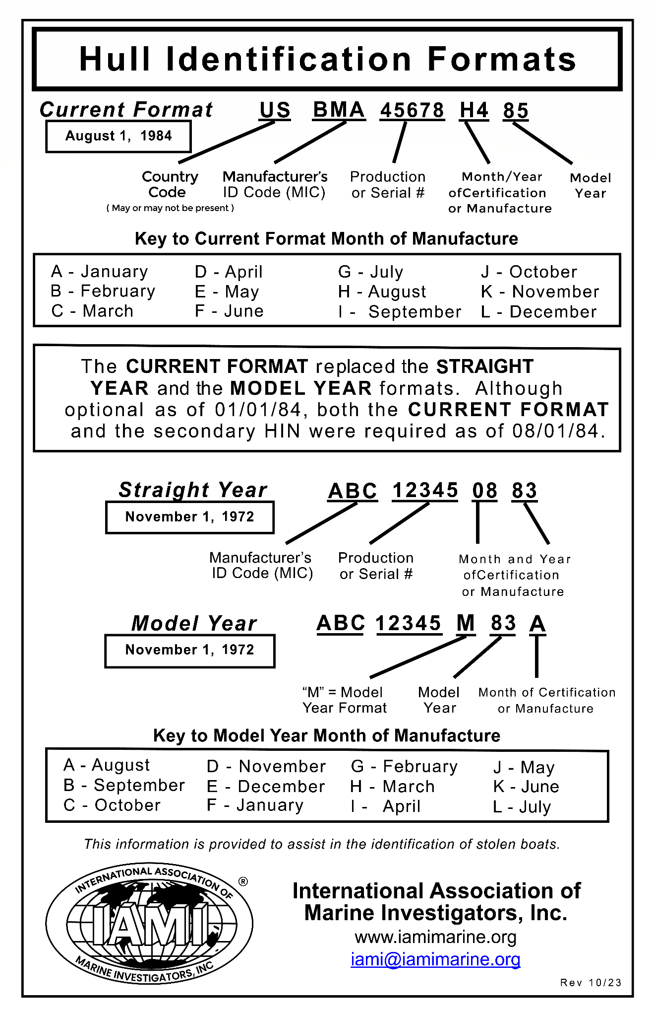

Slide 15
Vessel Types
Vessel Type options include:
(click on each word to see definitions and pictures)
It is important to select the correct vessel type on the aCON because:
It is used to physically identify the vessel which can help with search and rescue.
This information is used to report state statistical data to the USCG as required, on form CGHQ-3923.
Follow USCG guidance to correctly document vessel type to ensure data consistency. For example, paddlecraft, inflatable boats, and rowboats that are registered WITH a motor (mechanically propelled) shall be recorded as an “Open Motorboat” on the aCON, which directly impacts the CGHQ-3923.
Airboat
Auxiliary Sail
Cabin Motorboat
Houseboat
Inflatable
Open Motorboat
Paddlecraft
Personal Watercraft
Pontoon
Rowboat
Sail Only
Other

Slide 16
Hull Material
The hull is the main body of the vessel. Hull Material options include:
Aluminum
Fiberglass
Plastic
Rubber/Vinyl/Canvas
Steel
Wood
Other

Slide 17
Propulsion Type
Propulsion refers to how a vessel is moved through the water.
Options for propulsion include:
(click on each word to see definitions and pictures)
Manual
Propeller
Sail
Water Jet
Air Thrust
Other

Slide 18
Engine Drive Type
Engine Drive refers to the mechanical mechanism used to propel a vessel through the water.
Engine Drive Type options include:
(click on each word to see definitions and pictures)
Inboard
Outboard
Pod Drive
Stern Drive
Other

Slide 19
Fuel Type
Fuel type refers to the fuel used to power the vessel’s engine.
Fuel type options include:
Electric
Diesel
Gas
Other

Slide 20
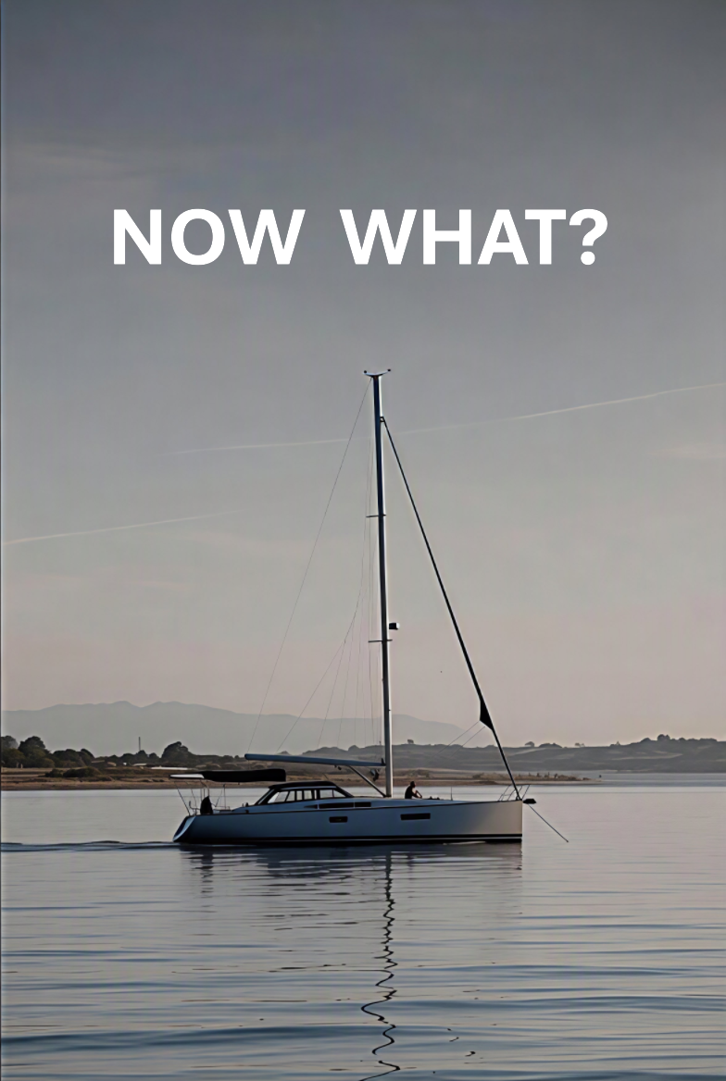
Important Information
  Once you have correctly completed or reviewed an aCON as outlined in 33 CFR Part 174, there is still important information to understand and communicate to the customer:
  Temporary Certificates of Number (tCON)
  Certificate Formats and Duration
  State CON Format
  State CON and validation Sticker Information

Slide 21

Temporary Certificates
  Temporary Certificates of Number (tCON) are used by issuing authorities to bridge processing delays and allows the customer to legally use the vessel while they await issuance of the CON. For example, the issuing authority may need time to print and mail the CON registration cards and decals to the customer.
  A tCON should be given to the customer when the aCON is complete and registration paid.
  The tCON style varies by issuing authority but must include:
  HIN (if any),
  Make
  Overall Length
  Type of Propulsion
  State of principal operation
  Owner Name/Address/Signature
  Date of Issuance
  Expiration Notice (not to exceed 60 days from date of issuance)

Slide 22
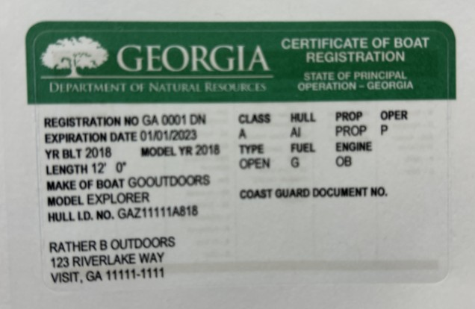
Certificate Formats and Duration
  A CON can be valid for no more than 3 years from the date of issuance and can be issued in hard-copy or digital format.
  Hard-copies must be pocket-sized or folded into pocket-sized.
  “Digital” refers to the display of a CON on an electronic device, such as a cell phone, tablet, or computer. NASBLA’s recommended best practices for a digital CON is found at: Best Practices - Digital CON
  Whether issued in hard copy or in digital format, the CON MUST be carried onboard the vessel, unless it is retained onshore by the leasing agent.

Slide 23
State Numbering Format
  Once the aCON is complete, your organization, as the issuing authority, will assign a number to the vessel for identification.
  The State number:
                Begins with the two-letter state boat abbreviation (ex: GA, FL, AL, NJ, etc…
                it’s important to note that the state boat abbreviation is different than the state postal code abbreviation – see the complete list here)
  Followed by:
                1-4 numbers plus 1-2 letters (ex: GA 1234 AB), or
      1-3 numbers plus 1-3 letters (ex: GA 567 ABC)
  Letters I, O, and Q are never used in the number suffix to prevent confusion with numbers one (1) and zero (0).

Slide 24
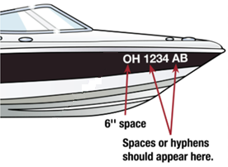
State Number Information
  Ensure the customer is fully aware of what to do with the State number you provide them. This number must be:
  Affixed on both the starboard side (right) and port side (left) of the vessel’s bow. For efoils, affixed only once to the forward half of the vessel’s deck or freeboard
  Must be not less than 3-inch block letters
  Contrast with the vessel color (ex: black numbers and letters on a white hull or vice versa)
  Letters separated with a space or hyphen (ex: OH 1234 AB or OH-1234-AB)

Slide 25
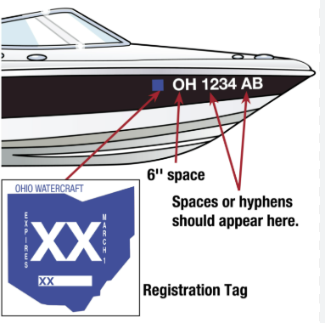
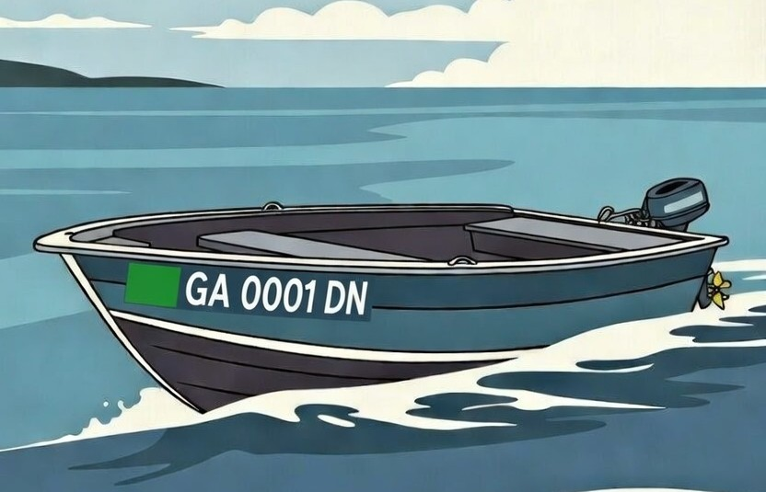
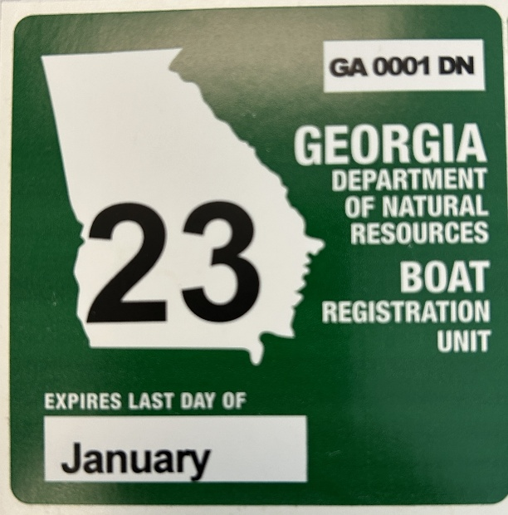
Sticker Information
  Validation stickers or decals, must be placed within six inches of the State issued number - either in front of or behind the State issued number depending on State law.
  Since 1973, sticker color rotates by vessel registration expiration year beginning with blue and using the following pattern: Blue → International Orange → Green → Red
  Vessels with registrations that expire in:
  2027 will be issued a green sticker
  2028 will be issued a red sticker
  2029 will be issued a blue sticker, and so on…

Slide 26
Common Data Inaccuracies
Watch for these frequent errors when reviewing an application:
HIN errors - miscounted or mistyped characters (0 vs. O, 1 vs. I). Re-check all 12 characters against the hull.
Wrong State of Principal Operation - if the vessel is used mostly in another state, do not register or issue a CON.
Mismatched vessel, propulsion, or engine-drive type. Verify each against the definitions in this guide.
Incomplete owner information - missing co-owner name, address, or ID. Collect all required details before processing.
Missing supporting documents - confirm the bill of sale, title, or prior registration match the application.
When in doubt, pause the application and confirm with the customer or your supervisor before issuing the CON.

Slide 27
Key Takeaways
A complete and accurate aCON starts with a careful review of all 10 vessel specifications.
The HIN is the vessel’s unique fingerprint - verify every one of its’ 12 characters.
State of Principal Operation determines if the vessel is registered in your state
Primary Operation describes how the vessel is used (recreational or commercial).
Choose vessel type, hull material, propulsion, and engine drive using the definitions in this guide.
Catch errors at intake: accurate data protects sales, transfers, and law enforcement investigations.
CONs are valid for up to 3 years; explain formats, numbering, and sticker rules to every customer.

Slide 28
Still have questions?
The NASBLA: Vessel Identification, Registration & Titling (VIRT) Committee posts best practices, model acts, registration and titling guidance, and vessel type classifications referenced in this training aid, and other information at:
https://www.nasbla.org/nasblamain/advocacy/virt

Slide 29
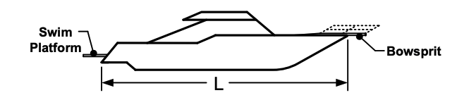
Vessel Length
Length means the straight line horizontal measurement of the overall length from the foremost part of the boat to the aftermost part of the boat, measured from end to end over the deck excluding sheer, and measured parallel to the centerline. Bow sprits, bumpkins, rudders, outboard motor brackets, handles, and other similar fittings, attachments, and extensions are not included in the measurement.

Slide 30
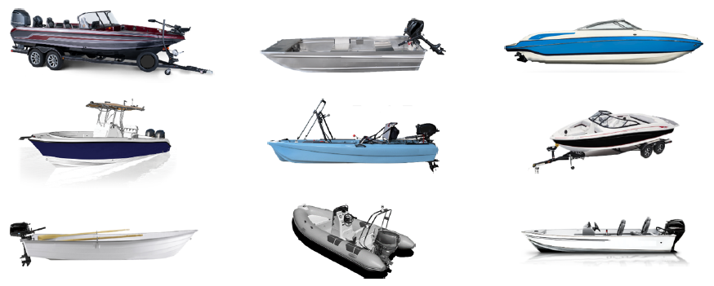
Open Motorboat
A vessel equipped with propulsion machinery and having an open load carrying area that does not have a continuous deck to protect it from the entry of water.
These vessels typically have little, if any, enclosed space to protect occupants from the outside environment. They are the most common type of vessel and include freshwater and saltwater fishing boats, Jon boats, skiffs, utility boats, runabouts, and ski boats.
Important: Vessels such as paddlecraft (canoes/kayaks/paddleboards), inflatable boats, and rowboats that can be propelled by paddles, oars, and other manual means, but have been equipped with mechanical propulsion, should be classified as an open motorboat.

Slide 31
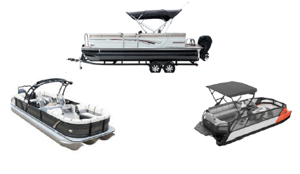
Pontoon Motorboat
A vessel with a broad, flat deck that is affixed on top of closed cylinders which are used for buoyancy, the basic design of which is usually implemented with two rows of floats as a catamaran or with three rows of floats as a trimaran.
This is a motorized vessel where occupants ride on top of pontoon hulls and are usually surrounded by protective railings. Most pontoon boats are constructed from aluminum, though fiberglass and polyethylene (plastic) are gaining in popularity.

Slide 32
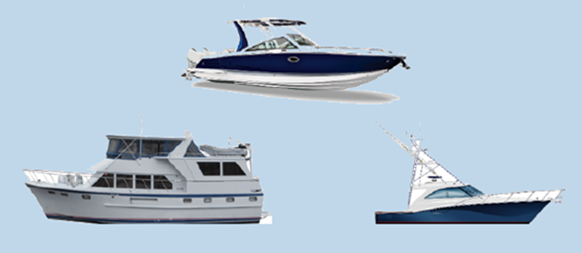
Cabin Motorboat
A vessel propelled by propulsion machinery and providing enclosed spaces inside its structure.
Vessels with enclosed spaces large enough to protect occupants from the outside environment for an extended period. They are generally larger than 23 feet and include cabin cruisers, trawlers, cuddy-cabin cruisers, and yachts.

Slide 33
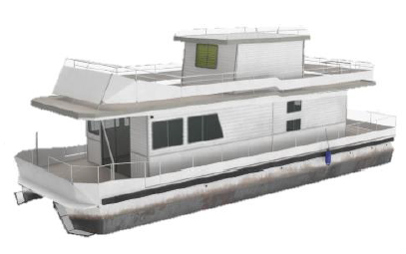
Houseboat
A motorized vessel that is usually non-planing and designed primarily for multi-purpose accommodation spaces with low freeboard and little or no foredeck or cockpit.
This is a vessel that is often stationary but has its own means of propulsion. These vessels usually have relatively large living accommodations and sometimes look like floating houses or RVs.

Slide 34
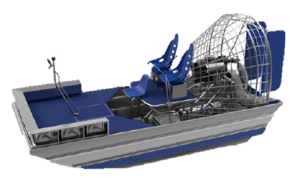
Airboat
A vessel that is typically flat-bottomed and propelled by an aircraft-type propeller powered by an engine.
These vessels are most often used in swamplands. The propeller pushes air rather than water.

Slide 35
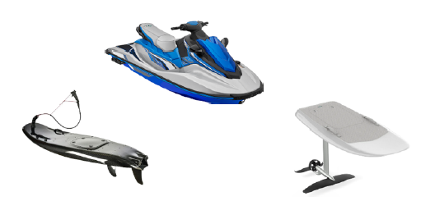
Personal Watercraft
A vessel propelled by a water-jet pump or other machinery as its primary source of motive power and designed to be operated by a person sitting, standing, or kneeling on the vessel, rather than sitting or standing within the vessel's hull.
These vessels are typically under 15 feet in length and sometimes referred to as jet skis or wave runners.
Included in this category are motorized surfboards and mechanically propelled personal hydrofoils.

Slide 36
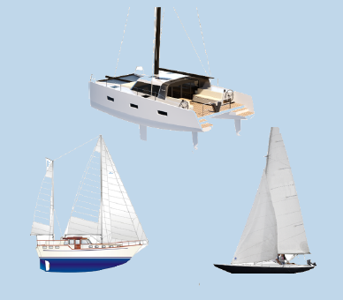
Auxiliary Sail
A vessel with sail as its primary method of propulsion and mechanical propulsion as its secondary method.

Slide 37
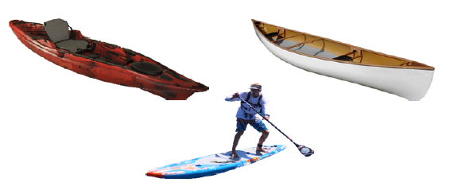
Paddlecraft
A vessel powered only by its occupants, using a single or double-bladed paddle as a lever without the aid of a fulcrum provided by oarlocks, thole pins, crutches, or similar.
This includes non-motorized canoes, kayaks, and paddleboards.
Important: Paddlecraft that have been equipped with mechanical propulsion should be classified as an open motorboat.

Slide 38
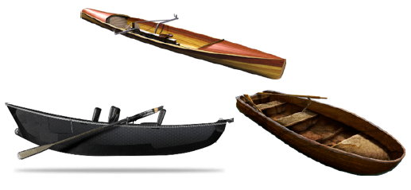
Rowboat
An open vessel manually propelled by oars.
Unlike paddlecraft, rowboats have at least two oars, permanently or temporarily attached to the vessel.
Important: A rowboat that has been equipped with mechanical propulsion should be classified as an open motorboat.

Slide 39
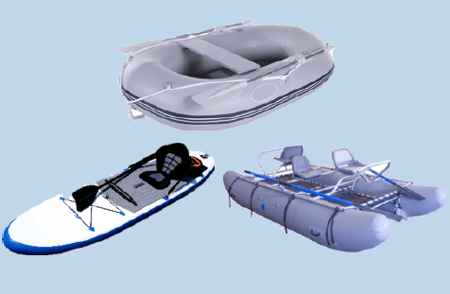
Inflatable Boat
A vessel that uses air-filled flexible fabric for buoyancy.
Important: An inflatable boat that has been equipped with mechanical propulsion should be classified as an open motorboat.

Slide 40
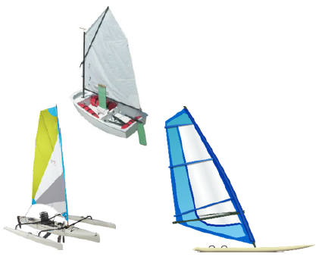
Sail Only
A vessel propelled only by sails and is not equipped with a motor

Slide 41
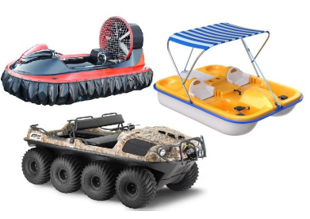
Other
A vessel that does not fit into any of the other vessel types.
This should be used on rare occasions. Examples include: pedal boat, amphibious vehicles, and hovercraft.

Slide 42

Manual
A form of non-mechanical propulsion. Used for a vessel propelled solely by human effort, such as paddles, poles, or oars.

Slide 43
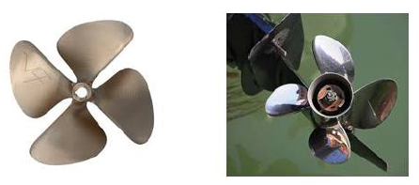
Propeller
A form of mechanical propulsion. A bladed apparatus is used to provide the rotational thrust that pushes against the water to move the vessel forward.

Slide 44
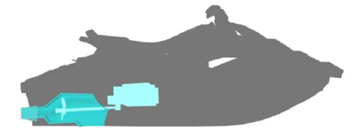
Water Jet
A form of mechanical propulsion. Thrust is created when water is taken into a pump unit located on the bottom of the vessel and discharged through a nozzle at a high pressure to move the vessel forward. Most Personal Watercraft (PWC) use water jet propulsion.

Slide 45
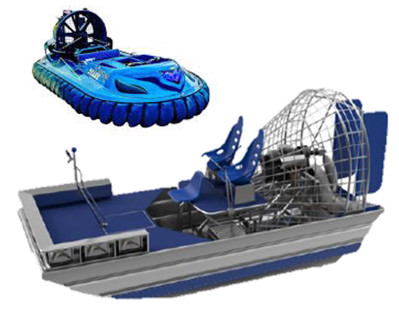
Air Thrust
A mechanical form of propulsion where a large, bladed propeller pushes against air to move the vessel over water. The propeller is typically mounted on the aft deck and resembles an aircraft propeller or industrial fan. This type of propulsion is most commonly used on airboats and hovercraft.

Slide 46
Sail
A non-mechanical form of propulsion where wind pushes against sails to move the vessel.
Important: This applies to sail-only vessels. Vessels that also have some form of mechanical propulsion (referred to as Auxiliary Sailboats) should be classified based on the engine’s propulsion type.

Slide 47
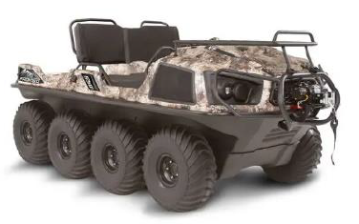
Other
Propulsion does not fit any of the descriptions of the above types.

Slide 48
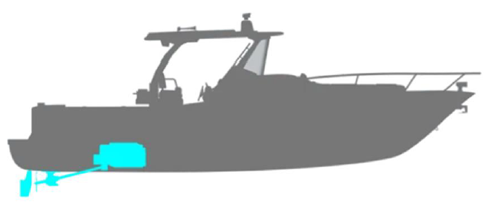
Inboard
An engine mounted inside the confines of a vessel which powers a drive shaft that turns a water jet impeller or that runs through the bottom of the hull and is attached to a propeller at the other end.
Inboards, as the name implies, are located inside the hull of the vessel. The drive shaft protrudes out of the bottom of the vessel on an angle to move the vessel through the water.

Slide 49

Outboard
An engine with propeller or water jet integrally attached, which is usually mounted at the stern of a vessel.
Outboard engines are self-contained and hang directly off the transom of a vessel.

Slide 50
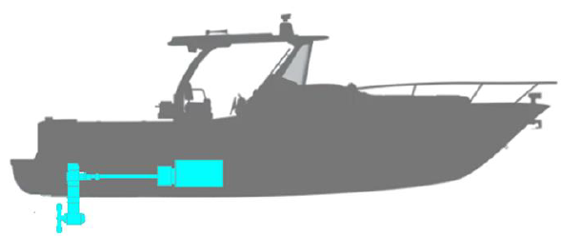
Pod Drive
An engine mounted in front of the transom of a vessel and attached through the bottom of the hull to a steerable propulsion unit.
Pod drive engines are rare and have a drive unit that protrudes directly beneath the hull of the vessel, where the unit can be rotated to change the vessel’s heading.

Slide 51
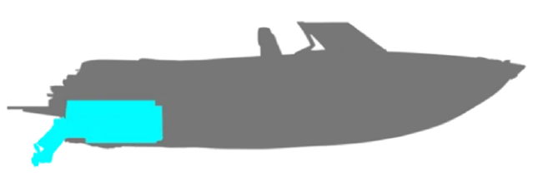
Stern Drive
An engine, powering a propeller through a series of shafts and gears, mounted in front of the transom of a vessel and attached through the transom to a drive unit that is similar to the lower unit of an outboard; and may also be known as an inboard-outdrive or an inboard-outboard.
A sterndrive is essentially a hybrid of an outboard and inboard. The engine itself is located inside the hull of the vessel, but the drive unit and propeller protrude through the transom.

Slide 52
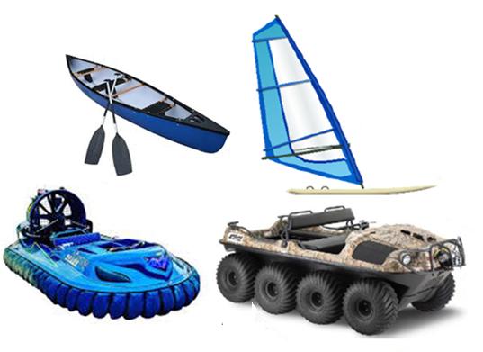
Other
Drive type does not fit any of the descriptions of the above types. “Other” should also be assigned to all vessels with a propulsion classification of sail, air thrust, manual, or other.

Slide 53
State Boat Abbreviations
Alabama - AL
Alaska - AK
American Samoa - AS
Arizona - AZ
Arkansas - AR
California - CF
Colorado - CL
Connecticut - CT
Delaware - DL
District of Columbia - DC
Florida - FL
Georgia - GA
Guam - GU
Hawaii - HA
Idaho - ID
Illinois - IL
Indiana - IN
Iowa - IA
Kansas - KA
Kentucky - KY
Louisiana - LA
Maine - ME
Maryland - MD
Massachusetts - MS
Michigan - MC
Minnesota - MN
Mississippi - MI
Missouri - MO
Montana - MT
Nebraska - NB
Nevada - NV
New Hampshire - NH
New Jersey - NJ
New Mexico - NM
New York - NY
North Carolina - NC
North Dakota - ND
N. Mariana Islands - CM
Ohio - OH
Oklahoma - OK
Oregon - OR
Pennsylvania - PA
Puerto Rico - PR
Rhode Island - RI
South Carolina - SC
South Dakota - SD
Tennessee - TN
Texas - TX
Utah - UT
Vermont - VT
Virginia - VA
Virgin Islands - VI
Washington - WN
West Virginia - WV
Wisconsin - WS
Wyoming - WY

