Slide 1

Polycystic Ovary Syndrome in Adolescent Girls
Dalinda A. Condino, MD
Chief, Division of Adolescent Medicine
Associate Professor of Clinical Pediatrics
UBMD-Pediatrics

Slide 2
Disclosure
I have no relevant financial relationships with the manufacturer(s) of any commercial product(s) and/or provider(s) of commercial services discussed in this CME activity.
I intend to discuss off-label use of medication (metformin, oral contraceptive pills) in the context of standard PCOS treatment.

Slide 3
Objectives
Understand the epidemiology and diagnostic criteria for PCOS
Recognize the clinical spectrum and pathophysiology of androgen excess in adolescents
Develop a management strategy for a PCOS- affected adolescent

Slide 4
Case 1
NW is an 18 year old female who presents for ‘fertility concerns.’ She has had irregular periods since menarche. Her primary care provider prescribed birth control pills 3 yrs ago for contraception which she has not been taking.
She is now concerned because she has not yet conceived after being off the pill for months. Her boyfriend of two years is ready to have children. On ROS she reports that she visits the salon weekly for hair removal, denies significant problems with acne, has an elevated cholesterol, and no other health problems. On exam she is well developed, Tanner V female with a BMI of 35, with AN, some pustules on her back, FG of 10, but exam is otherwise unremarkable.

Slide 5
Case 2
ST is a 19 year old female who presents to student health for a routine exam. She reports that she has not had a period in more than six months. She is an athlete who runs indoor and outdoor track and has been doing so since about the age of 15 years. She has also been a dancer since age 6 and prior to doing track danced semi-professionally. She was evaluated by her PMD for this and told that she wasn’t having periods because she was “too athletic and thin.” FH and other PMH are non-contributory. She reports having a healthy diet and not limiting herself at all. She eats meals with her team and coaches who encourage lots of complex carbohydrates at mealtimes. She is an honor student, never been sexually active, but is dating. She has normal vitals, a BMI of 20, Tanner V breasts and pubic hair, and no other significant findings.

Slide 6
They Both Have PCOS!
Obesity & classic features vs. Lean, healthy girl
Difference = 10 years between their diagnoses and initiation of treatment

Slide 7
Polycystic Ovary Syndrome
Common reproductive endocrine disorder
  5-10% of women of reproductive age
  Strong family history/evidence of genetic basis
  Studies of first degree relatives of PCOS patients
    24% mothers
    32% sisters
First described by Stein & Leventhal (1935)
  Seven women with amenorrhea, infertility, enlarged ovaries
  Follow report added hirsutism to observations
  Wedge resections (1930s) →Hormonal management (1970s/80s)
Stein IF, Leventhal NL Amenorrhea associated with bilateral polycystic ovaries. Am J Obstet Gynecol, 1935; 29:181–191

Slide 8
Cost of PCOS
The total cost of evaluating and providing care to reproductive-aged PCOS women in the United States
Initial Evaluation | $93 Million (2.1%)
Treating menstrual dysfunction (hormonal | $1.35 Billion (31%)
Providing infertility care | $533 Milion (12.2%)
PCOS-related diabetes | $1.77 Billion (40.5%)
Treating Hirsutism | $622 Million (14.2%)
Total | $ 4.36 Billion
Azziz R, Marin C, Hoq L, Badamgarav E, Song P, Health Care-Related Economic Burden of the Polycystic Ovary Syndrome during the Reproductive Life Span, The Journal of Clinical Endocrinology & Metabolism, 2005; 90(8):4650–4658

Slide 9
Quality of Life
Subscale | PCOS | Healthy Comparisons | β | p
General Health Perception | 68.6 | 76.3 | -7.7 | .04
Physical Functioning | 91.2 | 94.8 | -4.1 | .001
Family Activities | 77.2 | 81.8 | -6.0 | .029
Behavior | 93.9 | 94.8 | -2.9 | .04
Mental Health | 66.5 | 70.3 | -3.8 | .065
Change in Health/Yr | 2.8 | 2.5 | .26 | .04
Trent M, et.al., Arch Ped Adol Med, 2002; 156: 1-5.

Slide 10
Where does it all start?
Peri-menarchal period
Abnormal physiological transition to puberty
  LH secretion
  Adrenal androgen production
  Body mass
  Insulin resistance
Area of active research→ the cause is still unknown
  Focus
 Lutenizing hormone stimulation ovary
 GnRH secretion / gene expression
 Insulin involvement in androgen production

Slide 11
Clinical Features
Menstrual Dysfunction
  Amenorrhea
  Oligomenorrhea
  Anovulation or oligoovulation
  Infertility
  Dysfunctional Uterine Bleeding
  Endometrial Hyperplasia

Slide 12
Hyperandrogenism
Hirsutism (Ferriman-Gallwey Score > 8)¹
Acne (Global Acne Score)²
Male pattern baldness/alopecia
One or more elevated androgens: Testosterone (T), Free Testosterone, Dehydroepiandrosterone (DHEAS), Androstenedione
1) Ferriman D, Gallwey JD. Clinical assessment of body hair and growth in women J Clin Endocrinol Metab
1961; 121:1440 , 2) Doshi A, Zaheer A, Stiller M. A comparison of current acne grading systems and proposal of a novel system. (Reproduced with permission in: Emans SJ, et.al. Pediatric and Adolescent Gynecology, Lippincott, Williams, & Wilkins,
5th Ed, 205, p305-307

Slide 13
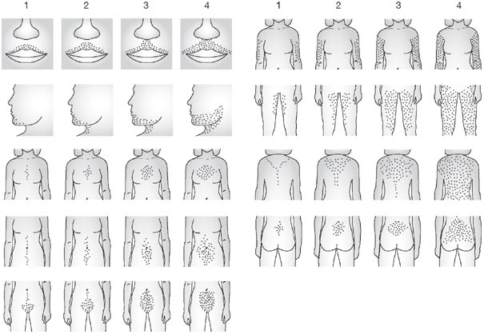
Ferriman Gallwey Score

Slide 14
Diagnostic Criteria
Clinical Findings | NIH | Rotterdam, 2003 | Androgen Excess Society, 2006/2009*
Androgen Excess | Required | 2 of 3 Required | Required
Menstrual abnormality | Required |  | 1 of 2 Required
PCO on ultrasound
ACOG Practice Bulletin, 2009, 114 (4): 936-949, Azziz R. et.al. Fertil Steril, 2009, 91 (2): 456

Slide 15
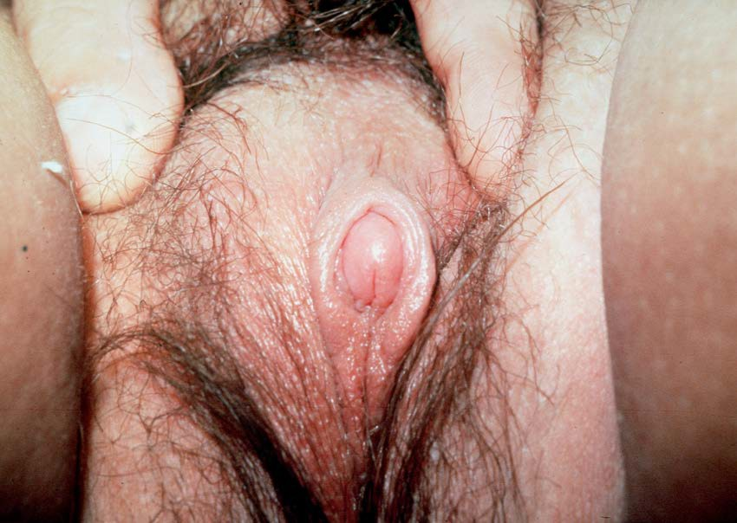
Clitoromegaly
Normal clitoral width<5mm
Courtesy of Dr. Jean Emans, Adolescent Medicine Program, Boston Children’s Hospital

Slide 16
Ovarian Pathology
Classic Morphology:
  thickened, white capsule
  enlarged ovary with multiple small cysts
  at least 10 follicles, 2-8 mm in diameter
Non-specificity:
  PCO in 92% women with idiopathic hirsutism
  87% with oligomenorrhea
  26% with amenorrhea
  23% with reported regular cycles

Slide 17
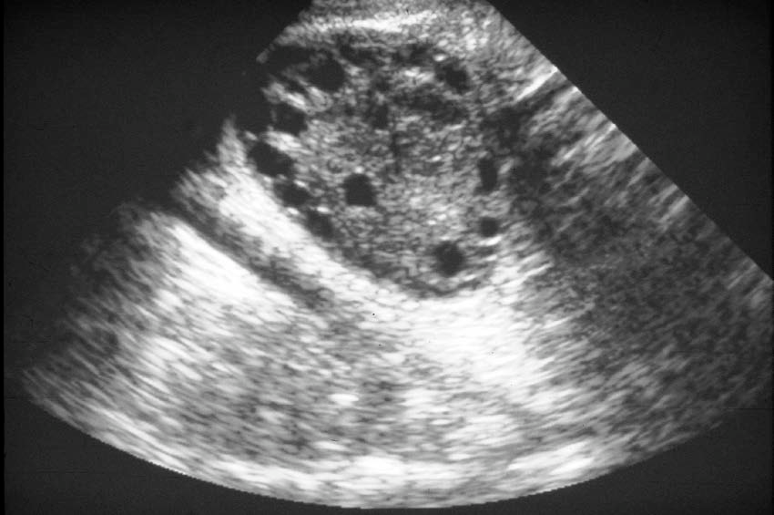
Classic Ovarian Morphology
“String of Pearls”
Courtesy of Dr. Jean Emans, Adolescent Medicine Program, Boston Children’s Hospital

Slide 18
Hyperinsulinemia
PCOS pts: increased hyperinsulinemia and insulin resistance
Clinical finding: Acanthosis Nigricans/Obesity
Insulin: augments ovarian androgen response to LH
Cytochrome 450c17alpha enzyme activity increased
Involvement of IGFs
Clinical improvement after Metformin
Nestler et.al, NEJM 1996, 333:617-623

Slide 19
Differential Diagnosis
PCOS
Idiopathic Hirsutism
Late-Onset CAH
Drugs: steroids, anticonvulsants
Cushing syndrome/disease
Ovarian or adrenal tumors

Slide 20
History
Virilization: deepening of the voice, temporal recession, increased muscle mass, clitoromegaly
Hirsutism (time course, distribution)
Acne
Menstrual History
Acanthosis Nigricans
History of premature adrenarche
Family History

Slide 21
Physical Examination
Height, weight, vital signs
Ferriman-Gallwey Score
Acanthosis nigricans
Acne
Male pattern balding
Upper body muscle mass
Galactorrhea
Clitoromegaly
Ovarian masses

Slide 22
Laboratory Studies
Goals:
  To rule out adrenal or ovarian tumor
  To assess severity of androgen excess
  To evaluate source of hyperandrogenism
 Ovarian ( Free and total testosterone)
 Adrenal (DHEA-S)
 Additional supportive labs :
    LH
    FSH (Rule Out Ovarian Failure)
    17-OHP (Early AM)
    Lipid profile
    Fasting Glucose/2hour OGTT

Slide 23
Source of Androgen → Interpretation of Labs
 | Adrenal Cortex | Ovary | Peripheral Conversion of Precursors
Testosterone | ~25% | ~25% | ~50%
Androstendione | 50% | 50% | ---
DHEA | 90% | 10% | ---
DHEA-S | 100% | --- | ---
Emans SJ, et.al. Pediatric and adolescent gynecology, 5th ed. Philadelphia: Lippincott, Williams, Wilkins; 2005: 301

Slide 24
PCOS Treatment Options

Slide 25
Treatment Goals
Hormonal suppression to lower ovarian androgen levels
Improve menstrual irregularity
Prevent endometrial hyperplasia
Improve clinical findings affecting appearance (hirsutism and acne)
Increase insulin sensitivity
Prevent long-term complications

Slide 26
Oral Contraceptives and PCOS
Decrease LH levels and decrease androgen synthesis
Increase SHBG levels, increase T binding, and decrease free T
Inhibit 5 alpha-reductase which decreases conversion of T to DHT (active androgen)
Treat early

Slide 27
Progestin Only Therapy
Regulates menses
Lessens risk of endometrial cancer
Medroxyprogesterone 10 mg for 12-14 days every 1-3 months
Progestin only pills may not achieve menstrual regulation

Slide 28
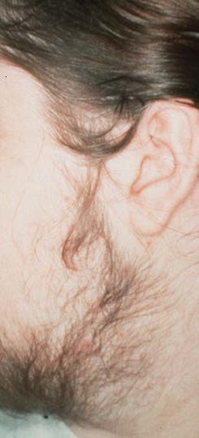
Managing Hirsutism & Acne
Hirsutism & Acne
Courtesy of Dr. Jean Emans, Adolescent Medicine Program, Boston Children’s Hospital

Slide 29
Temporary Methods
Method | Action | Side Effects
Bleaching | 6% peroxide bleaches hair | Irritation, ineffective, allergic reactions, syncope if persulfate used
Shaving | Mechanical cutting of hair | Quick growth, stubble, irritation
Chemical Depilatory | Dissolves hair shaft by reduction of disulfide bonds | Irritation, allergic/contact dermatitis, strong odor
Tweezing | Extraction of hair shaft | Pain, hyperpigmentaton, scar, folliculitis
Waxing | Uniform extraction of hair | Thermal burns, allergic/contact dermatitis, folliculitis, irritation, scarring

Slide 30
“Permanent” Methods
Method | Action | Comments
Electrolysis | Low flow current causes chemical reaction destroying hair follicle | Slow (1 minute per hair)
Thermolysis | High frequency current destroys hair follicle | Faster (seconds per hair)
Laser | Laser light targets melanin in follicle causing thermal injury | Thermal injury restricted to follicle Treatment of large areas with fewer side effects Traditional techniques cause significant side effects on darker skin

Slide 31
Laser
Nd: Yag felt to be safest
  Deeper penetration
  Less absorption by epidermal melanin
Newer Technique using longer-wavelength diode laser light effective in darker skinned patients
Requires multiple visits to dermatologist
Expensive
Battle EF, Soden CE. Use of Lasers in Darker Skin Types, Seminars on Cutaneous Medicine and Surgery, 2009; 28:130-140

Slide 32
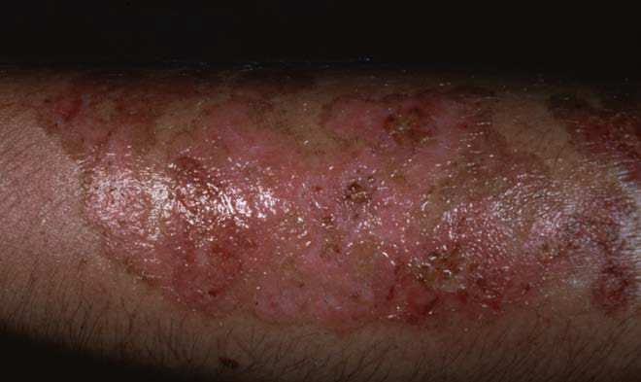
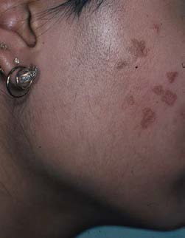
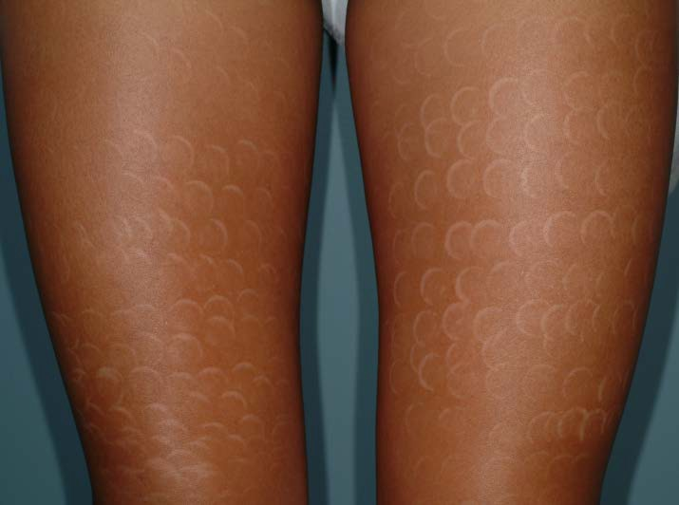
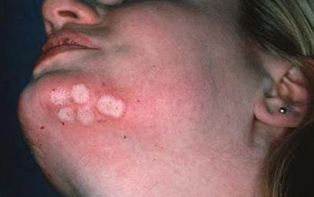
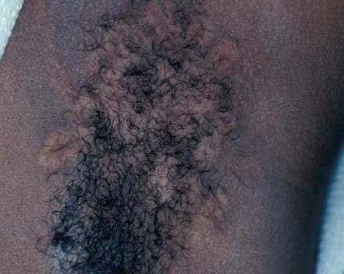
Potential Laser Side Effects
Courtesy: Dr. Eliot F. Battle, Jr , Cultura Cosmetic Dermatology & Laser Center/ Department of Dermatology Howard University Hospital, Washington, DC

Slide 33
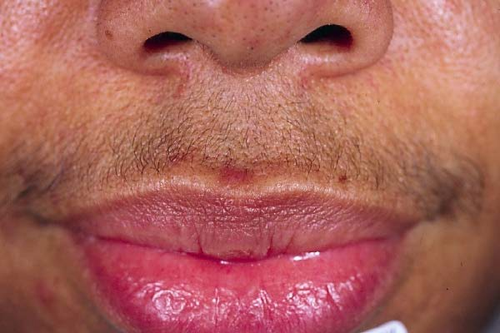
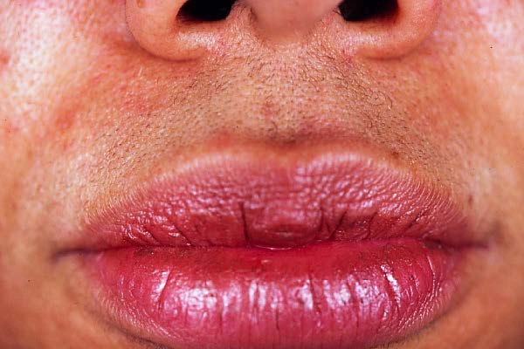
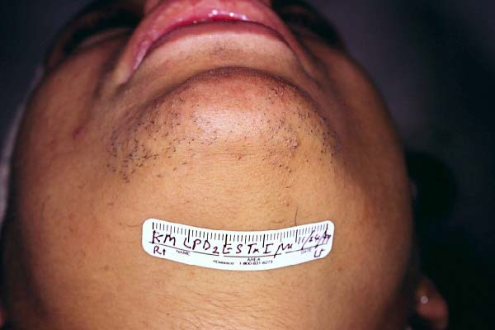
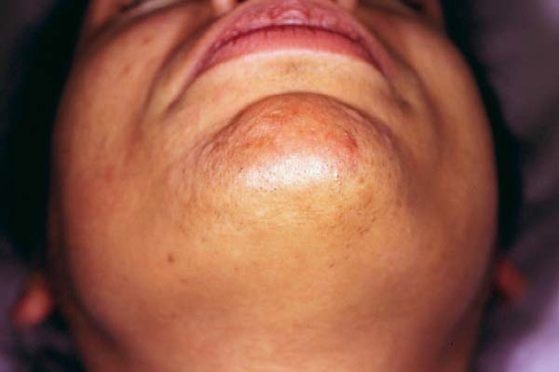
Laser Hair Removal: Safe and Highly Effective
2 years after last treatment
Courtesy: Dr. Eliot F. Battle, Jr , Cultura Cosmetic Dermatology & Laser Center/Howard University Hospital, Washington, DC

Slide 34
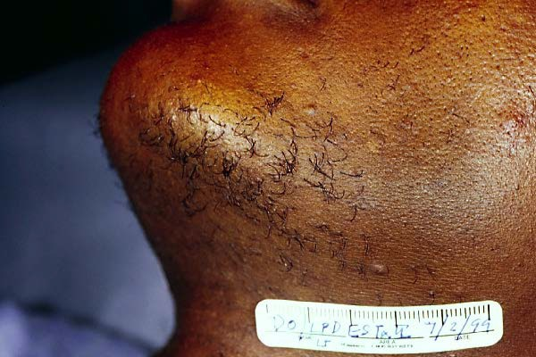
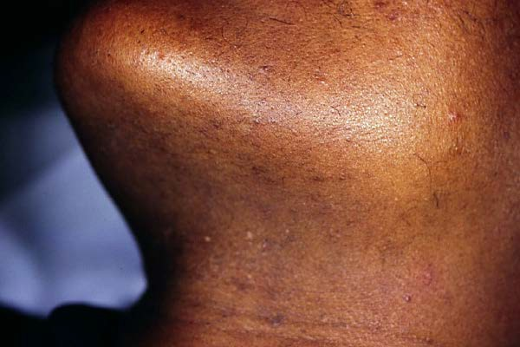
Improvement in Skin Tone/Texture
40 ms 30 J/cm ²
1 year after 12 Treatments
Courtesy: Dr. Eliot F. Battle, Jr , Cultura Cosmetic Dermatology & Laser Center/Howard University Hospital, Washington, DC

Slide 35
Hormonal Treatment of Hirsutism
Oral contraceptives
  Estrogens increase SHBG, decreasing free T
  Suppress gonadotropin dependent ovarian androgens
  Suppress adrenal androgens
  Cyclic versus continuous pills (QD or 84 days and 7 days off)
  Patches and Rings
 Limited research/clinical use documented in literature
 Theoretically should be considered for treatment
 Adherence

Slide 36
Hirsutism
Anti-androgens (e.g. spironolactone) to reduce hair diameter (41% at 12 months)
  best used with OCPs
○ 50-100 mg bid
Potential Side-effects: hypotension, lethargy, urinary frequency, hyperkalemia, nausea
O’Brien RC, Cooper ME, Murray RM, et.al. Comparison of the sequential cyproterone acetate/estrogen vs. spironolactone /oral contraceptive in the treatment of hirsutism, J Clin Endocrinol Metab 1991; 72: 1008.**

Slide 37

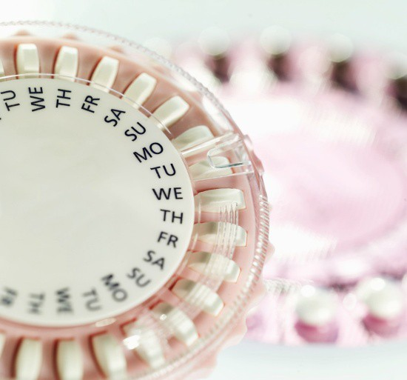
Observational study of women with PCOS
What about OCPs with Drosperinone?
Determine if clinical and biochemical features of PCOS are ameliorated by Yasmin™
17 patients treated x 6 months
Results:
  76% good cycle control
  no change in BMI
  increased insulin/triglycerides
  decreased testosterone/increased SHBG
  no change in hirsutism clinically
The anti-androgen contained in Yasmin ™ is just percentage of the spironolactone prescribed for PCOS
Palen-Singh M, et.al. An observational study of Yasmin in the management of women with polycystic ovary syndrome.Fam Plann Reprod Health Care. 2004 Jul;30(3):163-5.

Slide 38
Hirsutism
GnRH analogues
  Estrogen addback needed to preserve bone density
Prednisone for late onset CAH (21OH deficiency)
  Treatment with OCs appears to be equally effective

Slide 39
Topical: Eflornithine 13.9% Cream
Irreversible inhibitor of ornithine decarboxylase, an enzyme which mediates cell division and growth in hair follicles
Side-effects: burning, folliculitis (more likely if applied to shaved skin)
Need to continue mechanical hair removal methods
If discontinued hair growth will resume

Slide 40
Acne
Topical or oral medications depending on the type of acne
Oral contraceptive pills reduce the free and total testosterone improving acne

Slide 41
Acanthosis Nigricans
Treatment guided by its cause
Weight loss and treatment of underlying disorders
Topical: retinoic acid, corticosteroids, keratolytics
Oral: isotretinoin, ketoconazole

Slide 42
Insulin Resistance and Obesity
Weight loss if obese
  Reduces peripheral estrogen production
  Reduces cardiovascular risk
  Reduces insulin resistance and suppresses ovarian androgen production
Methods
  Exercise
  Decreased Caloric Intake
  Dietary modification
  Medications
 Metformin
 Orlistat
Tang T, et.al. Combined lifestyle modification and metformin in obese patients with polycystic ovary syndrome. A randomized placebo-controlled, double blind multicentre study, Human Reproduction, 2006; 21 (1): 80-89 Jayapogopal V, et.al. Orlistat is as beneficial as metformin in the treatment of polycystic ovary syndrome, J Clin Endocrinol Metab, 2005; 729-733.

Slide 43
Insulin Sensitizing Agents
•Reduce Insulin by binding to peroxisome proliferator-activated receptors
-Transcription of insulin-responsive genes
-Regulation of adipocyte differentiation and lipid metabolism
•Decreases hepatic gluconeogenesis
•Insulin Required for effectiveness
Metformin agent of choice in adolescents due to safety

Slide 44
Insulin Sensitizing Agents
Metformin
  decreases androgens, decreased weight slightly
  resumption of menses in 68-96%
  ovulation in 30-40%, ?effect on hirsutism
  Dosing:
 500 mg TID
 850 mg BID
 Extended Release (multiple formulations 500mg, then increase to 1-2g /day for most formulations)
  side-effects - GI (flatulence, diarrhea)

Slide 45
Glucose Intolerance
Study of 254 women with PCOS,
0 and 2 hr post 75 gm glucose:
  31% impaired glucose tolerance
  7.5% diabetes
In non-obese women:
  10.3% IGT and 1.5% diabetes
Fasting glucose poor predictor of IGT
Legro, J Clin Metab Endo 1999

Slide 46
Glucose Intolerance in Adolescents with PCOS
Study of 27 adolescents with PCOS
8/27 had IGT; 1/27 type 2 DM
Fasting blood glucose abnormal in 2/8
Glucose/Insulin ratio <4.5 in 15/18
Palmert J Clin Endo Metab, 2002

Slide 47
Special Case of Type II Diabetes
Criteria:
  Symptoms plus casual plasma glucose concentration ≥ 200 mg/dl or
  Fasting glucose ≥ 126 mg/dl (7.0mmol/L)
  2 hr glucose ≥ 200 mg/dl
Testing
  Overweight + any two risk factors (family history, race/ethnicity (AA/NA/H), signs of insulin resistance or conditions associated with insulin resistance (PCOS)

Slide 48
Risk of Progression to Diabetes
6.2 year follow-up
Normal Glucose tolerance test at baseline
○5/54 (9%) developed IGT
○4/54 (8%) DM
BMI at baseline significant predictor of later adverse glucose tolerance
Norman, Human Reproduction, 2001

Slide 49
Treatment
Manage urgent clinical needs
Treat PCOS and all comorbidities
Encourage lifestyle changes (nutrition and exercise)
Metformin
  Glycemic control
  Improves insulin resistance
  Improves reproductive function

Slide 50
Case 3
JS is a 15 year old who presents with classic findings of PCOS: menstrual irregularity, clinical evidence of androgen excess (hirsutism & acne), and morbid obesity with signs of insulin resistance. Basic labs were obtained, but due to a lab error, liver function tests obtained instead of androgens.
Labs: AST: 94, ALT: 97 ALK 124 Chol 226 Glucose 110 TSH 1.72, T4 1.3, Insulin 156
Repeat labs show elevated androgens, repeat glucose NL, Repeat LFTS AST 139, ALT 176, Negative screening for infectious hepatitis
Diagnosis? What do you do now?

Slide 51
Additional Labs
Ultrasound: Liver is large and shows echogenicity consistent with fatty infiltrate. No evidence of biliary obstruction. Large spleen, Kidneys nl. Pancreas not seen.
Referred to GI
Patient non-adherent to recommendations for GI follow-up, dietary change, metformin.
Later developed type 2 DM
Eventually went to GI appointment: Liver biopsy consistent with steatohepatitis

Slide 52
Non-Alcoholic Fatty Liver Disease (NAFLD)& Steatohepatitis (NASH)
NAFLD → Inflammation→ NASH
Associated with metabolic syndrome
  Obesity
  Hypertension
  Increased cholesterol
  Insulin resistance
Treatment
  No standard medical treatment
  Avoidance of toxic substances (ETOH, Medications)
  Weight Management
  Diabetes control
  Cholesterol control
 Caution with statins, but research promising
Zamor Curr Opin Cardiol. 2011 Jul;26(4):338-412011; Bugianesi, E. Am J Gastroenterology, 2005, 100: 1082 NIDDK Information sheet: http://digestive.niddk.nih.gov/ddiseases/pubs/nash/ (last accessed 11/15/11)

Slide 53
Case 4
JE is a 17 year old female with a history of PCOS. Patient returns to clinic for routine gynecologic & PCOS care. Patient has lost 20 lbs in the last 6 months through diet and exercise. She is doing well in school, got great SAT scores, and has selected six colleges . She has been on OCPs for 2 years. Now, she reports becoming sexually active with one partner for 3 months, but has stopped using contraception (including condoms). When you ask her about this she says, “We’ll I can’t get pregnant so why bother?”

Slide 54
Issues
PCOS patients can be oligo-ovulatory, not just anovulatory
Improvement in clinical status (weight loss, use of metformin) in an overweight patient can result in improvement in reproductive function →ovulation
Studies have shown that non-contraceptive use is likely to occur among girls who perceive fertility impairment
She is at risk for sexually transmitted infections and pregnancy
  Development of recurrent STIs or PID would only complicate her fertility picture
Rainey DY, et.al. Self-perception of infertility among female adolescents. Am J Dis Child 1993;147:11053– 6.

Slide 55
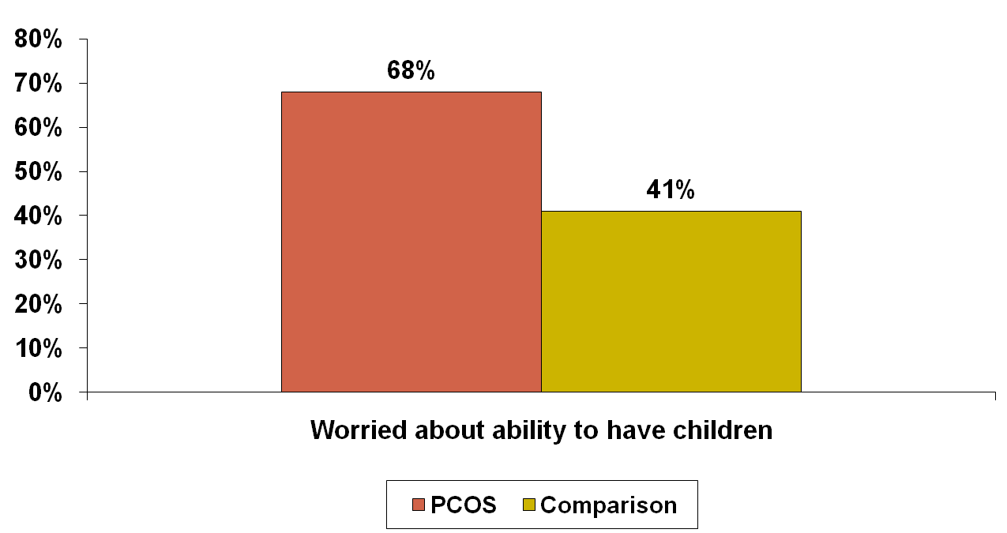
Fertility Concerns
Adjusted OR=3.4 95% CI: 1.9-6.2 (p<.001)
Trent M, et.al, Fertility Concerns and Sexual Behavior in Adolescent Girls with Polycystic Ovary Syndrome: Implications for Quality of Life, Journal of Pediatric and Adolescent Gynecology, 2003; 16 (1):33-7

Slide 56
Fertility Concerns
21% of PCOS patients expresses fertility concerns in spontaneous comments
  “Sometimes I’m worried about this disease because it makes me think about if I would have problems in the future with having babies.”
  “I’m not sure how this affects me in the long run. Is it something that can hurt me? (i.e. Not being able to have kids, more susceptible to other diseases, etc.)”
  “It really did nothing to my life, the only thing I think is that I am afraid I will never be able to have children.”

Slide 57

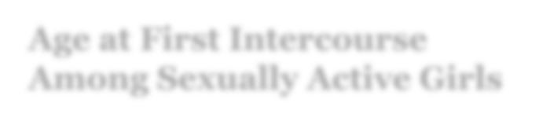
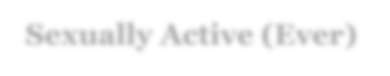
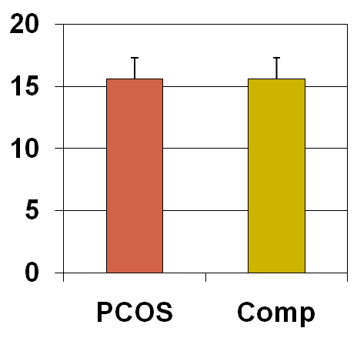
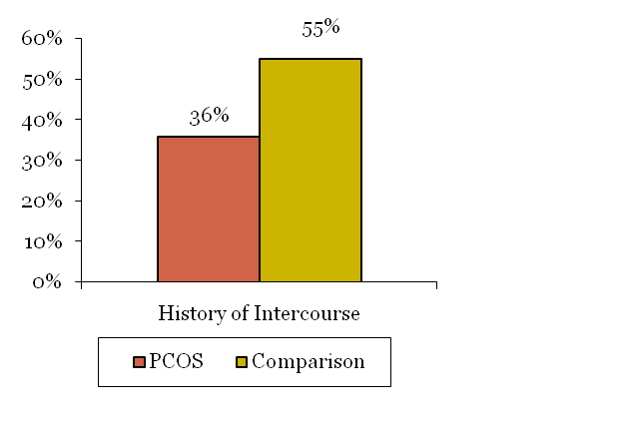
Sexual Risk Behaviors in Adolescents with PCOS
Age at First Intercourse Among Sexually Active Girls
Sexually Active (Ever)
No difference between age of initiation of sexual intercourse between groups
• PCOS = 15.7(± 1.5) years
Comparisons = 15.7 (± 1.8) years
Adjusted OR: 2.8 95% CI 1.4, 5.4
(p=0.003)
Trent M, Rich M, Austin SB, Gordon C. Fertility Concerns and Sexual Behavior in Adolescent Girls with Polycystic Ovary Syndrome: Implications for Quality of Life, Journal of Pediatric and Adolescent Gynecology, 2003; 16 (1):33-7

Slide 58

Fertility Concerns
Common question by the adolescent’s parents and late adolescent girl
Remain optimistic—many treatment alternatives & once pregnant outcomes similar to non-affected women of similar clinical status*
Avoid making specific recommendations regarding fertility treatment & focus on treating PCOS
Encourage academic development and achievement as future orientation is essential
Education to protect reproductive organs (e.g. STI prevention)

Slide 59
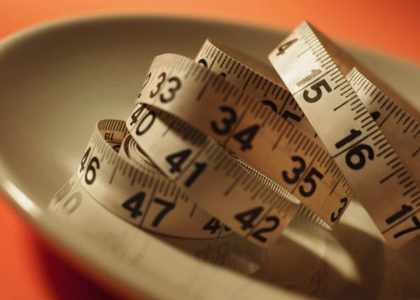
Infertility Therapies
Weight loss/exercise (If obese)
Metformin
Clomiphene citrate
Gonadotropin therapy
Invitro Fertilization
Surgical options

Slide 60
Summary
Optimal Medical Management
Identification/Treatment Co- Morbidities
  Obesity
  Diabetes
  NAFLD
  Hypertension
Referral for Services
  Cosmetic
 Aestheticians
 Dermatology
  Mental Health
  Reproductive Endocrinology
Extensive Ongoing Patient Education
  PCOS-Related
 www.youngwomenshealth.org
  Fertility
  Routine Adolescent
 STD/HIV & Risk reduction
 Reproductive/Sexuality
 Family planning
 Sexual relationships/negotiation
 Testing/Treatment for STIs
Support Groups
  PCOSsupport.org

Slide 61
QUESTIONS

