Slide 1
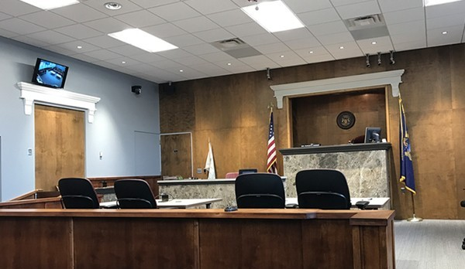
Court 101:
An Inside Look at the Court System

Slide 2

Who Am I — and How Did I Get Here?
🗹 My professional journey
🗹 My education
🗹 My current role
Good Morning! Jen Koperniak
Court Administrator
43rd District Court Hazel Park

Slide 3
My Path to Court Administration
Target → Leadership & Operations
47th District Court → Deputy Clerk
Law Firms → Legal Assistant / Paralegal
15th District Court → Lead Clerk
43rd District Court → Court Administrator

Slide 4
My Education:
🎓 Bachelor’s in Political Science
🎓 Master’s in Public Administration
🏅 Certified Court Manager
Professional Experiences:
⚖️ Law Office Internship
🏛️ Isabella County Trial Court Internship
📈 Target Business College

Slide 5

Who Keeps the Court Running?
What do you think a Court Administrator actually does?

Slide 6

Key Duties of My Role
⚙️ Operations
💰 Finance
💡 Innovation
🏢 Facilities

Slide 7

Now We’ll Explore..
✅ Court etiquette
✅ Common myths & misconceptions
✅ The role of Court clerks
✅ What happens behind the scenes

Slide 8
My Top 8 Court
Etiquette Rules
Expect security screening.
Be on time.
Bring all required documents.
Follow signs and instructions at the counter.
5. Dress appropriately.
6. Silence your phone.
7. Be respectful to staff.
8. Every court operates differently.

Slide 9
Common Court Misconceptions
Myth: Cases are resolved quickly.
Reality: Courts balance legal timelines, safety, fairness, and due process.
Myth: Everyone goes to jail.
Reality: Most cases involve probation, treatment, compliance, or payment options.
Myth: Tickets can’t be challenged.
Reality: Many civil infractions can be contested or reduced.
Myth: Judges and magistrates are basically the same.
Reality: They serve different legal functions.

Slide 10

Fun fact:
Court employees are often surprised to learn…
🚔 How involved Police Officers
are at hearings.
📂 Courts handle far more than
criminal cases.
💵 Payment plans are often
available.
📅 How much work goes into
scheduling dockets.

Slide 11
Court Employees are Public Servants:
What Court Staff Can & Cannot Do
Court Staff CAN ✅ | Court Staff CANNOT ❌
Explain procedure | Give legal advice
Share public records | Discuss confidential information
Facilitate access | Deny or discourage access
Provide forms | Tell you what strategy to use

Slide 12
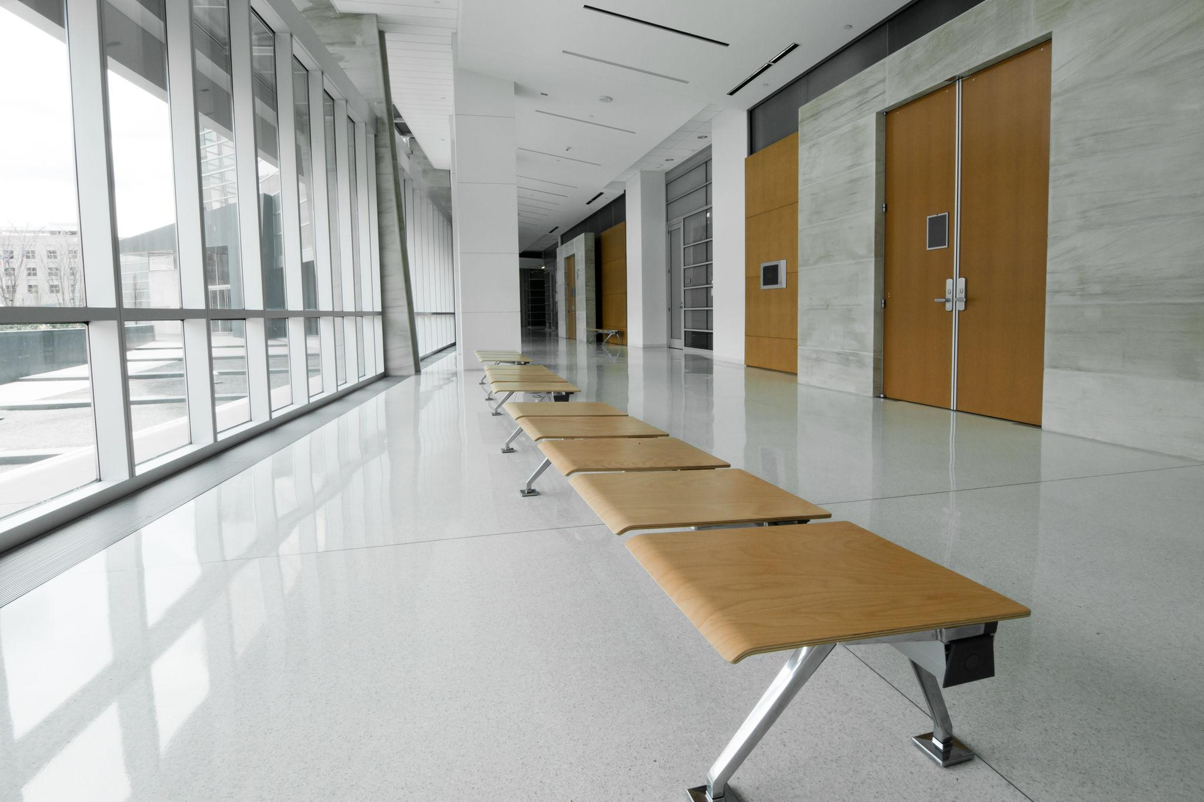
Taking a Deep Dive:
A practical look at Court processes, challenges, and lessons learned.

Slide 13

Court Filings:
Common Mistakes
❌ Wrong case number
❌ Incorrect court date on filing
❌ Service, missing or improper
❌ Incorrect filing fees
❌ Documents not filed timely per
statute
What other examples can you list?

Slide 14
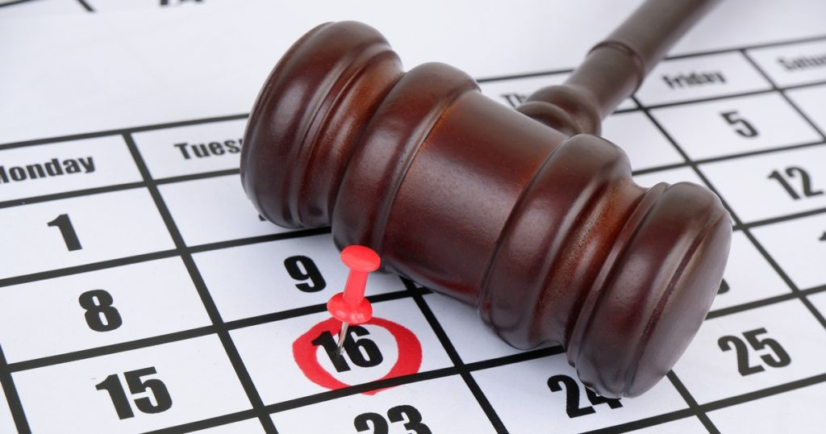
Court Scheduling
⬤ Last year our Court handled 29,515 cases.
⬤ In-person hearings vs. Zoom hearings
⬤ Hearing types
⬤ Courtroom usage

Slide 15
Court Backlog:
A Court backlog does not mean cases are being ignored.
How do you think adjournments impact
court operations?

Slide 16

Your First Court Appearance: Are You Ready?
⏰ Before Court: | 🎯 Be Prepared:
⚖️ Meet with your attorney | 👔 Dress professionally
📁 Prepare your documents and exhibits | ⏰ Plan for delays or adjournments
📍 Know your courtroom location | 💻 Test technology for virtual hearings

Slide 17
Advice from a former Paralegal
Don’t ever assume.
Ask for clarity from your attorney.
Every Judge is different.
Re-read every email before sending.
Leave concise voicemail messages.
Build relationships with the court staff.
Share knowledge—help your colleagues succeed.

Slide 18

Key Takeaways
🏛️ Courts are complex
⚖️ Court staff help while remaining
neutral
📋 Preparation matters
🤝 Professionalism and relationships
matter
💡 Understanding the court system
helps people navigate it with
confidence

Slide 19
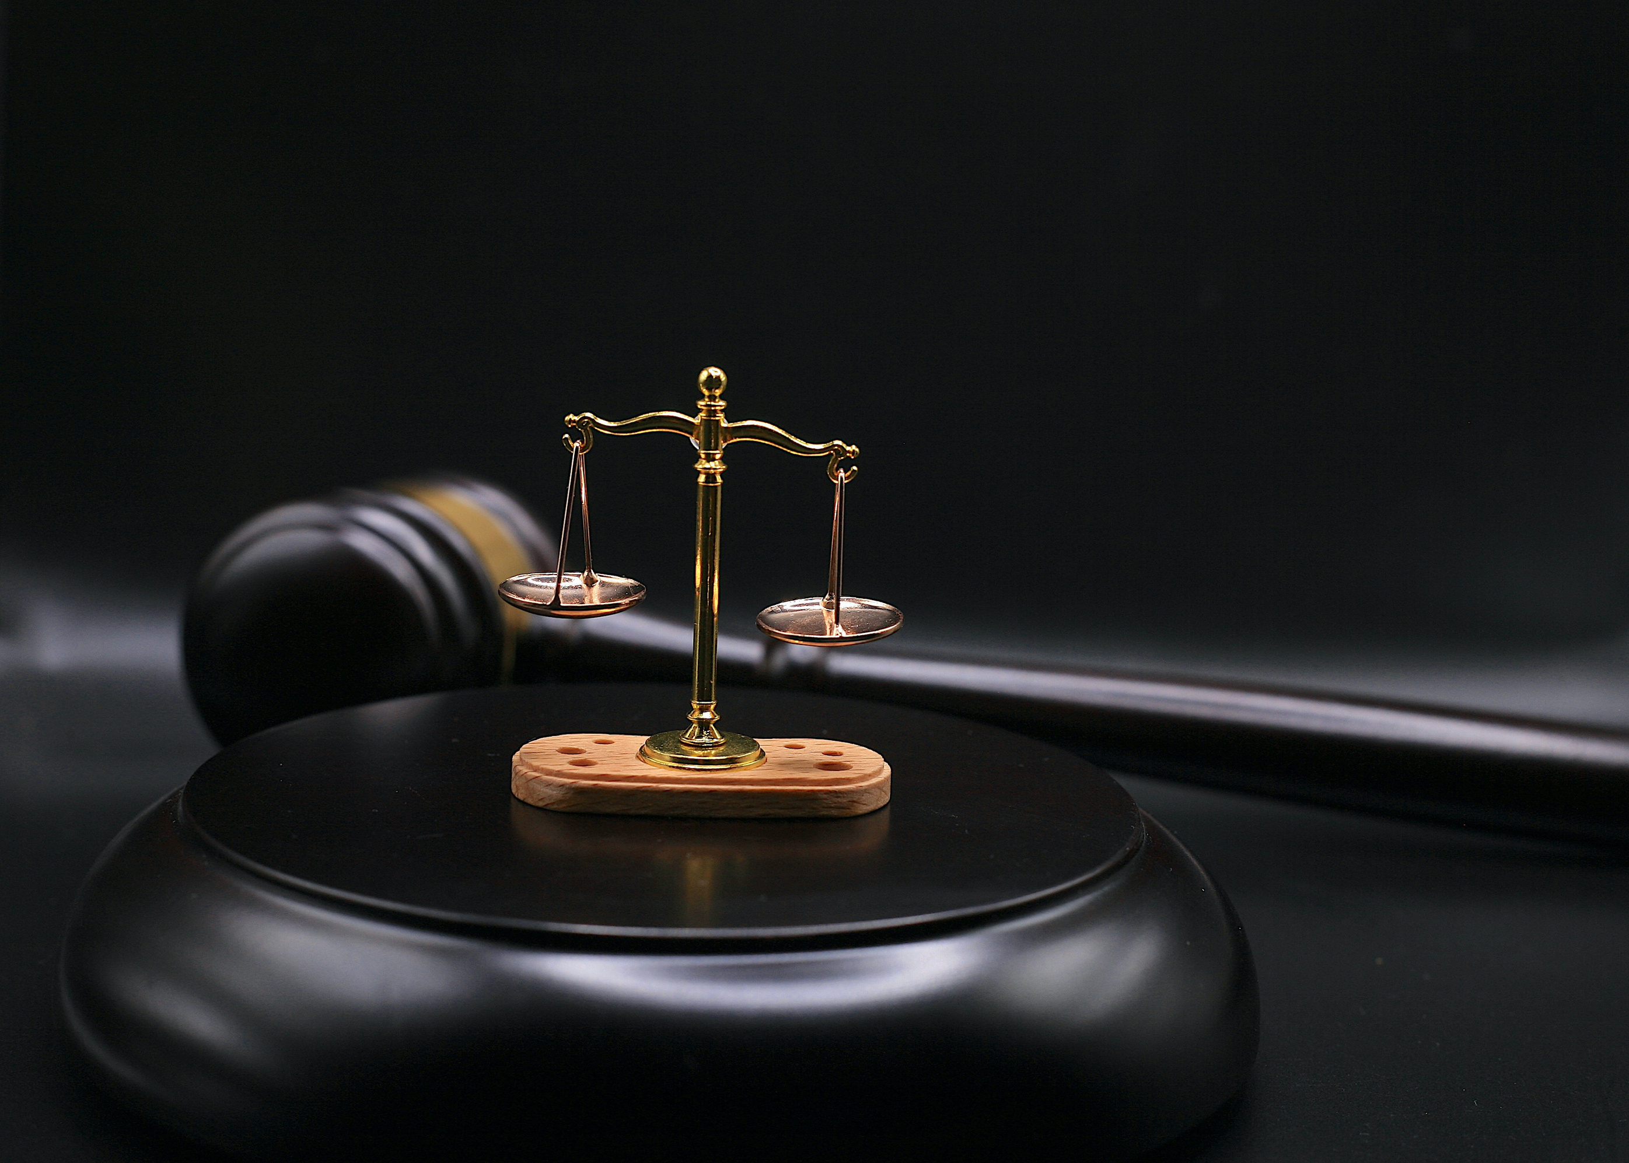
Ask me anything: the courts, common misconceptions, or what my job actually involves.

Slide 20
Contact Me
Jen Koperniak
43 E. Nine Mile Road Hazel Park MI 48030
(248) 547-3034
jkoperniak@hazelpark43rdcourt.com

