Slide 1

Welcome, KDP Members!
Get Ready to Celebrate YOUR Graduation & Amazing Success!

Slide 2
YOU did it!
Congratulations!

Slide 3


Slide 4
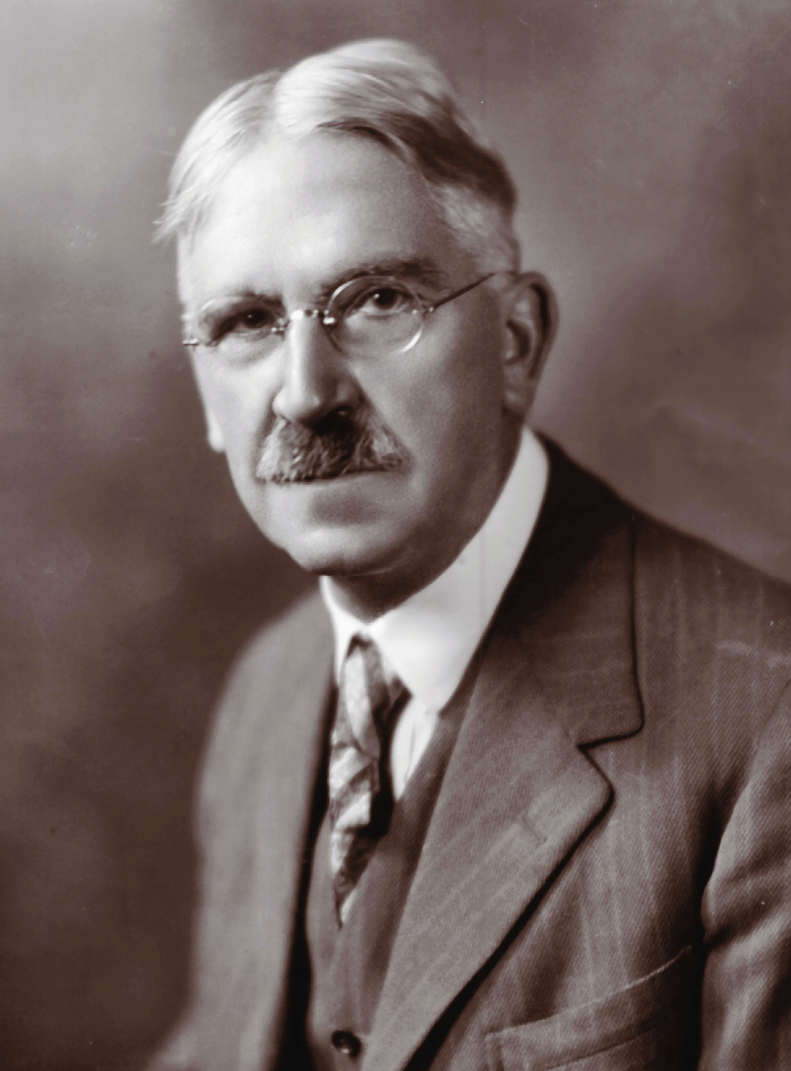

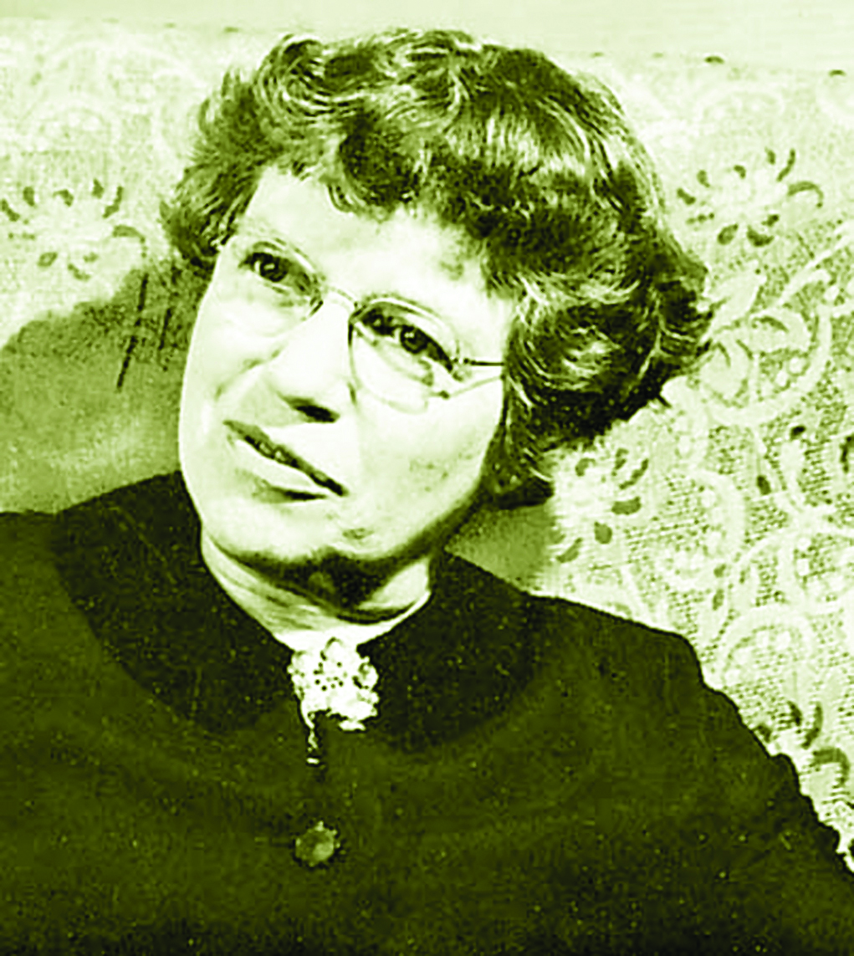

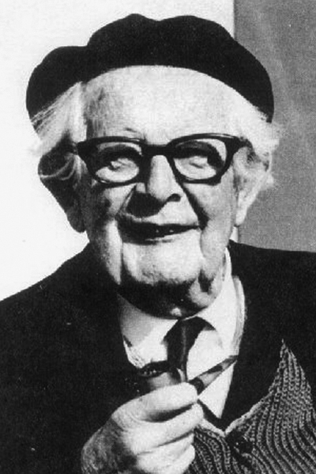
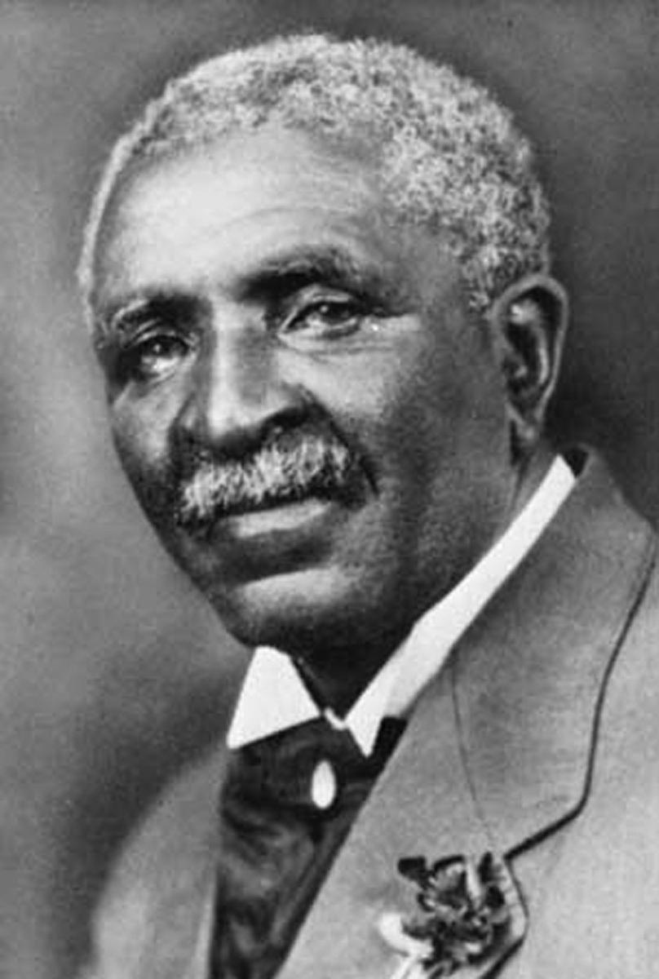
KDP Educational Excellence Throughout History
. . . And YOU!

Slide 5
You shall inspire and strengthen others
to pursue unbiased inquiry, peace, and social justice by encouraging students
to lead self-actualized lives.

Slide 6
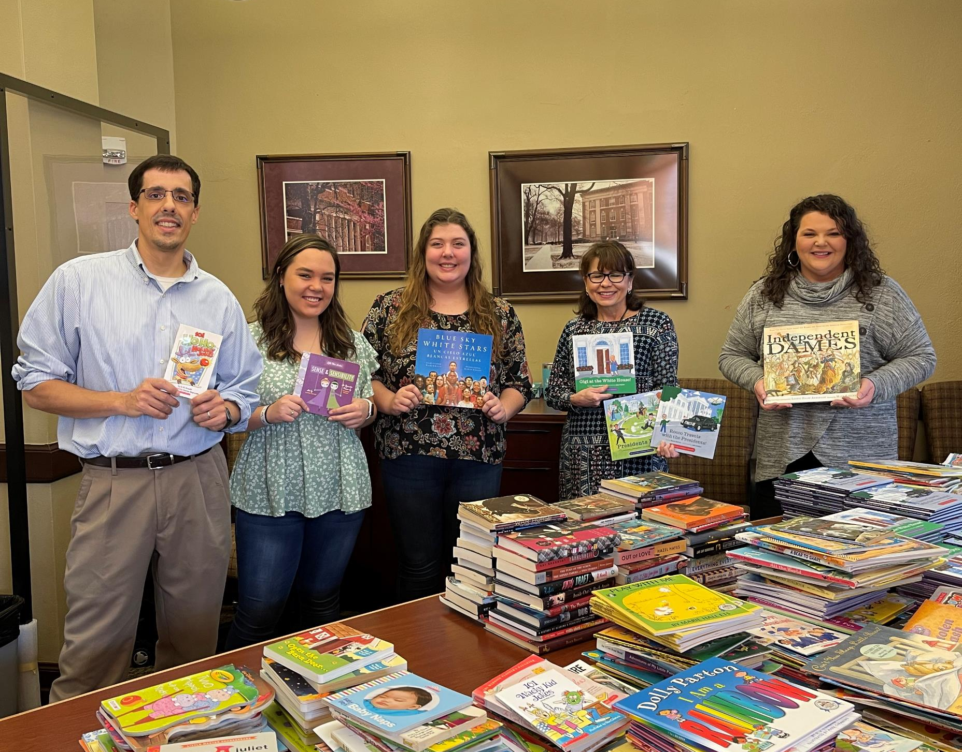
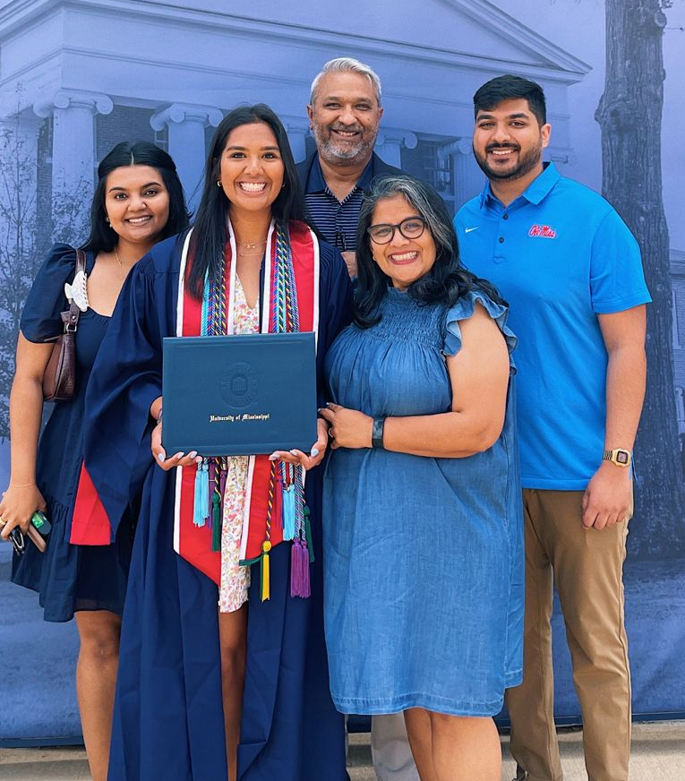
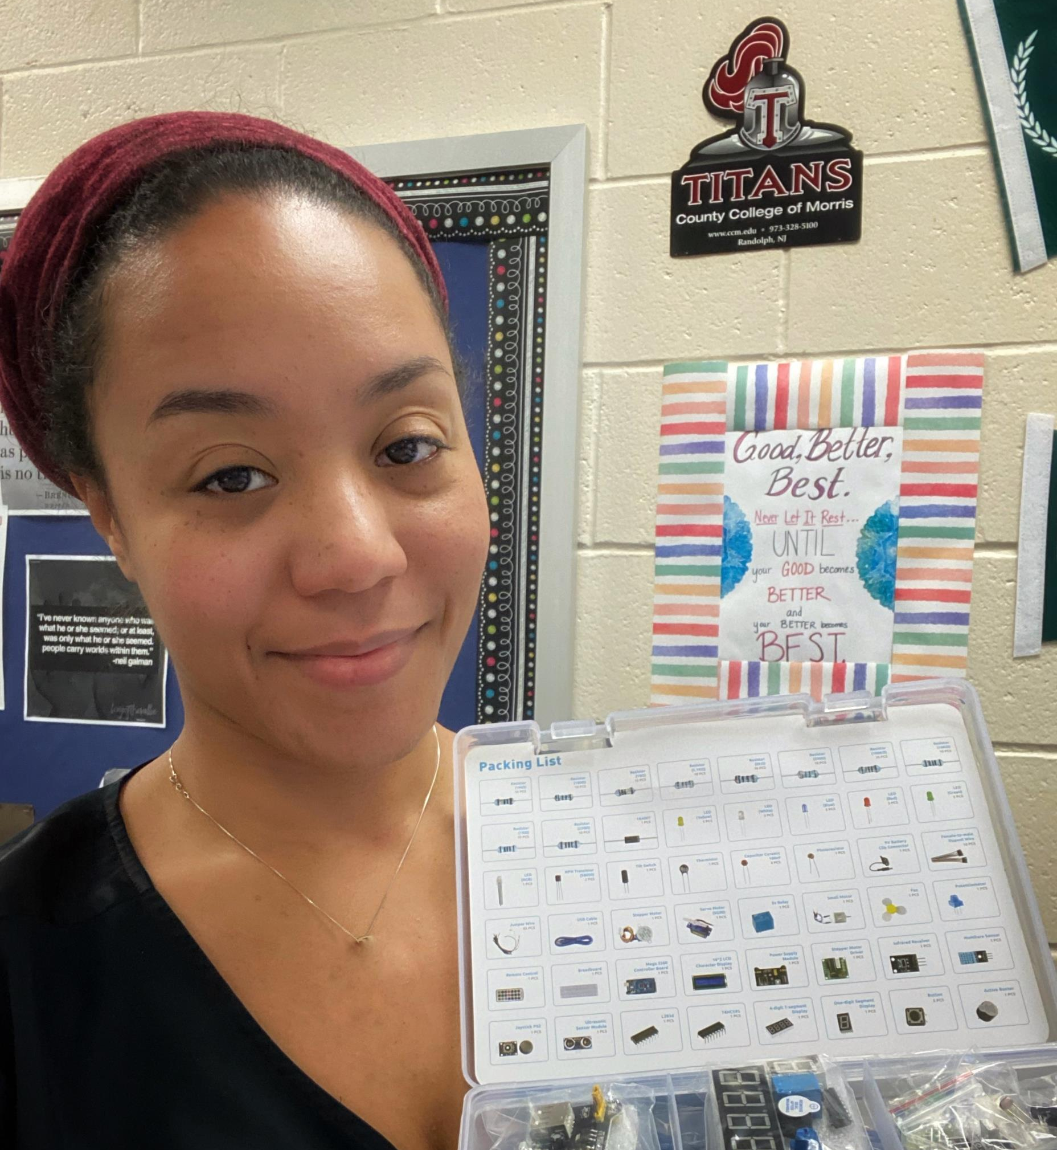
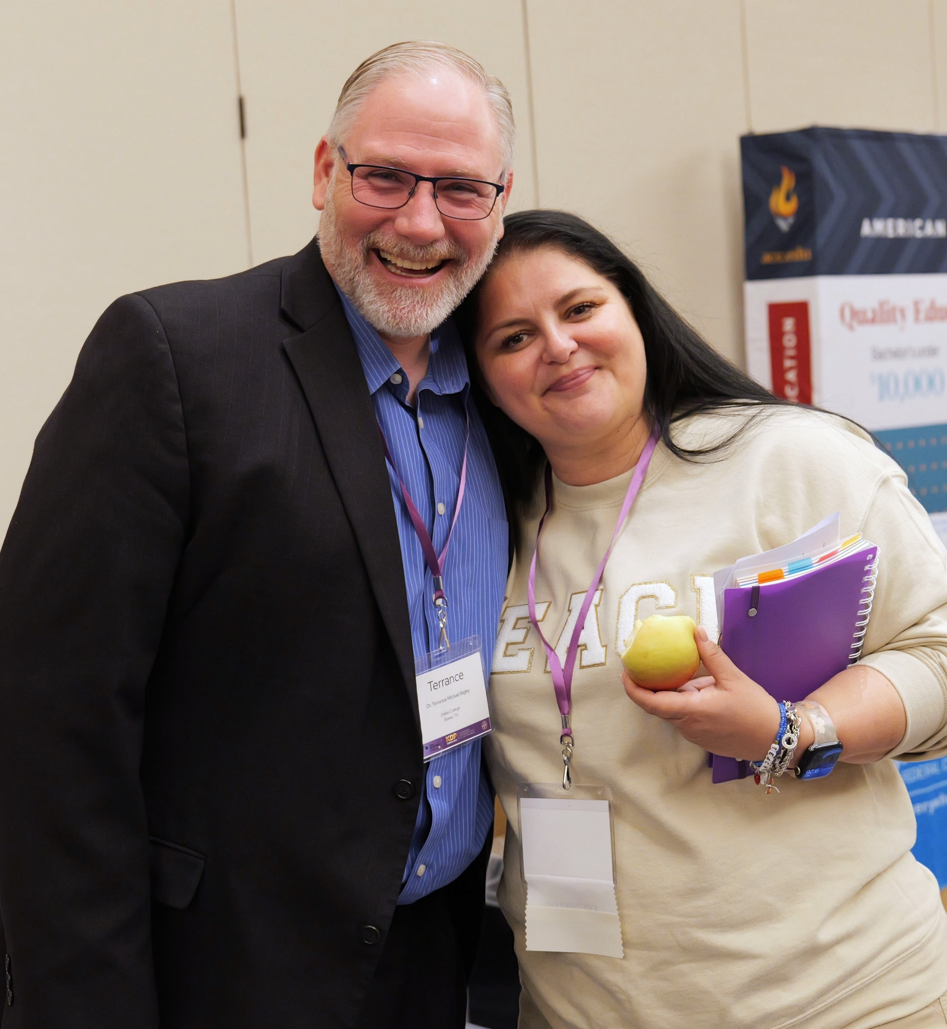

Slide 7
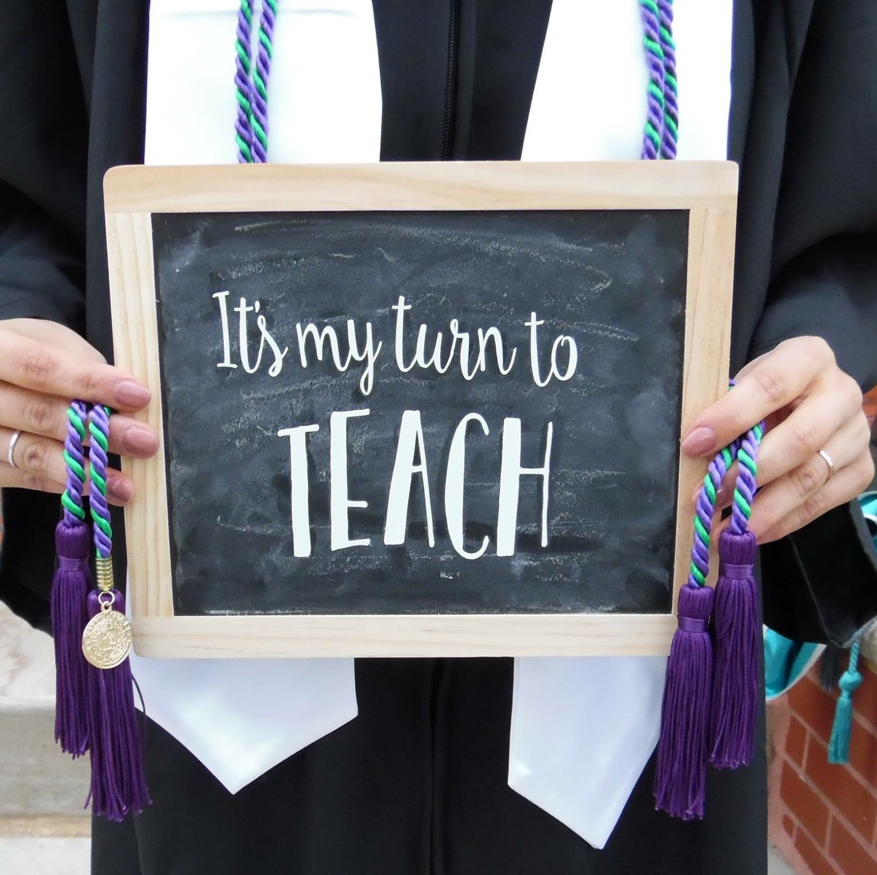
So to teach, that our words inspire a will to learn;

Slide 8
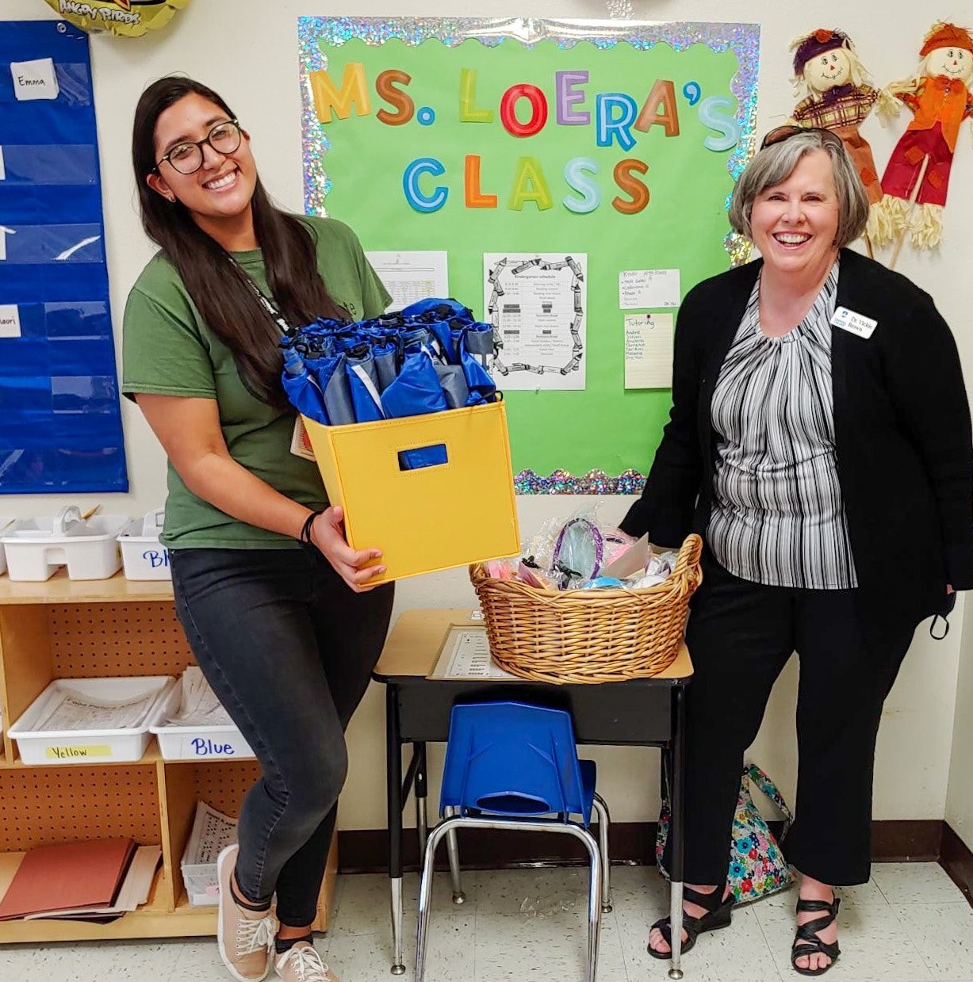
So to serve, that each day may enhance the growth of exploring minds;

Slide 9

So to live, that we may guide young and old to know the truth.

Slide 10

Welcome to your premier
KDP National Professional
Association for Educators
We’re here to support & celebrate YOU!

Slide 11
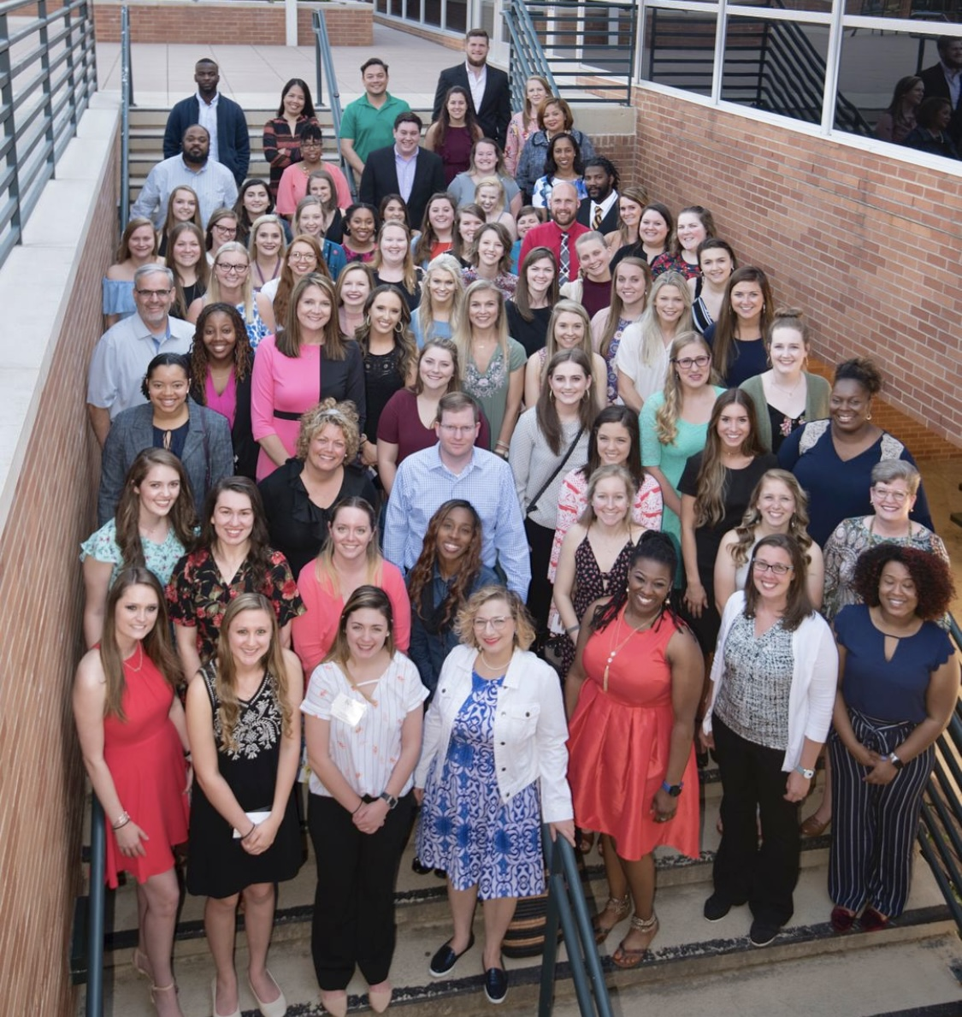
Community
Volunteer & leadership growth opportunities locally and nationally
In-person and virtual educator events
Private online community to connect and share with KDP colleagues in a safe, supportive environment
You belong here.
Notes:
Misty

Slide 12
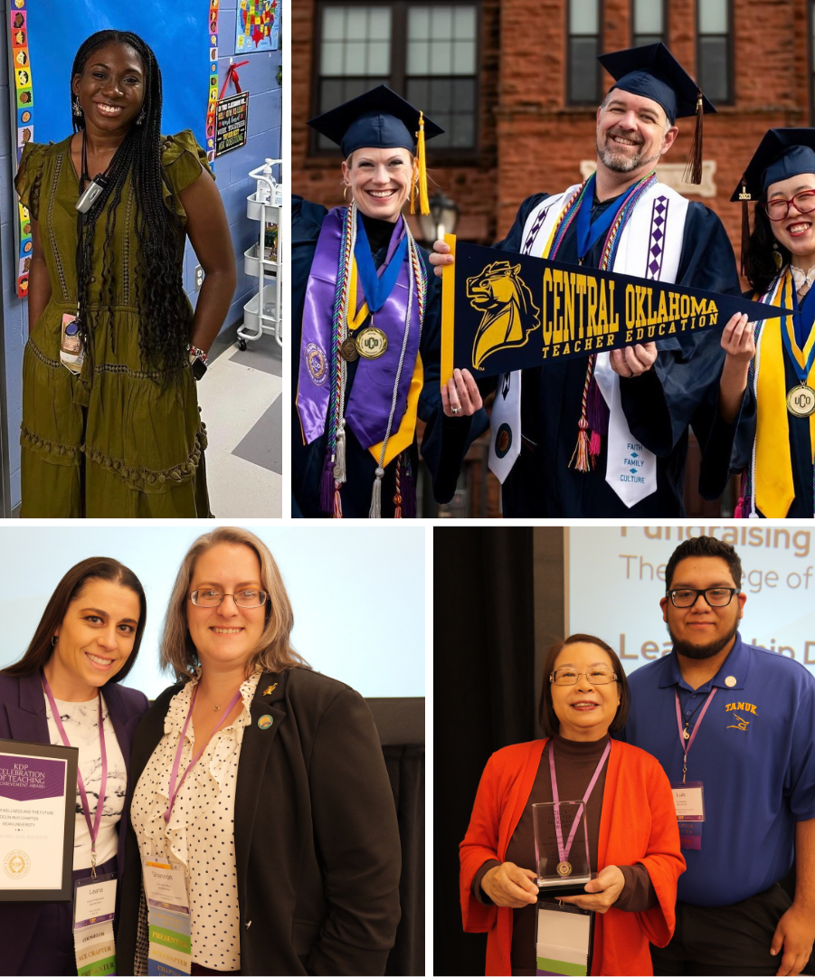
Celebration
KDP National awards & recognition of teachers of all stages of careers from campus to classroom to retirement
Classroom grant funds for your special teaching projects and programs
Scholarships for your continued education
You are appreciated.
Notes:
Khalil

Slide 13
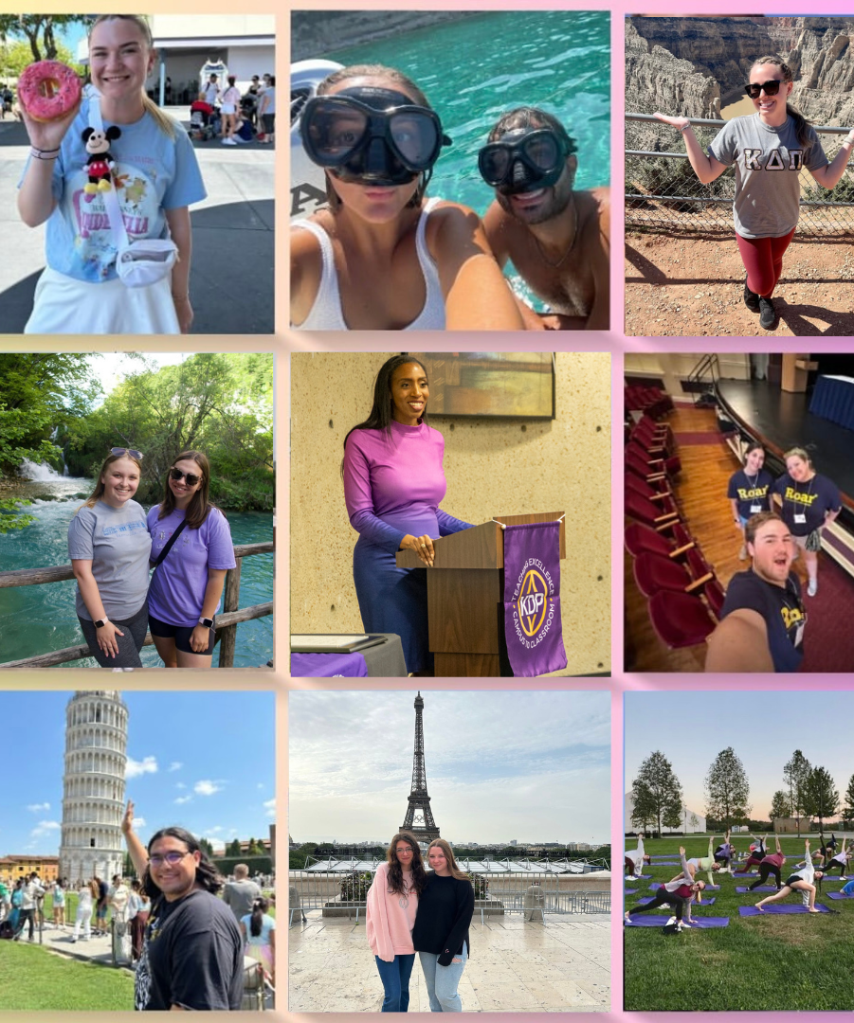
Care
The Rooted Teacher by KDP, a quality-of-life initiative for teachers: podcast, microlearnings, & support sessions to live your best life
On-going peer support by teachers for teachers
Travel discount programs
Insurance access for professional and personal well-being to protect yourself and your family
You will thrive!
Notes:
Misty

Slide 14

Career
Exclusive access to best practice, real world videos, lessons and peer coaching through Teaching Channel
The Teacher Advocate online magazine research-based articles for teachers by teachers
Employment search assistance nationally and locally
Professional development opportunities and credits
Certification exam preparation
You will grow as a professional.
Notes:
Khalil

Slide 15
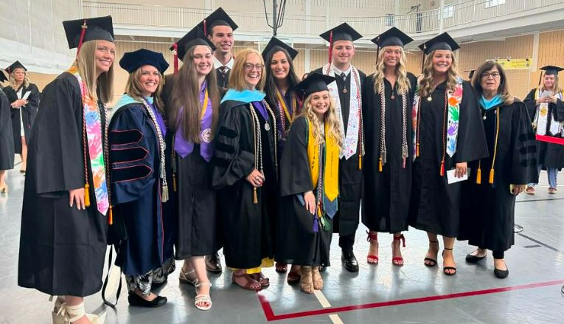

Slide 16


