Slide 1
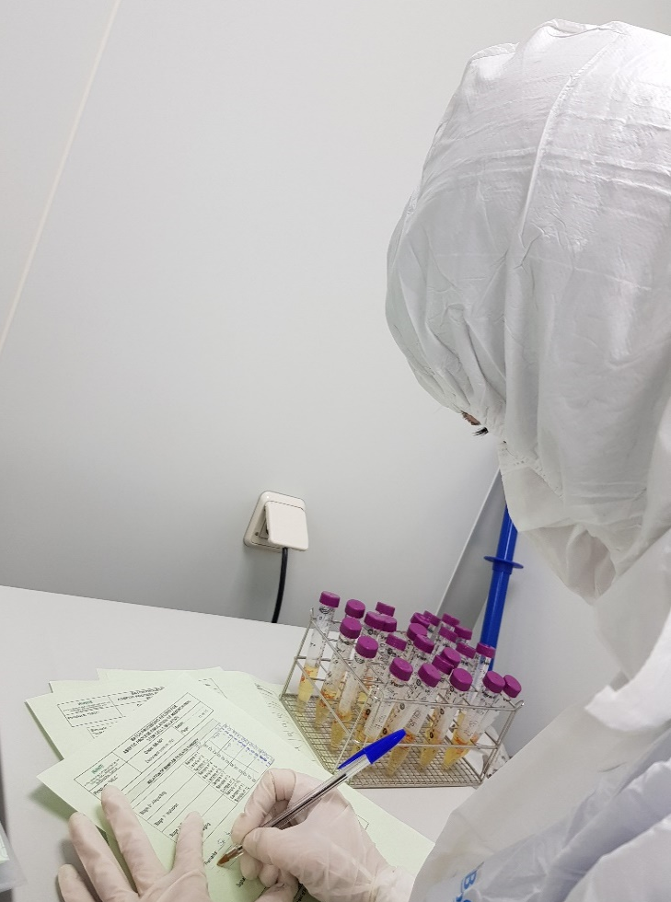
VALIDATION ACTIVITIES:
AN EXAMPLE OF CLEANING VALIDATION PROTOCOL
ISCT Lab Practice Committee
June 2021
Gloria Carmona Sánchez
Head of Quality Assessment and GMP Facilities.
Andalusian Network for the Design and Translation of Advanced Therapies
http://www.sspa.juntadeandalucia.es/terapiasavanzadas/index.php/en/

Slide 2
INDEX
CLEANING VALIDATION
CONCLUSIONS
VALIDATION ACTIVITIES

Slide 3
Ensures EQUIPMENT works according to expectations, complying with the specifications
Ensures an INSTRUMENT works as expected, under specifications
QUALIFICATION
CALIBRATION
VALIDATION
Applies to Processes and Systems
Ensures that a PROCESS is performed according to expectations, complying with the specifications

Slide 4

Should reinforce good manufacturing practices
Be conducted in accordance with defined procedures
Results and conclusions should be recorded
VALIDATION STUDIES
to demonstrate the ability to provide, on a continuing and reproducible basis, homogeneous products according to quality specifications.
OBJECTIVE

Slide 5

CONSIDERATIONS IN VALIDATION PROCEDURES
Significant changes to facilities, equipment and processes, which may affect the quality of the product, should be validated.
A risk assessment approach should be used to determine the scope and extent of validation.
All validation activities should be planned.
Key elements should be clearly defined and documented in a validation master plan.

Slide 6
Validation policy
Organizational structure of validation activities
Summary of facilities, systems, equipment and processes to be validated
Documentation format
Planning and scheduling
Change control
Reference to existing documents
Validation Master Plan
Notes:
What is a validation master plan? It is a document that includes…

Slide 7
VALIDATION MASTER PLAN
VALIDATION PROTOCOL
CONDUCT VALIDATION PROTOCOL
VALIDATION REPORT
STEPS DURING VALIDATION

Slide 8

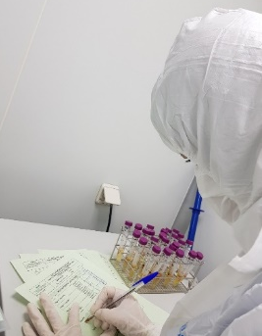
VALIDATION PROTOCOL
a written protocol
specifying
how validation will be conducted
critical steps and acceptance criteria need to be included
approved
reviewed
CONDUCT VALIDATION PROTOCOL
VALIDATION REPORT: Collect all data obtained after developing validation protocol

Slide 9
VALIDATION REPORT
A report that cross-references the validation protocol should be prepared, summarising the results, commenting on any deviations observed, and drawing the conclusions reached, including recommending changes necessary to correct deficiencies.
Any changes to the plan as defined in the protocol should be documented with appropriate justification.

Slide 10
PROCESSES THAT COMMONLY NEED TO BE VALIDATED
Cleaning validation
Environmental validation
Material disinfection validation
Process validation
Sterilization validation
Aseptic process validation
Transport validation

Slide 11
INDEX
VALIDATION ACTIVITIES
CLEANING VALIDATION
CONCLUSIONS

Slide 12
CLEANING VALIDATION
the documented evidence that a given cleaning procedure removes contaminants, residues from previous product, and cleaning agents below a pre-defined threshold.
OBJECTIVE
to demonstrate that the cleaning process consistently meets the predefined acceptance criteria

Slide 13
CLEANING VALIDATION PROTOCOL
Cleaning validation protocol should be described in a document which should cover:
Detailed cleaning procedure
Sampling procedures
By swabbing and/or rinsing or by other means depending on the production equipment
The sampling materials and method should not influence the result
Acceptance criteria
Specific rationale for setting limits should be included
The selection of the equipment should be representative of the worst case scenario

Slide 14
CLEANING VALIDATION PROTOCOL
Personnel responsible for conducting the cleanup must be trained in cleaning techniques
ASPECTS IN A CLEANING VALIDATION PROTOCOL
DISINFECTANTS
CLEANING PROCEDURE
CLEANING INTERVALS
CONTROLS TO BE PERFORMED AND MONITORING THE RESULTS
A specific plan needs to be established accordingly

Slide 15
CLEANING PROCEDURE AND CLEANING INTERVALS
The following considerations apply when designing the strategy:
The influence between manufacturing and cleaning should be taken into account to define dirty time for cleaning procedures
The influence between cleaning and use should be taken into account to define clean hold times for cleaning procedures

Slide 16
DISINFECTANTS
A. HOW TO SELECT THE ADEQUATE BIOCIDE TO DISINFECT
The selection of an adequate biocide to disinfect surfaces of aseptic zones is not easy
Depending on the type of product, the grade of the zone and the risks, different biocides can be used

Slide 17
DISINFECTANTS
A. HOW TO SELECT THE ADEQUATE BIOCIDE TO DISINFECT
GENERAL BIOCIDAL ACTIVITY
bactericide
fungicide
sporicide
virucide

Slide 18
DISINFECTANTS
B. EFFECT OF THE MOST COMMON BIOCIDES (ORIENTATIVE)
ALCOHOL
(IPA y etanol al 70%)
BACTERICIDE
FUNGICIDE
QUATERNARY AMMONIUM
BACTERICIDE
FUNGICIDE
HYDROGEN PEROXIDE 3%
BACTERICIDE
FUNGICIDE
VIRUCIDE
VIRUCIDE
VIRUCIDE
HYDROGEN PEROXIDE 6%
SODIUM HYPOCHLORITE
BACTERICIDE
FUNGICIDE
VIRUCIDE
SPORICIDE (in some cases)
HYPOCHLOROUS ACID
BACTERICIDE
FUNGICIDE
VIRUCIDE (depending on concentration)
SPORICIDE
BACTERICIDE
FUNGICIDE
VIRUCIDE (depending on concentration)
SPORICIDE
HYDROGEN PEROXIDE + PERACETIC ACID
BACTERICIDE
FUNGICIDE
VIRUCIDE
SPORICIDE

Slide 19

DISINFECTANTS
B. EFFECT OF THE MOST COMMON BIOCIDES (ORIENTATIVE)
ALCOHOL
BACTERICIDE
FUNGICIDE
QUATERNARY AMMONIUM
BACTERICIDE
FUNGICIDE
HYDROGEN PEROXIDE 3%
BACTERICIDE
FUNGICIDE
VIRUCIDE
VIRUCIDE
VIRUCIDE
HYDROGEN PEROXIDE 6%
SODIUM HYPOCHLORITE
BACTERICIDE
FUNGICIDE
VIRUCIDE
SPORICIDE (in some cases)
HYPOCHLOROUS ACID
BACTERICIDE
FUNGICIDE
VIRUCIDE (depending on concentration)
SPORICIDE
BACTERICIDE
FUNGICIDE
VIRUCIDE (depending on concentration)
SPORICIDE
HYDROGEN PEROXIDE + PERACETIC ACID
BACTERICIDE
FUNGICIDE
VIRUCIDE
SPORICIDE
Depending on the microorganism identified in your facility…the specific zone, grade….
The sporicides have an oxidative and corrosive capacity on aseptic surfaces, so their use needs to be reduced to a minimum

Slide 20
CONTROLS TO BE PERFORMED FOR MONITORING RESULTS
The following aspects need to be described
Monitoring points need to be defined…where, when , why…
How to codify the samples
Action and alert limits need to be established
Where the results are going to be recorded…

Slide 21
CONDUCT VALIDATION PROTOCOL
According to the approved validation protocol
Using the records previously defined
By the trained personnel

Slide 22
CLEANING VALIDATION REPORT
A report needs to be prepared including the following aspects:
Summary of the results
Any deviation observed
The conclusions reached
Recommended changes, if any, to correct deficiencies
Appropriate justification if any changes to the plan need to be done
The established dirty and clean hold times after validation
REVIEWED
APPROVED

Slide 23
CLEANING VALIDATION REPORT
All primary data need to be stored as part of validation report
Monitoring records
Disinfectants used during the cleaning validation
Any deviation occurred
People involved in cleaning procedure
Notes:
Any primary data need to be stored

Slide 24
INDEX
VALIDATION ACTIVITIES
CLEANING VALIDATION
CONCLUSIONS

Slide 25
CLEANING VALIDATION
KEYS FOR SUCCESS
To identify the factors that influence the effectiveness of the cleaning process
Operators
Rinsing times
The worst case scenario should be used
Cleaning equipment
Cleaning agents used
Number of operators
Number of times operators must enter the facility
Everything needs to be defined prior to start
Protocol and records
Materials to be used
Cleaning agents to be used and rotation plan
Personnel trained
Equipment, facilities

Slide 26

Have a question? Want to share a suggestion?
The Lab Practices Committee Laboratory Life Line forum is a great way to get in touch with your network for insight, collaboration and help!
https://my.isctglobal.org/forums/Default.aspx

Slide 27
REFERENCES
Eudralex – Volume 4 Good manufacturing practice (GMP) Guidelines. Part IV – GMP requirements for Advanced Therapy Medicinal Products. https://ec.europa.eu/health/sites/health/files/files/eudralex/vol4/2017_11_22_guidelines_gmp_for_atmps.pdf
PIC/S Validation-Master Plan, IQ, OQ, non-sterile Process Validation, Cleaning Validation (PI 006-3) Sept 2007. https://picscheme.org/docview/3447

