Slide 1

AI for Security Professionals

Slide 2

AGENDA
Basic overview
Prompt engineering
RAG
AI Agents
Final TIPS & TAKEAWAYS

Slide 3

Basic overview

Slide 4

AI, ML, Gen AI, LLM
High-level overview

Slide 5

Getting Familiar
What is AI (Artificial Intelligence)?
AI = Smart behavior by software
What is Machine Learning (ML)?
ML = Software that learns from data
What is Generative AI (GenAI)?
GenAI = AI that creates new things
What are Large Language Models (LLMs)?
LLM = AI that understands and generates language
Notes:
Slide 3: What is AI (Artificial Intelligence)?
Think of AI as software that can "think" or make decisions like a human
It doesn't have emotions or intent—it just follows patterns
Example: When your email filters spam – that’s a simple form of AI
What is Machine Learning (ML)?
ML is a type of AI where systems learn from data instead of being told what to do
It finds patterns and improves over time
Example: A model that learns which log entries are likely to be real threats
Slide 5: What is Generative AI (GenAI)?
GenAI is AI that can create new content (text, images, code, even music)
It doesn’t just analyze—it generates
Example: ChatGPT writing an audit checklist based on a framework
What are Large Language Models (LLMs)?
LLMs are a type of GenAI trained on tons of text
They understand language, context, and can generate very human-like responses
ChatGPT is an example of an LLM
They don’t "know" things—they predict the most likely next words based on your prompt

Slide 6
Using LLMs
LLM Options

Slide 7
Types of LLMs
Model | Maker | Notes
GPT-4 / GPT-3.5 | OpenAI / Azure OpenAI | Best for reasoning, APIs, memory, plugins
Claude 3 | Anthropic | Safer, better at summarizing long docs
Gemini 1.5 | Google | Strong in multilingual + web context
LLaMA 2 / 3 | Meta | Open source, for private environments
Mistral / Mixtral | Mistral AI | Small, fast open-source models
Command R / Cohere | Cohere | Trained for retrieval & enterprise tasks
Jurassic / AI21 Labs | AI21 | Strong in long-form writing

Slide 8
LLM Usage Examples
Task | Recommended LLM
Drafting audit reports | GPT-4, Claude
Comparing security policies | GPT-4 + RAG
Asking questions from 100-page policy | Claude 3 or Gemini (long context)
Private/internal-only use | LLaMA 3 / Mistral (self-hosted)
Real-time integration with Azure | GPT-4 (via Azure OpenAI)

Slide 9
Prompt engineering 101
R.a.p.i.d. prompt framework

Slide 10
Prompt examples
Create a checklist for ABC
Summarize this document
What is SOC2

Slide 11
The R.A.P.I.D. Prompt Framework
🧩 R.A.P.I.D.
Role – Who is the AI acting as?
Audience – Who is the response for?
Purpose – What are you trying to achieve?
Input – What context/data do you provide?
Delivery – What format do you want the output in?
Others: https://medium.com/@slakhyani20/10-chatgpt-prompt-engineering-frameworks-you-need-to-know-41d4b76ed384

Slide 12
Let’s Workshop this
Notes:
Create calendar https://chatgpt.com/c/67eda042-7988-800d-8104-4d807c462a96
Toyota add-on recos https://chatgpt.com/c/67f1e575-6c10-800d-b941-fcde717c0275
Revise OKRs https://chatgpt.com/c/e361500f-bbe0-4527-b10e-20fd0168138b
Hubspot report for CEOs https://chatgpt.com/c/e402f543-e525-480c-af67-63e35ce057b6
Building a simple RAG App https://chatgpt.com/c/67ff31d0-30b0-800d-9efb-33e6feec4d18

Slide 13

custom GPTs vs RAG
🧠 Custom GPTs
ChatGPT you can customize with instructions and upload a few static documents.
📚 RAG (Retrieval-Augmented Generation)
AI connected to a document library. It retrieves relevant content and answers using that specific info.
🧠 Think:
Custom GPT = private tutor reading a few pages
RAG = research assistant scanning your entire library
Notes:
Examples – SEBI CSCRF, Sales GPT, Anupriya’s Threat Modeling GPT. Each is comparable with default GPT.
https://chatgpt.com/g/g-67f68846e8d88191b5f18abdfdd4d089-evidence-elf
https://chatgpt.com/g/g-67f6662fadb48191926c17fc0d61ab60-ni-threat-modelling-gpt
https://chatgpt.com/g/g-67f54126a7bc8191a1026de2e26f6e6a-ni-report-qa-gpt
NotebookLM – what to build there?
Ideas – an IR drill app – basic ChatGPT, Custom GPT, NotebookLM
Another one is around NIST AI RMF, trained with NI documents.
AI examples:
ChatGPT – hallucinates, Claude is too brief, Perplexity is super comprehensive
https://chatgpt.com/c/67fef3a8-64a0-800d-8aee-f51d315558f7. Ask members to find the gaps. Another idea could be to generate mindmaps – ChatGPT vs. NotebookLM
https://claude.ai/chat/c2764140-7091-4b81-a7a1-493481e52cb4

Slide 14
RAG vs. Custom GPT
Feature | Custom GPT | RAG
File uploads | ✅ Limited | ✅ Unlimited (with vector store)
Search scope | Static | Dynamic + scalable
Updates | Manual | Automated with pipelines
Accuracy | Decent | High (when retrieval works well)
Use cases | Simple Q&A, fixed docs | Live policy search, many docs
Setup | No code | Low code / Dev help
Hosting | OpenAI | Self-host / Cloud-native

Slide 15
Agents

Slide 16
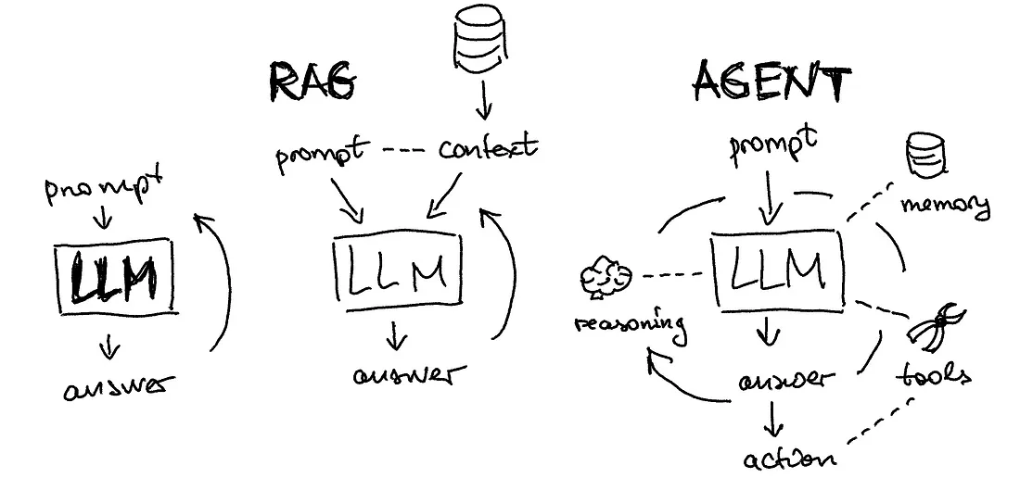
LLM vs RAG vs Agent

Slide 17
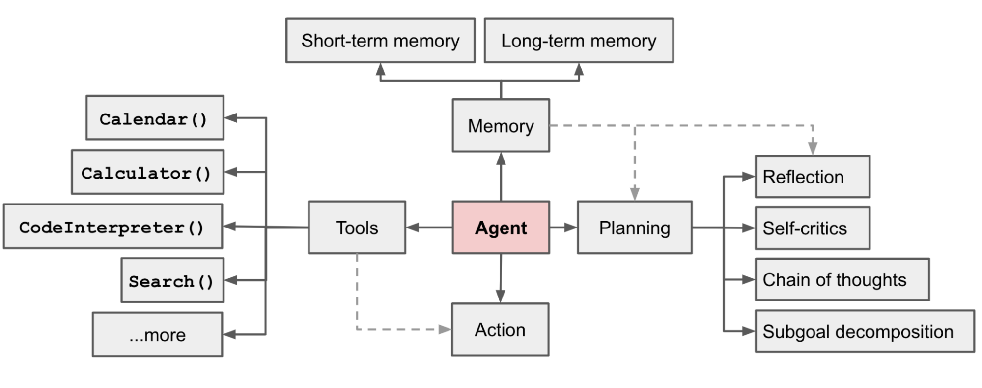
Agentic AI – Components
Image credit: https://lilianweng.github.io/posts/2023-06-23-agent/

Slide 18
No code agents
Manus.im
Zapier
N8n
Make

Slide 19

THANK YOU

