Slide 1
Reflections on OSWC 2016
Todd Zenger
University of Utah

Slide 2
Most topics of this flavor
Organizational Design Choice
Innovation

Slide 3
Themes
Should you (can you) contract for innovation?
Are flatter or deeper organizations more innovative?
Are lone ideators or teams more innovative?
Are self formed or hierarchically assigned teams more innovative?
Are small firms, large firms, medium-sized firms more innovative?
Are small firms or large firms benefitted more by shock that lowers costs of innovation?
Are firms disadvantaged over universities in doing basic research?
Does open source participation increase innovation?
Does knowledge sharing foster innovation?

Slide 4
It Depends
All results shaped by the nature of the innovation being sought, studied, and measured (or the problem being solved).

Slide 5
All results are correct (probably).
All results are wrong!

Slide 6
Themes
Should you (can you) contract for innovation?
Are flatter or deeper organizations more innovative?
Are lone ideators or teams more innovative?
Are self formed or hierarchically assigned teams more innovative?
Are small firms, large firms, medium-sized firms more innovative?
Are small firms or large firms benefitted more by shock that lowers costs of innovation?
Are firms disadvantaged over universities in doing basic research?
Does open source participation increase innovation?
Does knowledge sharing foster innovation?

Slide 7
Flat, deep; cent. vs. decent.
Small, large
Self selection, hier. Selection
Gov’t vs. Firms
Insource vs. outsource
Arms length vs. relational
Knowledge sharing vs. nominal group
Nature of the innovation (PROBLEM)

Slide 8
Relevant problem dimensions (Simon)
Problem complexity; decomposability
Hiddenness of knowledge deemed relevant

Slide 9
Problem complexity and solution search
Individual actors with heterogeneous knowledge can independently explore implications of design choices
Low interaction,
decomposable
SIMPLE PROBLEMS
high interaction,
Non-decomposable
Individual actors with heterogeneous knowledge must share knowledge and compose a theory or cognitive representation to efficiently search
COMPLEX PROBLEMS

Slide 10
Hidden Knowledge
External Actors
External Actors
Focal actor
Focal Actor
Narrow or Known
Location
Broad or Location
Unknown
Central selection
Self selection

Slide 11
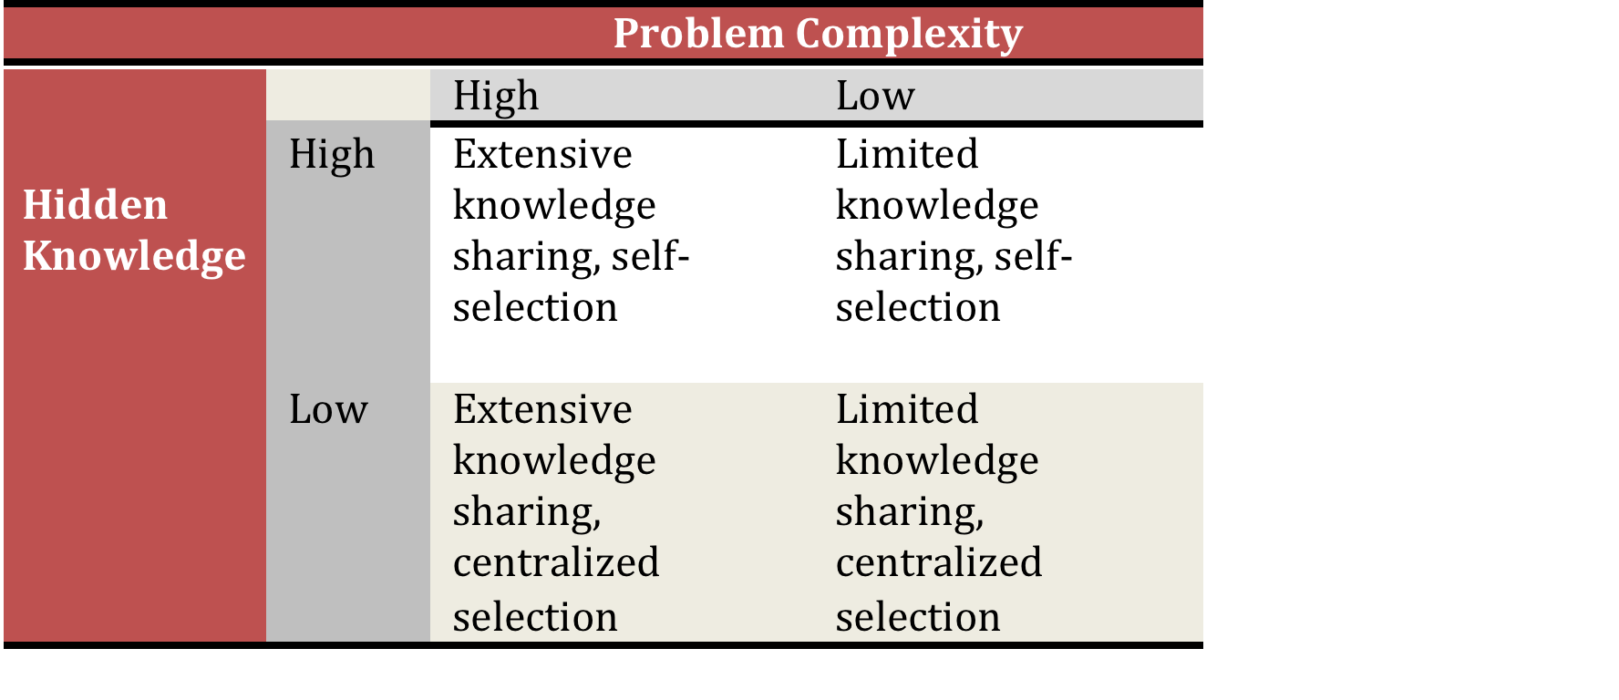

Slide 12
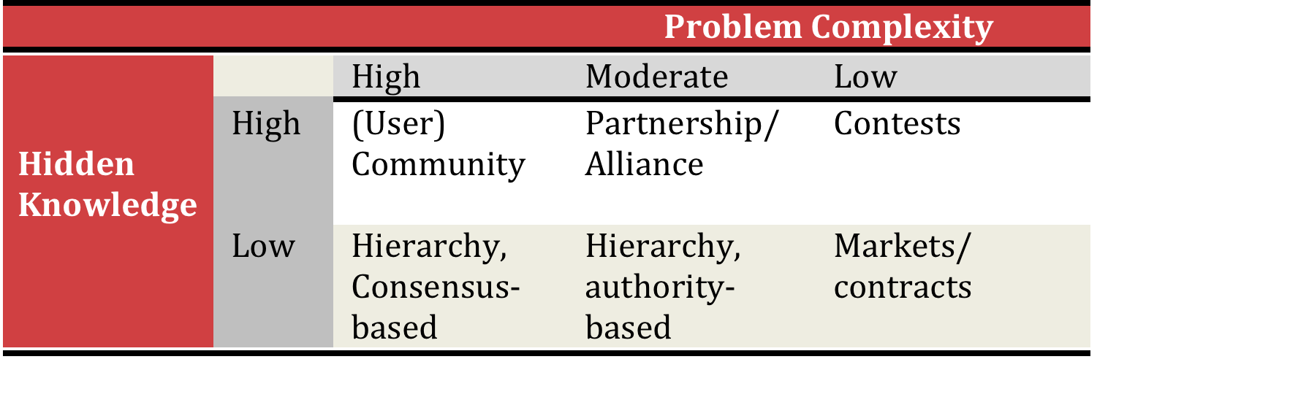
Matching Organizational Approach to Problems

Slide 13
Flat, deep; cent. vs. decent.
Small, large
Self selection, hier. Selection
Gov’t vs. Firms
Insource vs. outsource
Arms length vs. relational
Knowledge sharing vs. nominal group

Slide 14
Final Thoughts
What drives innovation depends on what innovation we seek.
We need more contingent studies of innovation.
Therefore, we need to develop an alignment between “drivers of innovation” and types of innovation
Or, match problems to governance forms
  What are the key dimensions of innovation types or problems that shape governance?
  How do organizational drivers work differently with different types of innovation?

Slide 15
