Slide 1
Supplier Innovation Strategy:
Transactional Hazards and Innovation in the Automotive Supply Chain
Jennifer Kuan, Stanford University
Daniel Snow, Brigham Young University
Susan Helper, Case Western Reserve University

Slide 2
Motivation
Extensive literature on shortcomings of innovation measurement (Cohen, 2010 survey)
2 measures, R&D spending and patenting, also focus on large firms, where data are available (some important exceptions, e.g., Acs & Audretsch, 1988, 1990)
European surveys do better job of expanding measures and set of firms (Hall & Jaffee, 2012)

Slide 3
Research question
Is there significant innovative activity that we have failed to measure?
Is there “dark” innovation? (Martin, 2013)
What are implications of this type of innovation for strategy?
Does this “dark” innovation matter?
Notes:
This addresses a gap in the literature, but also the supplier perspective pays surprising dividends

Slide 4
Research strategy
Look at “rust belt” firms, esp previously under-sampled smaller firms
Auto supply chain allows for strategic considerations
Interviews and plant visits for insight into innovative activity and attitudes
Nationwide survey, informed by Euro. Surveys
Apply transaction cost analysis to refine the make-or-buy question with greater reference to innovation concerns

Slide 5
Preview of Results
Find innovative activity that differs from currently measured innovation
Cluster analysis identifies 3 different innovation strategies among supplier firms
  High R&D
  High design
  High turn
By looking at the supplier side, we can see how buyers employ several strategies simultaneously
Refine the make-or-buy question for innovation

Slide 6



Example: Toyota
…drops relational contractor
…for high-R&D German supplier
Toyota’s Akio Toyoda announcing supplier change, Dec 2015
PHOTO: KIMIMASA MAYAMA/EUROPEAN PRESSPHOTO AGENCY

Slide 7
Data
Interviews and survey in 2010-2011
3 surveys sent to ~3800 firms
  Sales manager
  HR manager
  Plant manager
Overall response rate: 37%; N=1411
Sales survey response rate: 14%; N=544
Notes:
Talk about other variables, too: commitment to auto industry/ bargaining power, asset specificity is measured directly, piece price, tier.

Slide 8
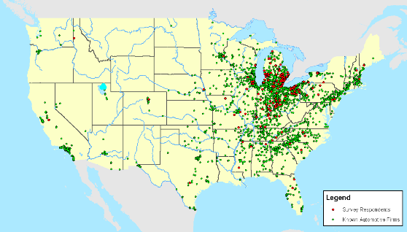
Response geography

Slide 9
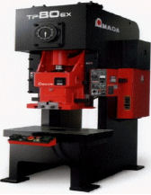
Example: stamping equipment
Stamping equipment for thicker metal stamps a part that is cast by a competitor. Saves energy and lowers cost.

Slide 10
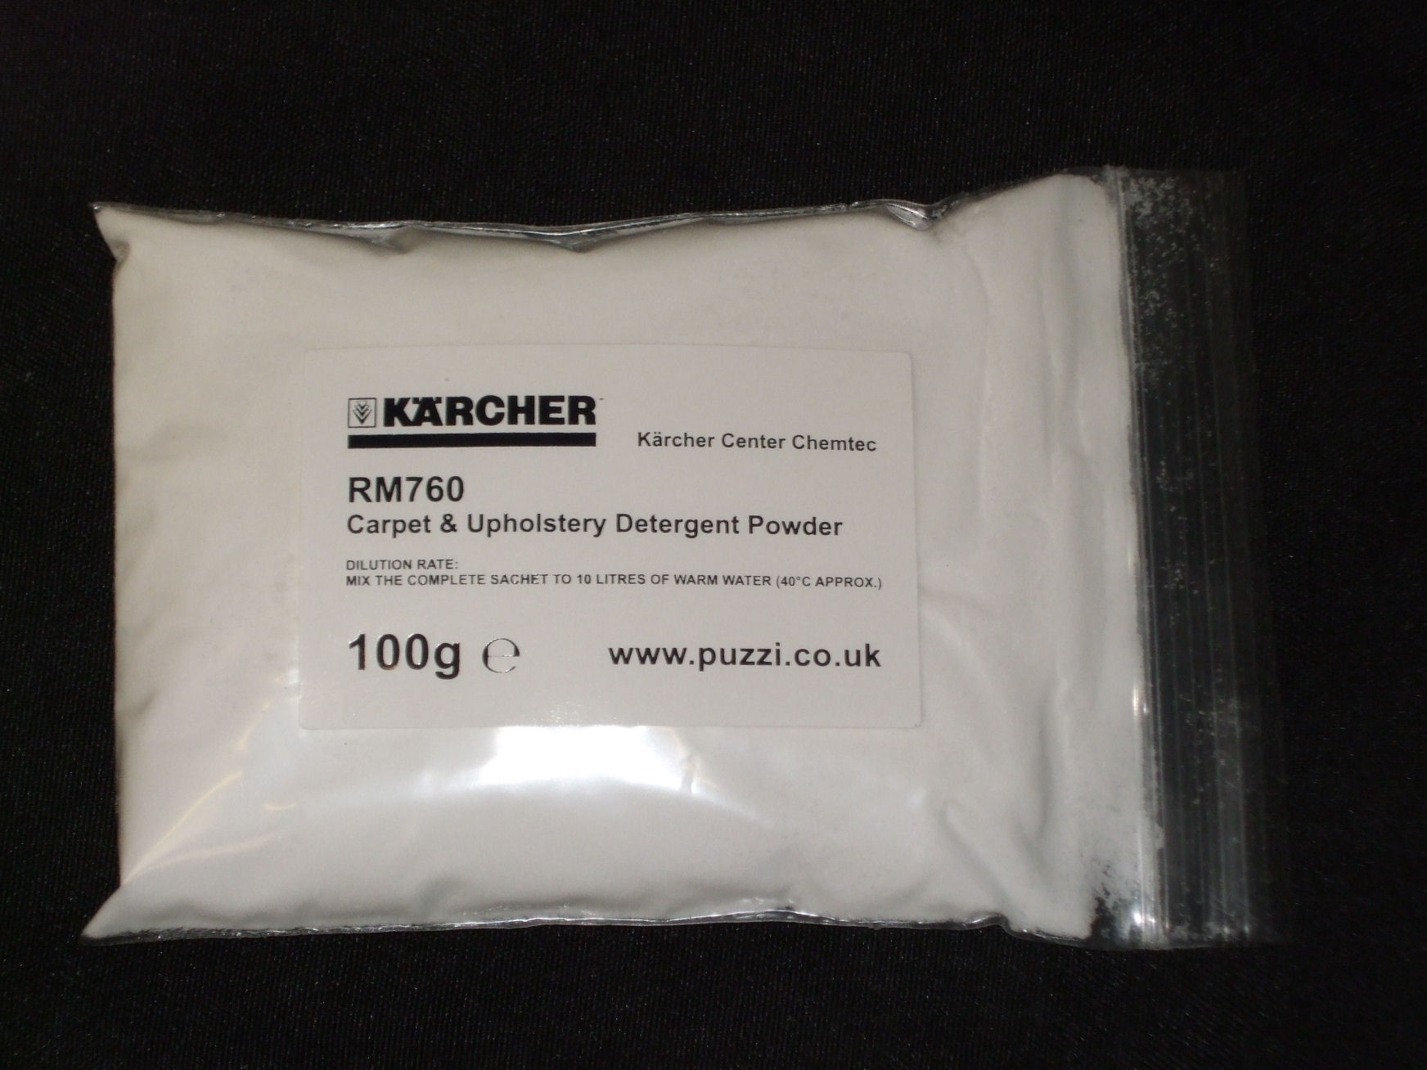
Example: “cake mixes”
Pre-measured sets of rubber additives instead of bulk sales. Improves customer ease-of-use inventory management and re-ordering.

Slide 11

Example: process refinement
Refine metal stamping process to stamp thin, perforated plastic.
Meets needs of customers in new, green energy industry.

Slide 12
Innovation survey questions
Which range best describes your business unit’s R&D as a percentage of sales?
  0
  0.1-1%
  1.1-2%
  2.1-3%
  3.1-4%
  >5%
Please indicate which descriptions apply to your firm’s role in product development for your company’s current model
  Customer took entire responsibility
  Customer provided majority of engineering hours; your business unit provided the rest
  Customer and your business unit contributed equally to the design
  Your business unit provided majority of engineering hours
  Your business unit took entire responsibility

Slide 13
Innovation questions (con’t)
Approximately what percent of your business unit’s sales come from products which it did not make 4 years ago?
What percentage of your sales come from products where you innovated in some way? By 'innovated', we mean that your business unit designed a product with improved features compared to what the market had seen before, or that you used a novel process to make the product.
  0-10%
  11-30%
  31-45%
  46-55%
  56-70%
  71-85%
  85-100%

Slide 14
Innovation variables

Slide 15
Innovation variables

Slide 16
Innovation variables

Slide 17
Innovation variables

Slide 18
Correlation matrix: innovation vars
 | R&D intensity | Design | New products | Innovation
R&D spending | 1
Design | 0.32*** | 1
New products | 0.06 | -0.14*** | 1
Innovation | 0.33*** | 0.20*** | 0.21*** | 1

Slide 19
Cluster analysis
Suggested by frequencies of innovation variables
Used k-means clustering
Tried various combinations and number of clusters
Picked 3-cluster result of 4 innovation variables; statistically significant

Slide 20
Clusters
N=93
N=126
N=175

Slide 21
Cluster comparisons
Cluster (High R&D omitted) | Piece price | Tier 1 (y=1) | % autos | Multiple OEMs
High design | -0.23 | -0.01 | 0.53* | -0.10
High turn | -0.95*** | -0.12* | 0.16 | -0.20**
N | 384 | 372 | 390 | 143
R2 | 0.08 | 0.01 | 0.01 | 0.03
Notes:
Think of these as conditional correlations, like a cross tab. Discriminate analysis

Slide 22
Comparison of innovation activities (OLS)
Variables | R&D intensity | Design | New products | Innovation
Piece price | 0.26*** | 0.31*** | -0.05 | 0.13***
Tier 1 (y=1) | 0.09 | 0.18 | -0.42** | 0.24*
Asset specificity | 0.01 | 0.10* | 0.01 | 0.10**
Constant | 2.44*** | 0.73*** | 2.62*** | 1.50***
N | 405 | 381 | 423 | 421
R2 | 0.044 | 0.118 | 0.019 | 0.034
Notes:
Regress characteristics on innovation variables, robustness check for clusters, find similar results.

Slide 23
Strategic response to hazards
High R&D
High design
High turn

Slide 24
Strategic response to hazards
High R&D
  High-value products, non-specific assets, multiple customers
High design
  High-value products, specific assets, focused on auto industry
High turn
  Low value parts, low levels of innovative activity

Slide 25
Relational contracting
Arms-length contracting with monopolistic
High R&D supplier
Transaction costs
= > in-house production
Arms-length contracting with competitive
Low-innovation supplier

Slide 26
Relational contracting
Arms-length contracting with monopolistic
High R&D supplier
Transaction costs
= > in-house production
Arms-length contracting with competitive
Low-innovation supplier

Slide 27
Relational contracting
Arms-length contracting with monopolistic
High R&D supplier
Transaction costs
= > in-house production
Arms-length contracting with competitive
Low-innovation supplier

Slide 28
Discussion
Survey supply chain, new measures of innovation, find “dark” innovation
We think “dark” innovation matters for conceptualizing supplier strategies
Heterogeneous strategies to respond to transaction costs
More complex picture of the buyer’s make-or-buy problem with innovation considerations

Slide 29
New questions
Other measures of innovation?
How do we think about allocating among supplier types?

Slide 30
Thank you!

