Slide 1
A Theory of Governing
Internal Innovation
Trey Cummings
Washington University in St. Louis
Jackson Nickerson
Washington University in St. Louis

Slide 2
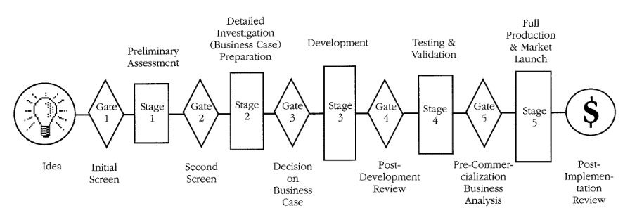
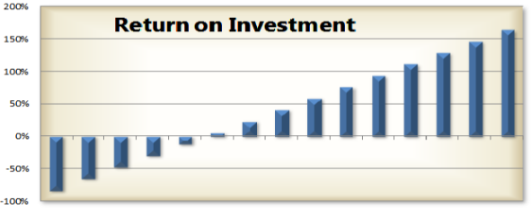
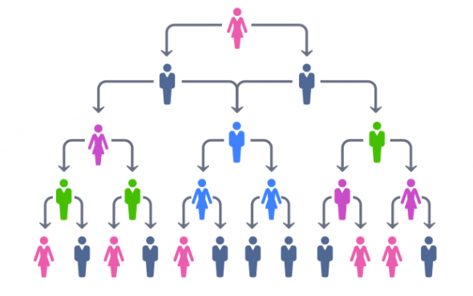
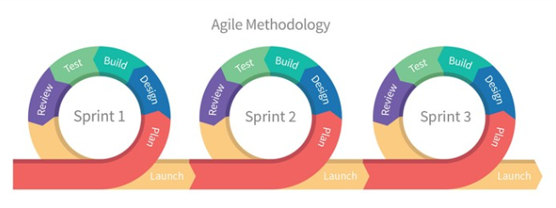
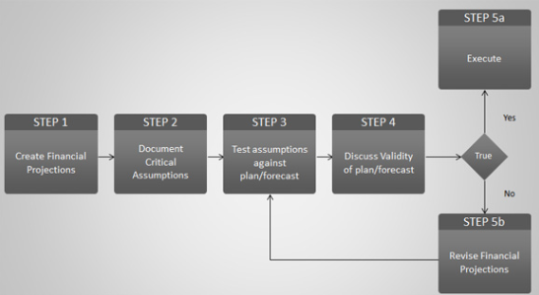
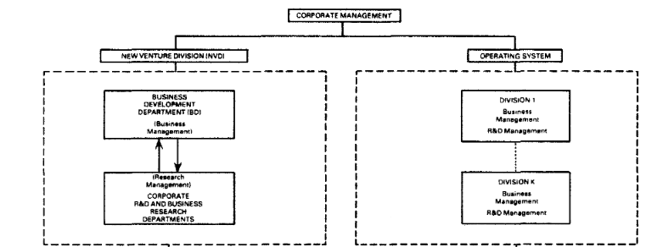
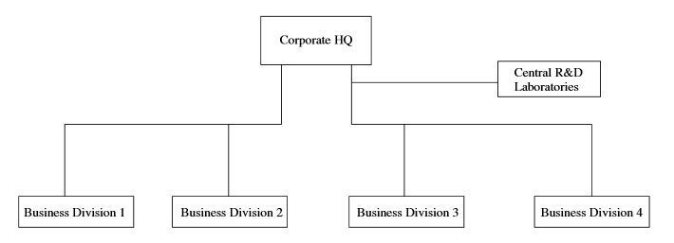
Internal Innovation Processes
Many concurrent and differing processes
Why? In what situations?

Slide 3
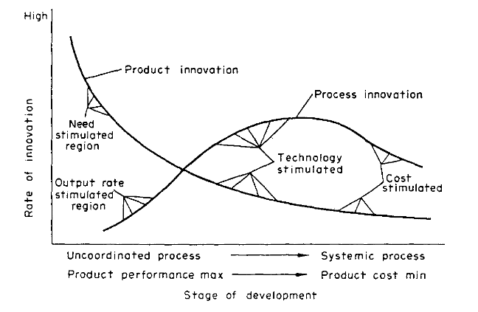
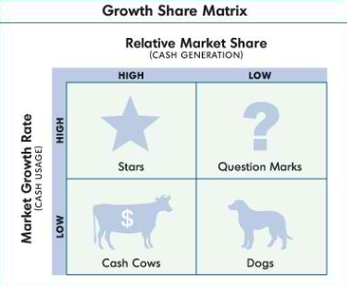
Internal Innovation Literature
Descriptive
  Product vs. Process (Utterback & Abernathy 1975)
  Growth Share Matrix (Boston Consulting Group 1972)
Process
  Stage-Gate Process (Cooper 1990)
  Agile Process (Karlesky & Voord 2008)
  Discovery Driven Planning (McGrath & MacMillan 1995)
Structure and Decision Locus
  Decision Making Locus (e.g., Sah & Stiglitz 1988)
  Centralization of R&D (e.g., Argyres & Silverman 2004)
  Internal Ventures (Burgelman 1983, Von Hippel 1977)

Slide 4
Key Research Questions
When and why do various processes, structures, & DM Locus offer a comparative advantage for innovation?
When and why might multiple they be used concurrently and/or sequentially?
What are the performance consequences of using them?

Slide 5
Our Approach
Problem Finding/Solving Approach
  Innovator thinking and behavior
  Parameterizing the problem
  Identifying governance alternatives in the firm and their costs and competencies for mitigating bias
Discriminating alignment of processes with respect to the problem attributes leads to:
  Efficacious search and innovation
  Different kinds of innovations dependent on governance approaches adopted

Slide 6

Model of Human Behavior
Homo Inventus
  Assume a single innovator
  Bounded rationality + …
  …the possibility of associative thinking biases that derive from “system 1” thinking
    E.g., anchoring, framing, representativeness, etc.
  Self-interest seeking with guile + …
  …the possibility of ego preservation biases
    E.g., confirmation, self-confirming beliefs, escalation of commitment, etc.

Slide 7

Problem context and uncertainty
Problem Context
  Cost of search differs by context
    Designing, enacting, and interpreting results to update theory and models varies systematically by context
    E.g., costs of inputs, access to knowledge, equipment, distribution channels, complementary resources, etc.
  We assume context can be parameterized
Problem Uncertainty
  Problem vary in complexity and ill-structuredness
  Such variation affects implicit ruggedness of landscape
  Ruggedness affects likelihood of finding a peak (i.e., a value creating opportunity)

Slide 8

Corrupting Effect of Biases
Objective is to engage in efficacious search.
  Problem finding
  Problem solving
Cost of Associative Thinking Biases increases in uncertainty
Cost of Ego Preservation Biases increases in context
Uncertainty
(Complexity & Ill-Structuredness)
Cost of Biases
Cost of Biases
Context
(Cost of Experiment)

Slide 9

(Preliminary) Discriminating Alignment
Centralized Research
Uncertainty
(Complexity & Ill-Structuredness)
Time Horizon
Internal Venture
Agile
Stage-Gate
Simple Hierarchical
Comparative
Context
(Cost of Experiment)

Slide 10
Insights
Internal governance choices influence the likelihood and kind of innovation contingent on the problem
Internal governance alternatives vary in their costs and competencies for efficacious search
Performance can suffer when firms do not adopt or align internal governance to problems

