Slide 1

DIFFUSING WINDOWS OF OPPORTUNITY
The transformation of fields to sustain radical innovation when moving toward deployment
Greetje F. Corporaal
[Gretta]
Natalia Levina * Julie Ferguson
Organization Science Winter Conference 02/06/2016

Slide 2


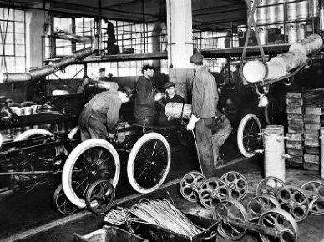
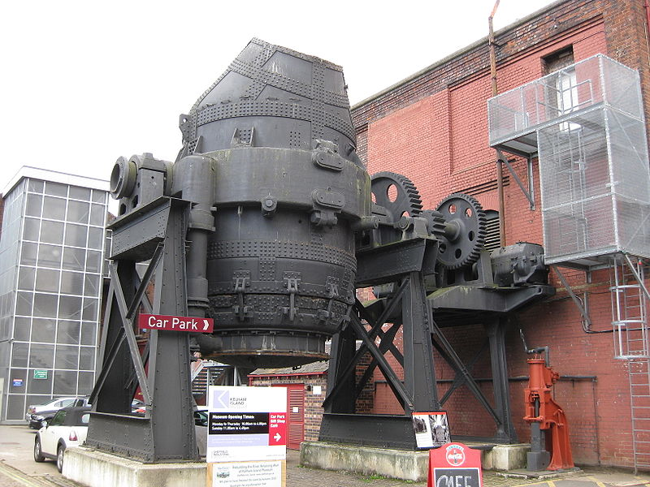
product
process
_{1/20} [technological innovation]
Notes:
We define technological innovation as a technology-based invention that leads to new technological development, production, and marketing opportunities (Garcia and Calantone, 2002).
1 Dyson dual cyclone vacuum cleaner
2 Henry ford moving assembly line
3 ICI/George Feachem polyethylene plastic
4 Henry Bessemer mass production of steel
Innovations are more radical when they yield an entirely new capability (Miller et al. 2005) and of which the commercialization has a “strong impact on the market, in terms of offering wholly new benefits, and on the organization, in terms of its ability to create new businesses” (O’Connor and Ayers, 2005, p. 24).
For incumbent organizations such as MNCs, radical innovations are essential for securing competitive advantage and growth (O’Connor and DeMartino, 2006; Slater et al., 2013), and contributing to their long-term success and survival in an environment characterized by intense global competition (Christensen, 1997; Levinthal and March, 1993).

Slide 3
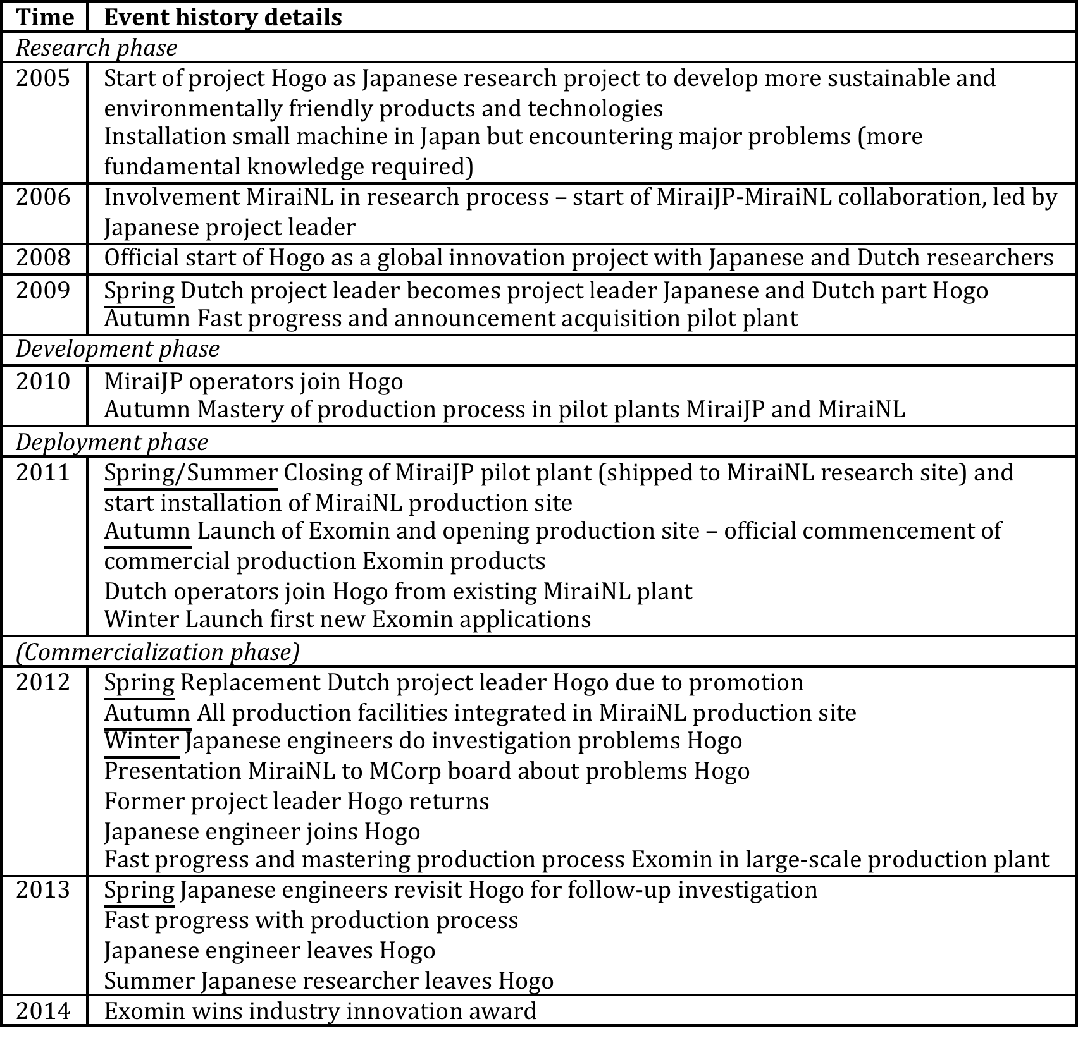
Research phase
JP-NL R&D team
Transition to development
JP engineers & operators join
2 pilot plants in JP and NL
Testing facility in DE
6 months – mastery production
Transition to deployment
JP engineers and operators leave project
JP pilot plant dissolved
Production site in NL
NL engineers and operators join
Substantial quality problems and delays
1.5 year - mastery of production
_{3/20} [project HOGO]

Slide 4
innovation implementation
.. when innovation projects transition toward production and individuals become increasingly skillful, consistent, and committed to using the innovation (Klein & Sorra, 1996)
.. successful in case of the incorporation or routine use of a technology on an ongoing basis (Edmondson et al., 2001)
challenges
* radicalness and complexity of innovation (Aiman-Smith &Green, 2002)
* disrupting existing work routines (Edmondson et al., 2001)
* climate and resources for implementation (Klein & Sorra, 1996)
* different objectives and expectations (Rice et al., 2002)
* share innovation knowledge (Aiman-Smith & Green, 2002; Edmondson et al., 2001; Tyre, 1991)
→ implementation failure (Klein and Sorra, 1996; Klein and Knight, 2005)
_{4/20} [theory]

Slide 5
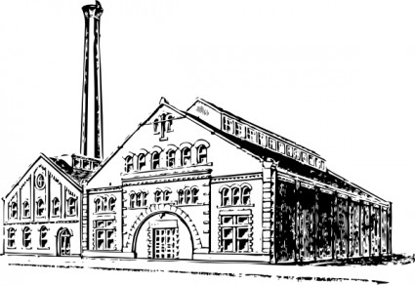
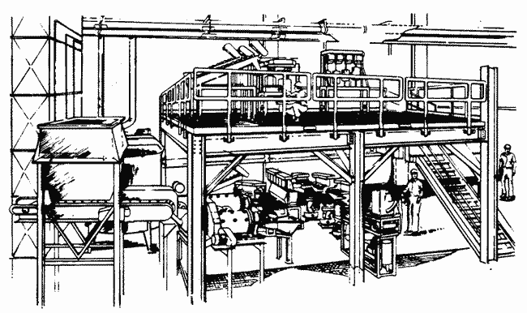
initial
implementation
pilot plant
continued-sustained implementation
production facility
_{5/20} [theory]

Slide 6
cross-boundary knowledge sharing
.. necessary as innovations transition toward implementation and involve members from different communities (e.g. engineers and operators)
.. through codification and transfer (March & Simon, 1958)
is challenging when innovation knowledge
.. is hard to codify & objectify when highly tacit (Nonaka, 1994; Polanyi, 1966)
.. is sticky (Szulanski, 1996; Tyre & Von Hippel, 1997; Von Hippel, 1994)
.. is more radical and requires substantial knowledge transformation (Bechky, 2003; Carlile, 2004; Carlile and Rebentisch, 2003).
and therefore requires cross-boundary interactions (Tyre, 1991; Douthwaite et al., 2001; Wood & Brown, 1998)
* boundary spanners (Allen, 1977; Hargadon and Sutton, 1997 )
* boundary objects (Carlile, 2002; Bechky, 2003)
* emergence of new joint field of practice (Levina and Vaast, 2005; 2014)
_{6/20} [theory]
Notes:
“field of practice” – the nexus of interconnected practices that unite actors in their pursuit of a common interest while producing their own unique form of capital (Bourdieu and Wacquant, 1992; Levina and Vaast, 2014; Schatzki, 2001)

Slide 7
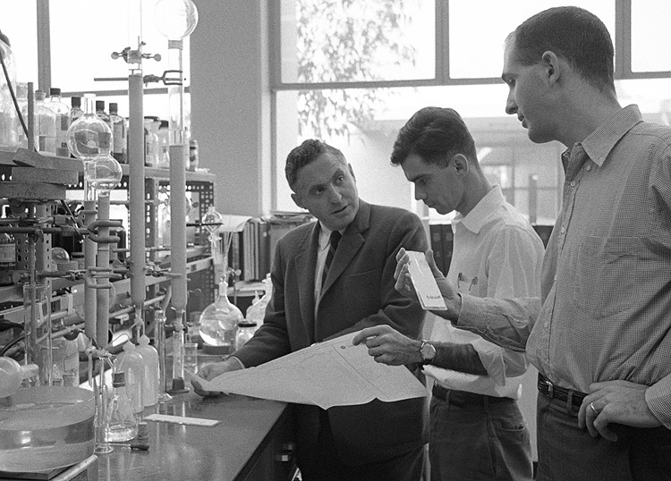
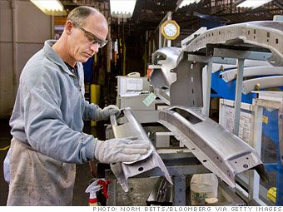
innovation implementation
knowledge sharing
transform knowledge and practices of existing members
transform knowledge & practices of new members
_{7/20} [paradox]
Notes:
Innovators confront a paradox
To move innovation projects forward, they need to change their practices to fit the context of production, in which innovations are implemented, thereby allowing members from different communities to put innovations to use. Yet, to successfully share innovation knowledge, new members also need to transform their existing knowledge and practices. How can new members transform their existing knowledge and practices, and learn new ones, while these are simultaneously being adapted?

Slide 8
What practices do organizational actors develop to successfully move innovation knowledge out of research labs into their sites of deployment?
_{8/20} [research question]

Slide 9
Mirai Corporation
HQ
Mirai Technologies
DIVISION
HOGO
MiraiNL
MiraiJP
Research
Research
Manufacturing
Manufacturing
Project Hogo
_{9/20} [approach and methods]
Notes:
Site visits to
MiraiJP
MiraiNL
Data collection
Longitudinal multi-cited field study
2 fieldwork periods with site visits to
MiraiNL and MiraiJP
Sept 2009-Sept 2010
Sept 2012-May 2013

Slide 10
multi-sited field study
MiraiJP
MiraiNL
2 fieldwork periods
Sept 2009-Sept 2010
Sept 2012-May 2013
methods
participant observation
document analysis
in-depth interviews
informal conversations
data analysis
process analysis
grounded theory
temporal bracketing
_{10/20} [approach and methods]
Notes:
2 Fieldwork periods
Sept 2009-Sept 2010
Sept 2012-May 2013
Site visits to
MiraiJP
MiraiNL
Data collection
Longitudinal multi-cited field study
2 fieldwork periods with site visits to
MiraiNL and MiraiJP
Sept 2009-Sept 2010
Sept 2012-May 2013

Slide 11
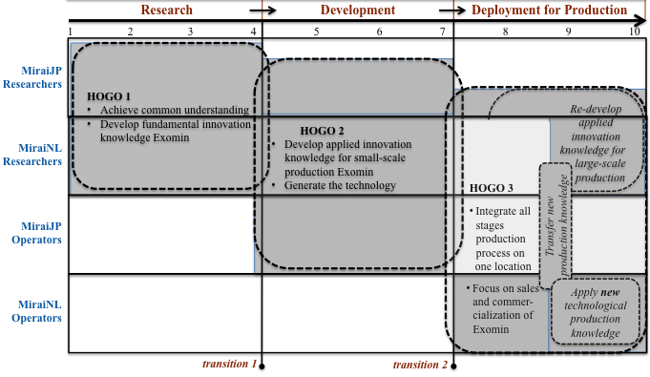
_{11/20} [transition moments]

Slide 12
Interests development
expand fundamental knowledge
create applied knowledge
create production knowledge
organizational practices
high continuity of people
involving researchers and operators in development of production technology (for small-scale production)
→ Exomin’s field of practice expanded
→ securing continuity of practice that enabled the integration of new members
_{12/20} [transition to development]

Slide 13
interests deployment
expand basic knowledge
expand applied knowledge
expand production knowledge
create sales knowledge
organizational practices
low continuity of people due to shut down pilot plant and job rotation
Japanese researcher not involved in development of production technology (for large-scale production)
→ securing continuity of practice absent
→ Exomin’s field of practice transformed too quickly
_{14/20} [transition to deployment]

Slide 14

problematization
contribution
* limited research on technological innovations deployed within organizations
* how to move innovation knowledge toward their sites of implementation?
* knowledge sharing processes during implementation
* how actors cope with the knowledge transformation paradox
_{17/20} [innovation implementation]

Slide 15

problematization
contribution
* once a new field of practice emerges, how then can it be sustained as innovations transition toward implementation and come to accommodate the interests of production?
* identify knowledge sharing practices across communities during innovation implementation
* need to secure continuity of practice prior to transformation of field in production context
_{18/20} [cross-boundary knowledge sharing]

Slide 16



g.f.corporaal@vu.nl
greetjecorporaal.com
g.f.corporaal
_{20/20} [thank you]

