Slide 1
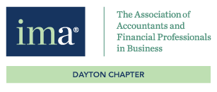

Akron Chapter IMA
is proud to present
CPA vs. CMA: What’s the difference?
Presented by Sue Mullen, Ashland University, and Alexandra Graham, Gleim Exam Prep
No CPE option
December 4, 2020

Slide 2

Recording
This session is being recorded.
2

Slide 3

Housekeeping
Thank you for joining us today!
Please note that you are muted upon entry.
Use the chat or Q & A feature to ask questions.
Questions will be handled at the end of the presentation.
3

Slide 4

Housekeeping (cont.)
To receive full school credit, you must:
Attend the full presentation
Answer questions through the poll or chat feature
4

Slide 5

Questions and Answers
Use the chat or Q & A feature to type questions.

Slide 6
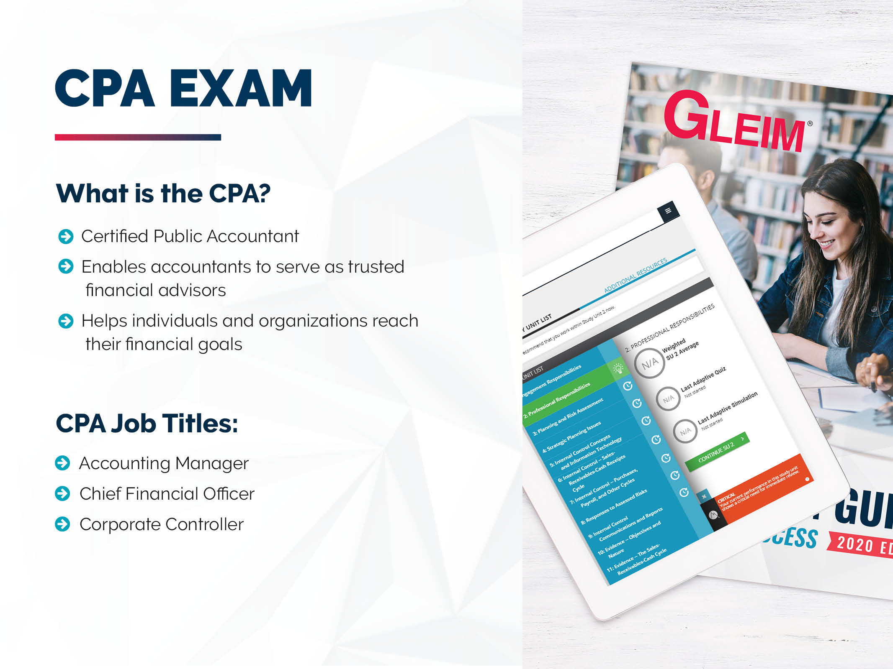

Slide 7


Slide 8
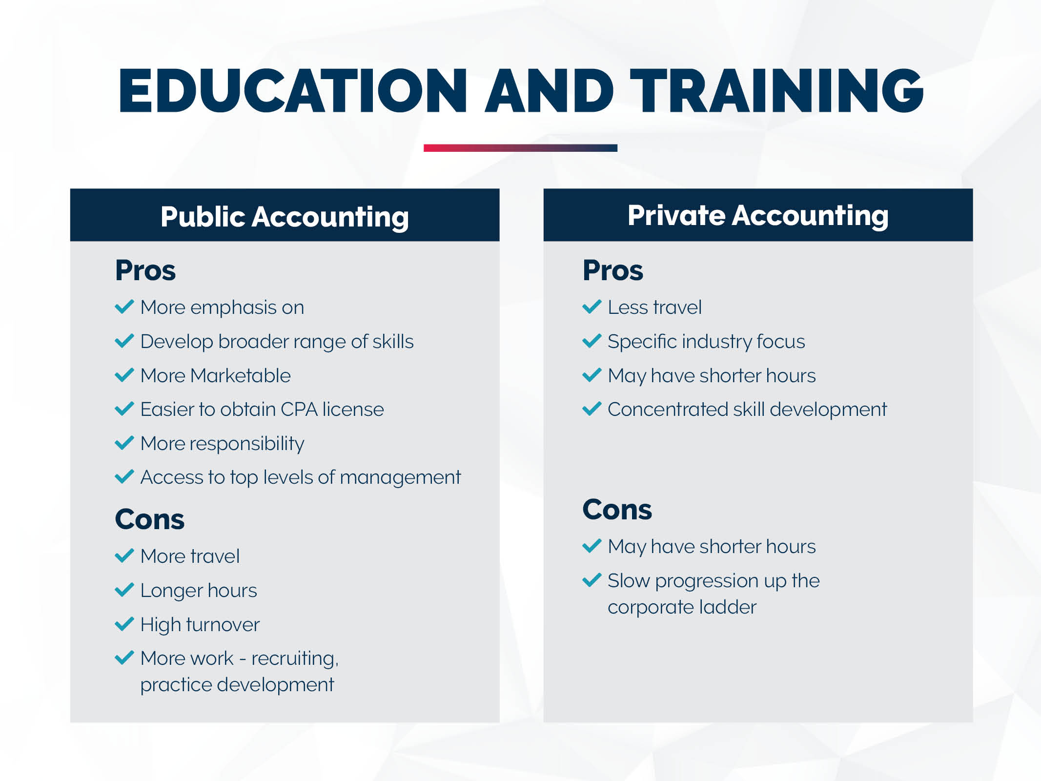

Slide 9
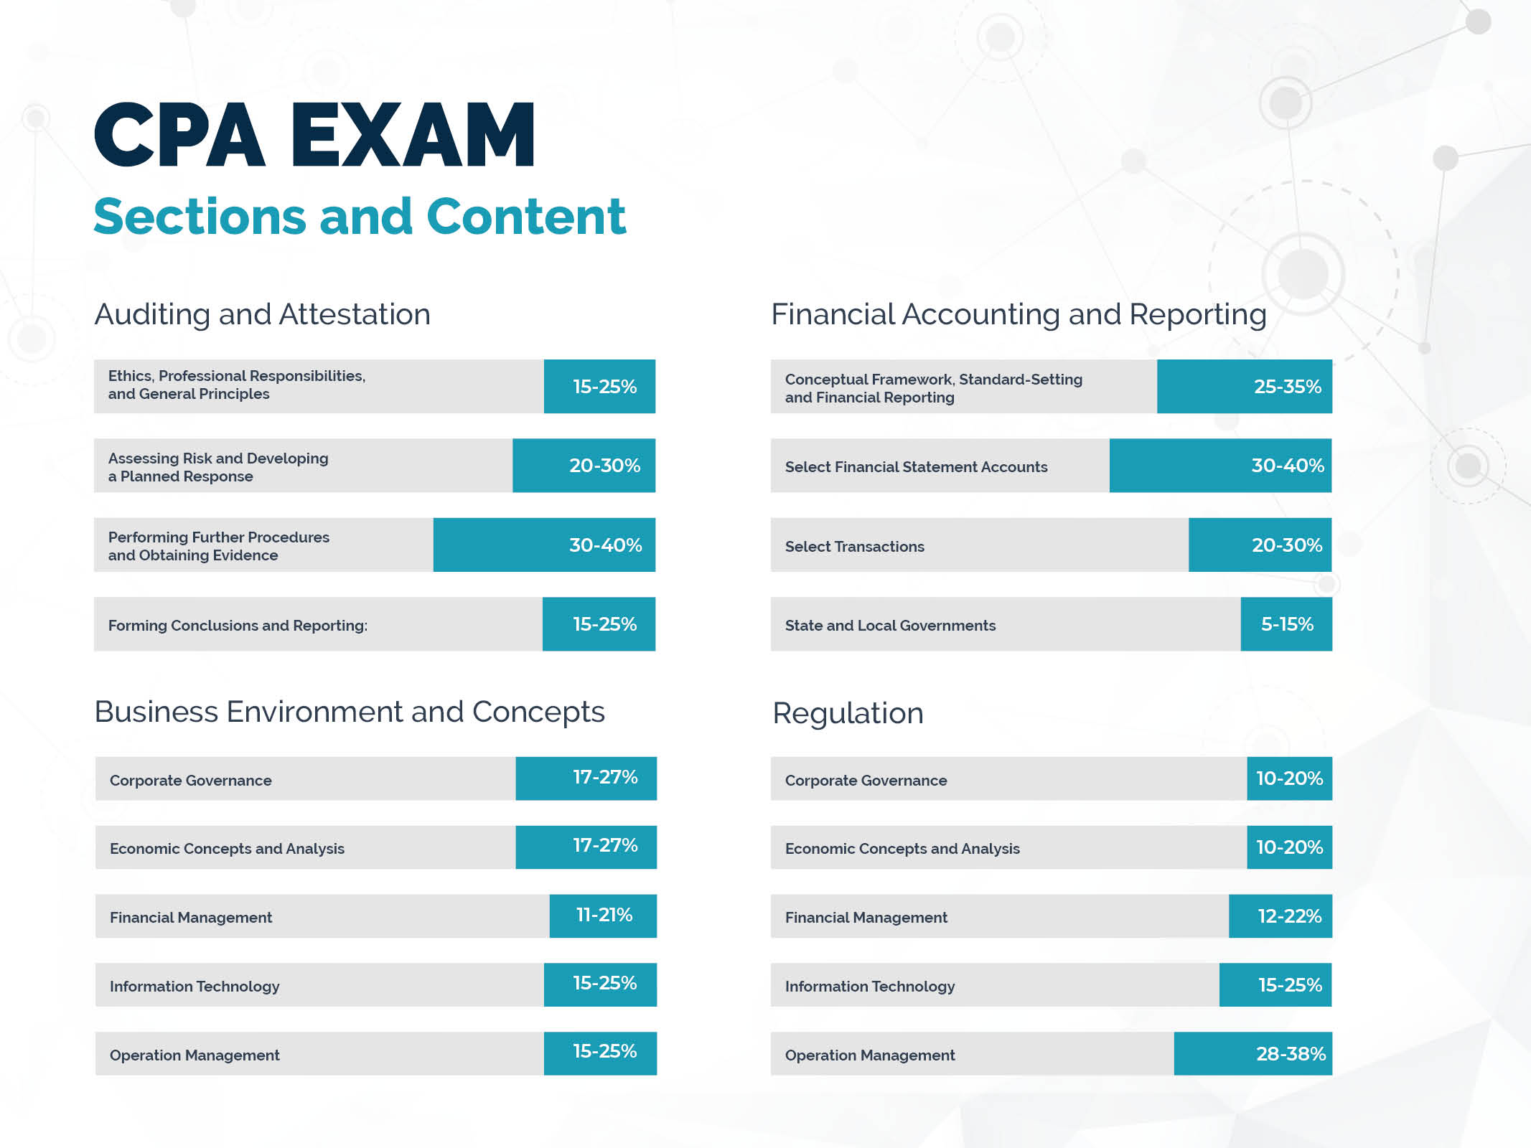
Ethics etc.
Business law
Federal taxation of property trans.
Federal taxation - individuals
Federal taxation - entities

Slide 10
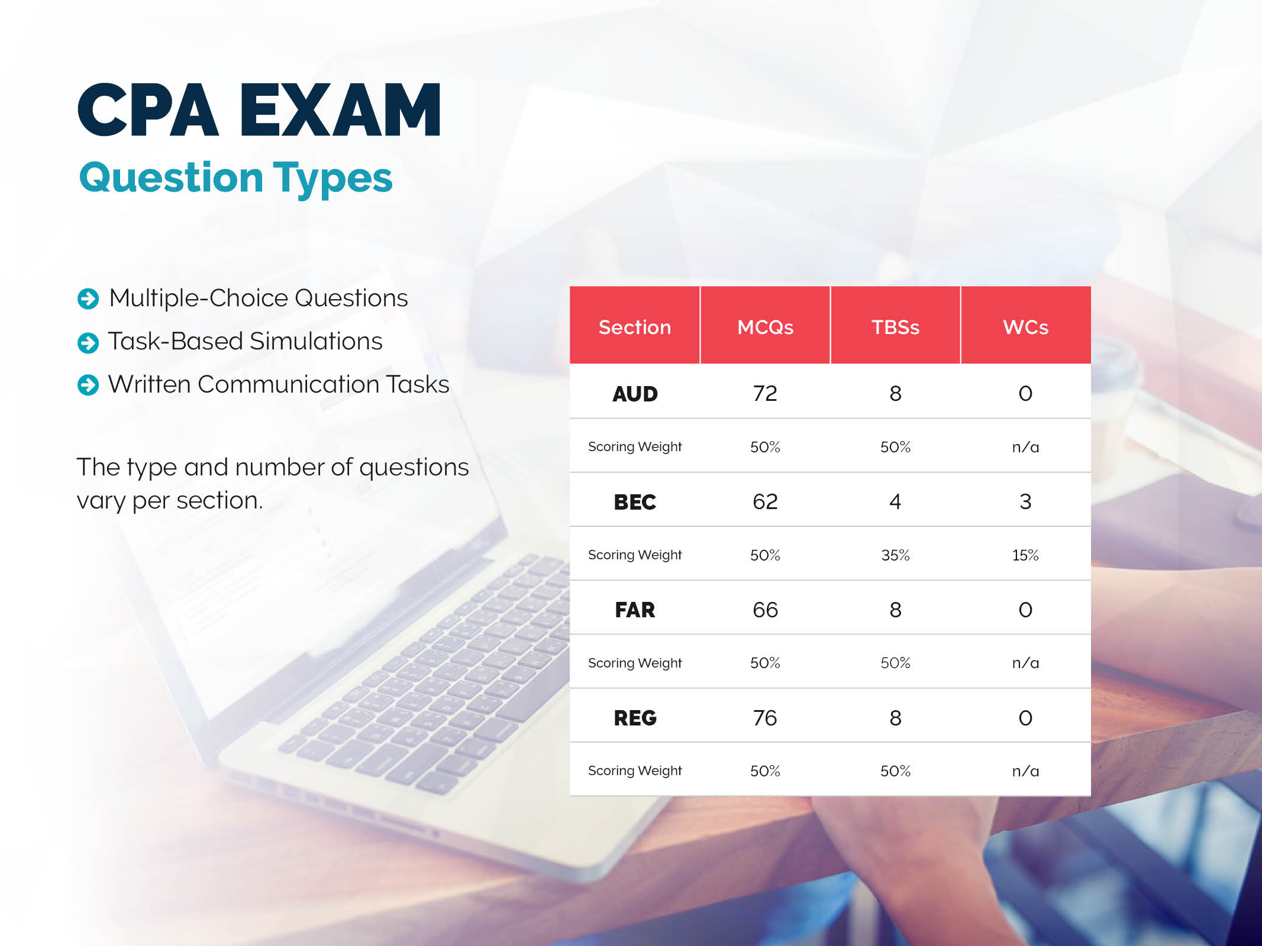

Slide 11


Slide 12
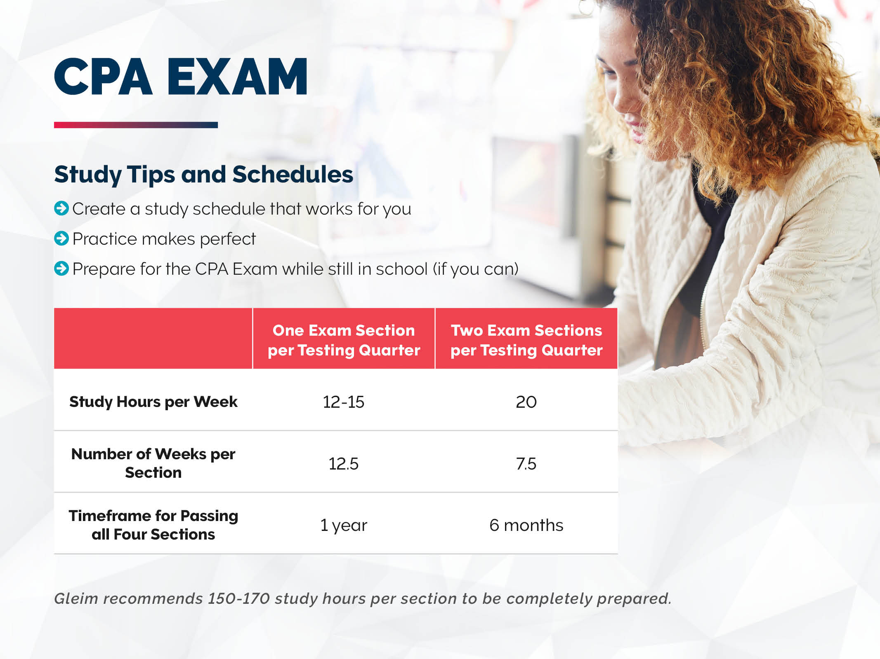

Slide 13
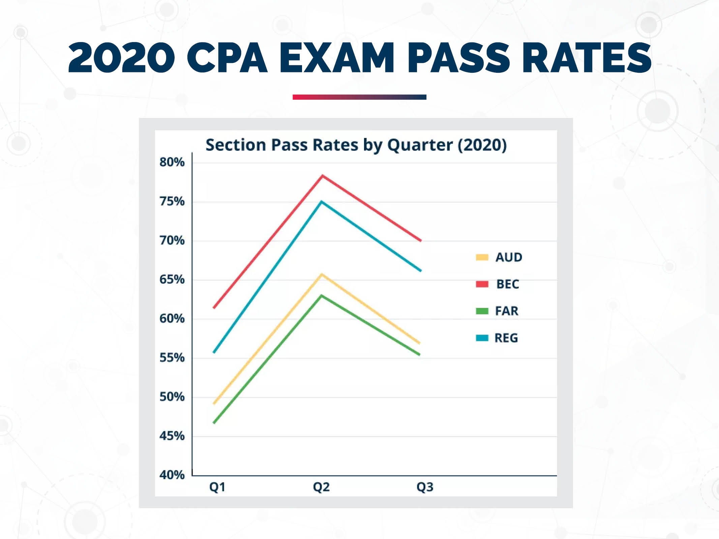

Slide 14
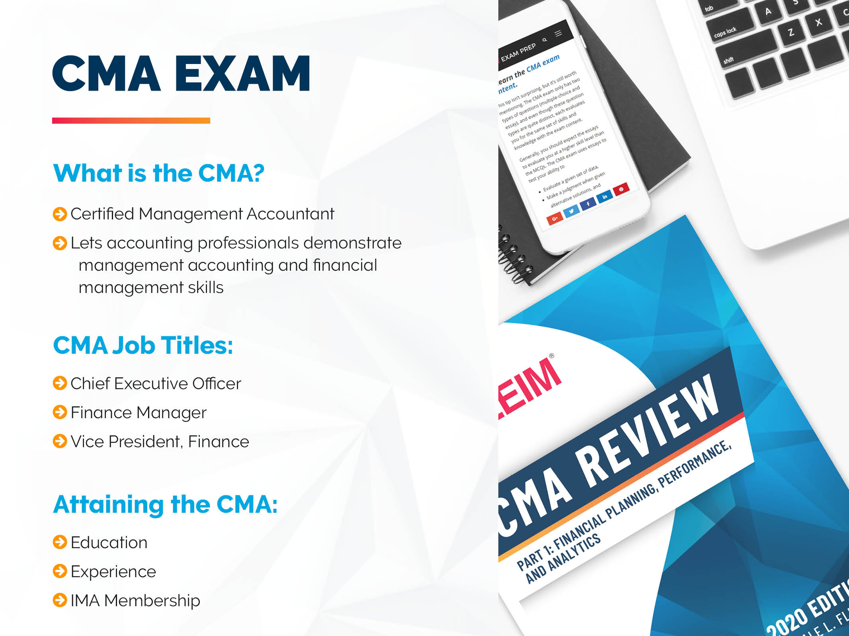

Slide 15
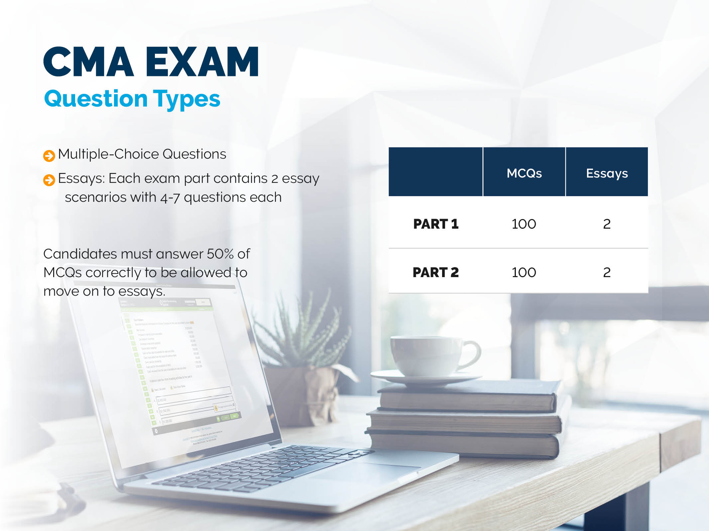

Slide 16
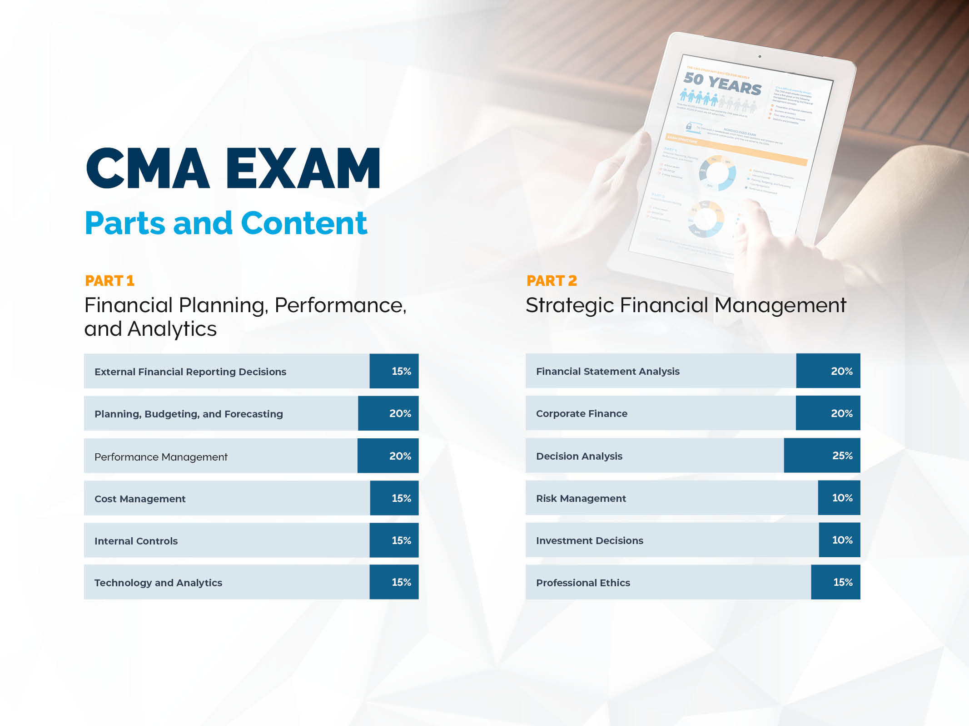

Slide 17


Slide 18
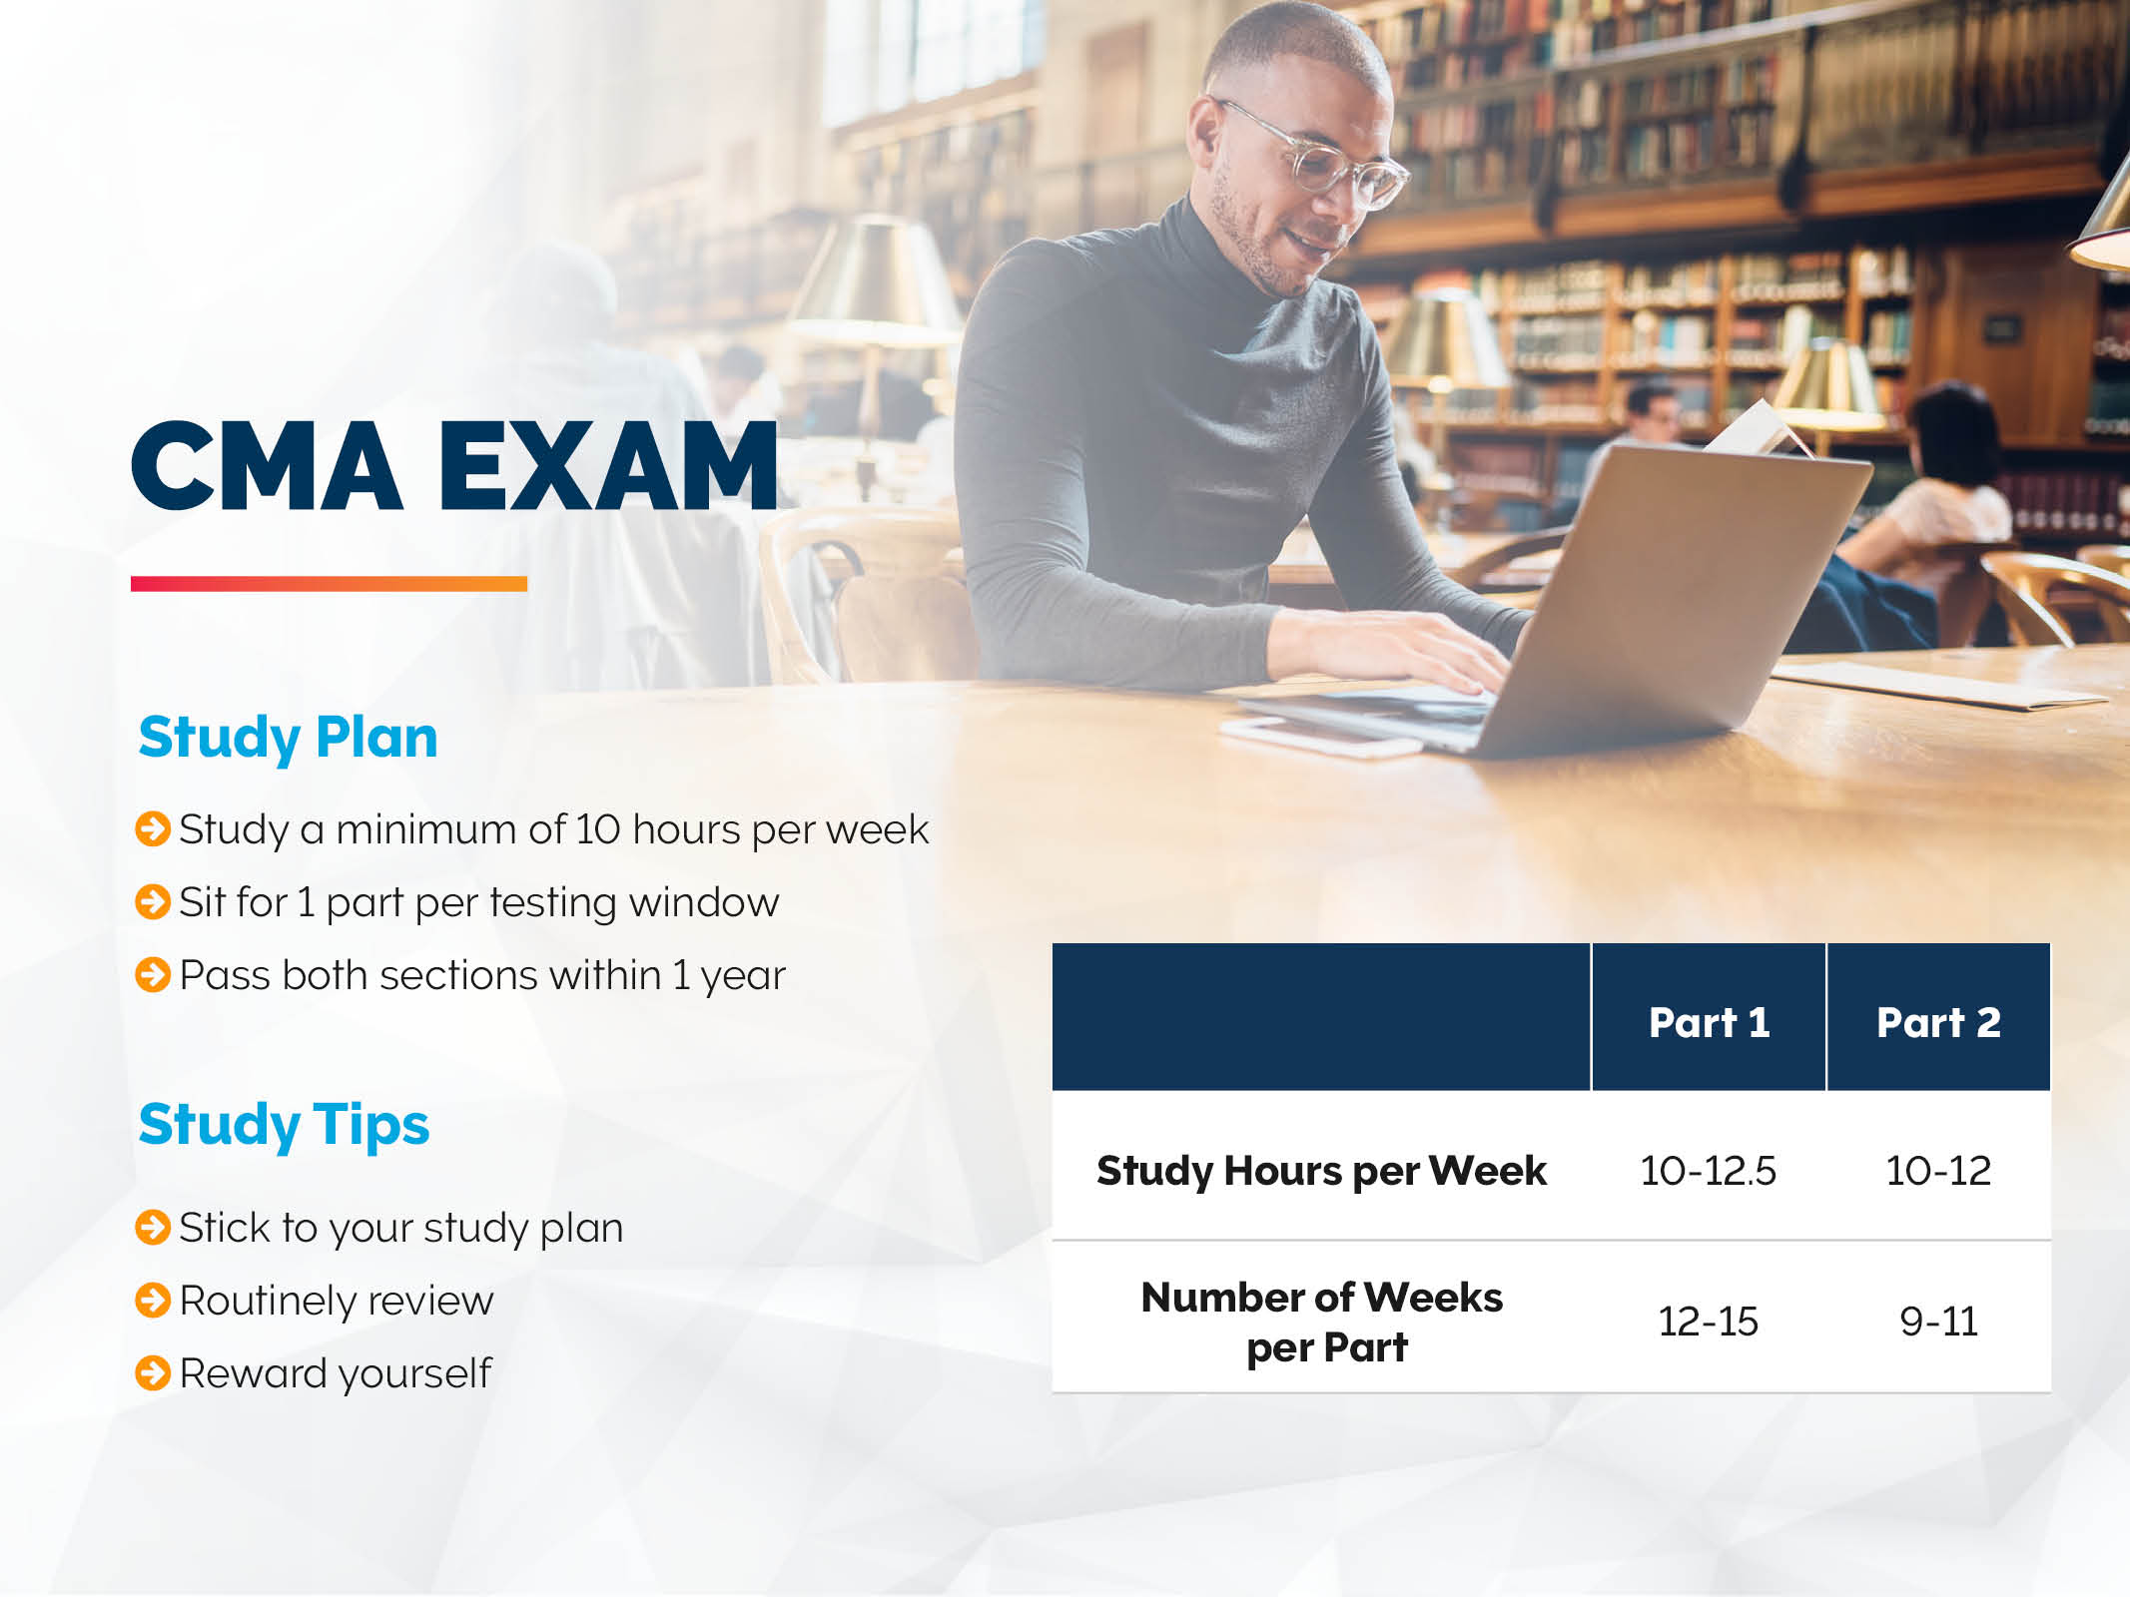

Slide 19
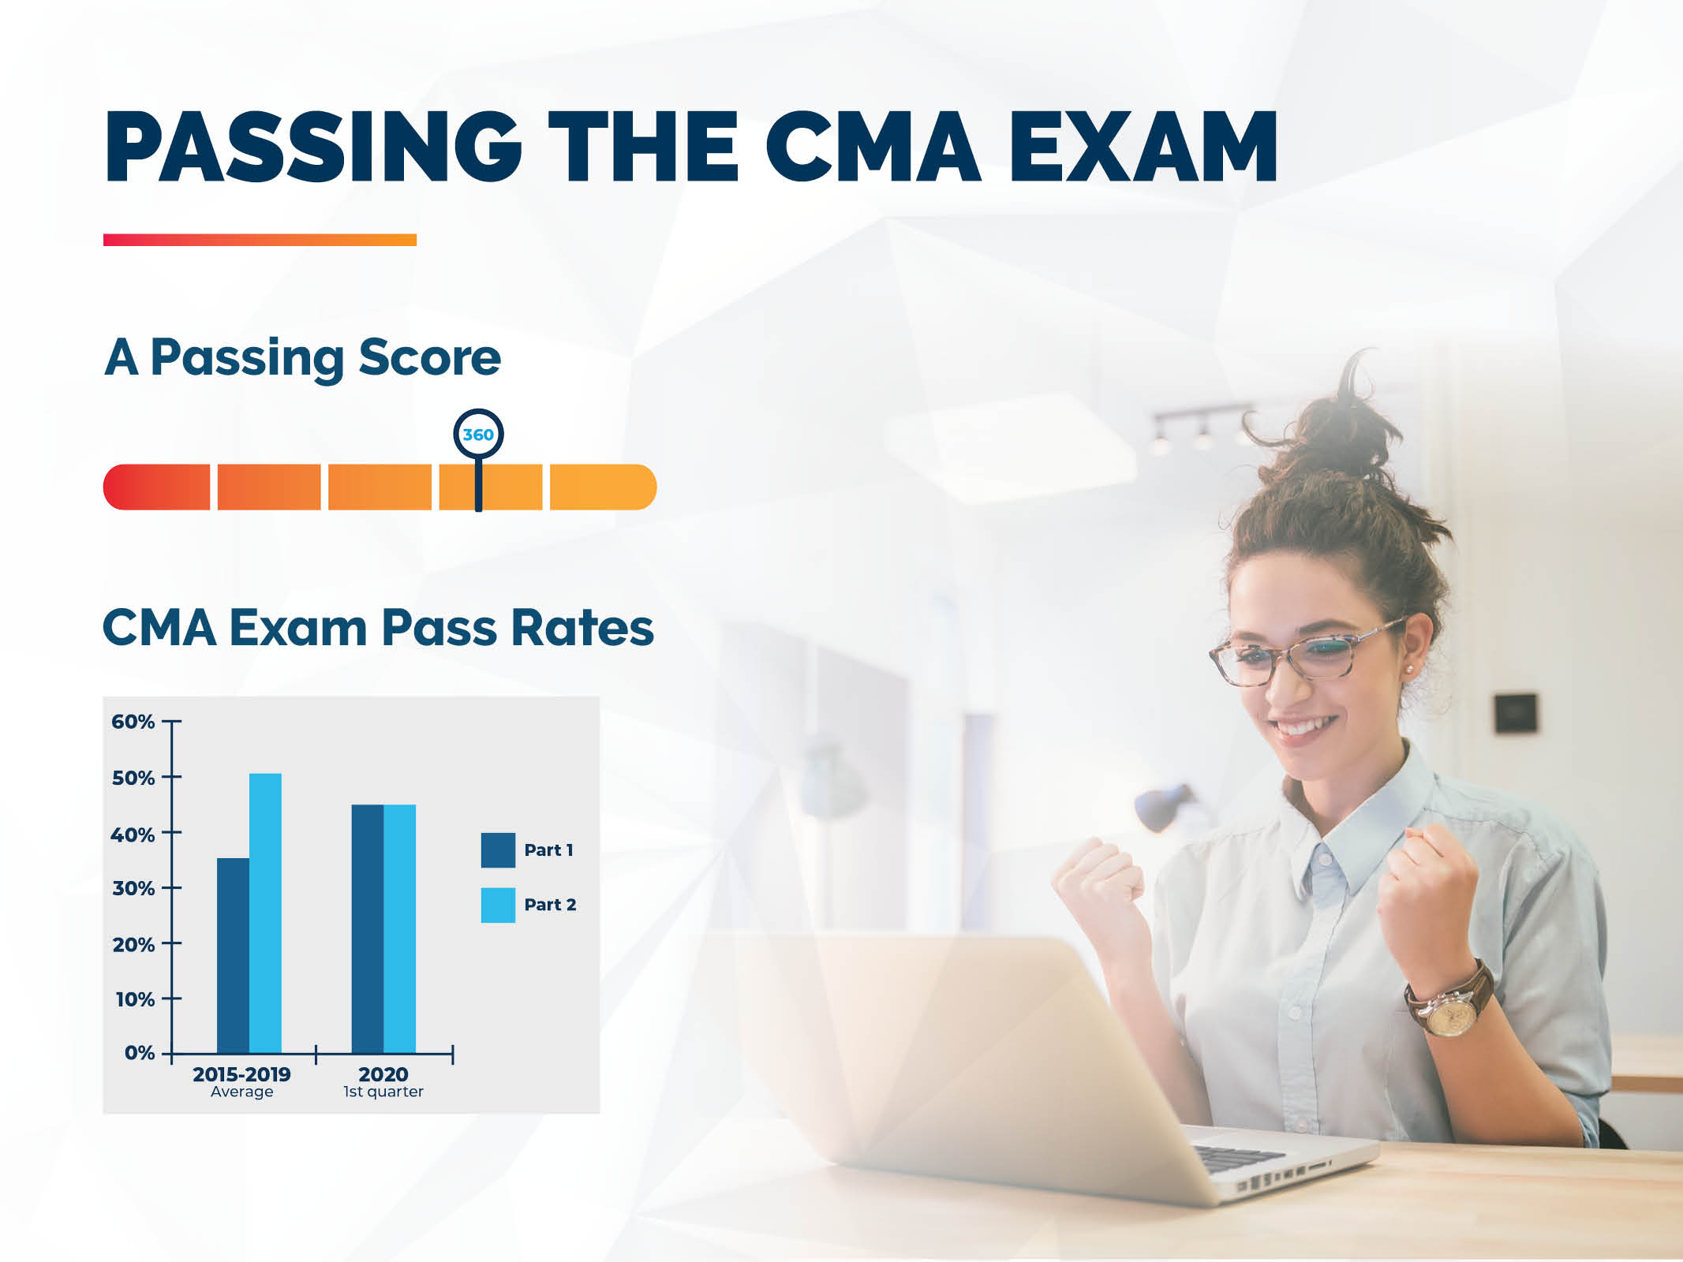

Slide 20


Slide 21
Upcoming 2020 webinar
Next up:
Slippery Slope of Greed (IMA Ethics),
Thursday., December 10, 11 am - 1 pm Eastern

Slide 22

Thank You!
The Akron Chapter would like to thank you for joining us for this event!
We hope you learned something that will help you.
akron.imanet.org

