Slide 1



Betting on Business to Help Save the World and Achieve Sustainable Development
Brandon Lloyd Shields
Associate Director, Assessment and Accreditation
College of Business Administration
Kent State University

Slide 2
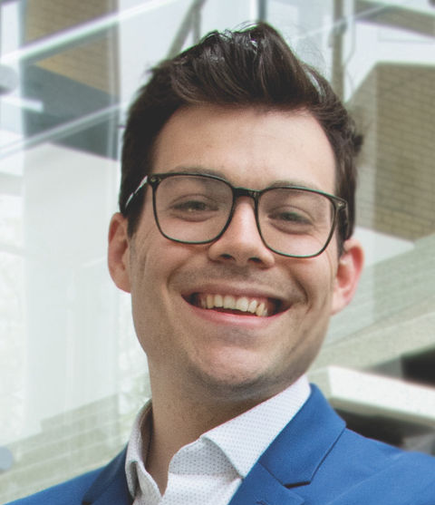
About Me
Job Title:
Associate Director, Assessment and Accreditation
Education:
MBA – Concentration International Finance
MSBA – Currently Pursuing
Role Model:
Serena Williams
Starbucks Order:
Venti iced Coffee, non-fat milk, sugar-free vanilla, no classic

Slide 3
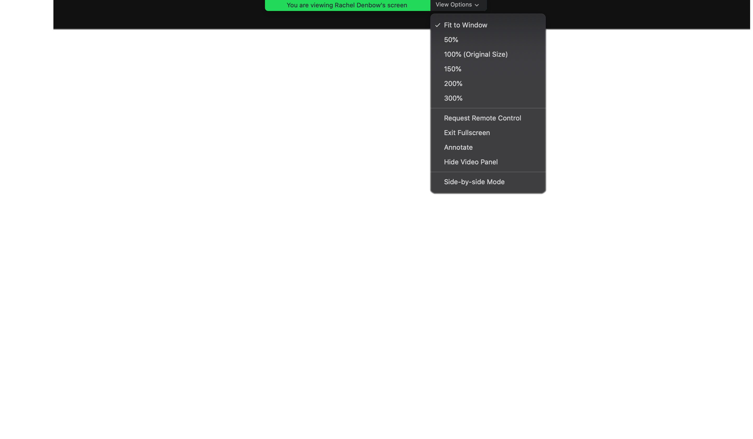
About Me
Job Title:
Associate Director, Assessment and Accreditation
Education:
MBA – Concentration International Finance
MSBA – Currently Pursuing
Role Model:
Serena Williams
Starbucks Order:
Venti iced Coffee, non-fat milk, sugar-free vanilla, no classic
Notes:
Remind them to use th reactions located on the menu bar at the bottom of the screen:
Happy
Clap
Celebrate
Heart
Surprise

Slide 4



Notes:
Why I am talking to you about Sustainable Development Goals?
Two years ago the college started a resposnible leadership inititive focusing on business as a force for good
This is inbedded in our core values of respect, collaboration, ethics and a sense of purpose in all we do
Advanced Signatory to PRME, which is closley associated with the United Nations
Associate Member of Globally Responsible Leadership Initiative – closely tied with our accreditor AACSB
AACSB now requires business schools to demonstrate how we achieve/ promote societal impact

Slide 5



10,000
100+
60+
Courses that discuss sustainable development topics
Published articles focusing on sustainability since 2015
Number of views of PRIME Time Snapchat campaign focused on the SDGs

Slide 6
Learning Objectives
Identify and apply the Sustainable Development Goal Framework
Understand driving forces behind business adoption of sustainable business practices
Give an example of how a company is helping achieve the SDGs
Understand the unique role that accounting, and finance professionals play in furthering the SDGs.

Slide 7
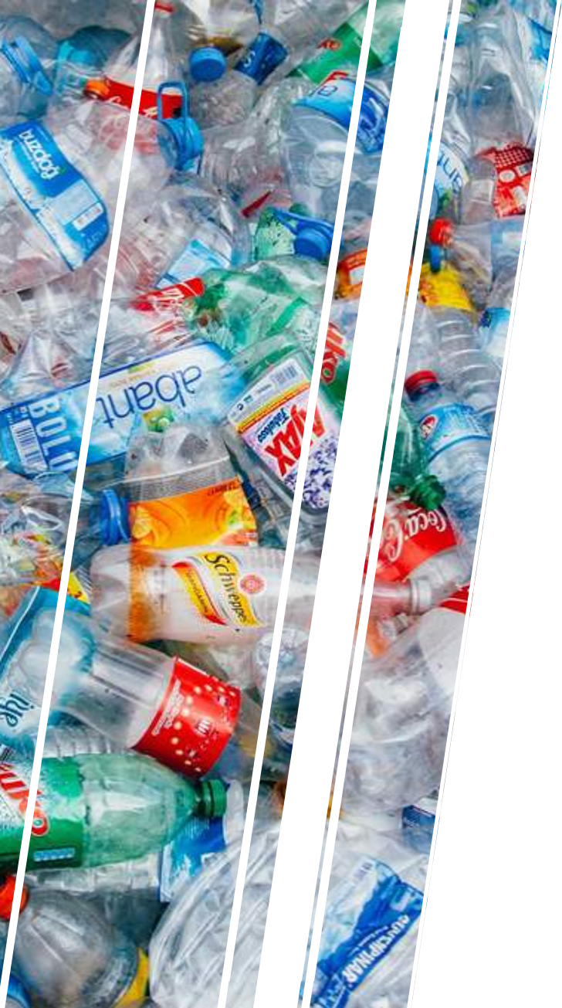

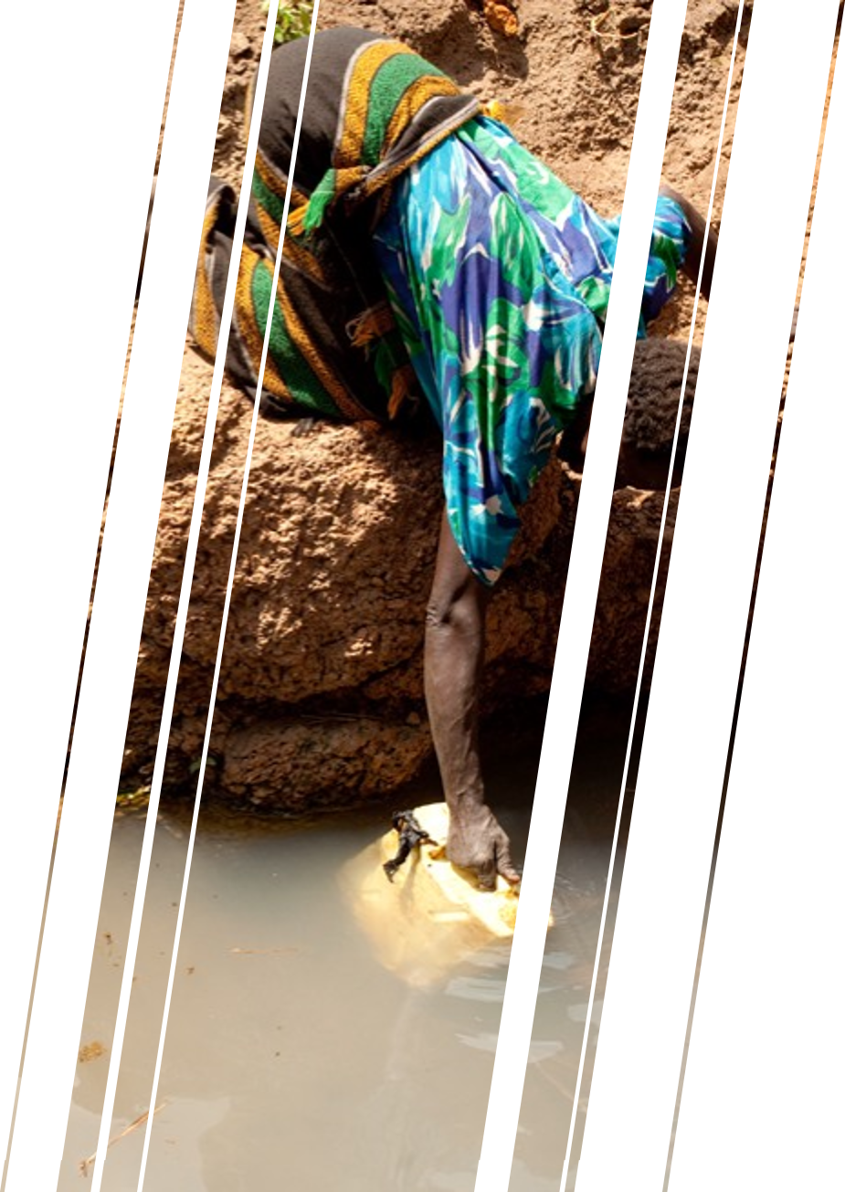
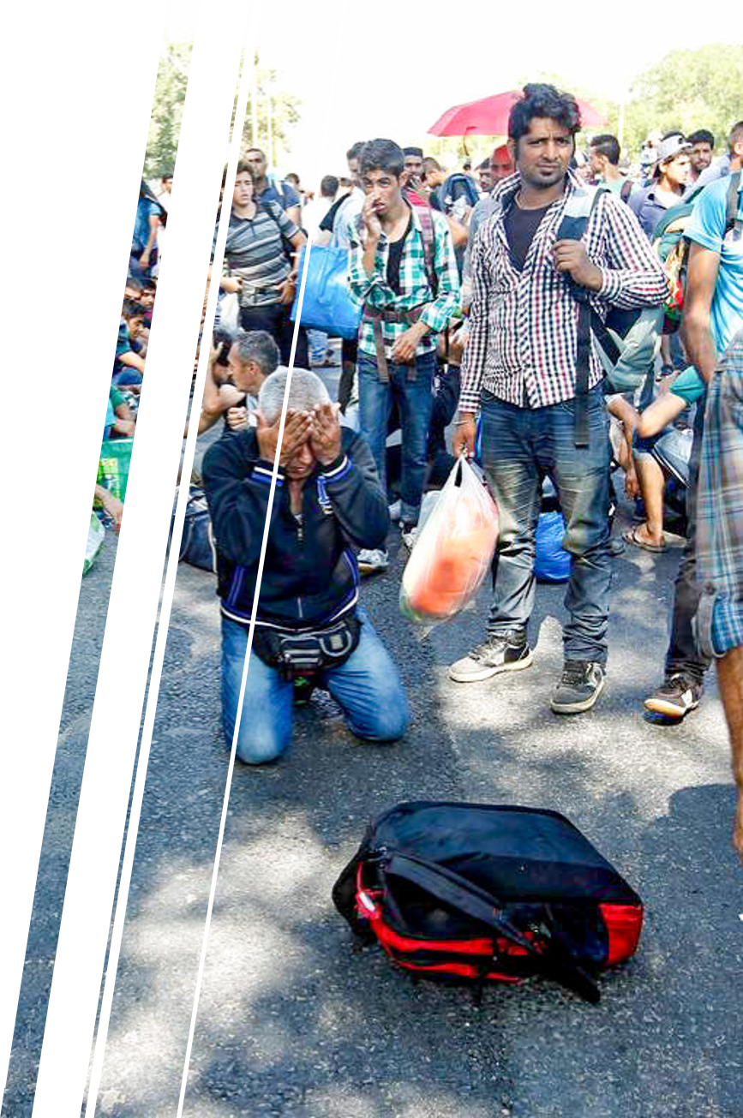
Society increasingly faces environmental and social crises
Notes:
Global Temperatures are increasing
Water/food/eltricity poverty/scarcity
Displacement of people do to war/ natural disasters

Slide 8
Climate change, if left unmanaged, could cost the world's financial sector how much money in present value terms?
Notes:
https://www.nature.com/articles/nclimate2972
Answer: 10 trillion

Slide 9
The SDGs: A Decade in the Making
Earth Summit Agenda –21 (1992)
UN Millennial Development Goals (2000)
Johannesburg Declaration on Sustainable Development Goals (2002)
United Nations Conference on Sustainable Development (2012)
2030 Agenda for Sustainable Development (2015)
Notes:
Started more than 25 yeasr ago with the Earth Summit Agenda that created the UN Millenial Development Goals.
Governemnts; Non-profis; and business were all consuted when creating the Sustainable Developemnt Goals.

Slide 10

Notes:
Have participants stamp which 2 or 3 goals interest them, or resonate with them.

Slide 11
Kent State Accounting faculty publish research related to which sustainable development goal most often?
Notes:
Answer : Goal 16

Slide 12


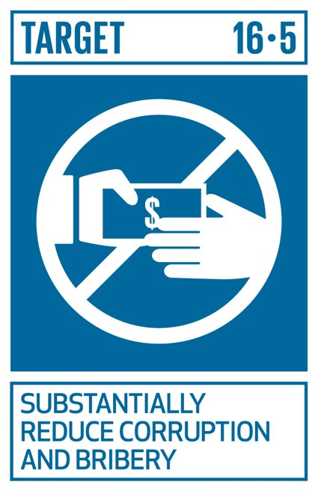

Select SDG Targets
Notes:
All goals have a series of specific targets. Not somethig we will go over but I wanted to make you aware.

Slide 13
Why adopt the SDGs and Sustainable Business Practices?
Identity
Profitability
Reputation
Notes:
89% of Global CEOs said commitment to sustainability is translating into real impact in their industry, and 87% believe the SDGs provide an opportunity to rethink approaches to sustainable value creation.”
Recent CGMA (Chrtered Global Management Accountant) research found that 80% of finance leaders recognized that embedding ethical standards is an important driver of reputation

Slide 14




Identity – Match Core Values to Company
"Use business to protect nature"
"A caring heart, kind, honest and consistent"
"...positive choices we all make, no matter how small, can have a great impact on our personal health and the health of our planet.
“Ingredients are traced from planting to processing to ensure that the process is ethical from start to finish.”
"Cause no unnecessary harm"

Slide 15

Profitability
Lower costs of debt and equity
Outperform market in medium and long-term
Reduced operational and regulatory risk
Decreased supply chain and logistics costs
Spurs product innovation
Source: PWC Navigating the SDGs: a business guide to engaging with the UN Global Goals (2019)
Notes:
This is often reffered to as the Business Case Sustainability
Sustainble companies lower costs of debt and equity – creditors see as lower risk
MSCI sustainable Impact index made up of companies whose core business align with at least one SDG outperforms their other indecies
A recent study around supply chains showed that responsible products generate 20% more revenue while reducing supply chain costs by 9%-16% Brand value increases by 15%-20%

Slide 16


Reputation
74%
47%
40%
Percentage of consumers more likely to buy goods and services from organizations engaging in SDGs.
Percentage of internet users who ditched products and services that violated their personal values. Protecting the environment was at the top of the list.
Percentage of millennials would take a pay cut to work at an environmentally sustainable company
PwC Making It Your Business: Engaging with the Sustainable Development Goals (2015)
Source: Fast Company - Most Millennials would take a pay cut to work at environmentally responsible company (2019)
Notes:
https://www.fastcompany.com/90306556/most-millennials-would-take-a-pay-cut-to-work-at-a-sustainable-company
Products and recruitment

Slide 17

Generation Z:
The Purpose Driven Generation
"We" centered mentality
Looking to make an impact on underlying societal problems
60% want to have an impact on the world with their jobs
40% want to change the world by inventing something
Time Magazine; Coming Soon to Your Office: Gen Z (2014)
Notes:
This is one of the motivating factors for designing a business curriculum round resposnibl mmangement – because this what our students our demanding out of a modern business education.
Now we will look at a couple of examples of companies who activties help achieve the SDGs

Slide 18





Affordable Energy: M-Kopa
6 million households in Kenya use kerosene to power homes
M-Kopa sought a renewable energy solution
Deposit for solar system, pay daily fee to use
Once system paid for, owned by the buyer
Significantly reduces CO2 emissions
Source: PWC Navigating the SDGs: a business guide to engaging with the UN Global Goals (2019)
Notes:
By 2020 global demand for energy will increase by 35%
1 in 5 people lack access to modern electricity with 3 billion using kerosene
M-Kopa developped a pay as you gosolar power technology
Over 6 million households in Kenya spend more than 1 billion dollars on kerosene.
MKOPA develpped solar energy kits tha could be initially pushased for $30.
Access to solar energy is granted by paying a daily fee until unity is paid off.
They have been placed in 340,000 homes in Kneya, Tanazia, and Uganda.
Poverty
Less expensive, kersoene cosst 20% of homes dispoable income
Addressing energy poverty
Resposnible Consumption and Climate Action
Kerosene buring produces a lot of harmful emissions

Slide 19
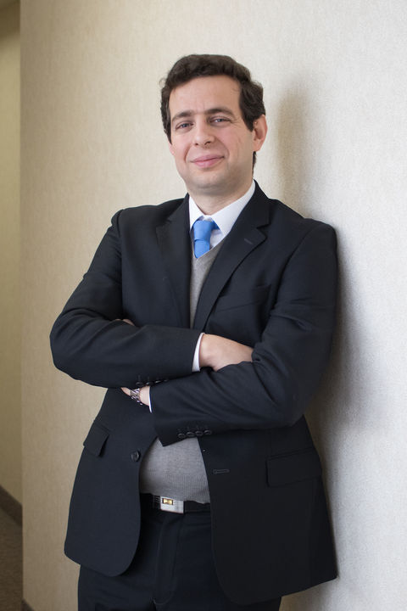

COBA Faculty Highlight - Dr. Razavi
Socio-economic Predictors of Electricity Theft in Developing Countries: An Indian Case Study

Slide 20




Gender Equality - Gap
73% of GAP workforce are women
In 2014, released compensation data showing equal payment for work
Created a global campaign highlighting gender and pay discrepancies
Enjoy reputation boost; higher retention among women employees
Source: PWC Navigating the SDGs: a business guide to engaging with the UN Global Goals (2019)
Notes:
There is a global labor force participation gap, estimated to cost the global economy US$1.6 trillion.56 The employment gap is often due to women being assumed to be primary child carers, and discriminatory or unsupportive maternity policies
Gap Inc. has created a digital campaign to illustrate the 21% missing from U.S. women’s pay slips by drawing an analogy to if 21% of a woman’s outfit was missing
This level of transparency was unprecedented at the time.
Reduced Inequalities
Promote women in the workforce at all levels
Peace Justice and Strong Institutions
Research shows companies with more diverse boards perofrm better and are more ethical

Slide 21
The global labor force participation gap is estimated to cost the global economy how much USD?
Notes:
The employment gap is often due to women being assumed to be primary child careers, and discriminatory or unsupportive maternity policies
Answer: 1.6 trillion

Slide 22
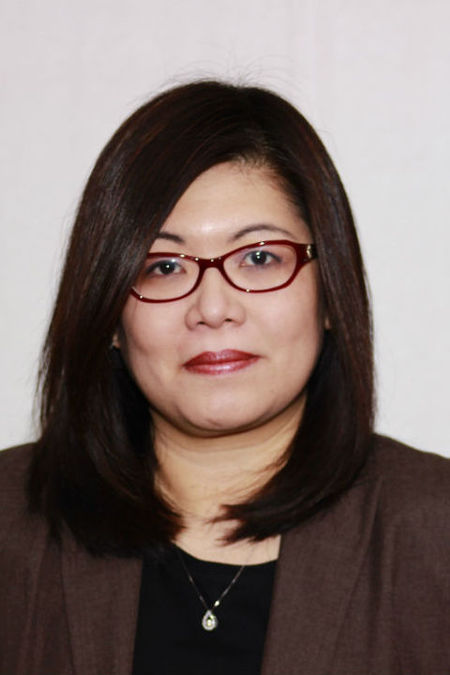
COBA Faculty Highlight– Dr. Laksmana
Female Leadership in Corporate Social Responsibility Reporting: Effects on Writing Readability and Future Social Performance
Board Diversity and Corporate Investment Oversight

Slide 23




Poverty – Grameen Danone Foods
Collaboration between Grameen Bank and Danone Foods
Create yogurt company to promote economic development and health
Sourced locally and sold at an affordable price
Learned to create a low-cost nutritious product
Source: PWC Navigating the SDGs: a business guide to engaging with the UN Global Goals (2019)
Notes:
Heads of Grammeen Banks and Danone foods led to the Grameen Danone Foods LTD.
Grameen Bank started by Muahmmed Yunus (Micro-financing – mico-loans economic developemnt to underserved or developped area focusing primarily on women).
Set up a small yogurt plant in Bogra Bangaldesh to prmotoe econmic development and health
DFL developed a yoghurt which is enriched with zinc, iron, iodine, vitamin A, and accounts for 30% of a child’s recommended daily nutrients; its brand name is “Shokti Doi” which means “strength yoghurt” in Bengali;
THe indgredients are sourced locally and disytibuted via a network of local women
Profits are spent on the wlefare of local people

Slide 24

COBA Faculty Highlight– Dr. Greenhalgh-Stanley
Food Deserts and diet related health outcomes of the elderly
The Impact of Food Deserts on SNAP Participation and Food Insufficiency among the elderly

Slide 25
“Overall, management accountants should approach the SDG journey in a spirit of determination to help drive opportunity, prosperity and trust and ultimately create a sustainable future for all.”
Source: Creating a Sustainable Future: The role of the accountant in implementing the sustainable development goals. - CGMA

Slide 26



Leading Through Technology & Innovation
Communicate how to create and preserve value
Capacity to tell story about SDG alignment and value
Access to data and knowledge of technology
Source: Creating a Sustainable Future: The role of the accountant in implementing the sustainable development goals. - CGMA
Notes:
Management accountant are story tellers – communicating how to create and preserve value.
Comprehensive knowledge of the organization and the data which helps demonstrate alignemnt and progress towarrds SDGs
Knowledge of cloud computing and visualization software help share an SDG story.

Slide 27



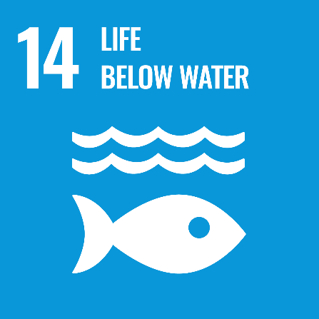
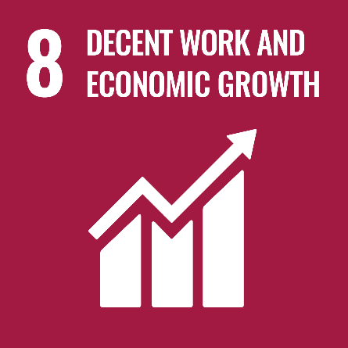



Driving ethical behavior across the value chain
Notes:
Global supply chains are growing in complexity. These supply chains represent aopportunties to collaborate. They also represent an reputational risk if ethical issues are found by ocnsumers in the supply chain. – Cancel Culture -
Risk assessment around human rights – envirmenmental – corruption
Regulary reporting on key KPIs and monitoring

Slide 28
Tightening the Focus on Governance and Stewardship
Staying updated on standards and regulations that impact the business.
Laws are strengthening in areas such as human rights, anti-corruption and data privacy
Source: Creating a Sustainable Future: The role of the accountant in implementing the sustainable development goals. - CGMA

Slide 29

Driving Increased Stakeholder Management and Partnership
Leverage skills in business partnering when conducting stakeholder management
Partnerships with government, non-profits and even competitors
Source: Creating a Sustainable Future: The role of the accountant in implementing the sustainable development goals. - CGMA
Notes:
Business partnerhip to achieve goals is important when:
Prioritising and aligning goals to company strategy
When executing plans on specific projects with measurable outcomes
Greatest impact occurs when collective action is taken. When Govenremts, non-profits and private companies work togther huge gains can be made in achieveing sustainable developemtn goals. This is called tri sector innovation. Kent State is offering a course on this in AY 2020-2021 and hope to have a speaker talk about the impact of tri-setor innovations.

Slide 30
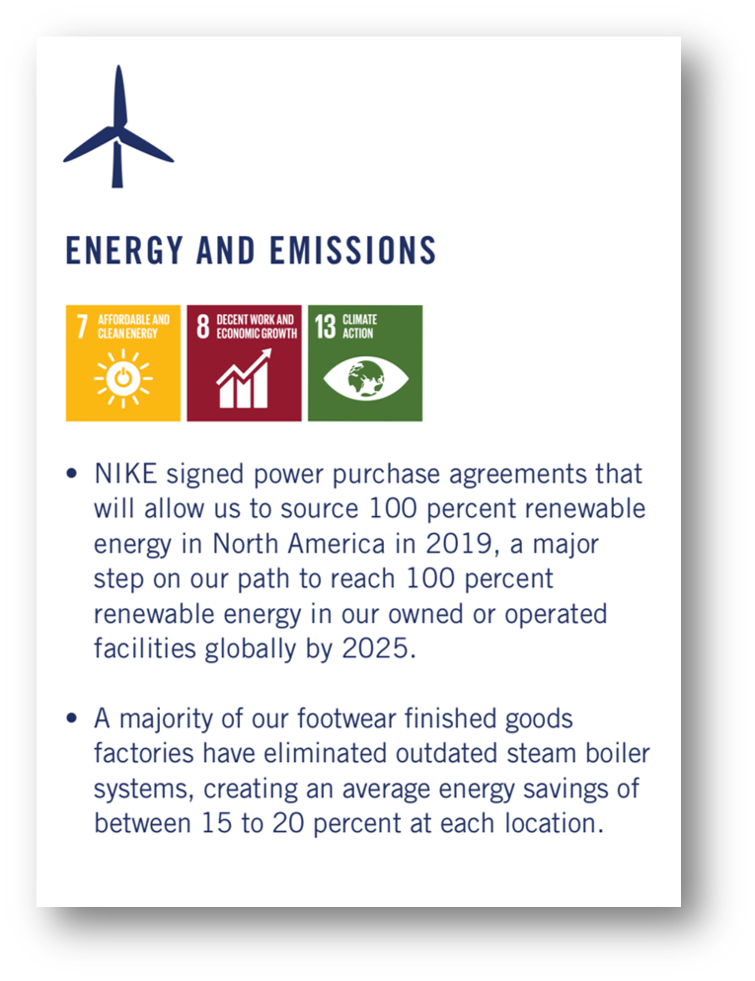
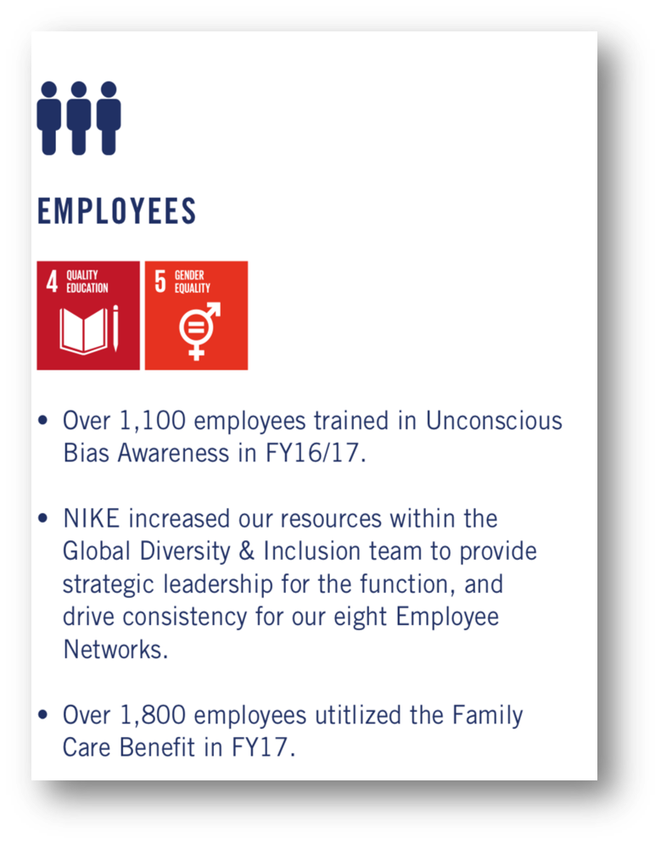
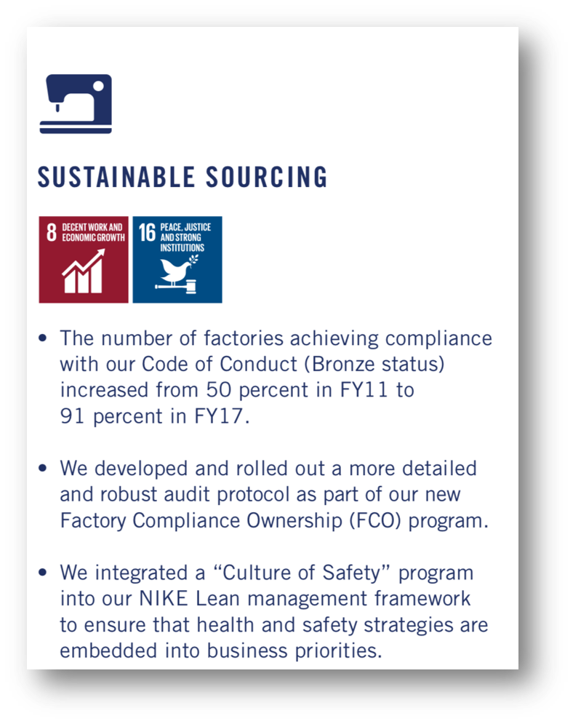
Building Corporate Reporting around Integrated Thinking
Increase focus on non-financials when measuring corporate performance
Source: * Screen shots from Nike's FY 16/17 Sustainable Business Report
Notes:
Campnies communicate SDGs in one of three main ways – annual reports, sustainability reports and letter from CEO.
Incresing emphaiss on non finacial reporting. The governance and Accountability insititute reproted that 82% of S&P 500 companies in 2016 had sustainability reports, up from 11% in 2011.
UN Global compact and GRI have developped an inventry of possible disclosures for SDGs.
If we are going to monitor and be tranparent we have to have reporting. Ad that might mean innovating new sources of data, how infomrtion is communiated etc.
Reporting will help guide startegy and business decision making

Slide 31

72%
of companies mentioned the SDGs in their reporting
25%
of companies included the SDGs in their published business strategy
1%
of companies measured their performance against SDGs and targets
21%
of companies include reference to the SDGs in their CEO or Chair statement
65%
of companies referred to a specific SDG
Source: PWC – Creating a strategy for a better world (2019)
Notes:
PWC reveiwed annual reports, sustainability reports and ceo statements of 1,141 companies in 31 countries across 7 industries.

Slide 32
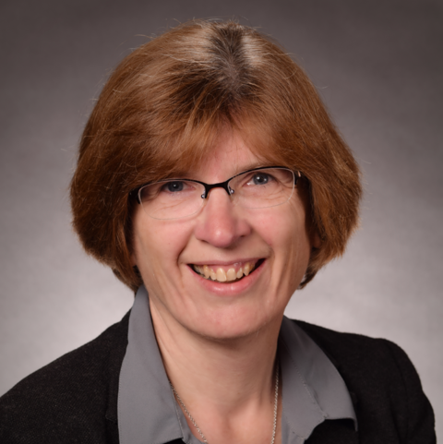
COBA Faculty Highlight– Dr. Tietz
Dr. Tietz has the Fundamental of Sustainability Accounting credential
Notes:
The FSA Credential is designed for professionals who benefit from understanding the link between material sustainability information and a company’s financial performance

Slide 33
According to the Sustainability Accounting Standards Board, about how many accountants are FSA credential holders?
Notes:
Answer ~500

Slide 34
COBA Faculty Highlight– Dr. Tietz
Dr. Tietz is one of only 500 people to hold the Fundamental of Sustainability Accounting credential
The only listed FSA credential holder in the state of Ohio
Notes:
The FSA Credential is designed for professionals who benefit from understanding the link between material sustainability information and a company’s financial performance

Slide 35
Learning Objectives
Identify and apply the Sustainable Development Goal Framework
Understand driving forces behind business adoption of sustainable business practices
Give an example of how a company is helping achieve SDGs
Understand the unique role that accounting, and finance professionals play in furthering the SDGs.

Slide 36

Next Steps on your SDG Journey
Find out if your employer’s activities are aligned to the Goals
Consider how your activities and the information you work with could help to pursue relevant SDGs
If your employer is not actively aligning, suggest it to your manager and work out how you can contribute to the business case.
Source: Creating a Sustainable Future: The role of the accountant in implementing the sustainable development goals. - CGMA
Notes:
Are employers activites aligned with SDGs
How does your role relate to pursuing SDGs
Suggesting how aligning can contribute to business cases to manager

Slide 37

See akron.imanet.org for additional webinars hosted by the Akron Chapter of the Institute of Management Accountants.
http://tiny.cc/akronima9

