Slide 1

Determining IM PD & PD Support Resource Requirements
Melvin Blanchard
AAIM Analysis of PD Time & Motion
Program Director Competency Summit – 12.12.18

Slide 2
OUTLINE
Overview & Background
Method/ Process
Results
PD Duty Hours
Faculty, CR, PA Support
Perception of Time Allocation Needs
Activities Survey
Conclusions

Slide 3
OVERVIEW
2017 APDIM strategic planning session
Identified game changing opportunities for PDs – PD time & motion
Richard Alweis led team
Craig Brater engaged Industrial Engineers from Purdue U
Craig Brater engaged Eric Holmboe
APDIM council collected data

Slide 4
BACKGROUND
PDs shape the training & training environment
Graduates have long term impact
US workforce and prosperity
Quality & length of life
40 years of practice
What resources do PDs need for success?

Slide 5
DATA COLLECTION METHOD
Qualitative
2016 APDIM survey
Quantitative
2018 APDIM survey
APDIM councilor survey of program activities

Slide 6
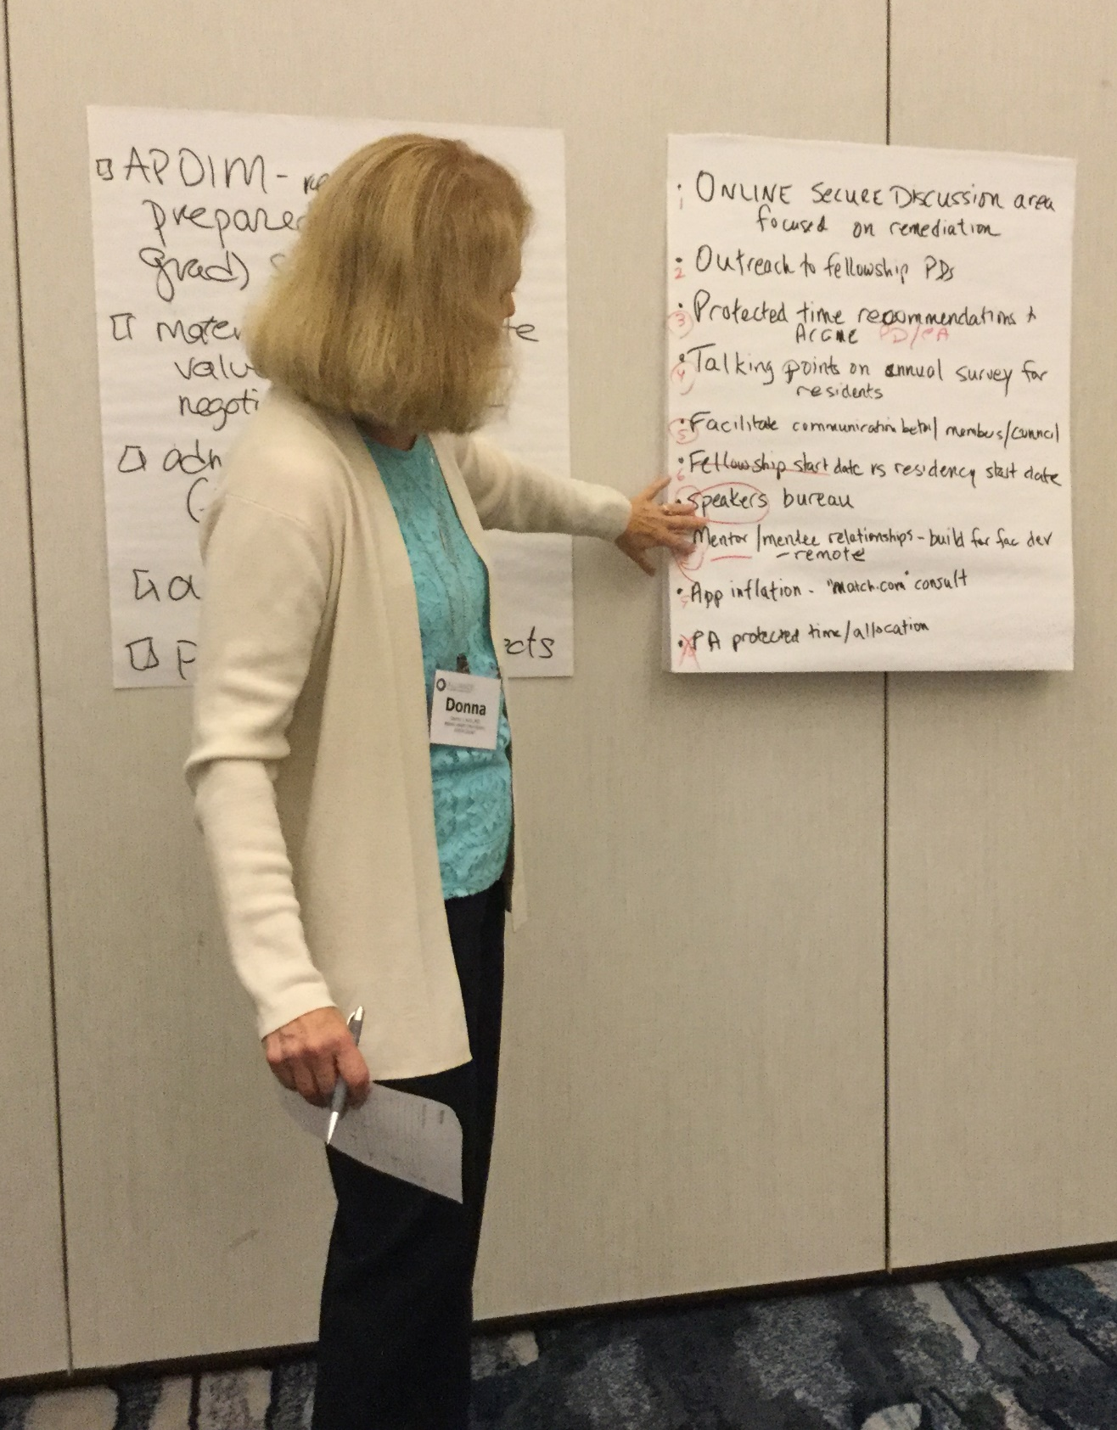
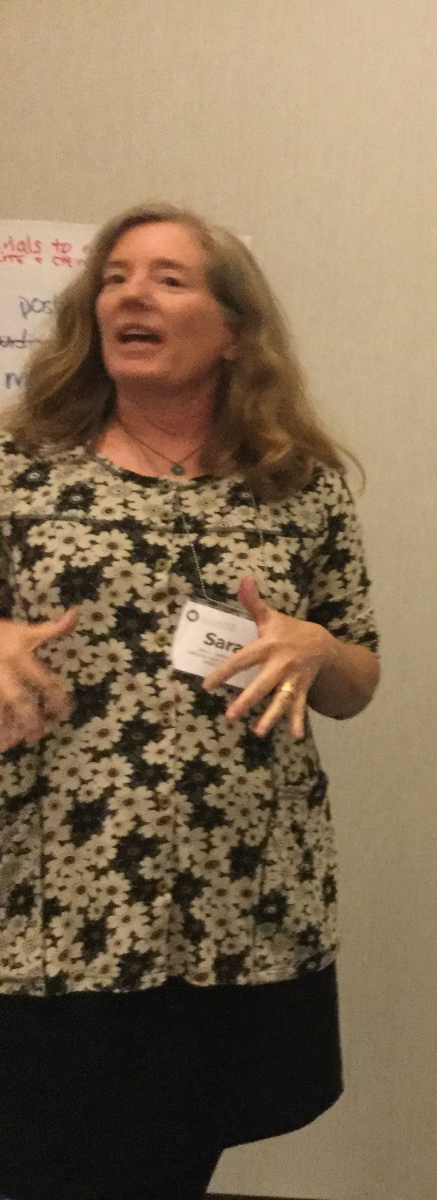


Slide 7
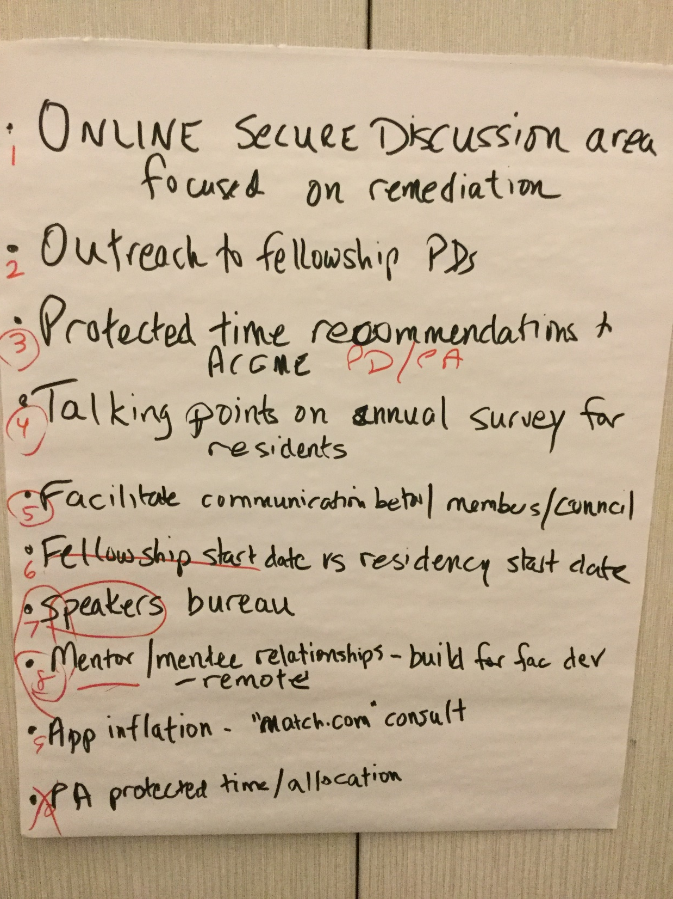
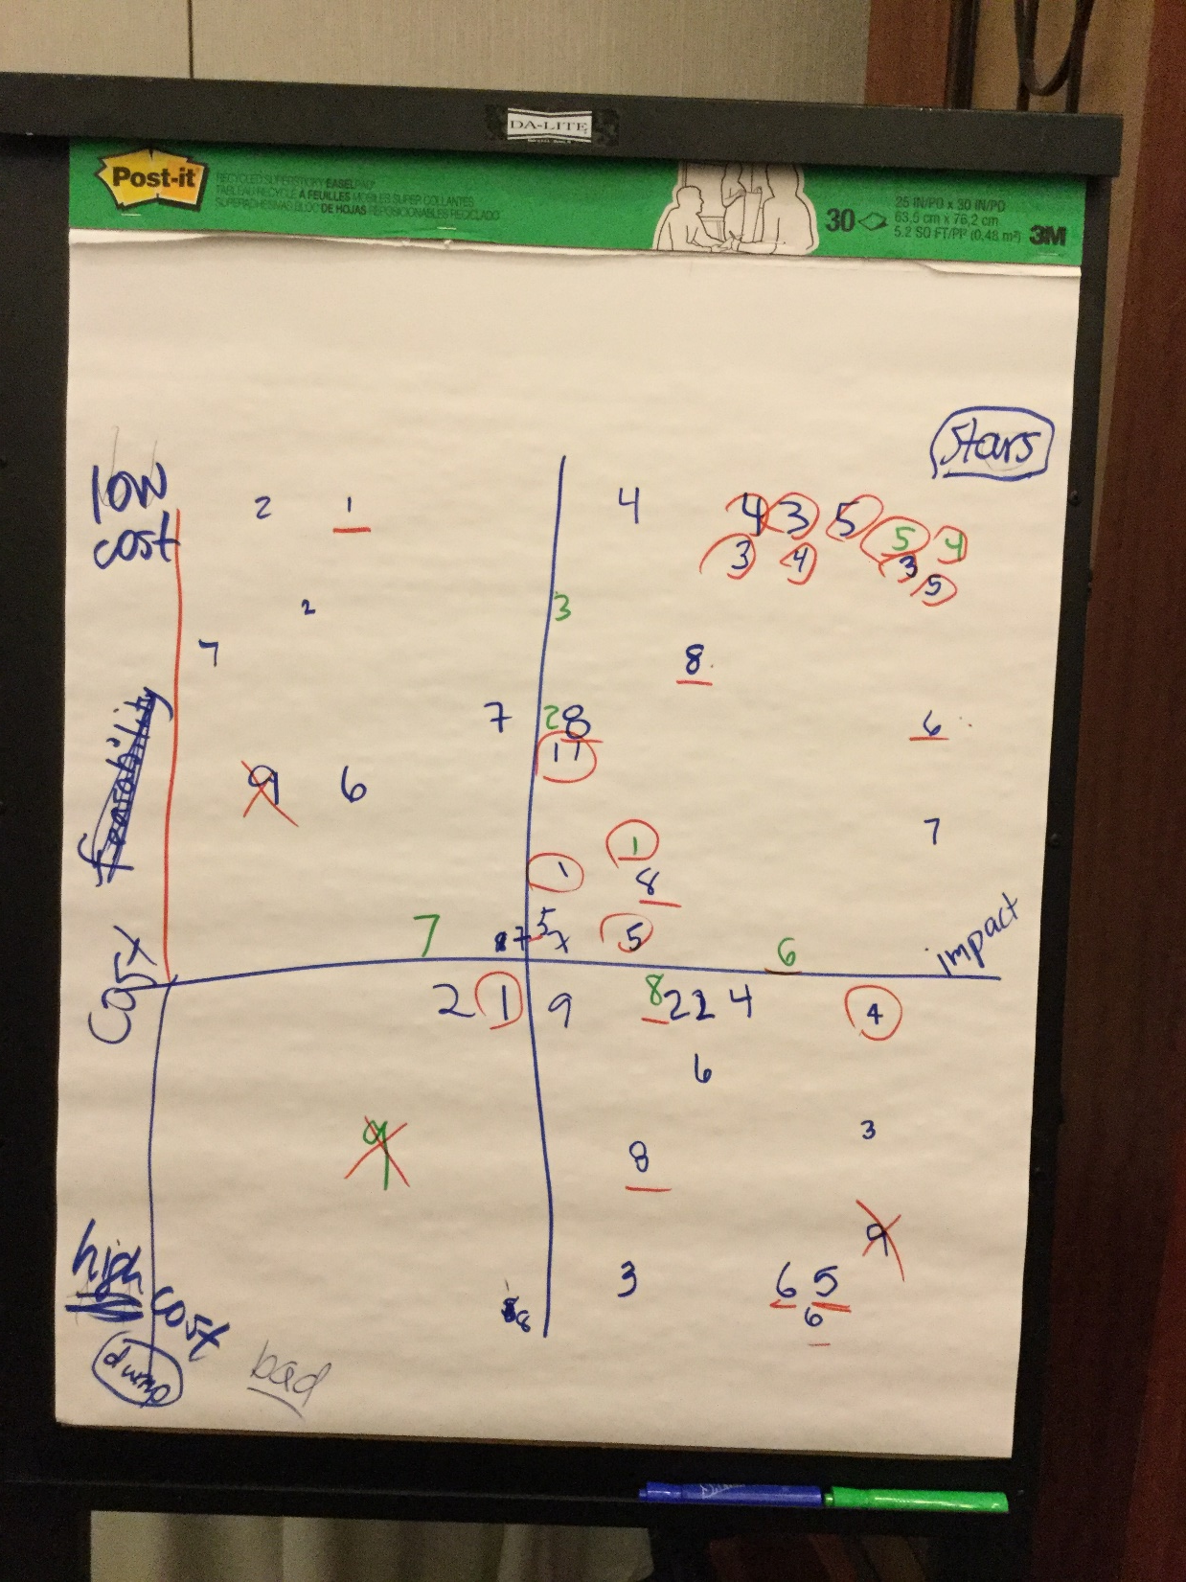

Slide 8
APDIM 2018 PD Survey
Annual
400 PDs surveyed
~70% response rate

Slide 9
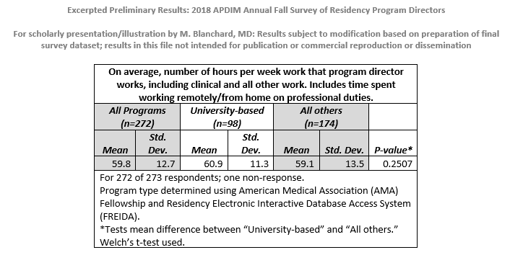
PD Duty Hours

Slide 10
How IM PDs actually spend their time

Slide 11
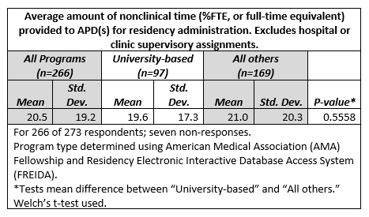
APDs & their Duty Hours

Slide 12
CRs & Administrative/ Staff Support

Slide 13
Is the ACGME minimum requirement of 50% protected time for IM PD adequate?

Slide 14
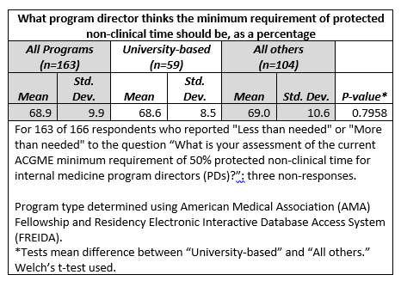
What should be the minimum time requirement?

Slide 15
Activities Survey
APDIM Council
8 programs
5 University
3 Community based
Used EPA tool developed by Robert Bing-You, Eric Holmboe, et al
Academic Medicine 2017;92:739-742.

Slide 16
Activities¹ | Activity Description | Program Director | Associate Program Director | Chief Residents | Program Coordinator | Other Faculty
Maintain Program Accreditation | WEBADS, APE & responses to ACGME resident & faculty surveys, Self-study | 7.00 | 6.29 | 6.86 | 17.88 | 1.75
Conduct a resident evaluation program | Semi-annual/ annual reviews, CCC meetings & prep, exit interviews, creation of assessment tools, etc. | 8.88 | 18.00 | 4.14 | 6.71 | 5.33
Support and mentor residents | Mentoring/ advising system, special tracks within program, career planning, LOR writing, etc. | 10.25 | 14.29 | 16.40 | 0.80 | 8.33
Develop and strengthen faculty | Faculty development including prep time, recruitment of new faculty, retention of present faculty, annual faculty evaluations, etc. | 4.00 | 2.00 | 0.00 | 0.50 | 1.75
Promote a positive clinical learning environment | Wellness programs, remediating faculty, oversight of clinical rotations, etc. | 4.57 | 9.15 | 15.00 | 2.20 | 3.20
Work as an administrative team member in institution | Meetings including Chair, GMEC, nursing, Quality/ Safety; peer review/ incident reports/RCA, etc | 6.25 | 4.33 | 6.83 | 3.40 | 2.40
Direct a recruitment and selection process | ERAS management, selecting applicants to interview, interviewing candidates, rank list generation, etc. | 22.50 | 14.14 | 9.25 | 25.43 | 16.83
Oversee the remediation of underperforming residents | Developing improvement plans, monitoring progress, etc. | 5.50 | 7.50 | 9.50 | 1.40 | 1.75
Manage program evaluation and improvement | PEC meetings, generation of action items, implementation of programmatic changes, etc. | 6.38 | 3.83 | 7.50 | 4.80 | 3.60
Conduct continuous self-assessment and professional development | Professional society memberships/ meetings, CME, volunteerism, etc. | 4.50 | 6.29 | 5.80 | 2.33 | 2.00
Prepare and review program reports | Institutional & departmental updates, track resident involvement in patient safety committees, track resident involvement in healthcare disparity migration efforts, etc. | 2.86 | 1.40 | 0.25 | 7.50 | 0.75
Oversee daily residency operations | Didactic scheduling & quality control, residency schedules, residency budget, updating program policy manual, etc. | 4.00 | 4.80 | 24.57 | 24.14 | 1.25
Verify resident education | State licensing, credentialing, ABIM Fastrac, etc. | 2.14 | 0.50 | 0.00 | 8.75 | 0.00
 |  | #DIV/0! | #DIV/0! | #DIV/0! | #DIV/0! | #DIV/0!

Slide 17
PD Competencies
Brainstorm to identify required competencies of PDs

Slide 18
13 Competencies of Effective PDs
Able to manage self
Able to functionally build teams
Must have excellent interpersonal communication skills
Must have excellent organizational skill
Must be adaptable
Must be able to solve conflicts
Must be able to motivate & influence people
Must have the ability to foster culture
Must have an understanding of the healthcare system & allow that knowledge to inform the educational curriculum
Should have knowledge of finances to the extent that they are involved in managing a budget for their residency
Must have clinical skills as the one person regarded as the role model & ultimate coach
Able to advocate for their program
Committed to lifelong learning

Slide 19
Conclusions
PDs are essential for assuring an effective physician workforce
Protected time for PDs is important for their effectiveness
PDs work long hours – 60 hours per week across all program size
PDs find the ACGME minimum protected time of 50% is insufficient
PDs spend their time on the activities of the program that require their skill
The support of APDs, CRs & Administrative Assistants are critical
More work should be done to assess how program leadership is structured, trained & how the various personnel can be optimized

Slide 20
THANK YOU
Richard Alweis
Lisa Willet
Donna Astiz
APDIM council
AAIM
Craig Brater
Eric Holmboe

