Slide 1
This presentation includes the audio recording from the “Review of the Internal Medicine Subspecialty Reporting Milestones” webinar held on September 11, 2013.
Please note the recording will play continuously as you move through the slides.

Slide 2

Subspecialty Milestones Webinar Three

Slide 3
Basic Definitions

Slide 4
Curricular Milestones
Granular descriptions of the specific knowledge, skills and attitudes/behaviors that describe competent behavior over the course of internal medicine residency training. Curricular milestones are specialty specific.

Slide 5
Patient Care
ACGME Competency | Developmental Milestones Informing ACGME Competencies | Approximate Time Frame Trainee to Achieve Stage | Assessment Methods/Tools
Clinical skills and reasoning Manages patients using clinical skills of interviewing and physical examination | Historical Data Gathering Acquire accurate and relevant history from the patient in an efficiently customized, prioritized, and hypothesis driven fashion Seek and obtain appropriate, verified, and prioritized data from secondary sources (e.g. family, records, pharmacy) Obtain relevant historical subtleties that inform and prioritize both differential diagnoses and diagnostic plans, including sensitive, complicated, and detailed information that may not often be volunteered by the patient | 6 months 9 months 18 months | Standardized patient Direct Observation Simulation
Notes:
I specifically have a box around the 18 month milestone in preparation for the next slide…

Slide 6
Reporting Milestones
Reporting milestones provide narrative descriptions of the trainee and are “context free”. They describe the learner independent of the learning environment and do not describe the post-graduate year of education
The reporting milestones are organized by ACGME competency domains and are broken down into 22 subcompetencies. Each subcompetency consists of behaviors describing the development of competence from that of an early learner up to and beyond that expected for unsupervised practice

Slide 7
Internal Medicine Milestones
Version 12/2012
sub-competency
Milestone
Copyright (c) 2012 The Accreditation Council for Graduate Medical Education and The American Board of Internal Medicine. All rights reserved. The copyright owners grant third parties the right to use the Internal Medicine Milestones on a non-exclusive basis for educational purposes.

Slide 8
Entrustable Professional Activities (EPA)
An activity that is part of the essential work of a profession, specialty or subspecialty with the following characteristics: requires the integration of knowledge, skills and attitudes and their demonstration within an authentic context; is independently executable within a given timeframe by qualified personnel; and leads to observable and measurable outputs. An EPA describes a unit of work, while a competency describes an individual.

Slide 9
Entrustable Professional Activities (EPA)
The internal medicine GME community has embraced EPAs as a meaningful and manageable assessment strategy for focusing the assessment of trainees in the clinical environment performing highly synthetic (capturing multiple milestones) work-based activities. On Miller’s pyramid, these activities reflect the “does” level, or tip of the pyramid and reflects the critical work of the profession – delivery of safe and effective patient care.

Slide 10
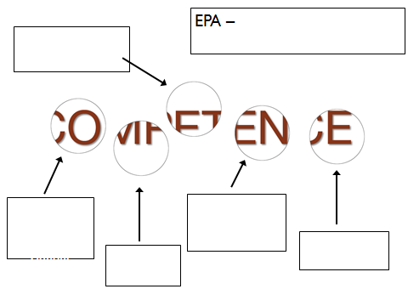

Slide 11
Entrustment for remote or unsupervised patient care

Slide 12
Entrustment for remote or unsupervised patient care
Recognize need for urgent or emergent care
Recognize when to seek additional guidance
Recognize scope of abilities and ask for supervision
Performing a physical exam
Historical data-gathering

Slide 13
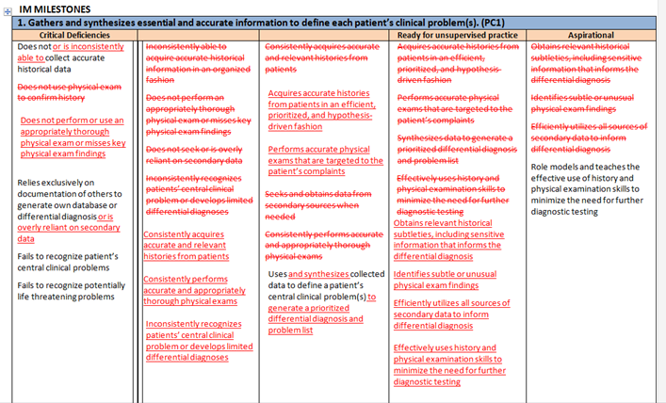
Example of Highly Edited Milestone

Slide 14
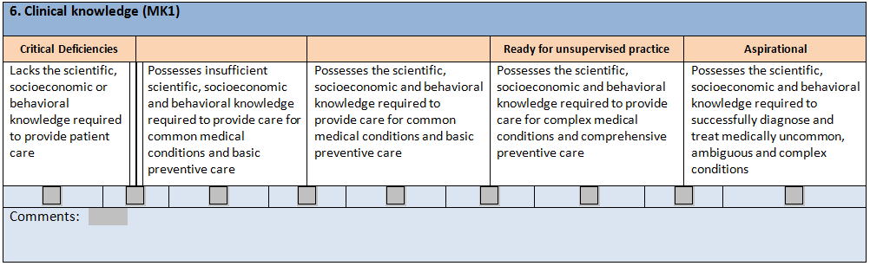
Example of Unedited Milestone

Slide 15
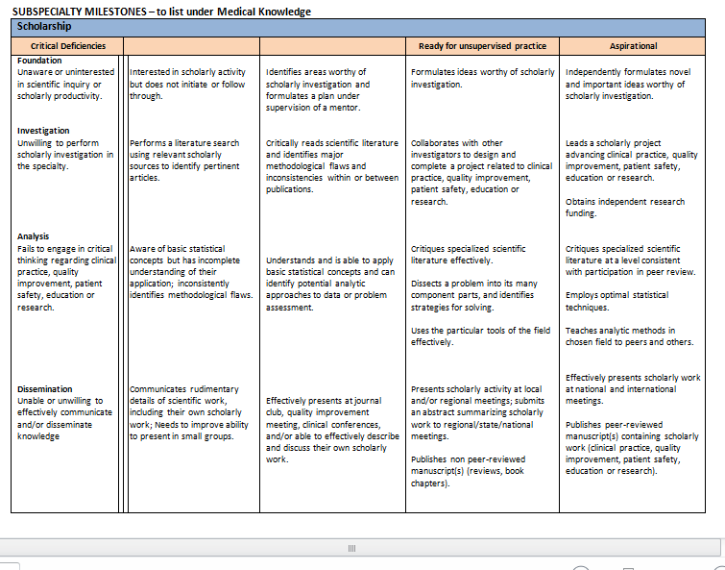

Slide 16
Questions:
1. Is the content of the IM Subspecialty Milestones appropriate for your subspecialty?
2. Do the levels within each milestone describe a realistic and appropriate progression of a fellow in your specialty?
3. Does the "Ready for Unsupervised Practice" level describe an appropriate performance expectation for a fellow who is completing his or her training in your specialty?
4. Do you support the use of the IM Subspecialty Reporting Milestones for reporting trainee competence in the Next Accreditation System for your specialty? If not, what types of changes are needed in order for the milestones to be acceptable for reporting?

