Slide 1


Maximizing Your ILTA Partnership
Presented by ILTA Business Partner Committee
With Special Guest
Adriana Vitale - Chief Business Development Officer Cornerstone

Slide 2

Agenda
Maximize Your ILTA Partnership Benefits
ILTA Year-Round (Not only ILTACON)
Thought Leadership
Direct Engagement
Advertising
Events
Planning
SESSION GOALS
2

Slide 3

About ILTA
Understanding Our Global Impact
Membership Statistics
ILTA boasts 26,200 members across 1,083 entities, representing over 282,000 lawyers worldwide. Our international presence spans North America, Europe, LATAM, and Asia, showcasing our vast reach and network capabilities.
KEY INSIGHTS
3

Slide 4
Why Year-Round Engagement Matters
Visibility
Continuous involvement enhances brand visibility, allowing partners to stand out and ensure their services are recognized in the legal community throughout the entire year, not just during events.
Connections
Engaging year-round fosters lasting relationships with peers and clients, creating a strong network that can lead to valuable opportunities and collaborations within the ILTA community.
Awareness
Maintaining consistent communication increases awareness of partner insights and solutions, ensuring members are informed about offerings that can enhance their operations and effectiveness all year long.
KEY INSIGHTS
4

Slide 5
Planning & Metrics
Strategic Planning
Key Events
Silver-level sponsors and above receive access to ILTA’s full Media Kit, which includes year-round marketing, advertising, and thought-leadership opportunities across ILTA’s publications, digital channels, and content programs. These benefits are provided in addition to the sponsorship opportunities tied specifically to ILTACON. By combining ILTACON visibility with Media Kit offerings, sponsors can build a continuous presence throughout the year and strategically align their campaigns with ILTA’s broader engagement calendar.
Highlighting ILTA's signature events, such as Evolve and ILTACON, provides opportunities to showcase your brand and connect with industry leaders, enhancing visibility and strengthening relationships within the community.
NOTES & INSIGHTS
5

Slide 6
ILTA Year-Round
Foundation Benefits
Key Features
Communities Involved
The partnership includes a foundational set of benefits that provides essential resources and year-round support, ensuring partners stay connected, informed, and fully equipped to maximize their engagement with ILTA.
Partners gain access to features such as directory listings, Tech Survey participation, and webinars, enhancing their visibility within the legal technology community and fostering professional connections.
The partnership encompasses various communities, including Business Partner, LegalSec, DEI, and Women Who Lead, allowing for tailored engagement and collaboration opportunities across the ILTA network.
Enhanced Networking
Continuous Engagement
Through ILTA365, partners can enjoy enhanced networking opportunities that facilitate meaningful relationships and collaboration among peers, significantly enriching their experience within the ILTA community.
Year-round engagement allows partners to maintain their visibility and influence within the legal technology sector, ensuring they remain top-of-mind for potential clients and industry colleagues.
NOTES AND INSIGHTS
6

Slide 7
ILTA Sponsorship In Action
Practical Examples
Use the Sponsor Directory to connect with firms.
Join open eGroups to share thought leadership.
Post job openings, press releases, and company news.
Attend virtual events and webinars for continuous visibility.
NOTES AND INSIGHTS
7

Slide 8
Volunteering with ILTA
Get Involved, Stay Connected
Volunteering is open to all ILTA365 through ILTAMAX partners.
Opportunities range from light involvement to deeper committee participation.
Short-term contributions: writing articles, speaking on webinars, participating in projects
Ongoing roles: committee service, content development, event support
Volunteering helps you:
Build deeper relationships with ILTA members
Strengthen brand visibility and credibility
Contribute meaningfully to the legal tech ecosystem
The Business Partner Committee is a great starting point for engagement.
ILTA can help match volunteer interest with the right fit.
NOTES AND INSIGHTS
8

Slide 9
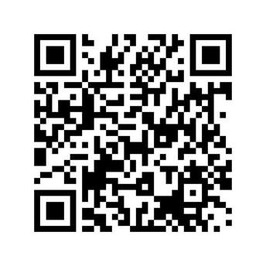

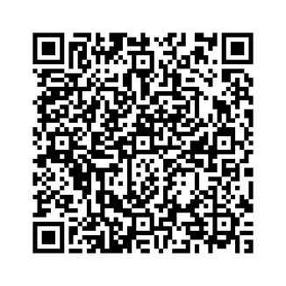
Volunteering with ILTA
Open Opportunities
Fill out the form!
Content Strategy Focus Groups
If you're interested in sharing your perspective on what content is most useful, how you like to engage with it, and what you'd like to see more of, we'd love to hear from you.
Local Experience
Local Experience Leadership Committee Co-Chair
Local Experience Team Coordinator
Local Experience Operations Committee Member
All Opportunities here!
NOTES AND INSIGHTS
9

Slide 10



Thought Leadership
Writing
Speaking
Announcements
Contribute articles to Peer to Peer publications.
Share insights on ILTA Voices platforms., webinars, conferences, local events.
Distribute press releases to the ILTA community.
ADDITIONAL IDEAS
10

Slide 11



Connection Opportunities
Webinars
Local Experiences
Social Events
Interactive online sessions for knowledge sharing and learning.
Networking opportunities in familiar and friendly environments.
Informal gatherings to foster professional relationships.
ENGAGEMENT HIGHLIGHTS
11

Slide 12
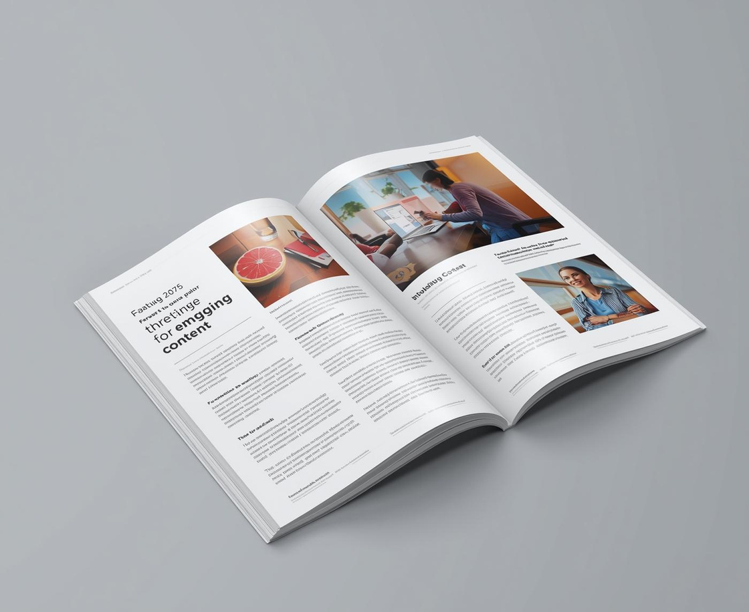
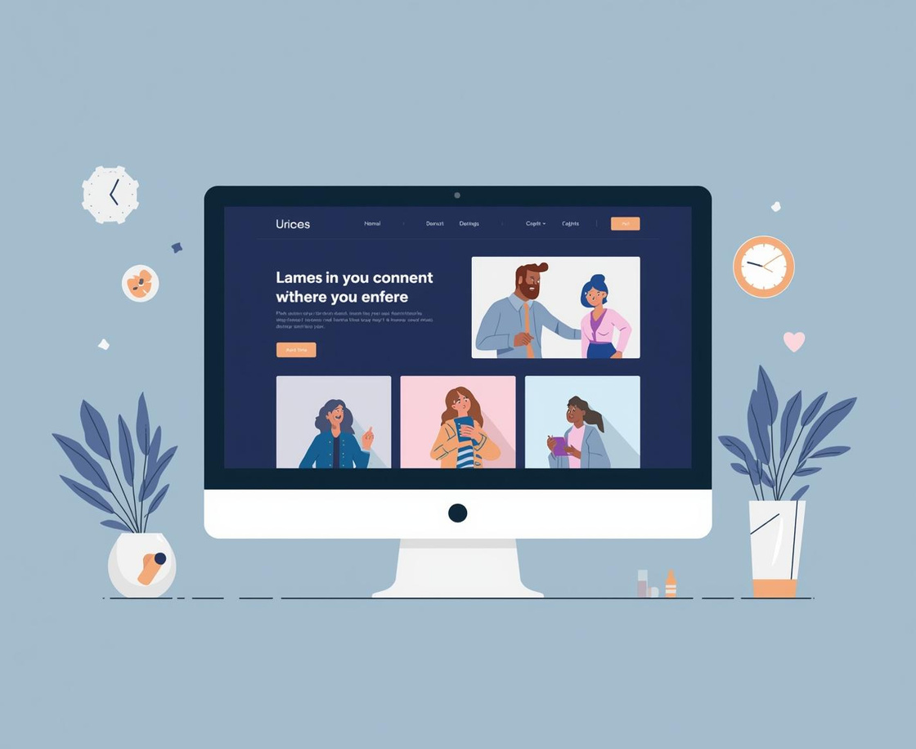
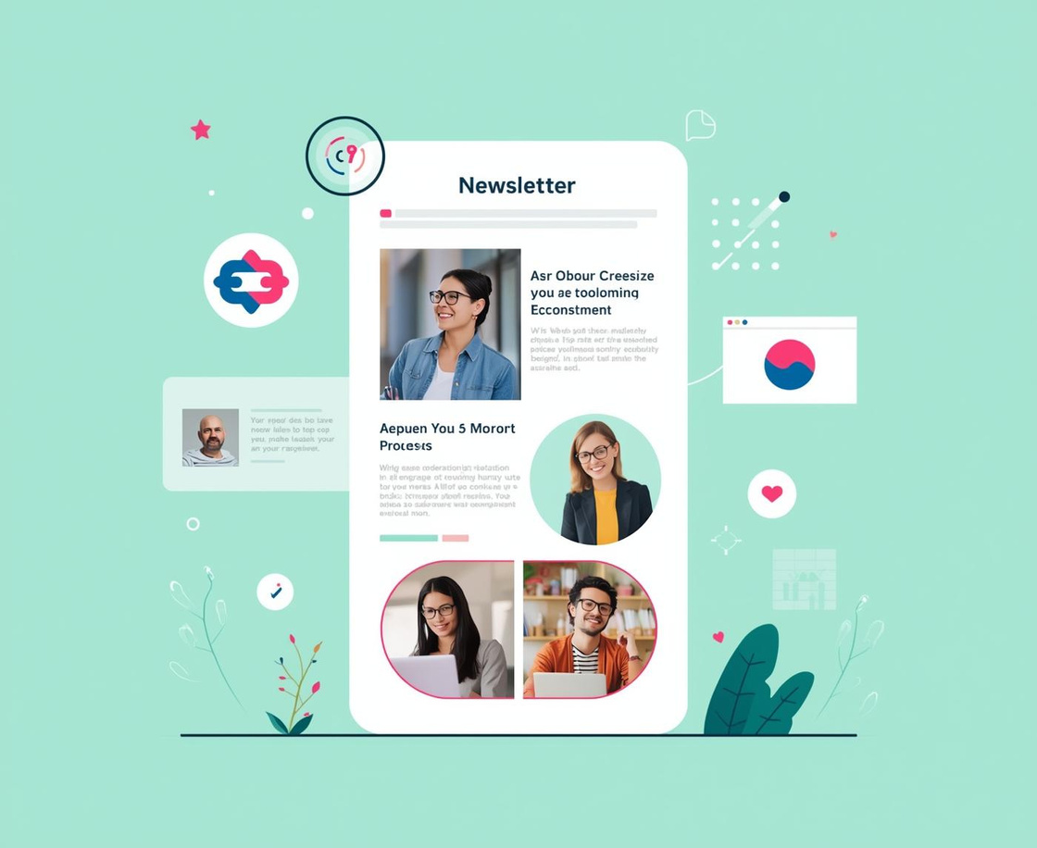
Media & Advertising Options
Peer to Peer
Website Ads
Hub Newsletter
Engage with 20,000 views per issue.
Reach 50,000 views monthly for maximum exposure.
Connect with 21,000 subscribers effectively.
NOTES ON ENGAGEMENT
12

Slide 13
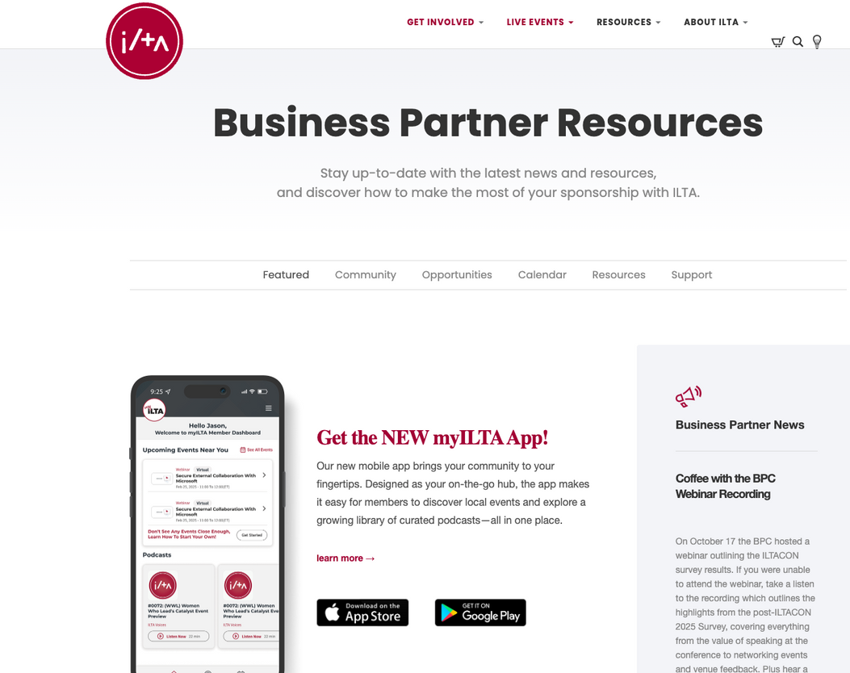
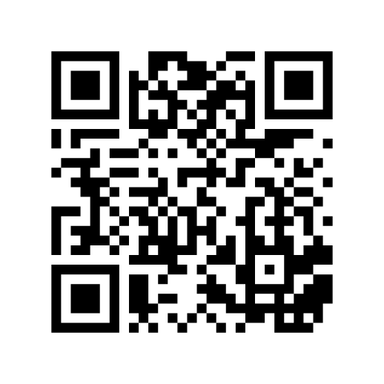
Resource
Business Partner Landing Page
Bookmark!
NOTES & INSIGHTS
13

Slide 14

ILTA Distinguished Peer Awards
Celebrating Excellence
The Distinguished Peer Awards honor outstanding contributions in the legal tech community.
Categories include:
Individual awards
Organizational achievements
Solutions and innovation awards (often relevant for business partners)
Business partners can:
Nominate clients, partners, or peers
Apply for applicable award categories
Promote achievements through ILTA channels
Award winners receive significant visibility at ILTA events and across ILTA media.
Recognition strengthens credibility and demonstrates leadership in the industry.
KEY INSIGHTS
14

Slide 15

ILTA Business Partner Spotlight
Showcase your Expertise
The Business Partner Spotlight highlights ILTA partners who are making an impact in the legal tech community.
Spotlights appear across ILTA channels
A great opportunity to:
Share your company’s story, mission, and value
Highlight recent achievements, innovations, or case studies
Build credibility and strengthen your presence within the ILTA community
Spotlights help members get to know the people behind the products — creating stronger, more human connections.
Ideal for partners who want to increase brand awareness, thought leadership, and engagement.
KEY INSIGHTS
15

Slide 16

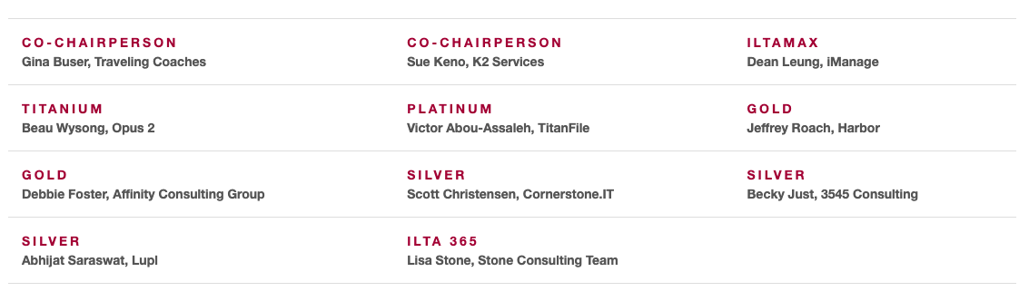
Your partnership is powerful — use it year-round!
Your Business Partner Committee
ADDITIONAL INFORMATION
16

Slide 17

ILTA BP
Team Members
Connect with Us Today
Tyler Howes
VP of Business Partner Development and Strategic Alliances email: tyler@iltanet.org
Sharon Stewart
Manager, Partner Development & Project Mgmt
email: sharon@iltanet.org
Ashley Kowitz
Manager, Partner Development & Operations
email: ashley@iltanet.org
Courtney Oliver
Business Partner Operations Coordinator
email: courtney@iltanet.org

