Slide 1
2026 ILTACON The Booth Lottery
Thursday 2 April 2026

Slide 2
Booth Selection
ARPIL 6
APRIL 27
DURING CALL & TIPS
Initial Booth Selection Calls Begin (Qualified for Lottery)
Initial Booth Selection Calls Conclude (Qualified for Lottery)
Calls will last approximately 20 minutes.
Please be prepared with alternate selections for booth spaces as well as demo rooms and other sponsorship opportunities.
Select booth space
Select demo room(s) and/or hospitality suites
Select any additional opportunities such as clings, banners, or meeting bags
An email will be sent after the call to confirm all choices made during the call and to provide the space request form.

Slide 3
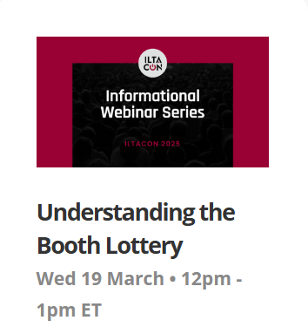
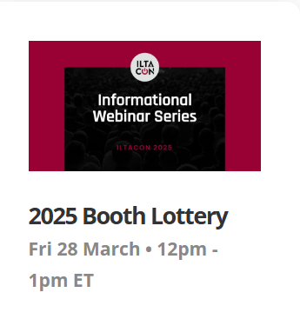
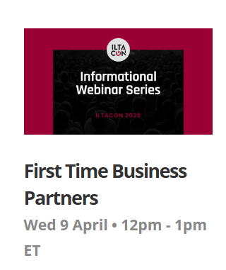
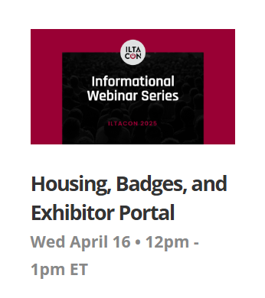
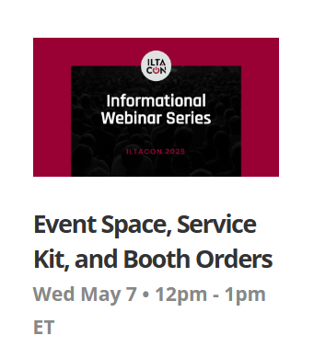
SAVE THE DATES All webinars will be recorded and posted for viewing at a later date. iltacon.org/about/webinars
All about the Booth
Lottery
Wed 25 March- 12pm-1pm
ETET
2026 Booth
Lottery
Thurs 2 April- 12pm-1pm
ETET
All about Housing,
Registration, and the
ILTACON Portal
Wed 13 April- 12pm-1pm
ETET
All about Hosting
Events, Service Kit
& Booth Orders
Wed 13 May- 12pm-1pm
ETET
Startup Hub
Wed 10 June- 11am-12pm
ET
ILTACON 2026: What to
Expect
Wed 29 July- 12pm-1pm
ETET

Slide 4
Lottery – Order of Selection Criteria
Sponsorship Level (ILTAMAX, Titanium, Platinum, Gold, Silver, Step Up)
Category Level within each Sponsorship Level
Category 1: 6 plus years
Category 2: 4-5 years
Category 3: 2-3 years
Category 4: 1 year (new sponsors)
3. Lottery Number (established NEXT!)

Slide 5
Booth Lottery
SEE YOU IN NASHVILLE!

Slide 6
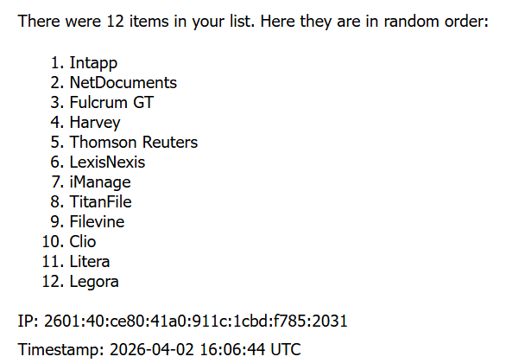
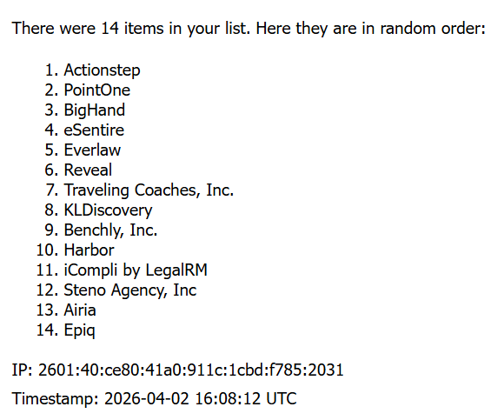
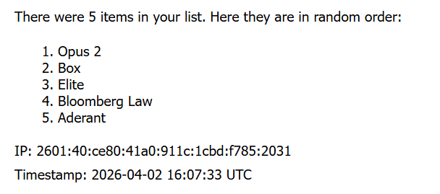
Booth Lottery Results
1
ILTAMAX Results
Reminder: Order of booth selection is based on sponsorship level, category level, and the booth lottery.
3
Platinum Results
2
Titanium Results

Slide 7
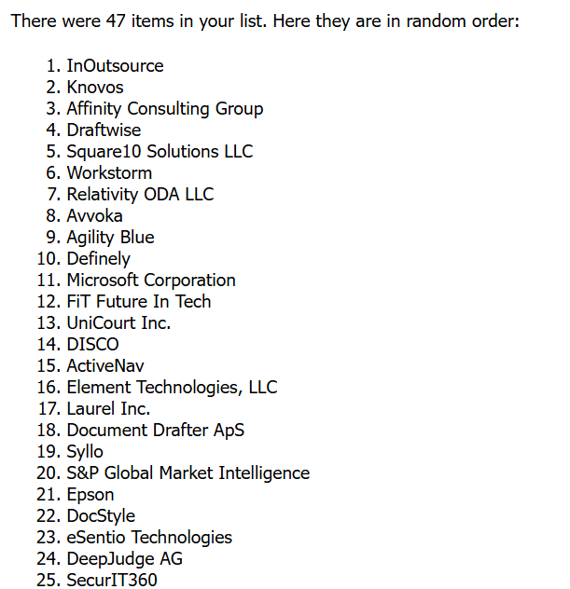
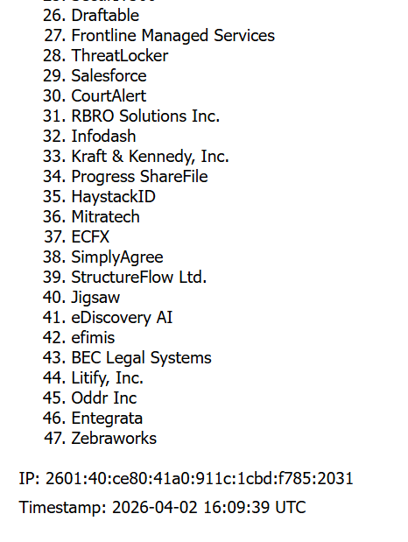
Booth Lottery Results
Reminder: Order of booth selection is based on sponsorship level, category level, and the booth lottery.
4
Gold Results

Slide 8
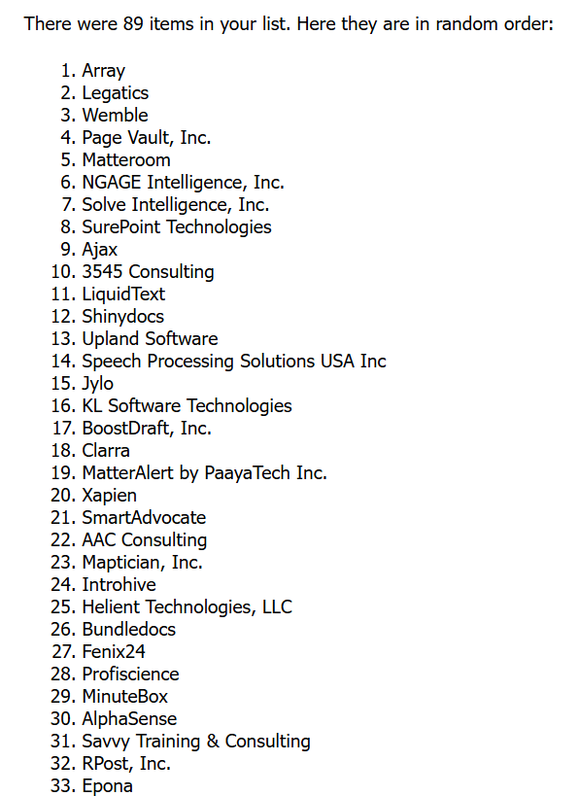
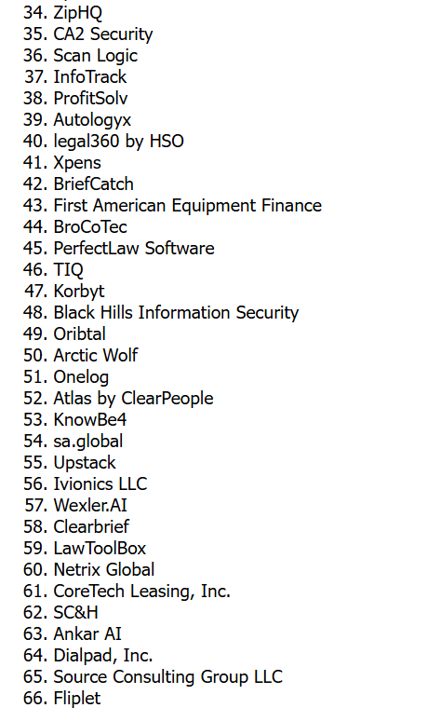
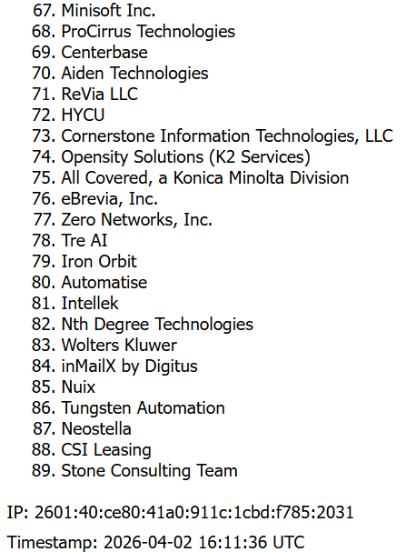
Booth Lottery Results
5
Silver Results
Reminder: Order of booth selection is based on sponsorship level, category level, and the booth lottery.

Slide 9
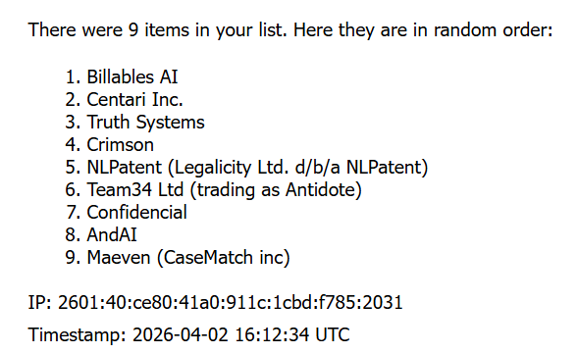
Booth Lottery Results
5
Step Up Results
Reminder: Order of booth selection is based on sponsorship level, category level, and the booth lottery.

Slide 10
Thank You!
SEE YOU IN NASHVILLE!

