Slide 1


BUSINESS PARTNER COMMITTEE
Coffee with the BPC
All Things ILTACON 2026
Your game plan for maximizing every moment on the exhibit floor
May 20, 2026 | 11:00 AM Central | #WeAreILTA | #ILTACON2026
Notes:
1

Slide 2
TODAY'S AGENDA
01
04
What's New at ILTACON 2026
On-Site Best Practices
Exhibit hall updates, new features & opportunities
Booth activity, lead gen & networking
02
05
Goal Setting & Conference Strategy
Post-Conference Follow-Up
Establish your mission, KPIs, and team plan
Converting connections into results
03
06
Pre-Conference Marketing
Q&A
Promotion, outreach & brand visibility
Open discussion
Notes:
2

Slide 3




WHAT'S NEW IN 2026
#WeAreILTA
Exhibit Hall Updates & New Opportunities
Startup Hub Pitches — Back!
New In-Hall Stage
Two stages near the exhibit entrance. Pitches run Tuesday through Wednesday with headphones provided. Great energy — position your booth to capitalize on the foot traffic.
Host a company update or master class right on the exhibit floor. Limited sponsorship slots available. Headphones keep the noise contained — attendees stay focused on you.
Podcast Booth Opportunities
Layout Changes for More Traffic
Plexiglassed recording spaces return to the show floor. Sponsorships available for business partners to participate in live recordings. Confirm signup details with Sharon.
Food & beverage carts placed at back left and right to pull attendees deeper into the hall. The new layout is designed to drive engagement — plan your booth placement accordingly.
Notes:
3

Slide 4


VENUE SPOTLIGHT
Broadway to Broadway Theme
What to know for the Monday Night Reception
Monday night reception kicks off the week — don't miss it. This is prime networking real estate.
Large property — build in extra time for navigation. Plan your team's meetup points in advance.
Lean into the Broadway theme for your booth energy and team attire if it fits your brand vibe.
Use the reception to set up in-booth meetings for Tuesday — warm intros convert better than cold drops.
Notes:
4

Slide 5

GOAL SETTING & CONFERENCE STRATEGY
Showing up is only half the battle. Build your plan before you pack.
Mission & Vision
Why are you at ILTACON? What does success look like for your team?
KPIs
PRO TIP
Leads captured, meetings booked, demos run, connections made — decide in advance.
Schedule a pre-conference team huddle. Walk in aligned on goals, talking points, and who's handling what. Ad-hoc planning on the show floor costs you deals.
Budget
Account for booth costs, sponsorships, events, team time, and follow-up resources.
Task List & Schedule
Assign owners, set deadlines, track deliverables before you arrive.
Team Safety & Wellness
Set expectations for team availability, communication, and self-care on the ground.
Notes:
5

Slide 6
PRE-CONFERENCE MARKETING & OUTREACH
Visibility & Branding
Outreach & Scheduling
Content & Prep
Update booth graphics and handouts
Email opted-in contacts to book meetings pre-conference
Define your booth buzz — what's the one thing you want people to remember?
Promote your presence on social (use #ILTACON2026)
Send booth invites with your hook/giveaway details
Plan for lead capture (Klik badge scans, follow-up workflow)
Add ILTACON branding to email signatures
Schedule demos in advance — prime slots fill fast
Review ILTACON BP Portal for deadlines
Secure add-on sponsorships and branding opportunities
Train booth staff: talking points, lead capture process
Block Tue & Wed nights — open for your own events
⚠ OUTREACH ETIQUETTE
ILTA registration now defaults to opt-in for business partner emails — which is a big deal. Only contact members who have opted in. Blasting the full attendee list is not okay and undermines the trust we've worked hard to build with the membership. When in doubt, earn the conversation on the show floor first.
Notes:
6

Slide 7
LEAD GENERATION: MAKING IT COUNT
Leads don't close themselves. Here's how to build a pipeline that survives the post-conference inbox.
1
CAPTURE
2
QUALIFY
3
FOLLOW UP
Use Klik for badge scans — it's built in
Hot = ready for demo or follow-up call
Within 48 hours of the conference — not a week later
Note context immediately: what did you talk about?
Warm = expressed interest, needs nurturing
Reference your actual conversation (use your notes!)
Categorize leads by priority on the floor
Cold = good conversation, long-term brand play
Add to CRM and assign to a rep immediately
Notes:
7

Slide 8

ON-SITE BEST PRACTICES
#WeAreILTA
Networking & Booth Presence
Run pre-scheduled meetings — don't rely on walk-up traffic alone
Work your sponsorship and branding investments actively
Conduct product demos in booth; keep them tight and conversational
Take advantage of all networking opportunities: lunches, coffee breaks, receptions, lobby bar
Use Klik for badge scans; always note context right away
Volunteer with ILTA — visibility beyond the booth
Attend sessions to contribute — not to sell; respect your peers
Tue & Wed nights are yours — use them for hosted events or dinners
Continue your social media cadence from pre-conference
Participate in wellness activities; conference stamina is real
Notes:
8

Slide 9





POST-CONFERENCE FOLLOW-THROUGH
The conference ends. The work doesn't.
Follow Up Fast
Add Leads to CRM
Keep Nurturing
Reach out to warm contacts within 48 hours. Reference your actual conversation — it shows you were paying attention.
Import all leads and assign to reps. Don't let cards sit in a stack. Your CRM is where deals happen.
Not every conversation converts immediately. Stay visible through content, check-ins, and ILTA initiatives.
Team Debrief
Complete the Survey
Stay Engaged with ILTA
What worked? What didn't? Gather feedback while it's fresh. Document learnings for next year's plan.
Complete the ILTACON survey. ILTA uses this data — it helps shape the experience for business partners.
Blog recap, social posts, continued volunteering. Keep your brand present between events.
Notes:
9

Slide 10
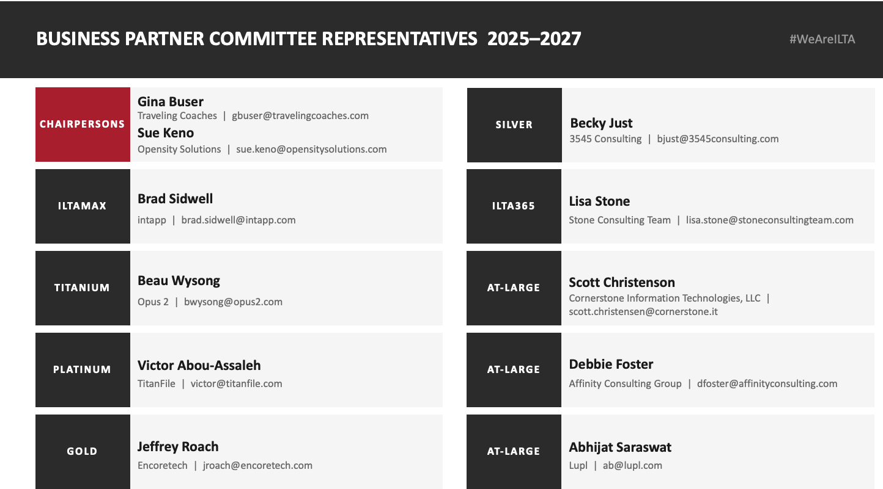
Notes:
10

Slide 11
QUESTIONS?
Comments? Anecdotes? Embarrassing ILTACON stories?
Thank you for joining Coffee with the BPC.
We'll see you at ILTACON 2026. | #WeAreILTA | #ILTACON2026
Questions between now and then? Reach out to any BPC rep listed in the prior slide.
Notes:
11

