Slide 1



23-27 AUGUST 2065 | NASHVILLE, TN
GAYLORD OPRYLAND RESORT & CONVENTION CENTER
2026
ILTACON INFORMATION
#ILTACON2026

Slide 2


Slide 3
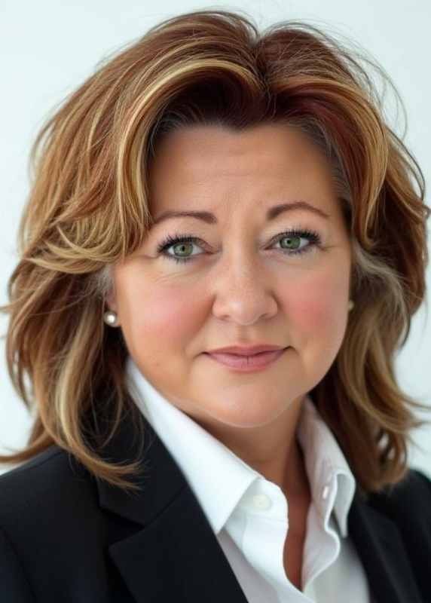
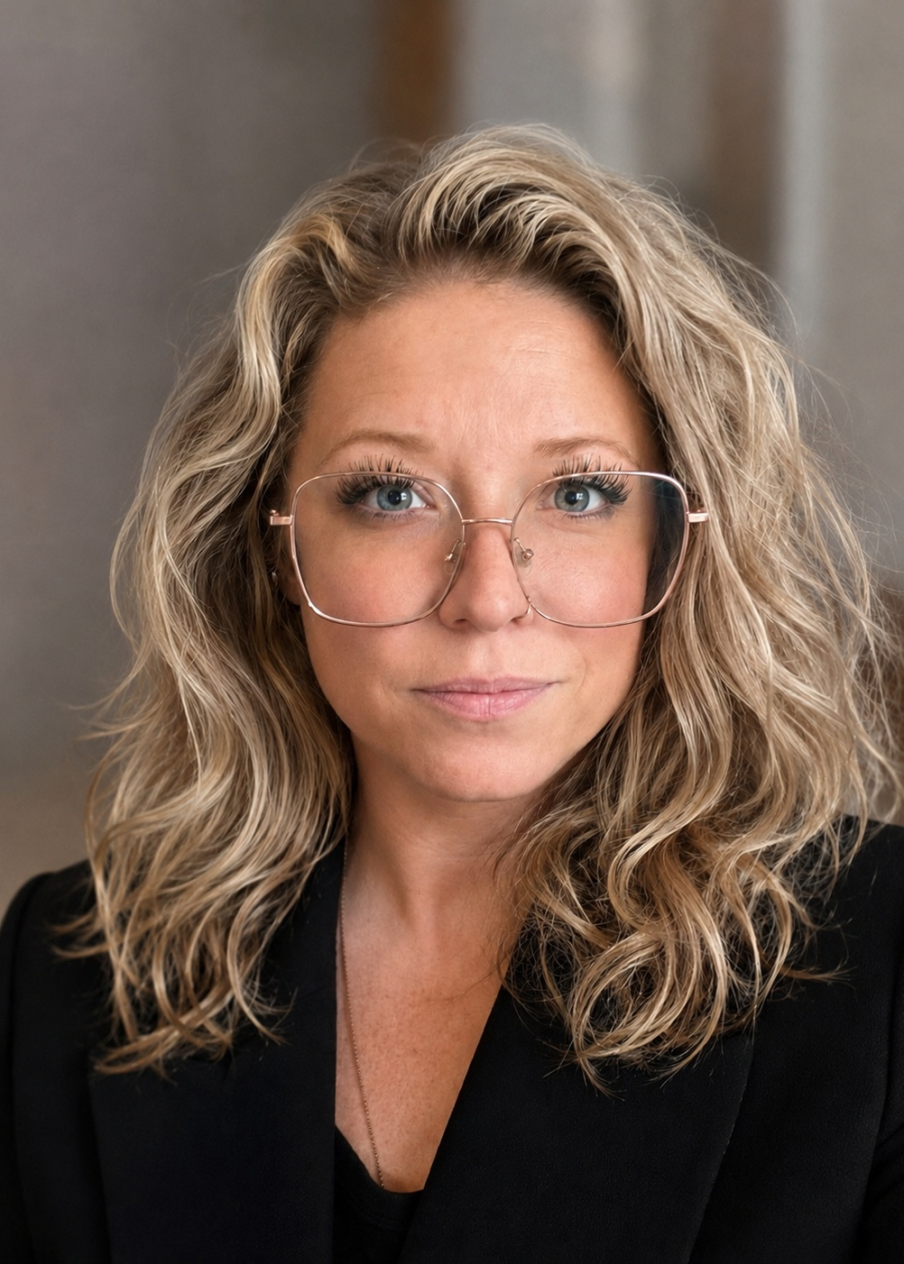
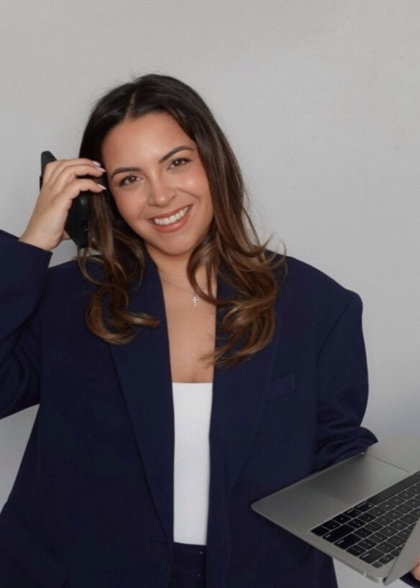
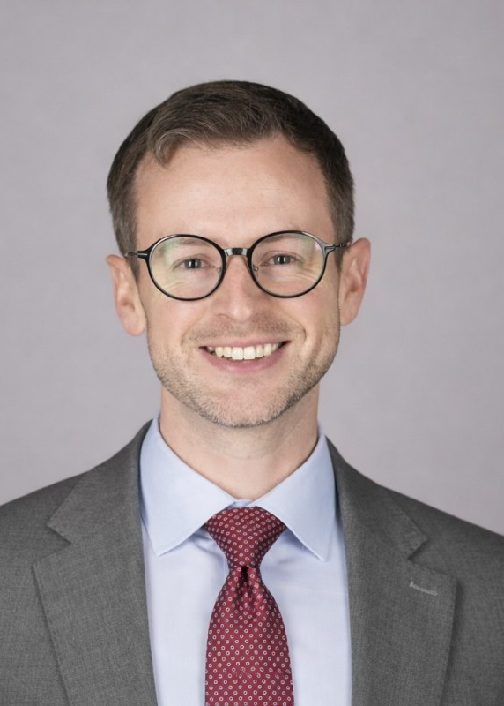
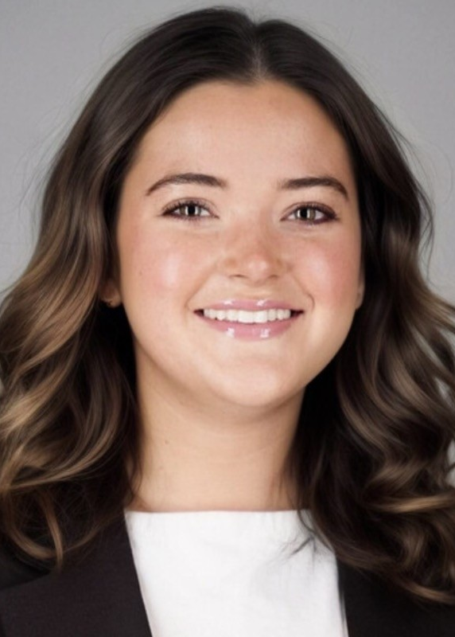
DAWN HUDGINS
JESSICA LYKINS
MELISSA COMMISSO
Tyler Minton
SARAH GRACE JOHNSON
Chief Experience Officer
Director of Event Experience
Experience Operations
Manager
Manager of Event Engagement and Experience
Special Event and Operations Manager
​MEET THE EVENT EXPERIENCE TEAM
Reach any of us at events@iltanet.org

Slide 4

First
KEY REMINDERS
first!
#ILTACON2026
23-27 August 2026
Nashville, TN

Slide 5
Bring your Government Photo ID to registration to get your badge and all reception bars if you are wanting an alcoholic drink.
For your safety and security
Must include name, picture, and age – Physical ID's only

Slide 6
ROOMS AND PUTTING DOWN A CARD
Please note that a credit card must be presented by each individual to swipe at check in and cover remaining room, tax, and any incidental charges.
If you or members of your team will not have the method of payment that will cover their room expenses with them at check in, a credit card authorization form must be submitted prior to arrival.
To request a secure credit card authorization, please call your hotel or email us at housing@iltanet.org

Slide 7
OFFICIAL ILTACON
2026 HOTEL PARTNERS
Gaylord Opryland Resort & Convention Center
(615) 889-1000
The Inn at Opryland
(615) 889-0800
Courtyard by Marriott Nashville at Opryland
(615) 882-9133
Fairfield Inn & Suites Nashville Opryland
(615) 872-8939
Hampton Inn & Suites Nashville North Skyline
(615)762-3500
Hilton Garden Inn Nshville Opryland
(615) 551-7779
Holiday Inn Express Nashville Opryland
(615) 829-7777
Nashville Airport Marriott
(615) 649-4200
Residence Inn by Marriott Nasvhille at Opryland
(615) 265-0345

Slide 8
The Gaylord Opryland Resort is a...
CASHLESS PROPRERTY

Slide 9
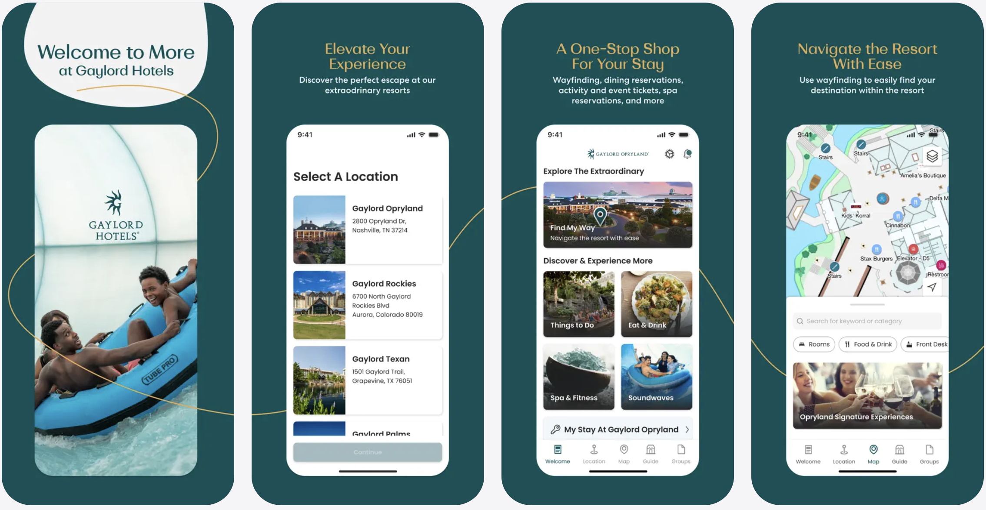
Gaylord Resort App

Slide 10
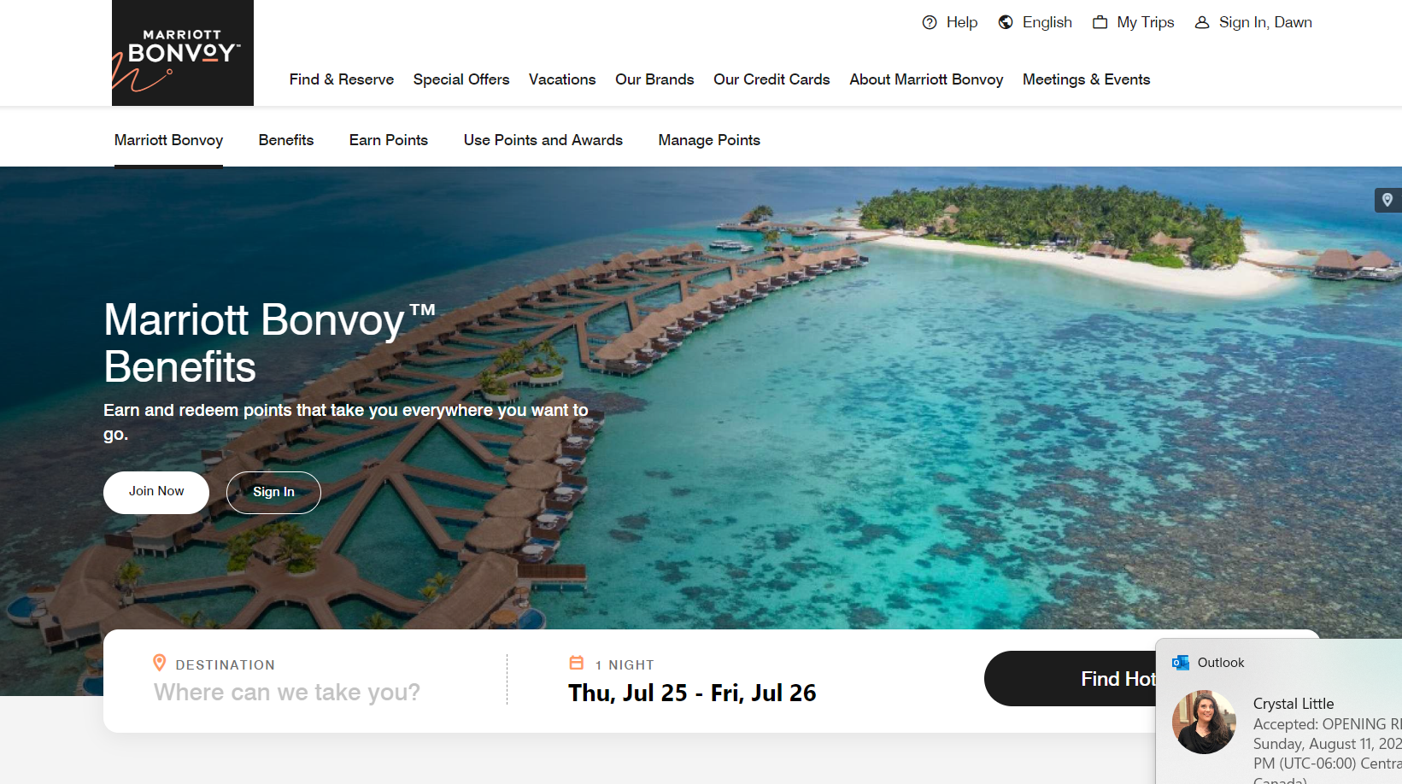
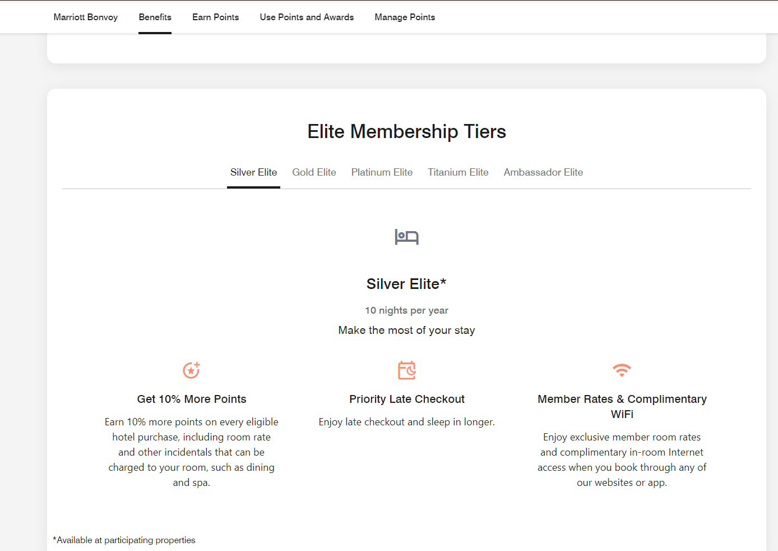
Marriott Bonvoy
Mobile Key check in/ Skip the line!
Quick requests: Towels / Food etc.

Slide 11
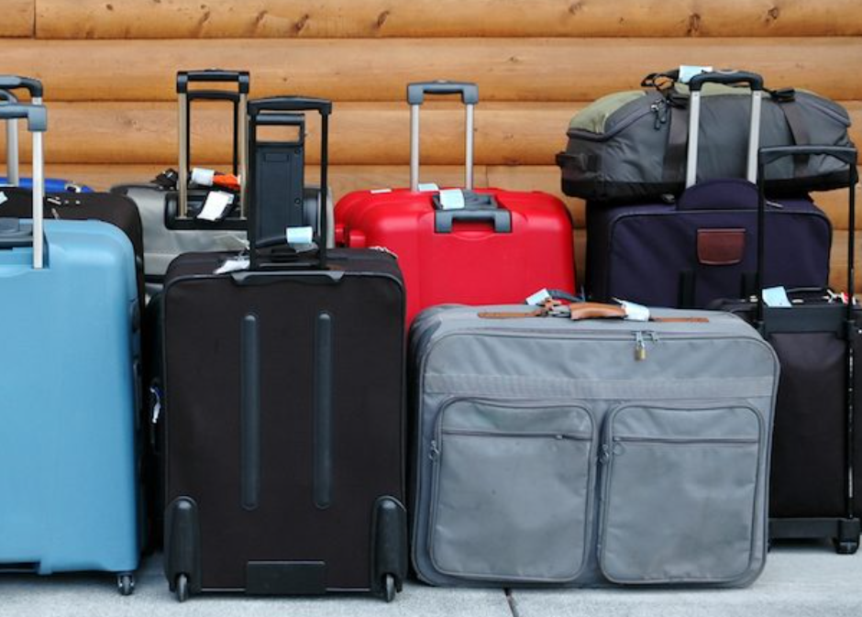
Staffed Luggage Hold
Magnolia Terrace
Thursday for those checking out of all ILTACON Hotels!
6:30 am to 6 pm
FREE! *wear your badge*

Slide 12
First
DO'S & DON’TS
first!
#ILTACON2026
23-27 August 2026
Nashville, TN

Slide 13
Wear comfortable shoes
Dress in layers – meeting rooms get cold!
Bring a reusable water bottle
Download Apps!
  Bizzabo – official conference app
  Marriott Bonvoy
  Gaylord Resorts
Program your friends/teams phone numbers in your phone
Form an emergency plan and save the emergency hotline number- 312-533-4125
Review the conference agenda to plan sessions and networking events you want to attend
DO'S AND.....

Slide 14
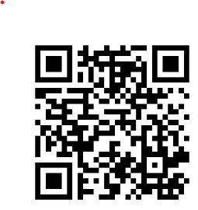
SPREADING THE WORD
BRAND HUB
Social Media templates
I’m Speaking
I’m Attending
I’m Exhibiting
I’ll be there!
#ILTACON2026

Slide 15
DON'T bring in outside food and beverage to the Gaylord
DON'T bring cash. Gaylord is a Cashless property
DON'T share or tamper with your registration event badge
DON'T Forget- not a sprint! ILTACON is a marathon! Pace yourself.
DON'T Forget your ID when attending an event that is serving alcohol
DON'T Forget to wear your badge AT ALL TIMES. You can purchase a new badge at our Member & Volunteer Services desk for $25 if you lose yours.
DON'T

Slide 16
First
ILTACON 2026 EVENTS
first!
#ILTACON2026
23-27 August 2026
Nashville, TN

Slide 17
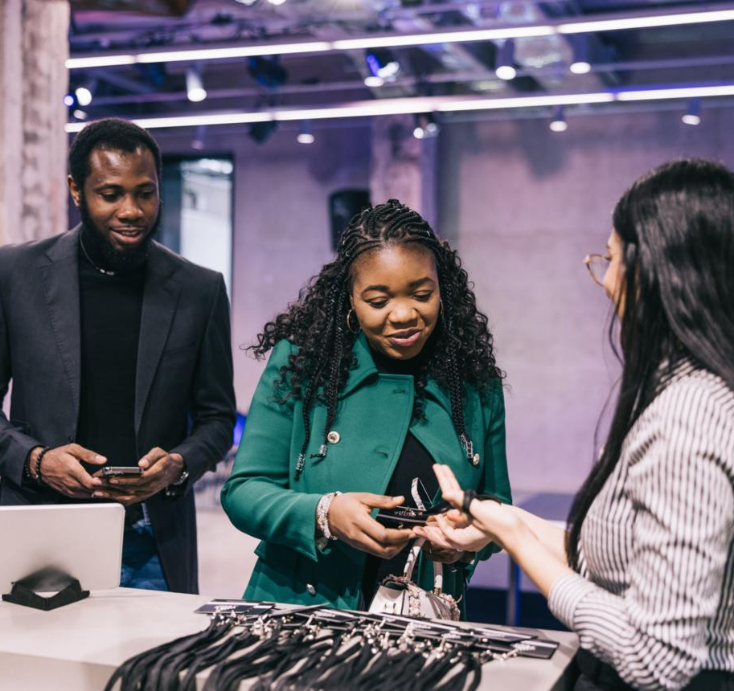
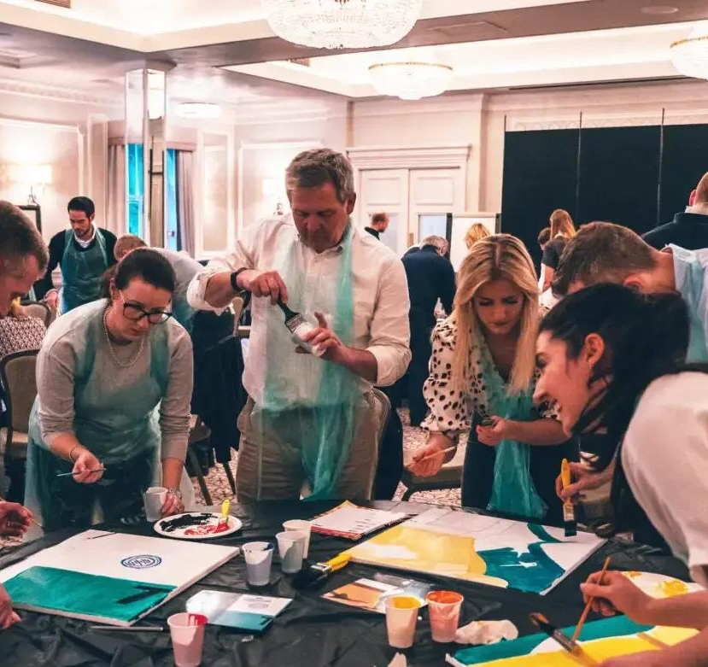
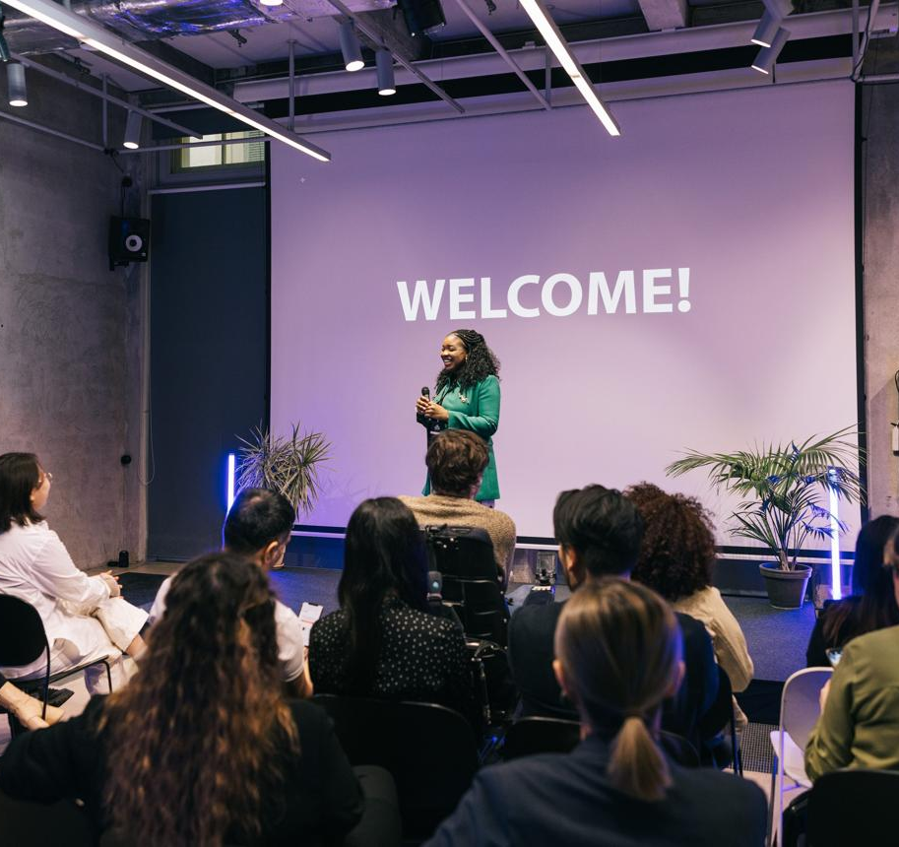
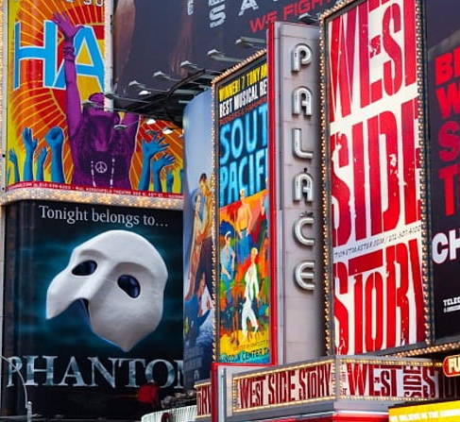
SUNDAY 8/23
Badge Pickup and Registration
Regional Team Building
Attendee Orientation
ILTACON Opening Reception
ILTACON 2026 officially launches with registration and badge pickup at 12pm in the Delta Lobby BCD
Sunday's regional team-building activities give attendees a unique opportunity to build relationships in a fun, interactive setting and kick off ILTACON with meaningful conversations.
New to ILTACON or a returning attendee? Attendee Orientation will help you maximize your experience with helpful tips, conference highlights, networking opportunities, and updates on what's new this year.
Opening Night sets the stage for the week ahead with a high-energy welcome celebration bringing the entire ILTA community together.

Slide 18
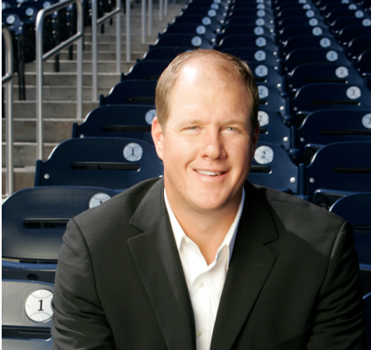
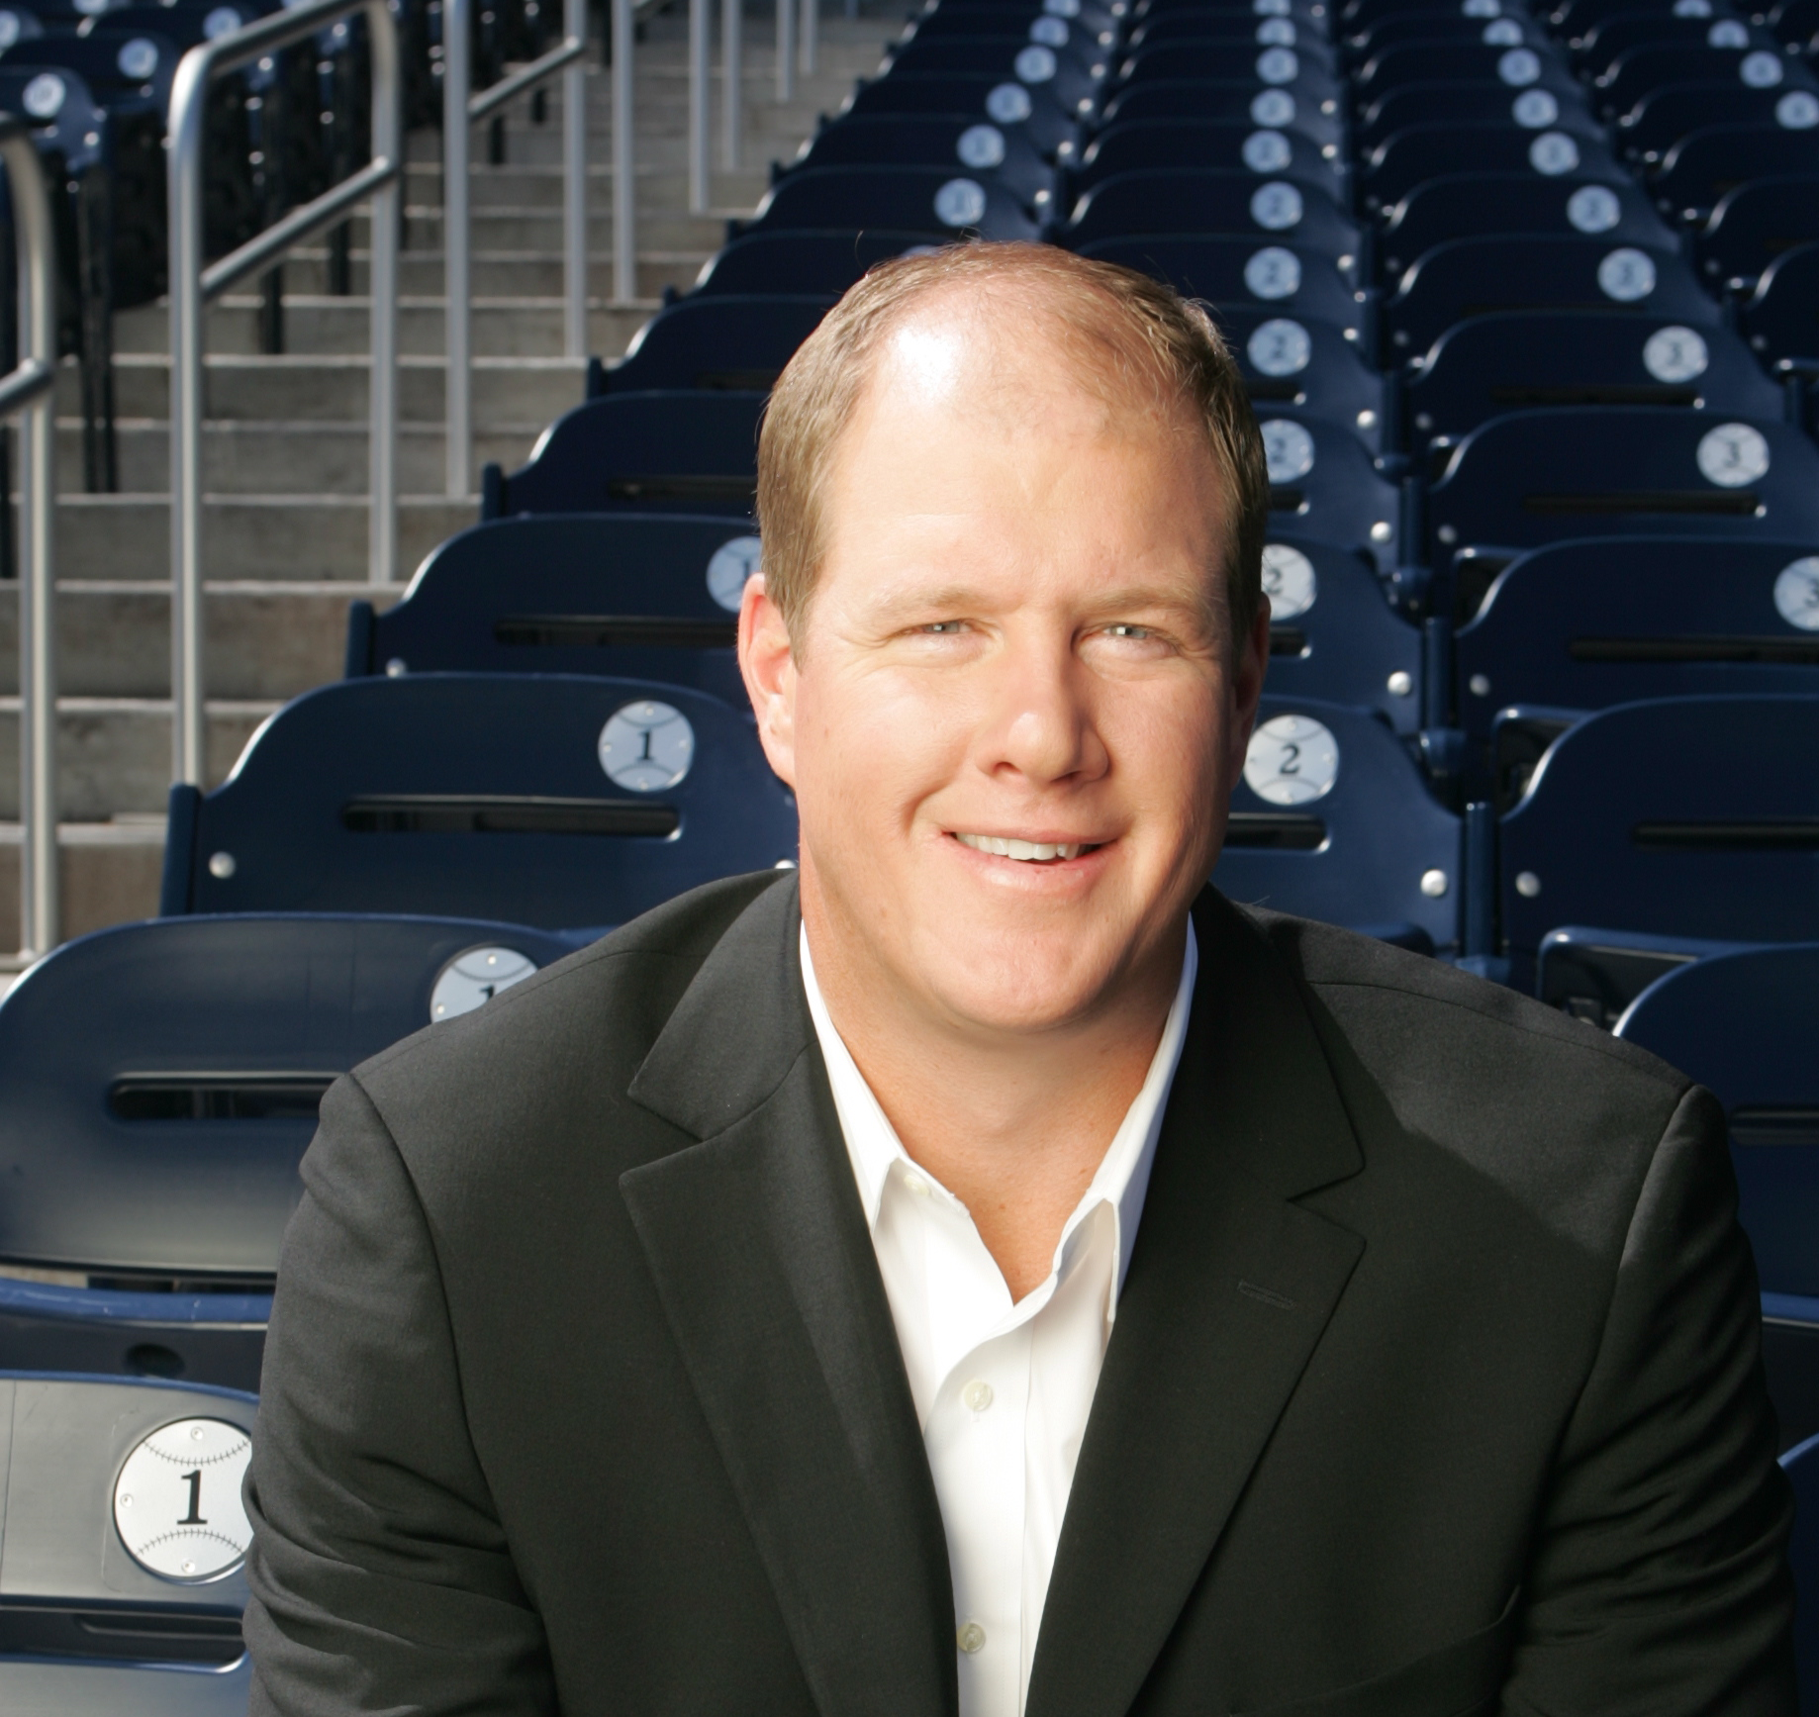

MONDAY 8/24
All Day | Education, Master Classes, Company Updates
9:00 AM | Jim Abbott Keynote
From Flint Michigan to Yankee Stadium, Jim Abbott’s story draws upon an extraordinary and improbable life spent facing down adversity on and off the baseball diamond.
12:00 PM | ILTACON LIVE! And ILTA VOICES Podcasts
Check out our podcast booths in the Delta BCD Lobby
5:30 PM | Community Receptions
Next Gen, International Attendees, Small Firm Attendees, DEIC/Black Affinity, My Mentor
Curtain Up: Showstoppers of Legal Tech
The Expo officially takes the stage.
Be among the first to explore the ILTACON Exhibit Hall and connect with the solution providers shaping the future of legal technology. This opening reception offers the perfect opportunity to discover new tools, engage with partners, and begin meaningful conversations that continue throughout the week.
With hundreds of innovative solutions on display, the Exhibit Hall is where ideas come to life.
.

Slide 19
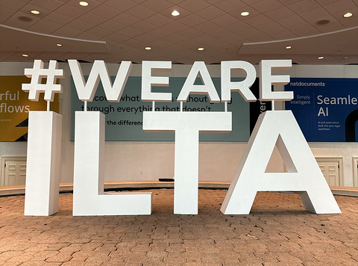
TUESDAY 8/25
All Day | Master Classes, Company updates, Education
7:30 AM | Lessons in Leadership Book Launch and Author Signing
10:45 AM | Startup Hub Pitches
12:00 PM | ILTACON LIVE! And ILTA VOICES Podcasts
Check out our podcast booths in the Delta BCD Lobby AND in the Exhibit Hall
9:00 PM | Next Gen Game Night

Slide 20
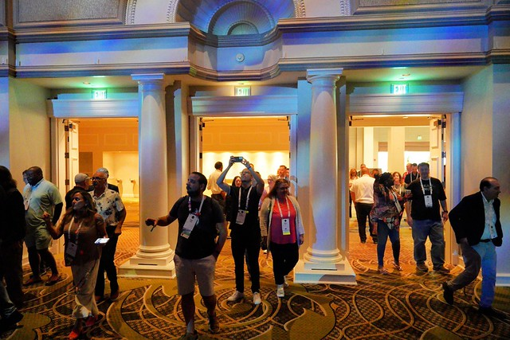
WEDNESDAY 8/25
All Day | Master Classes, Company updates, Education
9:00 AM | 911 Tribute and Kevin Fong Keynote
10:45AM | Startup Hub Pitches
11:00 AM | Tech Survey Session
4:30 PM | Women Who Lead Reception

Slide 21
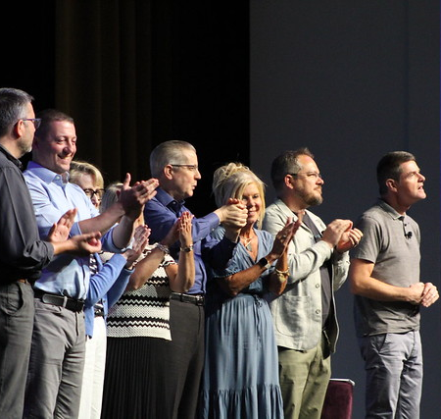
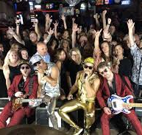
All Day | Master Classes, Company updates, Education
9:00 AM | G100/ G200 Wrap Up Keynote
12:00 PM | Annual Group Meeting
12:15 PM – Business Meeting begins for Members and Business Partner Committee members, only
12:35 PM – Doors open for all non-members, press, and Business Partners
THURSDAY 8/27
Final Curtain: A Night in the Spotlight
Take the stage and celebrate an incredible week.
ILTACON concludes with a high-energy Closing Night celebration featuring live band karaoke on the General Session main stage. Whether you step into the spotlight or cheer on your colleagues, this unforgettable finale brings the community together one last time before the curtain falls.
Join us as we celebrate the connections, ideas, and experiences that make ILTACON the premier legal technology conference.
.

Slide 22
Thursday Annual Group Meeting
NOON - Doors will open for ILTA Members Only and the Business Partner Committee only, food service will begin immediately.
At 12:15 the streaming Closed Business Meeting, will begin, where a portion of the business meeting will take place. This will conclude at 12:35.
At 12:35 the doors will open and business partners as well as press and non-members are welcome to join for continued lunch service and a continued streaming business meeting.
Pre-submitted questions will be answered after the final annual report presentation.
Meal service will continue during this time.
For the respect of the speakers and those interested in hearing what is being said please refrain from speaking during the business meeting.
At 1:15 the business meeting will conclude.
Doors for Delta A will close at 1:30 for a room flip.
ANNUAL GROUP MEETING

Slide 23
VENDOR BINGO:
Engage in conversation / Answer Questions – then get a stamp.
  When your card is full turn it in at the Business Partner Service Desk, for the opportunity to win some great prizes!
THINGS TO CHECK OUT:
Headshot Lounge brought to you by TitanFile
Golf Simulator and closest to the pin with Fulcrum GT
F1 Formula Simulator by Thomson Reuters
Attendee Lounges by Clio and Filevine
Chair Massages provided by Cosmonauts
Rage Room! (Tuesday and Wednesday Only)
ILTA Live! And ILTA Voices Podcasts presented from the show floor
Startup Hub Presentations Tuesday and Wednesday on Exhibit Hall Stage 2
THE EXHIBIT HALL

Slide 24
Monday:
  Breakfast bites: Delta BCD Lobby and Volunteer lobby
  Breaks in Delta BCD Lobby and Volunteer lobby
  Lunch: Ryman Hall B
Tuesday and Wednesday:
  Breakfast bites: Delta BCD Lobby and Volunteer lobby
  Breaks in the exhibit hall and throughout convention space
  Lunch exhibit hall
Thursday:
  Breakfast bites: Delta BCD Lobby and Volunteer lobby
  AM Break in the exhibit hall
  PM Breaks throughout the convention space
  Lunch: Delta A for plated lunch / Annual Group Meeting or
  Boxed lunches for those tearing down exhibit hall
MEALS

Slide 25
Mothers Room
  Delta Mezzanine Office 1
  Will provide electric for pumping and soft seating for your comfort
  *please see ILTA staff member if storage is needed for breastmilk
Prayer Room
  Delta Mezzanine Office 1
  A quiet space to pray away from the noise of ILTACON
Tranquility Room
  Davidson Breakout 5
  Unwind in zero gravity chairs, enjoy low lighting and quietness, or take advantage of our electric calf massagers when feeling tense or needing a break throughout the week. Be sure to check out the agenda for scheduled Sound Baths throughout the week.
SPECIAL OFFERINGS

Slide 26
The Wellness Window by Harvey
  *Delta Lobby BCD | 10:30 – 3:30pm daily
  Monday | Essential Oil Bar
  Create your own personalized essential-oil blend and start the week with a moment of calm.
  Tuesday | Hydration Station
  Recharge with specialty hydration packets designed to help you refresh and keep moving through a full day at ILTACON.
  Wednesday| Oxygen Bar
  Pause, breathe, and enjoy a refreshing midweek reset before heading back into the action.
  Thursday | Protein Packed Shakes
  Finish strong with a delicious protein-packed shake—the perfect boost for the final day.
SPECIAL OFFERINGS

Slide 27
First
NAVIGATING ILTACON
first!
#ILTACON2026
23-27 August 2026
Nashville, TN

Slide 28
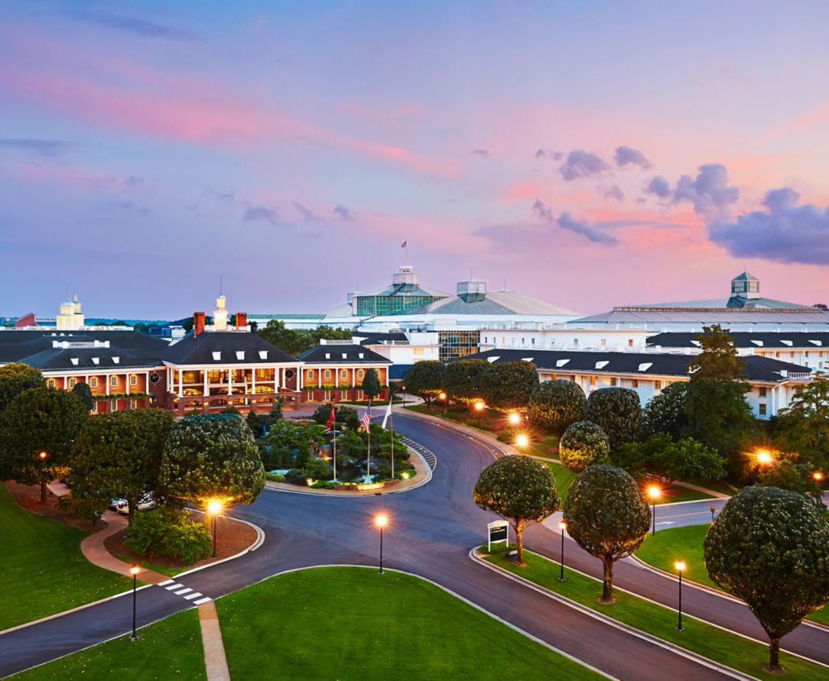
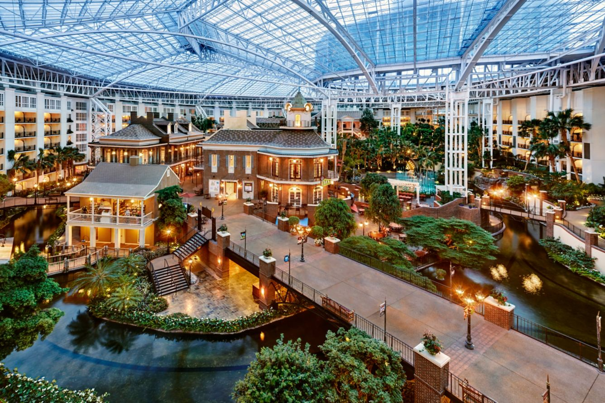
EVENT VENUE
& LAYOUT
Gaylord Opryland Resort & Convention Cetner
2800 Opryland Dr
Nashville, TN 37214
Situated in the heart of Nashville, Gaylord Opryland Resort & Convention Center welcomes guests to a stunning resort experience. From SoundWaves, the city’s premier aquatic attraction, to an exciting lineup of activities, there’s something for the entire family to enjoy. Spend the day at our Opryland hotel golf course. Guests can explore nine acres of airy indoor garden atriums, award-winning restaurants and bars, our world-class Opryland hotel spa, and a state-of-the-art fitness center. From seasonal events and entertainment to high-end amenities and stunning spaces, Gaylord Opryland welcomes you to enjoy more of what you love.
Getting Here-
The closest airport near Gaylord Opryland Resort & Convention Center is the Nashville International Airport (BNA). BNA is located approximately 8.3 Miles from the hotel.

Slide 29
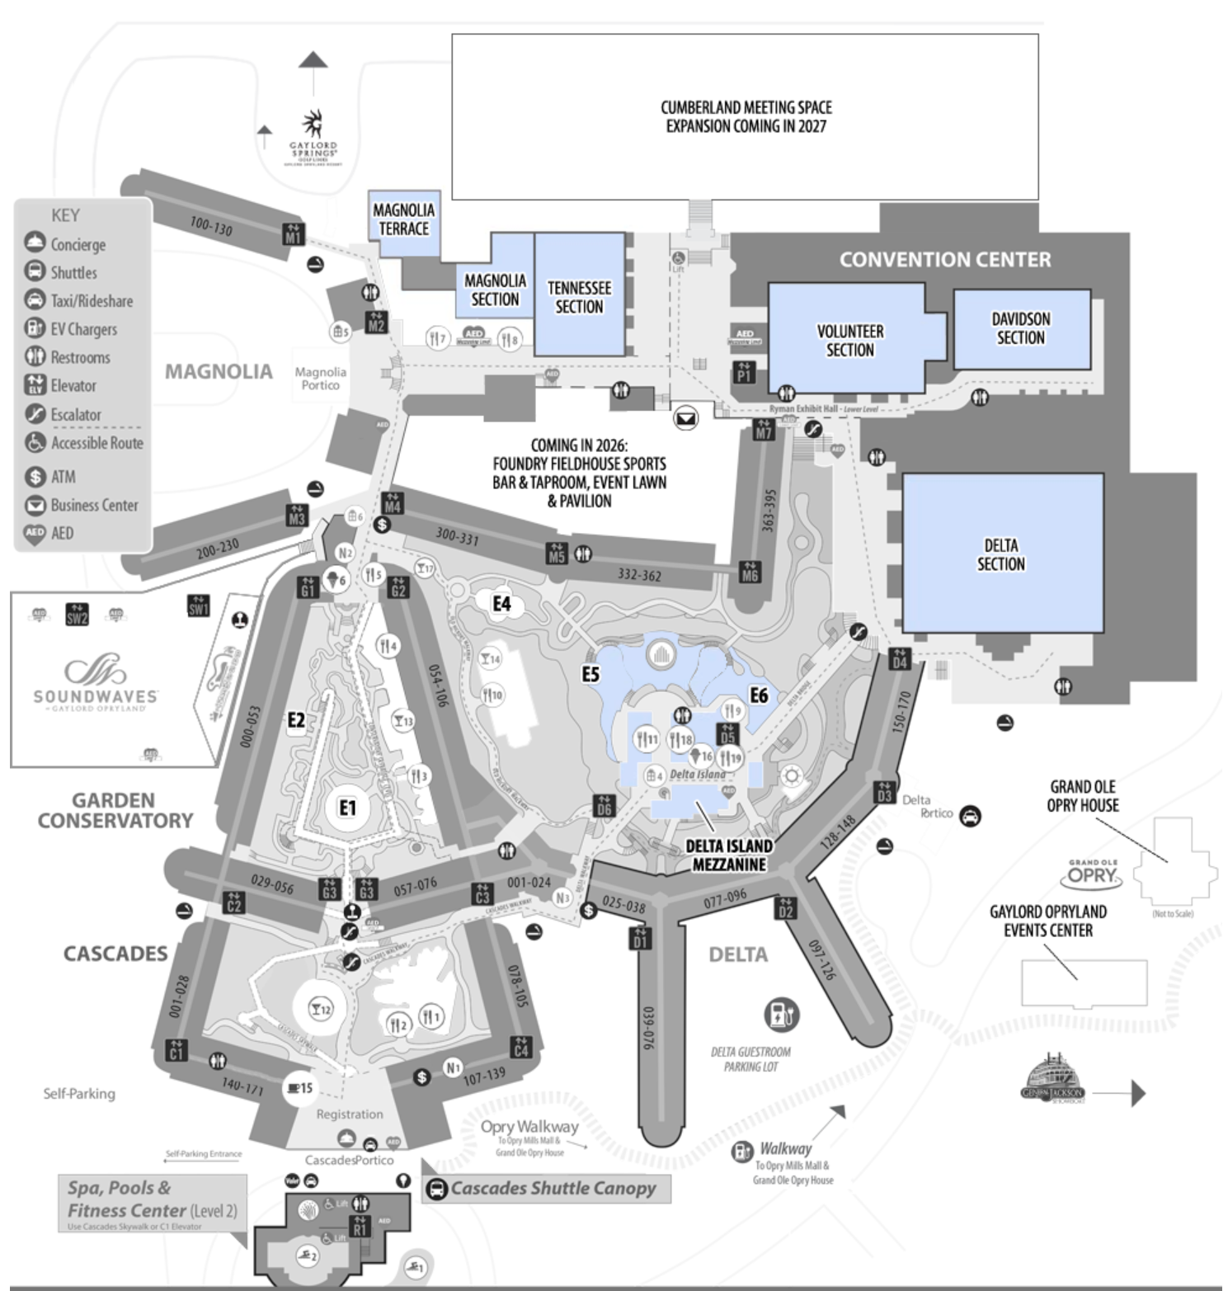
Shuttle Pickup and Dropoff
Conference Registration
Hotel Check In @ Cascades Entrance

Slide 30
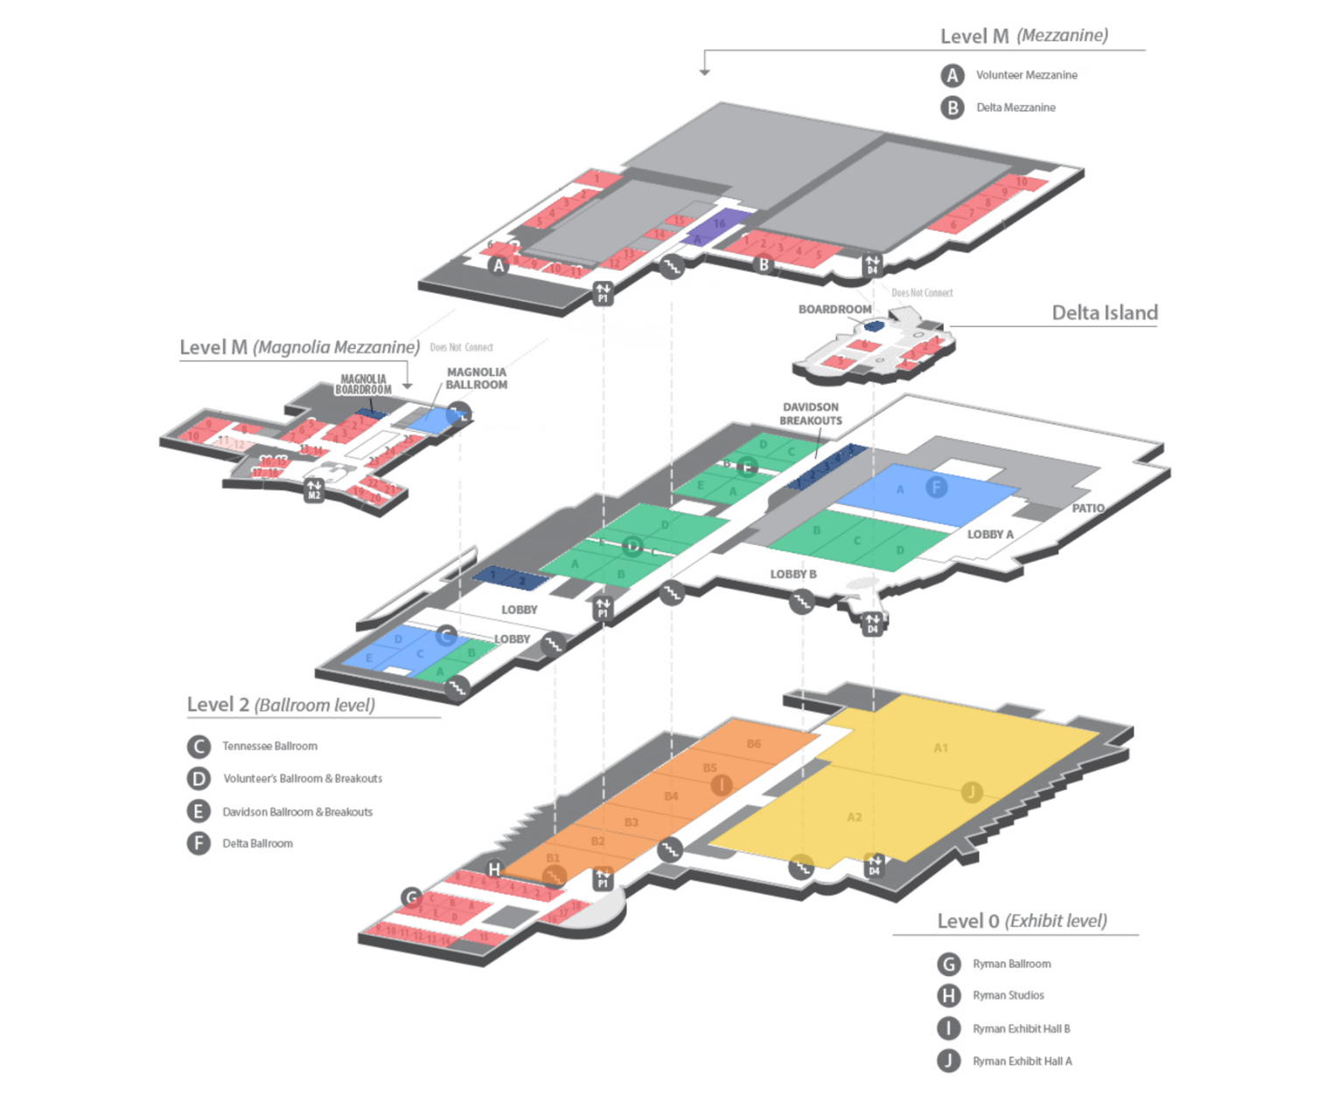
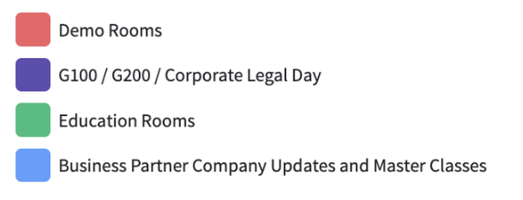
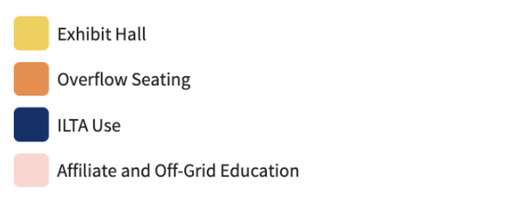

Slide 31
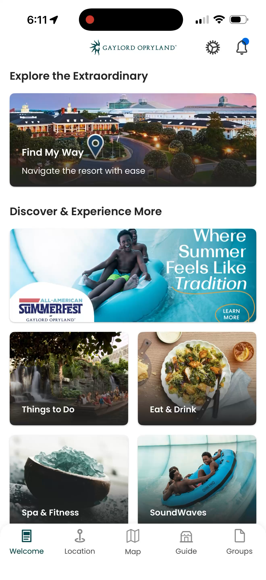
Navigate on the Gaylord Resort App

Slide 32
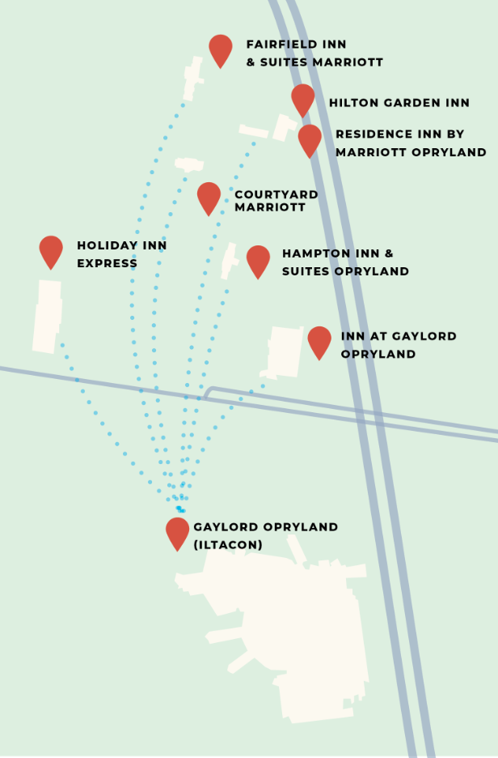
SHUTTLE SERVICES
Shuttles will stop at each hotel every 30 minutes (times may vary based on traffic)
Shuttles will run:
Sunday – 11 am – 10 pm
Monday – 7 am – 10 pm
Tuesday – 7 am – 10 pm
Wednesday – 7 am – 10 pm
Thursday – 7 am – 10 pm
(1) of the buses will be ADA. for assistance with this bus, please call 312-533-4125
Serving All
ILTACON Hotels
Gaylord Opryland
Inn at Opryland
Residence Inn Opryland
Hilton Garden Inn
Holiday Inn Express
Fairfield Inn & Suites
Courtyard by Marriott
*Nashville Airport Marriott
*Hampton In Skyline
Shuttles will drop off and pick up at the Magnolia Canopy at the Gaylord Opryland
Ride Shares will drop at the Cascades Entrance
*not pictured on graphic

Slide 33
First
SAFETY & SECURITY
first!
#ILTACON2026
23-27 August 2026
Nashville, TN

Slide 34
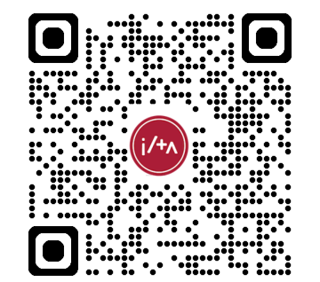
Official Government Picture ID shown at badge pick up/and where alcohol is served
All conference attendees must wear their assigned badge
All persons, to attend the conference, must have signed an ILTA Anti-Harassment Agreement
Any party guilty of violating ILTA’s anti - harassment policy or BADGE SHARING is potentially subject to:
  Employer notification
  Removal from property
  Removal from conference
  Banned from conference
  Employer banned from conference
SAFETY & SECURITY
Incident Report Form
312-533-4125
Emergency 24-hour hotline

Slide 35
For all ILTA events, including those held internationally and in a hybrid environment, suitcasing is defined as when a non-attendee, start-up, consultant, affiliate, or business partner, etc., who is not an ILTA conference sponsor or attendee, conducts commercial activity from a hotel guest room or hospitality suite, an onsite restaurant or club, or any other public place of assembly.
Additionally, suitcasing may occur at venues other than on the exhibition floor and at other events held during ILTA conference dates.
Ultimately, we ask that no ILTA conference attendee accept promotional materials, meeting invitations, or offsite event invitations from individuals who are not sponsoring any ILTA conference, including ILTACON.
Should an individual or group be found suitcasing, ILTA may levy penalties for violations, up to and including, suspension from participation in future events.
Suitcasing takes away from our supportive Business Partners, drives traffic away from educational sessions and the Exhibit Hall floor, and it has a negative effect on our ILTA community.
Should you have concerns about any individual or organization who appears to be suitcasing or are not wearing a badge designating them as an event attendee, please use the following form to submit, or contact us at the following number: 312-533-4125
SUITCASING

Slide 36
First
MOBILE APP
first!
#ILTACON2025
10 – 14 August 2025
National Harbor, MD

Slide 37
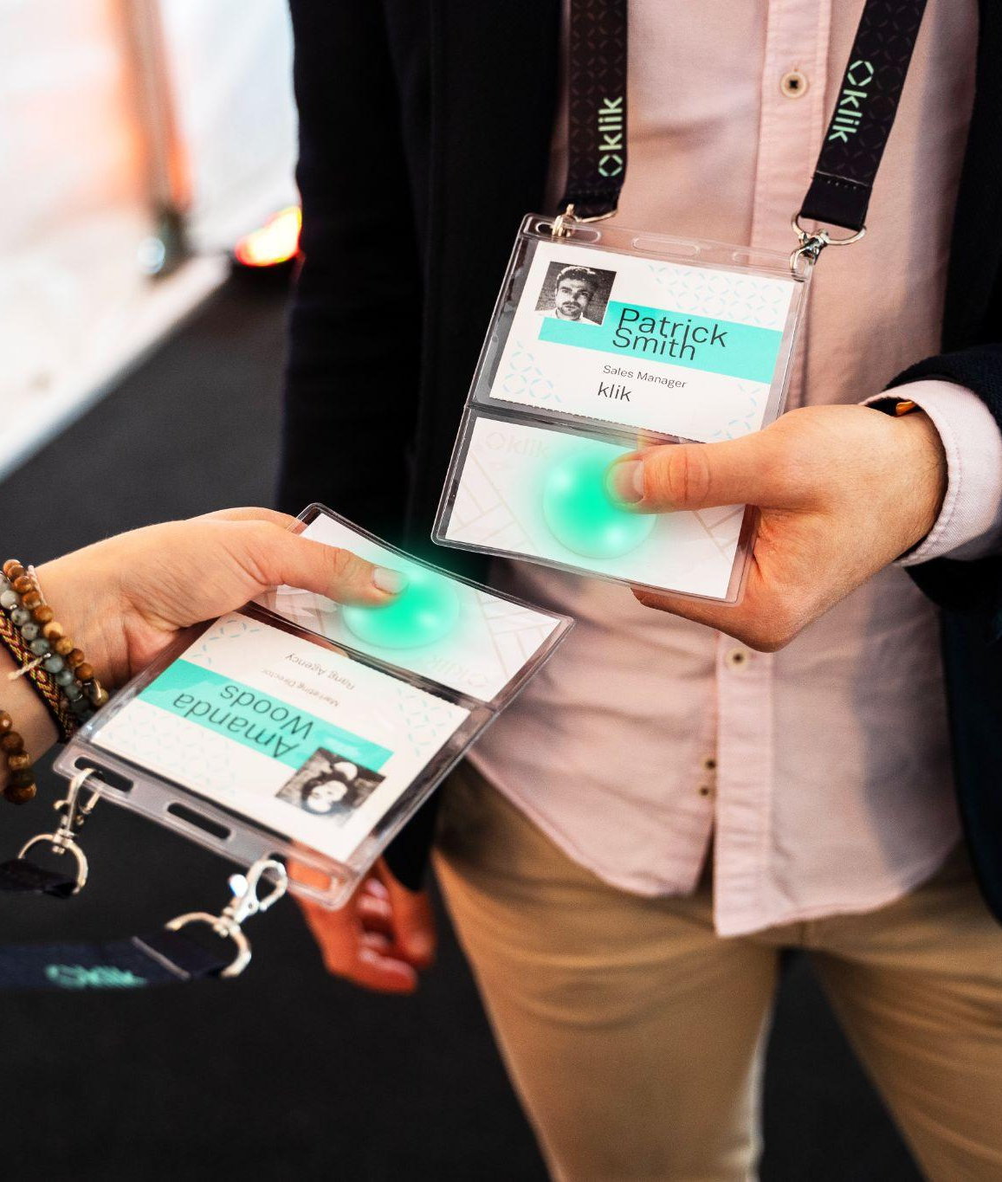

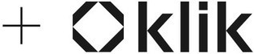
Launching Friday!
One stop shop for conference schedule and contact exchanges during ILTACON
Notes:
The International Legal Technology Association (ILTA) is pleased to announce the implementation of innovative lead retrieval technology to further support the goals of our esteemed Business Partners.
Thanks to their feedback, along with that of the Business Partner Committee, we are thrilled to introduce KLIK as our Lead Generation Platform.
Klik’s innovative technology and user-friendly interface align perfectly with our event’s objectives, enabling us to enhance attendee engagement, capture more qualified leads, and make this year’s event even more successful.

Slide 38
First
SAVE THE DATES!
first!
#ILTACON2026
23-27 August 2026
Nashville, TN

Slide 39
2026
2027
2028
2029
2030
2031
23 – 27 August – Gaylord Opryland, Nashville, Tennessee
8 – 12 August – Gaylord Opryland, Nashville, Tennessee
6 – 10 August – Orlando World Center, Orlando, Florida
12 – 16 August – Gaylord National, National Harbor, Maryland
11 – 15 August – Orlando World Center, Orlando, Florida
10 – 14 August – Gaylord National, National Harbor, Maryland
SAVE THE DATE

Slide 40
ILTACON would not be possible without our volunteers, staff, business partners, and member
THANK YOU!

