Slide 1
How the Pieces Fit
Why do the details matter?
How accounting practices performed today affect end of year reporting.
This includes your annual audit, grant reporting and year-end closing.
Notes:
MS

Slide 2



Introductions
Mitchell Serota: Moderator
- President, Mitchell I. Serota and Associates, Inc.
Tera Wagner: Speaker
- Director of Finance, Consolidated High School District 230
Cynthia Hooten: Speaker
- Payroll Specialist, Franklin Park School District 84
Notes:
MS

Slide 3
Outline
ISBE
Illinois State Board of Education – State & Federal Grant Administration Policy
Illinois School Code - 23 Illinois Administrative Code Part 100
Accounts Payable Cycle
Purchase Order Cycle
Coding Expenditures
Vendor Maintenance
Common Mistakes
Reimbursements
Bidding
Internal Controls
Considerations
Resources
Notes:
TW

Slide 4

ISBE - 23 Admin Code 100
The Illinois School Code provides the basis and legal framework of school district accounting,
“the primary consideration to any public agency is demonstration of prudent stewardship of funds.”
Further considerations and discretion should be maintained at all times when spending District funds.
Notes:
TW
IPAM provides the basis for complete accounting of all district receipts and disbursements, systematic development of program budgeting, and the accumulations and dissemination of program-oriented costs. The Educational Purpose must be clearly Identified on all purchases

Slide 5


Overview of Accounts Payable
In accounting, “Accounts Payable” are obligations resulting from purchasing resources or receiving services on credit or on an open account. You have accounts payable when you have not yet paid for the resources or services you have received.
For the purpose of this presentation, Accounts Payable will refer to the best practices for the documentation, maintaining receipts and procedures of issuing payments for merchandise, services, reimbursements, etc.
Notes:
TW

Slide 6
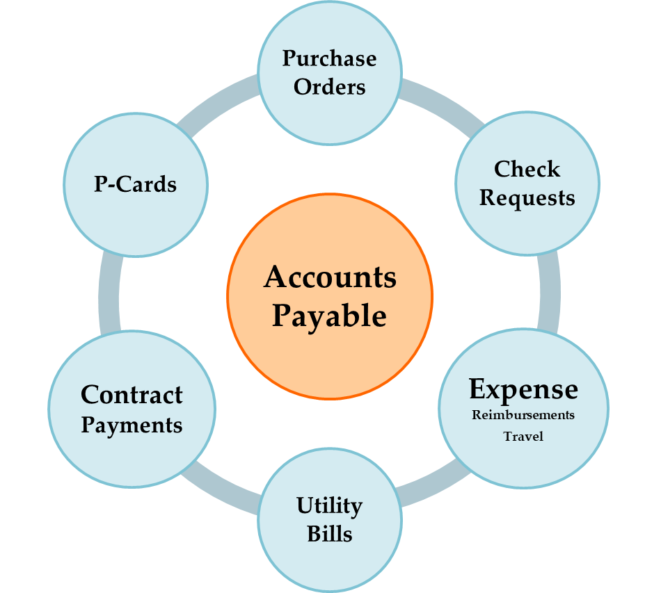
Overview of Accounts Payable
Notes:
TW

Slide 7
Overview of Accounts Payable
Payments processed through Accounts Payable
Purchase Orders
E-Commerce
Utility Bills
Contractual Agreements
P-Cards
Check Requests/Travel
Expense Reimbursement
Petty Cash
Additional Accounts Payable Tasks
Vendor Files / Stale Dated Checks
W-9’s and 1099’s
Record Retention
Bid Process
Internal Controls
Audit considerations
Notes:
TW Ask if attendees have other items handled through AP?

Slide 8
Purchase Orders
Purchase orders create the encumbrance to obligate funds for a purchase
Provides necessary approvals as required at the Federal, State & Local levels regardless of revenue source
Procedures require advance approval of purchases
SHIP TO: Central receiving (if applicable)
BILL TO: Accounts payable
Backdating of PO is not permitted.
Authorization to sign contract/enter into agreements
? Who has authority based on Board policy?
Notes:
TW Business Office ensures the policy

Slide 9
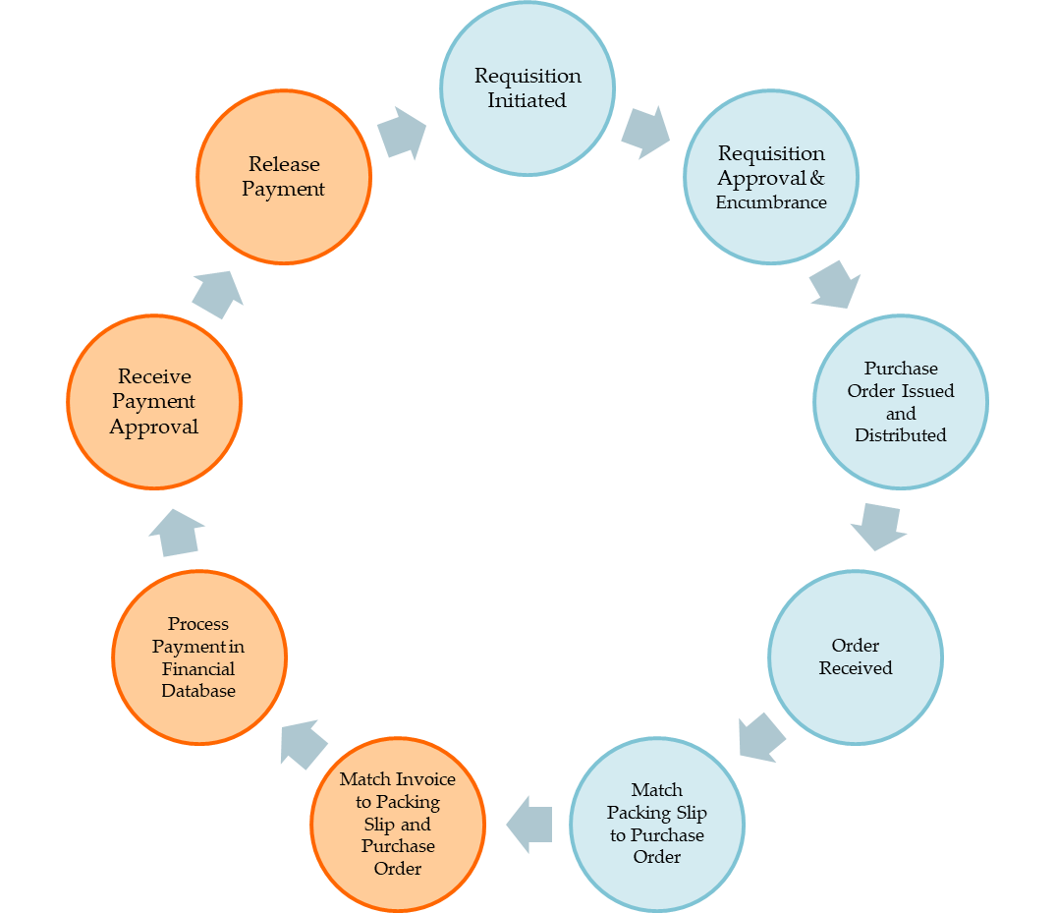
Purchase Order Payment Cycle
Purchase Orders
Notes:
TW

Slide 10
Invoices
Best Practice: valid invoice (not a quote)
All invoices go directly to Accounts Payable
Purchase orders should specify remit address
Statements go directly to Accounts Payable to verify no outstanding invoices
Duplicate Invoice Checking
Establish procedures for recording invoice numbers
No invoice number? Establish standardized procedures
Identify a method that allows AP system to capture duplicate payments
Notes:
TW W-9 can’t change, Ask the question if your district has started ACH payments? Checks stolen or lost in mail? What is your volume per month? What forms for ACH required? Just to confirm the banking info is correct?

Slide 11
How Expenditures Are Coded
23 IL Administrative Code (IAC) for Local Education Agencies (LEAs)
Part 100 is Requirement for Accounting, Budgeting, Financial Reporting and Auditing
Replaces Part 110 Program Accounting Manual (IPAM)
Replaces Part 125 Student Activity Funds and Convenience Accounts
www.isbe.net/23IAC Part 100
Notes:
TW

Slide 12
How Expenditures Are Coded
Expenditures coded on ISBE AFR & budget by:
Fund
Function
Object
Your acct. structure may also include location, program, source of funds
Example: 10E000 4814 0000 00 901000
Fund T Loc Func Obj Source
Notes:
TW

Slide 13
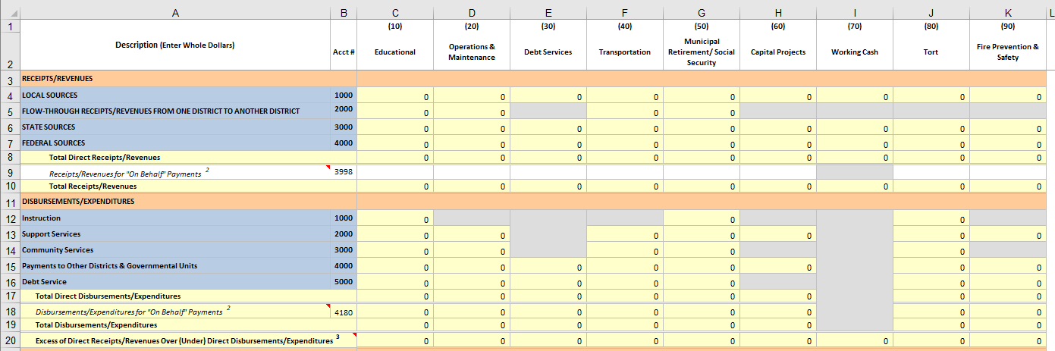
Where the data goes!
WHY CODING IS SO IMPORTANT
Notes:
TW

Slide 14
Purchase Orders & Accounts Payable
Match Invoices to Packing Slip and Purchase Order
Date/Time Stamp Invoice Upon Receipt
Identify discrepancies and resolve
Mark Purchase Order as Partially or Fully Received
Do NOT pay without packing slip or confirmation items received
Process Payments in Financial Database
Run Check Register and other reports
Post to General Ledger
Receive Payment Approval and Release Payment
Vouchers
Check Summary Review and Approval
Print Checks and mail checks or EFT Payments
Notes:
TW

Slide 15
Other Considerations
Local Government Prompt Payment Act
50 ILCS 505/1-9
Approved bills shall be paid within 30 days from approval; not 10 as some vendors require
See if your financial system can lock out certain object codes from certain Business Office functions
Allows Payroll to input only salary codes
Allows Purchasing to input only non-salary codes
Reviewing/changing account codes takes time due to the large volume of accounts utilized by districts
Notes:
TW We follow the IL government prompt payment act for vendors. Board policy may allow utilities to be paid sooner or those vendors with early bird discounts. Be aware of your board policies. Software features can insure that AP only work with AP account codes and PR only work with salary codes.

Slide 16
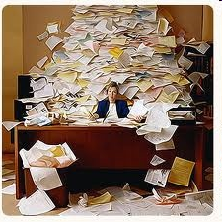
Ready for Some More?

Slide 17
Vendor Management
Establish a procedure for adding and verifying new vendors (do they accept purchase orders?)
Identify if remittance address is different than the order from address
Do they need to complete a W-9?
ACH Form - Getting the Bank Information from the Vendor
Identify Sales contact, A/R contact, etc.
Identify and record special payment terms and/or ordering instructions
Work with Vendors to bill according to BOE approved check processing dates
Notes:
CH When setting up new vendors with ACH, Follow up with phone call. Such a high incidence of fraud. Hover over the email address to see the sender email. You can’t be too vigilant!

Slide 18
W-9’s
Who Completes a W-9?
Independent Service Contractors
Non-employees
Attorneys
Medical & Health Care Professionals
Individual = Social Security Number
Business = FEIN Number
Notes:
CH

Slide 19
1099’s
Who Receives 1099-NEC?
Who Receives 1099-MISC?
Independent Service Contractors
Only those who received
> $600.00 in service
payments during TAX year
Expense reimbursements should NOT be included on the 1099
Attorneys
Medical & Health Care Professionals
Only those who received
> $600.00 in service
payments during TAX year
Expense reimbursements should NOT be included on the 1099
Notes:
CH Just be happy you don’t have to complete Form 1099-Rs…Form 1099-NEC is for reporting non-employee compensation that is usually subject to the self-employment tax. The 1099-MISC is used to report payments not subject to self-employment tax.

Slide 20
Record Retention
All must follow application for disposal process:
Agreements, Contracts, and Leases – 10 years after termination or completion of the terms of the agreement, contract, or lease
Bids – 10 years after acceptance or rejection
Purchase Orders – 2 years
Accounts Payable Invoices and Paid Bill Records – 7 years
Accounts Payable Invoice Listings – 2 years
Accounts Payable Check Registers – 7 years
Accounts Payable Check Summaries – 2 years
1099’s – 7 years
https://www.ilsos.gov/departments/archives/records_management/home.html
Notes:
CH https://www.ilsos.gov/departments/archives/records_management/home.html IL State Records Management Manual

Slide 21
Bidding Process
Requirements
Parameters
Formal Limit $25,000
**check BOE policy**
Applies to
Equipment
Supplies & Materials
Some Services
Contracts
Repairs
Exceptions
Skilled Professional Services (RFP)
Duplicating Machines
Data Processing Equipment, Software or Services
Publish bid notice 10 days before opening
Notify 3 days before opening
Opening must be public
Bids must be sealed
Opened by BOE member or employee
Contents announced
Notes:
CH

Slide 22
Internal Controls
Adopted BOE Policies
How often A/P can be processed
Who has authority to process checks outside of BOE approved dates and for what purposes
Written Business Office Procedures
Checks and balances - verification processes
Expense reimbursements (per diem vs. actual expenses)
Acceptable P-Card purchases, authorized purchase limit
Pay invoices NOT statements
Distinct Lines of Authority (Approval Process)
Budget vs. Purchase order vs. Check Requests
One approver, two approvers, exceptions
Segregation of Duties
Separate purchasing and receiving responsibilities
Separate invoice entry and posting to GL responsibilities
Separate check processing and check mailing responsibilities
Notes:
CH

Slide 23
Other Resources
http://www.iasbo.org
http://www.isbe.net
http://www.gfoa.org (Government Finance Officers Assoc.)
http://www.gasb.org (Governmental Accounting Standards Board)
IASBO, IASB, IASA publications
Legislative updates
Contact your colleagues!
Notes:
TW will wrap up and summarize

Slide 24
Questions and Answers
We thank you for your time!

Slide 25
Presenters:
MODERATOR INFO:
Mitchell Serota, President; Mitchell I Serota and Associates, Inc.
(847) 965-5100; actuary@miserota.com
PRESENTER INFO:
Tera Wagner, Director of Finance; Consolidated High School District 230
(708) 745-5228; twagner@d230.org
Cynthia Hooten, Payroll Specialist; Franklin Park School District 84
(847) 455-4230; chooten@d84.org

