Slide 1
Evidenced-Based Funding
What’s Next?
An update from the
Professional Review Panel

Slide 2




Introductions
Ralph Martire (Speaker)
- Executive Director of the Center for Tax and Budget Accountability, and Arthur Rubloff Professor of Public Policy at Roosevelt University
- Member, Professional Review Panel
Michelle Turner Mangan, Ph.D. (Speaker)
- Professor & Chair, Department of Research, College of Graduate Studies, Concordia University Chicago
- Chair, Professional Review Panel
Susan Harkin, CSBO, SFO (Speaker)
- Chief Operating Officer, Community Unit School District 300, Algonquin, IL
- Vice Chair, Professional Review Panel
Maureen Jones, CSBO (Moderator)
- Assistant Superintendent of Finance & Operations,
CCSD 89, Glen Ellyn, IL

Slide 3
Learning Objectives
Background Professional Review Panel (PRP)
Focus and Structure of the Panel
Committee Work to Date
Looking Forward

Slide 4
Legislation
Public Act 100-0465
Sec. 18-8.15.
A Professional Review Panel (PRP) is created to:
Study and review implementation and effect of the EBF; and
Recommend continual recalibration of, and future study topics and modifications to the EBF.

Slide 5
Breakdown of Districts Spending Above and Below Adequacy Targets, 2018
 | Count | % of All Districts | % of Students who are White | % of Students who are Black | % of Students who are Latino
Districts Spending Above Adequacy Targets | 146 | 17.12% | 67.62% | 4.08% | 14.40%
Districts Spending Below Adequacy Targets | 707 | 82.88% | 46.00% | 19.56% | 27.27%
Source: CTBA analysis of ISBE FY2015, FY2016, and FY2017 Illinois Report Cards; CTBA analysis of FY 18 ISBE Evidence-Based Funding Formula Distribution Full Calculations

Slide 6
FY2018 EBF Funding Distribution
 | New $ | % of New Money
Tier 1 | $326,630,217 | 89.09%
Tier 2 | $36,313,680 | 9.91%
Tier 3 | $3,299,490 | 0.90%
Tier 4 | $366,609 | 0.10%
Total | $366,609,996 | 100.00%
Source: CTBA analysis of ISBE FY18 EBF Quick facts

Slide 7
FY2018 EBF Distribution as Percentage of State Total
As a % of Illinois | % Final Tier Funding | % Supplemental English Learner Grant | % Total New Money from EBF | % Enrollment (ASE) | % Low Income | % EL
Cook | 19.3% | 18.3% | 19.2% | 18.7% | 18.3% | 26.4%
Collar Counties* | 28.4% | 30.4% | 28.6% | 28.5% | 20.1% | 31.6%
Downstate | 34.2% | 9.3% | 32.4% | 34.0% | 31.8% | 10.3%
CPS | 18.1% | 42.0% | 19.9% | 18.8% | 29.8% | 31.7%
Source: CTBA Analysis of ISBE Data, FY 2018 EBF Distribution Quick Facts​, 4/30/2018
As a % of County, Area, District | % Low Income | % EL
Cook | 48.2% | 14.0%
Collar Counties* | 34.7% | 11.0%
Downstate | 46.2% | 3.0%
CPS | 77.9% | 16.7%
Illinois | 49.3% | 9.9%
*Note: Collar Counties consist of DuPage, Kane, Lake, McHenry, and Will Counties.

Slide 8
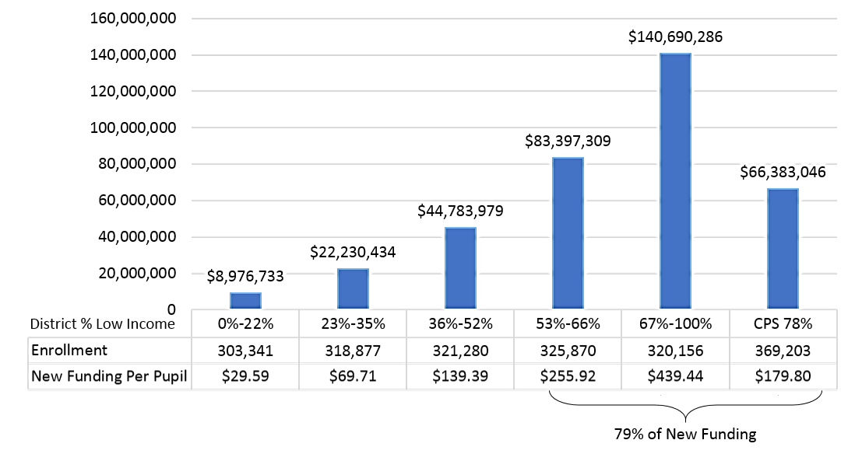
Distribution of $366M in New EBF Funding by Low Income Concentration, FY2018
Source: CTBA analysis of FY2018 EBF Distribution Full Calculation

Slide 9
Average Adequacy Gap per Pupil by Race/Ethnicity, Excluding Districts Spending in Excess of Adequacy Target, 2018
 | Average Enrollment, 2015-2017 | Total Adequacy Gap, Weighted | Adequacy Gap per Pupil
White | 854,854 | $2,829,200,598 | $3,309.57
Black | 348,085 | $1,620,778,837 | $4,656.28
Latino | 489,610 | $2,386,295,960 | $4,873.87
Total | 1,838,110 | $7,369,105,965 | $4,009.07
Source: CTBA analysis of ISBE FY2015, FY2016, and FY2017 Illinois Report Cards; CTBA analysis of ISBE FY18 Evidence-Based Funding Formula Distribution Full Calculations

Slide 10
Panel Members
The Professional Review Panel (PRP) is composed of:
27 members
Voting members are appointed by both the State Superintendent
Non-voting members are appointed by each of the four General Assembly caucus leaders & the Governor
State Superintendent appointments include representatives from school districts and communities reflecting the:
Geographic,
Socio-economic,
Racial, and
Ethnic diversity of this state.
The State Superintendent is also required to ensure that the membership of the panel includes representatives with expertise in bilingual education and special education.

Slide 11
Scope & Reporting Structure
Panel makes recommendations to the Illinois State Board of Education, the General Assembly, and the Governor.
All EBF model elements
Annual Spend Plan
Comparable Wage Index
At-risk student definition
Benefits
Local Capacity Target

Slide 12
Scope & Reporting Structure
Funding for Alternative Schools, Laboratory Schools, safe schools, and alternative learning opportunities programs
Funding for college and career acceleration strategies
Special education investments
Early childhood investments
Evaluative Study
Hold harmless
Recalibration
Gifted, instructional materials, assessment, student activities, maintenance & operations, central office, & technology

Slide 13
Timeline – Annual Basis
The State Superintendent shall recalibrate the following per pupil elements on the Panel’s study of average expenses as reported in the most recent Annual Financial Report.
Gifted
Instructional Materials
Assessment
Student Activities
Maintenance & Operations
Central Office
School Year 2018-2019
School Year 2019-2020
School Year 2020-2021
School Year 2021-2022
School Year 2022-2023

Slide 14
Timeline – Periodic Basis
2020-2021
2021-2022
Alternative, Safe & Laboratory Schools
2022-2023
Comparable Wage Index
Benefits
College and Career Acceleration Strategies
Special Education (Accounting for Disability Type)
Maintenance & Operations (Capital Included)
At-Risk Student Definition
Adequate Funding for Poverty Concentration
Evaluative Study
Technology
Local Capacity
Hold Harmless
Timeline not Specified
Format & Scope of Annual Spending Plan
Early Childhood
By School Year 2020-2021
By School Year 2021-2022
By School Year 2022-2023

Slide 15
Committee Work to Date
Evaluative Study
Equity
Recalibration
Regional Office of Education Funding
Annual Spend Plan

Slide 16
Evaluative Study
Within five years after implementation, the PRP is required to complete a study of the entire Evidence-Based Funding model, including an assessment of whether or not the formula is achieving state goals.
The PRP is required to submit a report including the findings of the study to the State Board of Education, General Assembly, and the Governor’s Office.

Slide 17
Research Questions to Guide the Evaluation
Did growth in student achievement and other student outcome measures occur from the baseline 2017-18 school year through the 2021-22 school year in Illinois public schools?
How faithful was the implementation of the EBF model in Illinois public schools from the 2017-18 to 2021-22 school years?
Did changes in school-level expenditures predict changes in student growth factors?
What systemic and organizational change elements were necessary to close the achievement gap?
10
Notes:
Use a dashboard with Student Outcome Measures (broken down by racial & low-income)
Reduced disciplinary rates,
Reduced truancy rates,
Increased 4- and 5-year graduation rates,
Dropout rates (new)
SAT with all reported subgroups (new)
ISBE Goals (including closing achievement gaps in racial & low-income subgroups:
Growth in 3rd grade reading scores,
Growth in 5th grade math scores,
Growth in 9th grade students on track to graduate, and
Growth in college & career ready high school graduates.

Slide 18
Data Collection
Quantitative
Student achievement data & other student outcome measures (ISBE School report card, AFR, EIS, & other data sets)
EBF school-level elements (FTEs and $$)
Annual Spend Plan
Timeline: Baseline 2017-18 & 4 subsequent years of implementation
Qualitative
Principal interviews & teacher focus groups
Timeline: Year 2021
15
Notes:
Quantitative data sets
ISBE data sets (student achievement & outcome measures)
AFR
EIS
Annual Spend Plan
Adequacy Gap Analysis Tool – proposed revisions
Four columns: (1) Adequacy target from the state for each element; (2) Actual staffing; (3) Difference between 1 & 2; (4) proposed changes based on Difference column and student learning needs
FTEs and dollar amounts would be pre-populated from the state in the first column.
Current actual staffing would be pre-populated from EIS data. Possible partnership with Forecast5 to allow access to their 5Sight tool.
Timeline: baseline 2017-18 school year & then 4 school years of implementation to compare spending in EBF elements and student achievement and other student outcome measures.
Who will collect this data?
This may be facilitated through IASBO/Forecast 5 to lessen workload for ISBE for first 5-year study and then if General Assembly extends this to additional studies, plan for a more sustainable model.
Qualitative case studies
Conduct interviews with principals and focus groups with teachers to address systemic change.
Think about including 5 Essentials survey data – safety, feelings of inclusion, etc. as part of the story in how we are going to close the racial achievement gap.
Timeline: interviews and focus groups would take place in year 2021.
Who will collect this data? Will take a minimum of 40 hours of data collection, plus time for travel and scheduling. Number of case studies will be determined based on population of Tier 1 districts that improved student achievement and other outcomes. Then can multiply each by half a day to determine total number of data collection hours. Travel and time writing up case studies would also be figured into the cost. Total budget is estimated to be up to $25,000. Would need General Assembly’s approval and allocation of funds. Then could put out an RFP.

Slide 19
Recalibration
Overview of Subcommittee Charge: Develop a shared understanding of the purpose for potentially recalibrating per pupil elements in the EBF
6 Recalibration Areas for Year One:
Gifted
Instructional materials
Assessments
Student activities
Maintenance and Operations
Central Office
Challenges:
AFR Data
Underfunded System
Hard to do Evidence-Based

Slide 20
Gifted Expenditures - AFR
 | Set by Statute | FY2017 AFR | FY2018 AFR
State Average | $40 | $28 | $34
Elementary District Average | -- | -- | $63
High School District Average | -- | -- | $4
90-110% Adequacy District Avg | -- | $57 | $89
Source: CTBA analysis of EBF statute, ISBE FY2017 and FY2018 AFR data
From AFR: Function 1650 “Gifted Programs”, all funds all objects

Slide 21
Instructional Materials - AFR
 | Set by Statute | FY2017 AFR | FY2018 AFR
State Average | $190 | $199 | $207
Elementary District Average | -- | -- | $239
High School District Average | -- | -- | $214
90-110% Adequacy District Avg | -- | $214 | $232
Source: CTBA analysis of EBF statute, ISBE FY2017 and FY2018 AFR data
From AFR: Ed Fund, all 1000 Functions excluding Student Activities Function 1500, 400 Objects “Supplies and Materials”
Note: CTBA FY18 AFR state average per pupil is lower than reported in ISBE’s analysis by $4 due to difference in enrollment numbers

Slide 22
Assessments - AFR
 | Set by Statute | FY2017 AFR | FY2018 AFR
State Average | $25 | $23 | $24
Elementary District Average | -- | -- | $23
High School District Average | -- | -- | $32
90-110% Adequacy District Avg | -- | $22 | $24
Source: CTBA analysis of EBF statute, ISBE FY2017 and FY2018 AFR data
From AFR: 2230 Function “Assessment and Testing”, all objects, all Funds

Slide 23
Student Activities - AFR
 | Set by Statute | FY2017 AFR | FY2018 State AFR Avg–CTBA analysis | FY2018 State AFR Avg–ISBE analysis | FY2018 AFR Avg of 90-110% Dists–CTBA analysis
Elementary Average | $100 | $101 | $90 | $104 | $84
Middle School Average | $200 | $202 | $204* | $208 | $238*
High School Average | $675 | $696 | $706 | $717 | $819
Source: CTBA analysis of EBF statute, ISBE FY2017 and FY2018 AFR data, ISBE Estimated FY2018 Cost Factors
From AFR: 1500 Function “Interscholastic Programs”, all objects, all Funds
Notes:
CTBA and ISBE high school average numbers differ slightly due to differences in enrollment numbers used
ISBE sets middle school cost at 29% of high school average, and elementary costs at 50% of middle school costs. CTBA analysis uses HS-only and Elem-only district averages to approximate HS and Elem expenditures. Asterisked values are approximated using ISBE methodology (29% of high school expenditures)

Slide 24
Maintenance and Operations
 | Set by Statute (FY2018) | FY2017 AFRs, All Dists | FY2018 AFRs, All Districts (CTBA) | FY2018 AFRs, All Districts (ISBE) | FY2018 AFRs, 90-110% Dists
Maintenance and Operations – Total Costs minus Benefits | $1,038 | $941 | $989 | $1,001 | $1,033
Maintenance and Operations – Salary costs | $353 | $366 | $357 | $364 | $387
Benefits as Percentage of Salaries | 30% | 36.6% | 20.2% | 20.2% | 19%
Source: CTBA analysis of EBF statute, ISBE FY2017 and FY2018 AFR data, ISBE Estimated FY2018 Cost Factors
From AFR: 2540 “Operation & Maintenance of Plant Services” Function, all objects except 500 Capital Outlay, all Funds
Notes:
ISBE also omits objects 700 Non-Capitalize Equipment and 800 Termination benefits from its FY18 AFR analysis, resulting in $11M less in total OM expend than CTBA’s analysis
EBF estimates benefits are 30% of salaries expenditures; might be able to adjust down based on data above

Slide 25
Central Office
 | Statute | FY2017 AFR, All Districts | FY2018 AFR, 90-110% Adequacy Districts | FY2018 AFR, All Districts (CTBA) | FY2018 AFR, All Districts (ISBE)
Per Pupil Cost, Total Minus Benefits | $742 | $782.34 | $819 | $767 | $781
Salaries | $368.48 | $400.78 | $434 | $409 | $417
Total Minus Salaries | $373.52 | $381.56 | $386 | $385 | $364
Benefits as Percentage of Salaries | 30.0% | 34.8% | 53% | 51.2% | N/A
Source: CTBA analysis of EBF statute, ISBE FY2017 and FY2018 AFR data, ISBE Estimated FY2018 Cost Factors
From AFR: Functions 2300, 2500, 2600, excluding 2372 (Transportation), 2530 (Facility acquisition), 2540 (Op & Maint), 2550 (Transportation) , and 2560 (food services)
Notes:
EBF estimates benefits are 30% of salaries expenditures; might be able to adjust upward based on data above

Slide 26
Equity
Overview of Committee Charge:
Develop a shared understanding of the issue and purpose for studying racial equity as it relates to evidence-based funding (EBF).
Determine what information is needed to address racial equity in the elements and distribution of EBF.
Determine if an expert is needed to provide information on racial equity in EBF.
Develop options and formal recommendations for racial equity in EBF.
Present a recommendation to the PRP regarding the elements and distribution of EBF that will facilitate closing the achievement gaps among racial groups of K-12 public school students in Illinois.

Slide 27
Average Adequacy Gap per Pupil by Race/Ethnicity, Excluding Districts Spending in Excess of Adequacy Target, 2018
 | Average Enrollment, 2015-2017 | Total Adequacy Gap, Weighted | Adequacy Gap per Pupil
White | 854,854 | $2,829,200,598 | $3,309.57
Black | 348,085 | $1,620,778,837 | $4,656.28
Latino | 489,610 | $2,386,295,960 | $4,873.87
Total | 1,838,110 | $7,369,105,965 | $4,009.07
Source: CTBA analysis of ISBE FY2015, FY2016, and FY2017 Illinois Report Cards; CTBA analysis of ISBE FY18 Evidence-Based Funding Formula Distribution Full Calculations

Slide 28
District Funding Per-Pupil by Source Old Formula

Slide 29
EAV Per-Pupil by Racial Supermajority

Slide 30
Percentage of Students Meeting or Exceeding PARCC by District/Racial Ethnic Majority

Slide 31
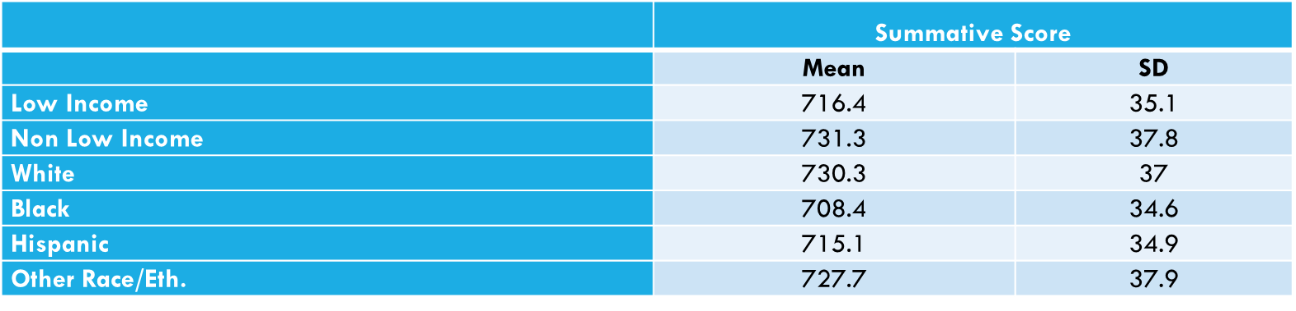
Controlling for Low-Income Status, Race Was Still a Predictor of PARCC Scores
Was race a predictor of PARCC summative scale scores in the 2016 & 2017 school years, controlling for low-income status?
Descriptive Statistics for PARCC by race and low-income status
Y’_{PARCC} = 755.50 – 18.23(Hispanic) – 27.53(Black) – 9.32(White) – 19.44(Low-Income)
Race was a statistically significant predictor of PARCC summative scale scores (F(4) = 346890, p<.0001), with an R² of .0561.

Slide 32
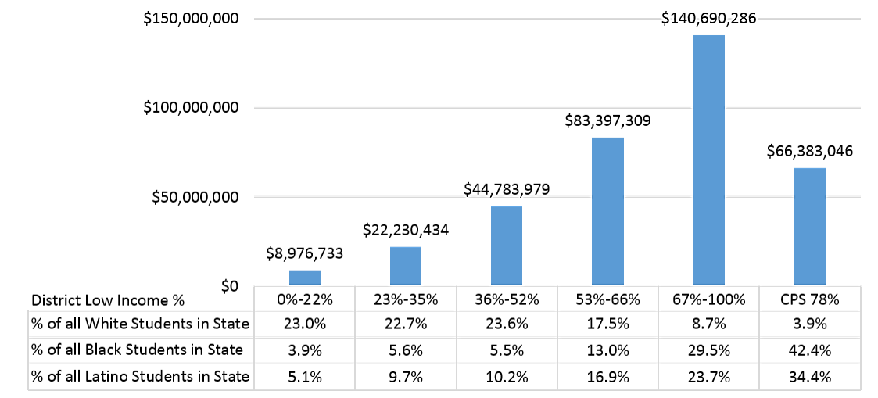
Distribution of $366M in New FY2018 EBF Funding, by Low Income Concentration and Race/Ethnicity
Sources: CTBA analysis of ISBE Evidence-Based Funding Formula Distribution Full Calculations; Enrollment by race from ISBE FY2017 Report Card data

Slide 33
Present Recommendations for Equity in the EBF to the PRP
Before PRP committee recommendations are brought to the full panel, the Equity Committee will view them through an equity lens to avoid possible adverse effects.
Identify elements that close racial achievement gaps and provide systemic support for implementation of EBF to stakeholders.
Professional Development (PD) is an important element to aid implicitly biased views and culturally relevant pedagogy. Embedded PD is the most effective. Utilize approved providers vetted by ISBE.
Evaluate Study: Disaggregate student achievement and other student outcome measures by race.
Use the Odden-Picus Adequacy Index and Horizontal weighted equity measure to assess adequacy and equity statewide.
Annual Spend Plan: Include racial achievement gap as part of goals for achieving student growth and state education goals.

Slide 34
ROE Funding Issue and Purpose for Studying
On any given day, the education for 7,127 students is funded differently from the other 2 million students in Illinois.
These students receive educational services from ROE/ISCs. These students may:
have multiple suspensions,
be expulsion eligible,
be in danger of dropping out, or
have significant attendance issues caused by a variety of problems.
Currently, the EBF model does not address the needs of these students as compared to the other students in Illinois Public Schools.
Notes:
Julie/Gregg

Slide 35
Summary of Issues Related ROE Funding
EBF funding for ROE/ISCs was and will be held flat because:
There is no local effort target for ROE/ISCs.
There is no low income count for ROE/ISCs.
The model does not account for dynamic program enrollment.
Because ROE/ISC FY18 funding was held flat, there was a supplemental appropriation in FY18 to fund FY17 programs that experienced increased enrollment.
Notes:
Julie/Gregg

Slide 36
Recommendation
The PRP approved the recommendation of the ROE Funding proposal as presented with the understanding that appropriation amounts for FY 2020 are sufficient so as to not impact or diminish the amount of tier funding available to a Illinois organizational units. This recommendation will sunset on June 30, 2020.
Modify the EBF state statute to allow Regional Safe School and Truant Alternative Optional Education Programs to receive Tier Funding effective with the FY 2020 budget cycle to include:
Setting a local effort to 10% ⇒ Mirrors Lab Schools
Establishing a Low Income Count of 50% ⇒ State average
Using a March Enrollment Count ⇒ Addresses the fact that programs grow throughout the year. ROE/ISC will receive the funding for these students/not the home school enrollment account with a phase of FY20 – Current year enrollment only, FY21 – Current year or two year average enrollment (highest of), and FY22 and ongoing – Current year or three year average enrollment (highest of)
Eliminate the Hold Harmless Base Funding Minimum for Regional Safe School, Truant Alternative Optional Education and Alternative Learning Opportunity Programs once they no longer continue
Continue studying the following items:
Alternative Learning Opportunity Program funding,
EBF elements in relation to RSSP, TAOEP, and ALOP, and
Truancy alternatives for students no longer in the public education system.

Slide 37
Annual Spend Plan (ASP) State Requirements
Timing: By the end of September, as part of the annual budget process
Requirements: Districts will create an annual district level spending plan that describes how they:
Will utilize its Evidence-Based funding with specific identification of the intended utilization of Low-Income, English learner, and special education resources,
Expect to achieve student growth, and
Will achieve State education goals.

Slide 38
Committee Guidelines for ASP
The Committee established the following guidelines for the development of the proposed ASP:
The ASP must comply with State legislation.
The committee should look for opportunities to utilize existing state reports to populate Annual Spend Plan, e.g., EIS reporting, Annual Budget, Adequacy Target Gap Calculator, etc.
The ASP data should be prospective.
The ASP should be a tool to facilitate local discussions tying school improvement goals to academic needs and resource allocation.

Slide 39
EBF FTE and Dollar Allocation Comparison
Using the ISBE Adequacy Target Gap Calculator, districts would be required to:
Enter projected FTE and dollar allocations aligned to the EBF elements and provide explanations for changes and
Provide explanations for funding out side of the EBF elements.

Slide 40
ASP Sample Subset
Position / Investment | FY 19 Adequacy Target | FY 19 Actual Staffing | FY 20 Budgeted Staffing | FY 19 Actual - FY 20 Budgeted | Explanation
Core Investments
Core Teachers | 970.70 | 900.00 | 905.00 | 5.00 | To maintain current class size
Specialist Teacher | 231.88 | 200.00 | 200.00 | - | No Change
Instructional Facilitator | 102.79 | 33.00 | 42.60 | 9.60 | To add coaches at Elementary Schools
Core Intervention Teacher | 42.08 | 20.00 | 20.00 | - | No Change

Slide 41
ASP Next Steps
Refine components of the ASP
Work with ISBE to develop the template to be utilized in the FY 2020 budget cycle
Finalize ASP at the June 2019 PRP Meeting
Rollout out to school districts for submission with their FY 2020 budget

Slide 42
Looking Ahead

Slide 43
EBF Shortfall in Millions of Inflation-Adjusted Dollars after $350M/Year New Money until Fully Funded
 | FY2019 | FY2020 | FY2030 | FY2040 | FY2051
Total Funding Needed to Fund EBF Fully (infl adj) | $7,350 | $7,504 | $9,284 | $10,522 | $11,055
Total New Money Put into EBF since FY2020 | -- | $350 | $3,850 | $7,350 | $11,200
Shortfall/Surplus (infl adj) | -$7,350 | -$7,154 | -$5,434 | -$3,172 | $144

Slide 44
EBF Shortfall in Millions of Inflation-Adjusted Dollars, Fully Funding EBF in 10 Years
 | FY2019 | FY2020 | FY2025 | FY2030
Total Funding Needed to Fund EBF Fully (infl adj) | $7,350 | $7,504 | $4,371 | $779
Total New Money Put into EBF since FY2020 |  | $779 | $4,676 | $8,572
Shortfall/Surplus (infl adj) |  | -$6,725 | -$3,592 | $0
Source: CTBA analysis of ISBE FY2019 EBF Calculation using Bureau of Labor Statistics ECI historical data.

Slide 45
Illinois Structural Deficit, Including Full Funding of EBF
Source: CTBA analysis of COGFA figures. Assumes expenditures keep pace with inflation and funding of the Evidence Based Formula as required under P.A. 100-0465, a total increase of $7.4 billion (on a fully inflation-adjusted basis in FY2018 dollars) by FY2029 (which totals $9.17 billion in FY2029); assumes revenues grow at historic rates, and assumes no change in law.

Slide 46
Questions and Answers
We thank you for your time!

Slide 47
Presenters:
MODERATOR INFO:
Maureen Jones, Assistant Superintendent of Finance and Operations
Community Consolidated School District 89
(630) 469-8900; mjones@ccsd89.org
PANELISTS INFO:
Ralph M. Martire, Executive Director, Center for Tax and Budget Accountability and Arthur Rubloff Endowed Professor of Public Policy at Roosevelt University
Center for Tax and Budget Accountability Roosevelt University, College of Arts & Science
(312) 332-1049 (312) 341-3766
rmartire@ctbaonline.org rmartire@roosevelt.edu
Michelle Turner Mangan, Ph.D., Professor & Chair, Department of Research
College of Graduate Studies, Concordia University Chicago
(708) 209-3493
michelle.mangan@cuchicago.edu
Susan Harkin, Chief Operating Officer/CSBO
Community Unit School District 300
(847) 551-8319; susan.harkin@d300.org

