Slide 1
Illinois School Funding Model

Slide 2
Funding Sources

Slide 3
D300 Revenue - FY 2018-19
Operating Funds
All Funds

Slide 4
All Illinois Schools Revenue FY 2016-17

Slide 5
Illinois School Funding History

Slide 6
Illinois School Funding History
Adopted a new formula for FY 2017-18
Previous formula was created in December 1997 and implemented for FY 1998-1999

Slide 7
1997 General State Aid (GSA) Formula
Overview
Issues
Foundation Formula
Guaranteed funding level
Foundation Level
$6,119 per student
Basic Formula
(Foundation Level – Local Resources)
X
Average Daily Attendance
Foundation Level Stagnated
$6,119 FY 2010 – FY 2017
Proration of Foundation Level
FY 2010 – FY 2016 (87%-98%)
Property taxes
Every year a district can increase their property taxes by CPI
Per Pupil Spending
Range of $6,167 to $34,306

Slide 8
Illinois Evidenced Based Funding for Student Success Act

Slide 9
2017 Evidenced Based Funding (EBF)
Overview
Components
Recognized Individual Student Needs
Account for Differences in Local Resources
Close Funding Gaps
Provide Stable Sustainable System
No Schools Lose State Funding
Adequacy Target
Local Capacity
Percent of Adequacy
Distribution Method

Slide 10
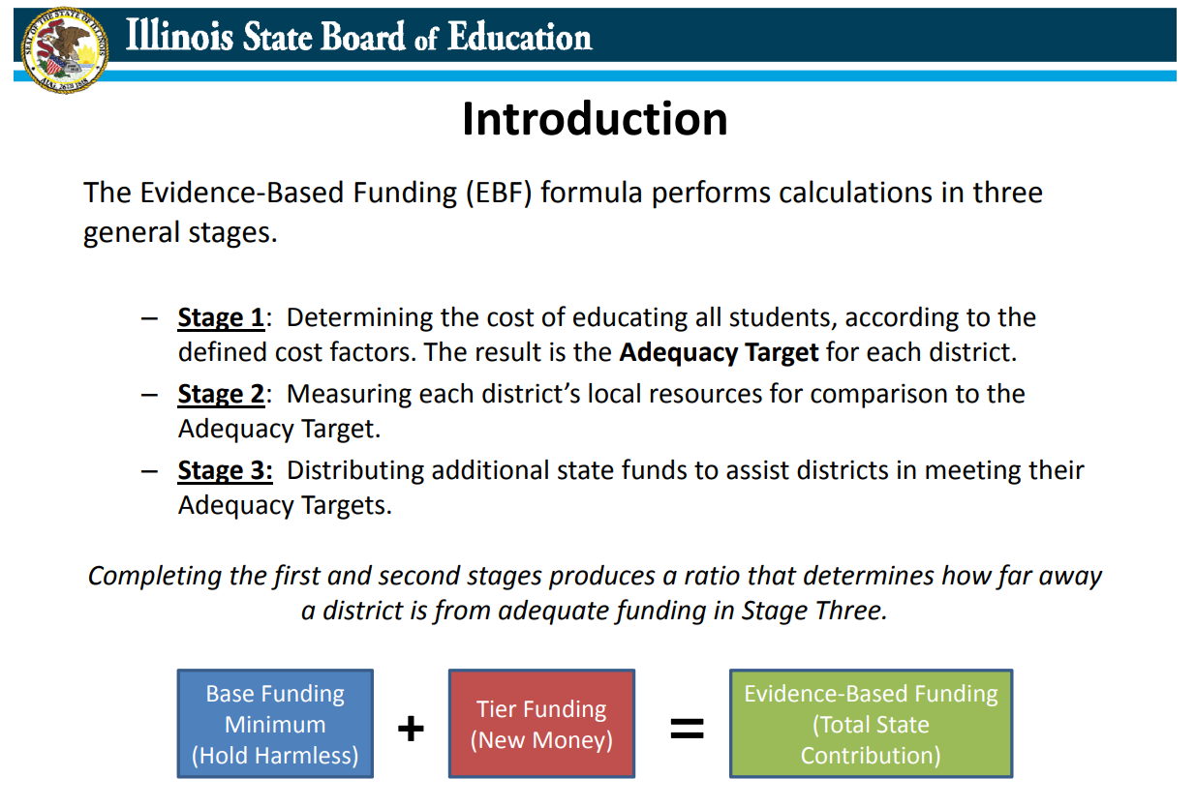

Slide 11
Provisions for the New Formula
Hold Harmless Provision
Consolidated 5 Grants
GSA
ELL
Special Education Personnel
Special Education for Children
Special Education for Summer School
Base Funding Minimum Used to Determine How Additional Funds will Be Distributed

Slide 12
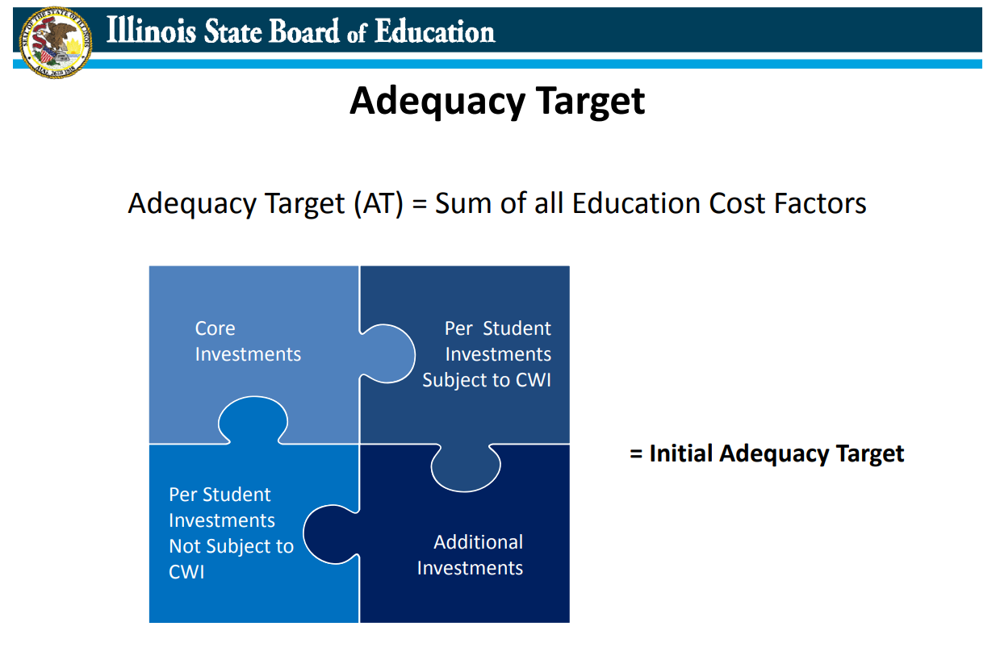

Slide 13
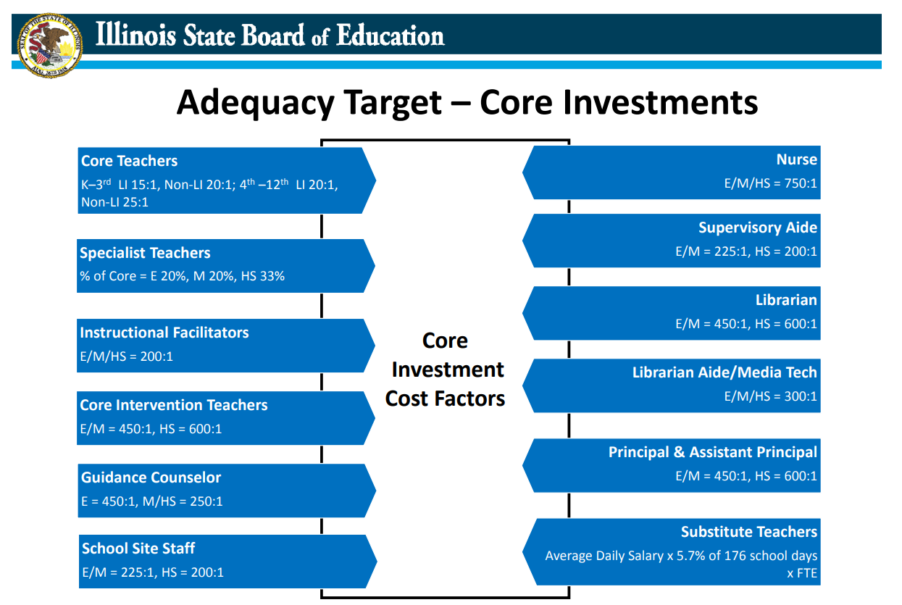

Slide 14
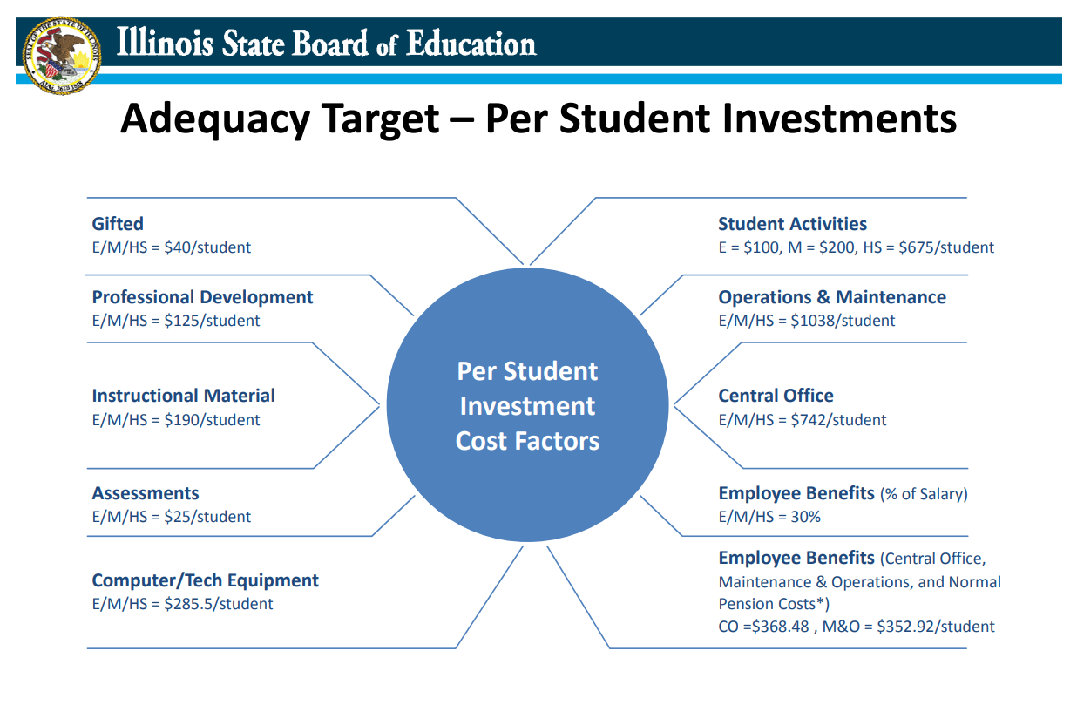

Slide 15
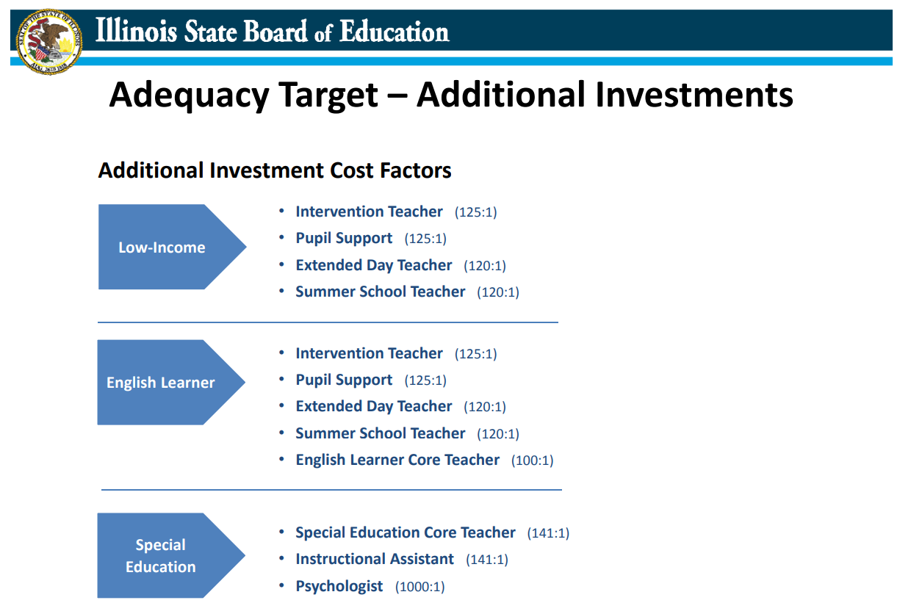

Slide 16
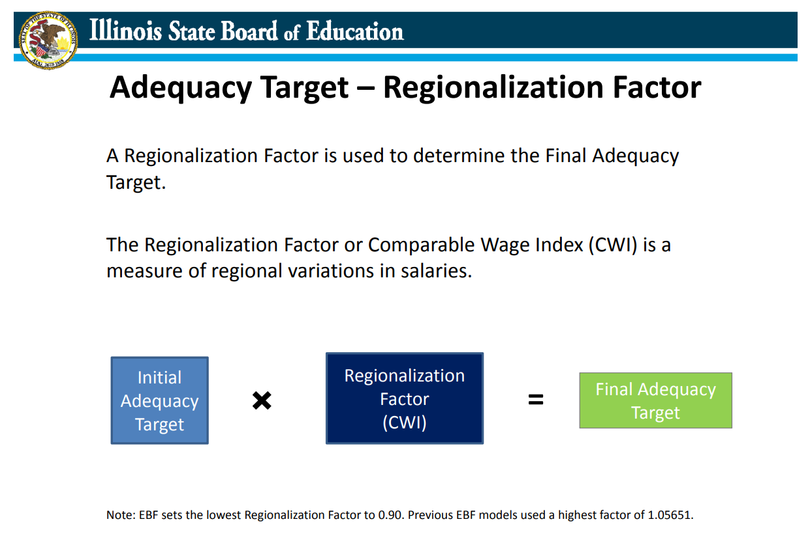

Slide 17
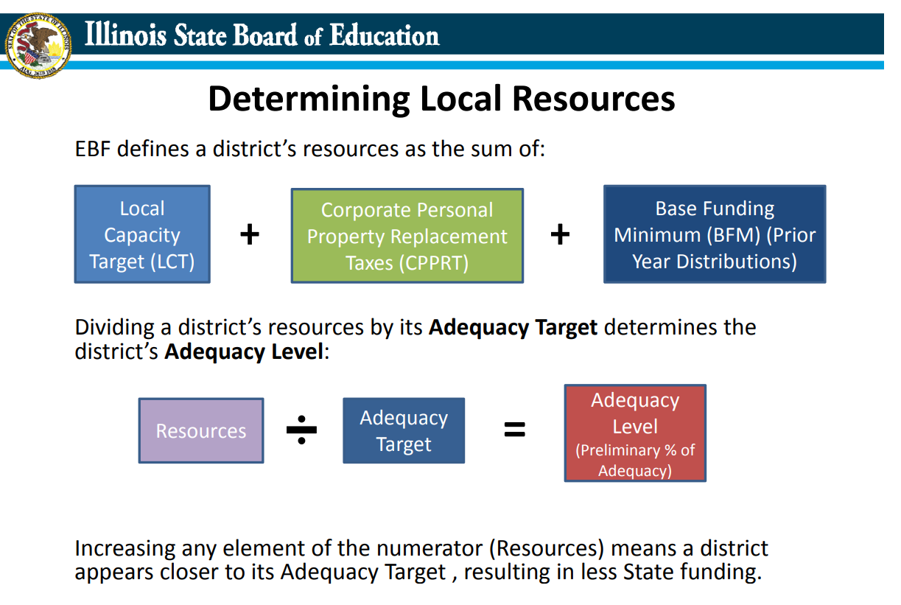

Slide 18
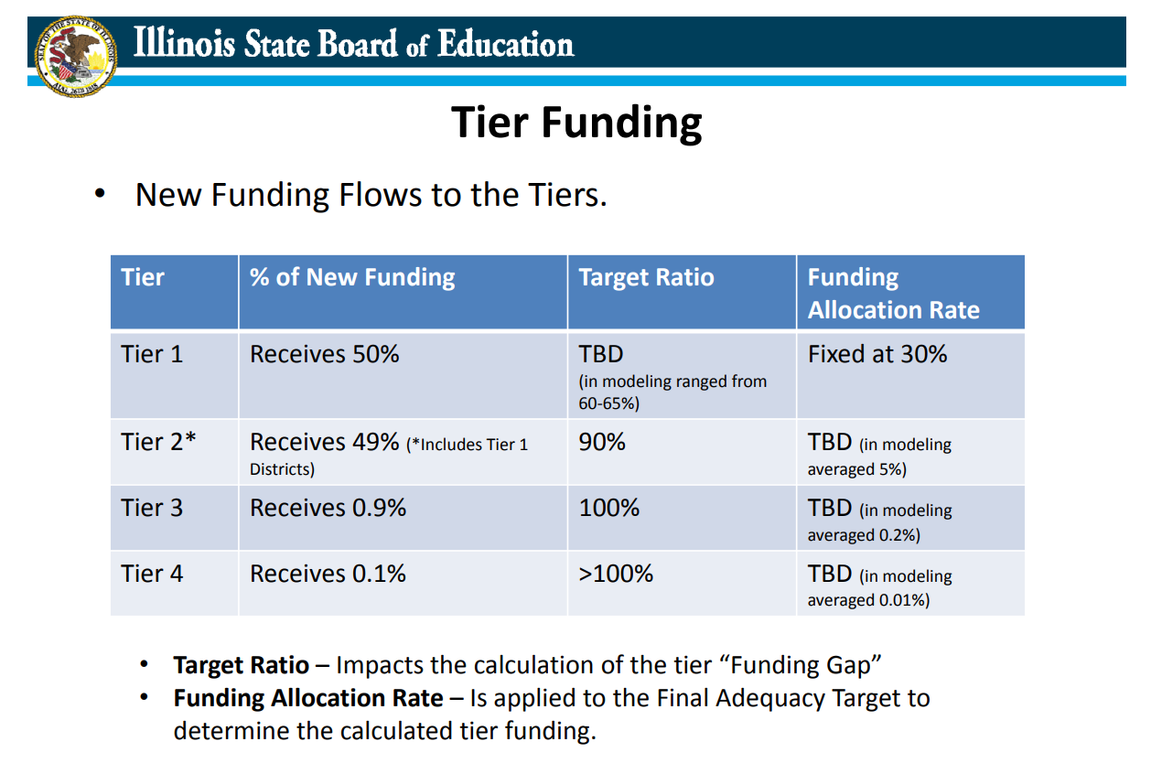

Slide 19
Funding
$350 million for FY 2017-18 additional funding
$300 million for FY 2018-19 additional funding
The Illinois EBF is an attempt to:
Create an equitable state funding model;
Lessen the effects of a child’s education defined by their zip code;
Retain local control; and
Strike a balance between local and state education funding.

