Slide 1
Leveraging Your Leadership Strengths
Presented on: Thursday, March 29, 2018 Iowa ASBO

Slide 2


Presenters
Susan Harkin, SFO Chief Operating Officer Algonquin IL Community Unit School District 300 susan.harkin@d300.org
Carrie Matlock President DLA Architects, Ltd. c.matlock@dla-ltd.com

Slide 3

Tools to be Shared
Five Levels of Leadership (Maxwell)
Five Fundamentals of Practices of Exemplary Leadership (Kouzes & Pousner)
Radical Candor (Scott)
Leader Competency (Mind Tools)

Slide 4
The Five Levels of Leadership
John Maxwell

Slide 5
Sources of Power
Personal
Positional
Expert (respect)
Info (possession)
Referent (personality)
Legitimate (position)
Reward (incentive)
Connection (legislative)
Coercive (negative consequences)

Slide 6
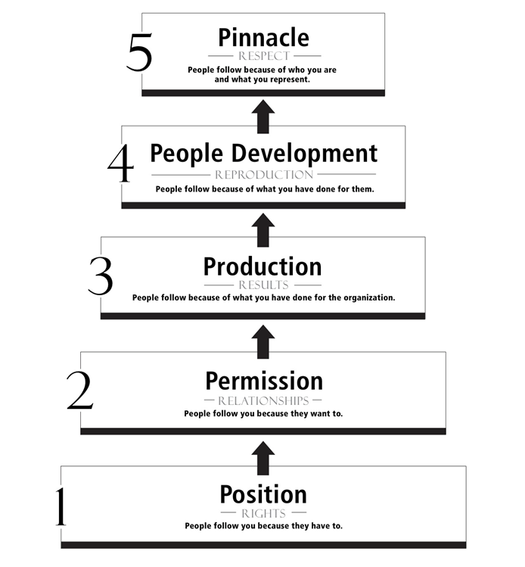
Five Levels of Leadership

Slide 7
Levels of Leadership
Position (Rights) – People follow because they have to
Permission (Relationships) – People follow because they want to
Production (Results) – People follow because of what you have done for the organization
People Development (Reproduction) – People follow because of what you have done for them
Pinnacle (Respect) – People follow because of who you are and what you represent
John C. Maxwell, “The 5 Levels of Leadership”

Slide 8
Activity: What Level are You?
Position (Rights) – People follow because they have to
Permission (Relationships) – People follow because they want to
Production (Results) – People follow because of what you have done for the organization
People Development (Reproduction) – People follow because of what you have done for them
Pinnacle (Respect) – People follow because of who you are and what you represent
John C. Maxwell, “The 5 Levels of Leadership”

Slide 9
Five Fundamental Practices for Exemplary Leadership
James M. Kouzes and Marry Z. Posner

Slide 10
Five Fundamental Practices for Exemplary Leadership
Model the Way
Inspire a Shared Vision
Challenge the Process
Enable Others to Act
Encourage the Heart

Slide 11

Model the Way
CLARIFY VALUES by finding your voice and affirming shared ideals
SET THE EXAMPLE by aligning actions with shared values

Slide 12

Inspire a Shared Vision
ENVISION THE FUTURE by imagining exciting and ennobling possibilities
ENLIST OTHERS in a common vision by appealing to shared aspirations

Slide 13

Challenge the Process
SEARCH FOR OPPORTUNITIES by seizing the initiative and by looking outward for innovative ways to improve
EXPERIMENT AND TAKE RISKS by constantly generating small wins and learning from experience

Slide 14

Enable Others to Act
FOSTER COLLABORATION by building trust and facilitating relationships
STRENGTHEN OTHERS by increasing self-determination and developing confidence

Slide 15

Encourage the Heart
RECOGNIZE CONTRIBUTIONS by showing appreciation for individual excellence
CELEBRATE THE VALUES AND VICTORIES by creating a spirit of community

Slide 16
Activity
What are you best at?
What can you work on?
Model the Way
Inspire a Shared Vision
Challenge the Process
Enable Others to Act
Encourage the Heart
Model the Way
Inspire a Shared Vision
Challenge the Process
Enable Others to Act
Encourage the Heart

Slide 17
Radical Candor
By Kim Scott

Slide 18



Radical Candor – Great Leaders
Provide Guidance, Care Personally and Challenge Directly

Slide 19
Radical Candor - Guidance
Do you have the right people in the right roles?
Rockstars or Superstars? Know their goals
Be a master of leading people not telling

Slide 20
Radical Candor – Care Personally
Are you emotionally present?
Are you “Centered”?
What is your team member’s life story?
Values? Motivations? Goals?

Slide 21
Radical Candor – Challenge Directly
Challenge others and let them challenge you
Don’t be afraid to admit mistakes
Be kind & clear
Be specific & sincere

Slide 22

Radical Candor
https://www.youtube.com/watch?v=xWaJ2pkDiWU

Slide 23
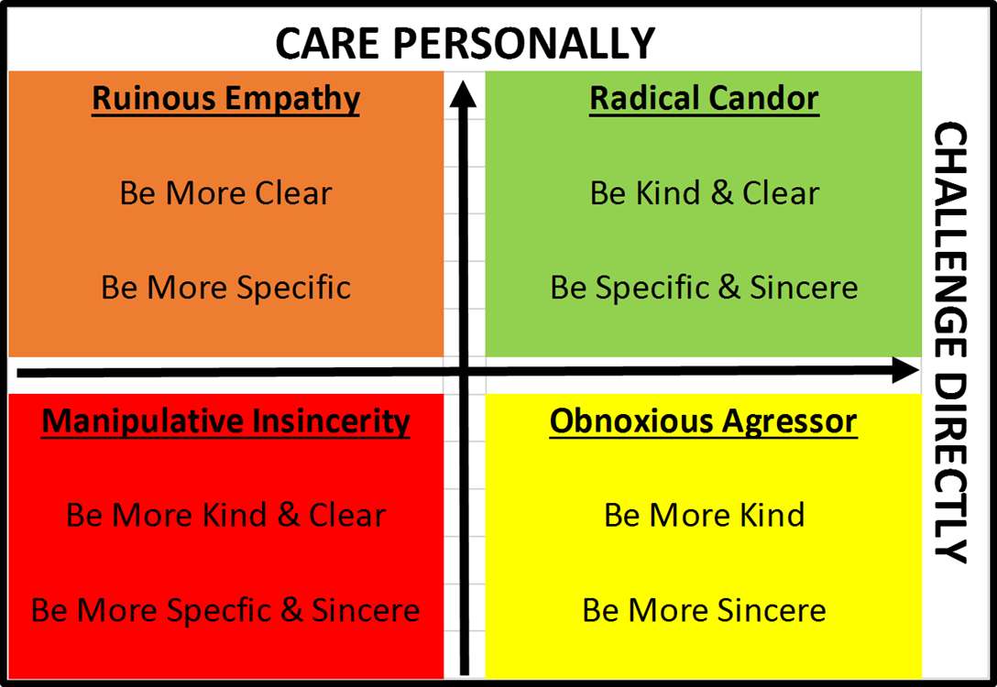
Activity: What quadrant do you fall?

Slide 24
Leader Competency
By Mind Tools

Slide 25
You Don’t Know, What You Don’t Know!
What is the “Competency Ladder”?
How does it apply to me and my leadership skills?
How Do we know what we don’t know?
Peers
Our own Failures/Mistakes
Self Examination

Slide 26
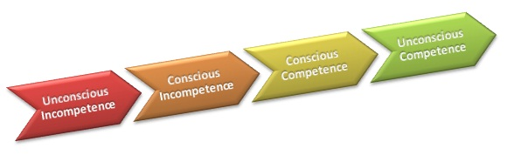
4 Levels of Leader Competency
Unconscious Incompetence
Conscious Incompetence
Conscious Competence
Unconscious Competence

Slide 27
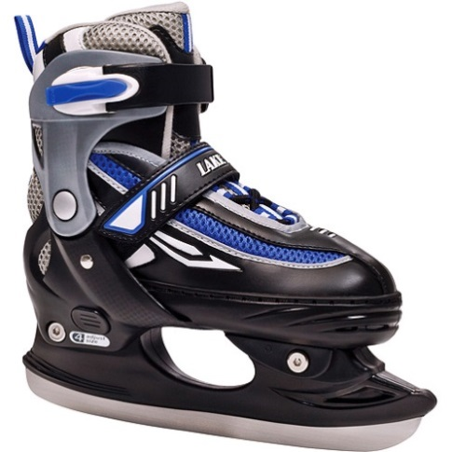
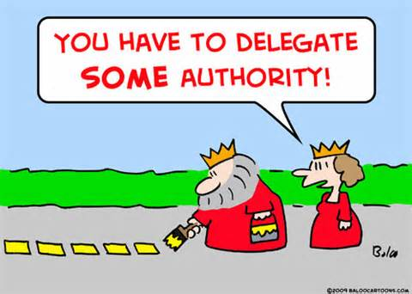
Unconscious Incompetence
Challenge: We don't know that we don't have this skill, or that we need to learn it.
How do we correct the problem?
Identify Deficiencies
Admit Deficiencies
Find the Right Resources

Slide 28

Conscious Incompetence
Challenge: We know we don’t know.
How Do We Do Correct the Problem?
Identify the appropriate resources
Books on leadership skills
Peer Support Network
Having an open mind

Slide 29
Conscious Competence
Challenge: Now we have the knowledge and the ability to correct the problem.
What Do we Do Now?
Apply it immediately
Track your progress
Stay accountable
Make it a habit!

Slide 30
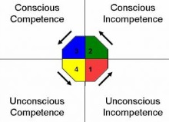
Unconscious Competence
Challenge: What was a struggle is now habit or instinct.
How do we stay here?
Time, frequency, consistency and peer support

Slide 31
Q&A

Slide 32
Conclusion
Reach for Level 5 Leadership
Incorporate the Five Fundamentals of Exemplary Leadership into your daily interaction with your team
Find ways to provide Radical Candor by being kind but clear, specific and sincere
Become an Unconscious Competent leader by continually finding ways to develop your leadership
Find leadership models that fit you and your team so you can be the best leader for your organization!!!

Slide 33
References
Kouzes, J. A. (2003). The five practices of exemplary leadership. San Francisco: Pfeiffer.
Maxwell, J. (2017, August 9). The 5 levels of leadership. Retrieved from The John Maxwell Co.: http://www.johnmaxwell.com/blog/5-levels-of-leadership
MindTools. (2018, March 14). The conscious competence ladder. Retrieved from MindTools: https://www.mindtools.com/pages/article/newISS_96.htm
Scott, K. (2017). Radical candor. New York, NY: St. Martin's Press.

