Slide 1
Extending Your
Leadership Toolbox
Presented on:
March 28, 2018
Iowa ASBO
Notes:
Susan

Slide 2


Presenters
Susan Harkin, SFO
Chief Operating Officer
Algonquin IL Community Unit School District 300
susan.harkin@d300.org
Carrie Matlock
President
DLA Architects, Ltd.
c.matlock@dla-ltd.com

Slide 3

Tools to be Shared
Life Orientation (LIFO)
(Atkins)
Emotional Intelligence (Mind Tools)
Art of Listening
(Nichols)

Slide 4
Life Orientation
The Schutz Company
Notes:
Carrie

Slide 5
Life Orientation (LIFO)
Goal
Confirm your LIFO
Matching communication styles
Understand how to leverage your LIFO

Slide 6
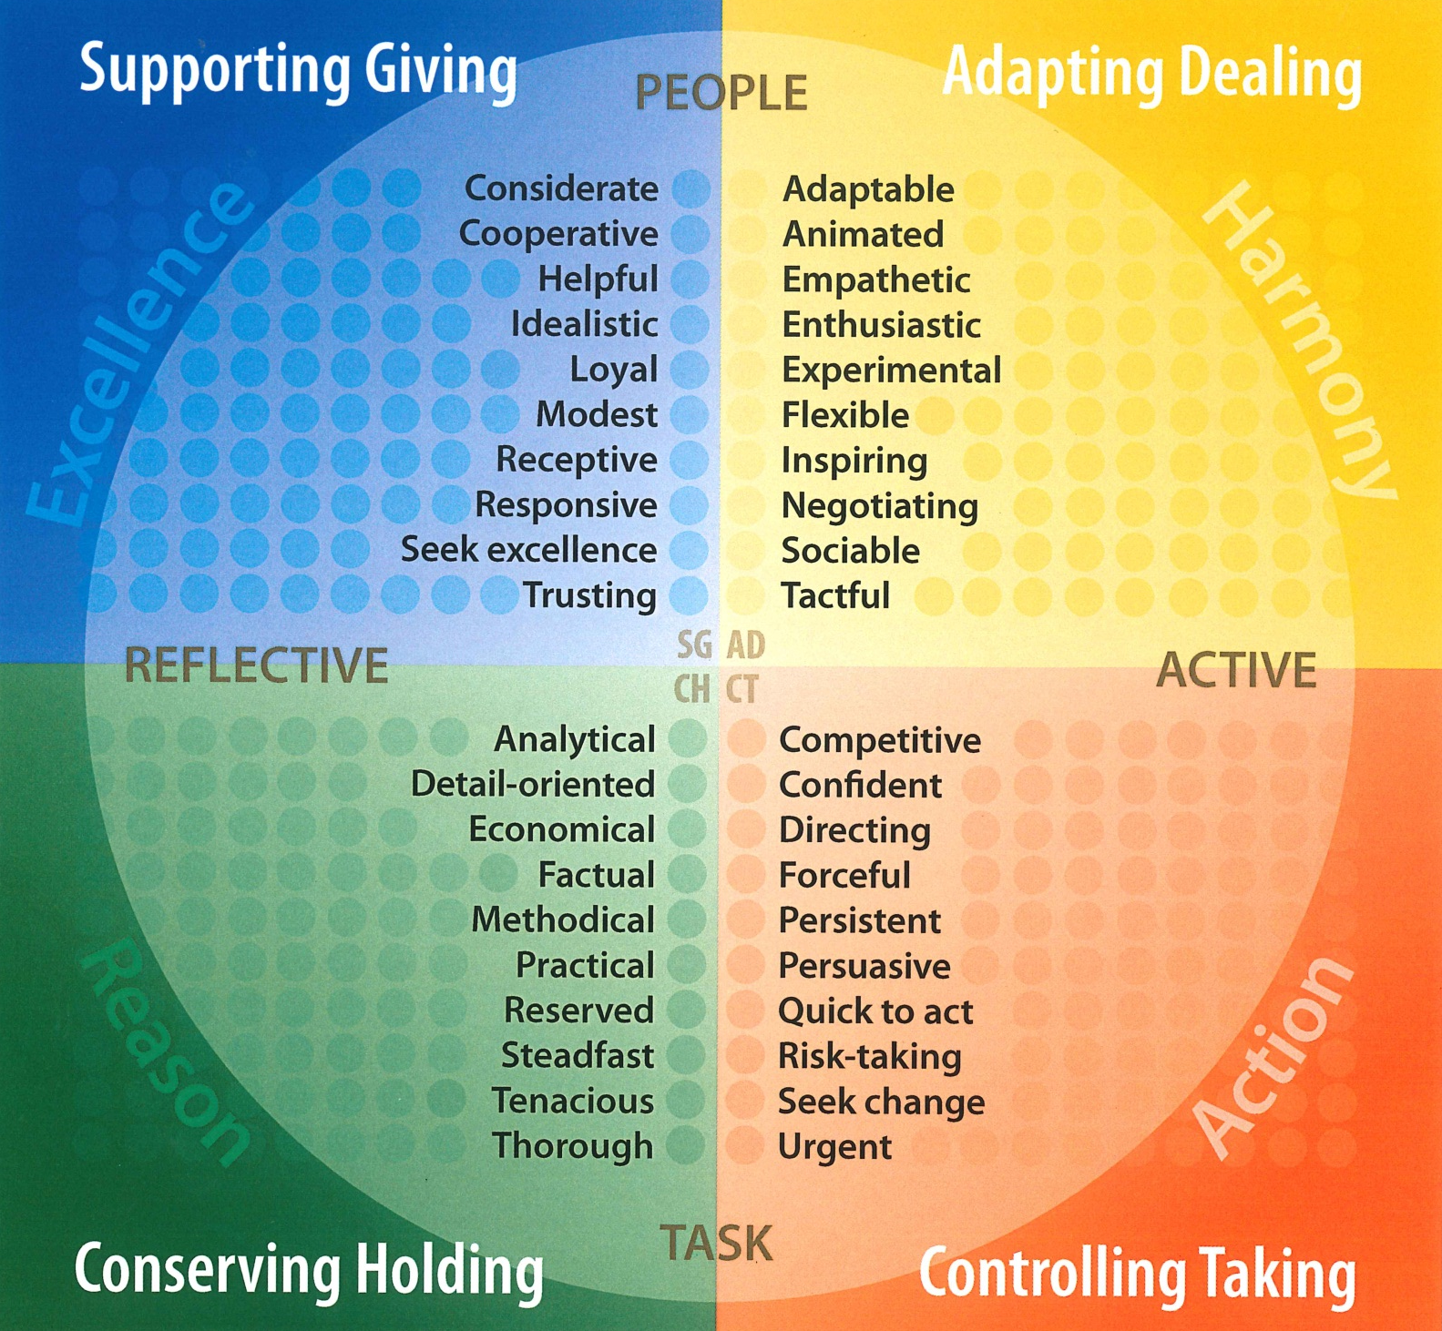
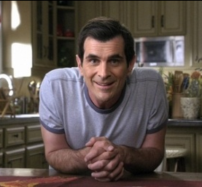
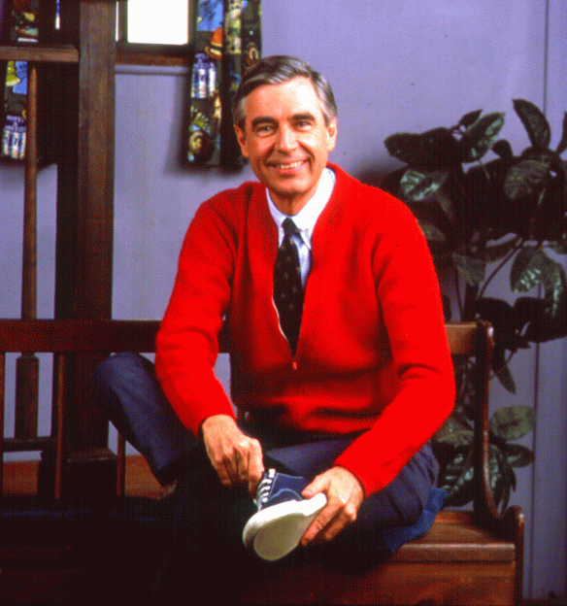

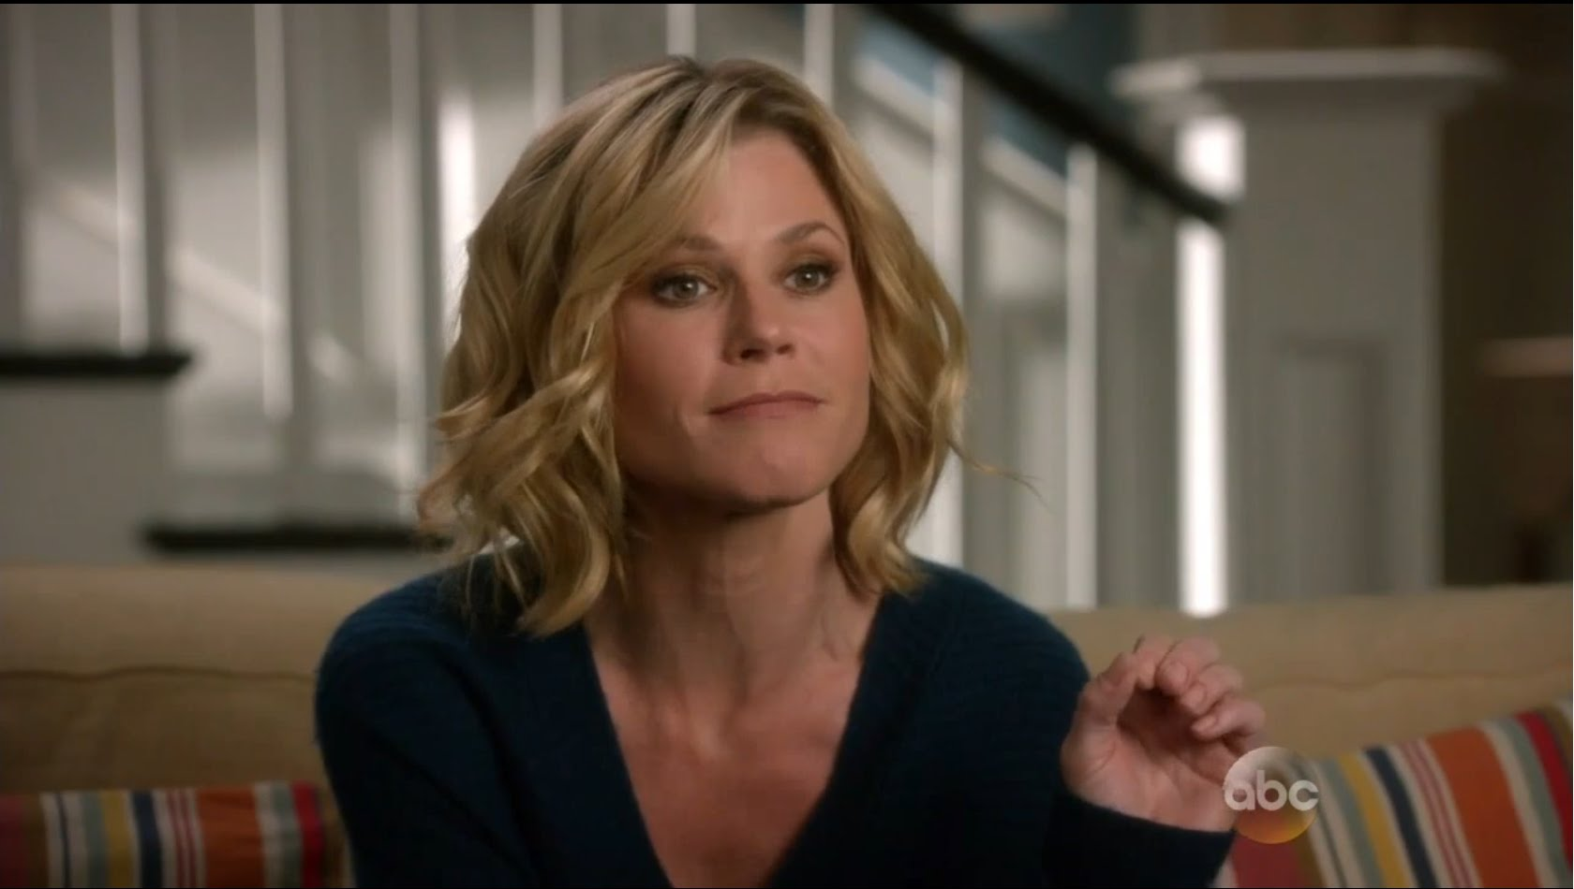
Activity
Confirming Styles

Slide 7
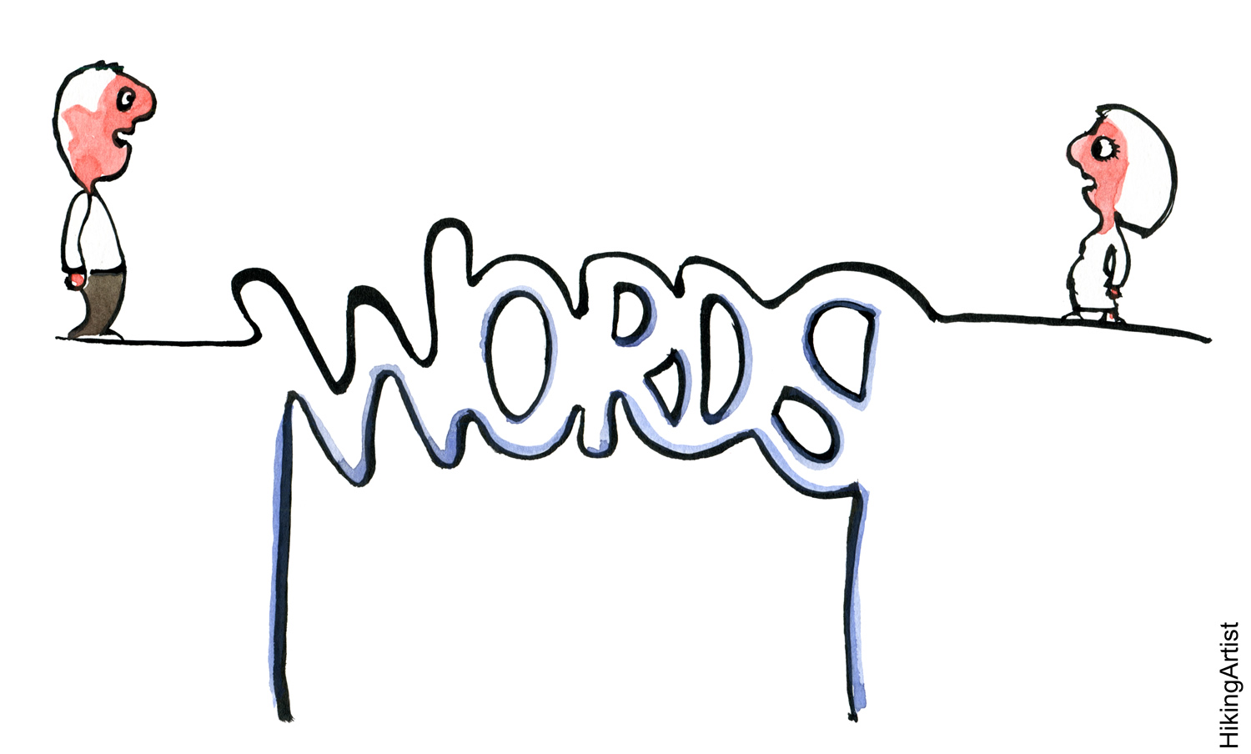
Bridging
This Photo by Unknown Author is licensed under CC BY-NC-ND
Notes:
MJ
Intro- bridging – two parts
Identify
Translate – speaking their language

Slide 8
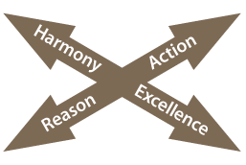
Mismatching
Excellence
Reason
Action
Harmony
Notes:
8
Day 2 -

Slide 9
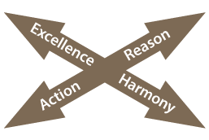
Matching
Excellence
Reason
Action
Harmony
Notes:
9
Day 2 – figure out how to best communicate with someone to have influence in the relationship
The idea of speaking their language (ie the French) metaphor.
How people help, control, analyze, compromise page. Bridging Workbook 6+7+12

Slide 10
Activity: Identify Other’s Styles in Email

Slide 11
Emotional Intelligence
By Mind Tools
Notes:
Susan

Slide 12
Emotional Intelligence (EI)
Goals
What is EI?
Components of EI
How to improve EI
Connecting EI in leadership using LIFO

Slide 13
Emotional Intelligence (EI)
Emotional intelligence (EI) is the ability to:
Monitor one's own and other people's emotions;
Discriminate between different emotions;
Label emotions appropriately; and
Use emotional information to guide thinking and behavior.

Slide 14
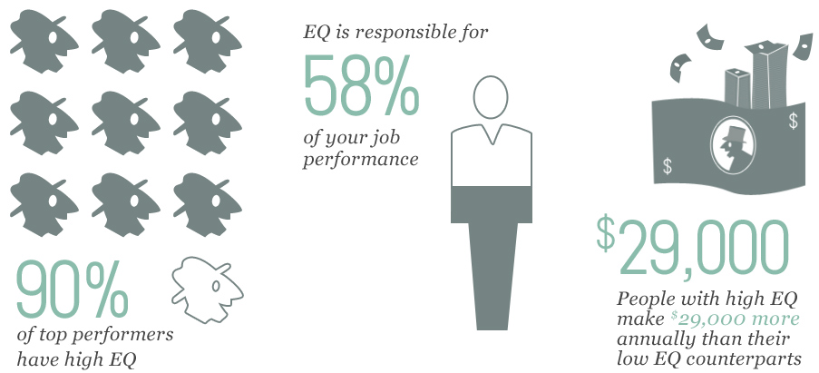

Slide 15
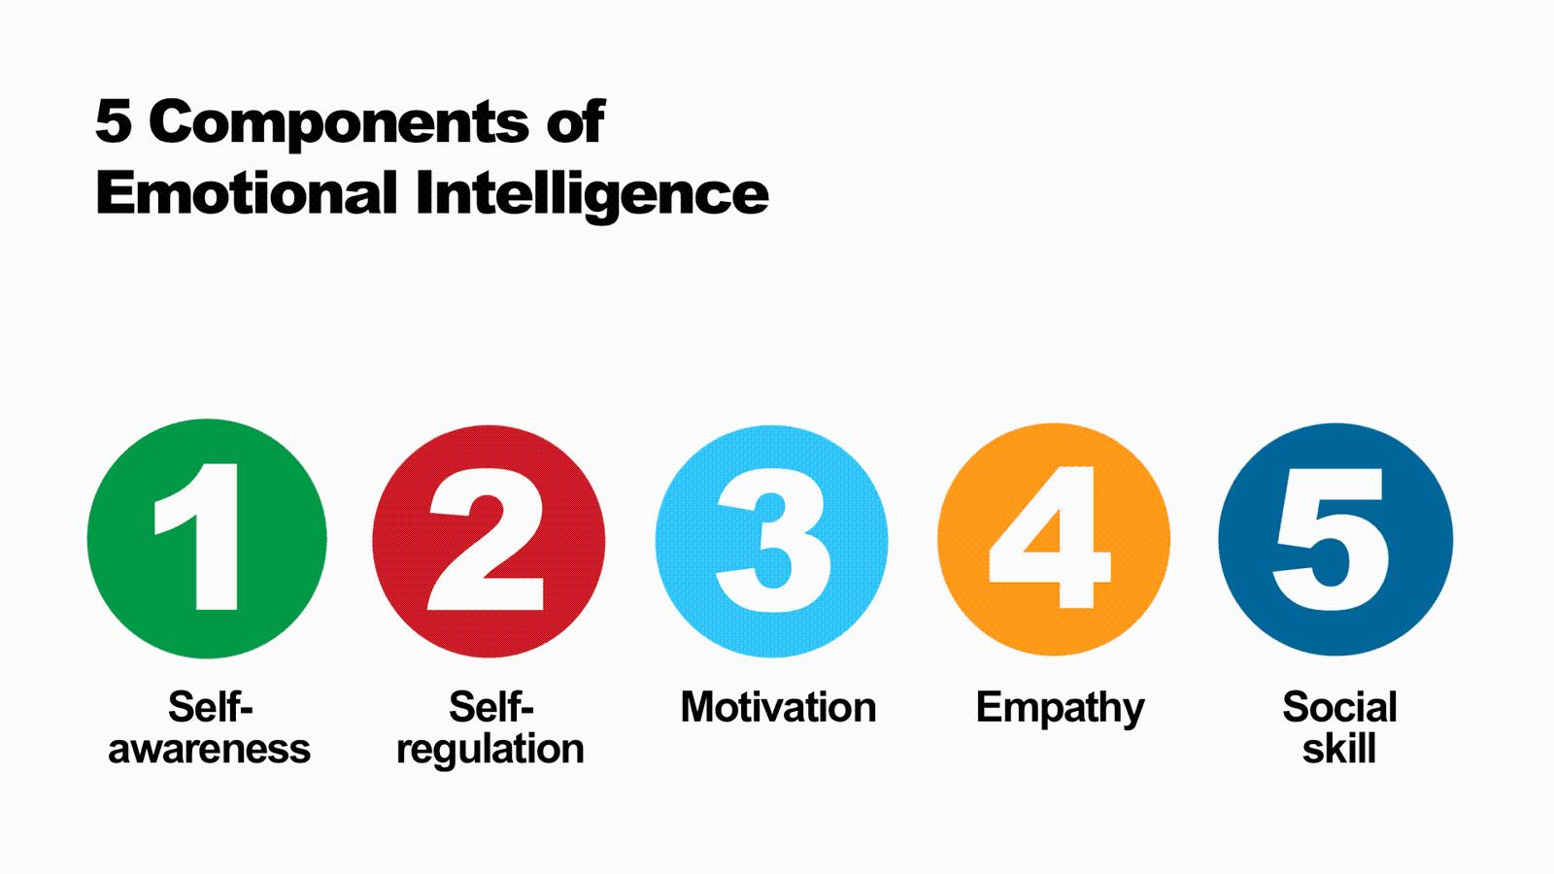

Slide 16
Attributes of High EI

Slide 17
Strategies to Improving EI

Slide 18
LIFO and Emotional Intelligence
Notes:
Carrie

Slide 19
Controlling/Taking
EI Characteristics
Low EI
High EI
Aggressive
Demanding
Egotistical
Bossy
Confrontational
Assertive
Ambitious
Driving
Strong Willed
Decisive
Notes:
Carrrie

Slide 20
Adaptive/Dealing
EI Characteristics
Low EI
High EI
Easily Districted
Glib
Selfish
Poor Listener
Impulsive
Warm
Enthusiastic
Socialable
Charming
Persuasive
Notes:
Carrie

Slide 21
Conserving/Holding
EI Characteristics
Low EI
High EI
Resistant to Change
Passive
Un-Responsive
Slow
Stubborn
Patient
Stable
Predictable
Consistent
Good Listener

Slide 22
Supporting/Giving
EI Characteristics
Low EI
High EI
Critical
Picky
Fussy
Hard to Please
Perfectionistic
Detailed
Careful
Meticulous
Systematic
Neat

Slide 23
Activity
Discuss your LIFO style with your neighbor in relation to EI.
What things you could do more of to improve your emotional intelligence?

Slide 24
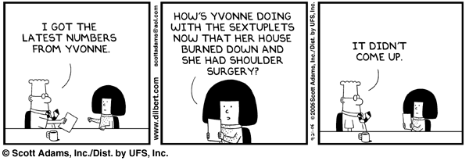
Review – Adaptive/Dealing
Notes:
Susan

Slide 25
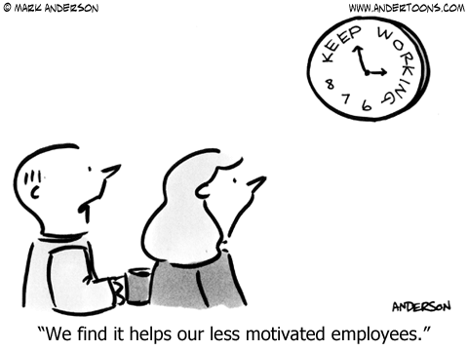
Review – Conserving/Holding

Slide 26
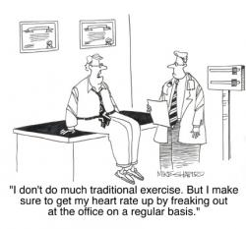
Review – Controlling/Taking

Slide 27
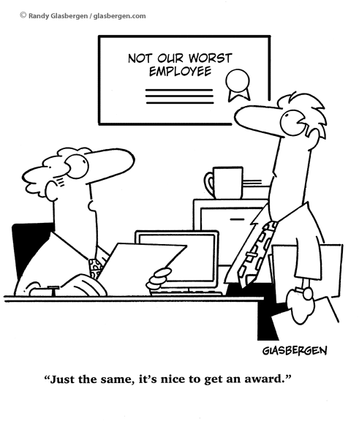
Review – Supporting/Giving

Slide 28
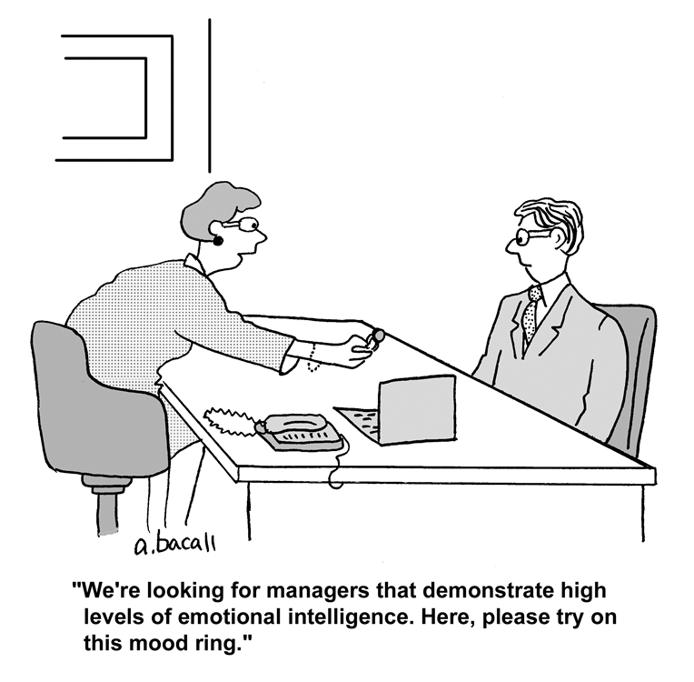

Slide 29

IQ
Competence
EI
Emotional Intelligence
IQ + EI = Success

Slide 30
Listening
By Mary P. Nichols, PhD.
Notes:
Susan

Slide 31
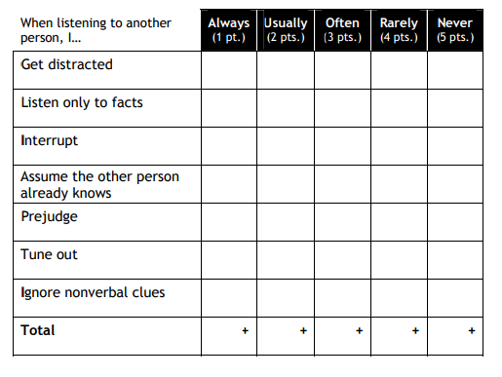
How Well do you Listen?
Questionnaire
Scoring
31-35 = Effective Listener
21-30 = Good Listener
14-20 = Not-so-good Listener
<13 = Huh???
Notes:
Luann talking
Susan & Brad helping with the activity

Slide 32

Listening Skills
Hearing is with your ears, listening is with the mind
  Keith Davis, Human Behavior & Work
Listening is playing catch with words
To play catch, both parties must participate
  Dr. Mortimer Adler
Notes:
Carrie

Slide 33
Then - Why Don’t We Listen?
Our brain is faster than our mouth
  We speak 125-150 words/minutes
  We listen to 400 words/minute
  Our brain can process 1,000-1,500 words/minute!!
Untrained listener understands/retains 50% of conversation!
Experts suggest that we all make at least one major listening mistake per day.
Notes:
Carrie

Slide 34
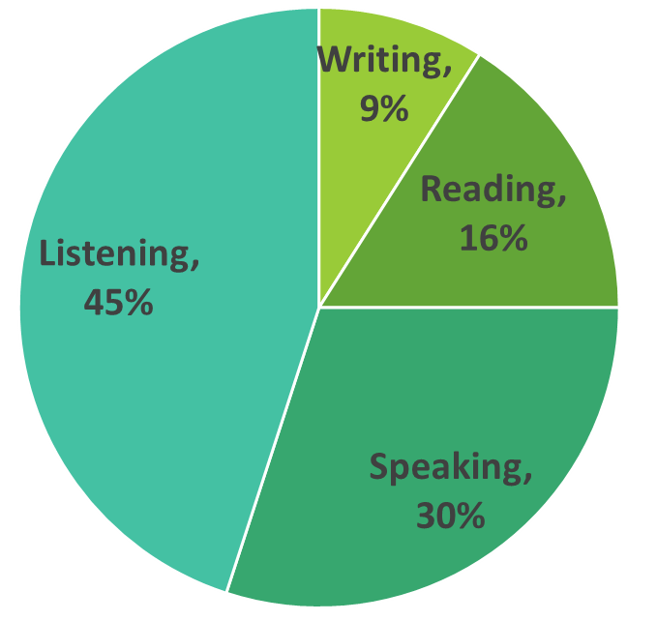
Pitfalls of Listening
See talking as an active role
See listening as a passive role
Over preparation of what you are going to say
Emotional filters or blinders
We educate our students in reading, writing and speech, when in reality our skill set requirements are:
Notes:
Susan

Slide 35
Why Effective Listening?
Increase your Knowledge
Save Time
Reduce Stress
Real Dialogue
Trust
Understand
Self-Esteem
Influence & Power
Develop your Potential
Notes:
Susan

Slide 36
Bad Habits –
Are you one of these?
Attention Faker
Fact Gather
Criticizer
Boring
Blockers
Distracter
Note Taker
Mental Rehearser
Notes:
Carrie

Slide 37
To Be a Great Listener
One must develop listening skills:
  Be Interactive
  Be Attentive
It does not come easily!!
Skills will help you to better receive true meanings your speaker is trying to convey!
Notes:
Carrie

Slide 38
LIFO and Listening
Notes:
Carrie

Slide 39
Controlling/Taking
Action
What makes them tune in?
What makes them tune out?
Competitive
Enterprising
Fast-moving
Pioneering
Resources restricted
Authority undercut
Less responsibility
No challenges

Slide 40
Adaptive/Dealing
Harmony
What makes them tune in?
What makes them tune out?
Social
Flexible
Informal
Accepting
Unfriendly people
Critical authority
Routines and details
Strict schedules
Notes:
Carrie

Slide 41
Conserving/Holding
Reason
What makes them tune in?
What makes them tune out?
Unemotional
Factual
Inquiring
Practical
Constant changes
Highly emotional
Fast decisions
Unplanned action
Notes:
Susan

Slide 42
Supporting/Giving
Excellence
What makes them tune in?
What makes them tune out?
Respectful
Accepting
Reassuring
Idealistic
Critical
Ridiculing
Failing
Unhelpful
Notes:
Susan

Slide 43
Activity
Discuss your LIFO style with your neighbor in relation to listening.
  Is what is listed for tuning in and out accurate?
Pick someone you have difficulty communicating with.
  If you know their LIFO preference, what can you do differently to make them tune in?

Slide 44
Attention Attention!!
Be motivated to listen
Ask questions if you must speak
Be alert to nonverbal clues
Allow speaker tell their story
DO NOT interrupt
Fight off distractions
Do not trust your memory
Listen with a goal in mind
React to message - not person
Give speaker undivided attention
DO NOT get angry
Impossible to listen/speak at the same time
Notes:
Susan/Carrie

Slide 45
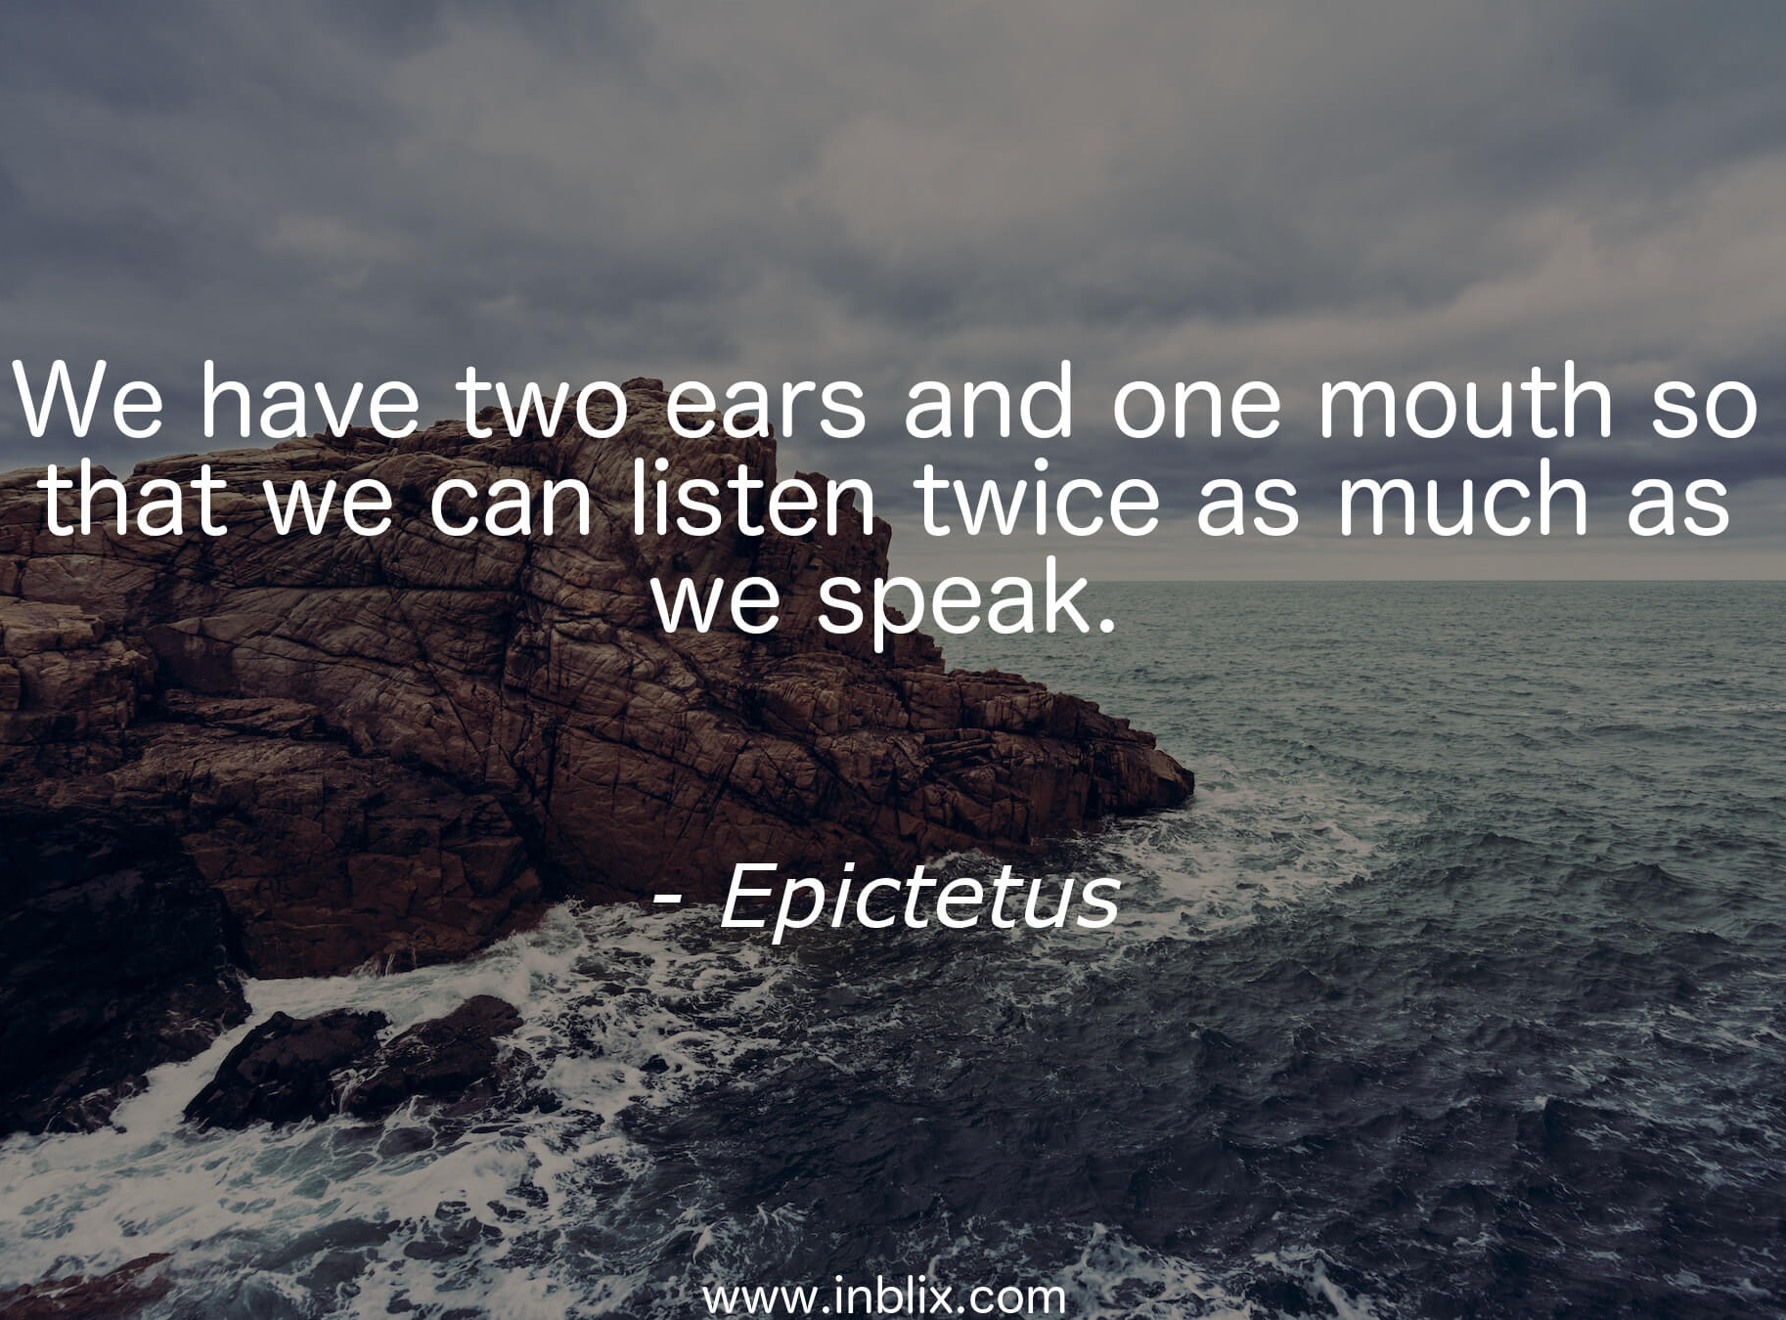
Notes:
Susan

Slide 46

High Performing Teams
Building Blocks
  Confirming strengths
  Treating negatives positively
  Utilizing differences
  Visioning the whole
  Getting agreement
  Controlling excess
Notes:
Carrie

Slide 47
Conclusion
Learn to speak and interact with others based upon their Life Orientations
Improve your Emotional Intelligence by:
  Observing how you react to people and stressful situation
  Taking responsibility for your actions
  Examining how your actions affect others
Become a better Listener by:
  Asking questions if you must speak
  Allowing speaker to tell their story - DO NOT interrupt
  Fighting off distractions and giving speaker undivided attention
  Understanding how what makes others tune in and tune out
Notes:
Susan

Slide 48
References
MindTools. (2018, March 14). Emotional intelligence. Retrieved from MindTools: https://www.mindtools.com/pages/article/newCDV_59.htm
The Schutz Company. (2009, August 9). How LIFO Produces Results. Retrieved from LIFO: Life Orientations: https://lifo.co/introduction-lifo/lifo-produces-results/
Nichols PhD., M. P. (2009). The lost art of listening: How learning to listen can improve relationships (2nd ed.). New York, NY: The Guilford Publications, Inc.

