Slide 1
Providing Platinum Customer Service in the Business Office

Slide 2



Introductions
Frank Adams, CSBO (Speaker), Assistant Business Manager Northbrook-Glenview SD 30
Susan Harkin, CSBO/SFO (Speaker), Chief Operating Officer, Algonquin CUSD 300
Dr. Ann Williams, EdD/CSBO/SFO (Speaker), Assistant Superintendent Crete-Monee CSD 201-U

Slide 3
Life Can be Frustrating
Platinum Customer Service?
Notes:
http://www.youtube.com/watch?feature=player_detailpage&v=HWTMa76BzH0

Slide 4

Who are your customers?
Students
Parents
Teachers/Staff/Administrators
Community Members
Board Members
Vendors
Visitors

Slide 5

What is the worst customer service experience you have had? Why was it so bad?
Moment of Reflection

Slide 6

How do you feel when
these things happen?

Slide 7
Expectations
As a customer what do you expect in reference to:
Service
Friendliness
Professionalism
Fairness
Honesty
Compassion
Empathy

Slide 8

Expectations
When these expectations are not met, what happens to that customer’s perception of you? Your district?
Notes:
8

Slide 9
Perceptions
Do you always think about your customers?
Do you realize how impactful YOU can be?

Slide 10
Perceptions
Often times, you are the face or the voice of the District.
Do you take on the responsibility or do you play the game?

Slide 11

Perception is Reality…until its Not.
Work to change a negative perception by:
Addressing the issue head on, especially if you were in the wrong.
Providing a more positive impression to stick in someone’s mind, you have to offer it up repeatedly.
Looking for characteristics you share with the person. Common ground will help soften their stance.
Notes:
11

Slide 12
Perception is Reality…until its Not.
Also Remember What NOT to do….
Don’t accuse the person of being wrong about you. Their perception is their perception, and it’s up to you to help “correct” it.
Don’t avoid working with the person. The more you’re in front of
them, the better.
Don’t expect the perception to change overnight.
Notes:
12

Slide 13
6 Ways to Handle Irritated People
Apologize
Kill them with Diplomacy
Go into Computer Mode
Ask, “Have I done something to upset you? I’d like to be a part of the solution.”
Show Empathy
Show Appreciation

Slide 14
Have You ever Played the Blame Game?
Does anyone ever want to hear:
I don’t know;
It’s not my job;
There is nothing I can do about it;
Someone ought to tell him;
All we can do is wait and see; or
If it were me, I would do it differently?
That’s the Blame Game
How could you be portrayed after saying any of these things by any of your customers?

Slide 15

Ways to Beat the Game
Remember that the leader is in YOU!
Do not allow others engage you in conflict
Be proactive instead of reactive
Tell them “You could be right” ☺

Slide 16
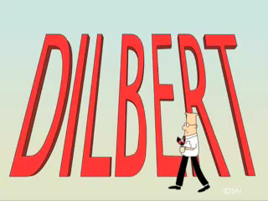
Ways to Beat the Game
Be a Good Listener….
Notes:
http://www.youtube.com/watch?v=DK4iU_CrwPM

Slide 17
Ways to Beat the Game
Effective listening requires active listening.
Use statements like; “That’s Interesting:
Tell me more about that
Why would you do that?
Why would you ask me that?
Why would you say that to me?”

Slide 18

Ways to Beat the Game
Be a team player
Be a lifelong learner
Put yourself in other peoples shoes

Slide 19
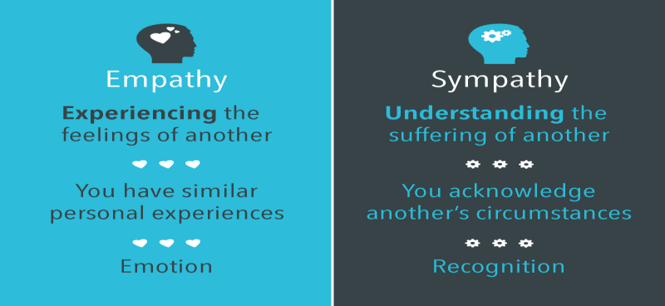
Sympathy versus Empathy
Notes:
Sympathy- “at least…”
Empathy-

Slide 20
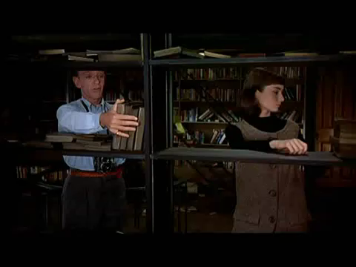

Slide 21
Group Activity: Ground Rules
No Names
No Districts
Be respectful
Try not to interrupt
Time constraints

Slide 22
How Others Succeed
What have you done? Did it work?
What do you wish you had done?
Difficult teacher situations
Difficult parent situation
Difficult community member
Difficult administrator
Difficult board member
Notes:
22

Slide 23
In Summary, providing Platinum Customer Service means….
Knowing who your customers are
Understanding their expectations
Acknowledging their perception (and working to change it if necessary)
Avoiding the blame game
Demonstrating empathy when appropriate
Knowing that you can make the difference!

Slide 24
Questions and Answers
We thank you for your time!

Slide 25
Presenters:
PANELISTS INFO:
Frank Adams, Assistant Business Manager; Northbrook-Glenview SD 30
(847) 400-8961 ; fadams@district30.org
Susan Harkin, Chief Operating Officer; Algonquin CUSD 300,
(847) 55-8319; susan.harkin@d300.org
Dr. Ann Williams, Assistant Superintendent, Crete-Monee CSD 201-U
(708) 367-8320; williamsa@cm201u.org

