Slide 1
You Don’t Know What You Don’t Know Leader Competency & Emotional Intelligence
Presented on Wednesday, April 29, 2015
Presented by
Susan Harkin, CFO, Algonquin CUSD 300
Jennifer Hermes, Asst. Supt. Business Services, Lake Forest SD 67 & 115
Roy Mason, Field Services Leader, Horace Mann Insurance

Slide 2
Overview
Leader Competency
Unconscious/Conscious Incompetence
Conscious/Unconscious Competence
Emotional Intelligence (EI)
What is EI?
Characteristics of EI
How to improve EI
EI in leadership

Slide 3
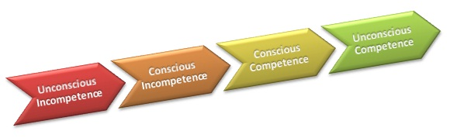
Leader Competency
Unconscious Incompetence
Conscious Incompetence
Conscious Competence
Unconscious Competence

Slide 4
You Don’t Know What You Don’t Know!
What is the “Competency Ladder”?
How does it apply to me and my leadership skills?
How Do we know what we don’t know?
Peers
Our own Failures/Mistakes
Self Examination

Slide 5
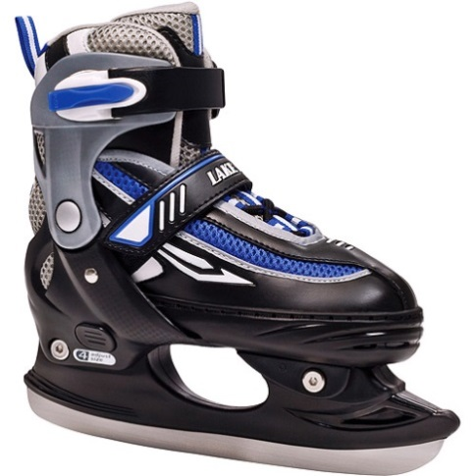
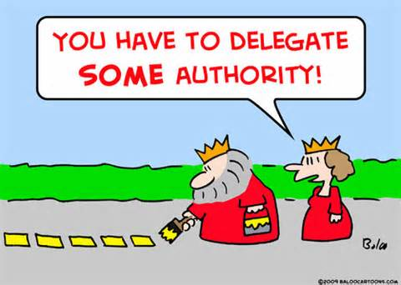
Unconscious Incompetence
Challenges
Identifying Deficiencies
Admitting Deficiencies
Finding the Right Resources
Examples:

Slide 6
Conscious Incompetence
How Do We Do Correct the Problem?
Identify the appropriate resources
Books on leadership skills
Peer Support Network
Having an open mind

Slide 7
Conscious Competence
Now we have the knowledge and the ability to correct the problem: What Do we Do Now?
Apply it immediately
Track your progress
Stay accountable
Make it a habit!

Slide 8
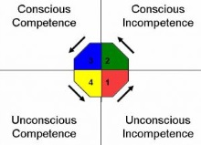
Unconscious Competence
What was a struggle is now habit or instinct.
Time, frequency, consistency and peer support

Slide 9
Emotional Intelligence (EI)
Emotional intelligence (EI) is the ability to monitor one's own and other people's emotions, to discriminate between different emotions and label them appropriately, and to use emotional information to guide thinking and behavior.

Slide 10
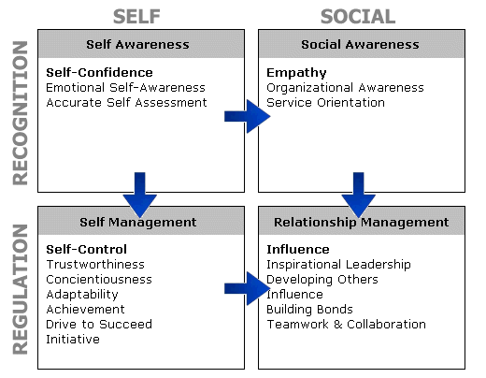

Slide 11
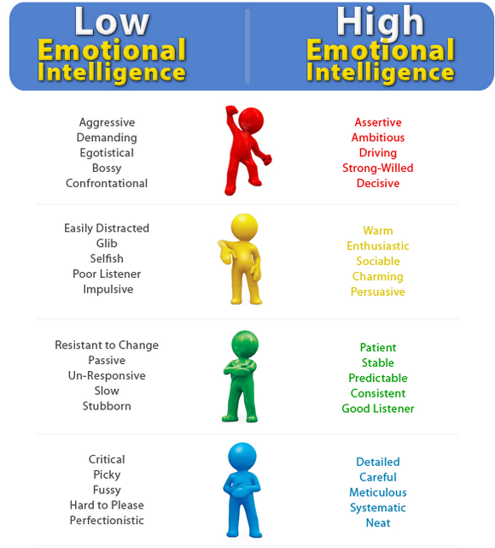
Characteristics

Slide 12
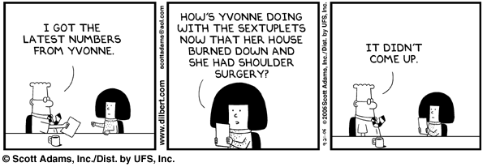
Review

Slide 13
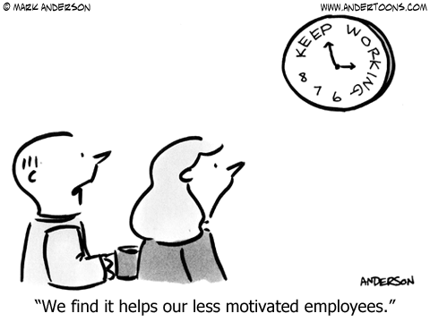
Review

Slide 14
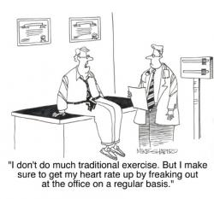
Review

Slide 15
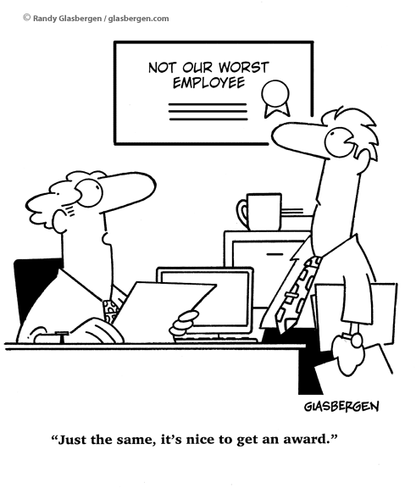
Review

Slide 16
Emotional Intelligence (EI)
How to Improve Your EI
EI in Leadership

Slide 17
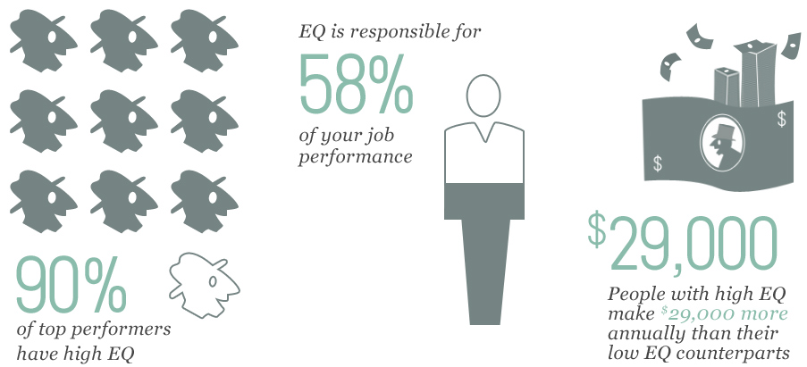

Slide 18
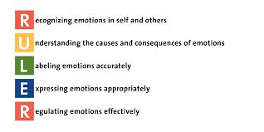

Slide 19
Strategies to Improving EI
Observe how you react to people
Look at your work environment
Do a self-evaluation
Examine how you react to a stressful situation
Take responsibility for your actions
Examine how your actions affect others

Slide 20
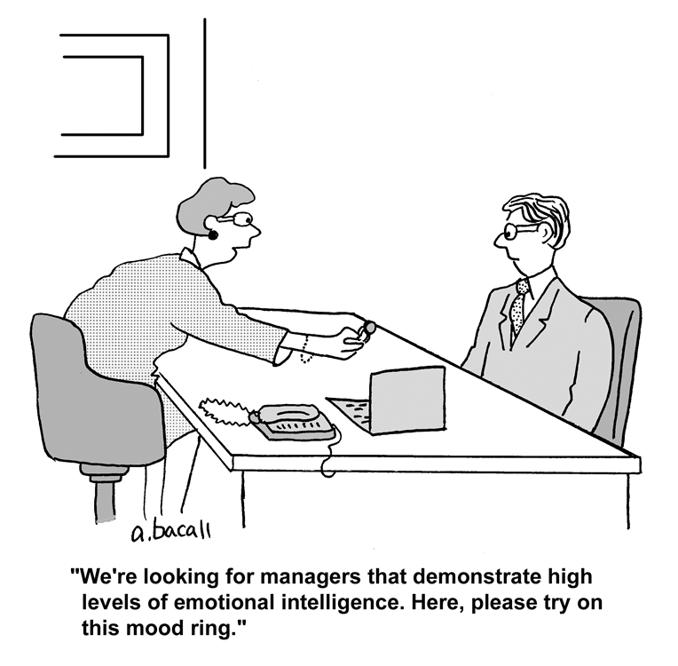

Slide 21
EI in Leadership
Self-awareness
Self-regulation
Motivation
Empathy
Social Skills

Slide 22

IQ
Competence
EI
Emotional Intelligence
IQ + EI = Success

