Slide 1


ASBO International
LEADING SCHOOL BUSINESS FORWARD

Slide 2

Uncommon Times
The worst economic meltdown since
the Great Depression of the 1930s.
Families and communities struggle with
Job Loss
Business Closures
Education Cuts
Notes:
The impact of the financial crisis has hit families and communities hard through job losses, business closures, and significant cuts to education. Unfortunately, it’s likely more cuts are ahead.

Slide 3

The Impact on Students
Instructional program reductions
Increased class sizes
Staff reductions
Reductions in transportation and other services
Fewer after-school activities
A four-day school week
Reductions and elimination of vital professional development staff
Notes:
With revenues declining and costs increasing, students are feeling the financial squeeze both in and out of the classroom.

Slide 4

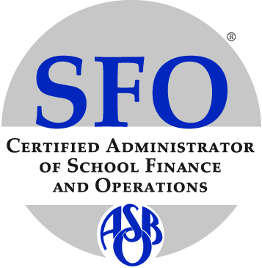
Wanted: Effective School Business Leaders
Must Have
Skills and experience to establish sound fiscal practices that support educational goals.
Reliable and current information upon which to base good decisions.
Excellent communication skills
A commitment to integrity and transparency.
Notes:
In these times of economic uncertainty, leadership is the common denominator for success, and as your professional association, the Association of School Business Officials International (ASBO) offers the educational, leadership, and networking opportunities that will strengthen your leadership skills and help you succeed.

Slide 5

ASBO International: Developing Leaders Since 1910
Our Mission
To provide programs and services to promote the highest standards of school business management practices, professional growth, and the effective use of educational resources.
Notes:
For more than 100 years, ASBO has been developing school business leaders and setting the standard for excellence in school business management.

Slide 6

Promoting Common Values
Competence
Integrity
Personal Growth
Responsibility
Accountability
Notes:
Our membership is a global community of professionals with a broad range of financial management responsibilities who share common values of competence, integrity, professional growth, responsibility, and accountability.

Slide 7
Elevating the Profession
SFO® Certification
Professionals with the Certified Administrator of School Finance and Operations® (SFO®) have met the standard of experience and expertise in school business management and demonstrated knowledge and skill through an examination of school business management competency.
Notes:
We work on your behalf to elevate the profession by offering certification known as the Certified Administrator of School Finance and Operations® (SFO®), which defines the essential skills and knowledge that every school business official needs,

Slide 8

Recognizing Excellence
Award and Recognition Programs
Certificate of Excellence
Eagle Awards
Meritorious Budget Award
Pinnacle Awards
Bridges to the Future Scholarship
Notes:
and by recognizing excellence through ASBO International award and recognition programs.

Slide 9

Fostering Professional Growth
Annual Meeting and Conferences
ASBO International conferences are the catalyst for meeting with peers, experts, and solution providers to share the latest information, tools, and resources, as well as face-to-face networking opportunities that will help you deal with the many issues you face daily in your school system.
Notes:
We promote leadership development and collaboration, including face-to-face networking opportunities at the Executive Leadership Forum, Eagle Institute,

Slide 10
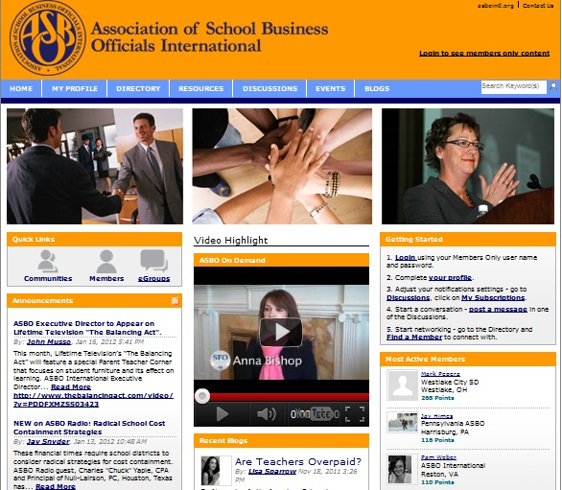
A Trusted Global Network
ConnectEd
Web-based community for members to collaborate and share resources.
Membership Directory of 4000+
Join discussion groups
Access the resource library
Blog and share
Notes:
and your link to a trusted global network of professionals through ASBO's ConnectEd, the Web-based community exclusively for ASBO International members.

Slide 11

Working Together
ASBO International and State/Province Affiliates
ASBO International affiliates work together with ASBO International to promote the highest standards of school business management practices and to provide professional growth opportunities.
Notes:
Working together with ASBO state/province affiliates, we are a stronger voice for the profession, operating efficiently to complement one another's efforts, share resources, and build a global network of successful school business leaders.

Slide 12

Spread the Word
Encourage your school business official to join ASBO International today
at www.asbointl.org.
Notes:
Join ASBO International today and encourage the colleagues in your school district to do the same at www.asbointl.org.

